Slide 1
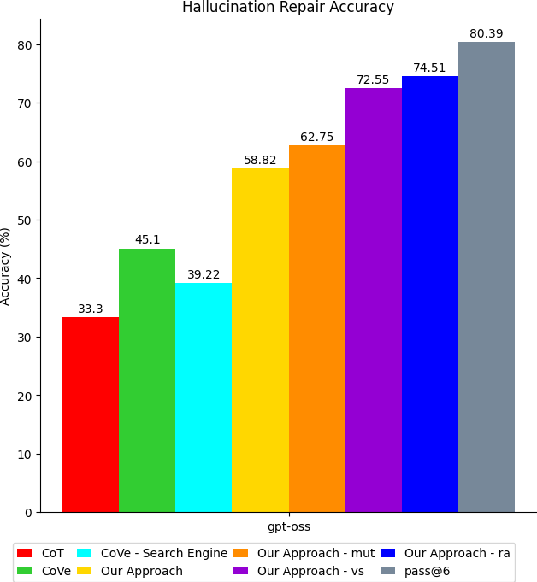
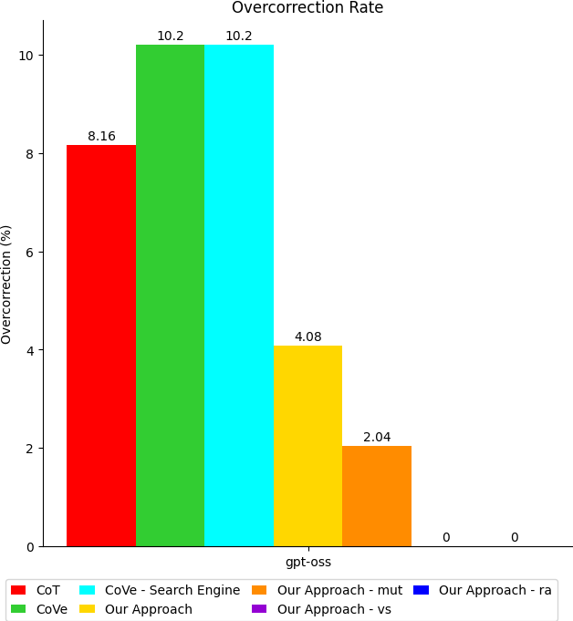

Slide 2
Experiment setup:
Experiment models:
open-source model: qwen3
close-source models: gpt-4o, gpt-5, gemini-2.5-flash-thinking
Experiment datasets:
817 samples from TruthfulQA, 399 samples from FreshQA, 610 samples from HotpotQA
total 1826 samples

Slide 3
Research Questions:
RQ1: overall performance (repair accuracy)
comparison between approaches without external knowledge source (chain of thought, chain of verification, our approach, our approach with mutations)
comparison between approaches with external knowledge source (cove-search engine, RAG, our approach, our approach with mutations)
how to compare with RAG?
RQ2: overcorrection
RQ3: stability
RQ4: ablations
number of mutations:
temperature in (mutation generation, llm-as-judge)
inner comparison in llm-as-judge (majority voting, confidence score, ranking)

