Slide 1
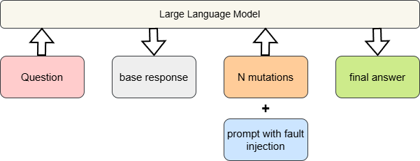
Idea
Inject the assumption of possible faults (hallucinations or factual errors) in a follow‑up prompt to trigger a self‑fact‑checking cycle.
Workflow:
Question to LLM -> base response -> generate mutations -> prompt LLM with prompt-> final answer
Prompt example:
RECHECK_PROMPT = """The **original response** may contains hallucinations or factual errors in answering the given question. Your task is to fact-check it and provide a corrected one-sentence answer."""

Slide 2
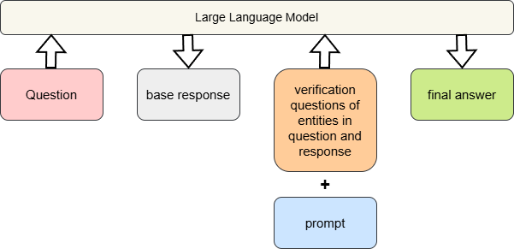
Baseline CoT’s idea https://arxiv.org/pdf/2201.11903
Use LLM’s deep-thinking mode and prompt LLM generate a more accurate answer.
COT_PROMPT = """You are given a question and original response. Let's think step by step and provide the most accurate final answer. """
Baseline CoVe’s idea https://arxiv.org/pdf/2309.11495
Generates a set of targeted verification questions that help fact‑check different parts of its original reasoning.
Next, the LLM independently answers these verification questions, often using retrieval, and uses the verified facts to revise the original answer.

Slide 3
Verbalized Sampling:
System prompt: You are a helpful assistant. For each query, please generate a set of five possible responses, each within a separate <response> tag. Responses should each include a <text> and a numeric <probability>. Please sample at random from the [full distribution / tails of the distribution, such that the probability of each response is less than 0.10].
User prompt: …
Output:
<response>
<text>context</text>
<probability>X</probability> X=The probability that the LLM will output this context
…

Slide 4
Enhanced Verbalized Sampling:
System prompt: …
Responses should each include:
…
-a numeric <confidence> field representing the model's confidence score for the factual correctness of the answer (range 0.00–1.00, two decimal places).
User prompt: …
Output:
<response>
<text>context</text>
<probability>X</probability> X=The probability that the LLM will output this context
<confidence>Y</confidence> Y=The model's confidence score for the factual correctness of the context
…

Slide 5
Comparison experiment
Experiment dataset: 150 samples: 100 from TruthfulQA, with 49 hallucination samples. 50 from HotpotQA, with 25 hallucination samples
Baseline: CoT(chain-of-thought, Google Reseach), CoVe(chain-of-verification, MetaAI)
Experiment result parameters:
hallucination rate after repair: hallucination in final_answer provided by approaches
hallucination repair: base_response = hallucination, final_answer = not hallucination
unsuccessful repair: base_response = hallucination, final_answer = hallucination
overcorrection: base_response = not hallucination, final_answer = hallucination
pass@6: at least 1 is correct in the checking results of (mutations + base_response)
avg token cost pre question
avg time cost pre question
Number of mutations: 5(synonym)

Slide 6
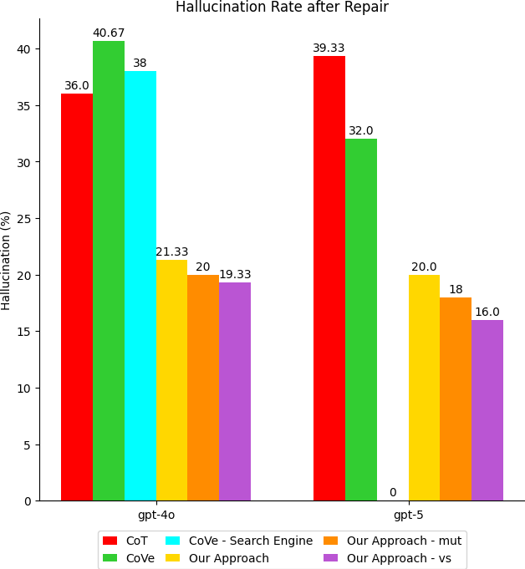
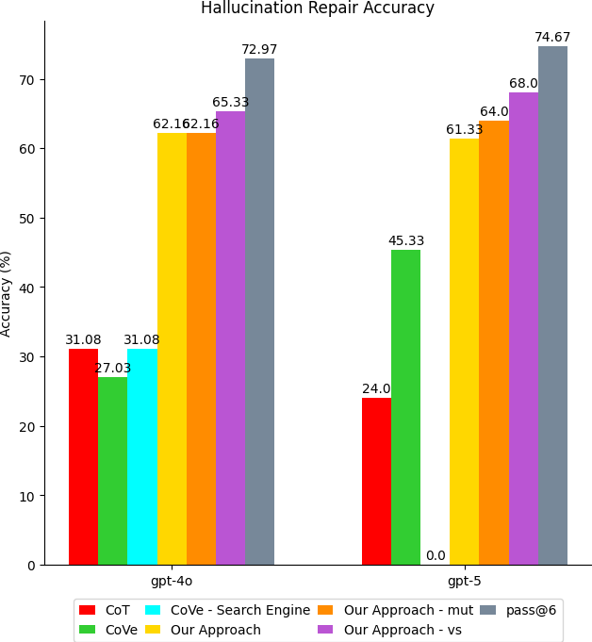
Experiment evaluation

Slide 7
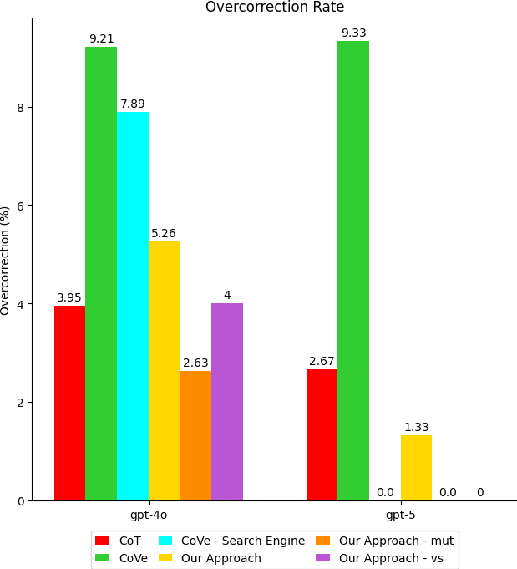
Experiment evaluation
Average Token Cost | Chain-of-Thought (CoT) | Chain-of-Verification (CoVe) | CoVe - Search Engine | our approach | our approach - mutations | our approach - vs
gpt-4o | 101.73 | 2633.25 | 4222.12 | 197.15 | 1763.87 | 596.13
gpt-5 | 87.03 | 6824.61 |  | 188.51 | 1775.89 | 580.05
Average Time Cost | Chain-of-Thought (CoT) | Chain-of-Verification (CoVe) | CoVe - Search Engine | our approach | our approach - mutations | our approach - vs
gpt-4o | 1.4113 | 30.0015 | 42.0007 | 1.8135 | 11.2498 | 4.4483
gpt-5 | 12.4434 | 202.180 |  | 21.4348 | 187.810 | 36.9961

Slide 8
TODO list

