Slide 1
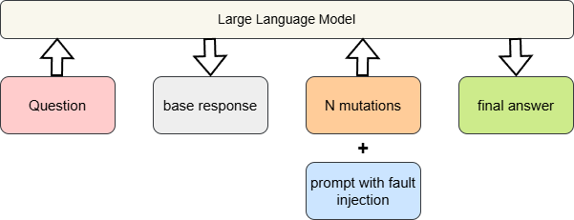
Idea
Inject the assumption of possible faults (hallucinations or factual errors) in a follow‑up prompt to trigger a self‑fact‑checking cycle.
Workflow:
Question to LLM -> base response -> generate mutations -> prompt LLM with prompt-> final answer
Prompt example:
RECHECK_PROMPT = """The **original response** may contains hallucinations or factual errors in answering the given question. Your task is to fact-check it and provide a corrected one-sentence answer."""

Slide 2
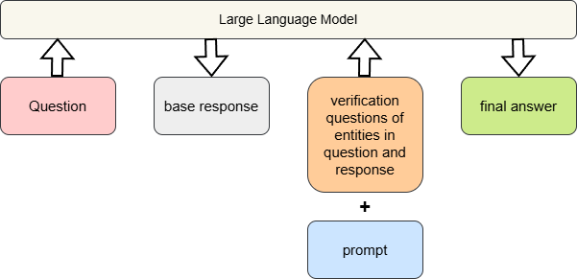
Baseline CoT’s idea https://arxiv.org/pdf/2201.11903
Use LLM’s deep-thinking mode and prompt LLM generate a more accurate answer.
COT_PROMPT = """You are given a question and original response. Let's think step by step and provide the most accurate final answer. """
Baseline CoVe’s idea https://arxiv.org/pdf/2309.11495
Generates a set of targeted verification questions that help fact‑check different parts of its original reasoning.
Next, the LLM independently answers these verification questions, often using retrieval, and uses the verified facts to revise the original answer.

Slide 3
Comparison experiment
Experiment dataset: 100 samples from TruthfulQA, with 49 hallucination samples and 51 correct samples
Baseline: CoT(chain-of-thought, Google Reseach), CoVe(chain-of-verification, MetaAI)
Experiment result parameters:
hallucination rate after repair: hallucination in final_answer provided by approaches
hallucination repair: base_response = hallucination, final_answer = not hallucination
unsuccessful repair: base_response = hallucination, final_answer = hallucination
overcorrection: base_response = not hallucination, final_answer = hallucination
pass@6: at least 1 is correct in the checking results of (mutations + base_response)
avg token cost pre question
avg time cost pre question
Number of mutations: 5(synonym)

Slide 4
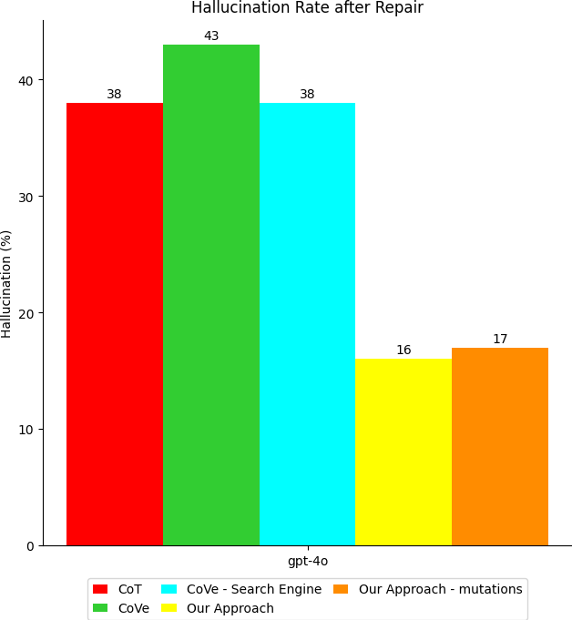
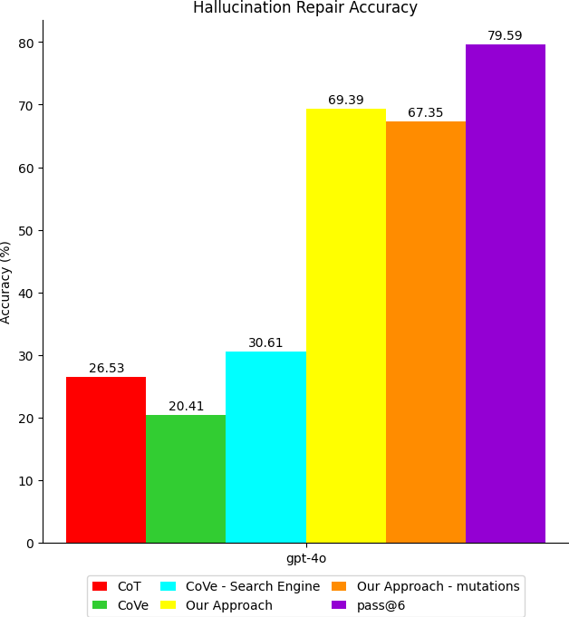
Experiment evaluation

Slide 5
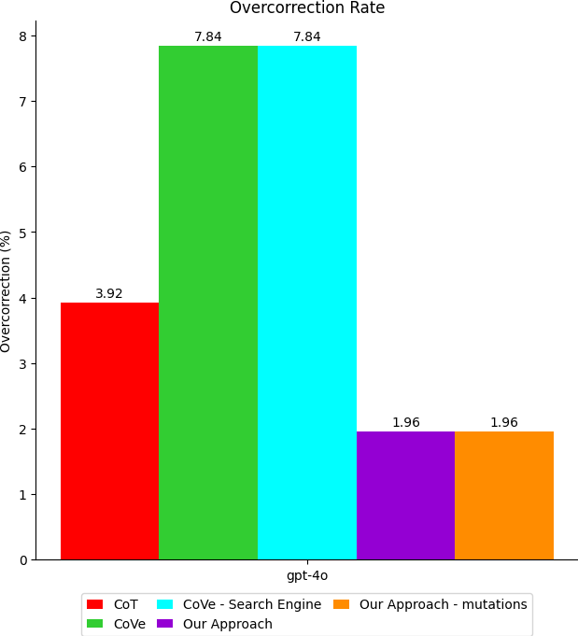
Experiment evaluation
Average Token Cost | Chain-of-Thought (CoT) | Chain-of-Verification (CoVe) | CoVe - Search Engine | our approach | our approach - mutations
gpt-4o | 101.73 | 2633.25 | 4222.12 | 197.15 | 1763.87
Average Time Cost | Chain-of-Thought (CoT) | Chain-of-Verification (CoVe) | CoVe - Search Engine | our approach | our approach - mutations
gpt-4o | 1.4113 | 30.0015 | 42.0007 | 1.8135 | 11.2498

Slide 6
TODO list
Extend dataset and include HotpotQA and FreshQA
Find one newer dataset
Preparing for full-scale experiment
Run small-scale experiment on gpt-5

