Slide 1





The ACM International Conference on the Foundations of Software Engineering (FSE) 2025
Exhibition | 23 – 27 June, 2025
Venue | Clarion Hotel Trondheim, Norway
Detecting Hallucinations in Large Language Models with Metamorphic Relations
Borui Yang (Institute of Software, Chinese Academy of Sciences)
Md Afif Al Mamun (University of Calgary)
Jie M. Zhang (King’s College London)
Gias Uddin (York University)
Notes:
Greetings everyone, this is Borui Yang.
I am the first author of our paper titled “Detecting Hallucinations in Large Language Models with Metamorphic Relations”.
This work was finished during I was an intern in King’s College London under the guidance of Dr. Jie Zhang. I am also very lucky to collaborate with Md Afif Al Mamun and Dr. Gias Uddin.
Today I’m totally excited to present this work at FSE. The core idea of our work is just like our title said, we use metamorphic relation to detect llm hallucinations.

Slide 2
Problem Statement
(i) What is a LLM hallucination?
Output factually incorrect, irrelevant, or nonsensical, however appears coherent.
Why detecting LLM hallucination is essential?
In critical domains (e.g. law, healthcare), misleading users without expertise lead to serious outcomes.
Improve trust to LLM.
Notes:
First, let’s go to this question, what is exactly a LLM hallucination?
In biology, hallucination generally refers to a false perception that does not correspond to real external objects or events.
In the area of Large Language Models, hallucination refers to the generation of factually incorrect, irrelevant, or nonsensical content by LLMs, even when the output appears coherent.
And why is detecting hallucinations essential?
An analogy can be drawn to software testing, in software testing, identifying and analyzing bugs informs debugging, improves system reliability, and builds user trust.
Similarly, hallucination detection in LLMs allows us to define trust boundaries, improve LLM design, and tailor applications for critical domains such as healthcare, legal, and education, where accuracy is important.
1min

Slide 3


Problem Statement
Notes:
Sometimes, LLM hallucinations can even threaten your life, if you blindly follow the recipes provided by LLMs to make a pizza, you will finally find your teeth attached to a slice of pizza, impressive!

Slide 4
Problem Statement
(ii) What is Metamorphic Relations? Why is it possible to detect LLM hallucinations with MRs?
MRs define how the output of a system should change when its input is systematically modified.
MRs originally used in software testing to handle the oracle problem.
Notes:
Remember that we use Metamorphic Relations to detect hallucination, but what are metamorphic relations and why they are proper to detect hallucinations?
MRs describe how a system’s output should change under controlled changes to its input, originally from software testing to handle the oracle problem.
1min

Slide 5
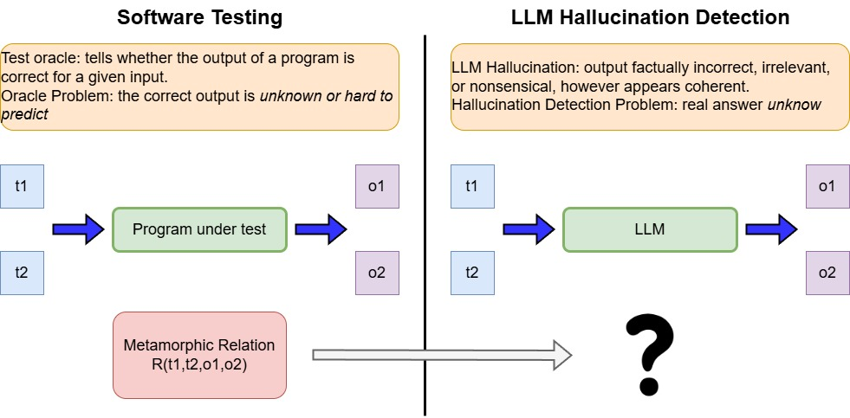
Problem Statement
Notes:
When the tester cannot correctly predict the expected result in testing process, that could lead to oracle problem,
quite similar to the hallucination problem in LLM, we actually usually don’t know the answer is correct or not without any connected knowledge.
That’s why it is possible to detect LLM hallucinations with MRs - we can also view it as an analogy to Software testing.
By applying MRs to LLM outputs and checking if the mutantions follow expected relations, can reveal possible hallucinations.

Slide 6
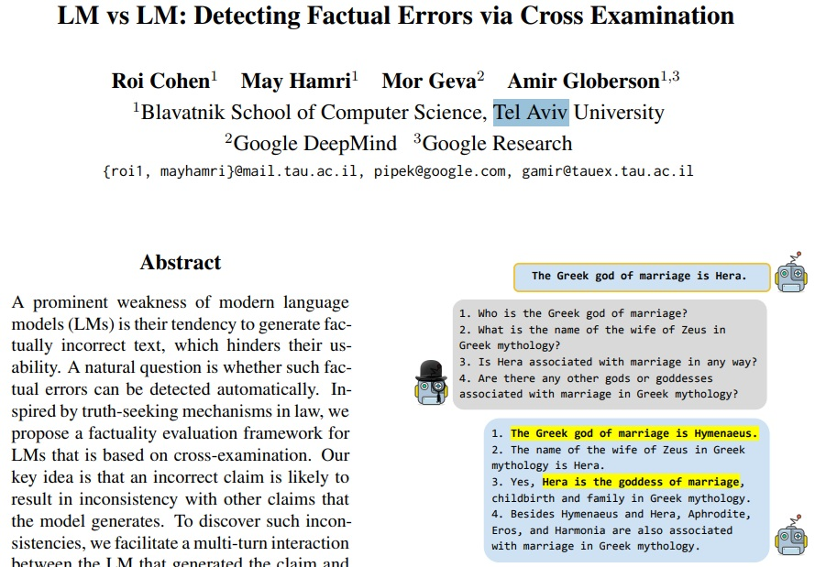
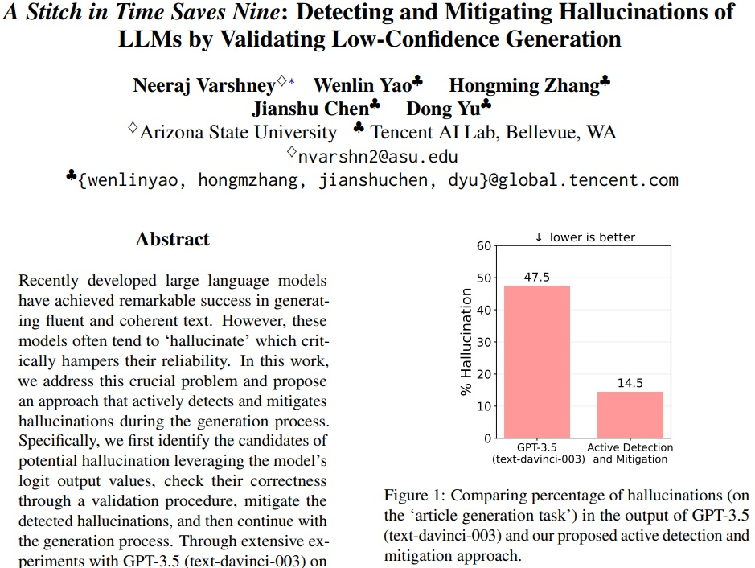
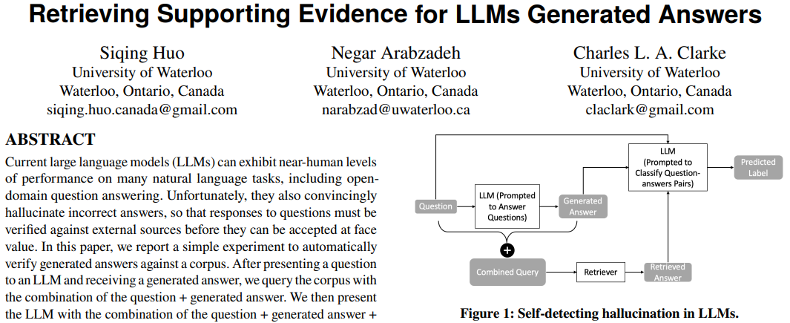
Problem Statement
(iii) Related work
Reliable knowledge sources (external databases, more costs)
Uncertainty measure (open-source models)
LM vs LM (external agents)
Notes:
In currect researches, one of the direct strategy of LLM hallucination detection is to use reliable knowledge sources, Huo’s work compare the response with the reliable answer, however this need external databases, and can lead to more costs.
We all know LLM hallucinations are inherently tied to the model’s uncertainty. The internal states of LLMs can serve as informative indicators of their uncertainty, Vanshney’s work use this idea to detect hallucination. However, this method only work on the open-source models. We don’t have access to find those indicators in closed-source models.
Cohen’s work use another Language Model to check the response from the origin one, this also use other agent to solve the problem.

Slide 7
Our Contribution
To fill this gap, we:
(i) Proposed MetaQA, a lightweight, dependency-free hallucination detection method.
(ii) Applied synonym- and antonym-based metamorphic relations to detect hallucination in LLMs responses.
(iii) Built TruthfulQA-Enhanced by updating 238 questions for TruthfulQA dataset.
(iv) Conducted evaluations, MetaQA outperforms baseline on precision, recall, and F1 score across 3 datasets and 4 LLMs.
Notes:
And to fill this gap: we proposed our method MetaQA, a lightweight, dependency-free hallucination detection method which means we don’t need external knowledge or truth verification sources.
Second, to the best of our knowledge, we are the first to apply synonym- and antonym-based metamorphic relations to detect hallucination in LLMs responses.
And we improve the TruthfulQA - a hallucination evaluation benchmark by updating 238 questions with new, on-time, correct answers. This can support more accurate hallucination detection research in the future.
Last, we conduct a large-scale evaluation of our method MetaQA, showing superior performance over the baseline method.
1min

Slide 8
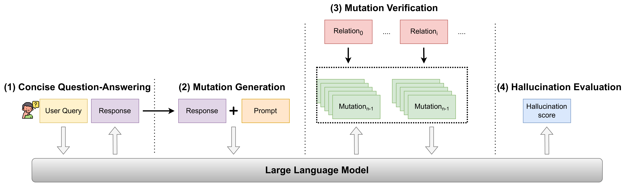
MetaQA Method Overview
The Workflow of MetaQA
Notes:
Here is the workflow of MetaQA, including 4 parts. Concise Question-Answering, Mutation Generation, Mutation Verification, and Hallucination Evaluation.
0.5min

Slide 9
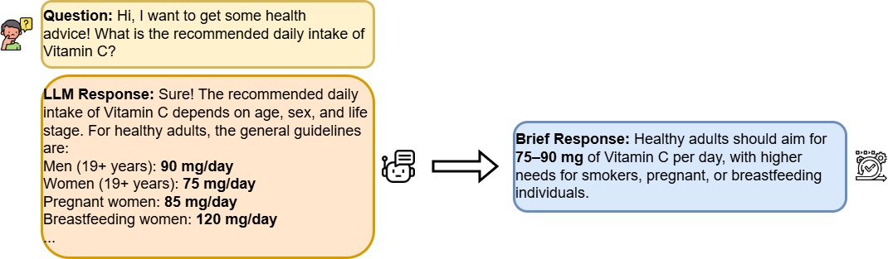
MetaQA Method Overview
Concise Question-Answering
Prompts LLMs to generate brief, contextually grounded answers.
Notes:
The first part is consise question-answering, not all the questions have one simple answers, in typical interactions, LLMs often generate detailed and lengthy explanations.
So, we have this part, to prevent overly long responses from disrupting the workflow of subsequent modules, we prompt LLMs to generate brief, contextually grounded answers.
0.5min

Slide 10

MetaQA Method Overview
(ii) Mutation Generation
Create multiple distinct high-quality mutations to the response.
$$mutation=f(subject, relation)$$
Two types of metamorphic relations are deployed:
Relation 1: Synonymy Relation
Synonymous mutation: same semantic meaning variation of the origin
$R(sub, verb, obj)⇒R′(\text{sub}\text{,}\text{verb}\text{′}\text{,} obj)$, $R(sub, verb, obj)⇒R′(obj\text{,}\text{verb}\text{′,}\text{sub})$
Relation 2: Antonymy Relation
Antonym mutation: opposite meaning to origin.
$$R(sub, verb, obj)⇒\text{¬}R(\text{sub}\text{,¬}\text{verb}\text{,} obj)$$
Notes:
The second part is for creating multiple distinct high-quality mutations to the response.
We deploy 2 kinds of metamorphic relations and generate mutations.
First is synonym relation, a synonym mutant refers to a mutant maintains the same semantic meaning, mainly followed the following rules.
Second is antonym relation, that antonym mutants share opposite meaning to the origin response.
1min

Slide 11
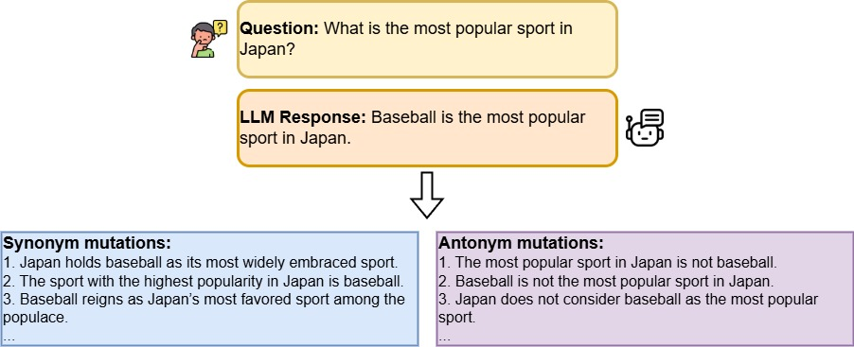
MetaQA Method Overview
Notes:
In this example, after we have the question and answer, we generate several distinct mutations.

Slide 12
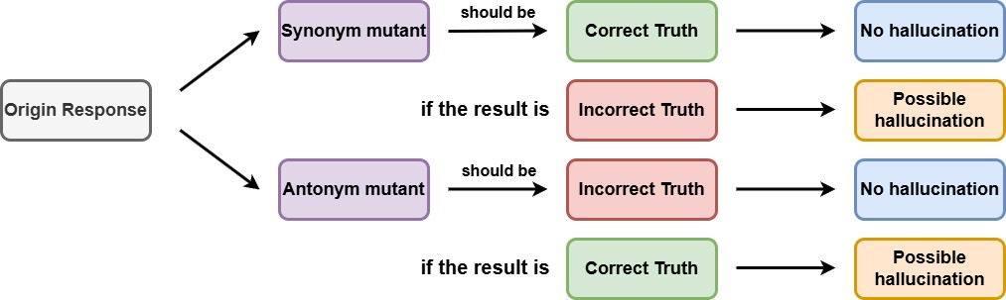
MetaQA Method Overview
(iii) Mutation Verification
Verify mutations are ground truth or not.
Prevent LLMs from associating with myths, fairy tales, or other fictional contexts.
The checking results should follow the rules below:
Notes:
In the third module, mutation verification. For each mutant, we verify if it conforms to expected truthfulness.
The checking results should follow the rules in figure: synonym mutants should be correct truth, which means no hallucination in origin response. In opposite, if they are not correct ground truth, means hallucination could occur in origin response. So is it same as antonym mutants.
Moreover, some questions in datasets may let LLMs associate fictional context, for ex, myths, fairy tales, movies, which could have influence on our process.
So, we also have special prompt to avoid this phenomenon as possible.
1.5min

Slide 13
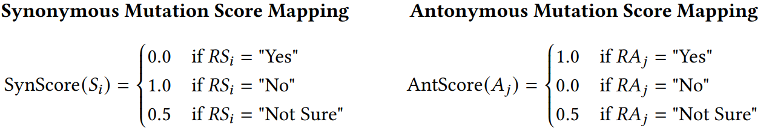

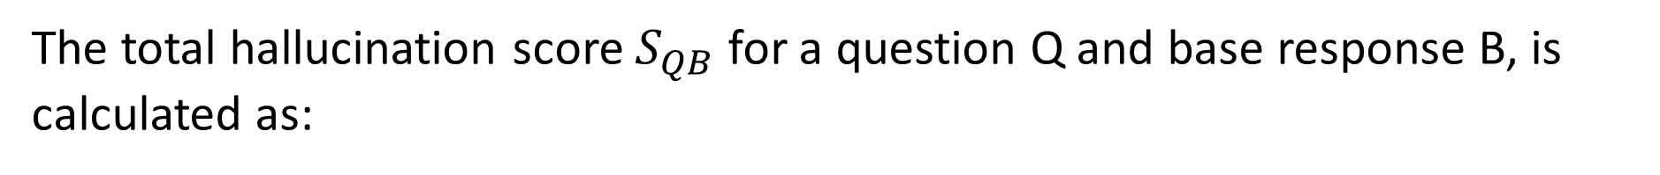
MetaQA Method Overview
(iv) Hallucination Evaluation
Calculate a hallucination score based on the verification results representing the likelihood of hallucination in the base LLM response.
The total hallucination score $S_{QB}$ for a question Q and base response B, is calculated as:
Notes:
Finally, we calculate hallucination score based on the verification results, representing the likelihood of hallucination.
The mapping rules are as followed.
Then the total hallucination score will be calculated by this formula.
Since our baseline deploys a similar methodology to generate Hallucination Scores, we can directly compare our results with those of our baseline under the same benchmark.
1min

Slide 14
Experimental Setup & Evaluations
(i) Research Questions
RQ1. Effectiveness: How effective is MetaQA in detecting hallucination in LLMs?
RQ2. Generalization: How does MetaQA perform on questions from various categories?
RQ3. Stability: How stable is MetaQA in its hallucination detection performance?
RQ4. Sensitivity to mutants: How do the categories and number of mutations impact MetaQA’s overall performance?
RQ5. Sensitivity to threshold: How does the performance of MetaQA and SelfCheckGPT vary across different threshold settings?
Notes:
After that, let's go to the experiment part.
In our work, we answered the following research questions by experiments.
Research Question 1 focuses on effectiveness.
Research question 2 is about Generalization, mainly about MetaQA on various categories.
Question 3 is about the stability of MetaQA.
Question 4 explains why we select specific number of mutants in our experiment.
Question 5 shows the sensitivity of MetaQA to threshold.
1min

Slide 15
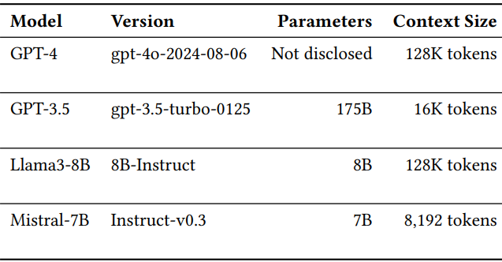
Experimental Setup & Evaluations
(ii) Experimental Setup
a) Baseline: SelfCheckGPT (the most and the only similar method to MetaQA, also state-of-art method)
b) Datasets: TruthfulQA (resistance to false narratives), HotpotQA (multi-hop reasoning and evidence-based questions), and FreshQA (on-time questions)
c) Studied LLMs: GPT-4 and GPT-3.5 (closed-source models), Llama3 and Mistral (open-source models)
Notes:
For the experiment, we select SelfCheckGPT, which is the most and the only similar one to our approach and which is also the state-of-art method.
What does SelfCheckGPT do, is that they will repeatedly feed the origin question to LLM and get sample answers.
Then it checks whether sample answers support the origin answer, generate a hallucination score.
And our experiment deploy on 3 datasets, TruthfulQA (TruthfulQA can evaluate models’ resistance to false narratives), HotpotQA (HotpotQA includes multi-hop reasoning and evidence-based questions) and FreshQA (FreshQA includes on-time questions).
We also deploy experimentds on 2 different kinds of LLMs - closed-source and open-source models, 4 in total. More details can be viewed in this table.
0.5min

Slide 16
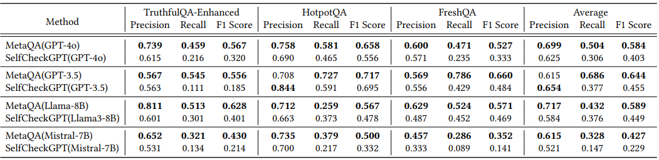
Experimental Setup & Evaluations
(iii) RQ1: Effectiveness
Comparison on various datasets and LLMs with the threshold 𝜃= 0.5:
Notes:
For RQ1, Effectiveness, we have the results in this table, of comparison on MetaQA and SelfCheckGPT across multi datasets and multi LLMs with the default threshold.
Bold numbers indicate higher results, that is, the side with better performance.
So as you can see, mostly MetaQA outperforms SelfCheckGPT.
0.75min

Slide 17
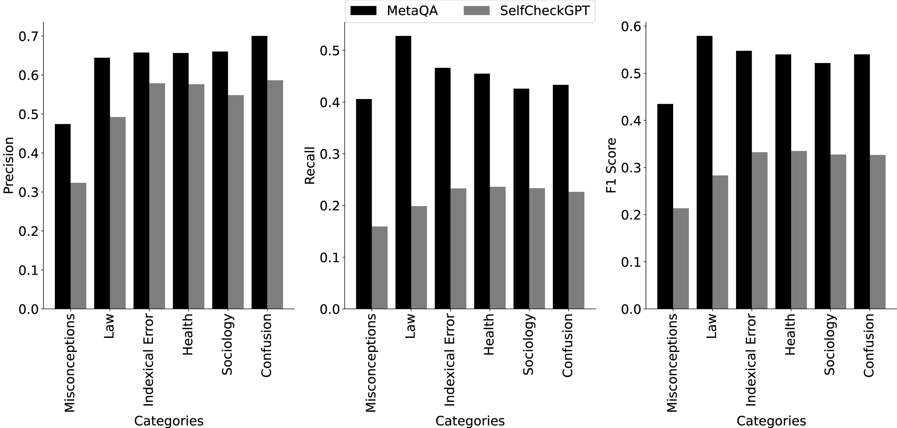
Experimental Setup & Evaluations
(iv) RQ2: Generalization
Overall Hallucination Rate of Specific Domains and Detected Proportion Comparison at threshold 𝜃 = 0.5.
Notes:
In RQ2, we compare the hallucination detection effectiveness of MetaQA and SelfCheckGPT across the six most frequently occurring categories in the TruthfulQA datasets.
It can be seen that MetaQA still outperforms SelfCheckGPT in those specific domains.
0.5min

Slide 18
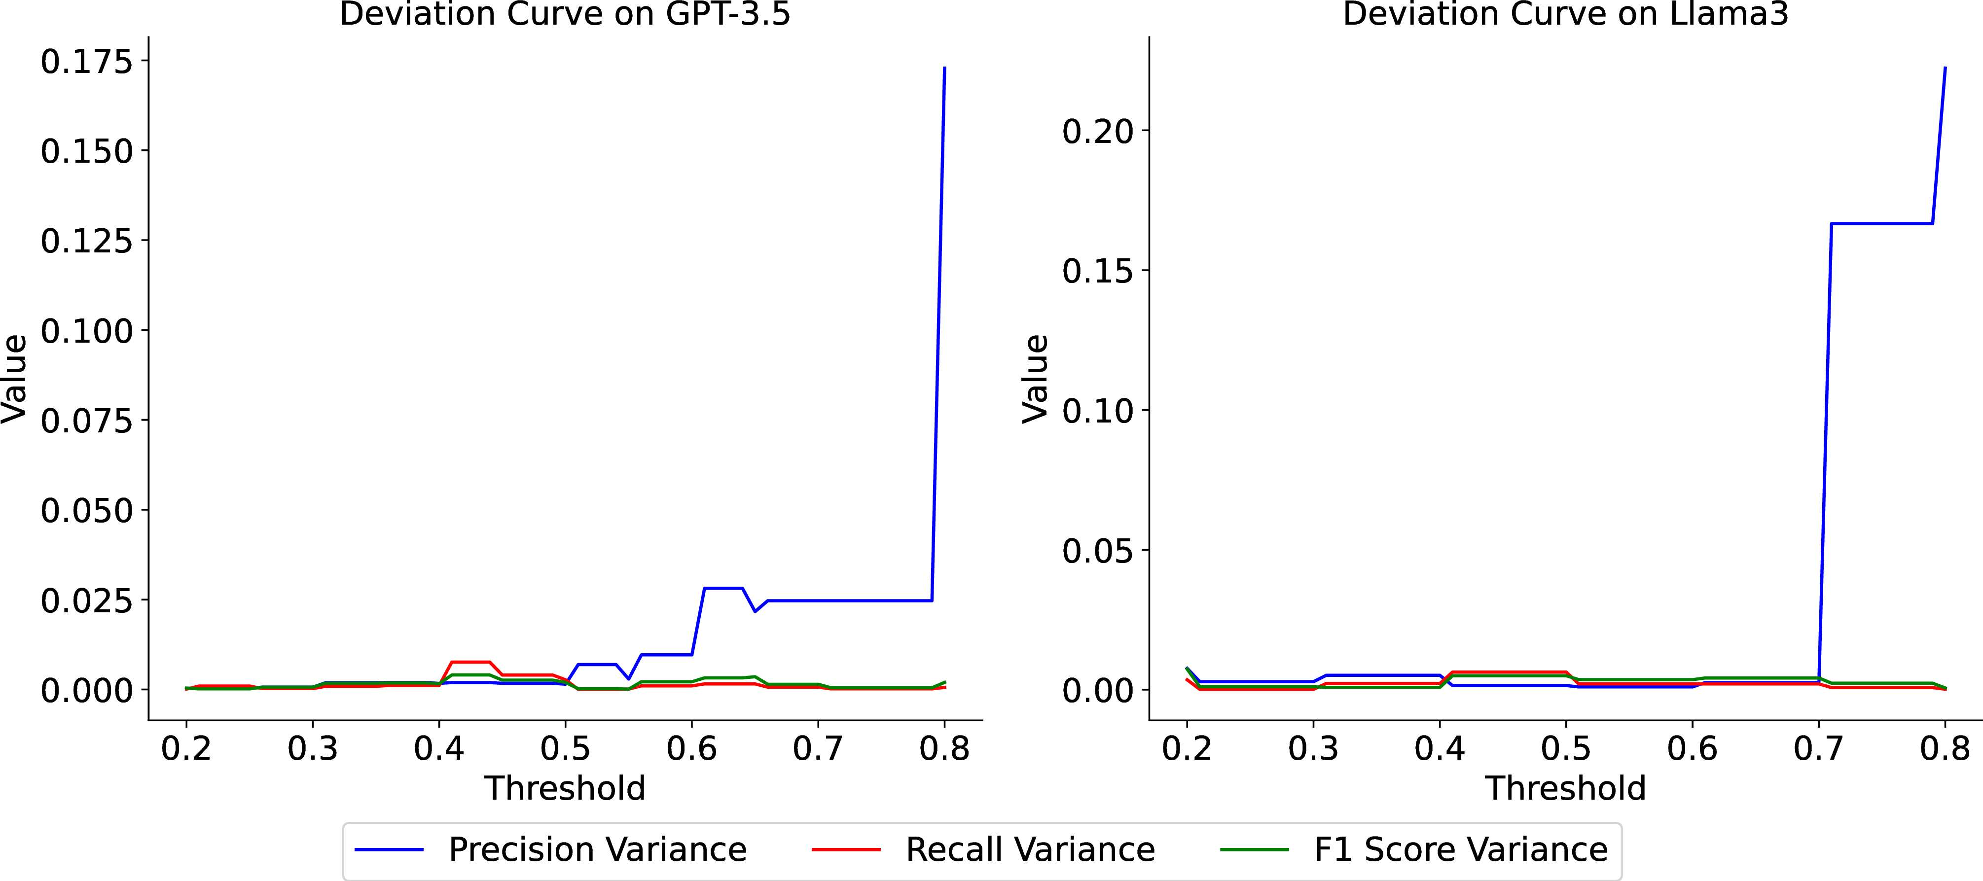
Experimental Setup & Evaluations
(v) RQ3: Stability
Deviation curves with MetaQA across different thresholds 𝜃:
Notes:
Given the randomness of hallucination generation in LLMs and the reliance of MetaQA’s workflow only on the LLM itself, it is crucial to assess whether MetaQA is affected by these uncertainties.
Therefore, we designed an experiment to verify the gap between the results of multiple experiments. It can be seen that within our preset threshold, MetaQA’s performance is quite stable.
0.75min

Slide 19
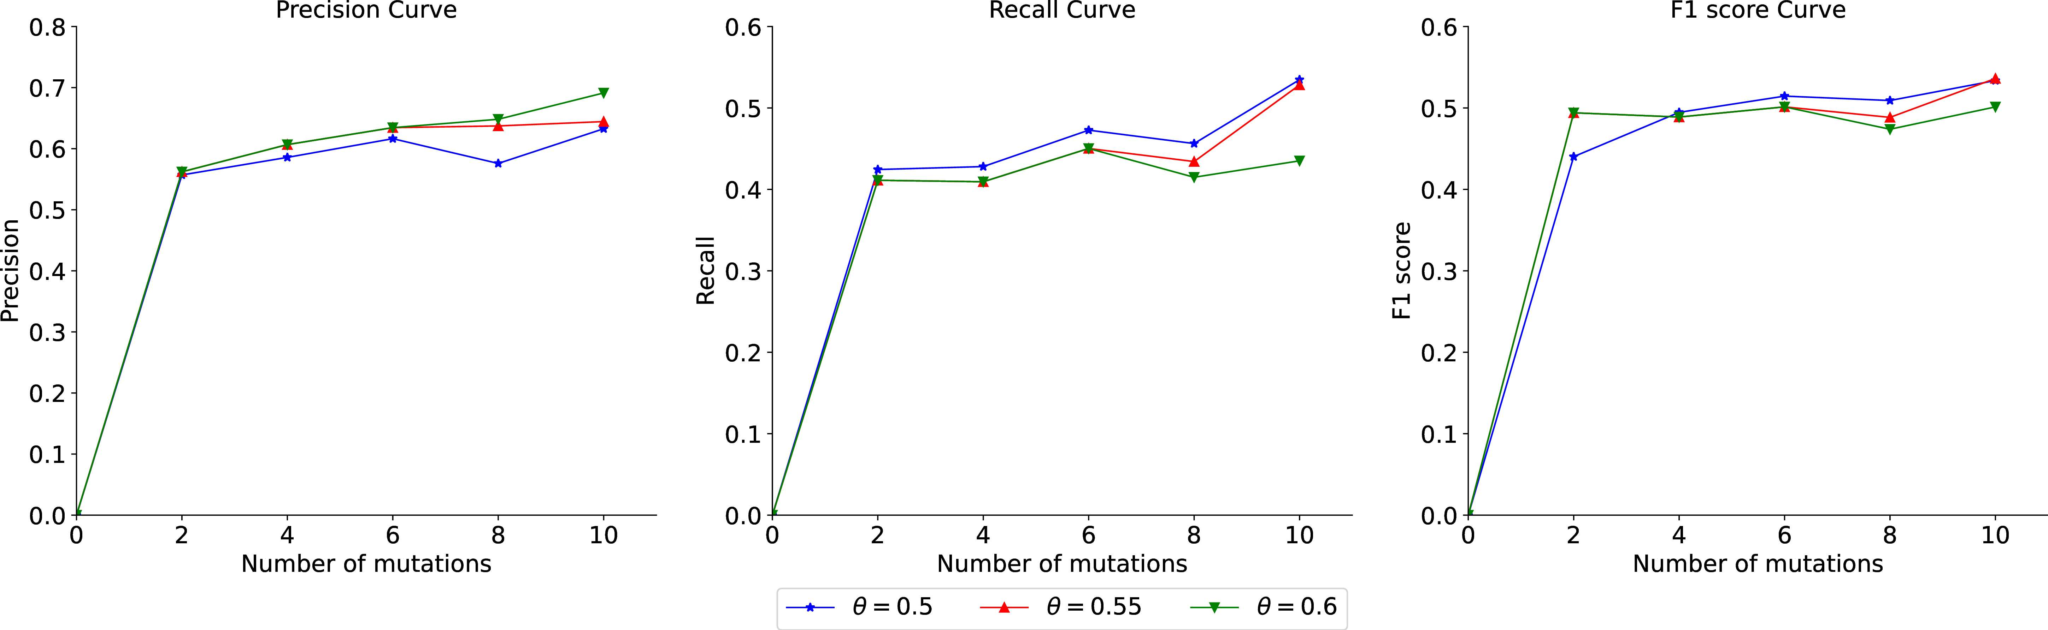
Experimental Setup & Evaluations
(vi) RQ4: Sensitivity to Mutants
Performance vs mutation numbers on GPT-3.5:
Notes:
This experiment explains why we use specific number of mutants. We use 10 in our experiments.
As can be seen from the figure, when the number is less than 10, the parameter is in a state of obvious increase, but after the number reaches 10, the performance of MetaQA is not very significantly improved, and more mutants may lead to a significant increase in token costs. Therefore, we choose 10 mutants in our experiment.
0.5min

Slide 20
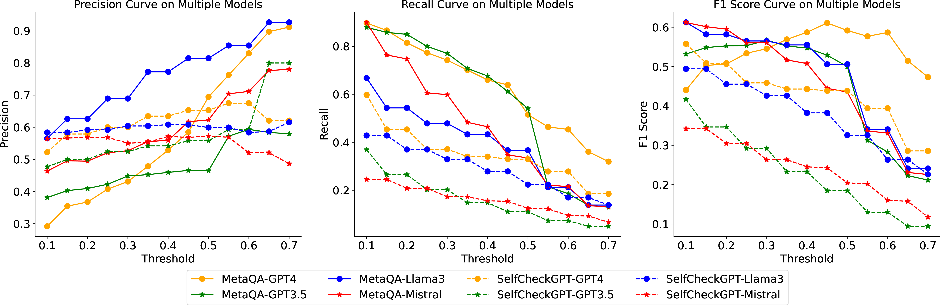
Experimental Setup & Evaluations
(vii) RQ5: Sensitivity to threshold
Parameter Curves in hallucination detection across thresholds 𝜃 ∈ [0.2, 0.7] and across multiple LLMs:
Notes:
The last experiment shows the performance of MetaQA and SelfCheckGPT at different thresholds.
First, we can see that MetaQA outperforms SelfCheckGPT at most thresholds.
In addition, this experiment also explains why we use 0.5 as the default threshold, because the performance indicators of both drop rapidly when the threshold exceeds 0.5.
0.75min

Slide 21
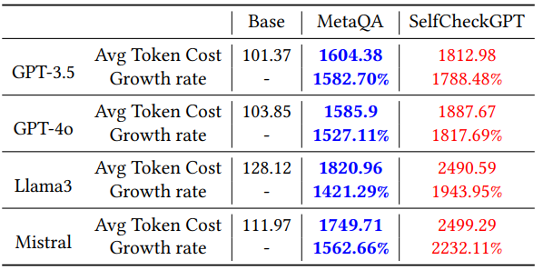
Discussion & Limitations
(i) Token Overhead Analysis
An average token-cost per QA-process comparison on multi models:
Notes:
When we use token-based models, may incur substantial costs when processing large datasets or executing multiple iterations.
Here is the average stat table during our experiment.
You can find that even our method spend less tokens than SelfCheckGPT, we are still spending 10 more times tokens than we simply ask 1 single question.
0.5min

Slide 22
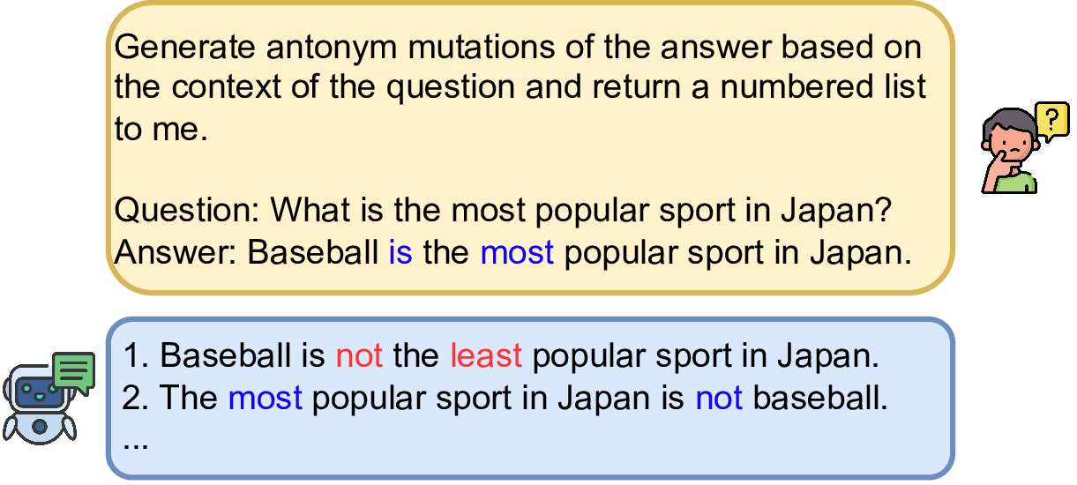
Discussion & Limitations
(ii) Threats to Validity
The effectiveness of MetaQA is heavily dependent on the accuracy of the generated mutations. A double negation example in generating antonym mutations below:
Notes:
As for the limitations, the effectiveness of MetaQA is heavily dependent on the accuracy of the generated mutations. Because our processes base on those mutations.
If these mutations do not accurately represent variations of their original responses, may yield unreliable results.
Here is a double negation example in generating antonym mutations and we also have prompt to guide LLMs to avoid this as possible.
1min

Slide 23

Conclusion & Future Work
(i) Conclusion
Present MetaQA, a MR-based method to detect Fact-Conflicting hallucinations in LLMs.
Extend approach to use software engineering methods to enhance the reliability of LLMs.
(ii) Future Work
Real-time LLM Hallucination Detect Application.
Hallucination Detection in other domains (e.g. Code).
Hallucination Mitigation.
(iii) Data Availability
Code Repository: https://github.com/zbybr/LLMhalu/tree/MetaQA-Open-Base
Email: buptzbybr@outlook.com
Notes:
Finally goes to the conclusion.
In conclusion, we present MetaQA, an MR-based method to detect Fact-Conflicting hallucinations in LLMs.
And this is also an extend approach to use software engineering methods to enhance the reliability of LLMs.
In future, we could apply MetaQA to, for example real-time application, so we can get hallucination detection results on-time.
We are trying to extend MetaQA or using other Software Engineering method to LLM hallucination detection in other domains, for ex, Programming Languages.
And we can also explore the possibility in hallucination mitigation.
You can find our open code base in this URL or scan this QR code, and I really appreciate reviewers and committee chairs selecting our paper as one of the distinguished paper, that really encourages us.
Raise any questions to me if you have, also I will soon be a PhD student in Chinese Academy of Sciences, if any possible research collaboration chance, just contact with me.
1.5min

Slide 24
The ACM International Conference on the Foundations of Software Engineering (FSE) 2025
Exhibition | 23 – 27 June, 2025
Venue | Clarion Hotel Trondheim, Norway
Thanks for your listening
24th June, 2025
Borui Yang (Institute of Software, Chinese Academy of Sciences)
Md Afif Al Mamun (University of Calgary)
Jie M. Zhang (King’s College London)
Gias Uddin (York University)
Notes:
And I believe that would be the end of my presentation, thanks for your patient listening!

