Slide 1

The ACM International Conference on the Foundations of Software Engineering (FSE) 2025
Exhibition | 23 – 27 June, 2025
Venue | Clarion Hotel Trondheim, Norway
Calibration of Large Language Models on Code Summarization
YUVRAJ VIRK, UC Davis, United States
PREMKUMAR DEVANBU, UC Davis, United States
TOUFIQUE AHMED∗ , UC Davis & IBM Research, United States

Slide 2
Research Background
Code summaries and comments help maintainers understand code.
However, LLM-generated summaries can be inaccurate, incomplete, e.g. generally, too dissimilar to one that a good developer might write.
It’s difficult to gauge whether an LLM-generated summary sufficiently resembles what a human might produce, without a “golden" human-produced summary to compare against.

Slide 3
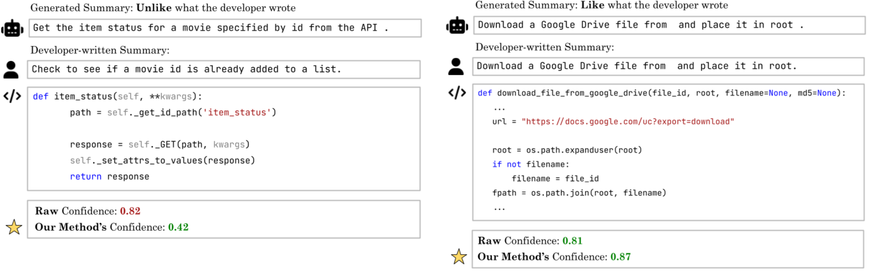
Problem Statement
Calibration problem: given just the code & the summary from an LLM, can we compute a confidence measure, that provides a reliable indication of whether the summary sufficiently resembles what a human would have produced in this situation

Slide 4
Problem Statement
Calibration: How to use unreliable outputs from flawed models
Notes:
背景与动机
神经网络模型是基于训练集用概率方法优化的。但在不同的测试集上，它们可能无法始终生成高质量的结果。 那么，如何在实际中使用这些存在缺陷的模型？ 这个问题与**校准（Calibration）**的概念直接相关。
为了简化，我们先考虑一个输出二分类预测的模型（例如对/错），其预测不总是正确。同时模型会对每个预测输出一个置信度（概率值，0 ≤ p ≤ 1）。 如果这个置信度是可靠的，我们希望它能真实反映预测正确的概率： 例如，模型在某个预测上输出 0.6 的置信度，那么这个预测在统计上应当有约 60% 的概率是正确的。 当这种对齐关系成立时，模型被称为 “校准良好”；它的置信度是对预期结果的良好预测，这样就可以更合理地用于决策。
举例：如果一个天气预测模型校准良好，那么用户会根据不同的置信度采取合适的行动：
下雨概率 10%：戴帽子
下雨概率 ≥ 50%：带伞
下雨概率 ≥ 80%：改乘公交车
校准的量化定义
校准本质上是“置信度 vs 正确率”的对应关系。 对预测置信度进行分箱（如 [0–0.1)、[0.1–0.2)…），在每个箱中统计预测正确的比例并作图（可靠性图）。
如果模型校准良好：每个箱的正确率 ≈ 箱的平均置信度（点接近对角线）
如果校准不好：偏差很大（点偏离对角线）

Slide 5
Problem Statement
Correctness of a generated summary
Notes:
在二元预测任务中（例如“明天会下雨吗”），正确性很简单——要么下雨，要么没下雨。 但对于由一系列 tokens 构成的代码摘要，正确性就更复杂：
是完全匹配（Exact match）？
还是部分匹配（Partial match）？
或者是语义相似？
幸运的是，代码摘要的评估领域已有不少研究 [Haque et al. 2022; Mastropaolo et al. 2024; Roy et al. 2021; Shi et al. 2022]。

Slide 6
Research Questions
RQ1: Are the LLM-produced confidence measures over the tokens in the generated summary well-calibrated?
RQ2: How does rescaling affect the calibration of various LLMs with respect to summary correctness?
RQ3: Are earlier tokens in the generated summary better calibrated than later tokens?
Notes:
RQ1.研究LLM 对每个生成token的置信度是否能直接作为整体可靠的置信度信号，使用BERTScore衡量生成摘要与人工摘要的相似度。
RQ2. 作者发现，直接将 LLM 生成摘要的token confidence取平均得到的置信度校准效果不好。为改善这一问题，他们尝试使用Platt Rescaling方法，对模型的置信度进行调整，使其更好地与实际事件发生的频率相匹配。
作者在前两个研究问题中是按整段输出的所有令牌平均概率来衡量 LLM 的置信度。但他们发现，生成序列中前后令牌的概率分布差异显著，因此提出 RQ3：探究生成摘要中早期令牌的置信度校准效果是否优于后期令牌。

Slide 7
Methodology
(i) Experiment Models:
GPT-3.5-turbo
Code-Llama-70b
DeepSeek-Coder-33b Instruct
(ii) Prompting Methods:
Few-shot Learning: prompt models with 3 exemplars as method-comment pairs
Retrieval Augmented: BM25 retrieval algorithm works better than few-shot learning
Automatic Semantic Augmentation of Prompt (ASAP): static analysis to extract "intermediate reasoning steps," injecting information such as repository metadata, identifier types with scope, and dataflow information, forming prompts similar to CoT reasoning.
Notes:
检索增强的少样本学习：提供 3 个方法-注释示例；使用 BM25 检索与最终查询最相关的示例以提升效果。
ASAP 利用静态分析提取“中间推理步骤”，注入信息包括仓库元数据、带作用域的标识符类型与数据流信息，形成类似链式思维的提示。

Slide 8
Methodology
How to measure models’ confidence in a token sequence? (RQ1)
Under the assumption of token independence, the sequence probability is the product of all token probabilities; after normalization, the geometric mean is taken.
Compared to the arithmetic mean, the geometric mean is better suited to represent the overall probability of a sequence and has empirically demonstrated better calibration performance.
Using the geometric mean reduces sensitivity to individual high-probability tokens, thereby lowering the risk of overconfidence.
Notes:
在假设令牌独立的情况下，序列概率为所有令牌概率的乘积；归一化后取几何平均。
几何平均相比算术平均更适合表示序列的整体概率，也在实验证明有更好的校准效果。
使用几何平均能降低对个别高概率令牌的敏感度，减少过度自信的风险。

Slide 9
Methodology
Evaluating similarity to human-produced summaries (RQ1)
Need a binary notion of correctness which separates a good and bad summary
Dataset selection for setting thresholds:
dataset from paper "Semantic similarity metrics for evaluating source code summarization“, includes reference and generated summaries for 210 Java methods
each method includes 3 human-assigned similarity ratings, 4 ratings ranging from "Strongly Disagree" to "Strongly Agree"
SentenceBERT offered the best correlation with human ratings
a "correct" summary = at least an "Agree" rating
Notes:
对于每段代码，取3位标注者评分的平均值，得到一个综合评分。使用该数据集评估不同自动相似度指标在判定“人工同意”与“人工不同意”时的分类准确性。

Slide 10
Methodology
Evaluating similarity to human-produced summaries (RQ1)
Selecting Thresholds:
for automated similarity metrics
for correct (perfect recall) while avoiding wrong classifications (perfect precision)
BERTScore was a reasonable proxy for human judgement of similarity
perfect recall: correct and positive
perfect precision: positive and correct

Slide 11
Methodology
Evaluating similarity to human-produced summaries (RQ1)
Grid search over the similarity and thresholds, at 0.01 intervals to identify:
1) the highest recall while maintaining a high precision (> 0.9),
2) the highest precision with high recall (> 0.9),
3) the highest F1 score (harmonic mean of precision and recall).
three classification strategies: Cautious (high precision), Lenient (high recall), and Balanced (best F1).
Results:
High Precision: BERTScore, threshold = 0.89
High Recall: SentenceBERT, threshold = 0.80
Best F1: BERTScore, threshold = 0.49

Slide 12
Methodology
Experiment dataset
Dataset:
from CodeXGLUE (Java: 164923 samples, Python: 251820 samples)
Method:
BM25 retrieval from the training set for relevant few-shot examples
Test set: 5,000 random samples per language
Dataset is de-duplicated to reduce train/test overlap
Evaluation Basis:
Compare generated summaries with human-written reference summaries; correctness determined by semantic similarity ≥ threshold

Slide 13
Methodology
Rescaling (RQ2)
Purpose: Adjust predicted probabilities to better match actual event frequencies for improved calibration.
Method: Platt Scaling
Procedure:
Perform 5-fold cross-validation.
Train on 4 folds, apply regression to the remaining fold.
Ensure folds contain samples from different repositories to avoid overlap.
Evaluation: Compute cumulative Brier and Skill scores across all folds.
Notes:
目的：调整模型预测概率，使其更符合实际事件的发生频率（提高校准度）。
方法：Platt Scaling（基于预测概率和真实标签的逻辑回归模型）。
选择理由：在既有的软件工程研究中表现良好。
流程：采用5折交叉验证。
使用4折进行训练，将回归模型应用于剩余1折。
每一折仅包含来自不同代码仓库的样本，避免训练/测试仓库重叠。
评估：在所有折上累计计算 Brier 分数和 Skill 分数。

Slide 14
Methodology
Using the first tokens to compute confidences (RQ3)
Purpose: Investigate whether using only the first t tokens in a summary improves confidence calibration.
Hypothesis: Early tokens strongly constrain subsequent content, potentially yielding more accurate confidence estimates.
Method:
Treat t as a hyperparameter; select the value that maximizes skill score.
Apply 5-fold cross-validation to determine and validate optimal t.
Evaluation:
Compare Brier scores (MSE of confidence) for "first t tokens" vs. "all tokens".
Use paired t-test for statistical significance.
Adjust p-values via Benjamini-Hochberg to control false discovery rate.
Notes:
目的：研究仅使用摘要的首 $t$ 个 token 来计算置信度是否能提供更好的校准效果。
假设：初始token对后续内容约束更强，可能带来更准确的置信度。
方法：$t$作为超参数，通过最大化 skill score 来确定最佳值
使用五折交叉验证，确保训练/测试在不同折中分离
评估：对比“使用首$t$个token”与“使用所有 token”的 Brier 分数
通过配对 t 检验判断显著性
使用 Benjamini-Hochberg调整p值，减少虚假发现

Slide 15
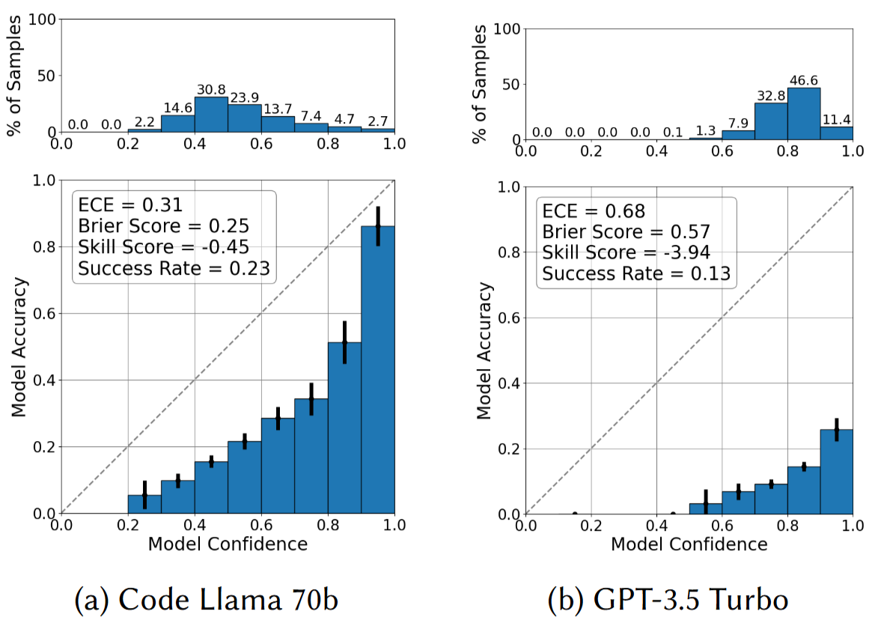
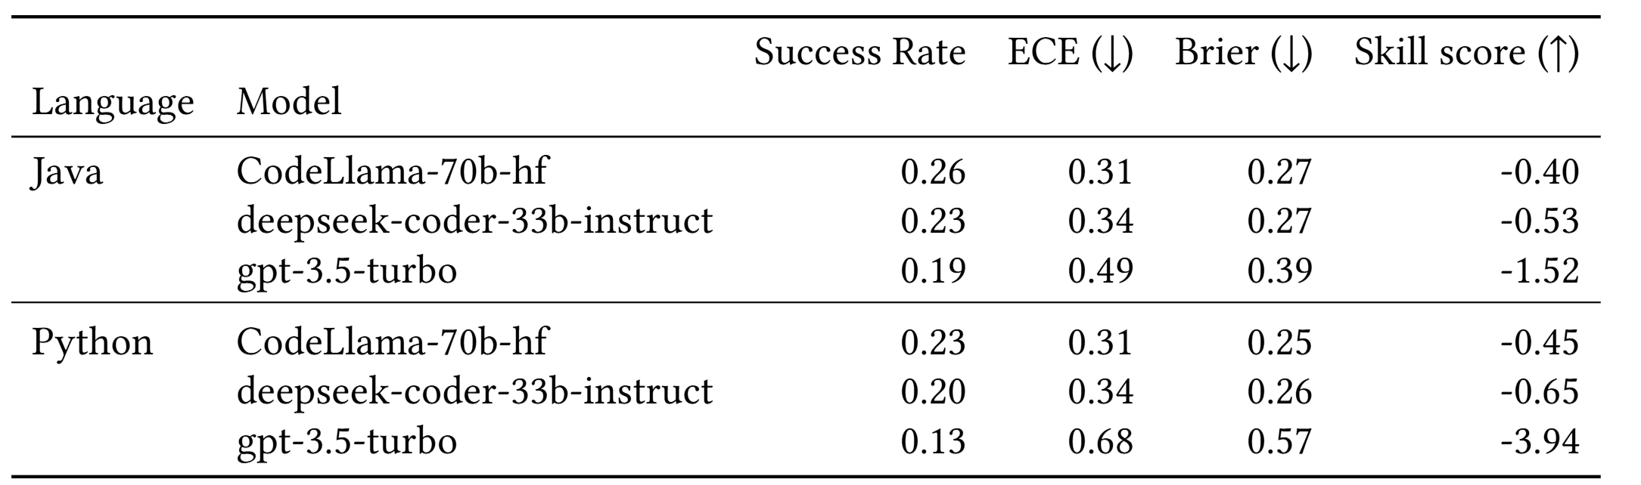
Experimental Result
RQ1 Calibration: LLM Confidence vs. Summary Correctness
Raw Calibration Metrics with summaries produced by Retrieval Augmented Few-Shot Summarization
Notes:
实验设置：BM25 检索 few-shot 示例生成摘要，使用最佳 F1 阈值的 BERTScore 进行校准评价。
结果：
Brier 分数：这是衡量预测概率与实际正确性差距的指标，越低越好。结果是 0.25~0.57，太高了，说明模型的置信度预测比随机猜测还差。
ECE（Expected Calibration Error）：衡量预测概率的平均偏差，也很高 → 不理想。
Skill score：负数 → 表示表现比一个简单基准模型还差。
虽然这些统计指标很差，但可靠性图仍然显示模型的置信度有一点规律性（有“信号”）。
相关性：
置信度和 BERTScore（衡量模型摘要与参考摘要的相似度）之间的相关性很低（在最佳情况下也只有 ρ = 0.45），也就是置信度并不能很好地预测 BERTScore。
他们强调：置信度的意义不是直接等于 BERTScore。 比如：模型给出 90% 的置信度，并不是说它的 BERTScore 会是 0.9，而是说——有 90% 的概率这个摘要是可接受的。

Slide 16
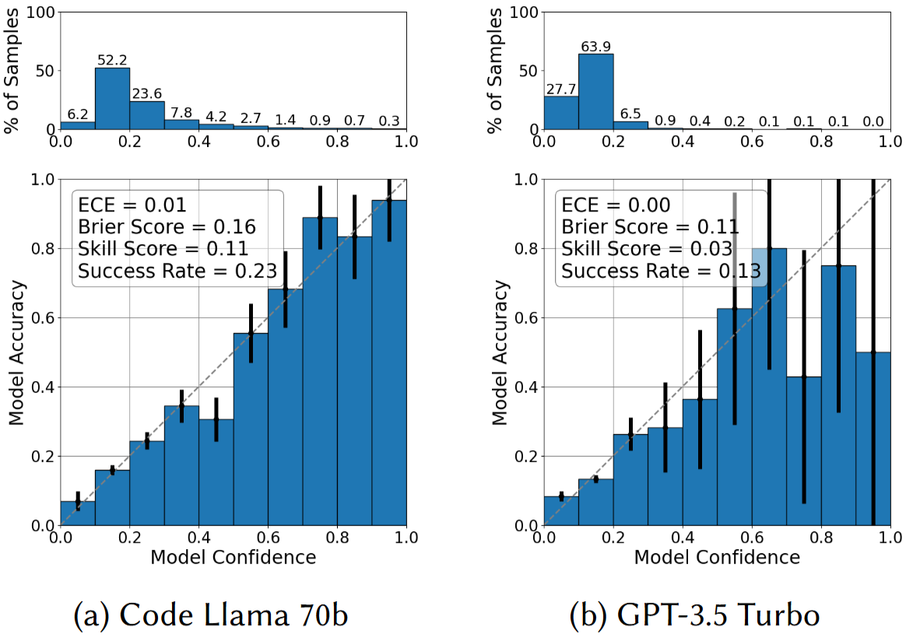
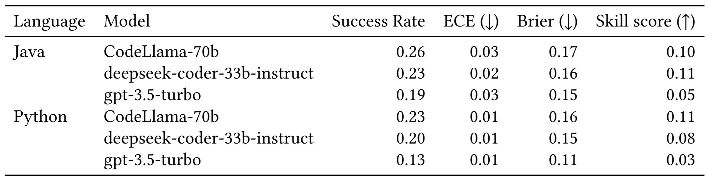
Experimental Result
RQ2: Platt Rescaled vs. Raw Calibration
Platt Rescaled Calibration using Retrieval Augmented Few-Shot Summarization on Java methods
Notes:
Platt 重标定效果：所有模型和语言的校准显著改善；skill score 全为正；DeepSeek-Coder-33B (Java) 和 CodeLlama-70b (Python) 最高达 0.11。
Brier 分数低至 0.11–0.17，ECE 仅 0.01–0.03 → 校准良好。
GPT-3.5-Turbo 改善最少。

Slide 17
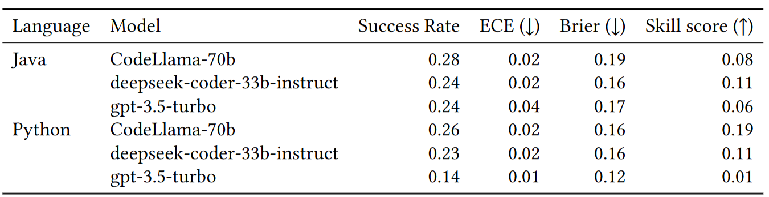
Experimental Result
RQ2: Platt Rescaled vs. Raw Calibration
Platt Rescaled Calibration using Automatic Semantic Augmentation + Retrieval Augmented Few-Shot for summarization of Java methods
Notes:
ASAP（静态分析信息）影响：
所有模型成功率提高。
Java：skill score 下降（可能信息冗余）
Python：skill score 上升（信息补充有用）
存在性能与校准的权衡。

Slide 18
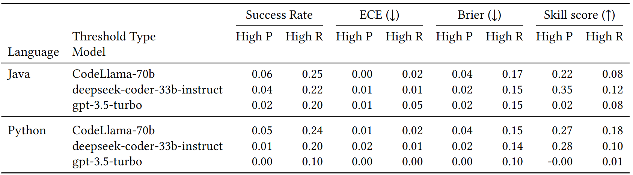
Experimental Result
RQ2: Platt Rescaled vs. Raw Calibration
Calibration under high precision and recall thresholds. Results are Platt Rescaled and summaries are generated using Automatic Semantic Augmentation + Retrieval Augmented Few-Shot for summarization
Notes:
阈值影响：
高精度阈值 (BERTScore ≥ 0.89)：成功率低但校准很好 (>0.2 skill)。
高召回阈值 (SentenceBERT ≥ 0.80)：成功率高，校准良好 (>0.08 skill)。
阈值选择对校准有显著影响。

Slide 19
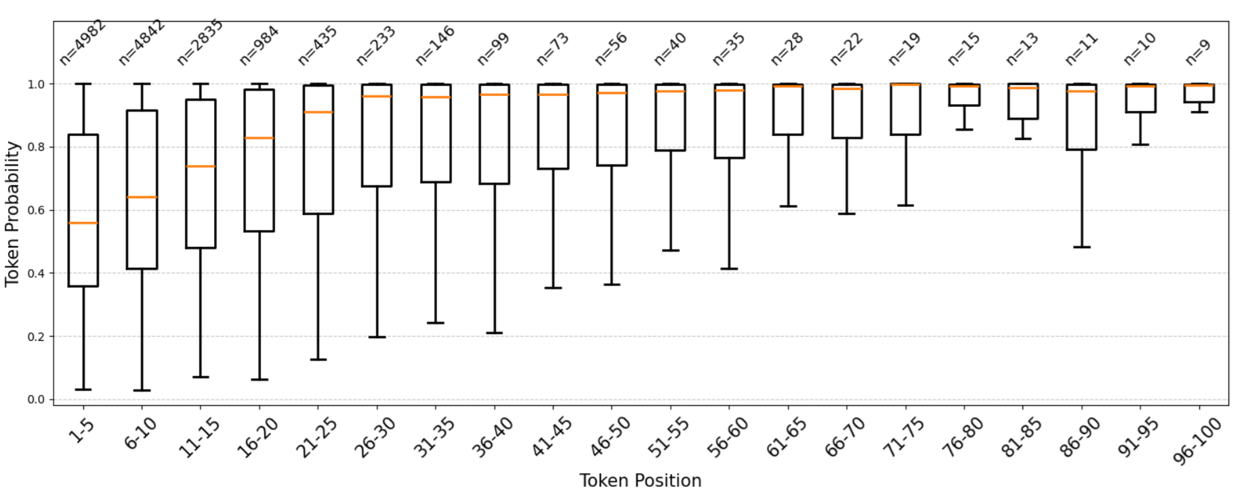
Experimental Result
RQ3: Effect of Token Position on Confidence
Model confidence increases with token position; after ~20 tokens, probabilities plateau above 0.9.

Slide 20
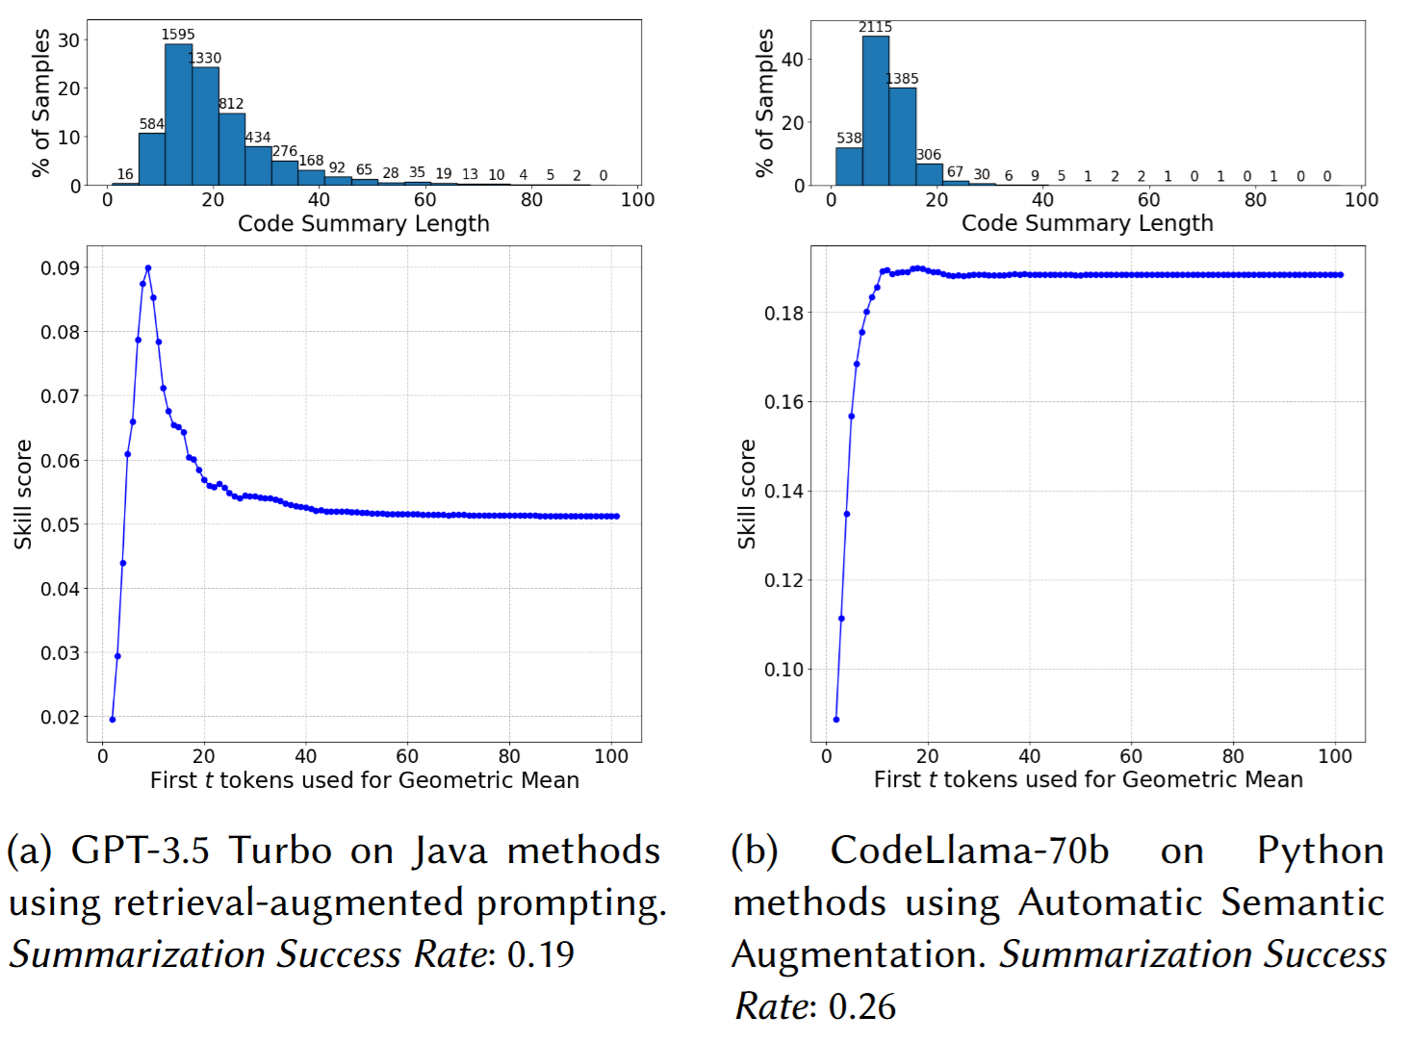
Experimental Result
RQ3: Effect of Token Position on Confidence
The skill score achieved, after platt scaling, when taking the arithmetic mean of the first t tokens
Notes:
技能分数变化：前 7 个 token 信号强，加入更多 token 会稀释不确定性 → skill score 降低
短摘要下，仅用前 $t$ token 影响较小

Slide 21
Discussion: Threats & Limitations
Do LLMs surpass code summaries found in open-source projects?
Potential Issue:
If LLM summaries surpass open-source ones in quality, references should shift to curated summaries or reference-free evaluation methods.
Current Evidence:
Some studies report LLM summaries are preferred by participants over open-source summaries, scoring higher in completeness and accuracy.
Limitation:
Evidence relies on human ratings, not on-task programming performance; prior work shows human ratings may not correlate with comprehension task outcomes.
Notes:
潜在问题：如果 LLM 摘要质量高于开源摘要，那么使用开源摘要作为参考不合适，应采用人工整理摘要或无参考评估。
已知情况：研究表明 LLM 摘要在人类评分中常优于开源摘要（完整性、准确性方面）。
限制：现有证据依赖人类评分，而非与实际编程任务相关的性能；有人类评分与代码理解任务表现不相关的证据。

Slide 22
Discussion: Threats & Limitations
Limitation: Summary Intent Capture
Code summaries may reflect different intents—how something is done, what was done, or why it was done.
Similarity metrics fail to explicitly capture or differentiate these intents.
Notes:
背景：代码摘要可能服务于不同意图（比如：做法、内容、原因）。
现状问题：现有相似度指标无法明确识别和区分这些意图。
未来方向：研究如何在自动评估指标和模型置信度预测中可靠地融入“摘要意图”。

Slide 23
Discussion: Threats & Limitations
Limitation: Platt scaling
Platt scaling is a common rescaling method; temperature scaling can outperform Platt scaling in certain cases.
Temperature scaling requires access to complete softmax outputs, which current OpenAI and TogetherAI APIs do not provide.
Notes:
背景：Platt 缩放是常用的概率重标定方法；温度缩放在某些情境下优于 Platt 缩放。
限制：温度缩放需要完整softmax输出，但现有API不提供。

Slide 24
Discussion: Threats & Limitations
Self-Reflection Calibration
Purpose: Evaluate models’ ability to self-assess their own summaries.
Methods:
Logit-based: True/False human-likeness query; logit for “True” used as confidence (only GPT-3.5-Turbo feasible) — showed severe overconfidence and negative skill score; rescaling degraded to base rate.
Verbalized: 1–4 similarity rating; CodeLlama-70B failed in zero-shot but worked in few-shot; calibration poor in both settings; higher temperatures and voting did not help.
Conclusion: Models exhibited poor calibration for all self-reflective confidence measures tested.
Notes:
目的：测试模型能否“自我反思”并评估自己生成的摘要质量。
方法：
Logit 法：True/False 问答提取 True 的 logit 作为置信度（仅 GPT-3.5-Turbo 可行），结果严重过度自信，Skill score 为负。
口头评分法：1–4 人类相似度分值（CodeLlama-70B 仅 few-shot 有效），校准差，提升尝试无效。
结论：目前模型在自我反思式置信度评分方面校准很差。

