Slide 1
Spring Security
Intro

Slide 2
About Spring Security
Began in 2003 as "The Acegi Security System for Spring"
Spring subproject 1.0.0 released in 2006
Rebranded as Spring Security in 2007
Current version 4.1.0 (ongoing)

Slide 3
Introduction
Comprehensive security services for Java EE-based enterprise software applications
Portability between server environments
Authentication & authorization
HTTP BASIC, HTTP Digest, HTTP X.509, LDAP, Form-based, OpenID, JA-SIG CAS, Automatic "remember-me", Anonymous, Run-as, JAAS, JEE container, Kerberos, JOSSO, OpenNMS, AppFuse, AndroMDA, Mule ESB, Direct Web Request, Grails, Tapestry, Jtrac, Jasypt, Roller, Elastic Path, Atlassian Crowd

Slide 4
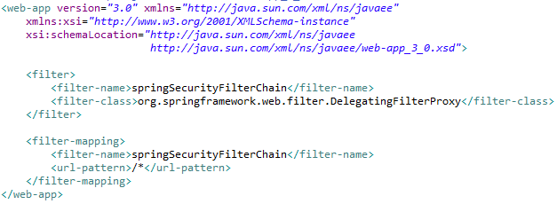
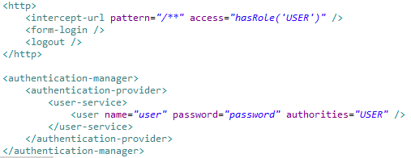
Spring Security – basic configuration XML
https://github.com/zbynekvavros/spring-security-intro.git

Slide 5
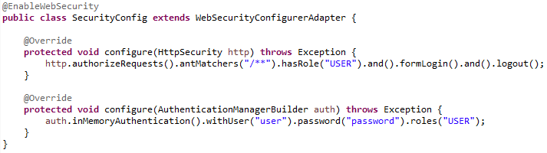
Spring Security – basic configuration JavaConfig

Slide 6
Spring Security Filter Ordering
http://docs.spring.io/spring-security/site/docs/4.1.0.RELEASE/reference/htmlsingle/#filter-ordering

Slide 7
Workflow
http://docs.spring.io/spring-security/site/docs/4.1.0.RELEASE/reference/htmlsingle/#tech-intro-web-authentication
FilterSecurityInterceptor → AccessDecisionManager
Authentication manager configured manually
security=”none”

Slide 8
Additional log in methods
Custom form
HTTP Basic
HTTP Basic for REST

Slide 9
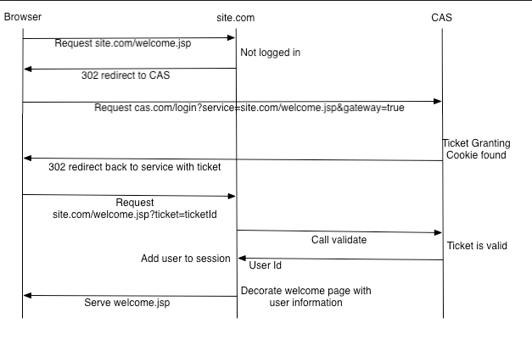
Additional authentication methods
JDBC
  http://docs.spring.io/spring-security/site/docs/4.1.0.RELEASE/reference/htmlsingle/#appendix-schema
LDAP
CAS (Jasig)

Slide 10
Method security
<global-method-security pre-post-annotations="enabled" />
@PreAuthorize(expression) on interface

Slide 11
Expressions
<http use-expressions="true">
http://docs.spring.io/spring-security/site/docs/3.0.x/reference/el-access.html

Slide 12
Additional features
Remember Me
CSFR - Cross-site request forgery
HTTP/HTTPS Channel Security (pattern/redirect)
Session management (AJAX !)
Concurrent Session Control
Session Fixation Attack Protection
Custom filter !

