Slide 1
音乐听我的
THE
MUSIC
Speaker：Wang Jiaming

Slide 2
The rain falls the strings, percussion windows, finger tapping bamboo, the original forms of life occasionally out of bounds.
The Attraction
MUSIC
As if to see another life spectacular, dangerous and beautiful.
But let me also dont understand music to exhaust all the skills, why is there so much charm? Its really a problem.
That is the bloom and fall of the other shore world, is from our blood and soul of the deepest throbbing.
This is music to my feeling, people will be attracted by the music is normal,

Slide 3

The Music
BUT
MUSIC
MUSIC
The music sounded, knocked down the big chime heavy color, dignified tinged with cruelty and misery, full of heavy sense of the drum for mountains as it is everywhere.
But it is equal to anything, ignorant, neither sad nor happy.

Slide 4
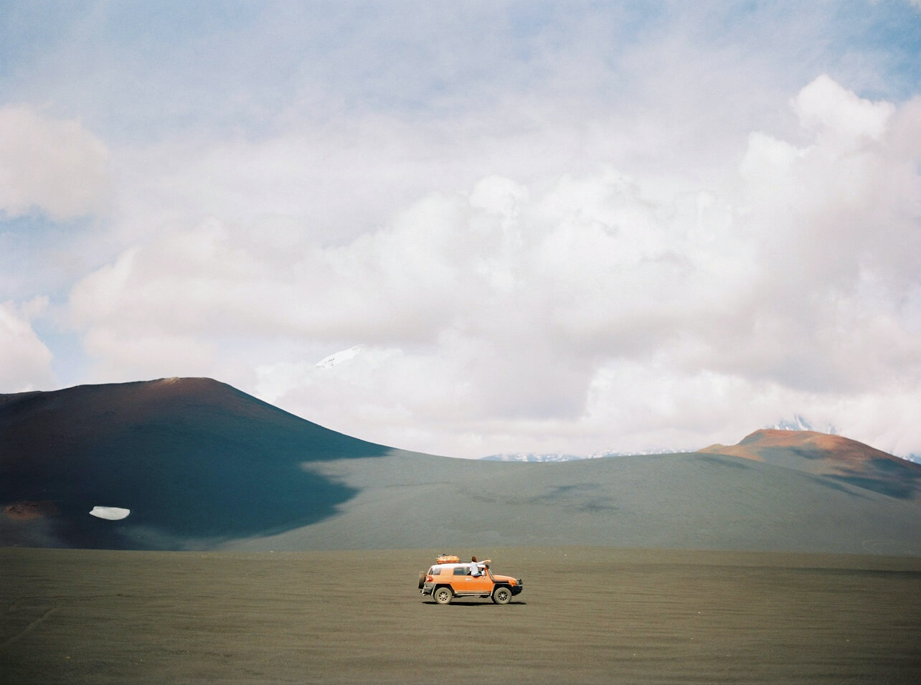
The Style
MUSIC
These songs, very elegant, should not make people feel sad, as though it should be flat and layers of curtains, skin from the snow woman placid face.
There are always some songs, can let your heart suddenly cracked open, the wind blows, a pond wrinkle. Instant smile, but see Sakura as flame burns, in the quiet world, we just need to ask you to stop Mo Mo, try to stay at the moment, but life is fleeting, youth from open from rest.
But who can hear the joy and sorrow of being buried in time under twelve gorgeous clothes?

Slide 5

The Effect
MUSIC
1
Bright, almost transparent voices tell us loneliness and hope. In the afternoon, the white clouds float across the sky, and at night we can see stars. In the sky, we can always find ourselves in the mood.
The song as always loud and high, more rare self-confidence, smile blooming in the melody. Collocation electronic piano music, every note in his life like jumping.
2
Music gives us too much heart throb, once the smoke, the eyes of the spring bloom, the youth are sing it with clean voice in the morning wake up, lazy to walk in the sun.
3

Slide 6

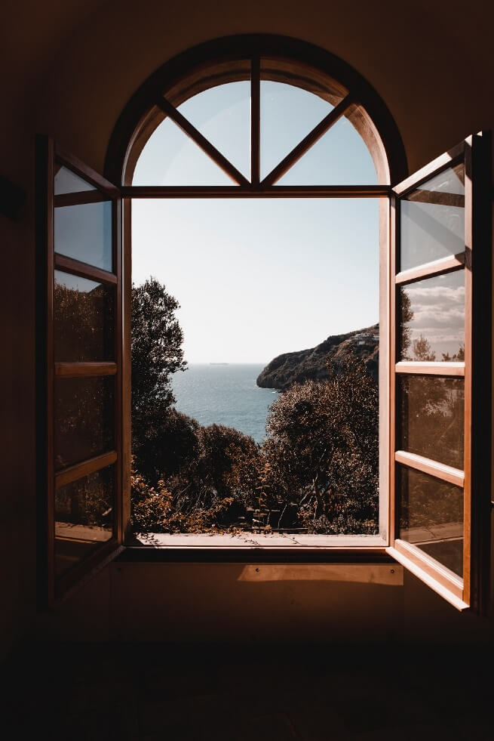
The Reason
MUSIC
It is the human heart that composes the music, and the music shows another inner world.
Why is there so much charm of music, listening to the sounds of tapping bamboo, I think I found the answer.

Slide 7
Thank you
Speaker：Wang Jiaming

