Slide 1
Education Data Visualization
DV Final Project

Slide 2
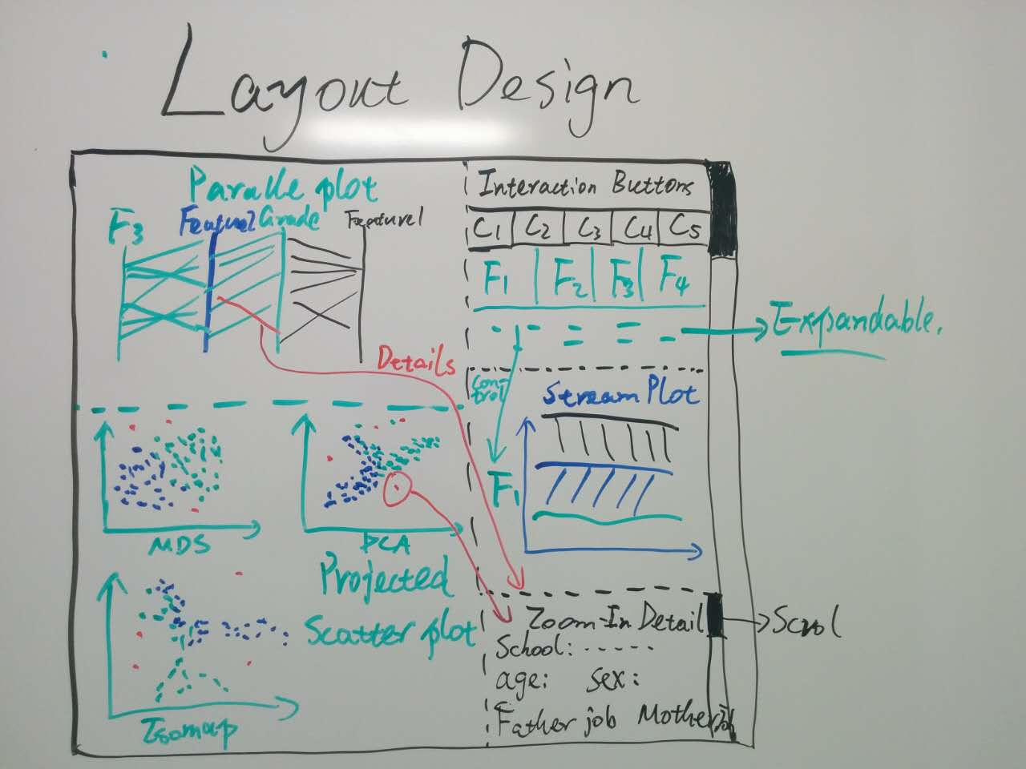
Initial Design

Slide 3
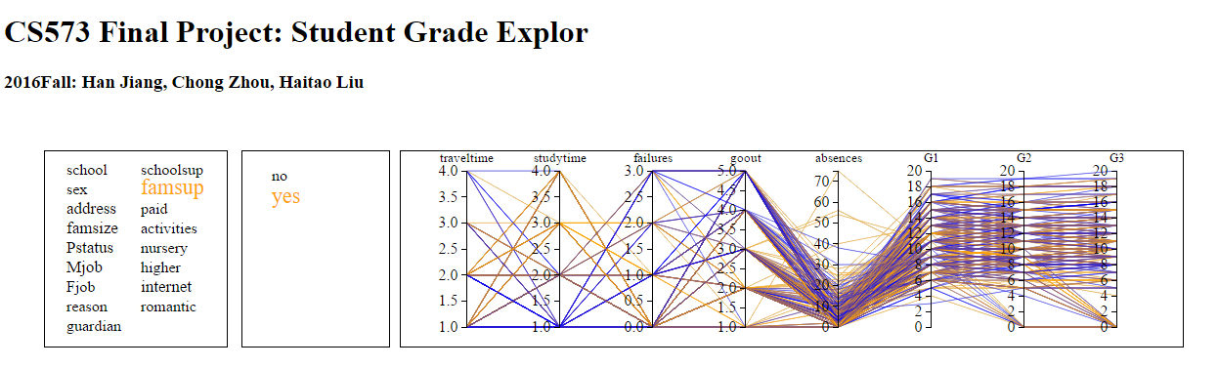

Slide 4
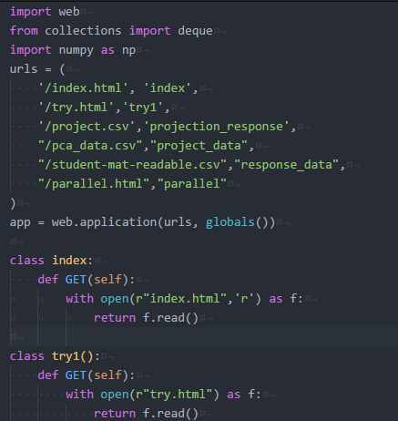
Server Side

