Slide 1
strawberry report
Chi Zhang

Slide 2
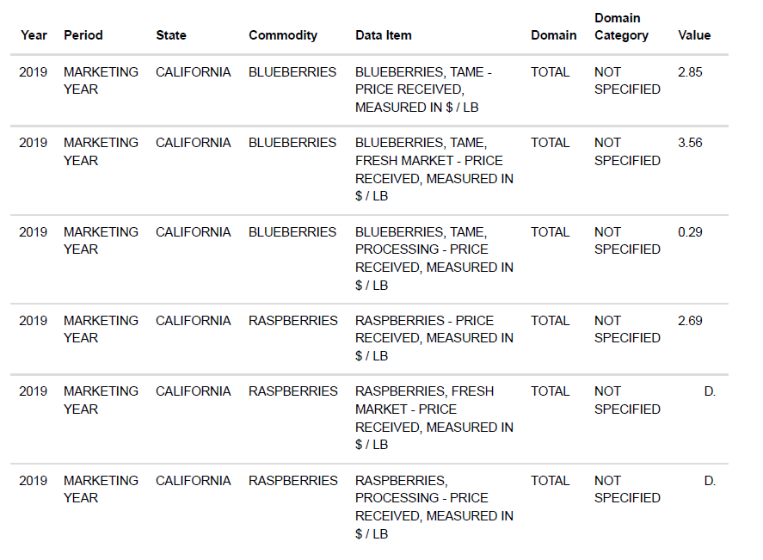
Meaningful data from usda

Slide 3
STEPS TO GET CLEANED STRAWBERRY DATA
1)Cleaning the data of strawpberry with time period “YEAR”.
2)Separate strawberry’s domain and domain category.
3)Eliminating the redundancy.
4)Clean it up.

Slide 4
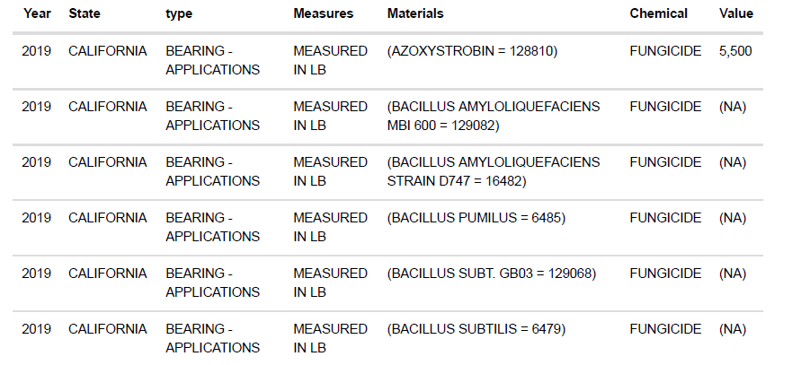
Here is the cleaned strawberry data.

Slide 5
Variables
year- the year of the list of data
State - the place of origin
type - the present state
Measures - what kind of information measured
Materials - Substances in chemicals
Chemical - what type of chemicals used
Value - value of chemicals

Slide 6
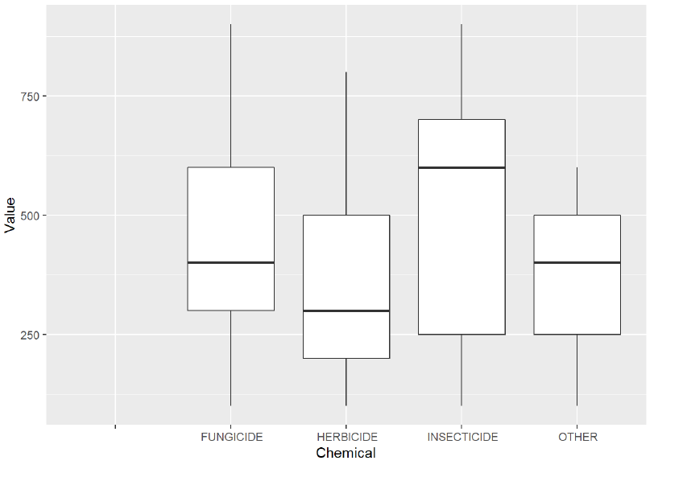
Exploratory data analysis
First, I would like to make graphs to compare the values of different chemicals used for strawberry.
I filtered data with measured in lb to compare different chemicals with their values. We can see that Insecticide
has the highest value, and followed by Fungicide, then, herbicide and other(Nitrogen, Sulfur, Potash) have
lowest value.

Slide 7
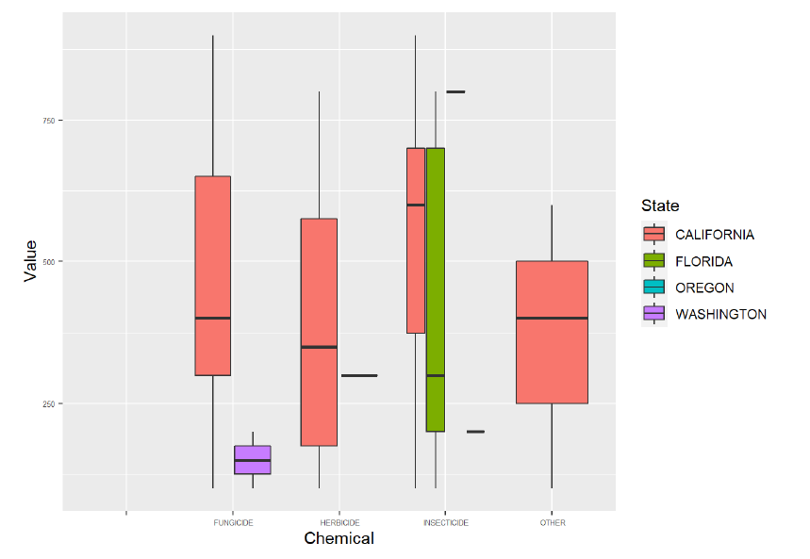
Exploratory data analysis
Now I added the continent variable to see if I can find any regional clues. The results showed that almost all kind of chemicals were used in California, Insecticide was the most common one, and Herbicide was least used; surprisingly, in Florida, people only used Insecticide as chemical, and in Washington state, people only used Fungicide as chemical.

Slide 8
Summary and conclusion
After a simple data analysis, I found some interesting things. For strawberries, Insecticide is the most used chemical for growing strawberries. California is the state with the most diverse chemicals, and almost every chemical is used; on the contrary, some states, such as Florida and Washington, use only one specific chemical to grow strawberries. The above analysis is based on the data about strawberries I cleaned, which has uncertainty and can only be used as a reference.

Slide 9
References
David Morison, Exploratory data analysis into the relationship between different types of crime in
London“https://towardsdatascience.com/exploratory-data-analysis-into-the-relationship-between-differenttypes-
of-crime-in-london-20c328e193ff (https://towardsdatascience.com/exploratory-data-analysis-into-therelationship-
between-different-types-of-crime-in-london-20c328e193ff)”
USDA, National Agricultural Statistics Service “https://quickstats.nass.usda.gov/results/D416E96E-3D5C-
324C-9334-1D38DF88FFF1 (https://quickstats.nass.usda.gov/results/D416E96E-3D5C-324C-9334-
1D38DF88FFF1)”
R for Data Science, Garrett Grolemund, Hadley Wickham“https://r4ds.had.co.nz/ (https://r4ds.had.co.nz/)”
Almost All American Strawberries Are Grown With Toxic Chemicals, NICOLA TWILLEYCYNTHIA
GRABERGASTROPOD SEPTEMBER 1, 2019“https://www.theatlantic.com/science/archive/2019/09/toxicchemicals-
used-grow-strawberries/596968/ (https://www.theatlantic.com/science/archive/2019/09/toxicchemicals-used-grow-strawberries/596968/)”

