Slide 1
Combining Policy Gradient and Q-Learning
Brendan O’Donoghue, R´emi Munos,
Koray Kavukcuoglu & Volodymyr Mnih, ICLR 2017.
Speecher : 曾揚、胡嘉安、黃晨
Date : 2021/6/24

Slide 2
Outline
1. Introduction
2. Technique
3. Implementation

Slide 3
1. Introduction

Slide 4
1. Introduction
Model – based reinforcement
Model - free reinforcement learning :
1. Action - value fitting ( Value-based ) :
Monte-Carlo , Q-Learning, DQN, etc.
2. Policy optimization ( Policy-based ) :
Actor-Critic, TRPO, DDPG, Reinforce, TD3, etc.
Combining both of them : PGQL ( policy gradient and Q-learning )

Slide 5
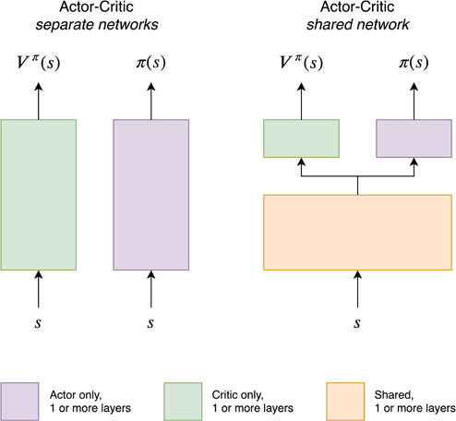
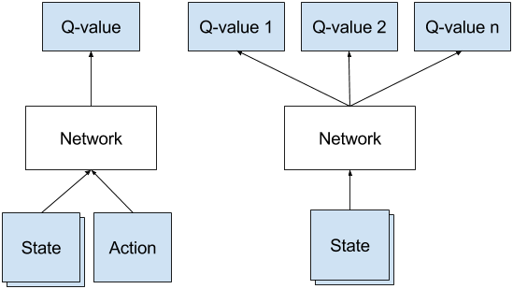

1. Introduce
1. Introduction
Combining both of them : PGQL ( policy gradient and Q-learning )
** Actually , it’s more similar to dueling DQN.
+
$$≈$$

Slide 6
1. Introduction
Action – value learning :
Bellman operator is approximated by sampling and boosttrapping.
→ explore-exploit issue → update unstable
Policy gradient :
If use discounted distribution of states, it will take a long time to reach and have poor empirical performance.
( Because will assign a low weight to state )

Slide 7
2. Technique

Slide 8

2. Technique
Exploration :
1. Epsilon greedy
2. Boltzmann exploration : ( in this paper )
$$π\left(s,a\right)=\frac{e^{\frac{W\left(s,a\right)}{α}}}{\sum_{b}{e^{\frac{W\left(s,b\right)}{α}}}}$$
** α is a temperature

Slide 9
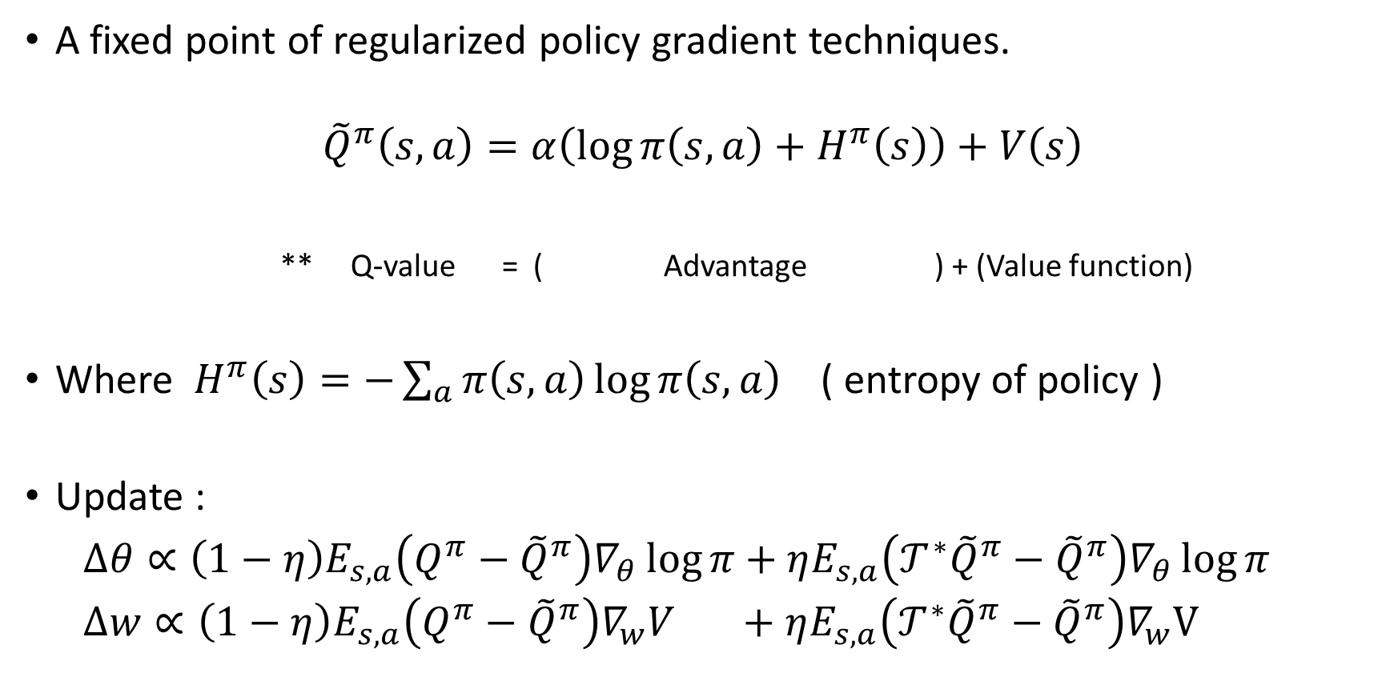
2. Technique
A fixed point of regularized policy gradient techniques.
$${\tilde{Q}}^{π}\left(s,a\right)=α\left(\log{π\left(s,a\right)+H^{π}\left(s\right)}\right)+V\left(s\right)$$
** Q-value = ( Advantage ) + (Value function)
Where $H^{π}\left(s\right)=−\sum_{a}{π\left(s,a\right)}\log{π\left(s,a\right)}$ ( entropy of policy )
Update :
$∆θ∝\left(1−η\right)E_{s,a}\left(Q^{π}−{\tilde{Q}}^{π}\right)∇_{θ}\log{π}+ηE_{s,a}\left(𝒯^{∗}{\tilde{Q}}^{π}−{\tilde{Q}}^{π}\right)∇_{θ}\log{π}$
$∆w∝\left(1−η\right)E_{s,a}\left(Q^{π}−{\tilde{Q}}^{π}\right)∇_{w}V +ηE_{s,a}\left(𝒯^{∗}{\tilde{Q}}^{π}−{\tilde{Q}}^{π}\right)∇_{w}V$

Slide 10
2. Technique
In this paper, use entropy regularization to ensure exploration.
( an alternative is to use KL-divergence as a regularizer. )
In this paper, use non-discounted distribution. → gamma = 0.99
( That prevent the policy becoming deterministic and ensure the agent will explore continually. )

Slide 11
3. Implementation

Slide 12
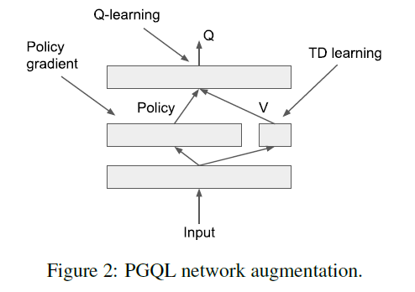
PGQL

Slide 13
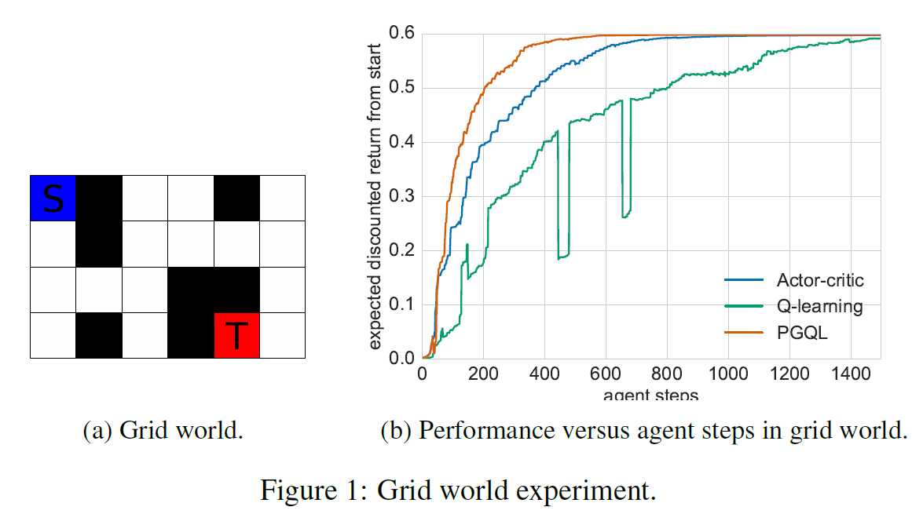
Experiment

Slide 14
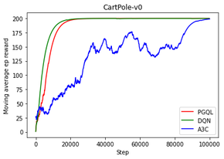
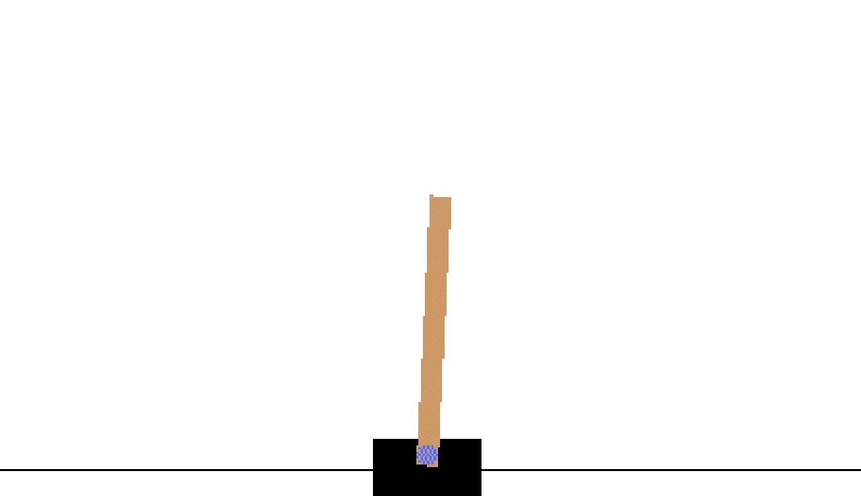

Experiment
Environment: CartPole-v0
Hyperparameters:
Learning rate: 0.001
Batch size: 32
Exploration: $ε$-greedy
Replay buffer
Result:

Slide 15
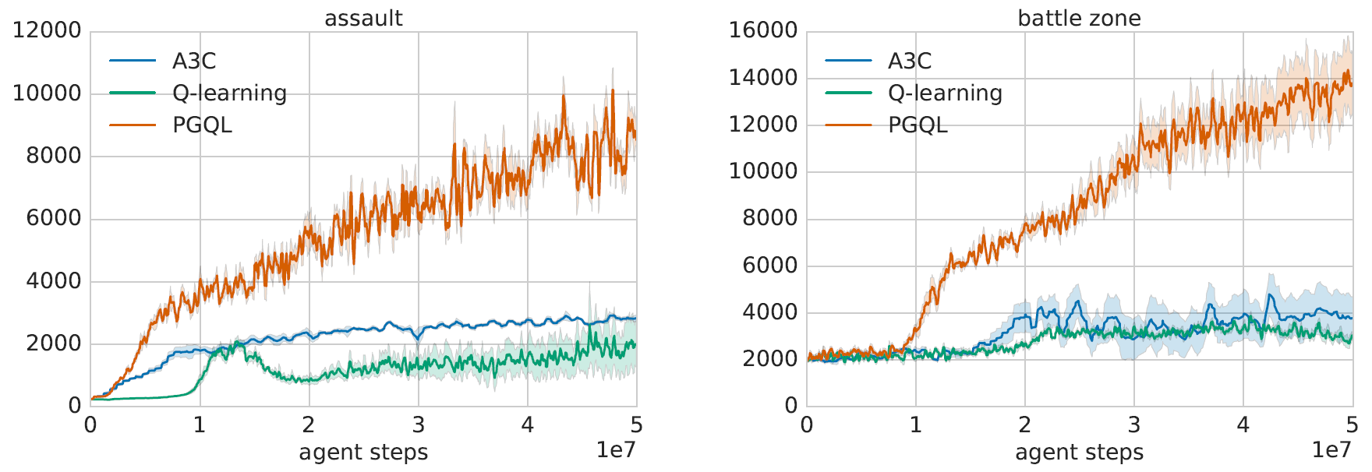
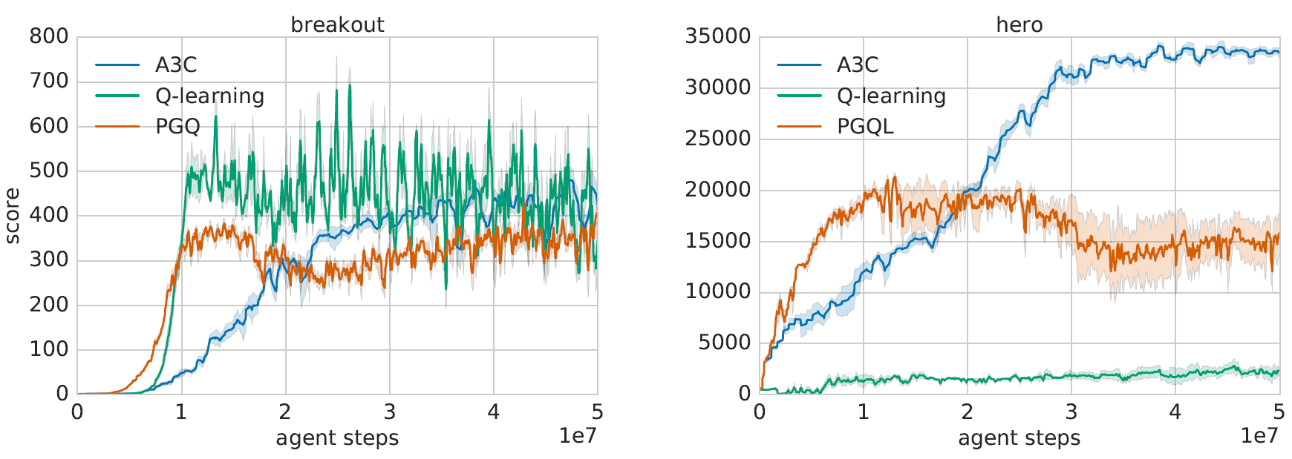
Experiment- Atari Games

Slide 16
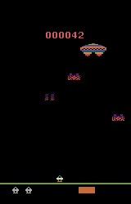
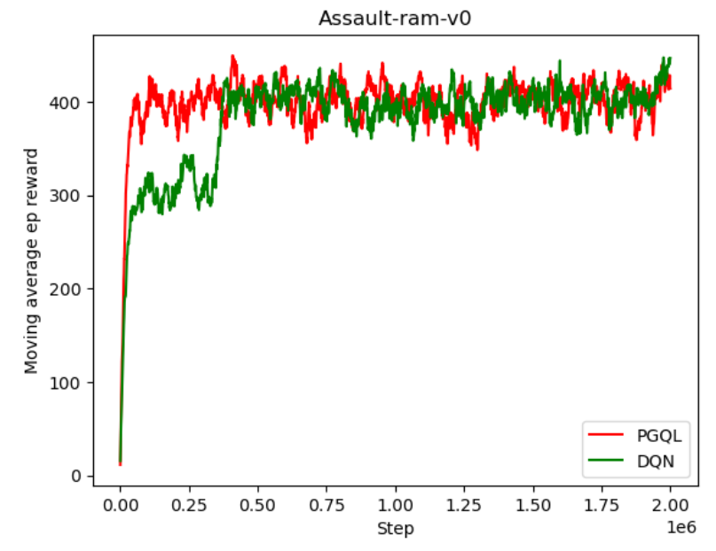
Experiment- Atari Games
Environment: Assault-ram-v0
Result:

Slide 17
Thank you

