Slide 1
Parallelization of Variants Calling on Hadoop
Zhengqiu Cai

Slide 2
Problem
There is currently no efficient method to parallelize variant calling.
It can take a day or longer to call variants on whole genome sequencing.
This can be a bottleneck for clinical applications.

Slide 3
Available approches to Parallelizing Variants Calling
Distribute jobs on LSF, SGE or Condor cluster:
GATK
java -jar GenomeAnalysisTK.jar -R ref.fa -T UnifiedGenotyper -I input -o output -L interval_file
Samtools
samtools mpileup -l interval_file -uf ref.fa input > output
Problem:
Data is located in a shared disk, and each computing node needs to read data from the same disk.
Load balance in the cluster is not guaranteed.
Notes:
Variant detection remains a major research focus of NGS sequencing experiments.
We have implemented the first variant calling pipeline on Hadoop.
Initial comparison shows a great speedup of variant calling on Hadoop.
14 min on a single node vs. 3 min on 3 node cluster (4 cores per node) to process a 661M BAM file
We have made an EBS-backed Amazon Hadoop AMI with tools and reference genomes loaded, and it is easy to start the Hadoop cluster and run the pipeline.
Current variant detection takes long for big NGS data.

Slide 4

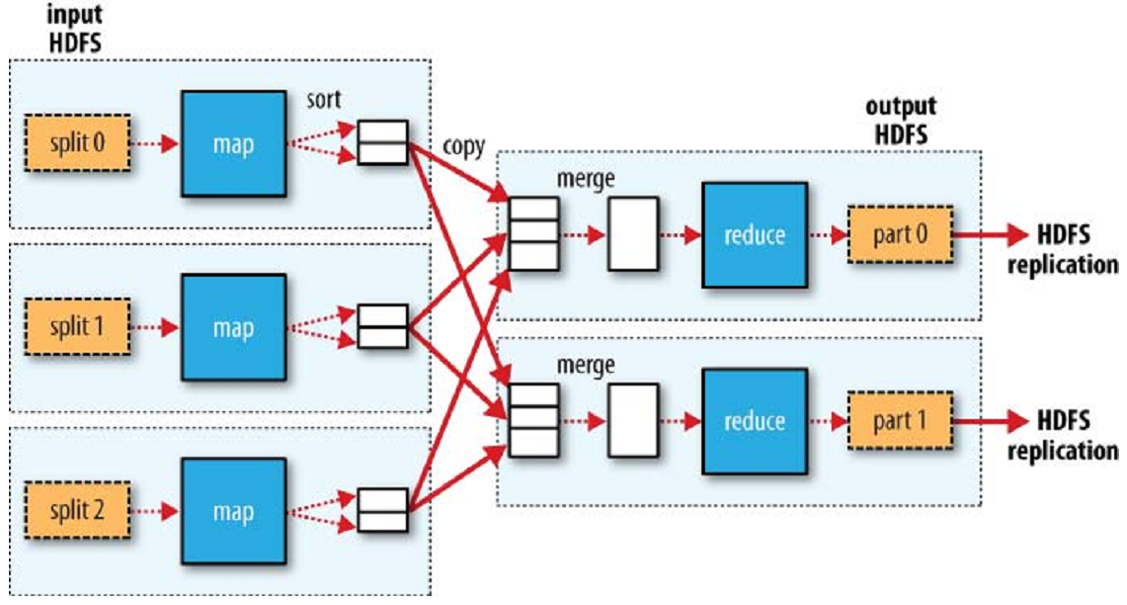
MapReduce data flow with multiple reduce tasks
A framework for distributed processing of large data using a simple Map/Reduce model

Slide 5
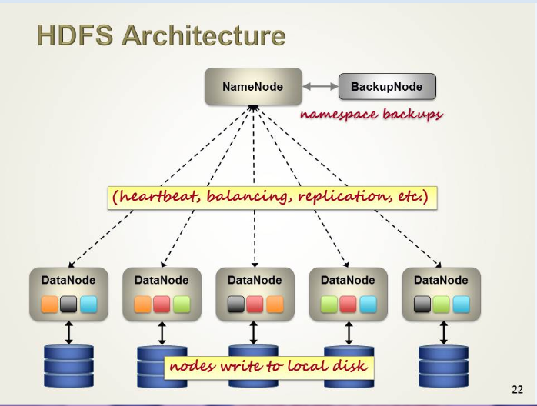

Primary storage system used by Hadoop applications
Multiple replicas of data blocks distributed on compute nodes
Enable reliable, fast access to data and rapid computations
Support terabytes(1000Gb) to petabytes(1,000,000Gb) of large files

Slide 6
Overview of Hadoop data replication
Input BAM file
1
2
3
4
5
6
7
Splitted and distributed on the Hadoop cluster
1
3
2
5
1
7
4
5
3
7
2
4
6
6
Data node 1
Data node 2
Data node 3

Slide 7
Overview of variants calling on Hadoop
Input BAM file
Data block (truncated BAM)
Data block (truncated BAM)
Data block (truncated BAM)
Data block (truncated BAM)
Data block (truncated BAM)
Data block (truncated BAM)
Data block (truncated BAM)
New BAM file created from the HDFS data block on data nodes
New BAM file
New BAM file
New BAM file
start
end
start
end
start
end
Call variants in the specific regions
Call variants in the specific regions
Call variants in the specific regions
Merged result

Slide 8
BAM file format
BGZF
BGZF
BGZF
BGZF
BGZF
BGZF
BGZF
A BAM file is a concatenation of many ordered BGZF data blocks.

Slide 9
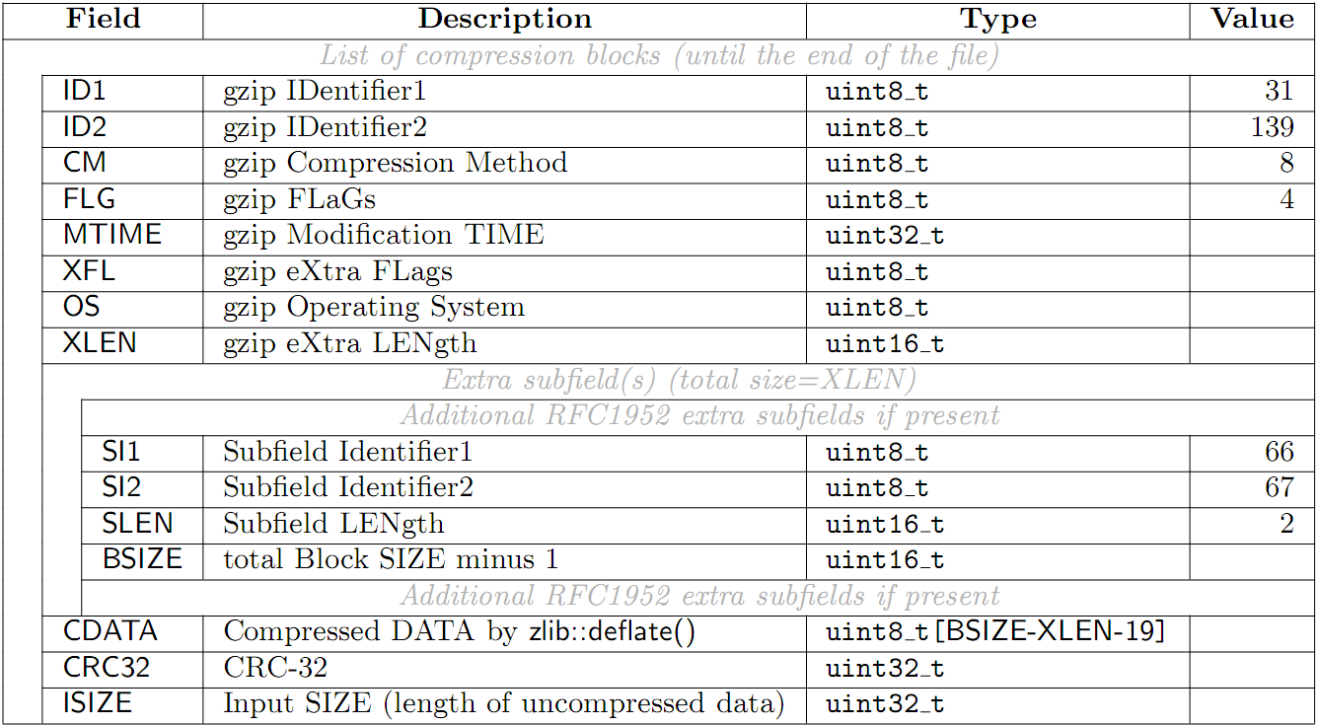
BGZF compression format

Slide 10
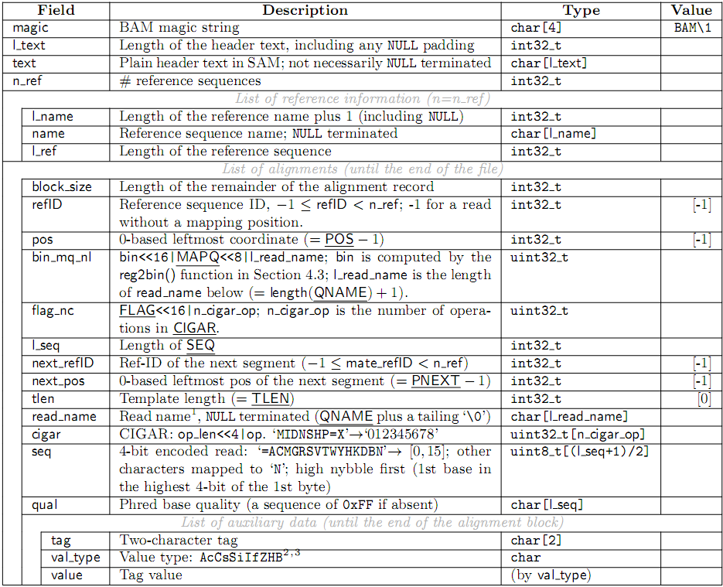

Slide 11
Algorithms to create BAM and interval files from a data block
createBAM(dataBlock){
findBGZFBlockBoundary()
inflateBGZFCompressedData()
findBAMRecord()
writeBAMHeaderInformation()
writeBAMContent()
writeBAMTailInformation()
}
createIntervalFile(dataBlock){
findBGZFBlockBoundary()
inflateBGZFCompressedData()
findStartBAMRecord()
findStartCoordinate()
findEndBAMRecord()
findEndCoordinate()
}

Slide 12
Performance and Results Comparison
Initial comparison shows a great speedup of variant calling on Hadoop:
6 hours on a single node vs. 1 hour on a 6 node cluster (4 cores per node) to process a 25Gb BAM file
The result is over 99.99% identical comparing with that on a single node.
“The reason you're seeing differences is due to downsampling, which involves randomly discarding a subset of reads, and is seeded differently for different intervals. The differences only affect marginal calls that are unlikely to be true positives anyway, so it's not something you need to worry about.”
Notes:
Variant detection remains a major research focus of NGS sequencing experiments.
We have implemented the first variant calling pipeline on Hadoop.
Initial comparison shows a great speedup of variant calling on Hadoop.
14 min on a single node vs. 3 min on 3 node cluster (4 cores per node) to process a 661M BAM file
We have made an EBS-backed Amazon Hadoop AMI with tools and reference genomes loaded, and it is easy to start the Hadoop cluster and run the pipeline.
Current variant detection takes long for big NGS data.

Slide 13
Utility program for data uploading
On a node of the Hadoop cluster, we can use this command the upload data:
hadoop fs -put source destination
If the data node is not part of the Hadoop cluster, we have to download the data to a node of the Hadoop cluster and then use the above command to upload it to hdfs.
RemoteUploadData.java
Upload data to a Hadoop cluster from a remote node out side of hdfs directly.

