Slide 1
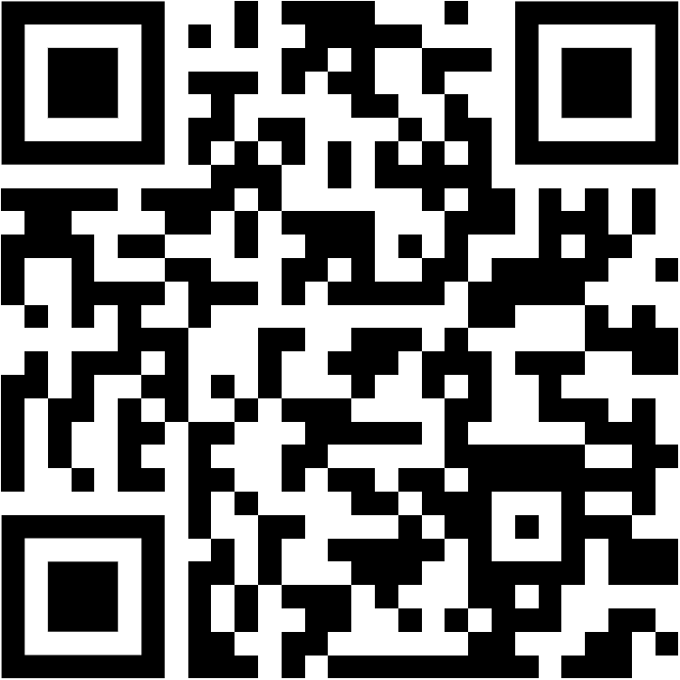

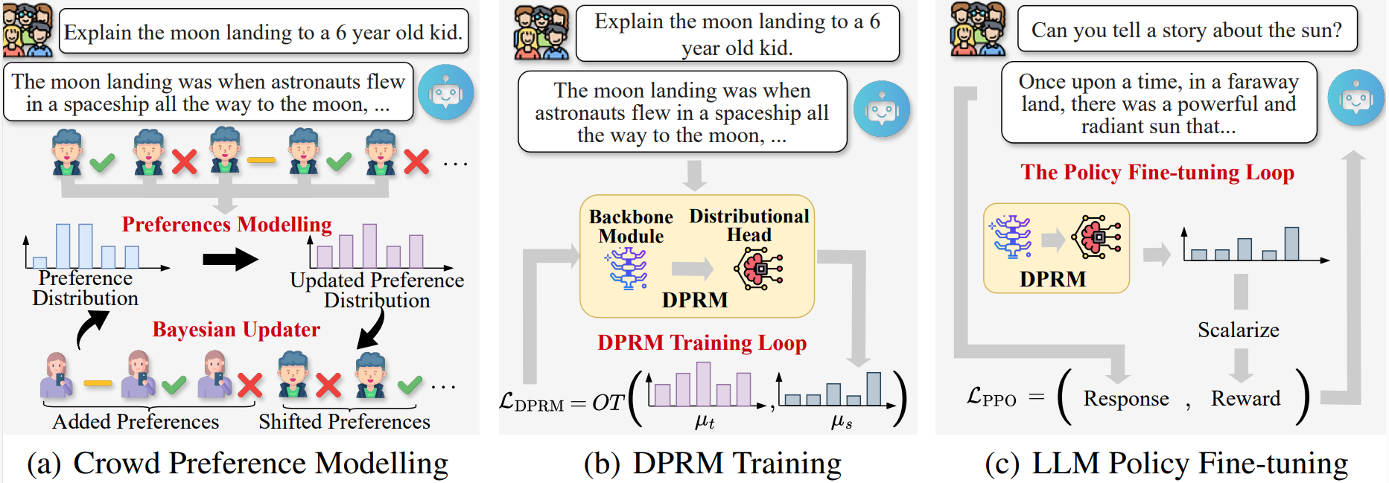
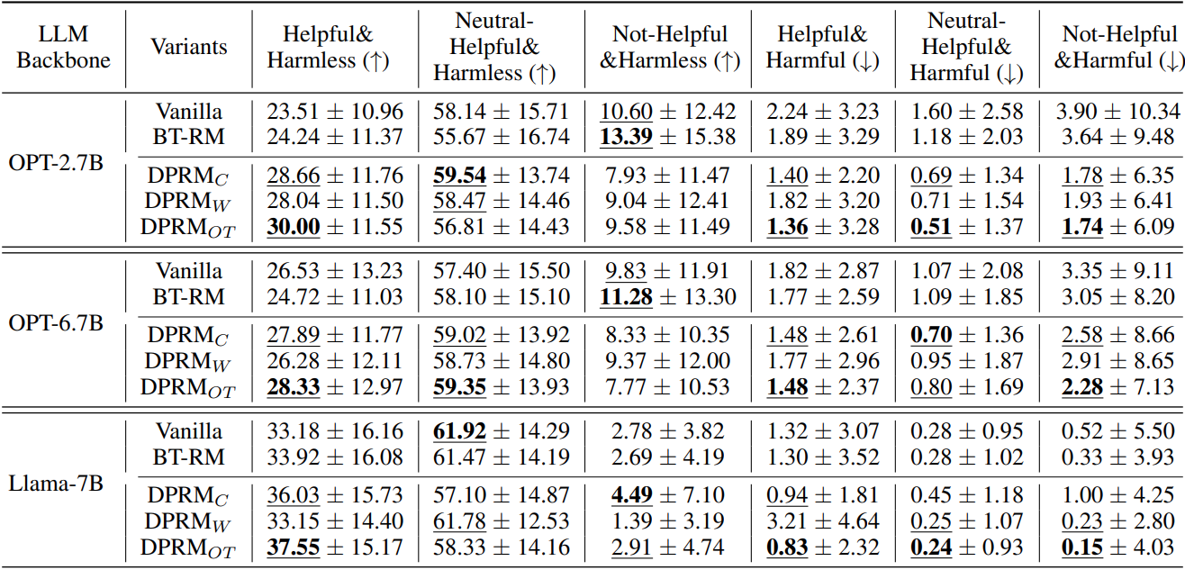
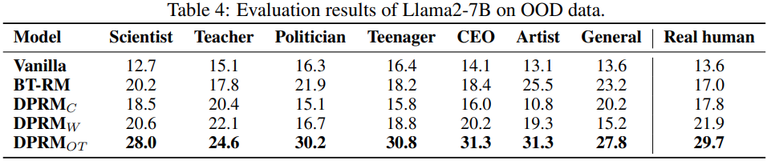
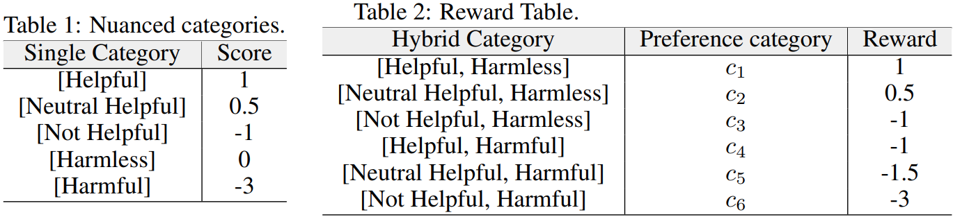
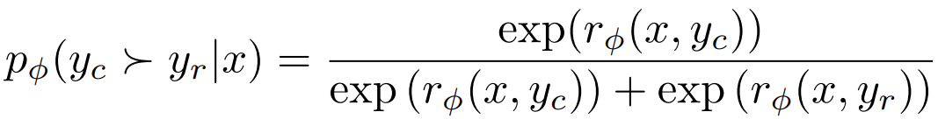
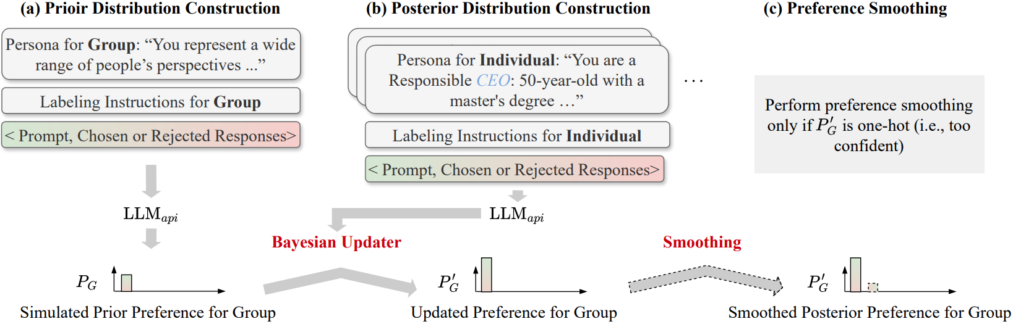
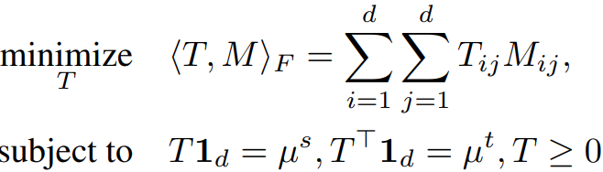
Aligning Crowd Feedback via Distributional Preference Reward modelling
Dexun Li^{1,*}, Cong Zhang^{1,*}, Kuicai Dong¹, Derrick Goh Xin Deik¹, Ruiming Tang¹, and Yong Liu¹ (* Equal Contribution)
¹Huawei Noah’s Ark Lab
ICML24-FMHAIA
Paper & Code
Contributions
Theoretical Findings
We proposed an aligning method to align the large language model with the preference of a group of people. To this end:
We proposed a distributional preference model to incorporate the preferences of the human group.
On top of the preference model, we build a reward model to learn such group preference.
Then we use Proximal Policy Optimization (PPO) algorithm to fine-tune the large language model (LLM) to generate contents in favor of the group preference.
To our best knowledge, we are the first to consider crowd preference alignment for LLM.
Motivation
Distributional Preference Reward modelling
Experiment Result
Preliminaries
Bradley-Terry Preference Model:
Pair-wise Reward Model Learning:
Synthetic Crowd Preference Data Construction
PPO Fine-tuning:
Optimal Transportation Distance:

