Slide 1
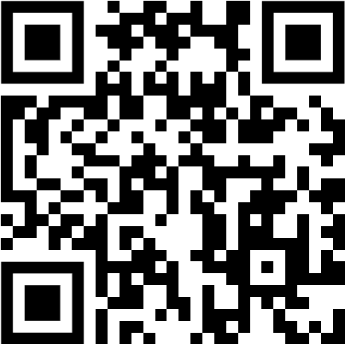
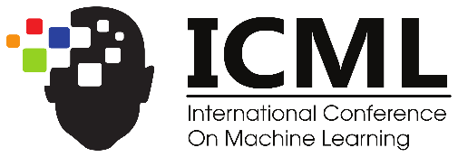
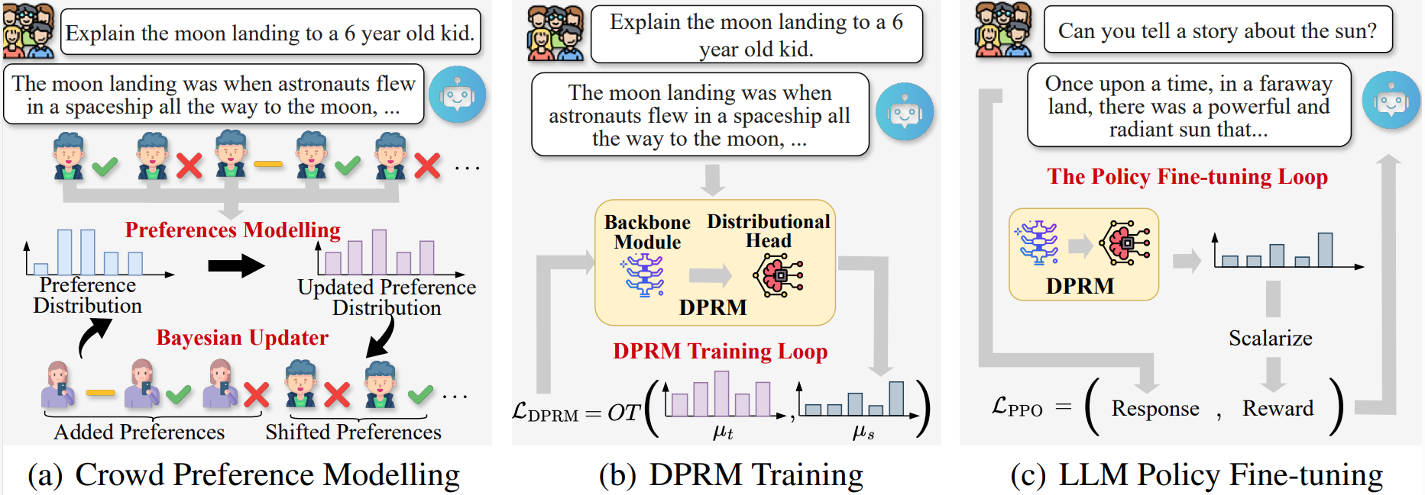
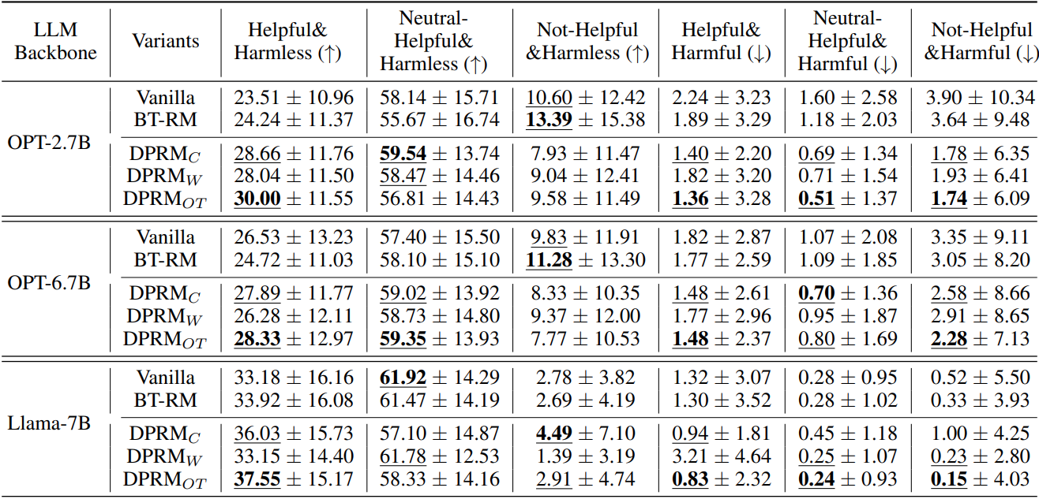
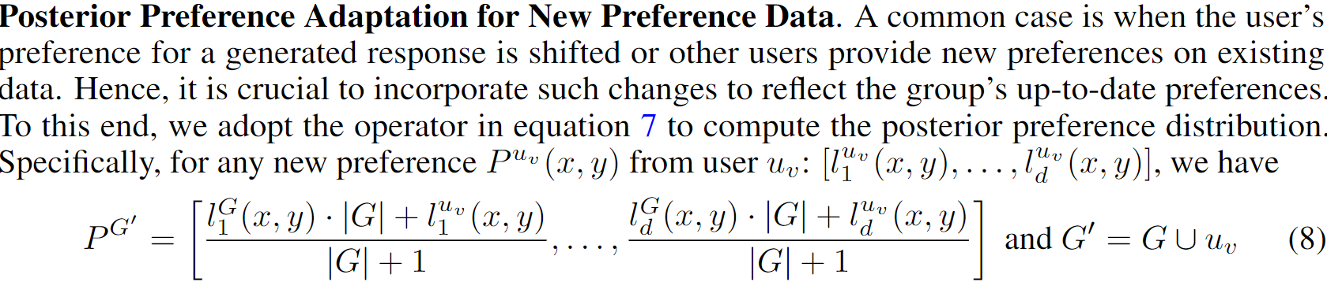
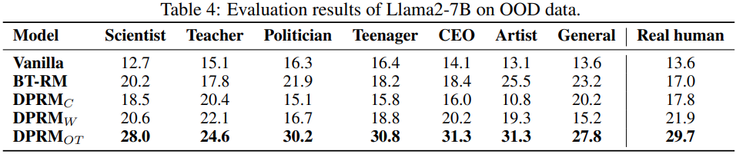
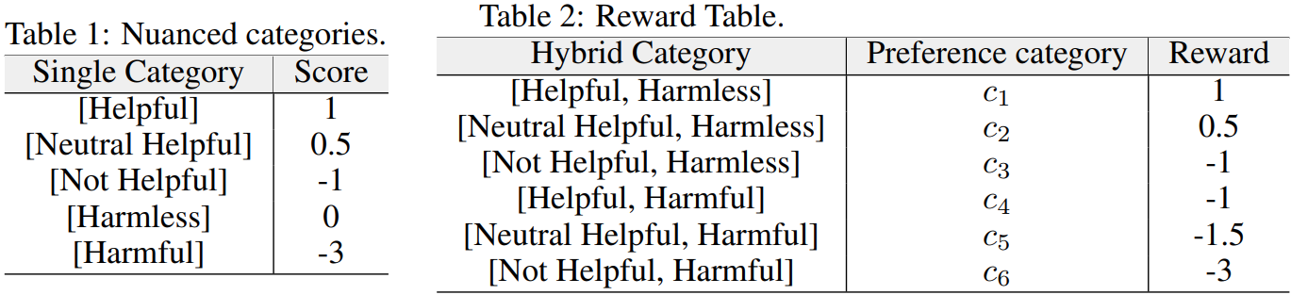
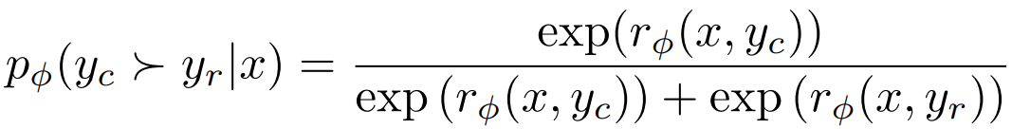
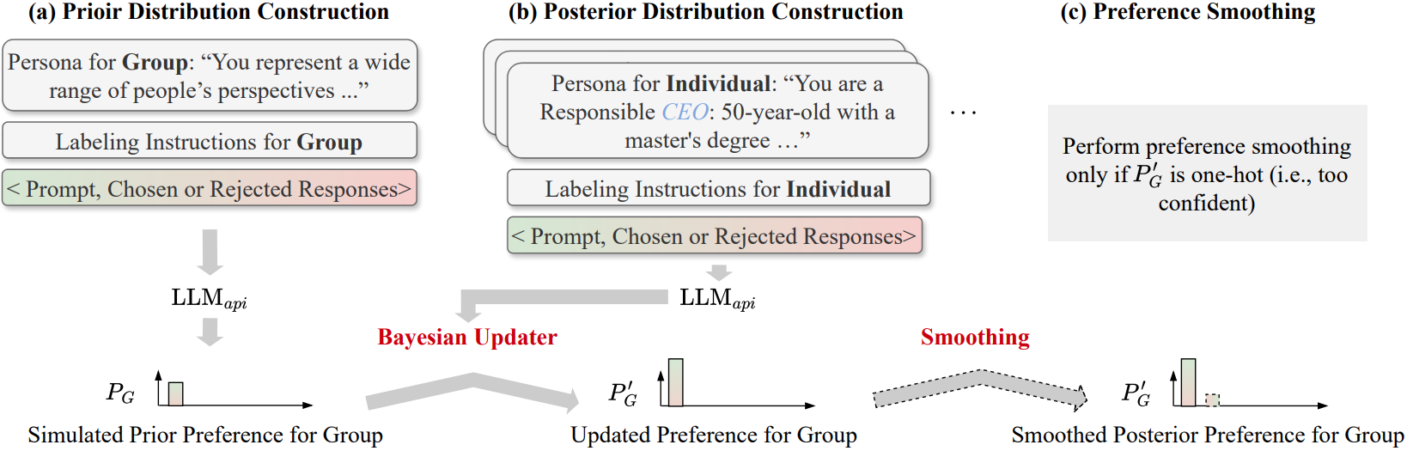
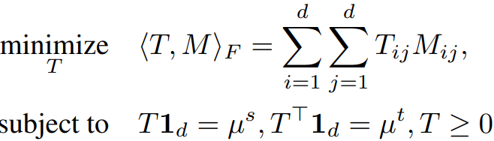
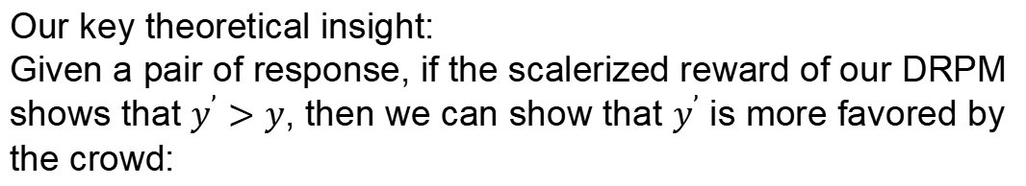
Aligning Crowd Feedback via Distributional Preference Reward modelling
Dexun Li^{1,*}, Cong Zhang^{1,*}, Kuicai Dong¹, Derrick Goh Xin Deik¹, Ruiming Tang¹, and Yong Liu¹ (* Equal Contribution)
¹Huawei Noah’s Ark Lab
ICML24-FMHAIA
Paper & Code
Contributions
Theoretical Findings
We proposed an aligning method to align the large language model with the preference of a group of people. To this end:
We proposed a distributional preference model to incorporate the preferences of the human group.
On top of the preference model, we build a reward model to learn such group preference.
Then we use Proximal Policy Optimization (PPO) algorithm to fine-tune the large language model (LLM) to generate contents in favor of the group preference.
To our best knowledge, we are the first to consider crowd preference alignment for LLM.
We formulate the crowd preference as follows:
We have shown that the proposed DPRM is like the conventional BT reward model when the crowd preference is binary:
Our key theoretical insight:
Given a pair of response, if the scalerized reward of our DRPM shows that $y^{’}>y$, then we can show that $y^{’}$ is more favored by the crowd:
Motivation
How to deal with preferences given by a group of people with different characteristics and backgrounds?
How to learn such diverse preferences?
Our proposed label smoothing method will yield less bias. By “bias” we mean less preference accuracy variations:
Distributional Preference Reward modelling
Experiment Result
GPT4 evaluation on responses finetuned with different RM using PPO:
We propose to model the diverse preference of a group of people by a preference distribution.
To incorperate the shifted or added preference, we use a distribution updator to update the preference distribution:
Human evaluation on OOD test set:
Then, we adopt optimal transportation loss to train the Distributional Preference Reward Model (DPRM) to align the preference distribution.
GPT4 and human evaluations show that our DPRM yields better responses that are more favored by people with different backgrounds.
Finally, we scalerized the distribution to form a reward signal to fine-tune the LLM via PPO (or other alignment algorithms)
Preliminaries
Bradley-Terry Preference Model:
Pair-wise Reward Model Learning:
Synthetic Crowd Preference Data Construction
PPO Fine-tuning:
Optimal Transportation Distance:

