Slide 1

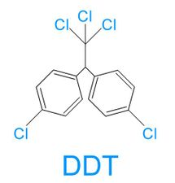

Predicting Henry’s Law Using Chemical Structure with Graph Neural Networks
Zach Calhoun
CEE690 Final Project
4/24/2022

Slide 2

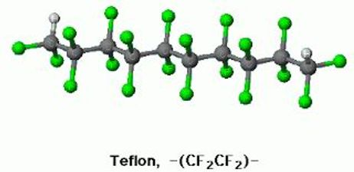

Motivation – How can we prevent environmental and health catastrophes?
Past – DDT, Today – PFAS, Future – ?
These manufactured chemicals are ubiquitous and often carcinogenic/mutagenic.
Found in soil, water, and atmosphere.
How do we predict chemical fate?
Yes, using partitioning coefficients.
Soil/Water
Soil/Air
Water/Air (Henry’s Law)
$$C \left(\frac{mol}{L}\right)=K_{H} × P(atm)$$
Notes:
As an environmental engineering student, I’m always thinking about how we prevent environmental catastrophes.
After taking a class on Environmental

Slide 3
How do we predict Henry’s Law?
School 1: Using Known Properties
School 2: Using chemical structure
OPERA (kNN model, used by the EPA in its CompTox dashboard)
Uses measurements to make predictions – requires info!
Solubility
Vapor Pressure
Boiling point
Biodegradability.
Et cetera…
Fairly accurate
Bond contribution method
Count types of bonds between atoms.
E.g., # of C-O bonds.
Does not look at entire structure.
Fingerprint methods?
Generates a sequence to uniquely identify the atom, which can be vectorized.
Limited by algorithm / complicated.
Not as accurate
Can we better model Henry’s Law using just the chemical structure?

Slide 4
Yes, we can – using Graph Neural Networks!
Found and cleaned a data set of measured Henry’s law values.
Created a Random Forest (RF) model using Physiochemical descriptors as a baseline.
Using just the structure, I created an Graph Convolutional Neural Network (GCNN) that achieved performance on par with the RF.
Performance was then evaluated against the OPERA model.

Slide 5

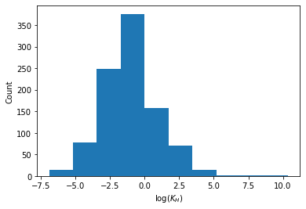
Finding a good dataset
Rolf Sander, chemist that compiled this data.
Found a compilation of Henry’s law for many compounds.
To keep, compound must have:
A measured value (not estimated)
A unique match in the PubChem database.
A subcategory with at least 5 examples.
At least one bond.
Log transform on Henry’s law used.
933 compounds left over.
Found in air
Found in water

Slide 6
Assessing this dataset using Random Forest
Extracted physiochemical properties for each compound using RDKit, which gave 208 features.
Tried to reduce dimensionality, but failed because of sparsity.
Optimal hyperparameters: 200 estimators w/ max depth of 10s.
Other models considered: kNN and Ridge Regression, but Random Forest performed best.

Slide 7
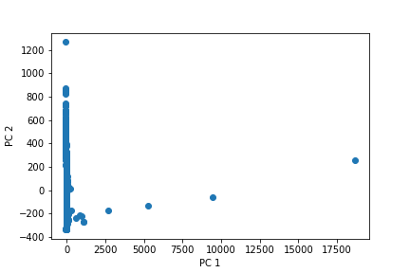
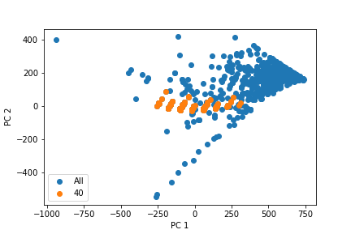
Dimensionality reduction failed, because of variance within subcategories that isn’t variance shared by all compounds
PCA on all data
PCA on subcategory 40 (polychlorinated biphenyls):

Slide 8
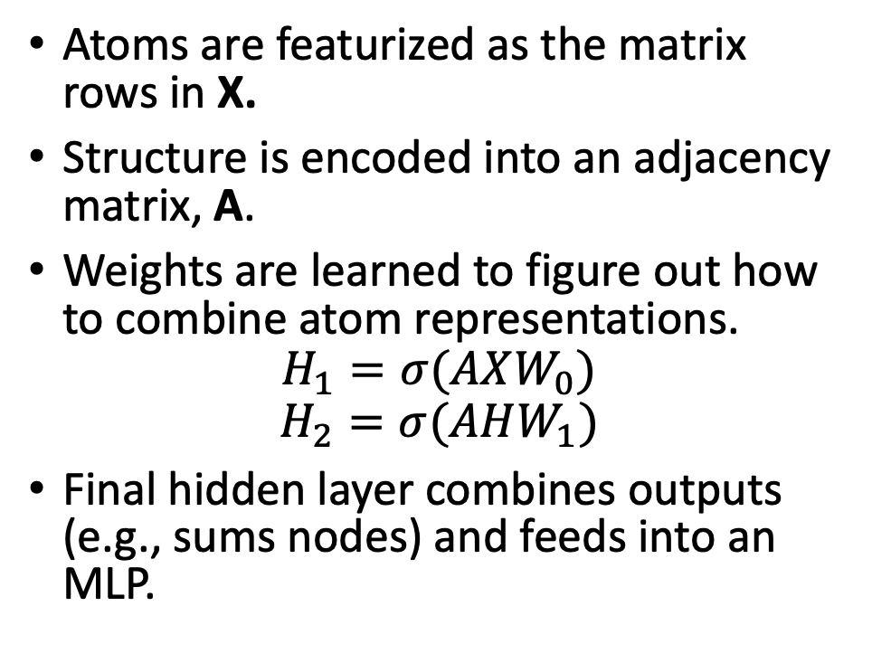
A VERY Basic Intro to Graph Convolutional Neural Networks
Atoms are featurized as the matrix rows in X.
Structure is encoded into an adjacency matrix, A.
Weights are learned to figure out how to combine atom representations.
$$H_{1}=σ(AXW_{0})$$
$$H_{2}=σ(AHW_{1})$$
Final hidden layer combines outputs (e.g., sums nodes) and feeds into an MLP.
1
3
2
4
Construct
adjacency
matrix
 | 1 | 2 | 3 | 4
1 | 1 | 0 | 1 | 0
2 | 0 | 1 | 1 | 1
3 | 1 | 1 | 1 | 0
4 | 0 | 1 | 0 | 1
Note: The method above is numerically unstable, and an actual GCNN normalizes A for stability. This explanation is provided for simplicity. See appendix C for more details.
Notes:
This simple solution was suggested in the article found here: https://theaisummer.com/graph-convolutional-networks/.

Slide 9
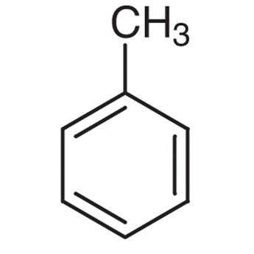
GCNNs applied to chemicals
DeepChem Featurizer: uses the SMILES representation to create a vector with length 30 for each atom.
Atom Type: One-hot encoding of C, N, O, F, P, S, Cl, Br, I, “other”
Formal charge
Hybridization
Hydrogen bonding: donor or acceptor (one-hot encoding)
Aromatic
Degree
Number of Hydrogens
Features all come from the structure alone!
Notes:
The molecule is a toluene molecule.

Slide 10
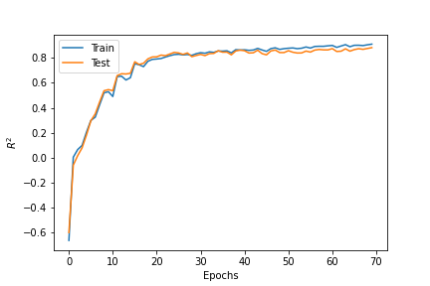
Training the model
Held out 20% of the data for the test set.
Used dropout at the MLP layer, which reduced overfitting.
A ReLU Activation function did not improve performance.
Achieved optimal performance around 70 epochs, using Adam as the optimizer (with MSE loss).
Fast training! <2 min on a CPU.

Slide 11
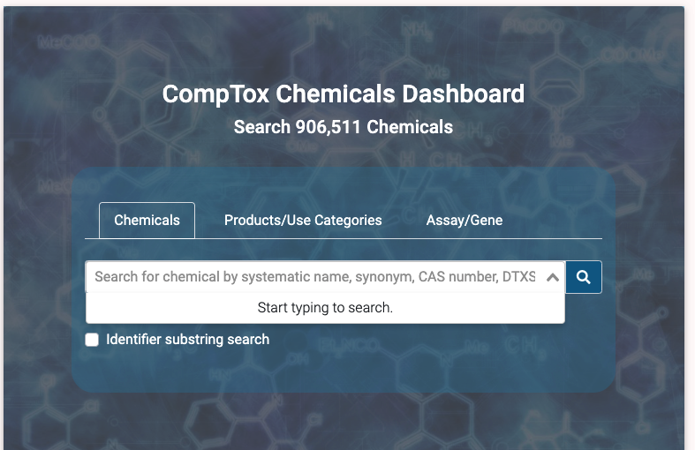
Benchmarking Performance on OPERA
OPERA model used as benchmark.
OPERA model uses a set of physiochemical properties to predict Henry’s law (and if Henry’s law is available, uses that measurement).
Predictions pulled from the CompTox dashboard using the batch search feature (https://comptox.epa.gov/dashboard/).

Slide 12
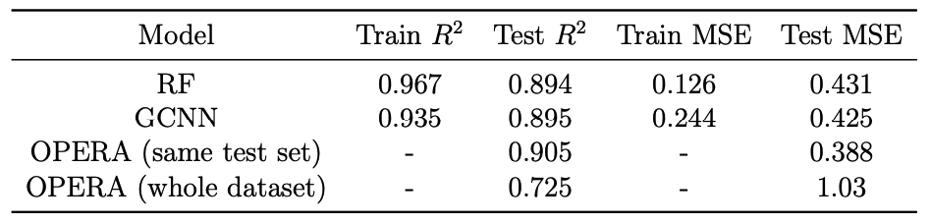
GCNN beat RF, with less overfitting.
On same test dataset, OPERA was slightly more accurate.
However, more validation needs to be done to assess accuracy. If the test set is different, how do results change?
Should evaluate subcategory MSE, too…for which class of compounds do these models fail?

Slide 13
Conclusion: GCNNs allow for accurate prediction on Henry’s Law using structure alone
Performance found to be on par with currently used models in the field that rely on known physiochemical properties.
To my knowledge, this is the first application of a GCNN on measured values for Henry’s Law prediction.
Next steps:
Further validate performance.
Continue to fine-tune hyperparameters.
Refine dataset: review data sources and validate against data sets used in other studies.

Slide 14
Appendix A: Example Subcategories
Cycloalkanes
Carbon oxides
Alcohols
Esters
Esthers
Nitriles
Amines
Organic fluorine

Slide 15
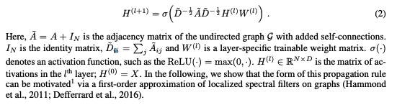
Appendix B: The Laplacian Graph
The adjacency matrix is made numerically stable by incorporating the Laplacian, using the renormalization trick.
Kipf, T. N., Welling, M (2016). Semi-Supervised Classification with Graph Convolutional Networks. https://arxiv.org/abs/1609.02907
Notes:
Comes from spectral graph convolutional theory – a method of

Slide 16
Appendix C: Mol2Vec
An alternative method for looking at structure was looked at in the Mol2Vec model (Jaeger et al., 2018).
This model used the “fingerprint” method to create a unique sequence for each molecule.
From this unique sequence, the Word2Vec method was applied to get molecule vectors.
Initial results using this method were not comparable to the GCNN, but this could be because transfer learning was used (in this case, I took learned embeddings used more for proteins, which doesn’t necessarily translate to this application).

