Slide 1
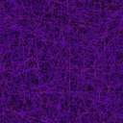
Life inside Schrödinger’s box

Slide 2
But how?!
How do we animate textures?
Uniforms and recompiling textures
X² + y² = radius
What kinds of textures look the best when animated?
A-symmetrical
Black background
How do we animate pixel colors?
More uniforms
color codes

Slide 3
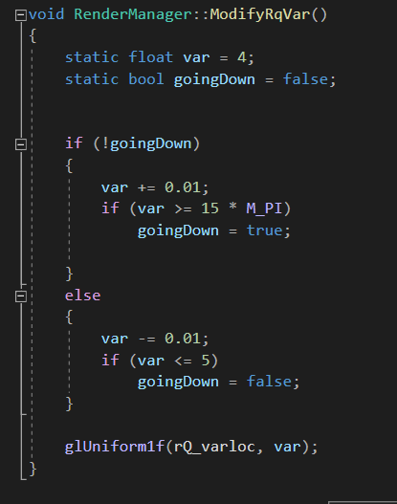
Uniforms and recompiling textures
Set up same as any other uniform we have used
We need a non-constant value
We also need to update that value in our recently recompiled shader
We can now use this uniform for many different types of animating be it color or texture coordinates

Slide 4

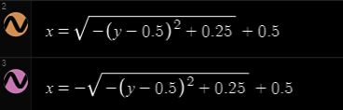
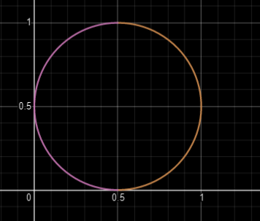
The equation of a circle
Texture coordinate’s origin is (0,0)
We want a circle whose points are contained entirely within our texture coordinates

Slide 5
Not exactly the same equation
Code for animation is based on the equation of a circle with some variation
Its not pretty to look at
The txmod variable is a modified (x, y) point on our texture based on tex_coord variable

Slide 6
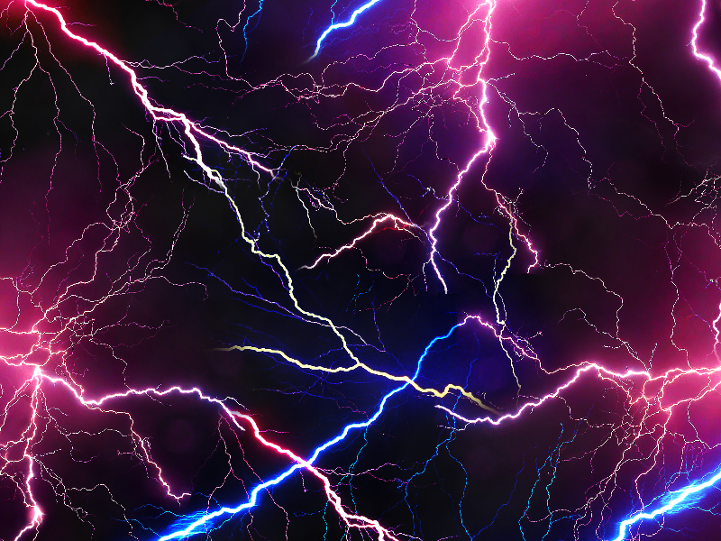
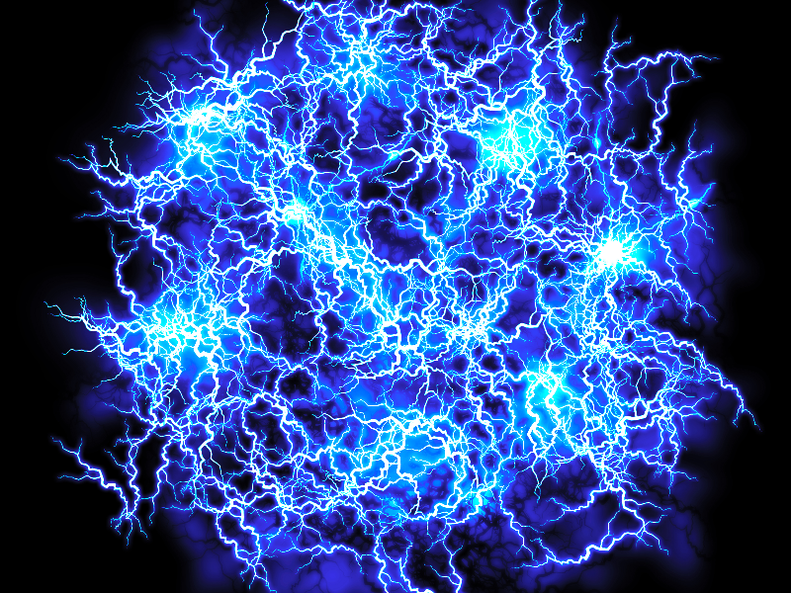
Textures that “work” with this equation
Digitally generated images of lightning from the internet
Symmetrical images gave pretty boring effects
These are the only two textures I used the rest is color modification

Slide 7

Color codes and repurposing our uniform
Repurpose uniform used for texture animation for color animation
Color codes as constant multiples
color code shown i am interpretting as (0.2, 0, 0.2)
change pixels that are all white to an animated color

Slide 8
The final product

