Slide 1
SNARKs for Ethereum
Sean Bowe
Casey Detrio
Joshua Gancher
Yuncong Hu
Andrew Miller
Eran Tromer
Zcash
Ethereum Foundation
Cornell University
Shanghai Jiao Tong University
IC3, UIUC, Zcash
Tel Aviv University, Columbia University, Zcash
27 July 2016
IC3-Ethereum Bootcamp

Slide 2
Bringing zero-knowledge SNARKs to Ethereum
Smart contracts where some of the computation is performed off-blockchain
  without sacrificing integrity
  with zero knowledge
Scalability
Privacy-preserving cryptocurrency
  Zerocash over Ethereum (ZoE)
  First milestone: Baby ZoE

Slide 3
Bringing zero-knowledge SNARKs to Ethereum

Slide 4












Baby ZoE
Simple coin mixer contract
Can deposit and later withdraw privately
Fixed denomination
Protocol based on commitments and Merkle trees
[Sander Ta-Shma 1999]
CRH
CRH
CRH
CRH
CRH
CRH
CRH
commit

Slide 5
Baby ZoE implementation components
Arithmetic circuit expressing the NP statement for the zkSNARK
Contract
Extend the Ethereum VM to support native SNARK verification
Wallet

Slide 6
Native SNARK verification
snarkverify(vk, proof, public_input)
  Verifies the zkSNARK proof with the verification key, given the public input
Parity EVM patch
Rust wrapper for libsnark

Slide 7
ZoE Circuit
Given serial, addr, rt, and MAC, there exists sk such that:
  cm := SHA256(sk || serial)
  cm appears in the depth-4 merkle tree with root rt
  MAC = SHA256(addr || sk)
rt
MAC
SHA256
SHA256
SHA256
SHA256
cm
SHA256
SHA256
serial
sk
addr

Slide 8
BabyZoE contract: Internal State
Internal Merkle tree for commitments
Verification key for zkSNARK
List of spent serial numbers
List of past Merkle tree roots

Slide 9
BabyZoE contract: Code
contract Mixer {
SnarkPrecompile zksnark = SnarkPrecompile(0x0000000000000000000000000000000000000005);
mapping (bytes32 => bool) public serials;
mapping (bytes32 => bool) public roots;
struct Mtree {
uint cur;
bytes32[16] leaves;
}
Mtree public MT;
bytes public vk;

Slide 10
BabyZoE contract: Code
function insert(bytes32 com) returns (bool res) {
if (MT.cur == 16) {
return false;
}
MT.leaves[MT.cur] = com;
MT.cur++;
return true;
}

Slide 11
BabyZoE contract: Code
function deposit(bytes32 com) returns (bool res) {
if (msg.value != 1 ether) {
msg.sender.send(msg.value);
return false;
}
if (!insert(com)) {
msg.sender.send(msg.value);
return false;
}
bytes32 rt = getRoot();
roots[rt] = true;
return true;
}

Slide 12
BabyZoE contract: Code
function withdraw(bytes32 serial, address addr, bytes32 rt, bytes32 mac, bytes proof) returns (bool success) {
success = false;
bytes20 addr_byte = bytes20(addr);
bytes memory pub = new bytes(128);
uint i;
for (i = 0; i < 32; i++) pub[i] = serial[i];
for (i = 0; i < 20; i++) pub[32 + i] = addr_byte[i];
for (i = 20; i < 32; i++) pub[32 + i] = 0;
for (i = 0; i < 32; i++) pub[32*2 + i] = rt[i];
for (i = 0; i < 32; i++) pub[32*3 + i] = mac[i];
if (roots[rt] == true) {
if (!serials[serial]) {
if (!zksnark.verify_proof(vk, proof, pub)) {
return false;
}
serials[serial] = true;
if (!addr.send(1 ether)) {
throw;
}
else {
success = true;
}
}
else {
return;
}
}
else {
return;
}
}

Slide 13
Next steps
Grown-up ZoE
  Variable denomination
  Splitting and joining coins
  Payment destinations
EIP for snarkverify precompile
Full wallet
Hawk over Ethereum
Cool contracts!

Slide 14
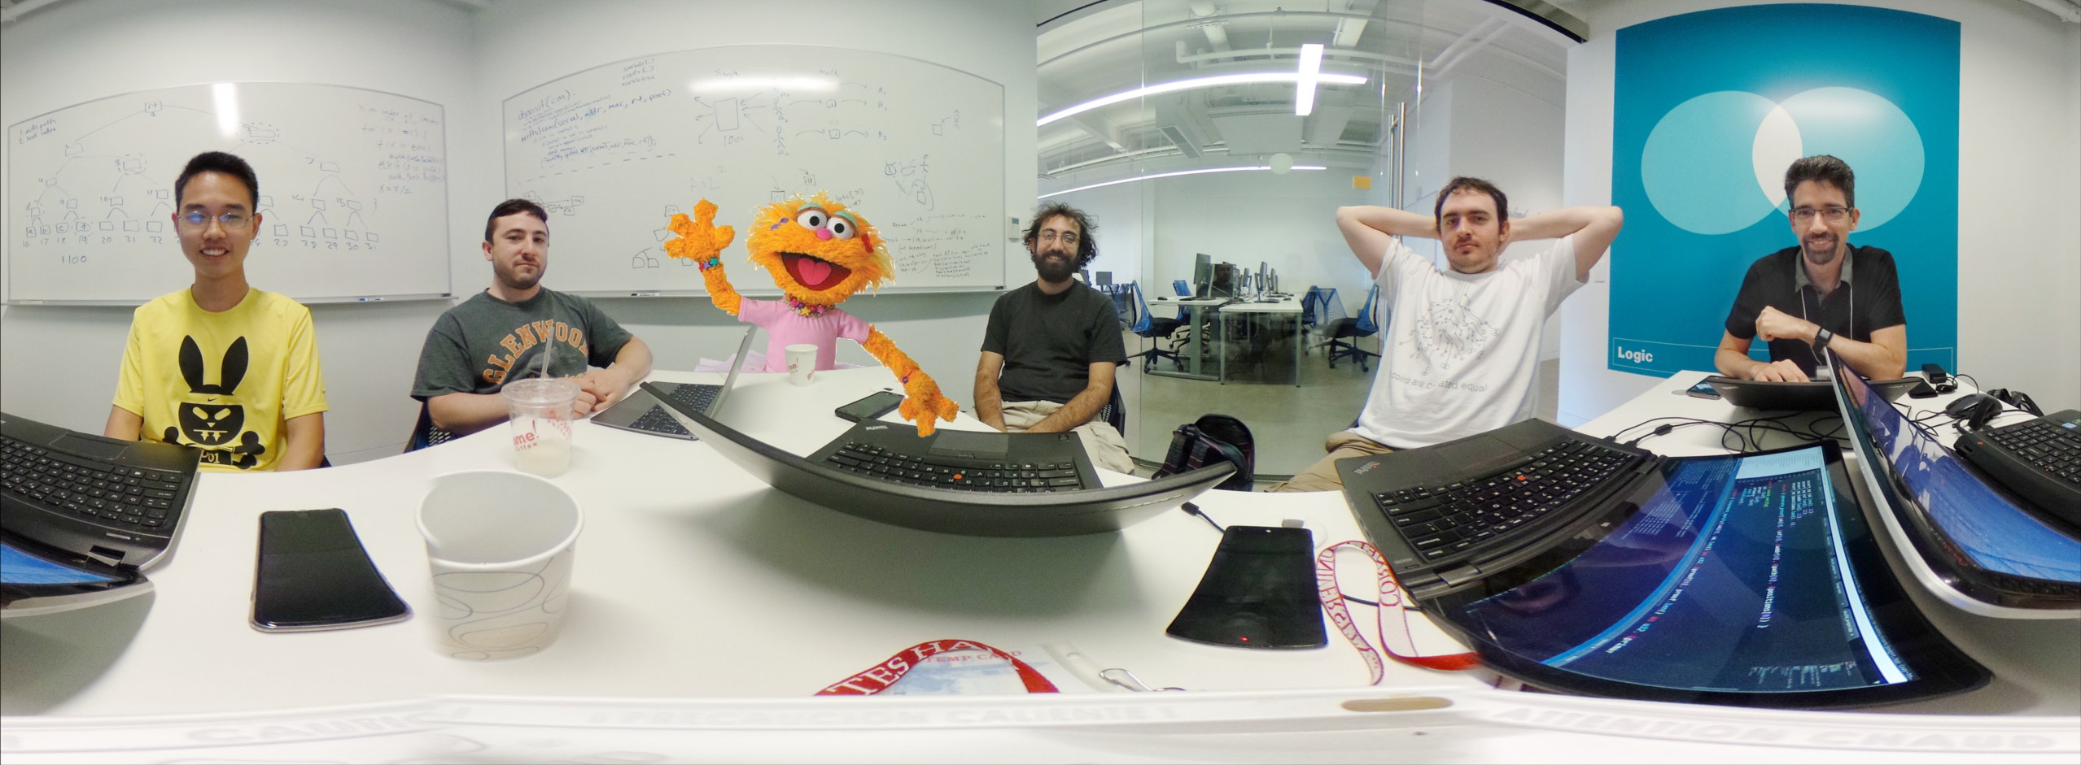
Help baby ZoE grow and prosper
http://github.com/zcash/babyzoe
(very soon)

