Slide 1
How to open Vuforia demo Android project

Slide 2
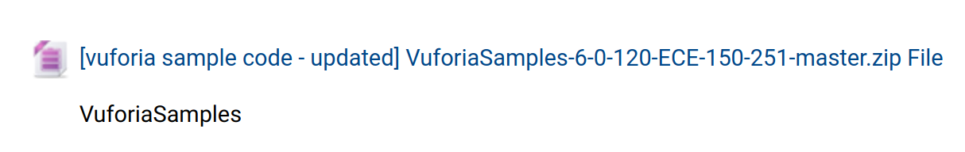
How to open Vuforia demo Android project
1) download code zip file from GauchoSpace
[vuforia sample code - updated] VuforiaSamples-6-0-120-ECE-150-251-master.zip

Slide 3
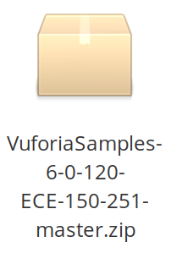
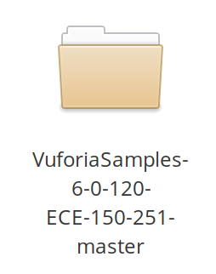
How to open Vuforia demo Android project
2) Unzip the zip file, and obtain a folder named “VuforiaSamples-6
-0-120-ECE-150-251-master”

Slide 4
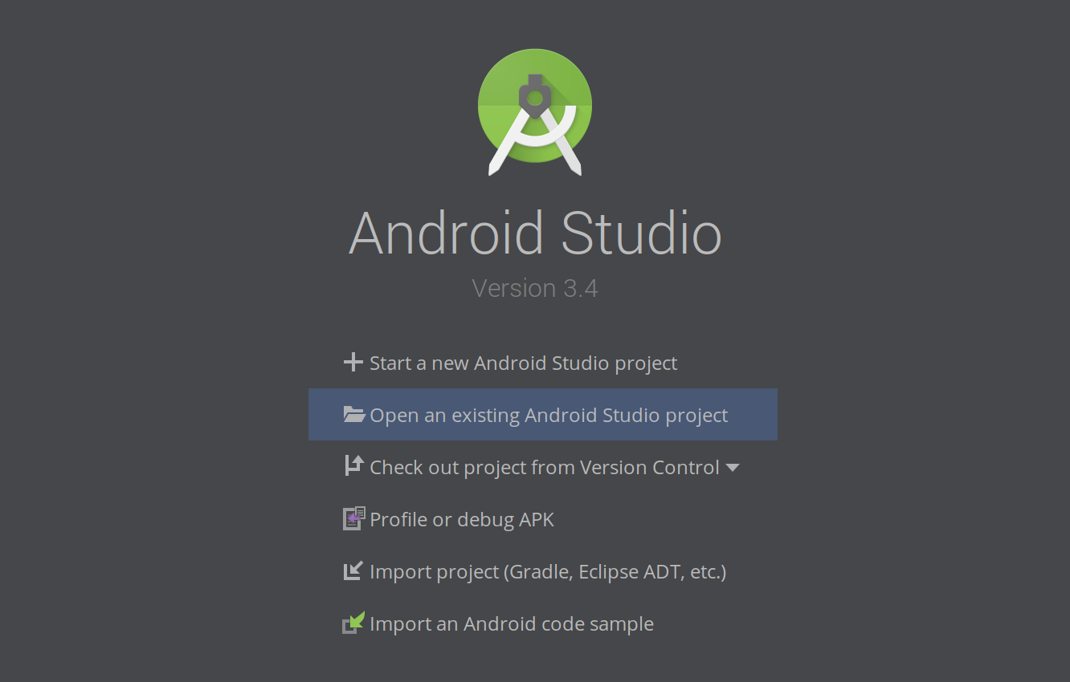
How to open Vuforia demo Android project
3) Start android studio, then click “Open an existing Android Studio project”

Slide 5
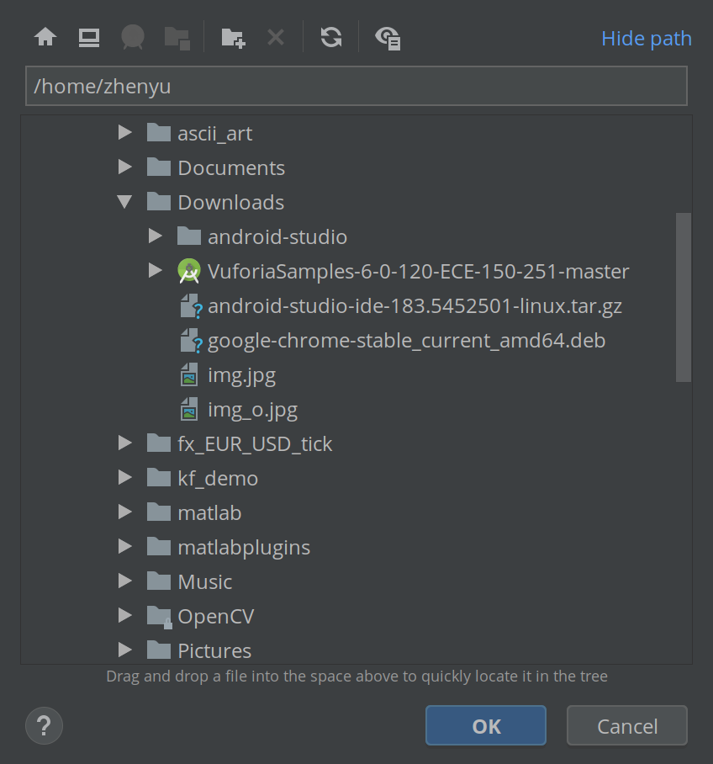
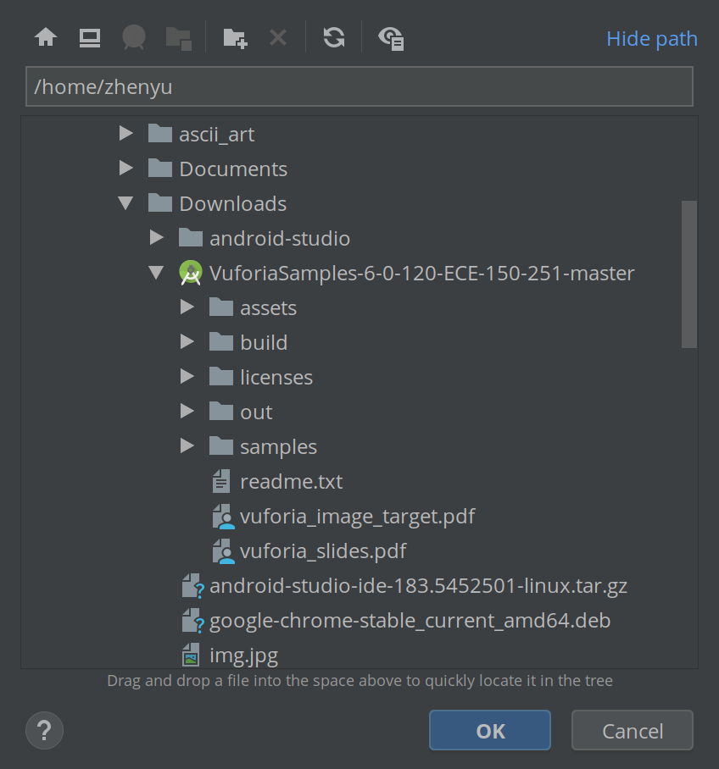
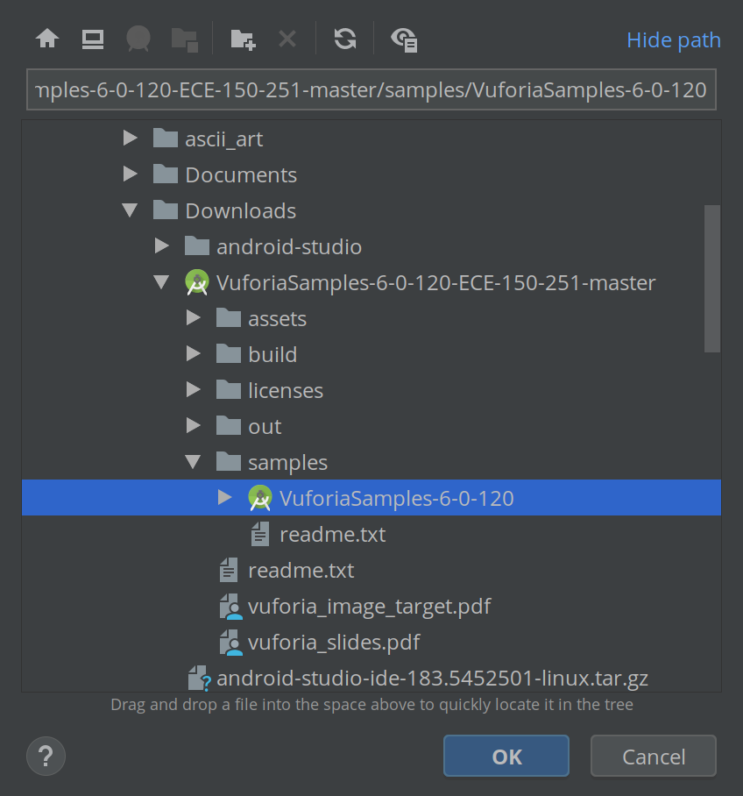
How to open Vuforia demo Android project
4) Navigate to the directory where the folder “VuforiaSamples-6
-0-120-ECE-150-251-master” locates. Expand it and then expand sub-fold “samples”
and then select sub-fold “VuforiaSamples-6-0-120”, click OK.

Slide 6
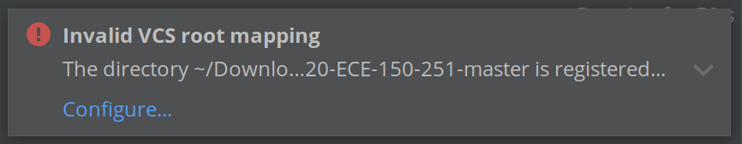
How to open Vuforia demo Android project
5) Android Studio will start importing the project. It may notify “Invalid VCS root mapping”,
you can ignore it because it just means the Android Studio is trying to link the project with
a git root.

Slide 7
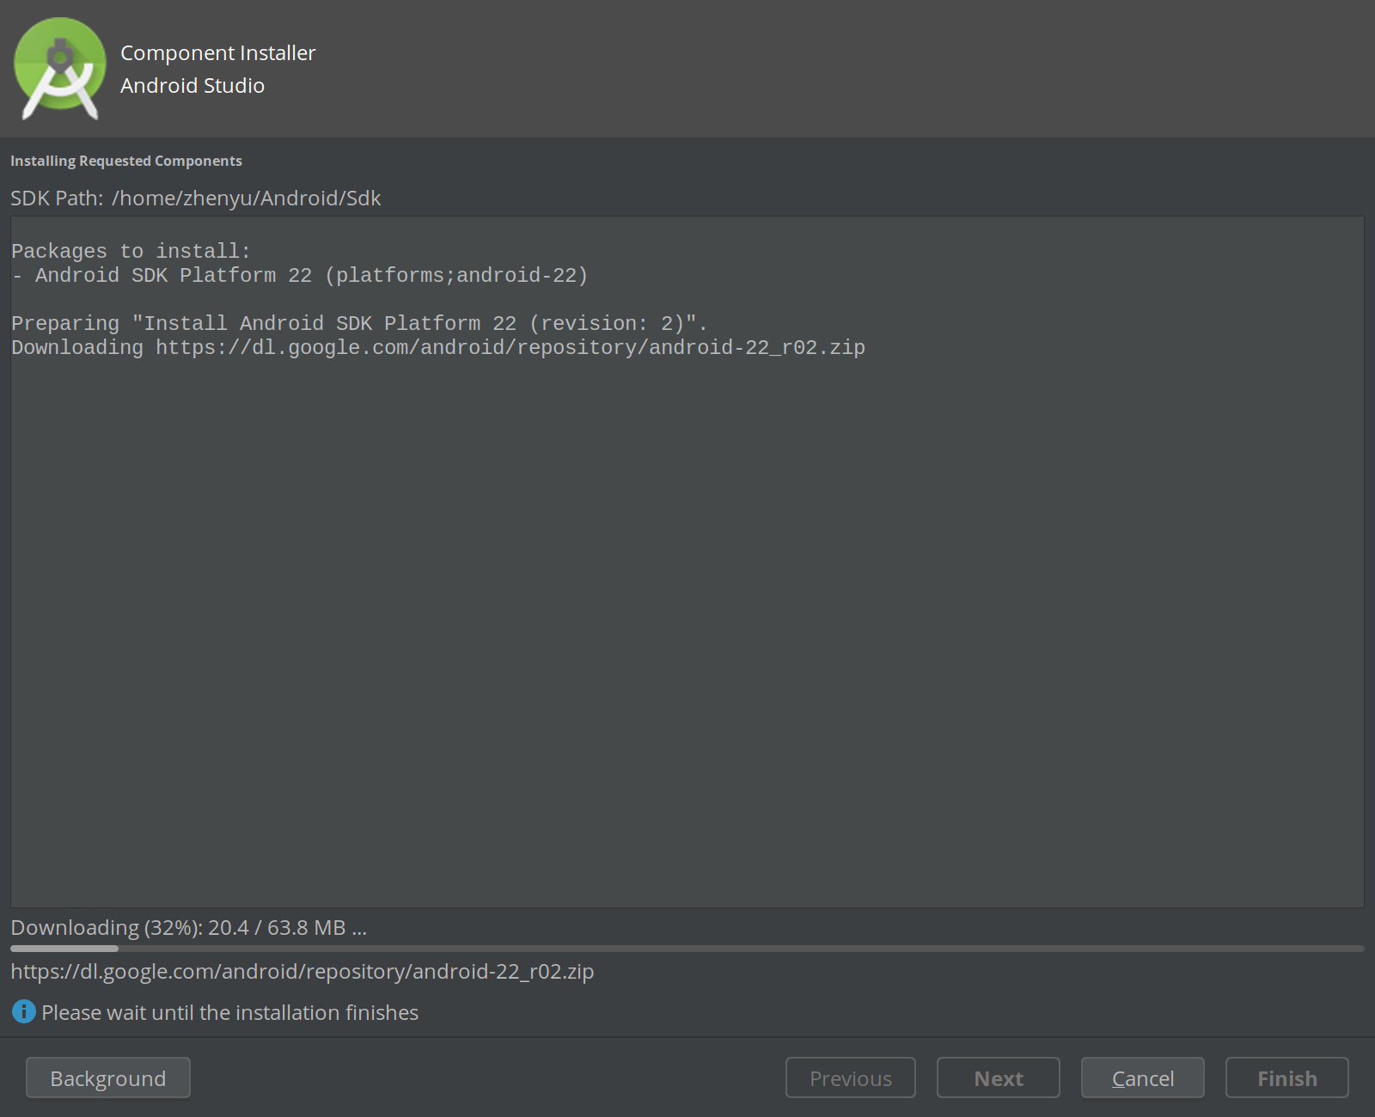
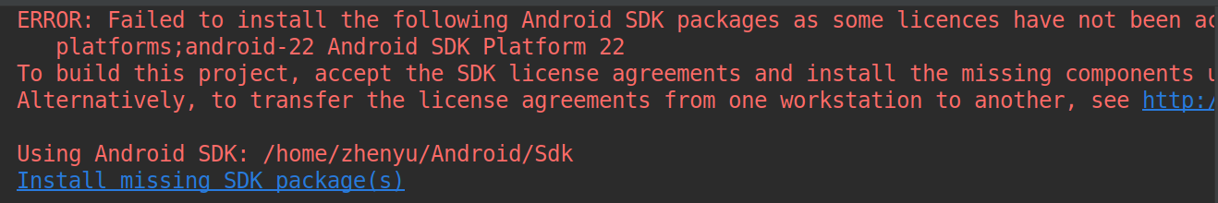
How to open Vuforia demo Android project
6) Android Studio may notify that an SDK is missing. Just click on the link and
Android Studio will start downloading the missing SDK.

Slide 8
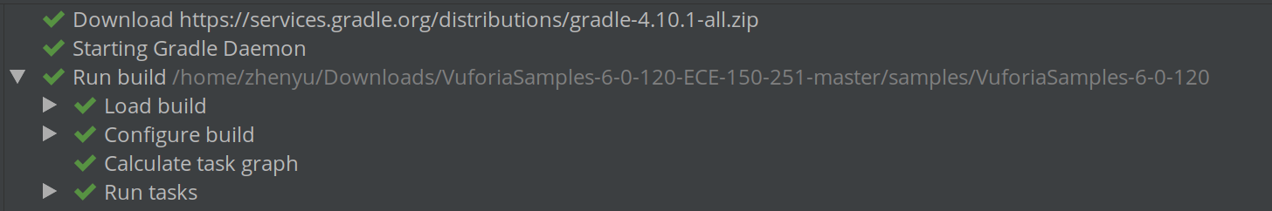
How to open Vuforia demo Android project
7) If everything is loaded properly, you will get something like this:

Slide 9
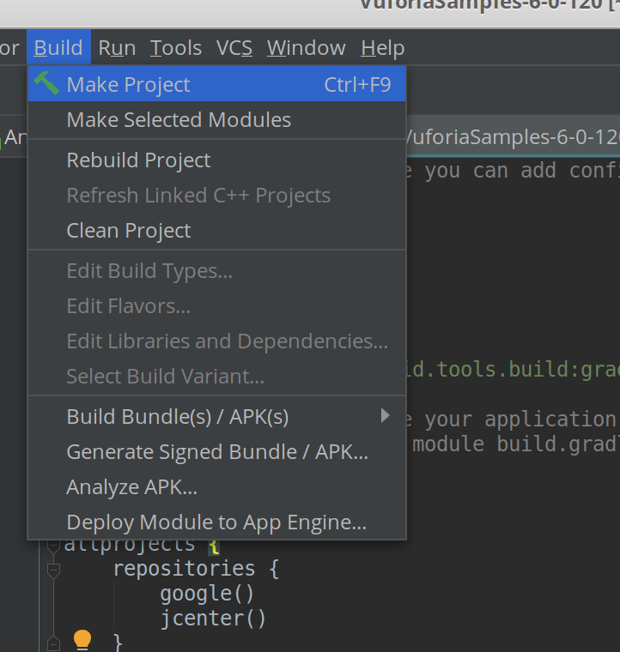
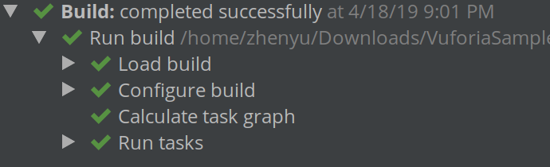
How to open Vuforia demo Android project
8) Now you can try to make the project by clicking “Build” and then “Make Project”.
If the building is successful, you will see something like the right image..

Slide 10

How to open Vuforia demo Android project
9) Now you can install the demo application onto your Android device by clicking
on the “Run” button.

