Slide 1
Is Q-learning Provably Efficient?
Jin, C., Allen-Zhu, Z., Bubeck, S. and Jordan, M.I., 2018. Is Q-learning provably efficient?. Advances in neural information processing systems, 31.
Presenter: Sopan Sarkar
Date: 12/05/2023

Slide 2
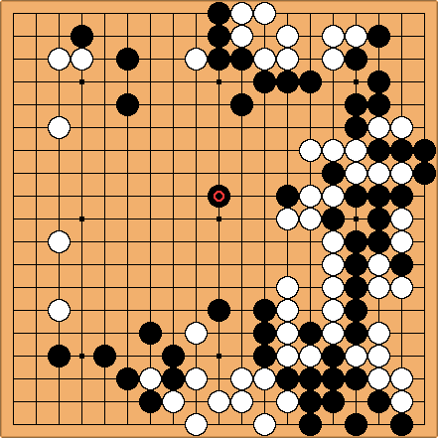
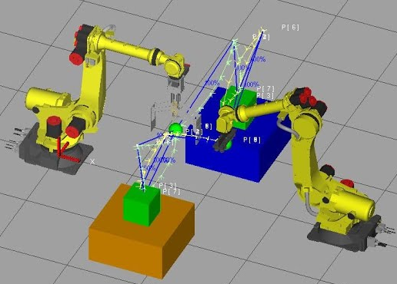
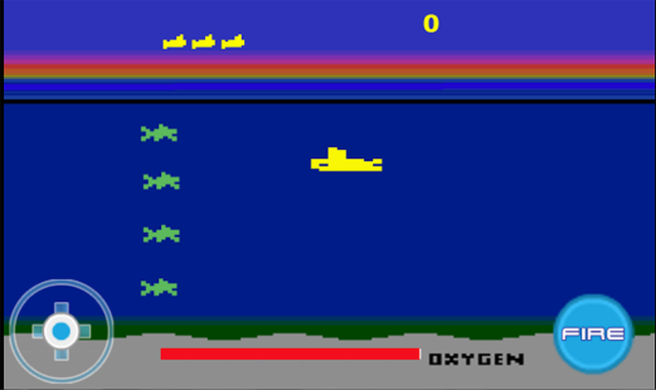

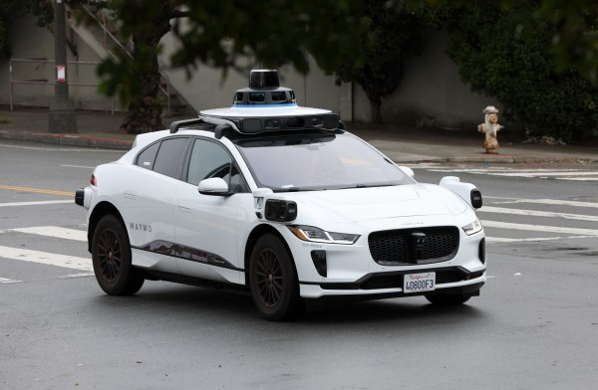


What This Paper is About?
Trained on $≥{10}^{6}$ samples
$≥{10}^{9}$ samples? how expensive?

Slide 3
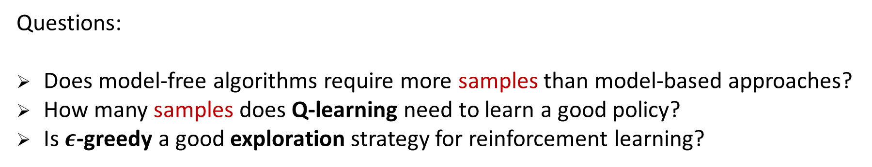
What This Paper is About?
Goal: design efficient algorithm to learn better policies with fewer samples
Theory: model-based algorithms for finite states and actions
Practice: model-free algorithms with deep nets as function approximators
Questions:
Does model-free algorithms require more samples than model-based approaches?
How many samples does Q-learning need to learn a good policy?
Is $ε$-greedy a good exploration strategy for reinforcement learning?

Slide 4
Presentation Outline
Background knowledge
Main Results
Proof for Q-learning with UCB-Hoeffding

Slide 5
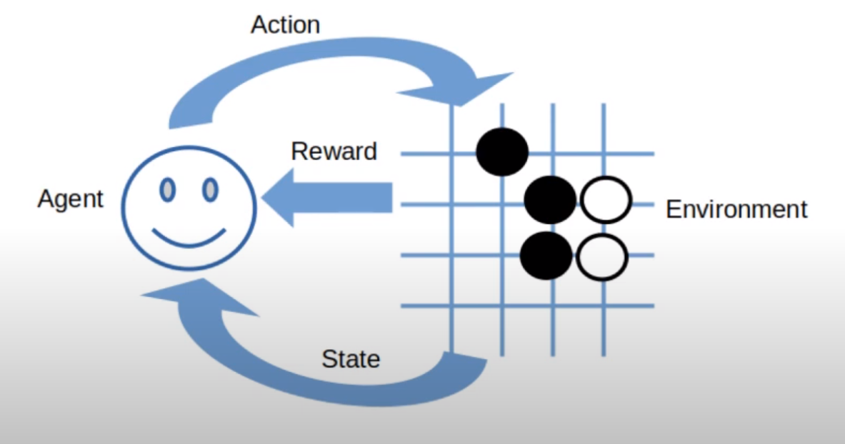
Brief Introduction to Reinforcement Learning
Reinforcement learning is a type of machine learning where an agent learns to make decisions by performing actions in an environment to achieve maximum cumulative reward

Slide 6
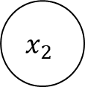
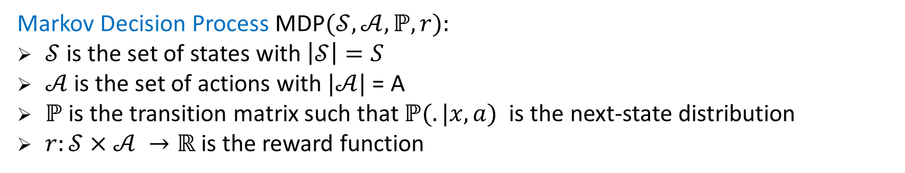
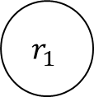
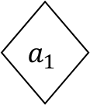
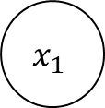
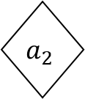
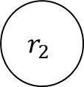
Markov Decision Process
Markov Decision Process MDP$(𝒮,𝒜,ℙ,r):$
$𝒮$is the set of states with $\left|𝒮\right|=S$
$𝒜$is the set of actions with $|𝒜|$ = A
$ℙ$is the transition matrix such that $ℙ(.|x,a)$ is the next-state distribution
$r:𝒮×𝒜 →ℝ$is the reward function
$$r_{1}$$
$$r_{2}$$
$$x_{1}$$
$$x_{2}$$
$$a_{1}$$
$$a_{2}$$

Slide 7
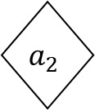
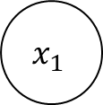
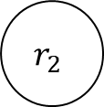

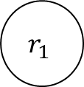

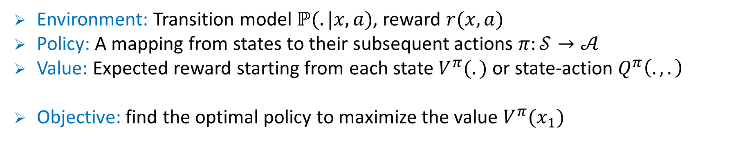
Environment, Policy, and Value
$$r_{1}$$
$$r_{2}$$
$$x_{1}$$
$$x_{2}$$
$$a_{1}$$
$$a_{2}$$
Environment: Transition model $ℙ(.|x,a)$, reward $r(x,a)$
Policy: A mapping from states to their subsequent actions $π:𝒮→𝒜$
Value: Expected reward starting from each state $V^{π}(.)$ or state-action $Q^{π}\left(.,.\right)$
Objective: find the optimal policy to maximize the value $V^{π}(x_{1})$

Slide 8
Model-based vs Model-free RL
Model-based RL
learning
Transition Model
planning
Experience
learning
Policy/Value
Model-free RL
acting
Model-based algorithms: Value/policy iteration using empirical transition matrix
Model-free algorithms: Q-learning, policy gradient methods

Slide 9
Model-free RL
Definition
A RL algorithm is model-free if its space complexity is always sublinear relative to the space required to store an MDP
Maintain transition matrix $ℙ(x^{′}|x, a): 𝒪(S^{2}A)$
Maintain Q-value function: $𝒪(SA)$
Advantage of model-free RL:
Simpler, more flexible to use, more prevalent in modern deep RL
Less sample efficient? [Deisenroth & Rasmussen 2011, Schulman et al. 2015]

Slide 10
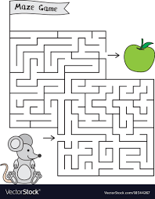
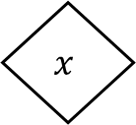
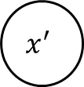
A Fundamental Question
Is model-free algorithms (Q-learning) sample efficient?
remains unknown even for basic scenario with finite state/actions
What did we know?
$$x^{′}$$
$$x$$
Simulator
a
r
Find best policy given all possible states and a “simulator”
Considered easier than standard RL, “planning that does not require exploration”

Slide 11
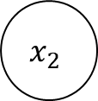
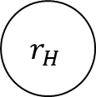
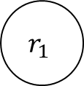
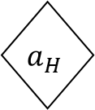

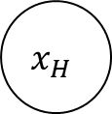


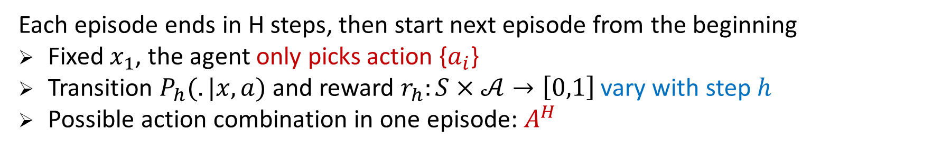

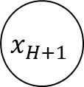
Episodic MDP
$$r_{1}$$
$$r_{2}$$
$$r_{H}$$
$$x_{1}$$
$$x_{2}$$
$$x_{H}$$
$$x_{H+1}$$
$$a_{1}$$
$$a_{2}$$
$$a_{H}$$
Each episode ends in H steps, then start next episode from the beginning
Fixed $x_{1}$, the agent only picks action {$a_{i}$}
Transition $P_{h}(.|x,a)$ and reward $r_{h}:S×𝒜→\left[0,1\right]$ vary with step $h$
Possible action combination in one episode: $A^{H}$

Slide 12
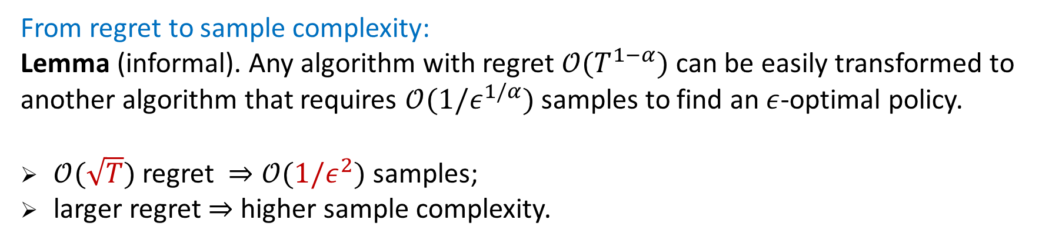
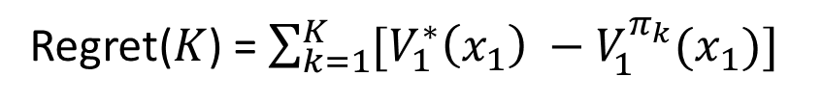
Regret
In $k^{th}$ episode, the agent plays according to policy $π_{k}$
Regret($K$) = $\sum_{k=1}^{K}{[V_{1}^{∗}\left(x_{1}\right) −V_{1}^{π_{k}}(x_{1})]}$
A policy $π$ is $ε$-optimal if $V_{1}^{∗}\left(x_{1}\right) −V_{1}^{π_{k}}\left(x_{1}\right)≤ε$
From regret to sample complexity:
Lemma (informal). Any algorithm with regret $𝒪(T^{1−α})$ can be easily transformed to another algorithm that requires $𝒪(1/ε^{1/α})$ samples to find an $ε$-optimal policy.
$𝒪(\sqrt{T})$ regret $⇒𝒪(1/ε^{2})$ samples;
larger regret $⇒$ higher sample complexity.

Slide 13
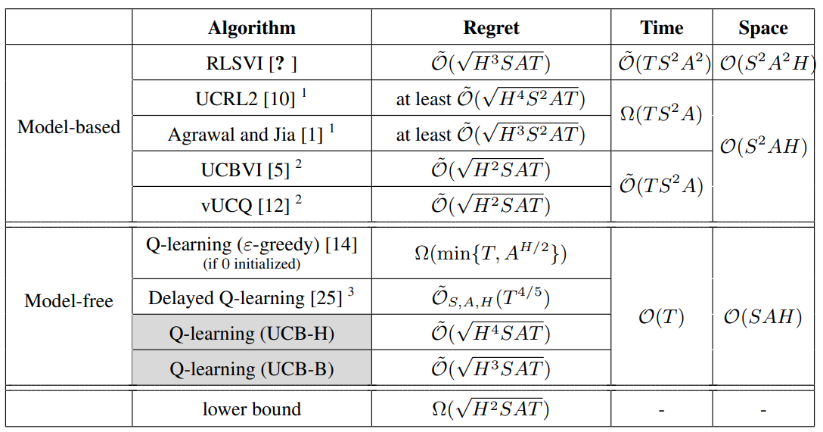
Summary of Results
* $H$: # of steps per episode, $S$: # of states, $A$: # of actions, and $T$: total # of steps played
* The table is presented for $T≥\text{poly}\left(S, A, H\right)$, omitting low order terms.

Slide 14
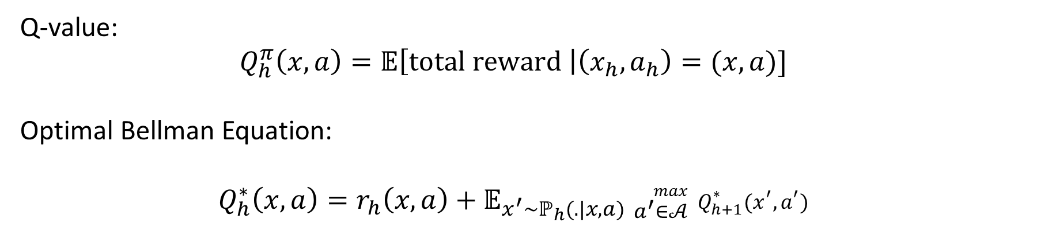
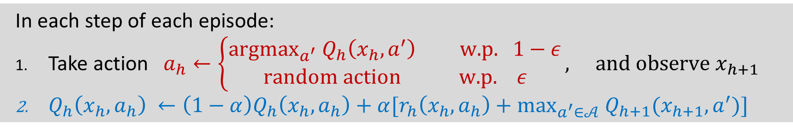
Q-learning
Q-value:
$$Q_{h}^{π}\left(x,a\right)=𝔼\left[\text{total} \text{reward} \right|\left(x_{h}, a_{h}\right)=(x,a)]$$
Optimal Bellman Equation:
$$Q_{h}^{∗}\left(x, a\right)=r_{h}\left(x, a\right)+𝔼_{x^{′}\sim ℙ_{h}(.|x,a)} {}_{a^{′}∈𝒜}^{max}{ Q_{h+1}^{∗}}(x^{′}, a^{′})$$
Q-learning with $ε$-greedy
In each step of each episode:
Take action $a_{h}←\left\{\begin{aligned}{\text{argmax}}_{a^{′}} Q_{h}\left(x_{h}, a^{′}\right) \text{w}\text{.}\text{p}\text{.} 1−ε \\ \text{random} \text{action} \text{w}\text{.}\text{p}\text{.} ε\end{aligned}\right., \text{and} \text{observe} x_{h+1}$
$Q_{h}\left(x_{h}, a_{h}\right) ←\left(1−α\right)Q_{h}\left(x_{h}, a_{h}\right)+α[r_{h}\left(x_{h}, a_{h}\right)+{\text{max}}_{a^{′}∈𝒜} Q_{h+1}(x_{h+1}, a^{′})]$
Two flexible pieces: (1) exploration strategy; (2) learning rate $α$

Slide 15
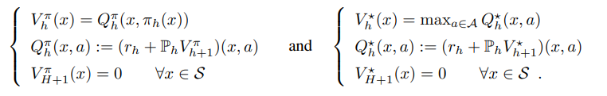
Bellman Optimality Equation (for reference)

Slide 16
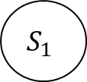



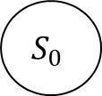






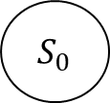

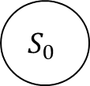



Inefficiency of $ε$-greedy
$$S_{1}$$
$$A$$
$$S_{1}$$
$$A$$
$$A$$
$$S_{1}$$
$$A/\{a^{∗}\}$$
$$A/\{a^{∗}\}$$
$$A/\{a^{∗}\}$$
$$A/\{a^{∗}\}$$
$S_{0}$
$$S_{0}$$
$$S_{0}$$
$$S_{0}$$
$$a^{∗}$$
$$a^{∗}$$
$$a^{∗}$$
$$a^{∗}$$
If 0 initialized, it requires $Ω(A^{H/2})$ episodes before discovering non-zero reward path.
Other initializations? not known, but the regret $≥Ω(T^{3/4})$

Slide 17
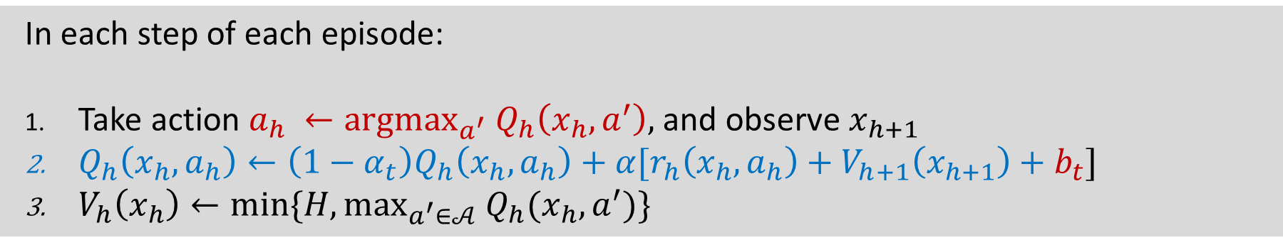

Q-learning with UCB-Hoeffding
Q-learning with UCB-Hoeffding
In each step of each episode:
Take action $a_{h} ←{argmax}_{a^{′}} Q_{h}\left(x_{h}, a^{′}\right),$ and observe $x_{h+1}$
$Q_{h}\left(x_{h}, a_{h}\right)←\left(1−α_{t}\right)Q_{h}\left(x_{h}, a_{h}\right)+α[r_{h}\left(x_{h},a_{h}\right)+V_{h+1}\left(x_{h+1}\right)+b_{t}]$
$V_{h}\left(x_{h}\right)←\text{min}\text{\{}H, {\text{max}}_{a^{′}∈𝒜} Q_{h}\text{(}x_{h},a^{′}\text{)\}}$
Counts: $t=N_{h}(x_{h}, a_{h})$
UCB bonus: $b_{t}=\tilde{𝒪}(\sqrt{H^{3}/t})$
Learning rate: $α_{t}=𝒪(H/t)$

Slide 18
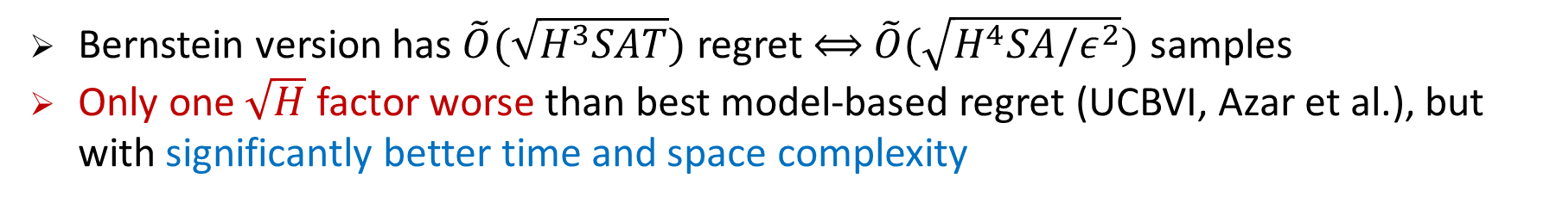
Theoretical Guarantees
Theorem (Hoeffding version)
W.h.p, the total regret of Q-learning with UCB-Hoeffding is at most $\tilde{𝒪}(\sqrt{H^{4}SAT})$
Bernstein version has $\tilde{O}(\sqrt{H^{3}SAT})$ regret $⟺$ $\tilde{O}(\sqrt{H^{4}SA/ε^{2}})$ samples
Only one $\sqrt{H}$ factor worse than best model-based regret (UCBVI, Azar et al.), but with significantly better time and space complexity
Key component in analysis:
design Upper Confidence Bound (UCB)
favoring later updates

Slide 19

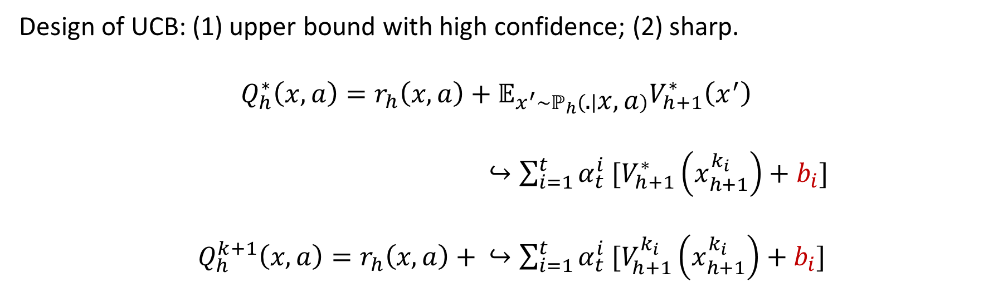




Upper Confidence Bound
$$a_{3}$$
$$a_{1}$$
$$a_{5}$$
$$a_{2}$$
$$a_{4}$$
Design of UCB: (1) upper bound with high confidence; (2) sharp.
$$Q_{h}^{∗}\left(x,a\right)=r_{h}\left(x,a\right)+𝔼_{x^{′}\sim ℙ_{h}\left(. | x,a\right)}V_{h+1}^{∗}\left(x^{′}\right)$$
$↪\sum_{i=1}^{t}{α_{t}^{i} [V_{h+1}^{∗}\left(x_{h+1}^{k_{i}}\right)+b_{i}]}$
$Q_{h}^{k+1}\left(x,a\right)=r_{h}\left(x,a\right) + ↪\sum_{i=1}^{t}{α_{t}^{i} [V_{h+1}^{k_{i}}\left(x_{h+1}^{k_{i}}\right)+b_{i}]}$

Slide 20
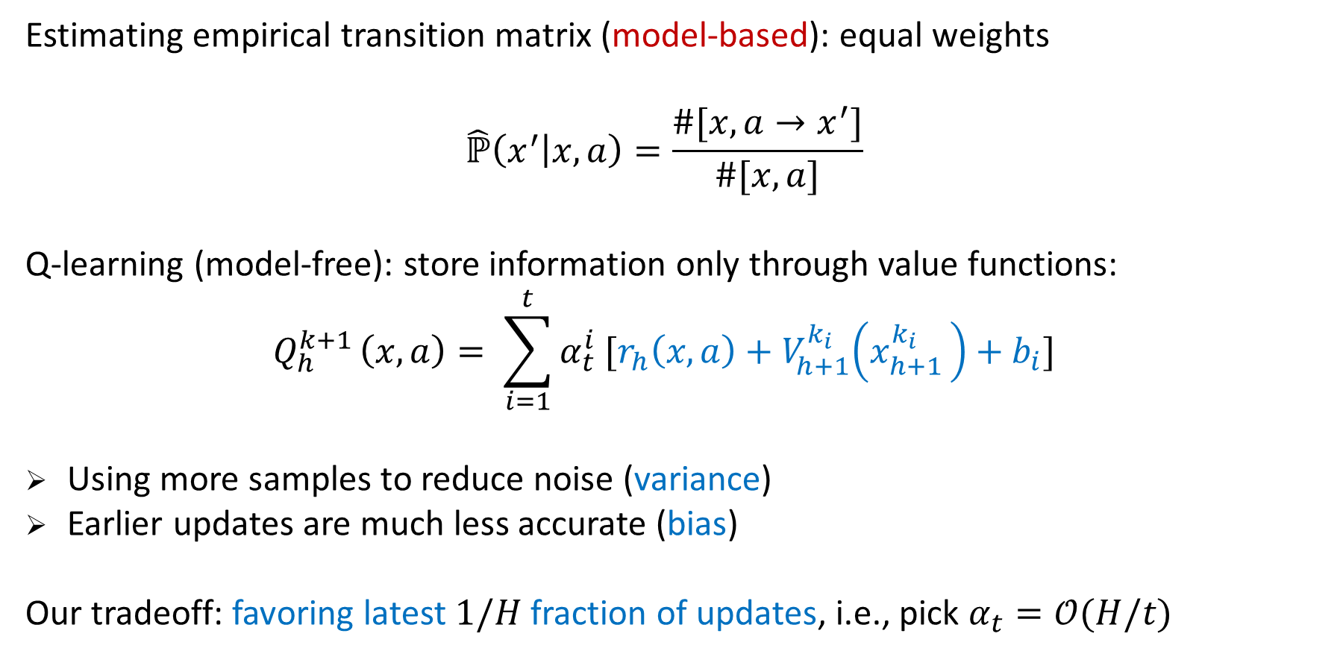

Favoring Later Updates
Estimating empirical transition matrix (model-based): equal weights
$$\hat{ℙ}\left(x^{′} | x,a\right)=\frac{\#[x,a→x^{′}]}{\#[x,a]}$$
Q-learning (model-free): store information only through value functions:
$$Q_{h}^{k+1 }\left(x,a\right)= \sum_{i=1}^{t}{α_{t}^{i} [r_{h}\left(x,a\right)+V_{h+1}^{k_{i}}\left(x_{h+1 }^{k_{i}}\right)+b_{i}]}$$
Using more samples to reduce noise (variance)
Earlier updates are much less accurate (bias)
Our tradeoff: favoring latest $1/H$ fraction of updates, i.e., pick $α_{t}=𝒪(H/t)$
$i$-th update

Slide 21
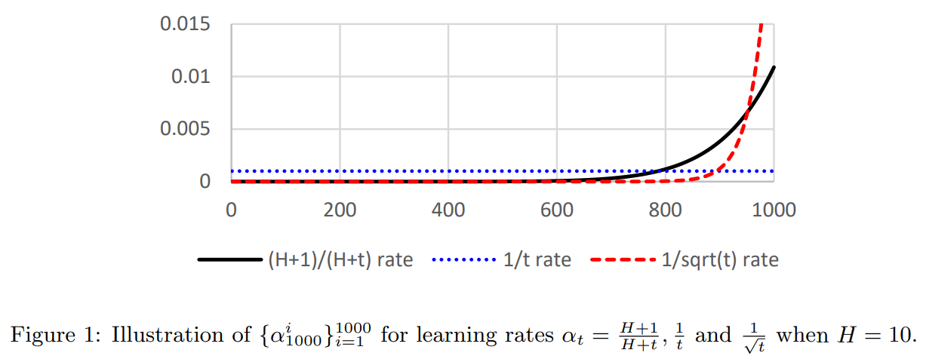
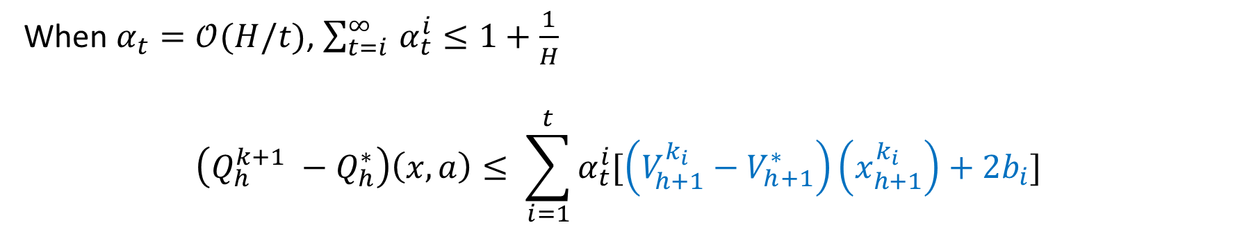

Favoring Later Updates II
When $α_{t}=𝒪(H/t)$, $\sum_{t=i }^{∞}{α_{t}^{i}≤1+\frac{1}{H}}$
$$\left(Q_{h}^{k+1} −Q_{h}^{∗}\right)\left(x,a\right)≤ \sum_{i=1}^{t}{α_{t}^{i}[\left(V_{h+1}^{k_{i}}−V_{h+1}^{∗}\right)\left(x_{h+1}^{k_{i}}\right)+2b_{i}]}$$
$i$-th update

Slide 22
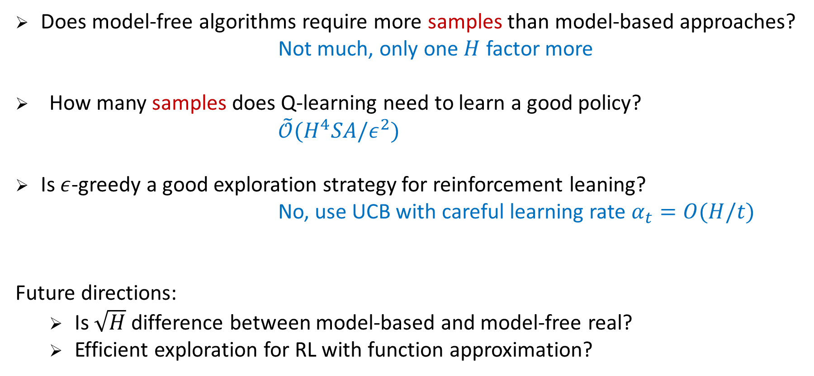
Discussion
Does model-free algorithms require more samples than model-based approaches?
Not much, only one $H$ factor more
How many samples does Q-learning need to learn a good policy?
$\tilde{𝒪}(H^{4}SA/ε^{2})$
Is $ε$-greedy a good exploration strategy for reinforcement leaning?
No, use UCB with careful learning rate $α_{t}=O(H/t)$
Future directions:
Is $\sqrt{H}$ difference between model-based and model-free real?
Efficient exploration for RL with function approximation?

