Slide 1
High-dimensional Sparse Linear Bandits (2020) by Hao, Lattimore, and Wang
Presentation by Aniket Panda
Notes:
Good afternoon, everyone. My name is Aniket Panda. I will be giving my presentation on the 2020 paper High-dimensional sparse linear bandits by Hao Lattimore and Wang.

Slide 2
Introduction
Sparse linear bandits: many features, few relevant ones.
Previous work has been in data-rich regime where time horizon is larger than ambient dimension.
Minimax lower bounds show worst-case linear regret for smaller time horizons, but these do not tell the whole story.
This hides rich structure in sparse linear bandits.
Bounds can be changed if the feature vectors admit a well-conditioned exploration distribution.
Notes:
This paper is concerned with sparse linear bandits. That is, bandits that have many features, but few relevant ones. Most of the previous work on sparse linear bandits has focused on the data-rich regime, which is where the time horizon, or the number of time steps the agent can look ahead when picking the best action, is larger than the ambient dimension. The reason this has been the case is that minimax lower bounds show worst-case linear regret for smaller time horizons, but these bounds don’t tell the whole story. They are a crude approximation that hide the rich structure that can be present in sparse linear bandits. The bounds can be changed if the feature vectors allow for a well-conditioned exploration distribution.

Slide 3


Problem Setting
Y_{t} is the reward given action A_{t} ⊆ ℝ^{d} at time step t.
η_{t} is an independent standard Gaussian random variable.
Parameter vector θ is s-sparse, meaning it has at most s non-zero values.
Notes:
Stochastic linear bandits generalize the standard reward model for multi-armed bandits by associating each action with a feature vector and assuming the mean reward is the inner product between the feature vector and an unknown parameter vector. Suppose we are at time step t. Given action At and and parameter vector theta, both d-dimensional vectors, we can define the reward Yt as the inner product of At and theta. Eta t is an independent standard gaussian random variable that is different from one time step to the next. We say that parameter vector theta is s-sparse if it has at most s non-zero values. In most practical applications, there are many candidate features but no clear indication about which are relevant, so dealing with sparsity is a valuable subject to explore. As a concrete example, imagine a news recommendation algorithm that tries to match users with articles they are likely to find interesting. The number of different topics across all articles is massive, but the number that will be especially appealling to any given user are likely to be small, hence sparsity.

Slide 4


Problem Setting
x* is the optimal action.
R_{θ}(n) is the regret faced by the agent.
Notes:
If we think of x* as the optimal action that maximizes the reward, let say, the user clicking on and reading the article for the most amount of time, then we can define the regret R-theta-n like so, as the expected cumulative difference between the x*’s reward and the actual reward over n time steps.

Slide 5
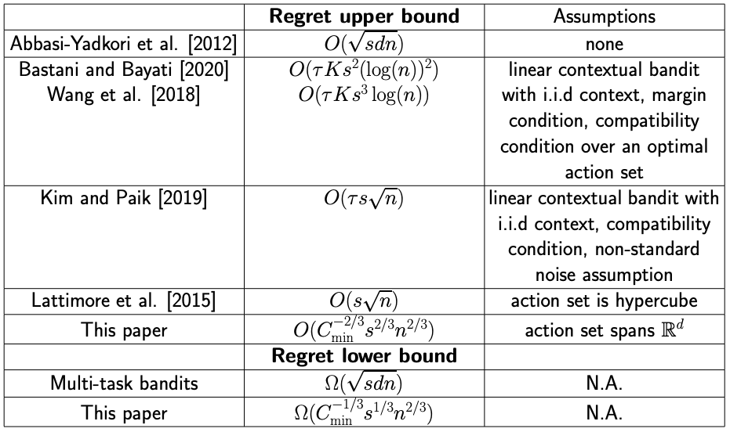
Previous Results
Notes:
This is a table summarizing the results of existing work. S is sparsity, d is ambient dimension and n is the time horizon. As mentioned earlier, most previous work is focused on the data-rich regime. For an arbitrary action set, Abbasi-Yadkori et al. [2012] proposed an online-to-confidence-set conversion approach that achieves a O( √ sdn) regret upper bound, where s is a known upper bound on the sparsity. The algorithm is generally not computationally efficient, which is believed to be unavoidable. A matching Ω(√ sdn) regret lower bound for data-rich regime was established by Lattimore and Szepesvari [2020]. This means you generally cannot avoid a dependence on d without additional assumptions. Because of this, other works tend to add assumptions about the context into their analysis. For example, Kim and Paik (2019 )developed a doubly-robust Lasso bandit approach with an O(τs√ n) upper bound but required the average of the feature vectors for each arm satisfies certain compatibility and non-standard noise conditions.
Note that tau here is a problem-dependent parameter that may have a complicated form and vary across different literature, but for the sake to simplicity, all those parameters are just labelled tau here. Bastani and bayati in 2020 along with wang et al similarly achieved bounds based on compatibility assumptions which are difficult to actually verify in practice. Note that in addition to tau, we have K here which is the number of arms. Another approach is to make assumptions around specific action sets. Lattimore et al. [2015] proposed a selective explore-then-commit algorithm that only works when the action set is exactly the binary hypercube. They derived an optimal O(s √ n) upper bound. However, once again, all of these papers focus on the data-rich regime, this paper differentiates itself from the rest by focusing on the data-poor regime. And on that basis we achieve the following bounds.

Slide 6
Contributions
Ω(n^{2/3}) regret lower bound unavoidable with large dimensionality.
O(n^{2/3}) dimension-free regret if feature vectors admit a well-conditioned exploration distribution.
O(n^{1/2}) dimension-free regret possible given certain signal quality on relevant features.
As horizon grows, an interesting transition occurs, since O((dn)^{1/2}) regret is optimal in data-rich regime.
Notes:
To summarize the main contributions of this paper, first we show that a n2/3 regret lower bound is unavoidable with large dimensionality. Previous work had shown a root sdn lower bound, so n2/3 is tighter as a lower bound and doesn’t rely on dimensionality, which can be valuable in a context where d is large and n is small. We also attain a matching O(n2/3) upper bound if feature vectors admit a well-conditioned exploration distribution. Again, n2/3 seems worse than root sdn but imagine if the dimensionality is large compared to n. Given certain conditions on the magnitude of the signal for relevant features, we can shrink that upper bound to O(n1/2). As the time horizon grows, the paper observed an interesting transition to O(dn1/2) which is optimal in a data rich regime anyway, so we aren’t getting worse results, we are just losing the advantage we showed in the data poor regime.

Slide 7


Minimax Lower Bound
Let P(A) be the space of probability measures over A. Then we define
Theorem (Minimax Lower Bound). For any policy π, there exists s-sparse parameter θ ∈ ℝ^{d}. and an action set A where C_{min}(A) is independent of d, n such that.
Notes:
Let P(A) be the space of probability measures over A. Then we define the following term Cmin, which is a measure of the degree to which there exist good exploration distributions over the actions. Then we get the following theorem. Ignore the constant in front. The important part is in the red box here. Our regret is bounded by the min between these two.

Slide 8
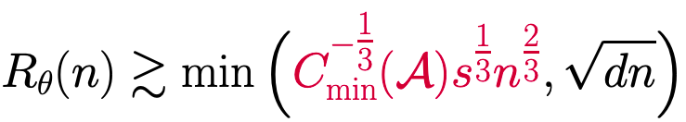
Minimax Lower Bound
Theorem: For any policy π, there exists s-sparse parameter θ ∈ ℝ^{d}. and an action set A where C_{min}(A) is independent of d, n such that.
For d > n^{1/3}s^{2/3} , R_{θ}(n) = Ω(n^{2/3}) and when d ≤ n^{1/3}s^{2/3}, R_{θ}(n) = Ω((sdn)^{1/2}).
Notes:
We can get the dimension free s1/3n2/3 scaled by the inverse of cmin to the ⅓, meaning that the larger cmin is, or the more well conditioned the distribution, the smaller this will be. That’s this papers unique contribution. Otherwise, we get root dn consistent with previous works. The conditions for which one it is are as stated here (read second point).

Slide 9
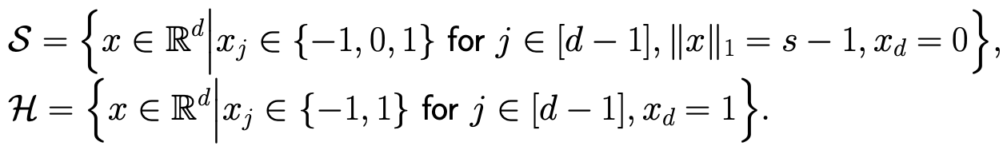

Step 1: construct a hard instance
Action sets S and H are low regret and informative, respectively. Note that 0 < κ ≤ 1 is a constant.
H is almost the entire binary hypercube, S is (s-1)-sparse.
Action set A = S ∪ H.
Notes:
Our first step in proving the lower bound is to construct a hard instance. We construct S to be a sparse low regret action set, and H to be a high information, but higher regret as well. H is almost the entire binary hypercube while S is s-1 sparse. If you notice, sampling from the corner of H provides more information to infer θ than from S but leads to high regret due to the last coordinate -1 in theta. The action set is the union of S and H.

Slide 10



Step 2: construct an alternative bandit
Notes:
The next step is to construct an alternative bandit. S’ is a subset of S where the s-1 non zero values are all in The supports of any x in S’ have no overlap with {1, . . . , s − 1}. Based on that we can define x~ as the action in S’ that minimizes cumulative squared reward and use it to define theta tilde like so.The key takeaway here is that this design guarantees the optimal arm x ∗ in bandit θ is suboptimal in alternative bandit θeand the suboptimality gap for x ∗ in bandit θeis maxx∈Ahx − x ∗ , θei = (s − 1)ε.

Slide 11

Step 2: construct an alternative bandit
When event D occurs, regret is large in the original bandit, otherwise regret is large in alternative bandit.
We can rewrite the bounds in terms of KL divergence.
When KL divergence in small between bandits, regret must be large for at least one of them.
Notes:
I wont delve into the details here. I’ll just give you the relevant points. Read the bullet points.

Slide 12

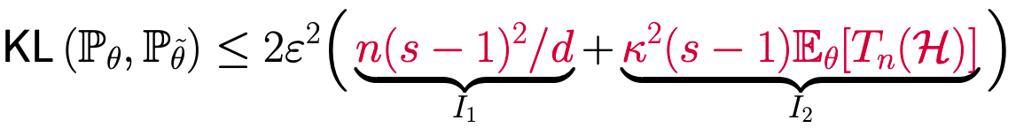
Step 3: calculate KL divergence
Let us define:
I₁ is the contribution from actions in the low-regret action set S, while I₂ is due to actions in H. The fact that actions in S are not very informative is captured by the presence of the dimension in the denominator of the first term.
Notes:
Now, we calculate the KL divergence. First let us define Tn(H) as the sum over n time steps how often action t is in H. Then we can show the following inequality. The important things to note are that the this first term on the rhs of the inequality, I1 is …

Slide 13

Step 4: conclusion
Notes:
After plugging the results from step 3 back into the the equations from step 2, we get the following, were k squared is defined as such. But we don’t need to focus on this the important points are in the next slide.

Slide 14


Step 4: conclusion
In data poor regime, d ≥ n^{1/3}s^{2/3} , we choose ε = κ^{−2/3}s^{−2/3}n^{−1/3}.
In data rich regime, d < n^{1/3}s^{2/3} , we choose ε = (d/(ns²))^{½} such that exponential term is constant.
Notes:
Read point, which gives the the following. The important part is boxed in red here. This was our original lower bound result. Likewise, in read point,. We get the following where the important part is the root dn. This gives us the results we talked about at the very beginning of the presentation.

Slide 15
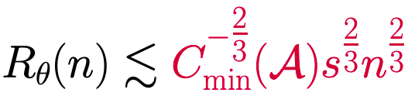
Matching Upper Bound
Theorem: Assume the action set A spans ℝ^{d}. The regret upper bound of explore-the-sparsity-then-commit (ESTC) algorithm satisfies
Notes:
Of course, there is also the matching upper bound. I wont go through the proof for this one. Note the exponent for n is the same but for s it is a factor of ⅓ larger, and for cmin it is a factor of ⅓ smaller. So, what is this explore the sparsity then commit algorithm exactly?

Slide 16
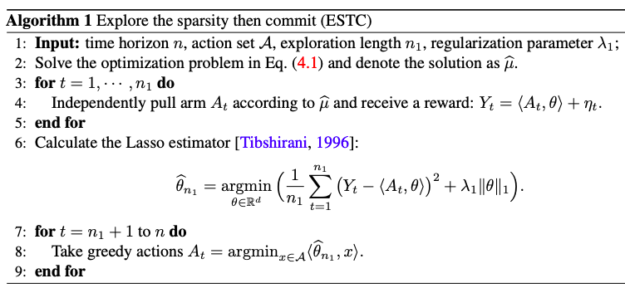
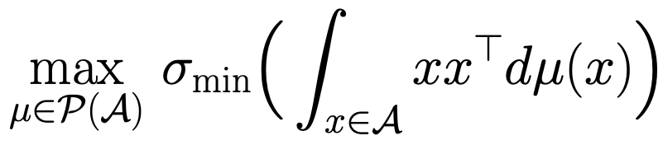
Notes:
Given an action set A and … , the algorithm first solves the following optimization problem to find the most informative design.

Slide 17
Notes:
Following mu hat, Independently pulls arms for n1 rounds and collects samples as {(A1, y1), . . . ,(An1 , yn1 )}. Then the algorithm calculates the lasso estimator ˆθn1 .

Slide 18
Notes:
Finally, we execute the greedy action At = argmaxx∈Ahx, ˆθn1 i for the remaining n−n1 rounds. There appears to be a typo in the paper. It says argmin instead of argmax.

Slide 19
Additional Remarks on Bounds
In regret upper bound, 1/Cmin(A) could be as large as d, giving minimax regret Θ((dn)^{1/2}), even with sparsity.
If sparsity is not known, we can set exploration length n₁ = n^{2/3} at the cost of an additional factor of O(s^{1/3}).
There is a (s/C_{min}(A))^{⅓} between the upper and lower bounds which the authors think can be tightened, but they do not currently know how to do so.
Optimism-based algorithms are not expected to achieve the minimax lower bound in data poor regime because they have been observed to not balance information and regret.
Notes:
Some additional remarks on the bounds we just calculated before we move on.

Slide 20
Improved Upper Bound
Assume a minimum signal condition. Then, with the use of the restricted phase elimination algorithm, the regret upper bound can be improved from O((sn)^{2/3}) to O((sn)^{1/2}).
Notes:
Given certain conditions on the magnitude of the signal for relevant features, we can shrink that upper bound from O(n2/3) to O(n1/2). Specifically, we use something called the restricted phase algorithm.

Slide 21
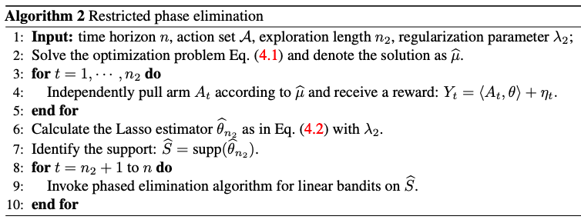
Notes:
This algorithm is almost identical to the first one. The difference is boxed in red here. After we perform the first-step Lasso estimation, we can use the phased elimination algorithm on the support of theta hat n2.

Slide 22
Experiment
Compare ESTC with LinUCB [Abbasi-Yadkori et al., 2011] and doubly-robust (DR) lasso bandits [Kim and Paik, 2019].
Case 1: linear contextual bandits with N = 20 arms, dimension d = 100, sparsity s = 5.
Case 2: hard problem instance. Recall the hard problem instance in the proof of minimax lower bound, sample 500 actions from the full informative action set and 200 from uninformative action set.
Notes:
In order to test the ESTC algorithm, the authors compared it to two other algorithms, namely read point. The ran the test in two different cases. The first was a linear contextual bandit setting with … The second case was our …

Slide 23
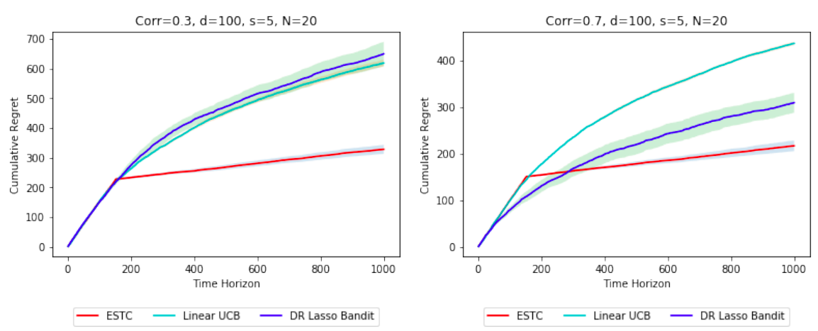
Notes:
The key takeaway here is that ESTC does well compared to other algorithms in a setting that was not specifically designed for it. We can also see that DR lasso bandit it hit hard in the low correlation setting since it relies heavily on its context distribution assumption

Slide 24
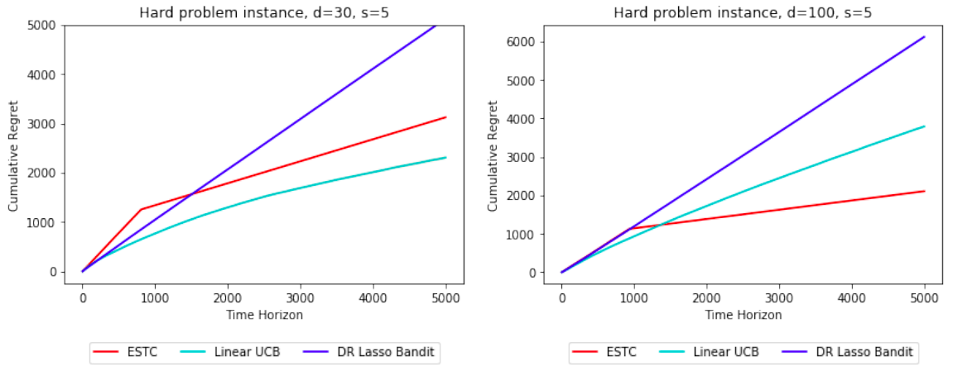
Notes:
Now, we look at case 2, which was our hard problem instance. Here, DR lasso bandit does very poorly compared to the others. We can see that Linear UCB is hit especially hard in the data poor regime since it ignores sparsity of information.

Slide 25
Discussion
Θ(n^{2/3}) is the optimal in the data-poor regime.
Sparse linear bandits create a challenge of balancing information and regret.
The shape of the action space and its effect on regret requires further exploration.
ESTC is optimal in data-poor regime, suboptimal in data-rich regime.
An algorithms that works well in both regimes would be interesting.
Notes:
Read the bullet points and expand as needed.

