Slide 1
Oracle-Efficient Pessimism: Offline Policy Optimization in Contextual Bandits
Authors: Lequn Wang, Akshay Krishnamurthy, Aleksandrs Slivkins
Presenter: Yanan Wang

Slide 2
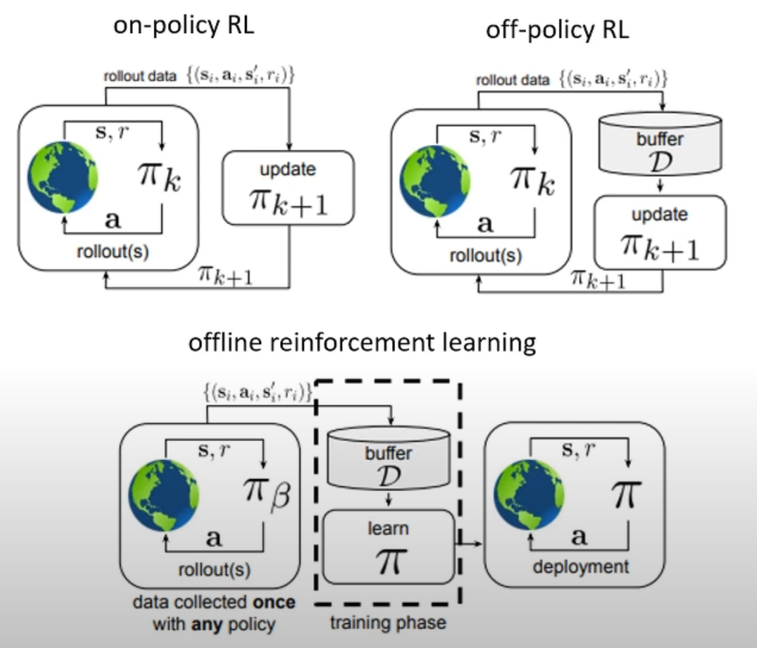
What is Offline RL?
This paper focuses on offline policy optimization (OPO) in contextual bandits
logging policy
learned policy

Slide 3
Challenges of Offline Policy Optimization in CB
Distribution shift
The logging and the learned policy induce different data distributions
Higher uncertainty of the learned policy and poor overall performance
Known solution: pessimism with the statistical guarantee
Computational efficiency
Existing offline policy optimization methods for contextual bandits (CB) are not efficient
This paper tackles both challenges

Slide 4
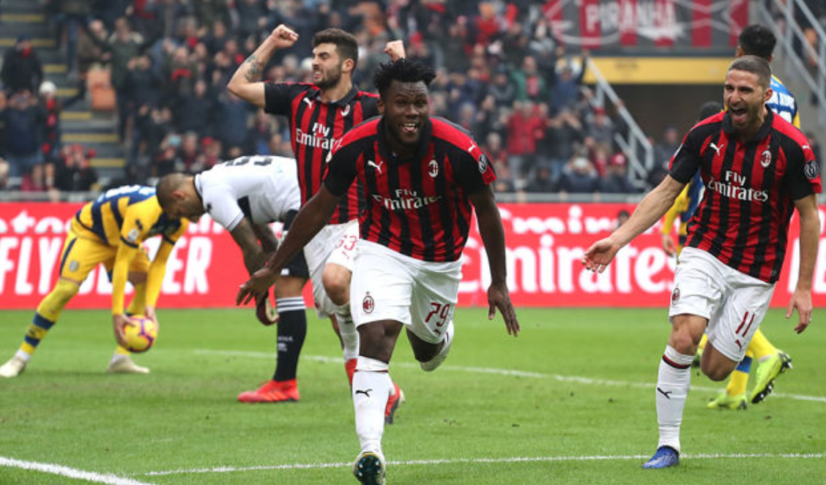







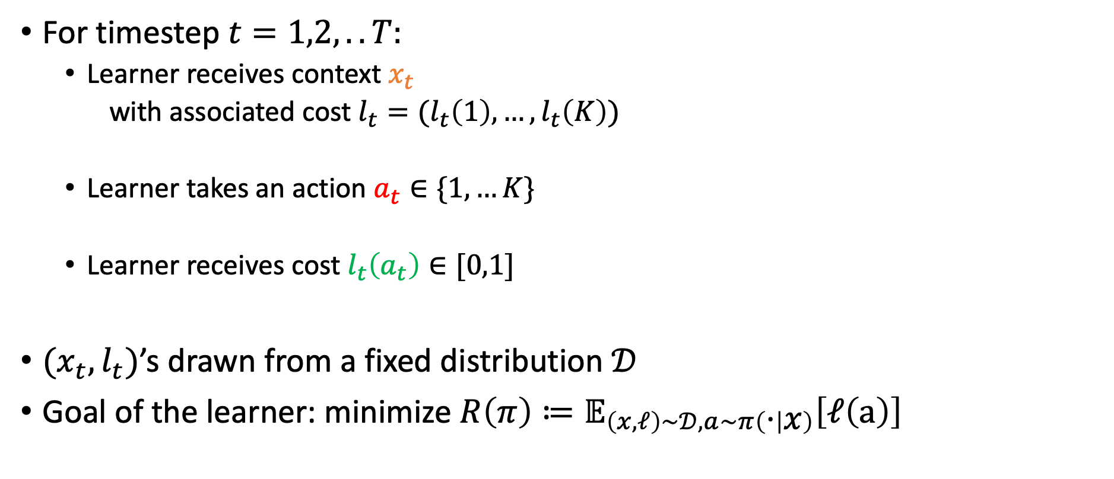




Contextual bandits
For timestep $t=1,2,..T:$
Learner receives context $x_{t}$
with associated cost $l_{t}=(l_{t}\left(1\right),…,l_{t}\left(K\right))$
Learner takes an action $a_{t}∈\{1,…K\}$
Learner receives cost $l_{t}\left(a_{t}\right)∈[0,1]$
$(x_{t}, l_{t})$’s drawn from a fixed distribution $𝒟$
Goal of the learner: minimize $R\left(π\right)≔𝔼_{\left(x,ℓ\right)∼𝒟,a∼π\left(⋅ | x\right)}\left[ℓ\left(a\right)\right]$
$$c_{t}$$
$$x_{t}$$
$$a_{t}$$
$$l_{t}(a_{t})$$
User
Learning algorithm
Slides modified from Chicheng Zhang’s presentation slides

Slide 5

Policy classes
Policy $π$: maps every $x$ to some action $π\left(x\right)∈\{1,…K\}$
Policy class $Π$: a structured collection of policies
E.g. {decision trees of depth 2}
$π^{∗}∈{argmin}_{π∈Π}R\left(π\right)$
Job = “programmer”?
Yes
No
Age > 50?
Yes
No
Slides modified from Chicheng Zhang’s presentation slides
Notes:
To help the learner make decisions, we assume the learner is given access to a set of policies. Each policy is a mapping from context to an action. As an example, the decision tree on the right looks into user’s job; if it is programmer, then the policy recommends tech article to the user; otherwise, it recommends other kinds of news based on the user’s other information.
A policy class is a structured collection of policies, for example, it can be all decision trees of depth 2.

Slide 6
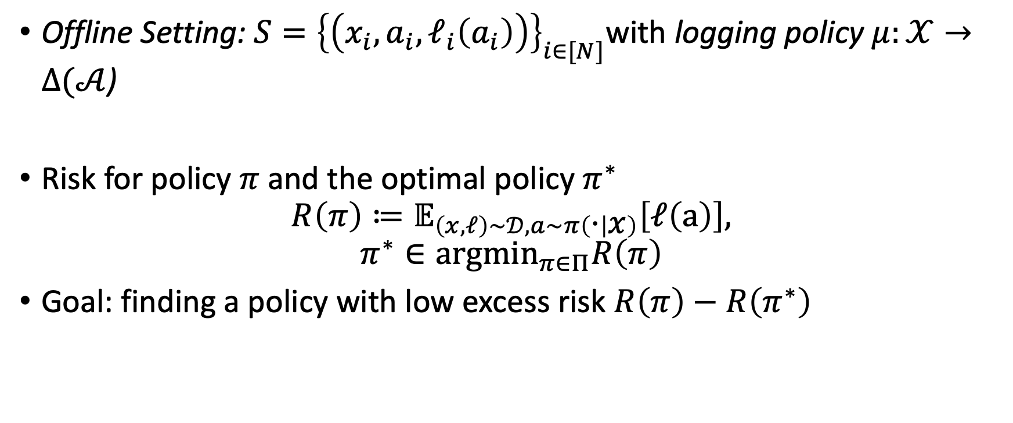
Offline Contextual Bandit
Offline Setting: $S={\left\{\left(x_{i},a_{i},ℓ_{i}\left(a_{i}\right)\right)\right\}}_{i∈[N]}$with logging policy $μ:𝒳→Δ(𝒜$)
Risk for policy $π$ and the optimal policy $π^{∗}$
$$R\left(π\right)≔𝔼_{\left(x,ℓ\right)∼𝒟,a∼π\left(⋅ | x\right)}\left[ℓ\left(a\right)\right],$$
$$π^{∗}∈{argmin}_{π∈Π}R\left(π\right)$$
Goal: finding a policy with low excess risk $R\left(π\right)−R\left(π^{∗}\right)$

Slide 7
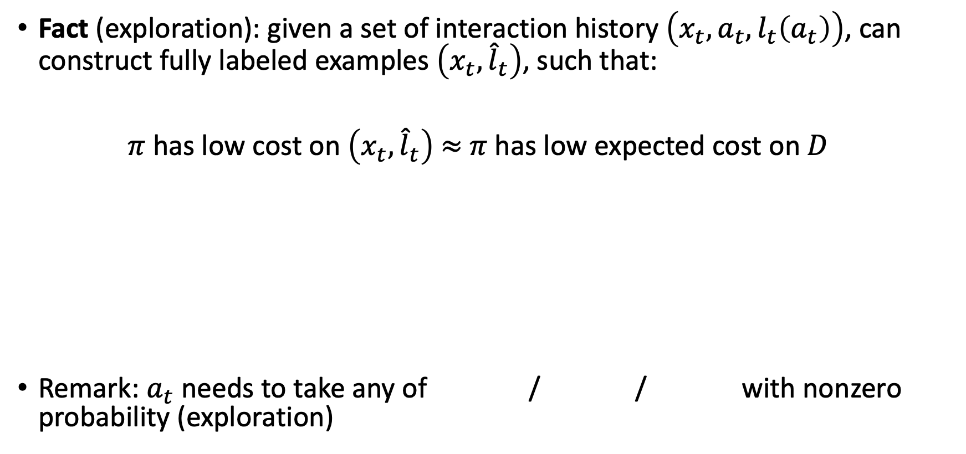
Transforming contextual bandit examples to fully supervised
Fact (exploration): given a set of interaction history $\left(x_{t}, a_{t}, l_{t}\left(a_{t}\right)\right)$, can construct fully labeled examples $\left(x_{t}, {\hat{l}}_{t}\right)$, such that:
$π$ has low cost on $\left(x_{t}, {\hat{l}}_{t}\right)$ $≈$ $π$ has low expected cost on $D$
Remark: $a_{t}$needs to take any of / / with nonzero probability (exploration)
Cost-sensitive classification (CSC) problem
Slides modified from Chicheng Zhang’s presentation slides
Notes:
How do we transform a contextual bandit example to a fully supervised example? It turns out that there are standard ways in previous work that does this transformation. Given a set of interaction history, we can use them to construct fully labeled examples, such that if a policy has a low cost on the fully labeled set, it will also have a low cost on the examples in the interaction stage.
However, the conversion comes with a price: each time, the action taken must explore all possible actions with nonzero probability – this is also called exploration.

Slide 8

Preliminaries
Computational oracle
Algorithm for some hard but well-studied problem
Given dataset $\left(x_{i},a_{i},ℓ_{i}\right),i∈\left[N\right],$ it can be converted to a cost-sensitive classification (CSC) problem
An oracle solves CSC problem
Limited number of calls
Policy learning algorithm
Oracle
(solves CSC problem)
Oracle efficient algorithm
Notes:
Off-set tree for learning with partial labels

Slide 9



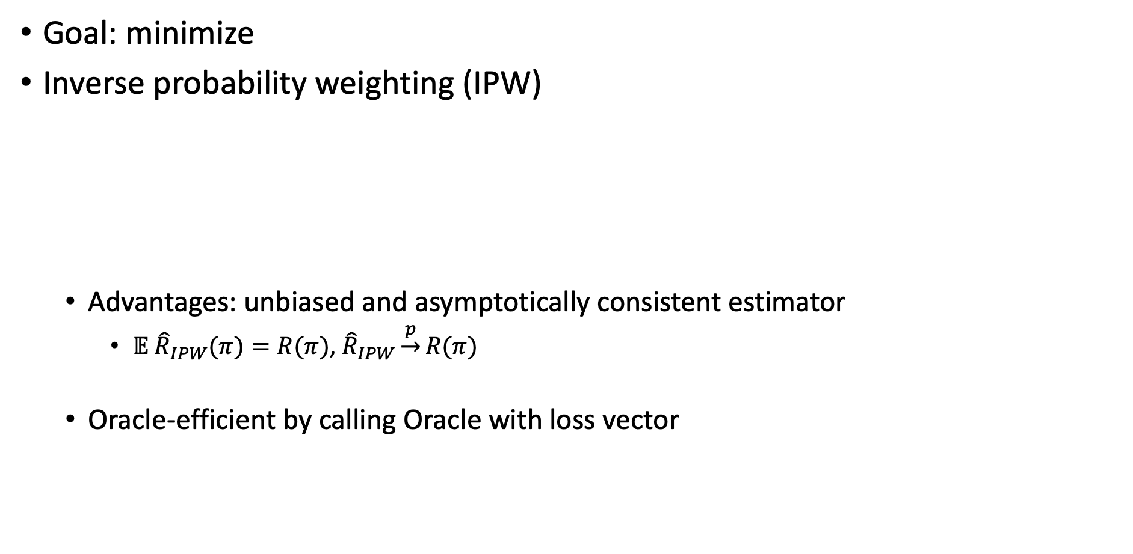
Naïve Solution: IPW
Goal: minimize
Inverse probability weighting (IPW)
Advantages: unbiased and asymptotically consistent estimator
$𝔼 {\hat{R}}_{IPW}(π)=R(π)$, ${\hat{R}}_{IPW}\underset{→}{p}R(π)$
Oracle-efficient by calling Oracle with loss vector
$$R\left(π\right)≔𝔼_{\left(x,ℓ\right)∼𝒟,a∼π\left(⋅ | x\right)}\left[ℓ\left(a\right)\right]$$

Slide 10
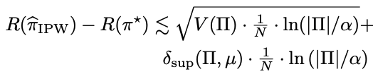

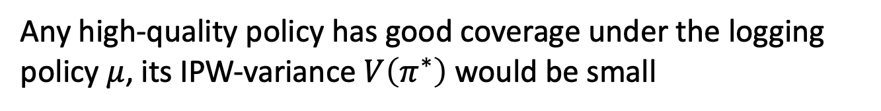
Known Issue of IPW: Distribution Shift
For any
Any high-quality policy has good coverage under the logging policy $μ$, its IPW-variance $V\left(π^{∗}\right)$ would be small
But a low quality policy with large variance can significantly degrade the finite sample performance

Slide 11





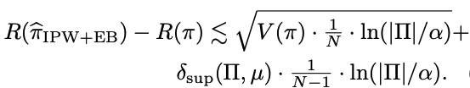

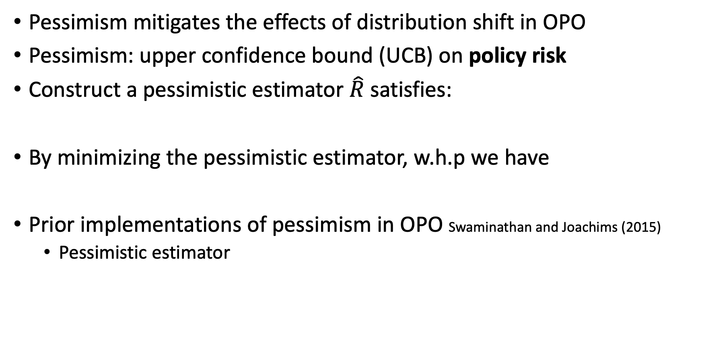
Known Fix: Pessimism
Pessimism mitigates the effects of distribution shift in OPO
Pessimism: upper confidence bound (UCB) on policy risk
Construct a pessimistic estimator $\hat{R}$ satisfies:
By minimizing the pessimistic estimator, w.h.p we have
Prior implementations of pessimism in OPO Swaminathan and Joachims (2015)
Pessimistic estimator
sample variance:
Better excess risk:

Slide 12


Computational Inefficiency of the Known Fix
Does not decompose across data points so it is not amenable to streaming or stochastic optimization methods
Yields a non-convex landscape with a differentiable policy class
Does not support non-differentiable policy classes except in highly specialized cases
Non-differentiable policy example: train a regression model
and induce the policy
Contribution of this paper: a computationally efficient algorithm with relatively good statistical guarantee

Slide 13
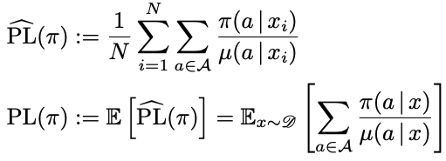

Method: Pseudo-loss
Optimization objective

Slide 14
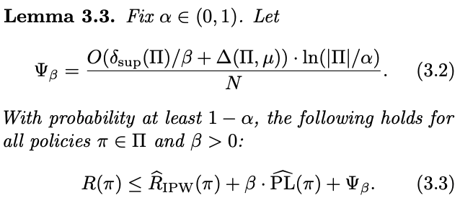

PL Implements Pessimism
The new risk estimator plus policy irrelevant term is the UCB of the policy risk
new risk estimator
policy irrelevant constant
Adding does not change the policy optimization result

Slide 15
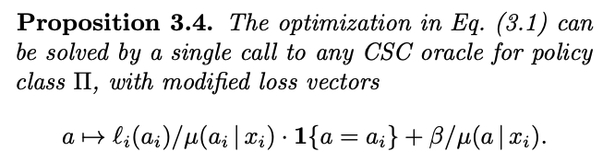
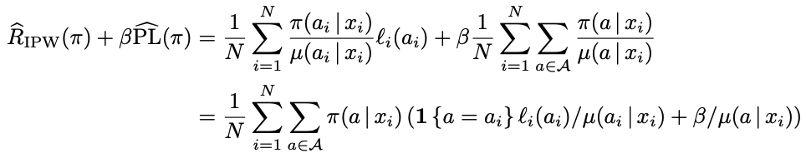
Oracle-efficient Implementation
In the loss vector, the actions with lower behavior density have a higher cost
Proof:

Slide 16
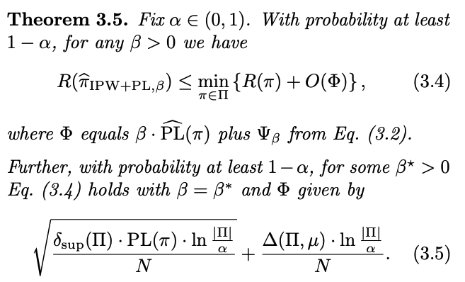

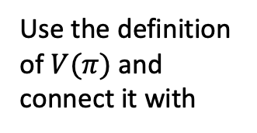
Performance Guarantees
Use the definition of $V(π)$ and connect it with
3
Suboptimality gap:
1
2
Comparison with previous method:
1
>=
2
4
3
>=
4
by the definition
The guarantee is worse than the previous method

Slide 17
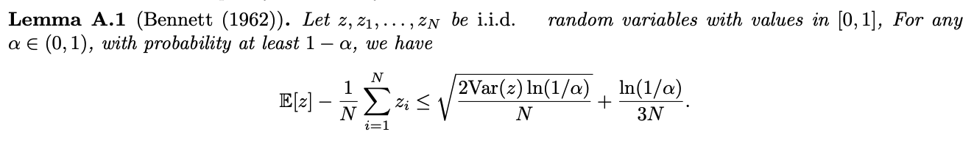
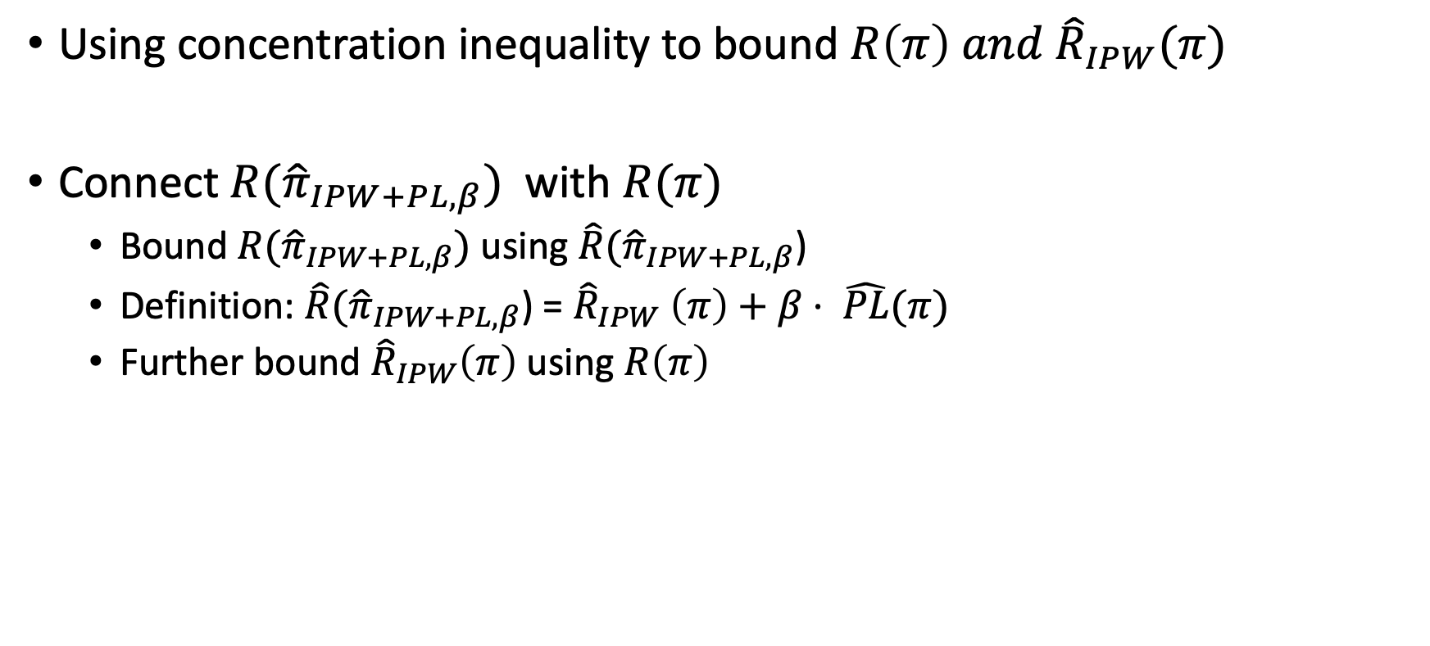

Proof Sketch
Using concentration inequality to bound $R\left(π\right) and {\hat{R}}_{IPW}(π)$
Connect $R({\hat{π}}_{IPW+PL,β})$ with $R(π)$
Bound $R({\hat{π}}_{IPW+PL,β})$ using $\hat{R}({\hat{π}}_{IPW+PL,β}$)
Definition: $\hat{R}({\hat{π}}_{IPW+PL,β}$) = ${\hat{R}}_{IPW} \left(π\right)+β⋅ \hat{PL}(π)$
Further bound ${\hat{R}}_{IPW}\left(π\right)$using $R\left(π\right)$
$𝔼 {\hat{R}}_{IPW}(π)=R(π)$
Bernstein inequality

Slide 18
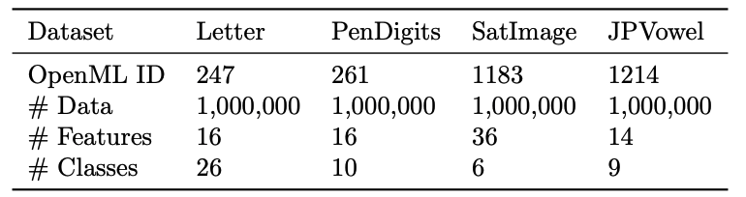
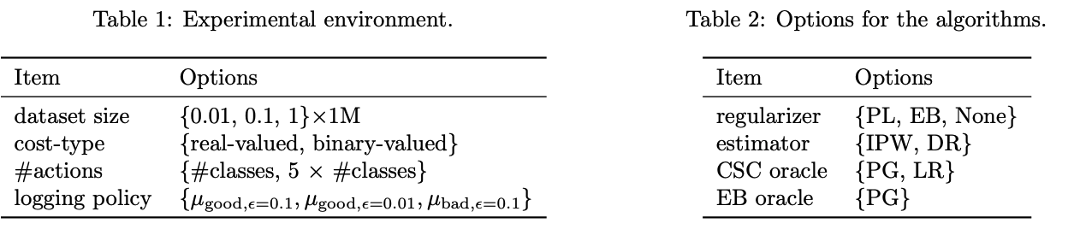
Empirical Evaluation
Experimental setup
Simulate offline contextual bandit instances from full-information classification datasets (This semi-synthetic setup gives us the ground-truth for evaluation)
multi-class classification

Slide 19
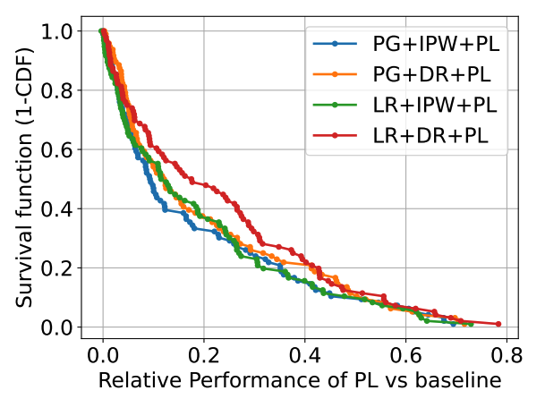

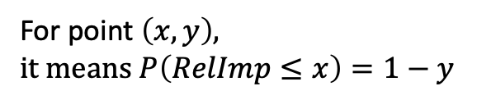
Results
Comparison with vanilla OPO with no pessimism
Comparison with EB method
EB offers median RelImp of 19.1% for the configurations where it is applicable
PG optimizer for EB is an order of magnitude slower than PL
The median RelImp is 11.7%. In our experiments, PL was, essentially, never worse than the no-pessimism baseline.
For point $\left(x, y\right), it means P\left(RelImp≤x\right)=1−y$

Slide 20

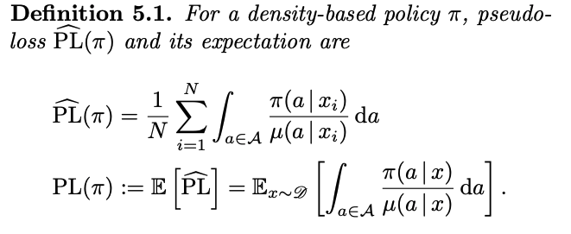
Extension: Continuous Actions
One-dimensional continuous action space
Challenge: CSC algorithms typically can only handle finitely many actions

Slide 21






Continuous Actions: Smoothing Trick
Mass-based policies over $K$ actions denoted as
Surrogate actions
Density-based policies
Optimize the PL-based objective
H: the bandwidth of smoothing

Slide 22
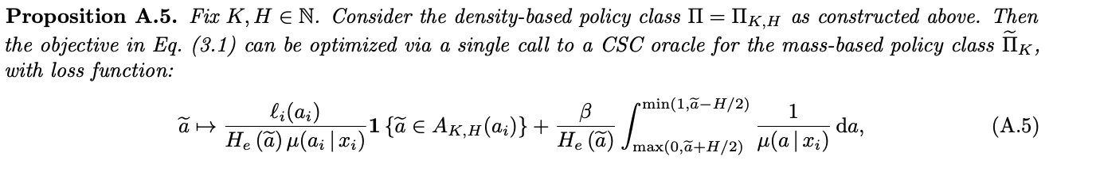
Continuous Actions: Performance Guarantee

Slide 23
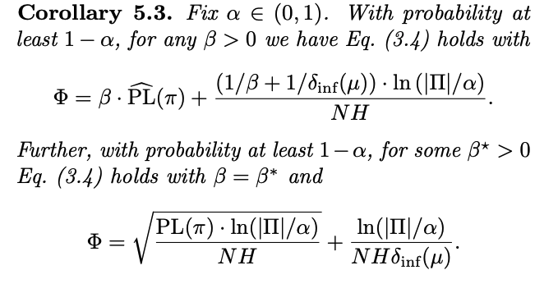
Continuous Actions: Performance Guarantee

Slide 24
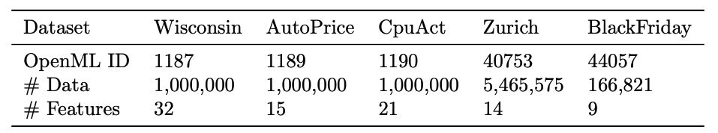

Empirical Evaluation
Simulate bandit instances using 5 regression datasets from OpenML

Slide 25
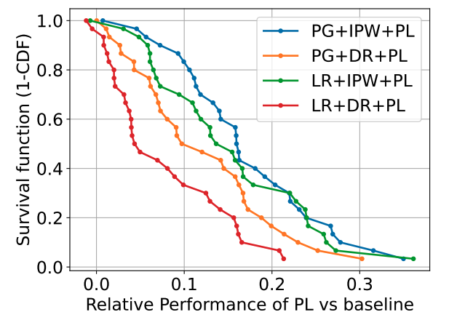
Results
Comparison with vanilla OPO with no pessimism
Comparison with EB method
on configurations when EB is applicable, EB offers a median RelImp of 25.2%, while PL offers a median RelImp of 15.8%
The median RelImp is 12% and we see improvement in 97.5% of the experimental conditions
For point $\left(x, y\right), it means P\left(RelImp≤x\right)=1−y$

Slide 26
Conclusion
A new pessimistic approach for offline policy optimization in contextual bandits based on the pseudo-loss (PL) regularizer
Favorable balance between computational complexity and statistical performance

