Slide 1
CSC 696H: Topics in Reinforcement Learning Theory
Chicheng Zhang
University of Arizona

Slide 2
Logistics info
Instructor: Chicheng Zhang (chichengz@cs.arizona.edu)
Class meeting time & venue: TuTh 3:30pm-4:45pm, Cesar E. Chavez Building 305
Lectures will be video-recorded
Class website: https://zcc1307.github.io/courses/csc696fa21/

Slide 3







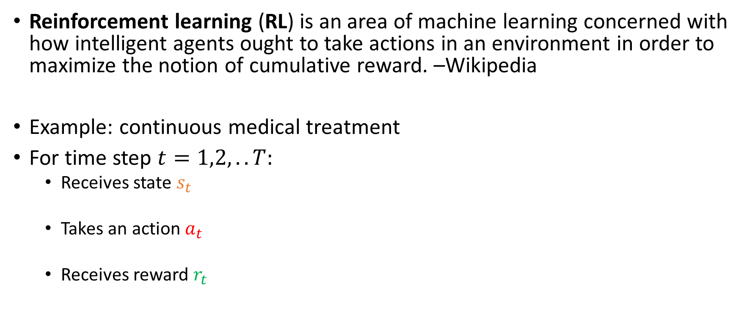


What is reinforcement learning?
Reinforcement learning (RL) is an area of machine learning concerned with how intelligent agents ought to take actions in an environment in order to maximize the notion of cumulative reward. –Wikipedia
Example: continuous medical treatment
For time step $t=1,2,..T:$
Receives state $s_{t}$
Takes an action $a_{t}$
Receives reward $r_{t}$
$$s_{t}$$
$$a_{t}$$
$$r_{t}$$
Patient
$$s_{t+1}$$
Learner
……

Slide 4

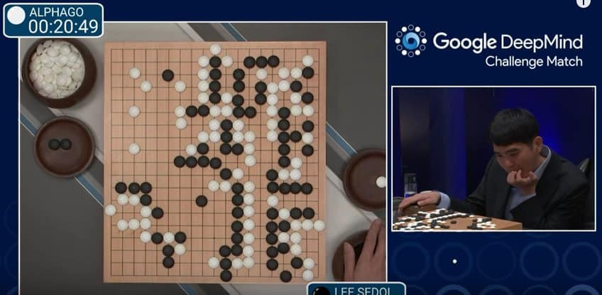

Other applications of RL
Robotics manipulation
Game playing
Conversational assistant
Advertising, autonomous driving, …

Slide 5
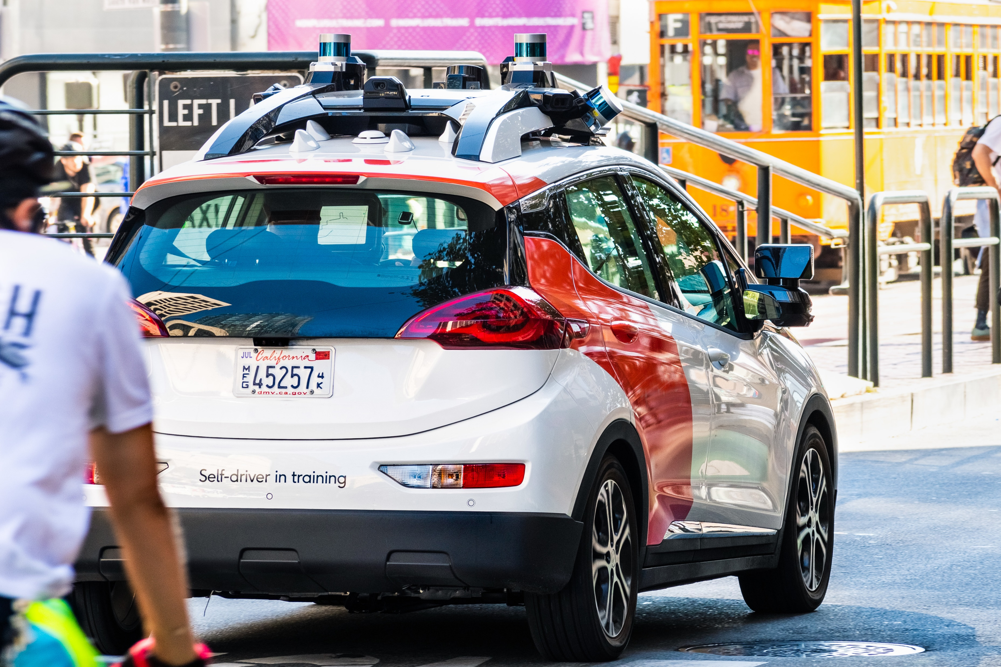
What this course is about
Study the design and analysis of RL algorithms with formal performance guarantees, using rigorous mathematical tools
Key performance measures:
Online regret
Sample complexity
Computational complexity
This course will not cover deep reinforcement learning, an important topic on its own
Assignments will mostly be proof-based; no programming assignments

Slide 6
Topics covered
Part 1: lectures
Markov Decision Processes (MDPs)
Dynamic programming and Bellman equation
Planning algorithms for tabular MDPs
Sample complexity results for RL with a generative model
Exploration in RL: tabular and function approximation settings
(If time permits) Policy optimization, offline RL, …
Part 2: student presentations
(Your choice of RL theory paper, from the course website, or upon my approval)

Slide 7
Prerequisite knowledge
Basic multivariate calculus
Linear algebra
Probability
Basic programming
Additional knowledge that can be useful (not strictly required):
Reinforcement learning
Machine learning theory
Stochastic processes
Algorithm design analysis
Optimization
…

Slide 8
Evaluations
Homework: 30% (two HWs)
Class participation: 10%
Scribe note taking: 10% (in LaTeX, will not be graded but will be given credit)
Paper presentation: 50%
See more details in the syllabus

Slide 9
Paper presentation: best practices
Choose a relevant RL theory paper
Start with the suggested papers on the course website
Long and technical papers? Try reading it in different passes with different levels of detail
Clarity
Spend some time defining the problem
Avoid presenting unnecessary technical details – present the core of the algorithm / analysis
You can do a whiteboard presentation or use slides
Goal: teach your classmates and me something new (10%-90% rule)

Slide 10
An overview of RL from a machine learning perspective
(largely based on slides of Nan Jiang, Chi Jin, Alekh Agarwal, Akshay Krishnamurthy, John Langford, Wen Sun)

Slide 11

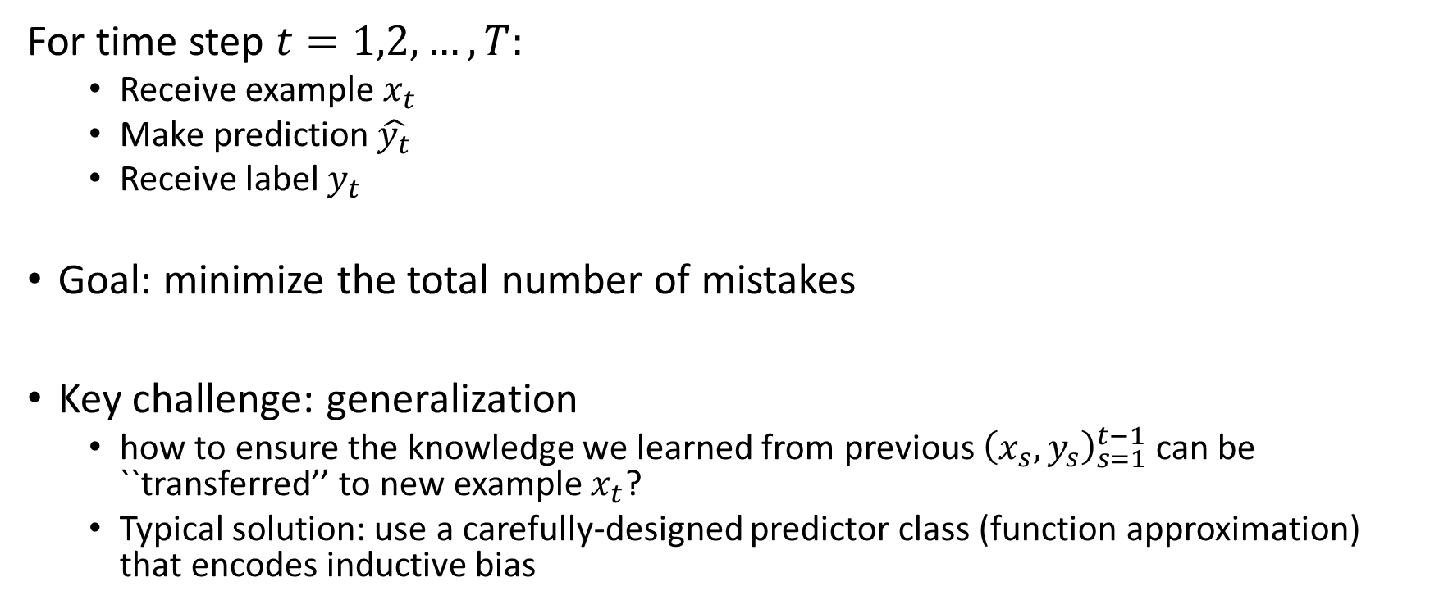
Paradigm: online supervised learning
For time step $t=1,2,…,T:$
Receive example $x_{t}$
Make prediction $\hat{y_{t}}$
Receive label $y_{t}$
Goal: minimize the total number of mistakes
Key challenge: generalization
how to ensure the knowledge we learned from previous ${\left(x_{s},y_{s}\right)}_{s=1}^{t−1}$ can be ``transferred’’ to new example $x_{t}$?
Typical solution: use a carefully-designed predictor class (function approximation) that encodes inductive bias

Slide 12


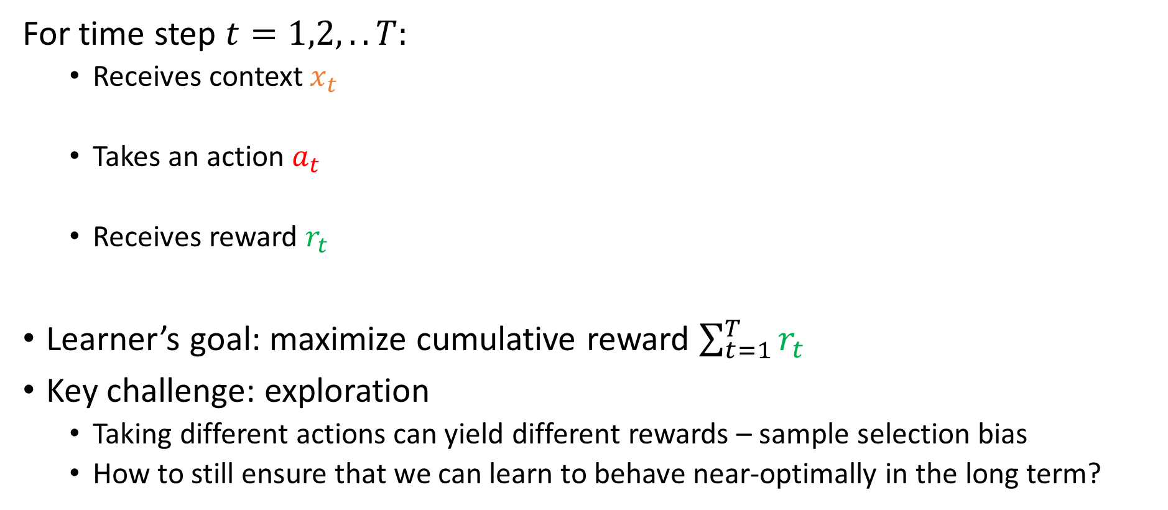


Paradigm: online bandit learning
For time step $t=1,2,..T:$
Receives context $x_{t}$
Takes an action $a_{t}$
Receives reward $r_{t}$
Learner’s goal: maximize cumulative reward $\sum_{t=1}^{T}{r_{t}}$
Key challenge: exploration
Taking different actions can yield different rewards – sample selection bias
How to still ensure that we can learn to behave near-optimally in the long term?
$$x_{t}$$
$$a_{t}$$
$$r_{t}$$
Patient
Learner
Notes:
In the intro, we’ve already seen the setup of contextual bandit learning. Let’s review it again here.
At each timestep, the learner sees a context, and takes an action based on it. For example, in news recommendation, algorithm sees a user’s profile, for example her location, browsing history, and tries to recommend a category of news that the user likes most. The learner then incurs a cost. In the news example, the cost depends on the user’s reaction to the recommendation, for example if she likes it she would click it. We also assume that each user has an underlying cost vector, which encodes the cost incurred by the learner if other possible actions are taken.
This talk, we assume that the context and cost pair is drawn from a fixed distribution. The goal of the learner is to incur low cumulative cost, or achieve best user satisfaction in the news example.
Usually there is a tradeoff

Slide 13




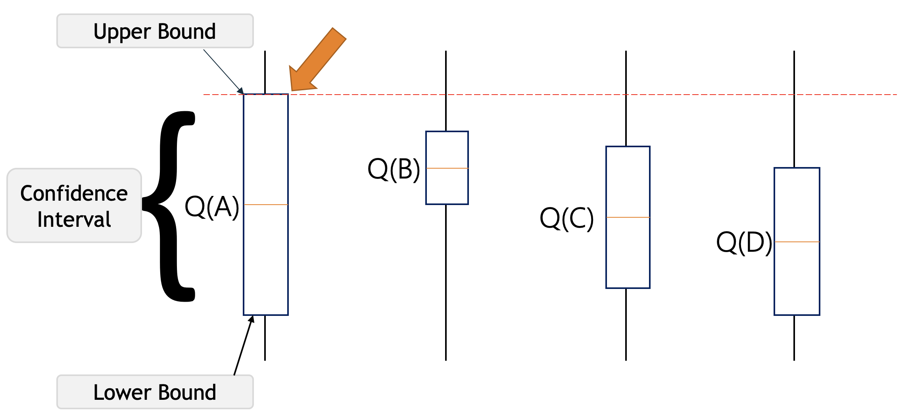
Paradigm: online bandit learning (cont’d)
Multi-armed bandits: a basic model for studying exploration-exploitation tradeoff
Example: where should I go for lunch?
Typical solution: confidence bound
based exploration

Slide 14
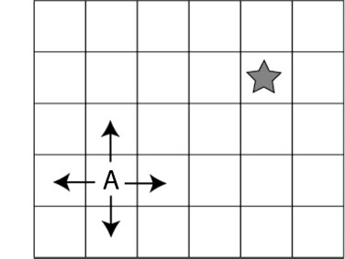
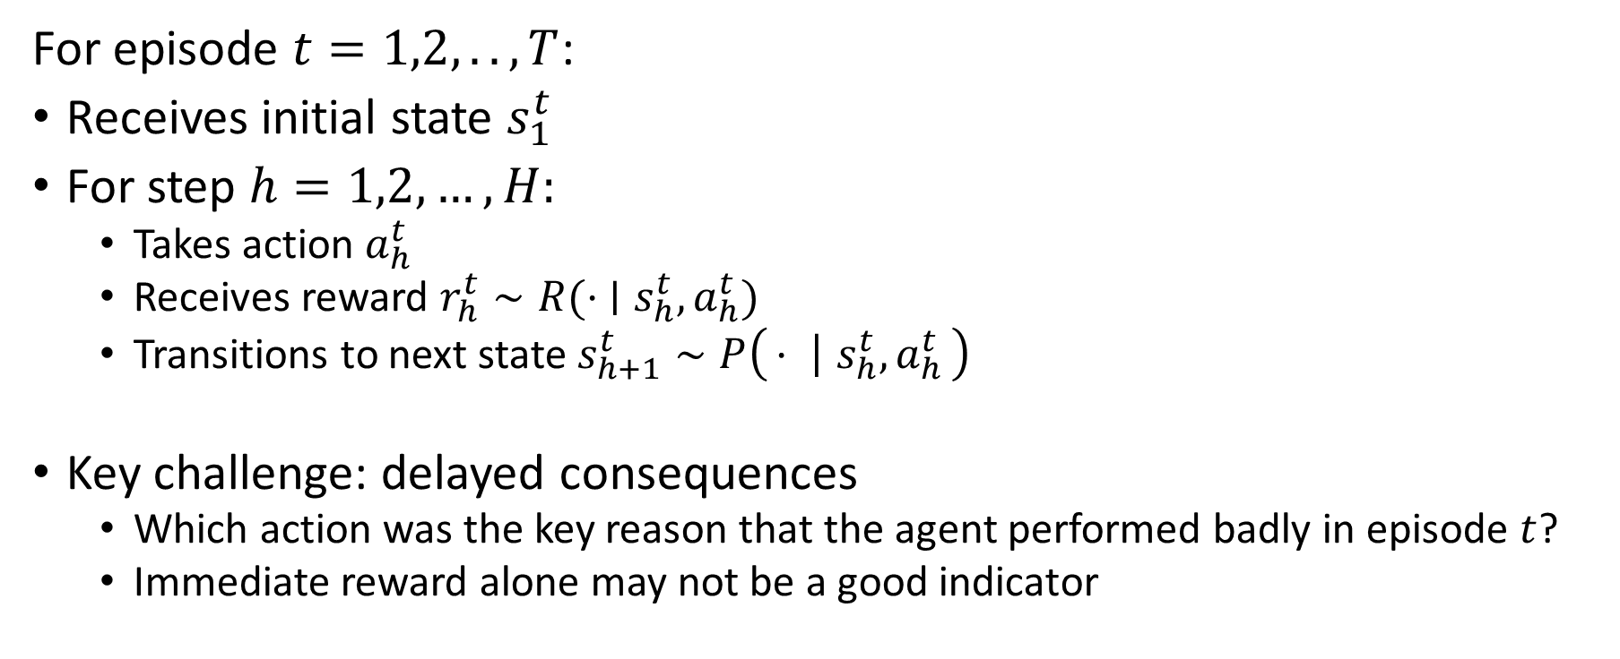
Paradigm: online episodic RL
For episode $t=1,2,..,T$:
Receives initial state $s_{1}^{t}$
For step $h=1,2,…,H:$
Takes action $a_{h}^{t}$
Receives reward $r_{h}^{t}∼R(⋅ ∣s_{h}^{t}, a_{h}^{t})$
Transitions to next state $s_{h+1}^{t}∼P\left(⋅ ∣ s_{h}^{t}, a_{h}^{t}\right)$
Key challenge: delayed consequences
Which action was the key reason that the agent performed badly in episode $t$?
Immediate reward alone may not be a good indicator

Slide 15
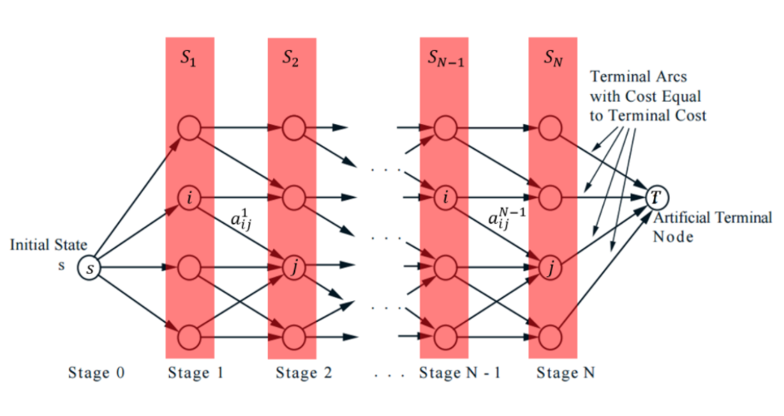
Paradigm: online episodic RL (cont’d)
Typical solution to address the delayed consequence issue:
For each (state, action) pair, calculate its optimal value – the best possible expected reward one can get starting from it
Use optimal values to guide learning
Compute optimal value by dynamic programming

Slide 16
RL challenges: summary
Generalization
Ideally: tackle all three challenges simultaneously
RL with simulators,
Offline RL, ..
Contextual bandits
Delayed consequences
Exploration
Discrete state-action
(tabular) RL

Slide 17
Thank you!

