Slide 1
Improved algorithms for efficient active learning halfspaces with Massart and Tsybakov noise
Chicheng Zhang
University of Arizona
Joint work with Yinan Li (University of Arizona)

Slide 2
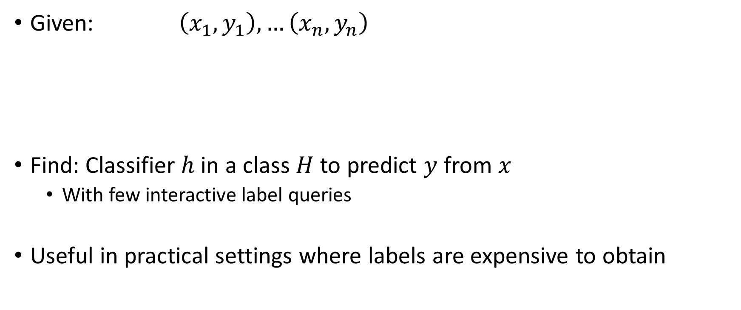
Active learning for classification
Given: $\left(x_{1},y_{1}\right),…\left(x_{n},y_{n}\right)$
Find: Classifier $h$ in a class $H$ to predict $y$ from $x$
With few interactive label queries
Useful in practical settings where labels are expensive to obtain
features
interactive label queries
Notes:
In active learning, the learning algorithm is not directly given a set of examples at the beginning. Instead, it is given a set of unlabeled examples (for instance, a collection of images from the Internet), and is allow to ask a labeler for the label of the examples in an interactive manner.
For example, suppose the learner asks about the label of this image, and it turns out to be a cat, and next one, also a cat, next one, also a cat.. Then it outputs a line that it thinks that can separate cats from dogs.

Slide 3
Outline
Active learning halfspaces with noise
The algorithm
Conclusion and open problems

Slide 4
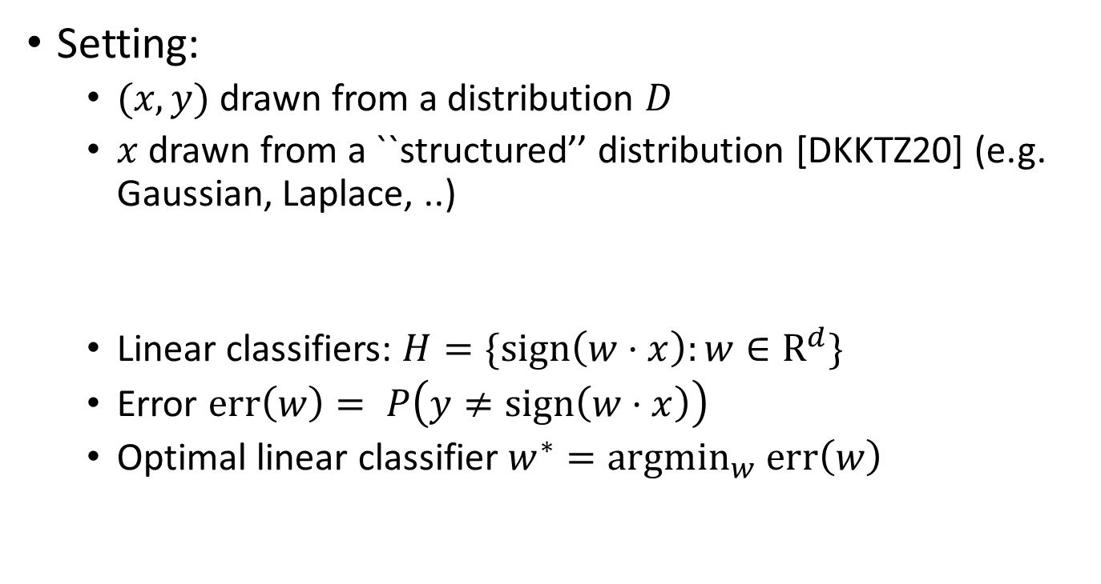




Active learning in the PAC model [V84,BBL06]
Setting:
$(x,y)$ drawn from a distribution $D$
$x$ drawn from a ``structured’’ distribution [DKKTZ20] (e.g. Gaussian, Laplace, ..)
Linear classifiers: $H=\{sign\left(w⋅x\right):w∈R^{d}\}$
Error $err\left(w\right)= P\left(y≠sign\left(w⋅x\right)\right)$
Optimal linear classifier $w^{∗}={argmin}_{w}$ $err\left(w\right)$
$$w^{∗}$$
$$+$$
$$w$$
$$−$$
Notes:
Specifically, we look at the setting where the labeled examples comes from a distribution; the distribution of the unlabeled examples is uniform over the unit ball.
We consider learning a linear classifier that separates the positive examples from the negative examples (e.g. separating cats from dogs) Linear classifiers can be thought of a generalization of threshold, where it is represented by a hyperplane. On one side, we predict +1, on the other side, we predict -1. We use the normal vector of its decision boundary to represent a linear classifier. The best linear classifier is the one that has the smallest error rate on the data distribution.

Slide 5
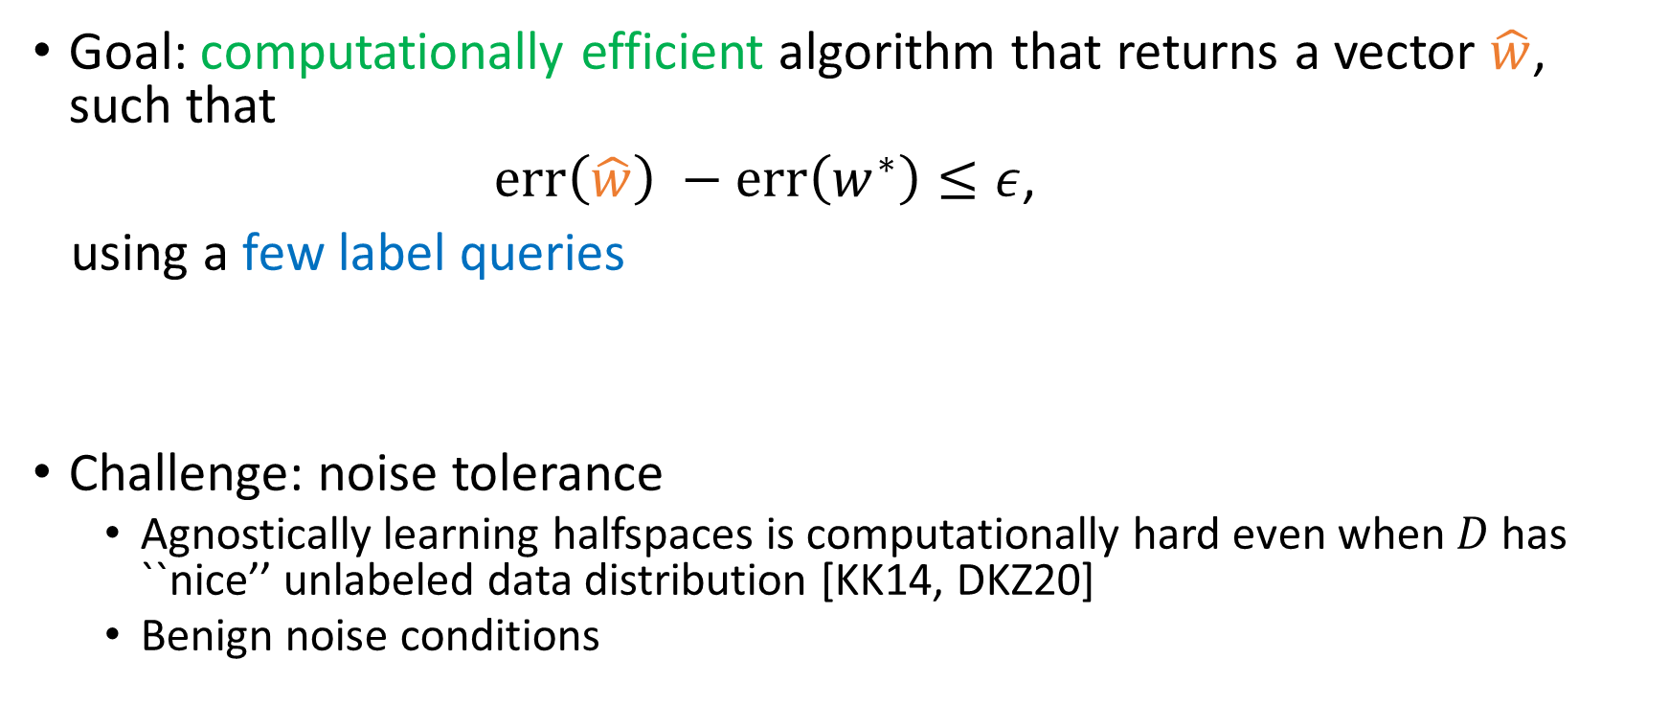




Active learning in the PAC model [V84,BBL06]
Goal: computationally efficient algorithm that returns a vector $\hat{w}$, such that
$err\left(\hat{w}\right) −err\left(w^{∗}\right)≤ε$,
using a few label queries
Challenge: noise tolerance
Agnostically learning halfspaces is computationally hard even when $D$ has ``nice’’ unlabeled data distribution [KK14, DKZ20]
Benign noise conditions
$$+$$
$$\hat{w}$$
$$w^{∗}$$
$$−$$
Notes:
Our goal is to develop a computationally efficient algorithm, such that it returns a linear classifier w hat, which has error at most the error of the best, plus some slack parameter epsilon. In addition, we would like to use as few label queries as possible.
[FGKP06, GR06, D16],

Slide 6


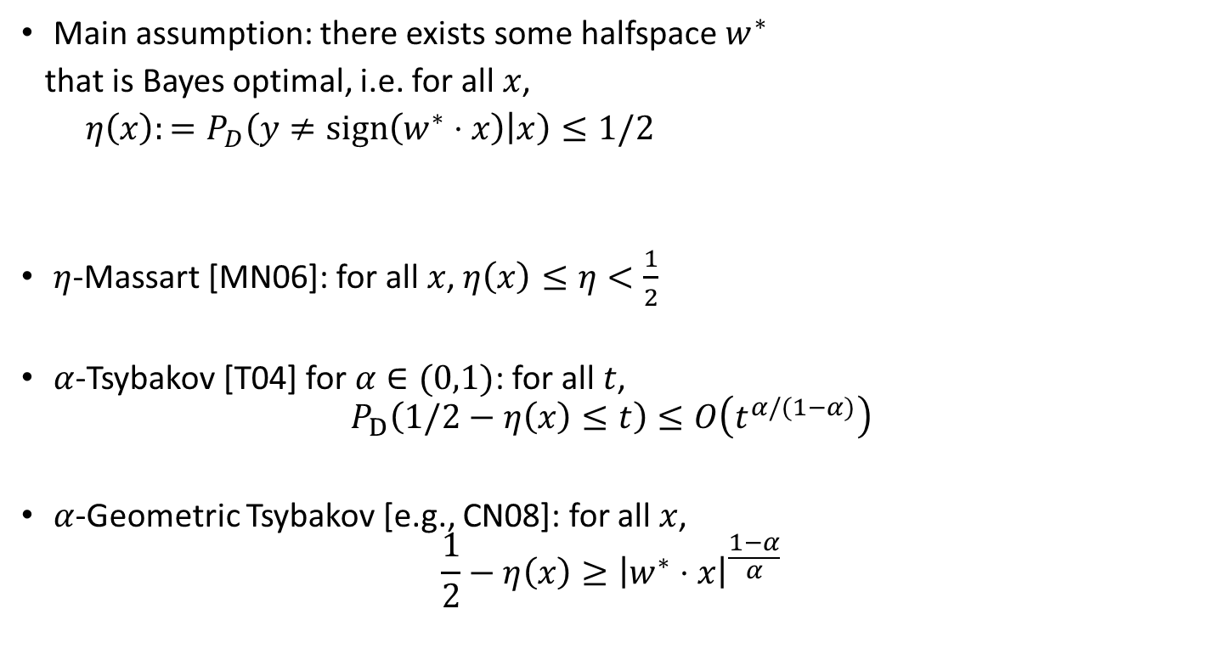










Learning halfspaces under benign noise
$$P(y=1∣x)$$
Main assumption: there exists some halfspace $w^{∗}$
that is Bayes optimal, i.e. for all $x$,
$η\left(x\right):=P_{D}\left(y≠sign\left(w^{∗}⋅x\right) | x\right)≤1/2$
$η$-Massart [MN06]: for all $x$, $η\left(x\right)≤η<\frac{1}{2}$
$α$-Tsybakov [T04] for $α∈(0,1)$: for all $t$,
$$P_{D}\left(1/2−η\left(x\right)≤t\right)≤O\left(t^{α/(1−α)}\right)$$
$α$-Geometric Tsybakov [e.g., CN08]: for all $x$,
$$\frac{1}{2}−η\left(x\right)≥{\left|w^{∗}⋅x\right|}^{\frac{1−α}{α}}$$
$$0.5$$
$$⟨w^{∗},x⟩$$
$$P(y=1∣x)$$
$$P(y=1∣x)$$
$$1−η$$
$$0.5$$
$$0.5$$
$$η$$
$$⟨w^{∗},x⟩$$
$$⟨w^{∗},x⟩$$
Notes:
It turns out that under this noise model, the optimal classifier is this w^*, so this is consistent with our optimal linear classifier notation defined before.
TNC: we allow a fraction of examples to have label flipping prob arbitrarily close to ½, and this fraction is smaller for larger \alpha
GTNC: the label flipping probability is closer to ½ when the example is closer the decision boundary

Slide 7

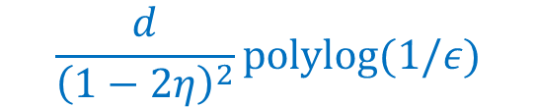

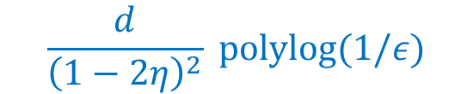



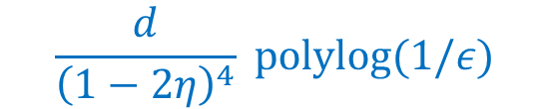

Main results - Massart noise
$$P(y=1∣x)$$
$$1−η$$
$$0.5$$
$$η$$
Such efficient and label-optimal results for learning Massart halfspaces were previously only known for uniform distribution [YZ17]
Our work significantly relaxed the distributional requirements
Some assumptions on unlabeled distribution seem necessary [CKMY20, DK20]
$$⟨w^{∗},x⟩$$
Algorithm
Efficient?
Label complexity in $\tilde{O}$
$$\frac{d}{{\left(1−2η\right)}^{2}}polylog(1/ε)$$
[BL13]
No
$$\frac{d}{{\left(1−2η\right)}^{4}} polylog(1/ε)$$
[ZSA20]
Yes
$$\frac{d}{{\left(1−2η\right)}^{2}} polylog(1/ε)$$
This work
Yes

Slide 8



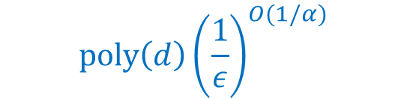




Main results – Tsybakov noise
$$P(y=1∣x)$$
$$0.5$$
$$⟨w^{∗},x⟩$$
Our label complexity results improve over passive learning for a range of $α$ values
Algorithm
Efficient?
Label complexity in $\tilde{O}$
$$d{\left(\frac{1}{ε}\right)}^{2−2α}$$
[BL13]
No
$$poly\left(d\right){\left(\frac{1}{ε}\right)}^{O(1/α)}$$
[DKKTZ20]
Yes
$$d{\left(\frac{1}{ε}\right)}^{\frac{2−2α}{2α−1}}$$
This work $(α∈\left(\frac{1}{2},1\right])$
Yes
$$d{\left(\frac{1}{ε}\right)}^{\frac{2−2α}{α}}$$
This work (Geometric Tsybakov)
Yes
Notes:
, a feature not enjoyed by previous efficient algorithms

Slide 9
Outline
Active learning sparse halfspaces with noise
The algorithm
Conclusion and open problems

Slide 10



The algorithm: overview
Main idea: maintain iterate $\{w_{k}\}$ such that $θ\left(w_{k},w^{∗}\right)$ shrinks geometrically
// Initialization
$w_{1}←Initialize()$.
// Refinement
In phases $k= 1,2,..,k_{0}=log(1/ε):$
$w_{k+1}←Refine(w_{k}, 2^{−(k+1)})$.
Return $w_{k_{0}+1}$.
Acute initialization
Ensuring $w_{k}$ has angle $≤2^{−k}$ with $w^{∗}$

Slide 11

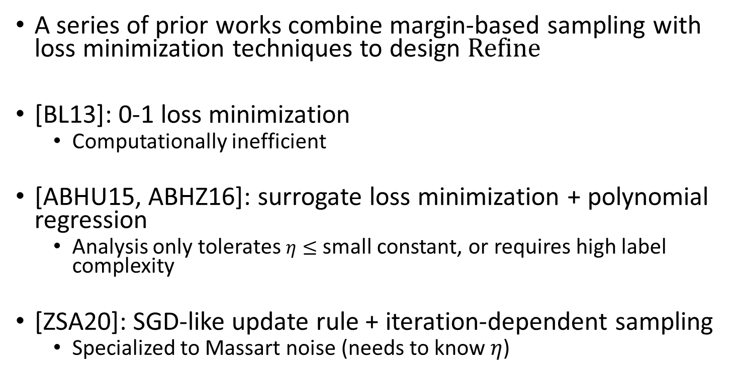



Refine: design challenges
$$w^{∗}$$
$$w_{k+1}$$
$$w_{k}$$
A series of prior works combine margin-based sampling with loss minimization techniques to design Refine
[BL13]: 0-1 loss minimization
Computationally inefficient
[ABHU15, ABHZ16]: surrogate loss minimization + polynomial regression
Analysis only tolerates $η≤$ small constant, or requires high label complexity
[ZSA20]: SGD-like update rule + iteration-dependent sampling
Specialized to Massart noise (needs to know $η$)
$$R_{k}$$

Slide 12





The algorithm: Refine
Input: halfspace $v_{1}$, target angle $θ$
Output: halfspace $v$ (that has angle $≤θ$ to $w^{∗}$)
For $t = 1,2,…,T$:
Sample: $(x_{t},y_{t})←$ example drawn from ${D|}_{B_{t}}$, where $B_{t}={ \{x:|v}_{t}⋅x|≤b\}\text{.}$
Update: $v_{t+1}←v_{t}−αg_{t}$, where $g_{t}=−y_{t}x_{t}$
Return average: $v←\frac{1}{T}\sum_{t=1}^{T}{v_{t}}$
$$w^{∗}$$
$$v_{t+1}$$
$$v_{t}$$
$$B_{t}$$
Key difference from [ZSA20]: simpler definition of $g_{t}$ leads to broader noise tolerance
Notes:
online mirror descent in general; can be online gradient descent when $s=d$ (similar to Perceptron)
Algorithmically similar to [GCB09, DKTZ20], but analysis very different
$Update\left(\right)$ $v_{t}−ηg_{t}$ $v_{t}−αg_{t}$

Slide 13
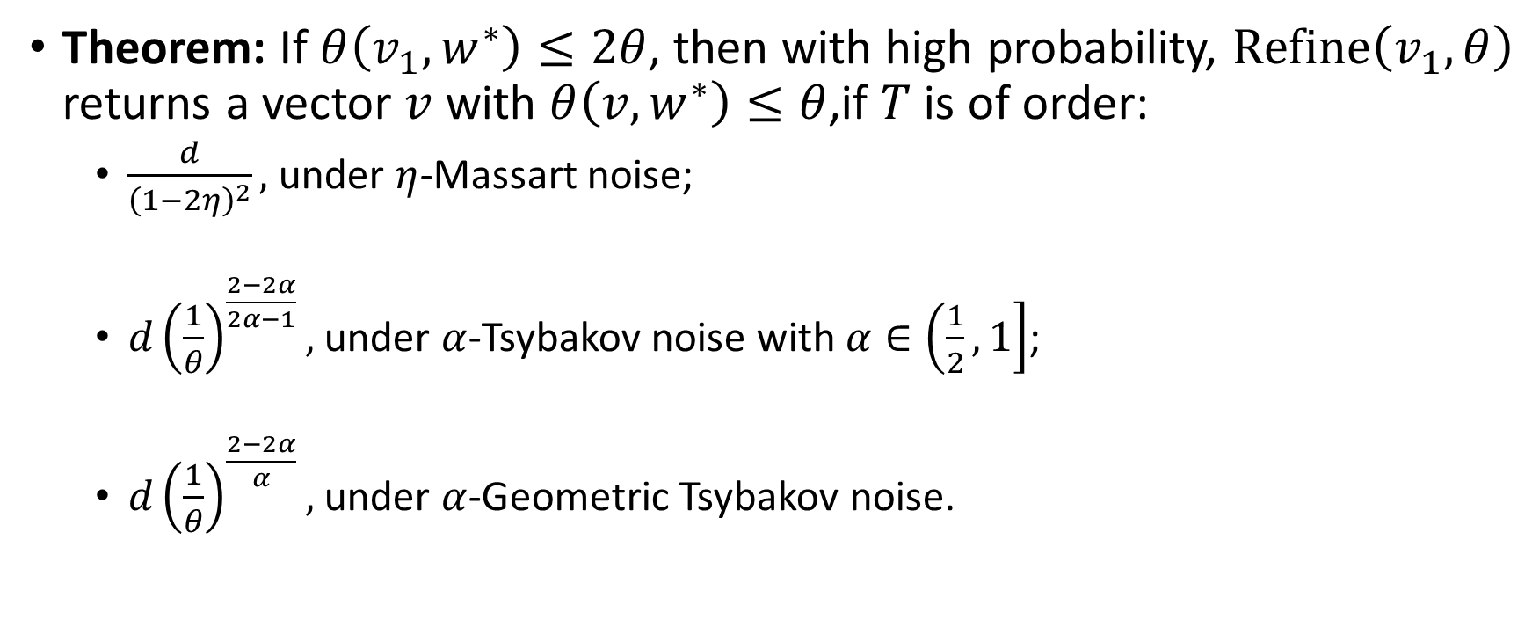
Refine: theoretical properties
Theorem: If $θ\left(v_{1},w^{∗}\right)≤2θ$, then with high probability, $Refine\left(v_{1}, θ\right)$ returns a vector $v$ with $θ\left(v,w^{∗}\right)≤θ$,if $T$ is of order:
$\frac{d}{{\left(1−2η\right)}^{2}},$under $η$-Massart noise;
$d{\left(\frac{1}{θ}\right)}^{\frac{2−2α}{2α−1}},$ under $α$-Tsybakov noise with $α∈\left(\frac{1}{2},1\right]$;
$d{\left(\frac{1}{θ}\right)}^{\frac{2−2α}{α}},$ under $α$-Geometric Tsybakov noise.
Notes:
Informally, $f_{w^{∗},θ}\left(w\right)$ is a ``proxy’’ of $θ\left(w,w^{∗}\right)$
$$ψ_{b}\left(w\right)=E \left[\left|w^{∗}⋅x\right|∣\left|w⋅x\right|≤b\right]$$
$T≅\left\{\begin{aligned}\frac{d}{{\left(1−2η\right)}^{2}}, under η−Massart noise \\ d{\left(\frac{1}{ε}\right)}^{\frac{2−2α}{2α−1}}, under α−Tsybakov noise \\ d{\left(\frac{1}{ε}\right)}^{\frac{2−2α}{α}},under α−Geometric Tsybakov noise\end{aligned}\right.$

Slide 14
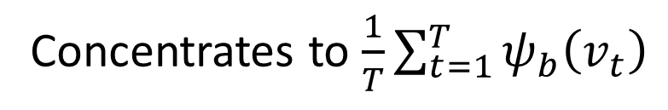
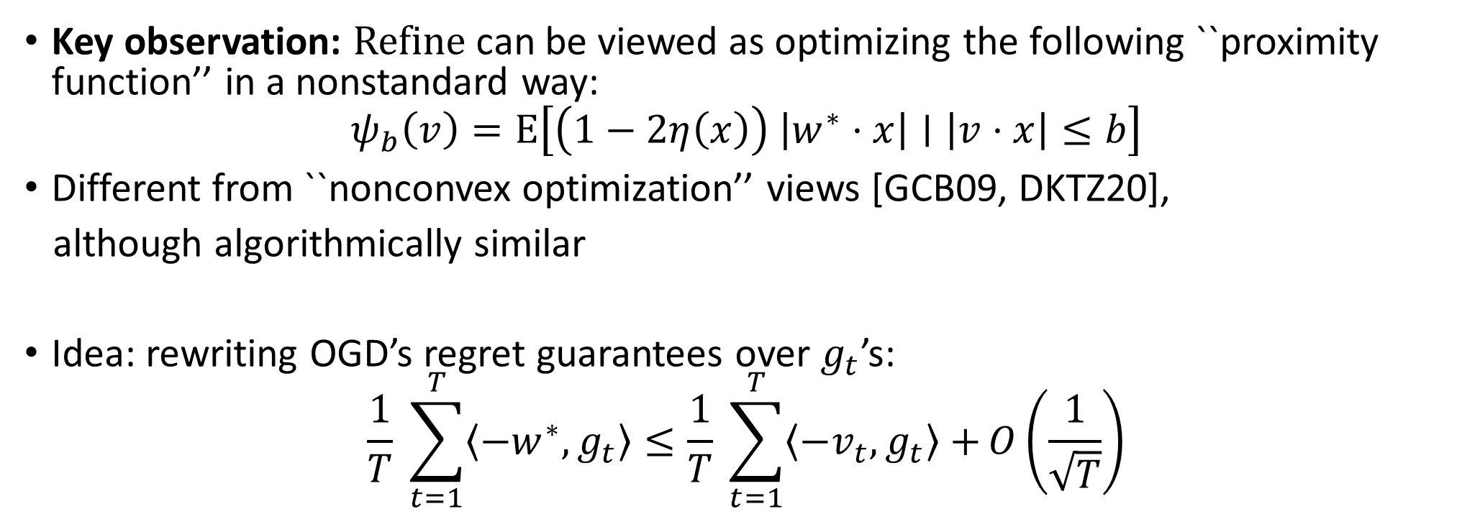
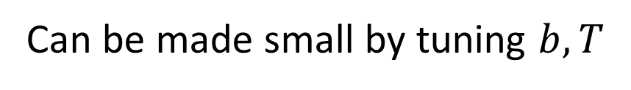



Refine: analysis
Key observation: Refine can be viewed as optimizing the following ``proximity function’’ in a nonstandard way:
$$ψ_{b}\left(v\right)=E\left[\left(1−2η\left(x\right)\right) \left|w^{∗}⋅x\right|∣\left|v⋅x\right|≤b\right]$$
Different from ``nonconvex optimization’’ views [GCB09, DKTZ20],
although algorithmically similar
Idea: rewriting OGD’s regret guarantees over $g_{t}$’s:
$$\frac{1}{T} \sum_{t=1}^{T}{\left\langle −w^{∗}, g_{t}\right\rangle }≤\frac{1}{T} \sum_{t=1}^{T}{\left\langle −v_{t}, g_{t}\right\rangle +}O\left(\frac{1}{\sqrt{T}}\right)$$
$$v$$
$$w^{∗}$$
$$b$$
Concentrates to $\frac{1}{T}\sum_{t=1}^{T}{ψ_{b}\left(v_{t}\right)}$
Can be made small by tuning $b, T$
Notes:
By rearranging the negative benchmark term to the left, and the negative cumulative loss term to the right

Slide 15
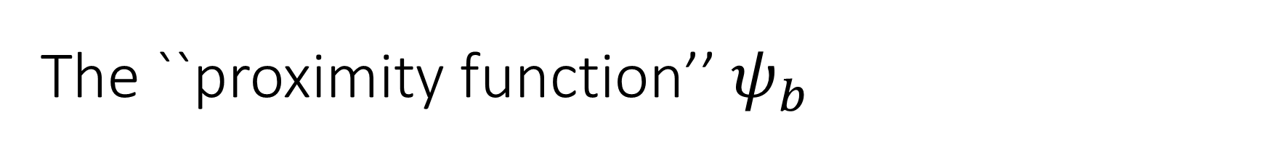
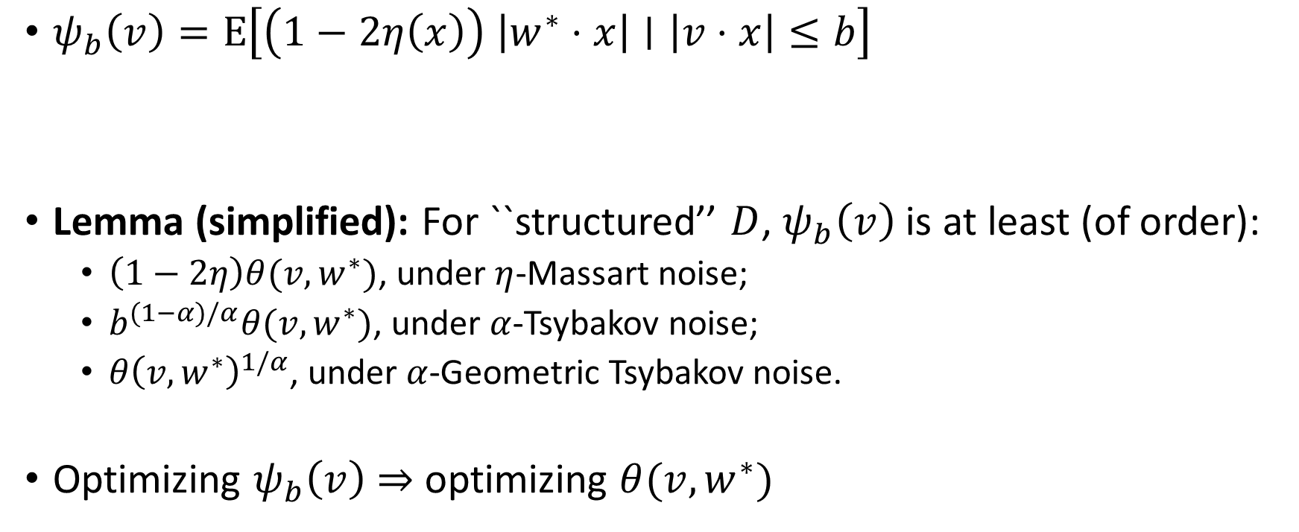
The ``proximity function’’ $ψ_{b}$
$$v$$
$$w^{∗}$$
$ψ_{b}\left(v\right)=E\left[\left(1−2η\left(x\right)\right) \left|w^{∗}⋅x\right|∣\left|v⋅x\right|≤b\right]$
Lemma (simplified): For ``structured’’ $D$, $ψ_{b}\left(v\right)$ is at least (of order):
$\left(1−2η\right)θ(v,w^{∗})$, under $η$-Massart noise;
$b^{(1−α)/α}θ(v,w^{∗})$, under $α$-Tsybakov noise;
$θ{\left(v,w^{∗}\right)}^{1/α}$, under $α$-Geometric Tsybakov noise.
Optimizing $ψ_{b}\left(v\right)$ $⇒$ optimizing $θ(v,w^{∗})$
$$b$$
Notes:
The proximity function can be lower bounded in terms of the angle between v and w^*

Slide 16
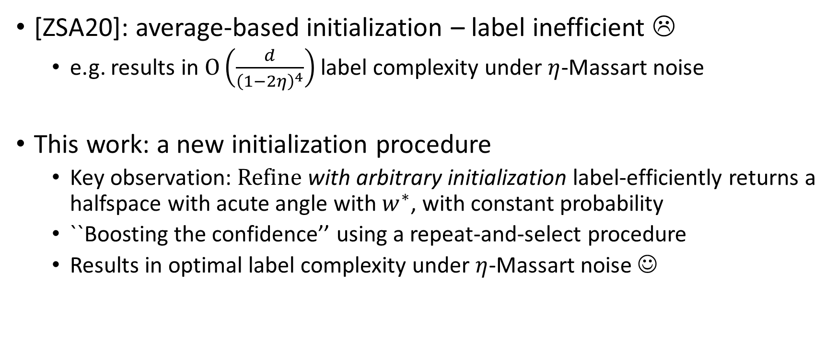
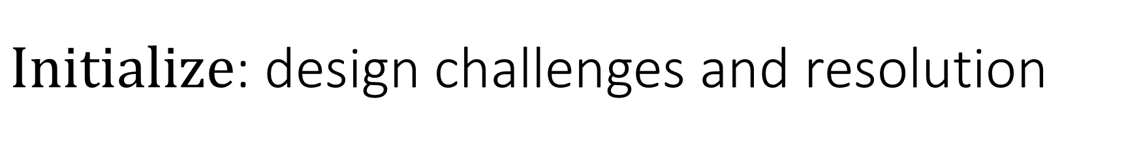
$Initialize$: design challenges and resolution
[ZSA20]: average-based initialization – label inefficient ☹
e.g. results in $O\left(\frac{d}{{\left(1−2η\right)}^{4}}\right)$ label complexity under $η$-Massart noise
This work: a new initialization procedure
Key observation: Refine with arbitrary initialization label-efficiently returns a halfspace with acute angle with $w^{∗}$, with constant probability
``Boosting the confidence’’ using a repeat-and-select procedure
Results in optimal label complexity under $η$-Massart noise ☺

Slide 17
Outline
Active learning sparse halfspaces with noise
The algorithm
Discussions

Slide 18
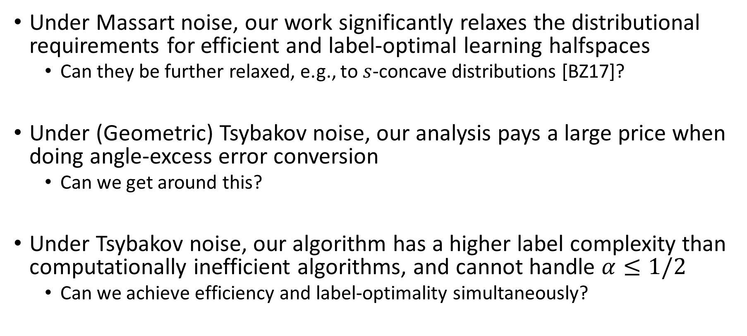
Discussions
Under Massart noise, our work significantly relaxes the distributional requirements for efficient and label-optimal learning halfspaces
Can they be further relaxed, e.g., to $s$-concave distributions [BZ17]?
Under (Geometric) Tsybakov noise, our analysis pays a large price when doing angle-excess error conversion
Can we get around this?
Under Tsybakov noise, our algorithm has a higher label complexity than computationally inefficient algorithms, and cannot handle $α≤1/2$
Can we achieve efficiency and label-optimality simultaneously?

Slide 19
References
[ABHU15] Pranjal Awasthi, Maria-Florina Balcan, Nika Haghtalab, and Ruth Urner. Efficient learning halfspaces with bounded noise. COLT 2015.
[ABHZ16] Pranjal Awasthi, Maria-Florina Balcan, Nika Haghtalab, and Hongyang Zhang. Learning and 1-bit compressed sensing under asymmetric noise. COLT 2016.
[BBL06] Maria-Florina Balcan, Alina Beygelzimer, and John Langford. Agnostic active learning. ICML 2006.
[BL13] Maria-Florina Balcan and Philip M. Long. Active and passive learning of linear separators under logconcave distributions.
[CKMY20] Sitan Chen, Frederic Koehler, Ankur Moitra, and Morris Yau. Classification under misspecification: Halfspaces, generalized linear models, and connections to evolvability. NeurIPS 2020.
[DK20] Ilias Diakonikolas and Daniel M Kane. Hardness of learning halfspaces with massart noise.arXiv preprintarXiv:2012.09720, 2020.
[DKKTZ20] Ilias Diakonikolas, Daniel M. Kane, Vasilis Kontonis, Christos Tzamos, Nikos Zarifis. A Polynomial Time Algorithm for Learning Halfspaces with Tsybakov Noise. ArXiv 2020.
[DKTZ20] Ilias Diakonikolas, Vasilis Kontonis, Christos Tzamos, and Nikos Zarifis. Learning halfspaces with massart noise under structured distributions. COLT 2020.
[DKZ20] Ilias Diakonikolas, Daniel M Kane, and Nikos Zarifis. Near-optimal sq lower bounds for agnostically learning halfspaces and relus under gaussian marginals. NeurIPS 2020.
[GCB09] A Guillory, E Chastain, J Bilmes, Active learning as non-convex optimization. AISTATS 2009.
[KK14] Adam Klivans and Pravesh Kothari. Embedding hard learning problems into gaussian space.
[V84] Valiant. A Theory of the Learnable. JACM, 1984
[YZ17] Songbai Yan and Chicheng Zhang. Revisiting perceptron: Efficient and label-optimal learning of halfspaces, NeurIPS 2017.
[ZSA20] Chicheng Zhang, Jie Shen, and Pranjal Awasthi. Efficient active learning of sparse halfspaces with arbitrary bounded noise. NeurIPS 2020.

Slide 20
Thank you!
arXiv: 2102.05312

