Slide 1


Provably Efficient Multi-Task Reinforcement Learning with Model Transfer
Chicheng Zhang and Zhi Wang
NeurIPS 2021

Slide 2











Heterogenous Multi-Task Online Reinforcement Learning (RL)
$$≈$$
$$≈$$
$$≈$$
Each robot learns the preferences of its paired individuals through interactions.
A group of assistive robots deployed to provide personalized healthcare services (Kubota et al., 2020).
Question: If the robots receive similar yet nonidentical feedback, how can they learn to perform their respective tasks faster in an online RL setting?

Slide 3



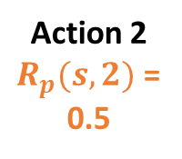
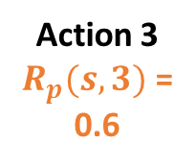

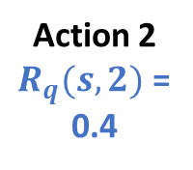
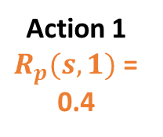
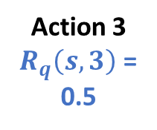
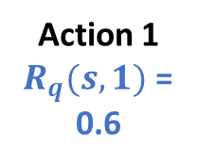
Multi-Player Episodic RL (MPERL)
A set of $M$ players (robots) concurrently interact with their respective environments, each represented as an Episodic MDP.
Alice
Bob
Actions = cognitive activities to recommend
Action 1
$R_{p}(s,1)$ =
0.4
Action 2
$R_{p}(s,2)$ =
0.5
Action 3
$R_{p}(s,3)$ =
0.6
Action 1
$R_{q}(s,1)$ =
0.6
Action 2
$R_{q}(s,2)$ =
0.4
Action 3
$R_{q}\left(s,3\right)$ =
0.5

Slide 4
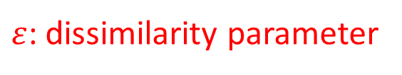



The $ε$-MPERL Problem
A set of $M$ players (robots) concurrently interact with their respective environments, each represented as an Episodic MDP.
Alice
Bob
Actions = cognitive activities to recommend
Action 1
$R_{p}(s,1)$ =
0.4
Action 2
$R_{p}(s,2)$ =
0.5
Action 3
$R_{p}(s,3)$ =
0.6
Action 1
$R_p(s,1)$ =
0.6
Action 2
$R_{q}(s,2)$ =
0.4
Action 3
$R_{q}\left(s,3\right)$ =
0.5
$$∀ p, q,s,a:$$
$$\left|R_{p}\left(s,a\right)−R_{q}(s,a)\right| ≤ ε$$
$${\left\|ℙ_{p}\left(⋅∣s,a\right)−ℙ_{q}\left(⋅ ∣ s,a\right)\right\|}_{1} ≤ ε/H$$
$ε$: dissimilarity parameter

Slide 5
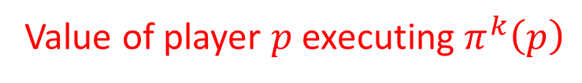
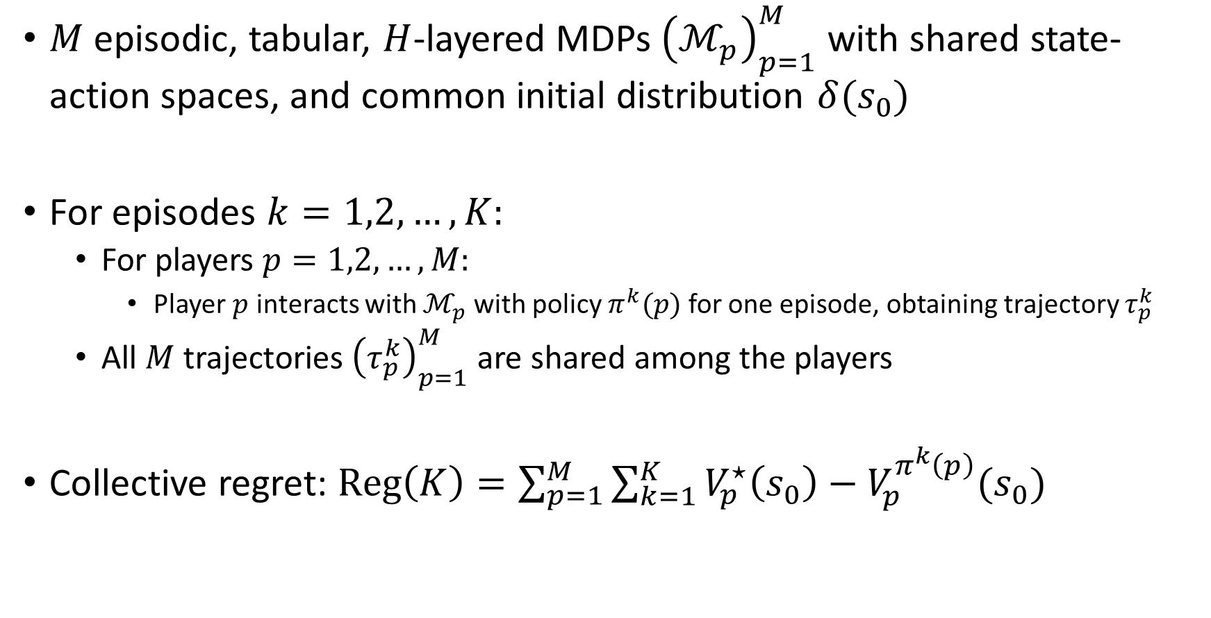
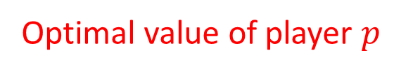

The $ε$-MPERL Problem: formal setup
$M$ episodic, tabular, $H$-layered MDPs ${\left(ℳ_{p}\right)}_{p=1}^{M}$ with shared state-action spaces, and common initial distribution ${δ(s}_{0})$
For episodes $k=1,2,…,K:$
For players $p=1,2,…,M:$
Player $p$ interacts with $ℳ_{p}$ with policy $π^{k}(p)$ for one episode, obtaining trajectory $τ_{p}^{k}$
All $M$ trajectories ${\left(τ_{p}^{k}\right)}_{p=1}^{M}$ are shared among the players
Collective regret: $Reg\left(K\right)=\sum_{p=1}^{M}{\sum_{k=1}^{K}{V_{p}^{⋆}\left(s_{0}\right)−V_{p}^{π^{k}\left(p\right)}(s_{0})}}$
Alice
Bob
Optimal value of player $p$
Value of player $p$ executing $π^{k}\left(p\right)$

Slide 6
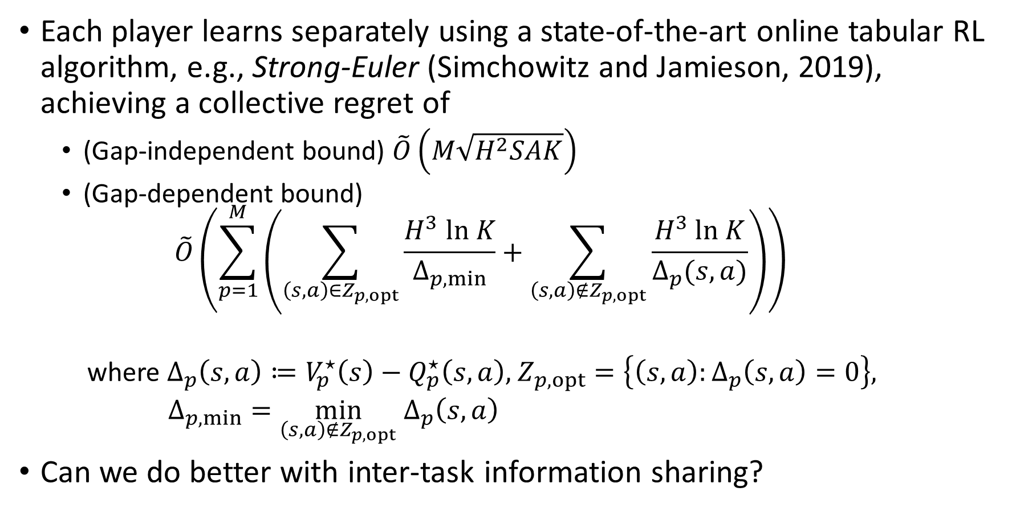
Baseline: individual single-task learning
Each player learns separately using a state-of-the-art online tabular RL algorithm, e.g., Strong-Euler (Simchowitz and Jamieson, 2019), achieving a collective regret of
(Gap-independent bound) $\tilde{O}\left(M\sqrt{H^{2}SAK}\right)$
(Gap-dependent bound)
$$\tilde{O}\left(\sum_{p=1}^{M}{\left(\sum_{\left(s,a\right)∈Z_{p,opt}}{\frac{H^{3} ln K}{Δ_{p,min}}}+\sum_{\left(s,a\right)∉Z_{p,opt}}{\frac{H^{3} ln K}{Δ_{p}(s,a)}}\right)}\right)$$
where $Δ_{p}\left(s,a\right)≔V_{p}^{⋆}\left(s\right)−Q_{p}^{⋆}\left(s,a\right),$ $Z_{p,opt}=\left\{\left(s,a\right):Δ_{p}\left(s,a\right)=0\right\},$
$Δ_{p,min}=\min_{\left(s,a\right)∉Z_{p,opt}}$ $Δ_{p}\left(s,a\right)$
Can we do better with inter-task information sharing?

Slide 7



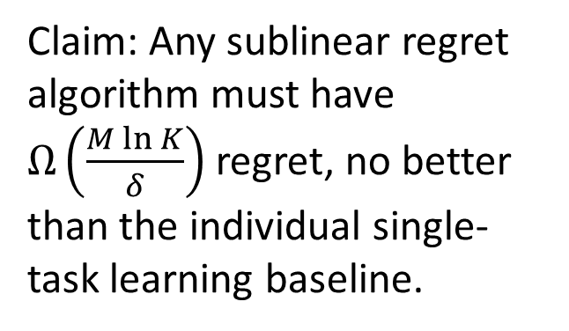
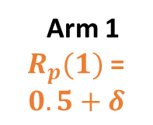
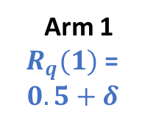




The benefit of multi-task learning
(Wang, Zhang, Singh, Riek, Chaudhuri, 2021): in a multi-task multi-armed bandit setting, information sharing sometimes does not help, information theoretically.
Example: For a fixed $ε$ and $δ< ε/4$, consider:
Key observation: the benefit of multi-task learning depends on the interaction between $ε$ and suboptimality gaps $Δ_{p}(s,a)$
$$Δ_{p}(2)= δ$$
Claim: Any sublinear regret algorithm must have $Ω\left(\frac{M\ln{K}}{δ}\right)$ regret, no better than the individual single-task learning baseline.
Arm 1
$R_{p}(1)$ =
$$0.5+δ$$
Arm 2
$R_{p}(2)$ =
$$0.5$$
Arm 1
$R_{q}(1)$ =
$$0.5+δ$$
Arm 2
$R_{q}(2)$ =
$$0.5$$
$ε$

Slide 8


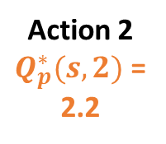
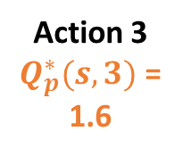

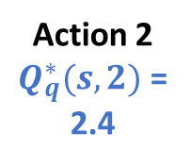
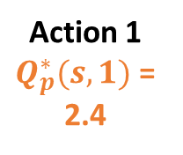
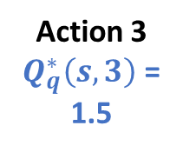
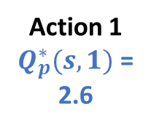
Key notion: subpar state-action pairs
Subpar state-action pairs:
$ℐ_{ε}=\left\{\left(s,a\right):for some p∈\left[M\right], Δ_{p}\left(s,a\right)≥Ω\left(Hε\right)\right\}$
Example:
$\left(s,3\right)∈ℐ_{ε}$; $\left(s,2\right)∉ℐ_{ε}$
Subpar state-action pairs are those amenable for inter-task information sharing
Alice
Bob
Action 1
$Q_{p}^{∗}(s,1)$ =
2.4
Action 2
$Q_{p}^{∗}(s,2)$ =
2.2
Action 3
$Q_{p}^{∗}(s,3)$ =
1.6
Action 1
$Q_{p}^{∗}(s,1)$ =
2.6
Action 2
$Q_{q}^{∗}(s,2)$ =
2.4
Action 3
$Q_{q}^{∗}\left(s,3\right)$ =
1.5

Slide 9

Our results
For $ε$-MPERL problems, assuming known $ε:$
Our algorithm, Multi-Task-Euler($ε$), achieves gap-dependent and gap-independent regret upper bounds
We also show gap-dependent and gap-independent regret lower bounds, that nearly match the upper bounds for constant $H$

Slide 10

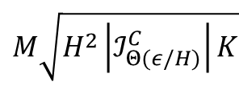











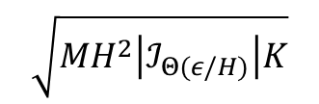
Our results: gap-independent bounds
State-action pairs
$$ℐ_{ε}^{C}$$
$$ℐ_{ε}$$
$$ℐ_{Θ\left(ε/H\right)}^{C}$$
$$ℐ_{Θ(ε/H)}$$
Individual
Strong-Euler
$$M\sqrt{H^{2}\left|ℐ_{ε}^{C}\right|K}$$
$$M\sqrt{H^{2}\left|ℐ_{ε}\right|K}$$
$$+$$
$$M\sqrt{H^{2}\left|ℐ_{ε}^{C}\right|K}$$
$$\sqrt{MH^{2}\left|ℐ_{ε}\right|K}$$
Multi-task-Euler($ε$)
$$+$$
$$M\sqrt{H^{2}\left|ℐ_{Θ(ε/H)}^{C}\right|K}$$
$$\sqrt{{MH}^{2}\left|ℐ_{Θ(ε/H)}\right|K}$$
Lower bound
$$+$$

Slide 11
















Our results: gap-dependent bounds
For player $p$’s contribution to the collective regret:
State-action pairs
$$Z_{p,opt}$$
$${\left(Z_{p,opt}∪ℐ_{ε}\right)}^{C}$$
$$ℐ_{ε}$$
$${\left(Z_{p,opt}∪ℐ_{Θ(ε/H)}\right)}^{C}$$
$$ℐ_{Θ(ε/H)}$$
Individual
Strong-Euler
$$\sum_{s,a}{}$$
$$\frac{H^{3} ln K}{Δ_{p,min}}$$
$$\frac{H^{3}ln K}{Δ_{p}(s,a)}$$
$$\frac{H^{3}ln K}{Δ_{p}(s,a)}$$
$$\sum_{s,a}{}$$
$$\frac{H^{3 }ln K}{Δ_{p,min}}$$
$$\frac{H^{3}ln K}{Δ_{p}(s,a)}$$
$$\frac{1}{M}⋅\frac{H^{3}ln K}{Δ_{p}(s,a)}$$
Multi-task-Euler($ε$)
$$\sum_{s,a}{}$$
$$\frac{H^{2 }ln K}{Δ_{p}(s,a)}$$
$$\frac{1}{M}⋅\frac{H^{2}ln K}{Δ_{p}(s,a)}$$
Lower bound

Slide 12
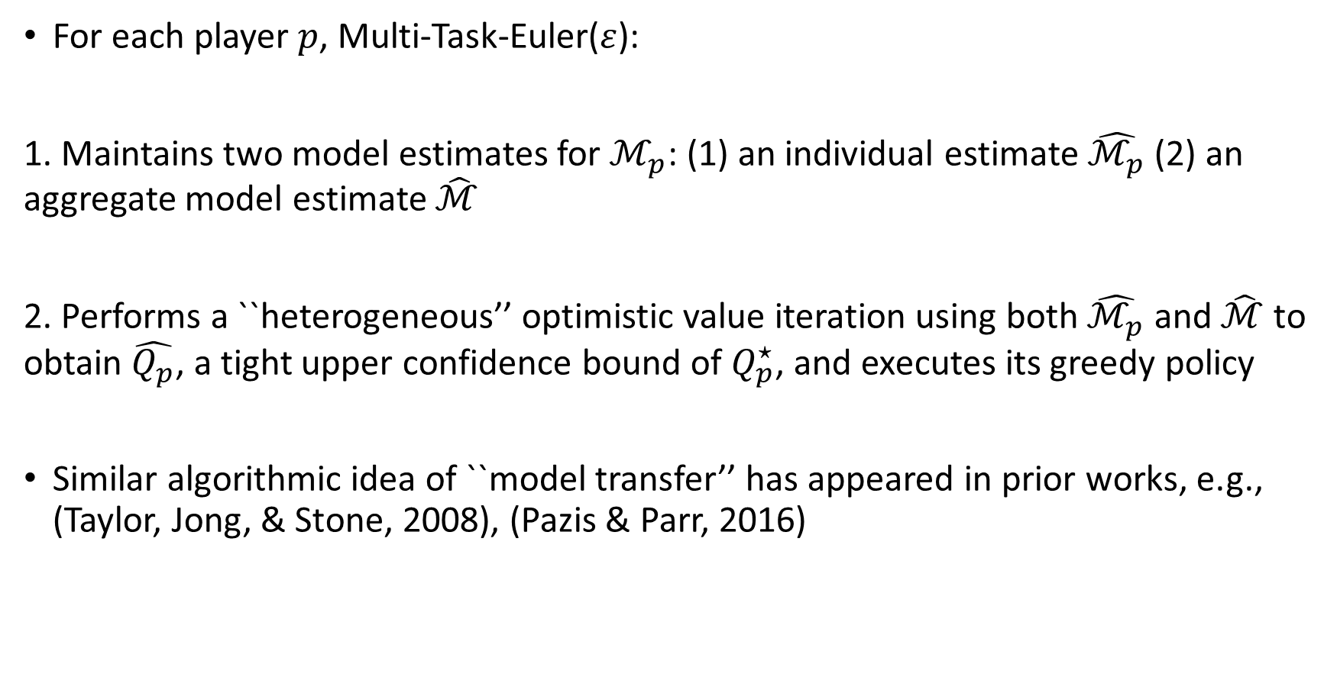
Multi-task-Euler(𝜀): main ideas
For each player $p$, Multi-Task-Euler($ε$):
1. Maintains two model estimates for $ℳ_{p}$: (1) an individual estimate $\hat{ℳ_{p}}$ (2) an aggregate model estimate $\hat{ℳ}$
2. Performs a ``heterogeneous’’ optimistic value iteration using both $\hat{ℳ_{p}}$ and $\hat{ℳ}$ to obtain $\hat{Q_{p}}$, a tight upper confidence bound of $Q_{p}^{⋆}$, and executes its greedy policy
Similar algorithmic idea of ``model transfer’’ has appeared in prior works, e.g., (Taylor, Jong, & Stone, 2008), (Pazis & Parr, 2016)

Slide 13
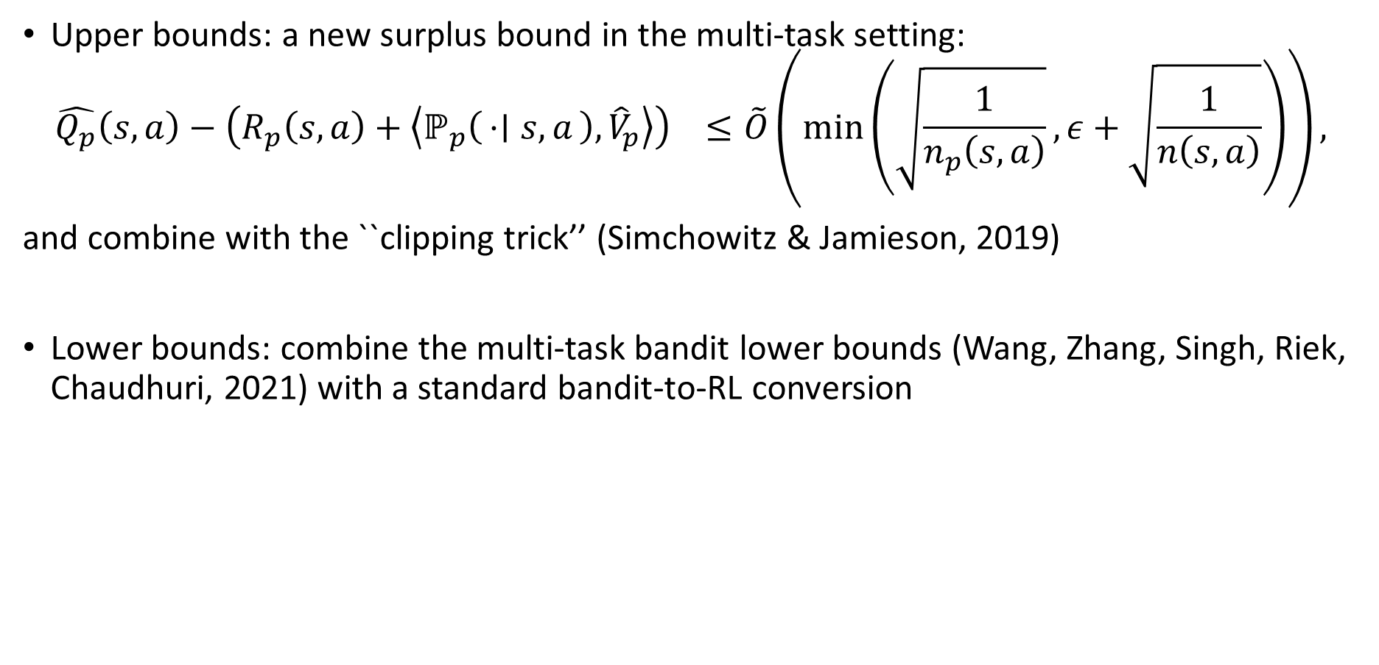
Technical overview
Upper bounds: a new surplus bound in the multi-task setting:
$$\hat{Q_{p}}\left(s,a\right)−\left(R_{p}\left(s,a\right)+\left\langle ℙ_{p}\left(⋅ ∣ s,a\right),{\hat{V}}_{p}\right\rangle \right) ≤\tilde{O}\left(min\left(\sqrt{\frac{1}{n_{p}\left(s,a\right)}}, ε+\sqrt{\frac{1}{n\left(s,a\right)}}\right)\right),$$
and combine with the ``clipping trick’’ (Simchowitz & Jamieson, 2019)
Lower bounds: combine the multi-task bandit lower bounds (Wang, Zhang, Singh, Riek, Chaudhuri, 2021) with a standard bandit-to-RL conversion

Slide 14
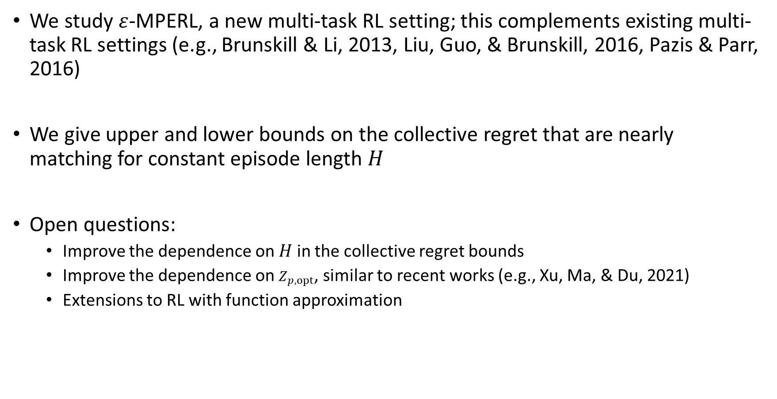
Conclusion and open problems
We study $ε$-MPERL, a new multi-task RL setting; this complements existing multi-task RL settings (e.g., Brunskill & Li, 2013, Liu, Guo, & Brunskill, 2016, Pazis & Parr, 2016)
We give upper and lower bounds on the collective regret that are nearly matching for constant episode length $H$
Open questions:
Improve the dependence on $H$ in the collective regret bounds
Improve the dependence on $Z_{p,opt}$, similar to recent works (e.g., Xu, Ma, & Du, 2021)
Extensions to RL with function approximation

Slide 15
Thank you!

