Slide 1

Top-$k$ eXtreme Contextual Bandits with Arm Hierarchy
Published in ICML, 2021
Authors:
Rajat Sen, Alexander Rakhlin, Lexing Ying, Rahul Kidambi, Dean Foster, Daniel Hill, Inderjit S. Dhillon
Presented by:
Arush Sharma, CSC 696H

Slide 2
Outline
Introduction
Motivation
Contribution
Algorithm (IGW and top-K eXtreme)
Results

Slide 3
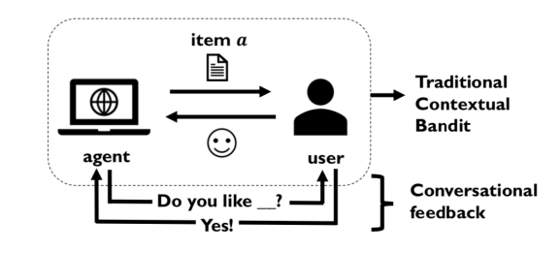

Introduction
In contextual bandits, at every time step the learner observes a context, presents one of the $A$ possible actions (for example: search query for electronic item during online shopping)
The learner receives a reward from user (such as clicking on query results)
Zhang, Xiaoying, Hong Xie, Hang Li, and John CS Lui. "Conversational contextual bandit: Algorithm and application.“
In Proceedings of the web conference 2020, pp. 662-672. 2020.

Slide 4
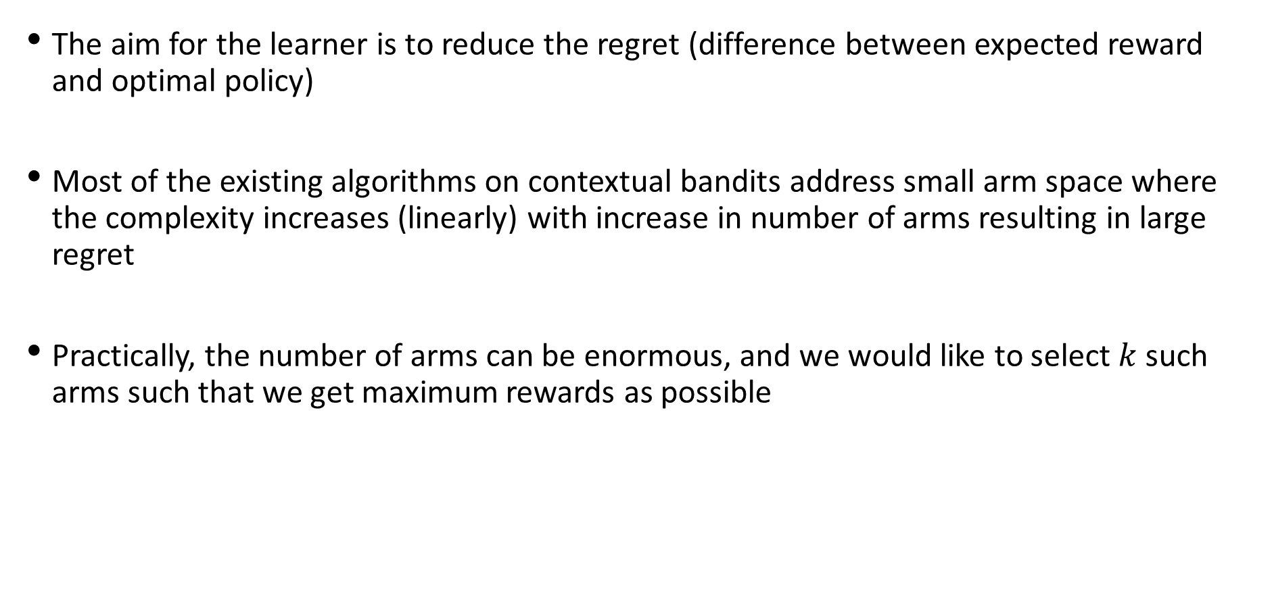
Introduction
The aim for the learner is to reduce the regret (difference between expected reward and optimal policy)
Most of the existing algorithms on contextual bandits address small arm space where the complexity increases (linearly) with increase in number of arms resulting in large regret
Practically, the number of arms can be enormous, and we would like to select $k$ such arms such that we get maximum rewards as possible

Slide 5
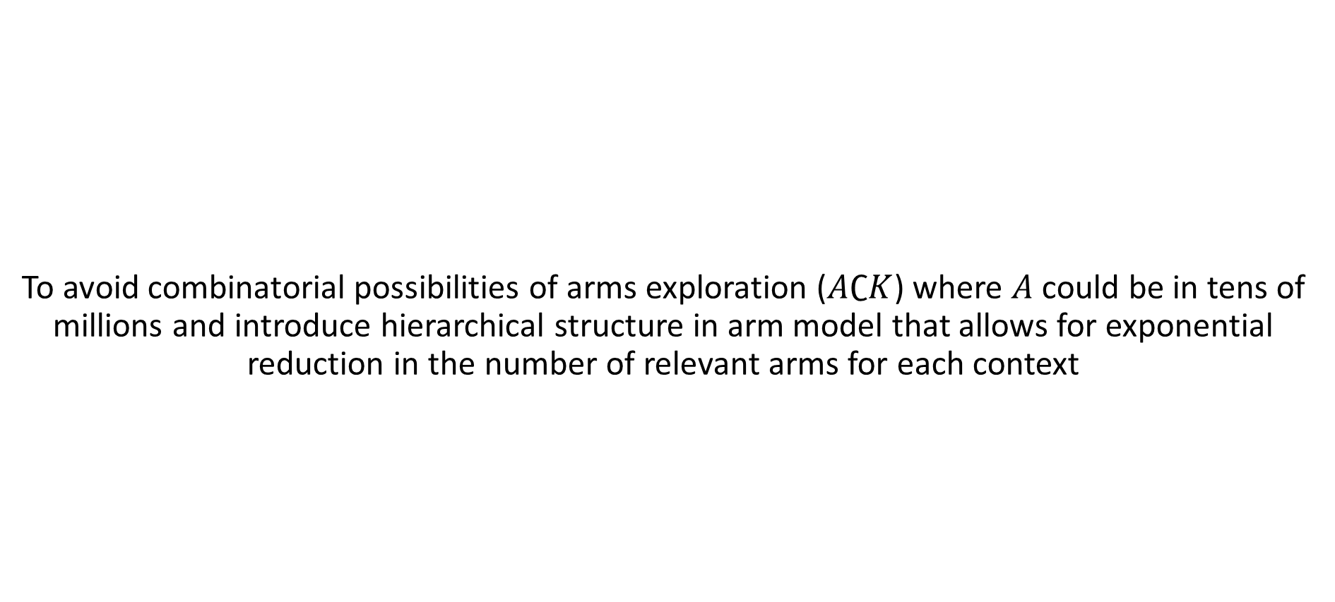
Motivation
To avoid combinatorial possibilities of arms exploration ($A∁K$) where $A$ could be in tens of millions and introduce hierarchical structure in arm model that allows for exponential reduction in the number of relevant arms for each context

Slide 6
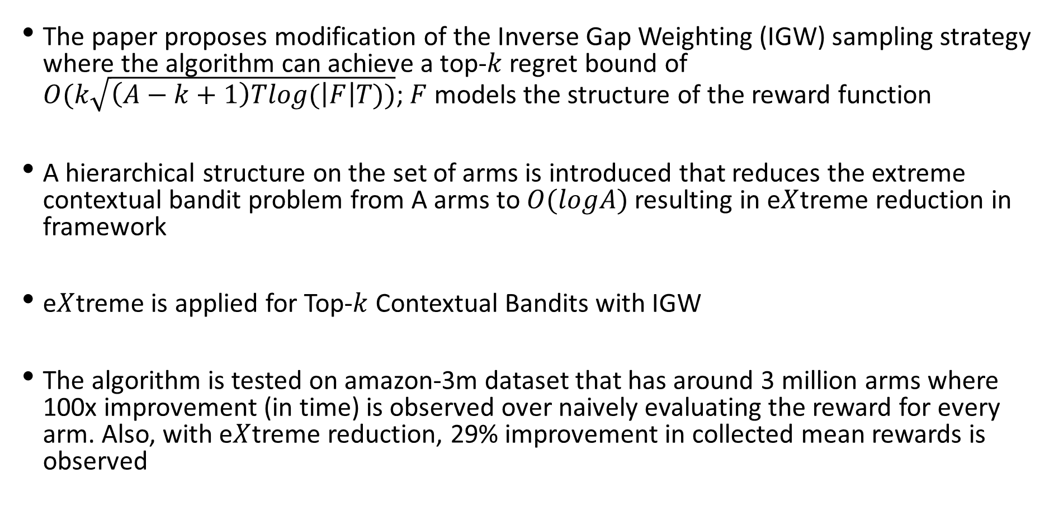
Contribution
The paper proposes modification of the Inverse Gap Weighting (IGW) sampling strategy where the algorithm can achieve a top-$k$ regret bound of $O(k\sqrt{\left(A−k+1\right)Tlog(\left|F\right|T))}$; $F$ models the structure of the reward function
A hierarchical structure on the set of arms is introduced that reduces the extreme contextual bandit problem from A arms to $O(logA)$ resulting in e$X$treme reduction in framework
e$X$treme is applied for Top-$k$ Contextual Bandits with IGW
The algorithm is tested on amazon-3m dataset that has around 3 million arms where 100x improvement (in time) is observed over naively evaluating the reward for every arm. Also, with e$X$treme reduction, 29% improvement in collected mean rewards is observed

Slide 7

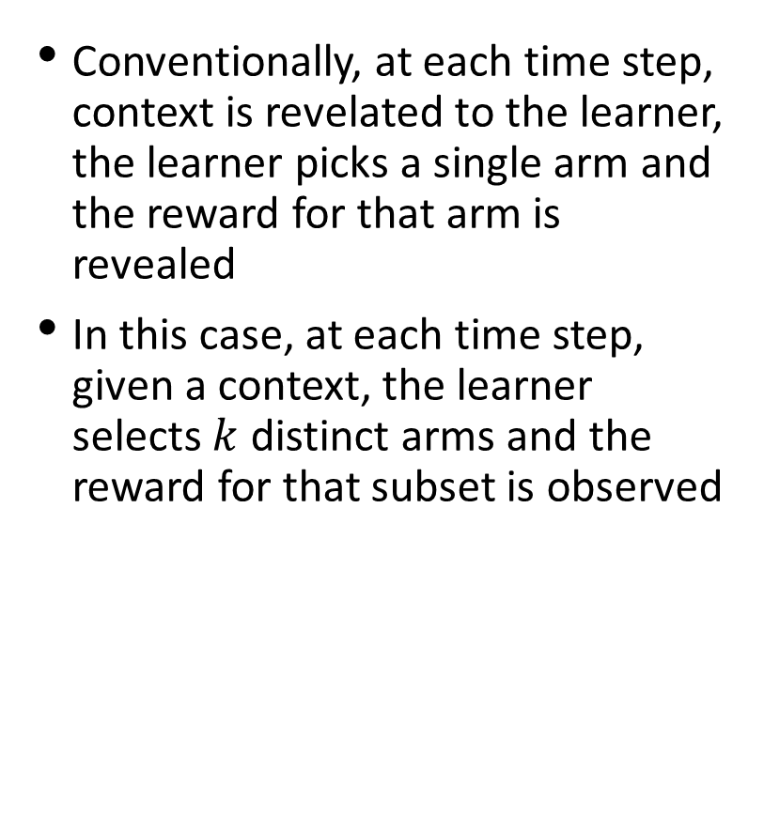
Top-$k$ Stochastic Contextual Bandit under Realizability
Conventionally, at each time step, context is revelated to the learner, the learner picks a single arm and the reward for that arm is revealed
In this case, at each time step, given a context, the learner selects $k$ distinct arms and the reward for that subset is observed

Slide 8
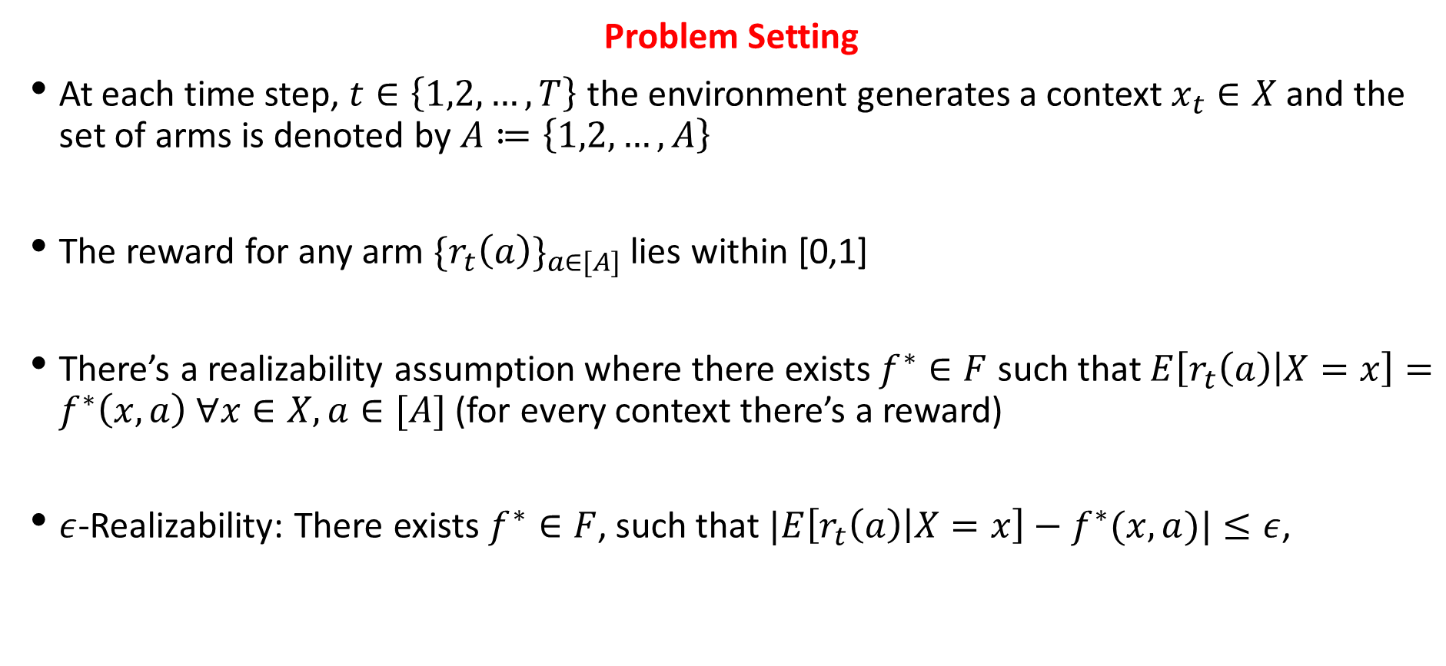
Top-$k$ Stochastic Contextual Bandit under Realizability
Problem Setting
At each time step, $t∈\left\{1,2,…,T\right\}$ the environment generates a context $x_{t}∈X$ and the set of arms is denoted by $A≔\left\{1,2,…,A\right\}$
The reward for any arm ${\{r_{t}\left(a\right)\}}_{a∈[A]}$ lies within [0,1]
There’s a realizability assumption where there exists $f^{∗}∈F$ such that $E\left[r_{t}\left(a\right) | X=x\right]=f^{∗}\left(x,a\right) ∀x∈X, a∈[A]$ (for every context there’s a reward)
$ε$-Realizability: There exists$f^{∗}∈F$, such that $|E\left[r_{t}\left(a\right) | X=x\right]−f^{∗}(x,a)|≤ε$,

Slide 9
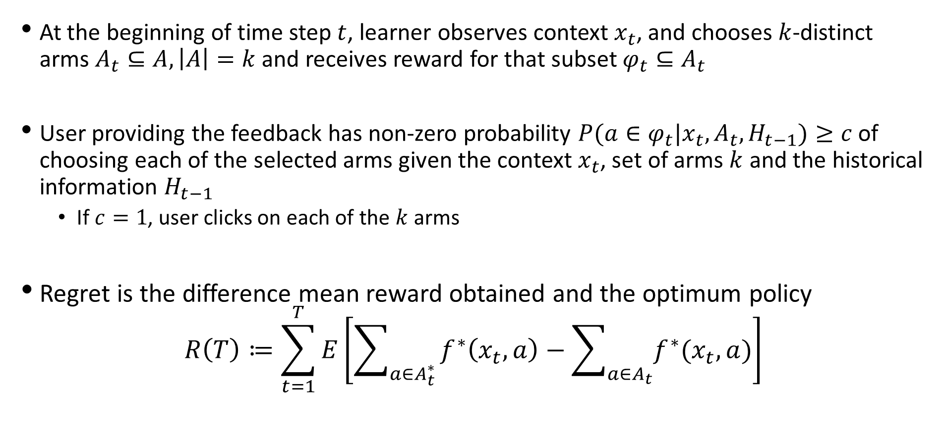
Top-$k$ Stochastic Contextual Bandit under Realizability
At the beginning of time step $t$, learner observes context $x_{t}$, and chooses $k$-distinct arms $A_{t}⊆A, \left|A\right|=k$ and receives reward for that subset $φ_{t}⊆A_{t}$
User providing the feedback has non-zero probability $P(a∈φ_{t}|x_{t},A_{t},H_{t−1})≥c$ of choosing each of the selected arms given the context $x_{t}$, set of arms $k$ and the historical information $H_{t−1}$
If $c=1$, user clicks on each of the $k$ arms
Regret is the difference mean reward obtained and the optimum policy
$$R\left(T\right)≔\sum_{t=1}^{T}{E\left[\sum_{a∈A_{t}^{∗}}{f^{∗}\left(x_{t},a\right)−\sum_{a∈A_{t}}{f^{∗}(x_{t},a)}}\right]}$$

Slide 10
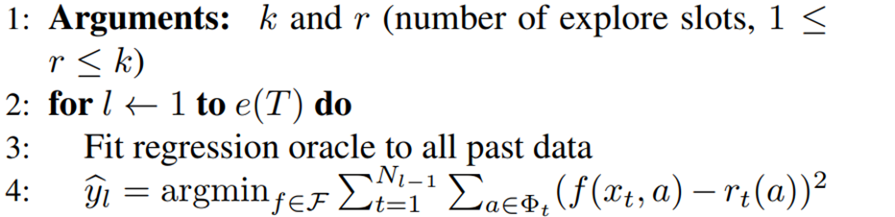
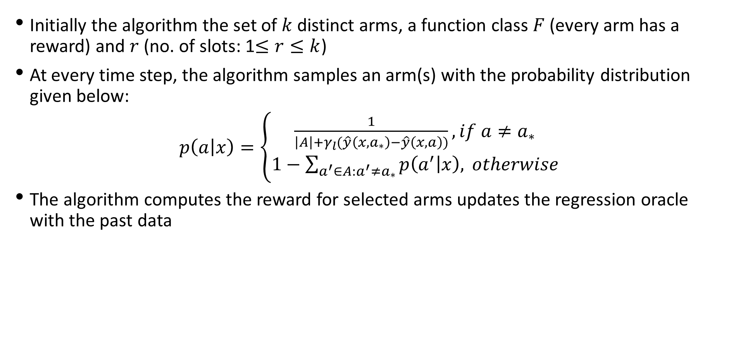
IGW for top-$k$ Contextual Bandits
Initially the algorithm the set of $k$ distinct arms, a function class $F$ (every arm has a reward) and $r$ (no. of slots: 1$≤r≤k$)
At every time step, the algorithm samples an arm(s) with the probability distribution given below:
$p\left(a | x\right)=\left\{\begin{aligned}\frac{1}{\left|A\right|+γ_{l}(\hat{y}\left(x,a_{∗}\right)−\hat{y}\left(x,a\right))}, if a≠a_{∗} \\ 1−\sum_{a^{′}∈A:a^{′}≠a_{∗}}{p\left(a^{′} | x\right),} otherwise\end{aligned}\right.$
The algorithm computes the reward for selected arms updates the regression oracle with the past data

Slide 11
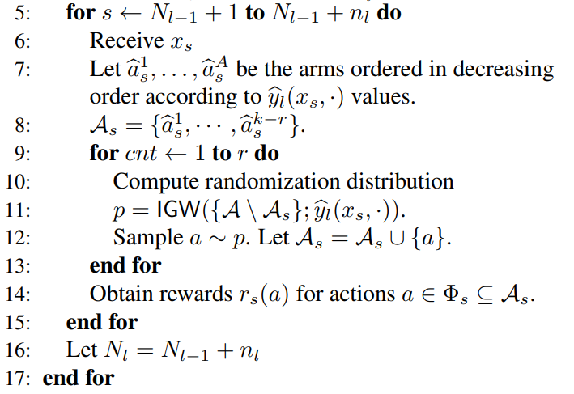
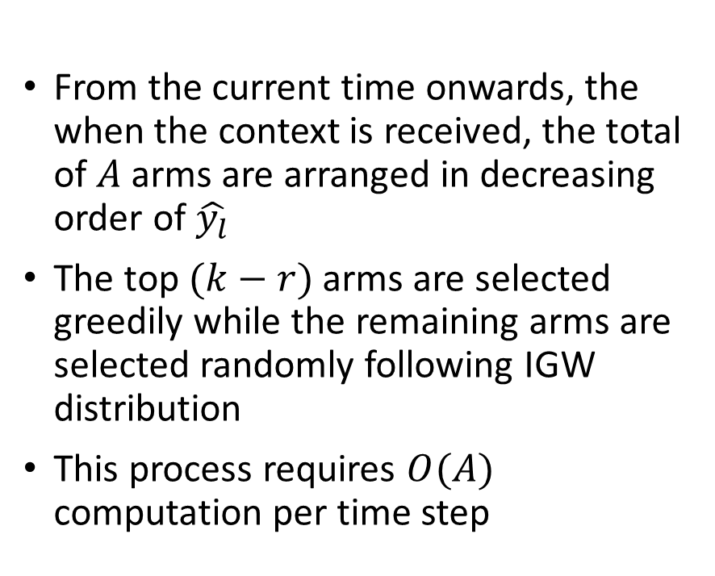
IGW for top-$k$ Contextual Bandits
From the current time onwards, the when the context is received, the total of $A$ arms are arranged in decreasing order of $\hat{y_{l}}$
The top $(k−r)$ arms are selected greedily while the remaining arms are selected randomly following IGW distribution
This process requires $O(A)$ computation per time step

Slide 12
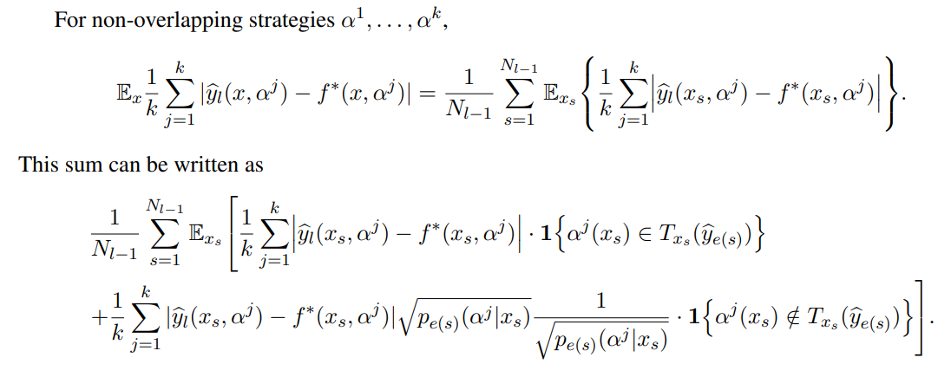
Regret Bound
By Cauchy-Schwartz Inequality, the last expression is upper bounded and the
final expression is resulted as follows:

Slide 13
Regret Bound

Slide 14
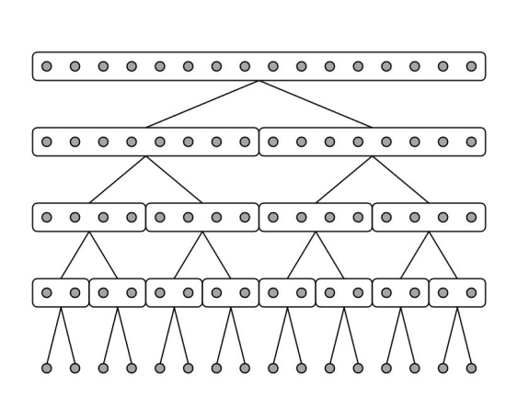
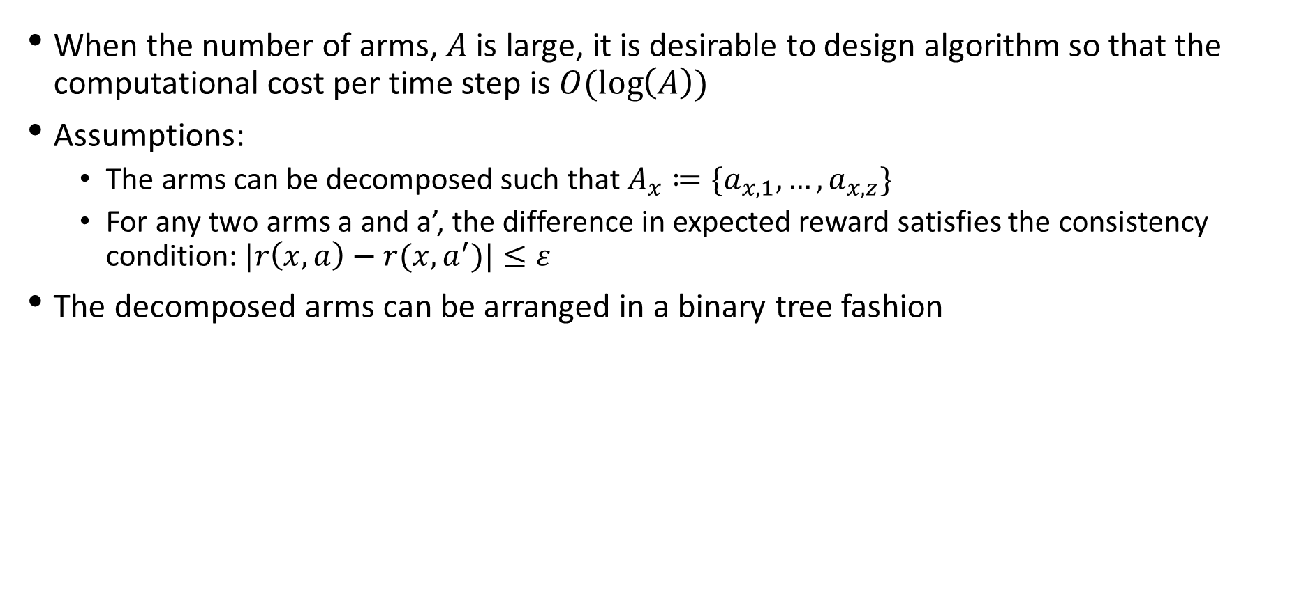

eXtreme Contextual Bandits and Arm Hierarchy
When the number of arms, $A$ is large, it is desirable to design algorithm so that the computational cost per time step is $O(\log\left(A\right))$
Assumptions:
The arms can be decomposed such that $A_{x}≔\{a_{x,1},…,a_{x,z}\}$
For any two arms a and a’, the difference in expected reward satisfies the consistency condition: $|r\left(x,a\right)−r(x,a^{′})|≤ε$
The decomposed arms can be arranged in a binary tree fashion
$$A$$

Slide 15
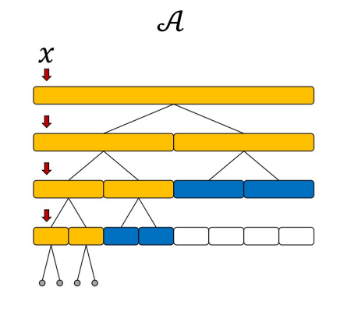

eXtreme Contextual Bandits and Arm Hierarchy
Each node $i$ at height $h$ denoted by $(e_{h,i})$ is associated with a routing function $g_{h,i}\left(x\right)=\frac{{rad}_{h,i}}{||x−{ctr}_{h,i}||}$ with ${rad}_{h,i}$ and ${ctr}_{h,i}$ being the radius and center of $e_{h,i}$
Given the context, the adaptive search from the root recursively explores the children of those nodes (arms) when $g_{h,i}\left(x\right)≥β$

Slide 16
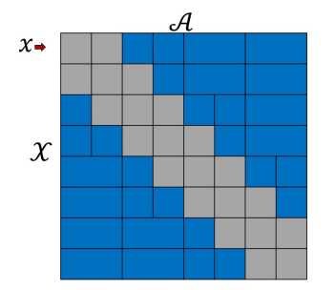

eXtreme Contextual Bandits and Arm Hierarchy
On the other hand, if the $g_{h,i}\left(x\right)≤β$, the node is considered far from the context $x$
The effective nodes/arms at the end of the search consists of singleton nodes and list of internal nodes (blue color)
After traversing the effective arms can further be used in IGW sampling

Slide 17
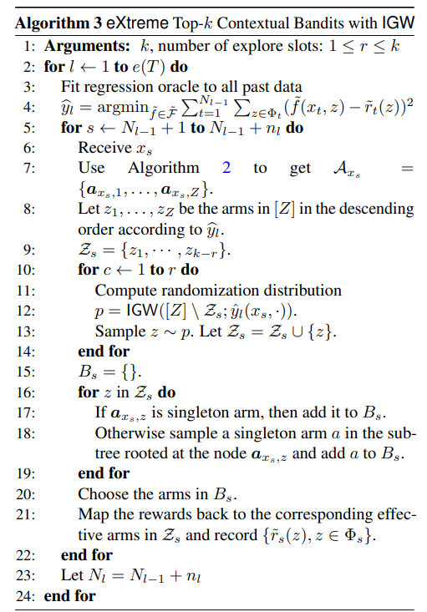
IGW for top-$k$ e$X$treme Contextual Bandits

Slide 18
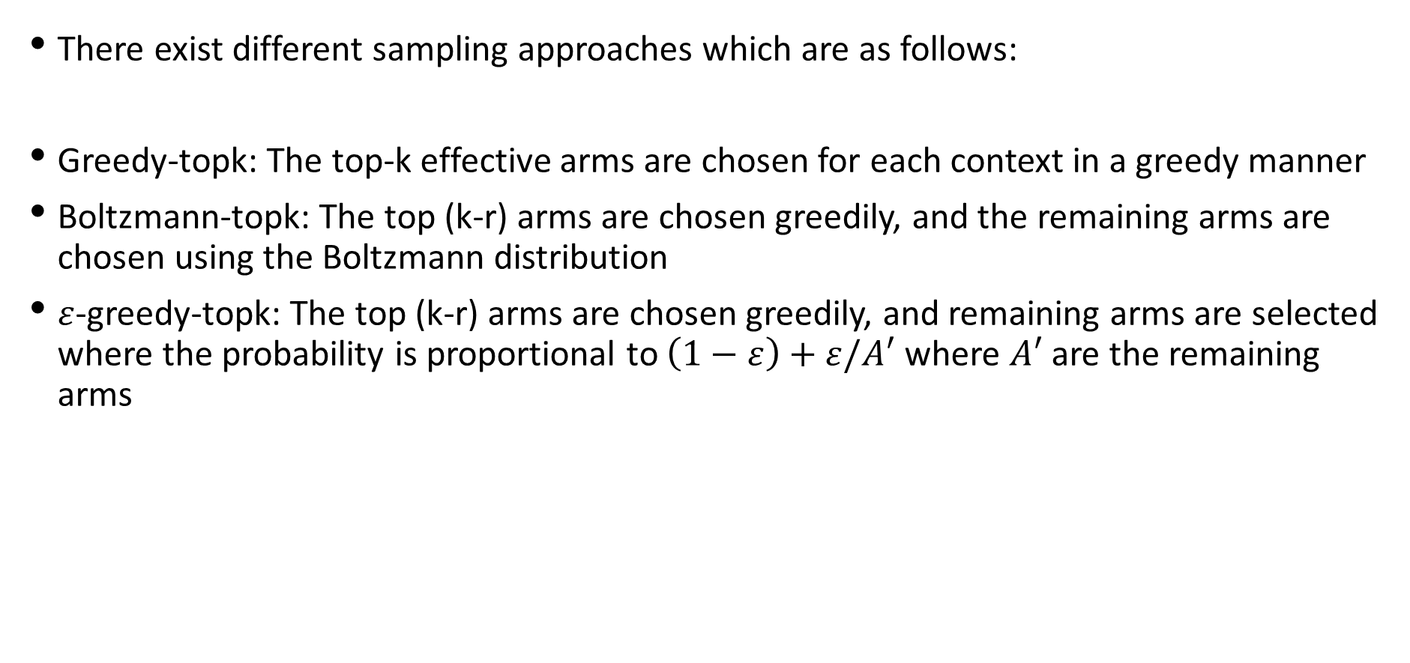
Sampling Strategies
There exist different sampling approaches which are as follows:
Greedy-topk: The top-k effective arms are chosen for each context in a greedy manner
Boltzmann-topk: The top (k-r) arms are chosen greedily, and the remaining arms are chosen using the Boltzmann distribution
$ε$-greedy-topk: The top (k-r) arms are chosen greedily, and remaining arms are selected where the probability is proportional to $\left(1−ε\right)+ε/A′$ where $A′$ are the remaining arms

Slide 19
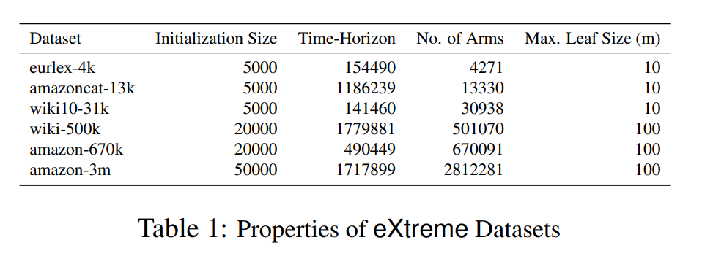
Dataset Description

Slide 20
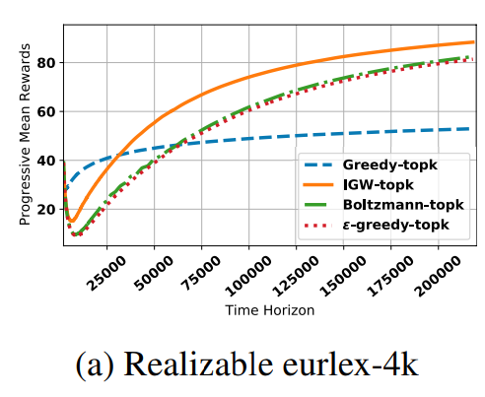
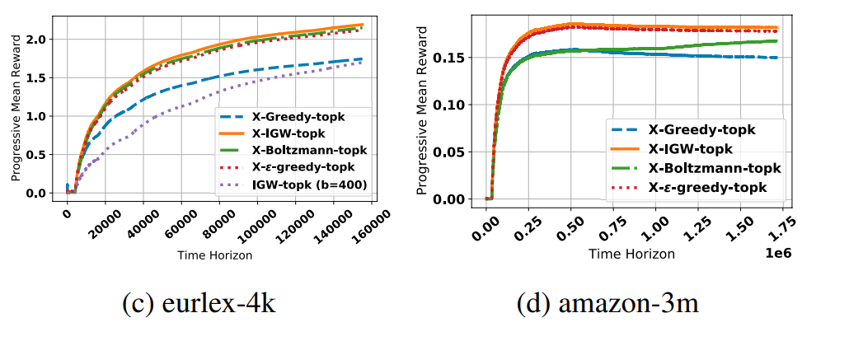


Empirical Results
$$k=50, r=25, b=10$$
$$k=5, r=3, b=10$$

Slide 21
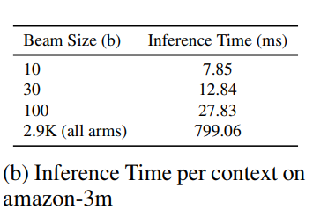
Empirical Results
Inference time is the amount of time it takes for the algorithm to make a prediction for a given context

Slide 22
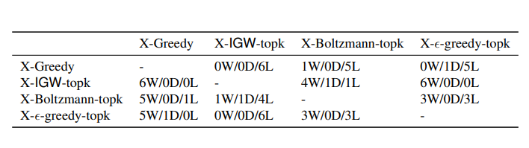
Win/Draw/Loss Statistics

Slide 23
Conclusion
The algorithm can be theoretically and practically extended to extreme number of arms in the dataset
When pitted against various benchmarks, X-IGW-topk algorithm outperforms the other competitors

