Slide 1
Provably Efficient RL with Rich Observations via Latent State Decoding
Simon S. Du, Akshay Krishnamurthy, Nan Jiang, Alekh Agarwal, Miroslav Dudík, John Langford
Presenter: Ruoyao Wang
Notes:
1

Slide 2
PRESENTATION AGENDA
Setting
Approach
Experiments
Notes:
2

Slide 3
Setting
Notes:
10

Slide 4
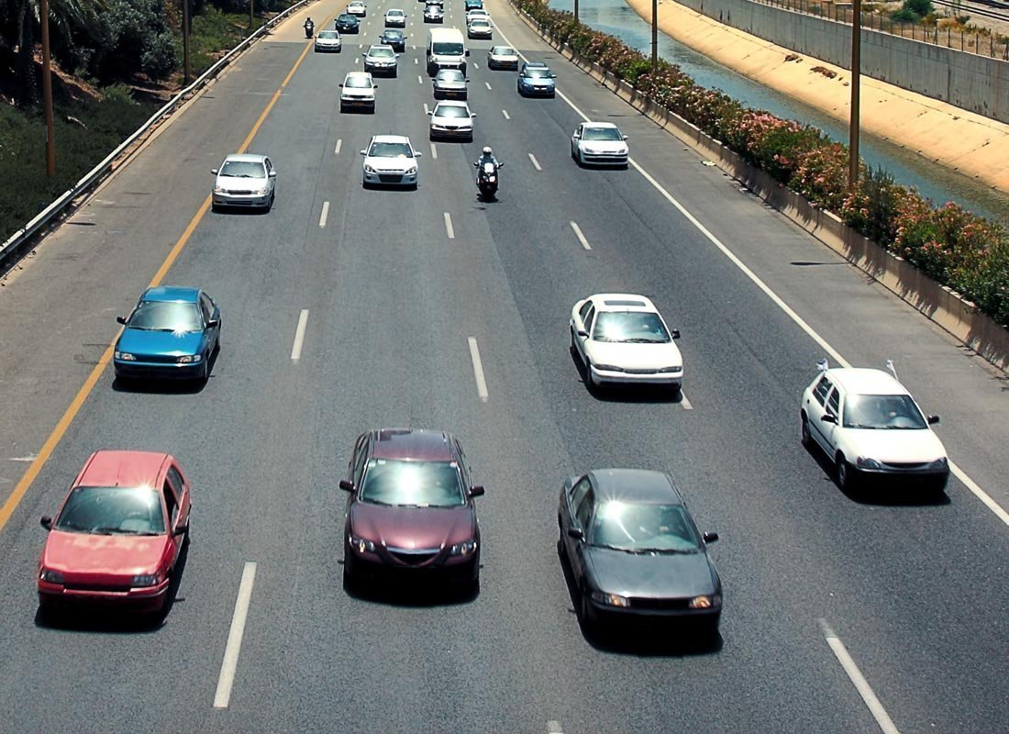
Task Setting
Rich Observation Environment: an agent can observe a large observation space, e.g., texts, images
Difficulty for RL with Rich Observation: it is not practical to explore the observation space
Assumption: Observations are generated by states from a small finite latent state space

Slide 5
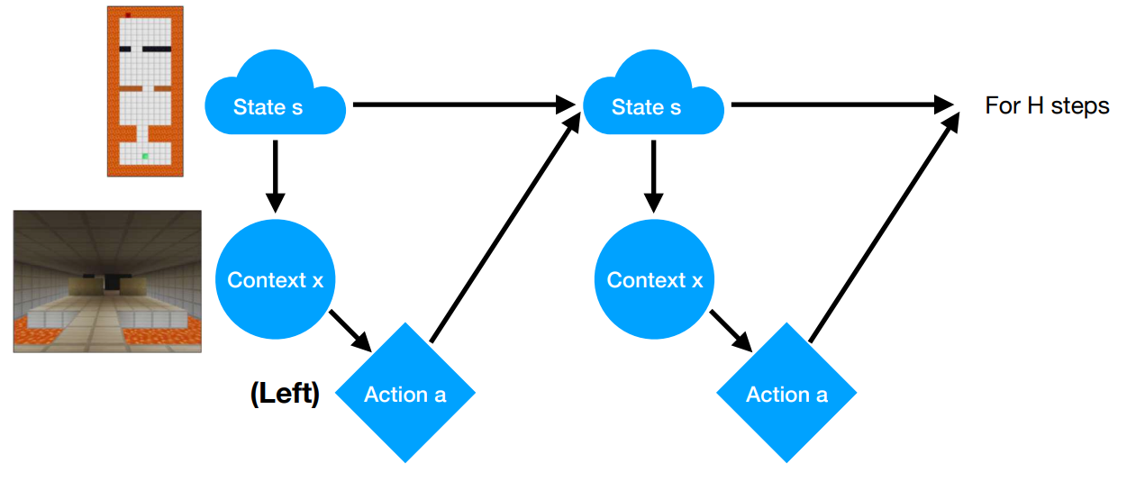
Block Markov Decision Process (BMDP)
Figure from paper authors’ slides

Slide 6
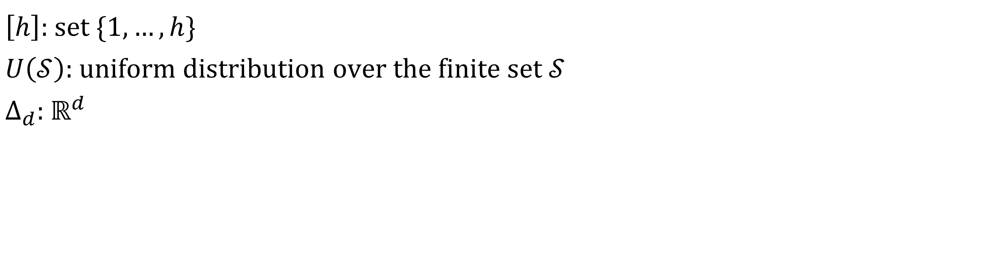
Notations
$\left[h\right]$: set $\{1,…,h\}$
$U\left(𝒮\right)$: uniform distribution over the finite set $𝒮$
$∆_{d}$: $ℝ^{d}$

Slide 7
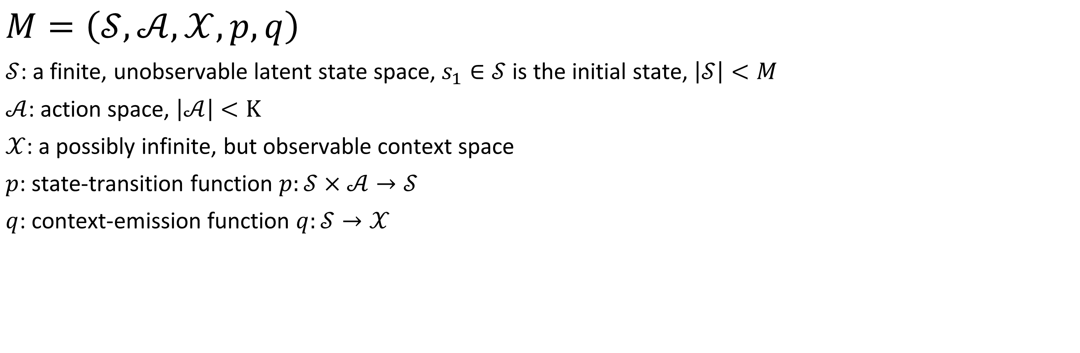
Block Markov Decision Process (BMDP)
$$M=\left(𝒮,𝒜,𝒳,p,q\right)$$
$𝒮$: a finite, unobservable latent state space, $s_{1}∈𝒮$ is the initial state, $\left|𝒮\right|<M$
$𝒜$: action space, $\left|𝒜\right|<K$
$𝒳$: a possibly infinite, but observable context space
$p$: state-transition function $p:𝒮×𝒜→𝒮$
$q$: context-emission function $q:𝒮→𝒳$
Notes:
Add a figure here to demonstrate

Slide 8



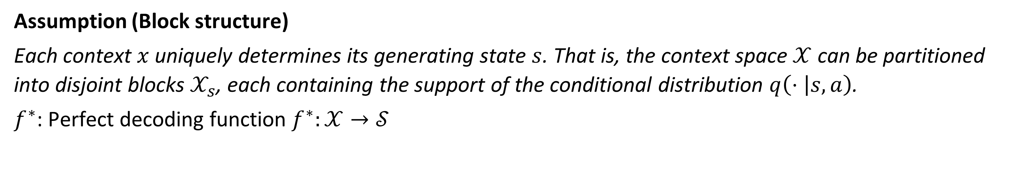





Block Structure Assumption
Assumption (Block structure)
Each context $x$ uniquely determines its generating state $s$. That is, the context space $𝒳$ can be partitioned into disjoint blocks $𝒳_{s}$, each containing the support of the conditional distribution $q\left(⋅ | s,a\right)$.
$f^{∗}$: Perfect decoding function $f^{∗}:𝒳→𝒮$
$$x_{1}$$
$$𝒳_{s_{1}}$$
$$s_{1}$$
$$x_{2}$$
$$x_{3}$$
$$𝒳_{s_{2}}$$
$$s_{2}$$
$$x_{4}$$

Slide 9
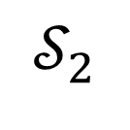
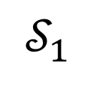

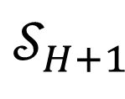
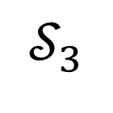
Episodic Assumption
$$𝒮_{1}$$
$$s_{1}$$
$$𝒮_{2}$$
$$𝒮_{3}$$
…
…
$$𝒮_{H+1}$$

Slide 10
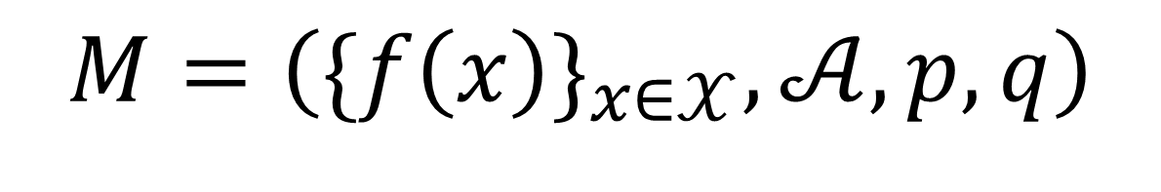

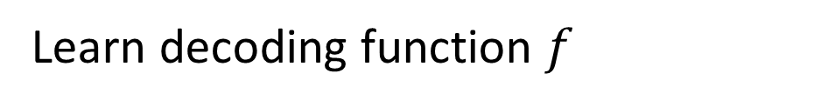

Idea
Solve rich observation BMDP by reducing it to a tabular RL problem.
$$M=\left(𝒮,𝒜,𝒳,p,q\right)$$
Hard
Learn decoding function $f$
$$M=\left(\{f{\left(x\right)\}}_{x∈𝒳},𝒜,p,q\right)$$
Sampled by a policy cover $Π$
$$M=\left(\hat{𝒮},𝒜,\hat{p}\right)$$
Easy

Slide 11
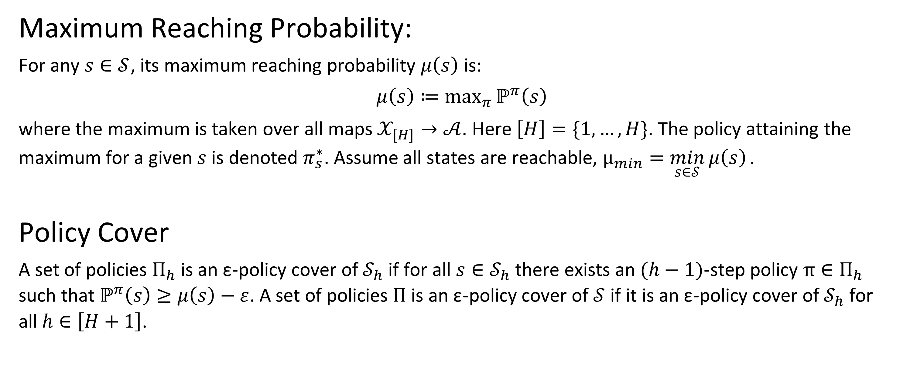
Maximum Reaching Probability and Policy Cover
Maximum Reaching Probability:
For any $s∈𝒮$, its maximum reaching probability $μ\left(s\right)$ is:
$$μ\left(s\right)≔\max_{π}{ℙ^{π}\left(s\right)}$$
where the maximum is taken over all maps $𝒳_{[H]}→𝒜$. Here $\left[H\right]=\{1,…,H\}$. The policy attaining the maximum for a given $s$ is denoted $π_{s}^{∗}$. Assume all states are reachable, $μ_{min}=\min_{s∈𝒮}{μ\left(s\right)}.$
Policy Cover
A set of policies $Π_{h}$ is an ε-policy cover of $𝒮_{h}$ if for all $s∈𝒮_{h}$ there exists an $(h−1)$-step policy $π∈Π_{h}$ such that $ℙ^{π}\left(s\right)≥μ\left(s\right)−ε$. A set of policies $Π$ is an ε-policy cover of $𝒮$ if it is an ε-policy cover of $𝒮_{h}$ for all$h∈\left[H+1\right]$.

Slide 12
Approach

Slide 13
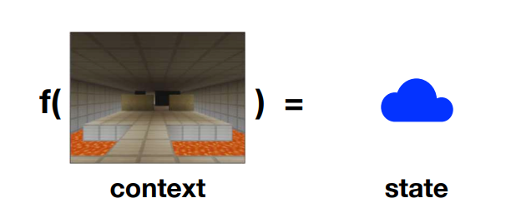
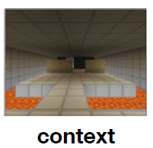



Learn the Decoding Function
Ideally
Unfortunately, we do not know about the state.
$$g(x)$$
$$φ\left(s\right)$$
Low-dimensional Shared Space
Parts of the figures from paper authors’ slides

Slide 14
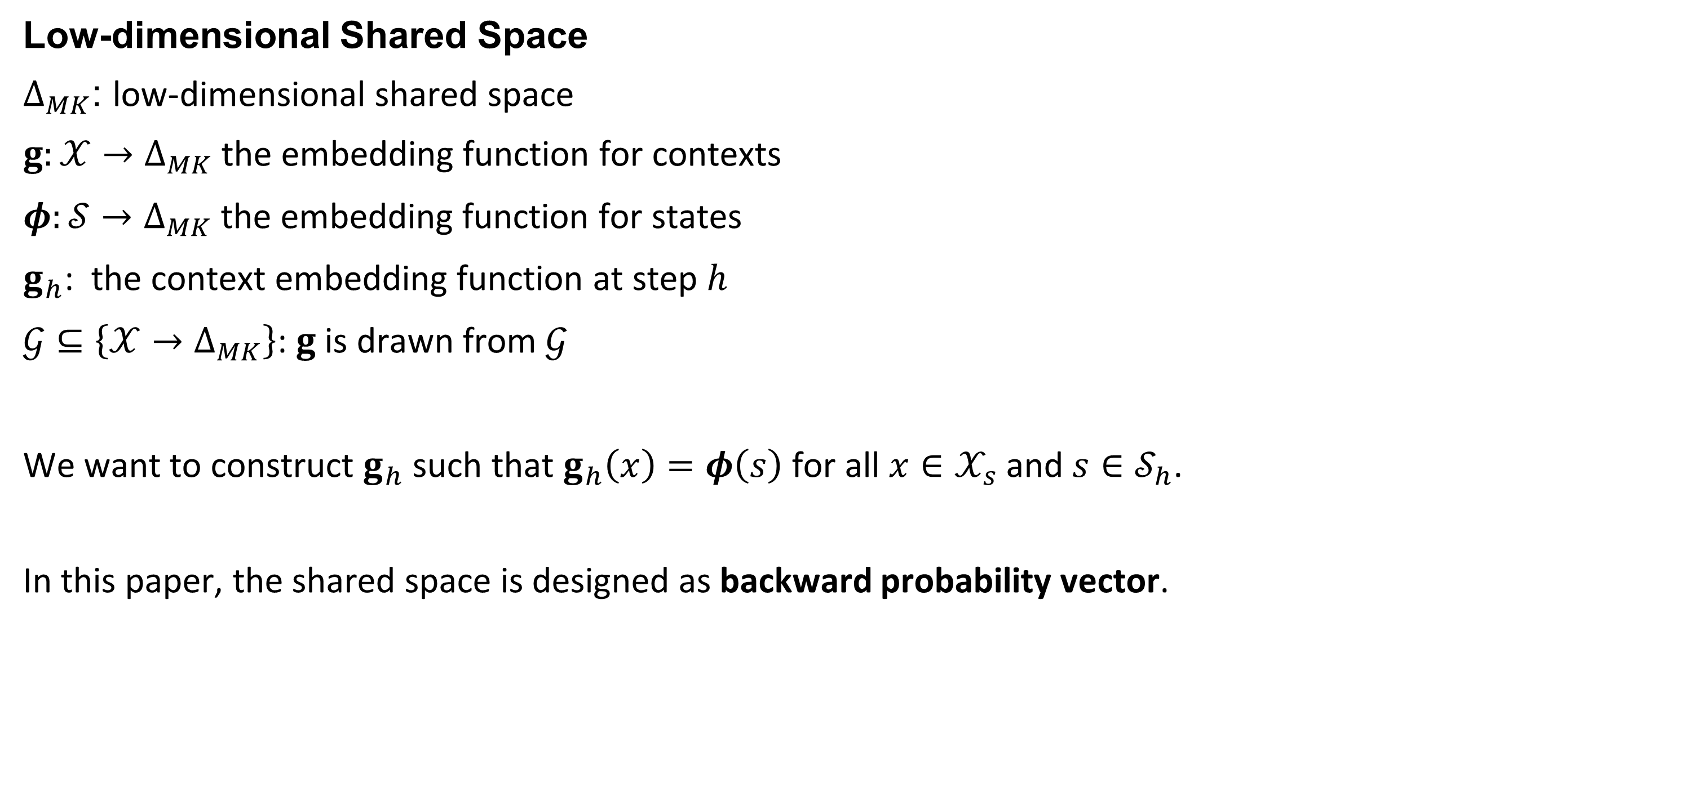
Learn the Decoding Function
Low-dimensional Shared Space
$Δ_{MK}$: low-dimensional shared space
$g:𝒳→Δ_{MK}$ the embedding function for contexts
$φ:𝒮→Δ_{MK}$ the embedding function for states
$g_{h}$: the context embedding function at step $h$
$𝒢⊆\left\{𝒳→Δ_{MK}\right\}$: $g$ is drawn from $𝒢$
We want to construct $g_{h}$ such that $g_{h}\left(x\right)=φ\left(s\right)$ for all $x∈𝒳_{s}$and $s∈𝒮_{h}$.
In this paper, the shared space is designed as backward probability vector.

Slide 15
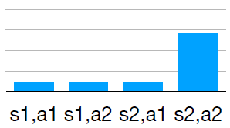
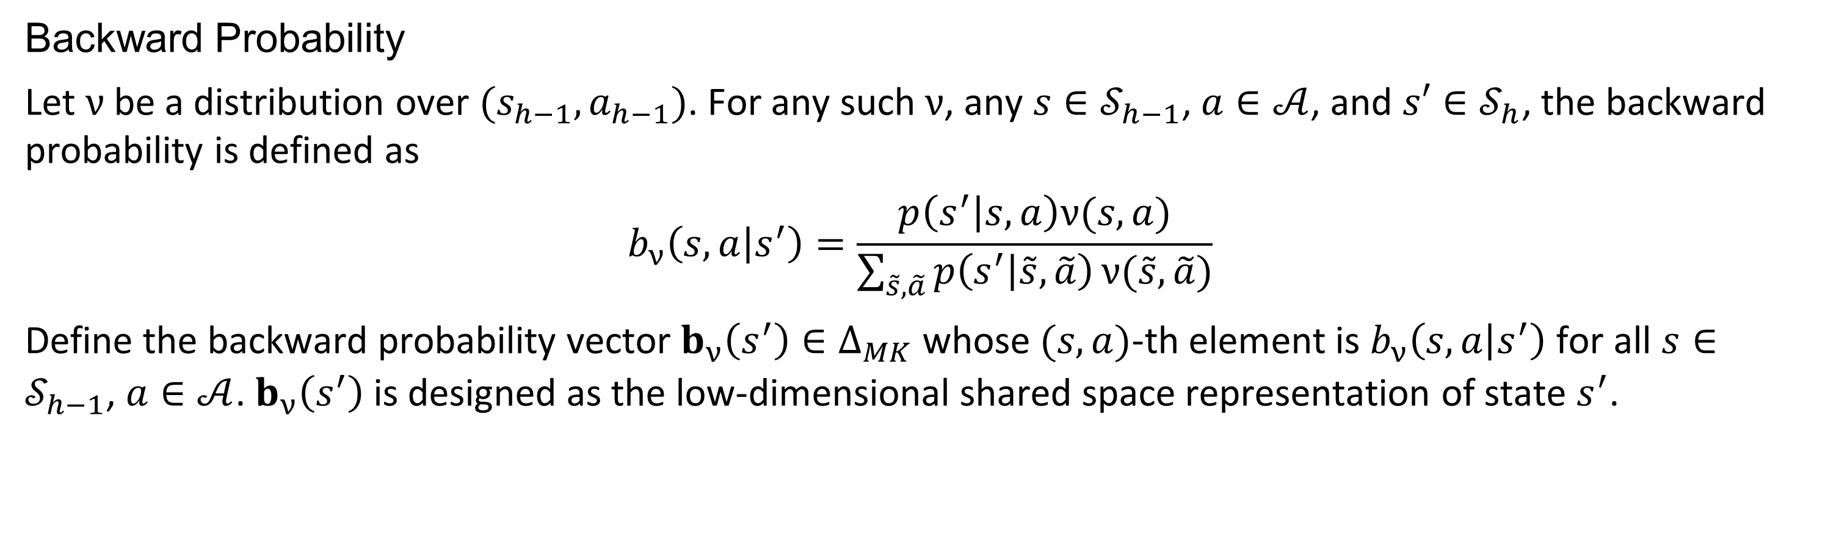
Learn the Decoding Function
Backward Probability
Let $ν$ be a distribution over $(s_{h−1}, a_{h−1})$. For any such $ν$, any $s∈𝒮_{h−1}$, $a∈𝒜$, and $s′∈𝒮_{h}$, the backward probability is defined as
$$b_{ν}\left(s,a | s^{′}\right)=\frac{p\left(s^{′} | s,a\right)ν(s,a)}{\sum_{\tilde{s},\tilde{a}}{p\left(s^{′} | \tilde{s},\tilde{a}\right)}ν(\tilde{s},\tilde{a})}$$
Define the backward probability vector $b_{ν}\left(s^{′}\right)∈Δ_{MK}$ whose $(s,a)$-th element is $b_{ν}\left(s,a | s^{′}\right)$ for all $s∈𝒮_{h−1}$, $a∈𝒜$. $b_{ν}\left(s^{′}\right)$ is designed as the low-dimensional shared space representation of state $s^{′}$.

Slide 16
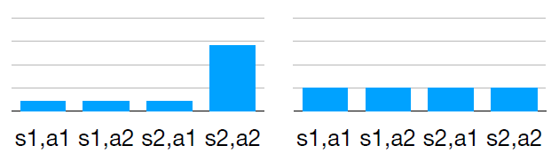
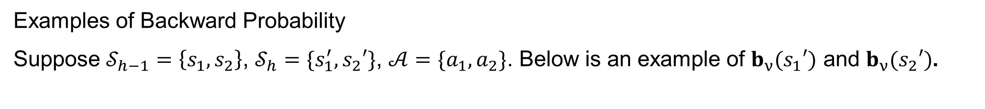


Learn the Decoding Function
Examples of Backward Probability
Suppose $𝒮_{h−1}=\left\{s_{1},s_{2}\right\}$, $𝒮_{h}=\{s_{1}^{′},s_{2}′\}$, $𝒜=\{a_{1},a_{2}\}$. Below is an example of $b_{ν}(s_{1}′)$ and $b_{ν}(s_{2}′)$.
$$b_{ν}(s_{1}′)$$
$$b_{ν}(s_{2}′)$$

Slide 17
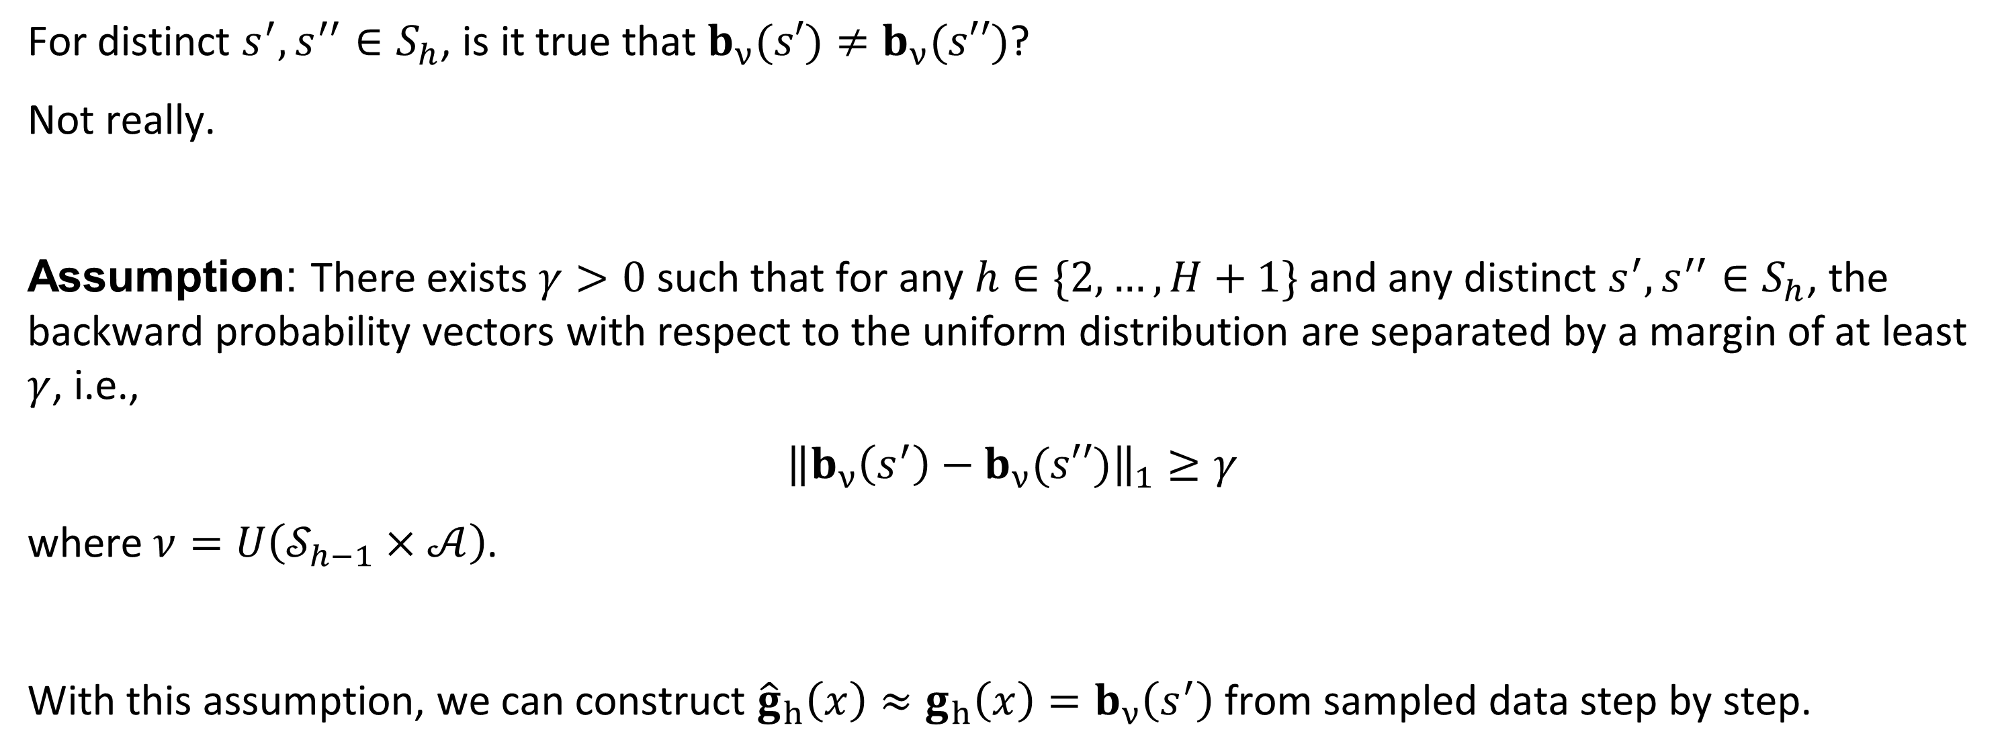
Learn the Decoding Function
For distinct $s^{′},s^{′′}∈S_{h}$, is it true that $b_{ν}(s′)≠b_{ν}(s′′)$?
Not really.
Assumption: There exists $γ>0$ such that for any $h∈\{2, …,H+1\}$ and any distinct $s^{′},s^{′′}∈S_{h}$, the backward probability vectors with respect to the uniform distribution are separated by a margin of at least $γ$, i.e.,
$${\left\|b_{ν}\left(s^{′}\right)−b_{ν}(s′′)\right\|}_{1}≥γ$$
where $ν=U\left(𝒮_{h−1}×𝒜\right)$.
With this assumption, we can construct ${\hat{g}}_{h}\left(x\right)≈g_{h}\left(x\right)=b_{ν}\left(s^{′}\right)$ from sampled data step by step.

Slide 18
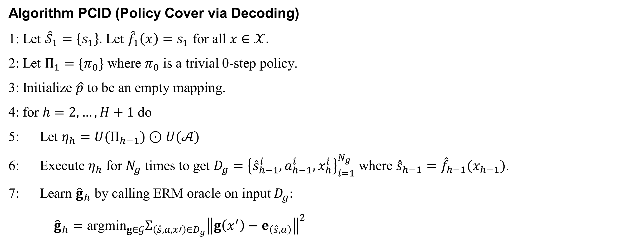
Learn the Decoding Function
Algorithm PCID (Policy Cover via Decoding)
1: Let ${\hat{𝒮}}_{1}=\left\{s_{1}\right\}.$ Let ${\hat{f}}_{1}\left(x\right)=s_{1}$ for all $x∈𝒳.$
2: Let $Π_{1}=\{π_{0}\}$ where $π_{0}$ is a trivial 0-step policy.
3: Initialize $\hat{p}$ to be an empty mapping.
4: for $h=2,…,H+1$ do
5: Let $η_{h}=U(Π_{h−1})⊙U(𝒜)$
6: Execute $η_{h}$ for $N_{g}$ times to get $D_{g}={\left\{{\hat{s}}_{h−1}^{i}, a_{h−1}^{i},x_{h}^{i}\right\}}_{i=1}^{N_{g}}$ where ${\hat{s}}_{h−1}={\hat{f}}_{h−1}(x_{h−1})$.
7: Learn ${\hat{g}}_{h}$ by calling ERM oracle on input $D_{g}:$
${\hat{g}}_{h}={\text{argmin}}_{g∈𝒢}Σ_{\left(\hat{s},a,x′\right)∈D_{g}}{\left\|g\left(x^{′}\right)−e_{\left(\hat{s},a\right)}\right\|}^{2}$

Slide 19
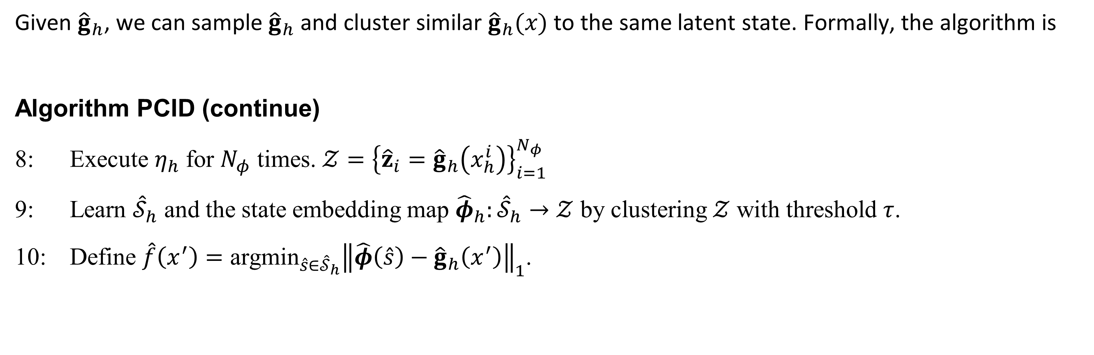
Learn the Decoding Function
Given ${\hat{g}}_{h}$, we can sample ${\hat{g}}_{h}$ and cluster similar ${\hat{g}}_{h}(x)$ to the same latent state. Formally, the algorithm is
Algorithm PCID (continue)
8: Execute $η_{h}$ for $N_{φ}$ times. $𝒵={\left\{{\hat{z}}_{i}={\hat{g}}_{h}\left(x_{h}^{i}\right)\right\}}_{i=1}^{N_{φ}}$
9: Learn ${\hat{𝒮}}_{h}$ and the state embedding map ${\hat{φ}}_{h}:{\hat{𝒮}}_{h}→𝒵$ by clustering $𝒵$ with threshold $τ$.
10: Define $\hat{f}\left(x^{′}\right)={\text{argmin}}_{\hat{s}∈{\hat{𝒮}}_{h}}{\left\|\hat{φ}\left(\hat{s}\right)−{\hat{g}}_{h}\left(x^{′}\right)\right\|}_{1}$.

Slide 20
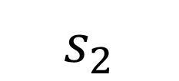

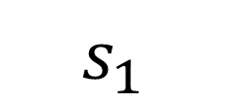




Learn the Decoding Function
$$s_{2}$$
$$z_{4}$$
$$z_{5}$$
$$s_{1}$$
$$z_{2}$$
$$z_{3}$$
$$z_{1}$$

Slide 21
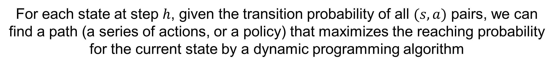
Learn the Policy Cover
Given ${\hat{f}}_{h}$, we can sample a dataset $D_{p}={\left\{{\hat{s}}_{h−1}^{i},a_{h−1}^{i},{\hat{s}}_{h}^{i}\right\}}_{i=1}^{N_{p}}$
Learn $\hat{p}\left({\hat{s}}_{h} | {\hat{s}}_{h−1},a_{h−1}\right)$ from $D_{p}$
For each state at step $h$, given the transition probability of all $(s,a)$ pairs, we can find a path (a series of actions, or a policy) that maximizes the reaching probability for the current state by a dynamic programming algorithm
Collect such a policy for all states and get the policy cover $Π_{h}$

Slide 22

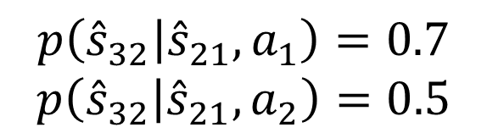


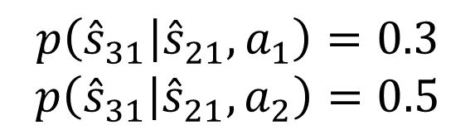




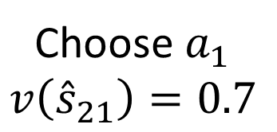



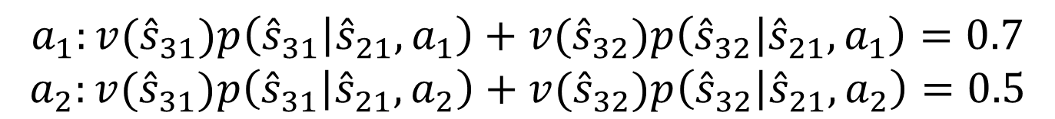
Learn the Policy Cover
Dynamic Programming for Reaching a State
Step
$$v\left({\hat{s}}_{31}\right)=0$$
$$v\left({\hat{s}}_{32}\right)=1$$
$$h=3$$
$${\hat{s}}_{31}$$
$${\hat{s}}_{32}$$
$$p\left({\hat{s}}_{31} | {\hat{s}}_{21},a_{1}\right)=0.3$$
$$p\left({\hat{s}}_{31} | {\hat{s}}_{21},a_{2}\right)=0.5$$
$$p\left({\hat{s}}_{32} | {\hat{s}}_{21},a_{1}\right)=0.7$$
$$p\left({\hat{s}}_{32} | {\hat{s}}_{21},a_{2}\right)=0.5$$
$$h=2$$
$${\hat{s}}_{21}$$
$$a_{1}:v({\hat{s}}_{31})p\left({\hat{s}}_{31} | {\hat{s}}_{21},a_{1}\right)+v({\hat{s}}_{32})p\left({\hat{s}}_{32} | {\hat{s}}_{21},a_{1}\right)=0.7$$
$$a_{2}:v({\hat{s}}_{31})p\left({\hat{s}}_{31} | {\hat{s}}_{21},a_{2}\right)+v({\hat{s}}_{32})p\left({\hat{s}}_{32} | {\hat{s}}_{21},a_{2}\right)=0.5$$
$${\hat{s}}_{22}$$
Choose $a_{1}$
$$v\left({\hat{s}}_{21}\right)=0.7$$
$$h=1$$
$$s_{1}$$

Slide 23
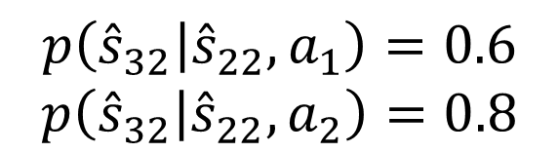
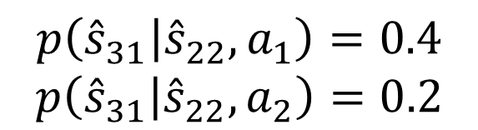
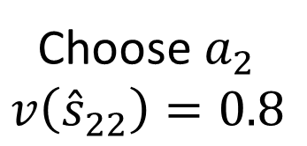


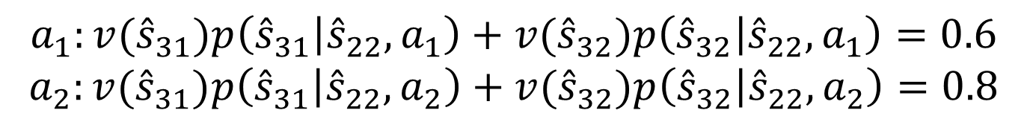
Learn the Policy Cover
Dynamic Programming for Reaching a State
Step
$$v\left({\hat{s}}_{31}\right)=0$$
$$v\left({\hat{s}}_{32}\right)=1$$
$$h=3$$
$${\hat{s}}_{31}$$
$${\hat{s}}_{32}$$
$$p\left({\hat{s}}_{32} | {\hat{s}}_{22},a_{1}\right)=0.6$$
$$p\left({\hat{s}}_{32} | {\hat{s}}_{22},a_{2}\right)=0.8$$
$$p\left({\hat{s}}_{31} | {\hat{s}}_{22},a_{1}\right)=0.4$$
$$p\left({\hat{s}}_{31} | {\hat{s}}_{22},a_{2}\right)=0.2$$
$$h=2$$
$${\hat{s}}_{21}$$
$$a_{1}:v({\hat{s}}_{31})p\left({\hat{s}}_{31} | {\hat{s}}_{22},a_{1}\right)+v({\hat{s}}_{32})p\left({\hat{s}}_{32} | {\hat{s}}_{22},a_{1}\right)=0.6$$
$$a_{2}:v({\hat{s}}_{31})p\left({\hat{s}}_{31} | {\hat{s}}_{22},a_{2}\right)+v({\hat{s}}_{32})p\left({\hat{s}}_{32} | {\hat{s}}_{22},a_{2}\right)=0.8$$
$${\hat{s}}_{22}$$
Choose $a_{1}$
$$v\left({\hat{s}}_{21}\right)=0.7$$
Choose $a_{2}$
$$v\left({\hat{s}}_{22}\right)=0.8$$
$$h=1$$
$$s_{1}$$

Slide 24
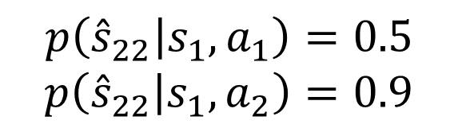
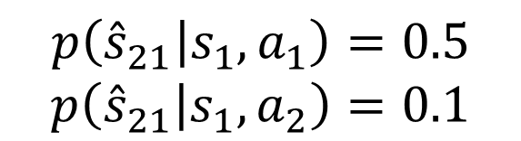
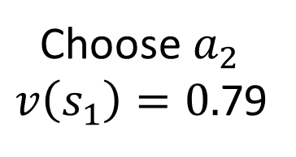
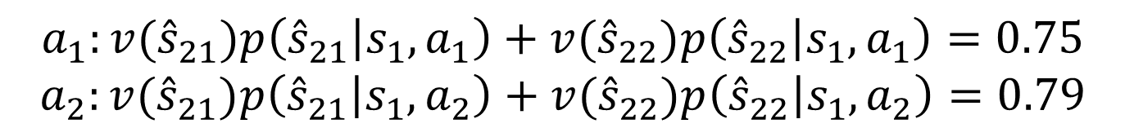
Learn the Policy Cover
Dynamic Programming for Reaching a State
Step
$$v\left({\hat{s}}_{31}\right)=0$$
$$v\left({\hat{s}}_{32}\right)=1$$
$$h=3$$
$${\hat{s}}_{31}$$
$${\hat{s}}_{32}$$
$$h=2$$
$${\hat{s}}_{21}$$
$$p\left({\hat{s}}_{21} | s_{1},a_{1}\right)=0.5$$
$$p\left({\hat{s}}_{21} | s_{1},a_{2}\right)=0.1$$
$$p\left({\hat{s}}_{22} | s_{1},a_{1}\right)=0.5$$
$$p\left({\hat{s}}_{22} | s_{1},a_{2}\right)=0.9$$
$${\hat{s}}_{22}$$
Choose $a_{1}$
$$v\left({\hat{s}}_{21}\right)=0.7$$
Choose $a_{2}$
$$v\left({\hat{s}}_{22}\right)=0.8$$
$$h=1$$
$$s_{1}$$
Choose $a_{2}$
$v\left(s_{1}\right)=0.$79
$$a_{1}:v({\hat{s}}_{21})p\left({\hat{s}}_{21} | s_{1},a_{1}\right)+v({\hat{s}}_{22})p\left({\hat{s}}_{22} | s_{1},a_{1}\right)=0.75$$
$$a_{2}:v({\hat{s}}_{21})p\left({\hat{s}}_{21} | s_{1},a_{2}\right)+v({\hat{s}}_{22})p\left({\hat{s}}_{22} | s_{1},a_{2}\right)=0.79$$

Slide 25
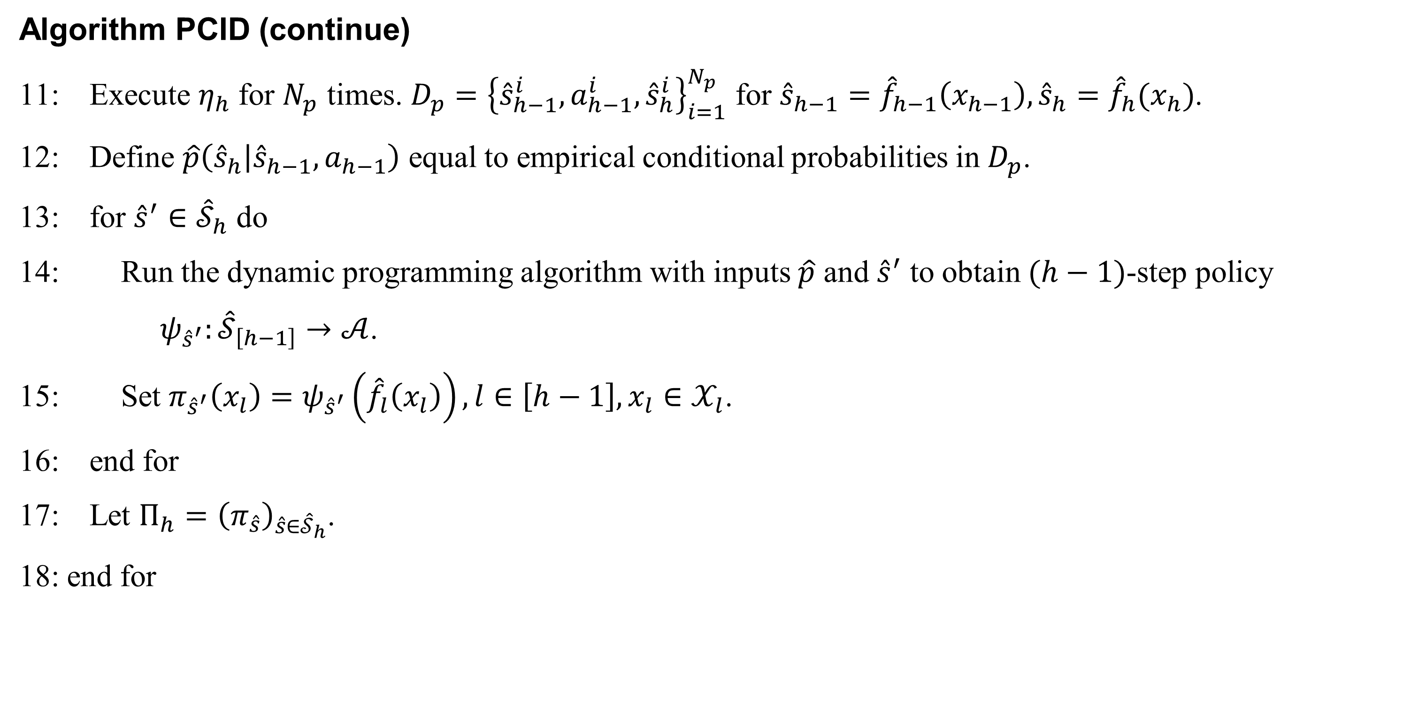
Learn the Policy Cover
Algorithm PCID (continue)
11: Execute $η_{h}$ for $N_{p}$ times. $D_{p}={\left\{{\hat{s}}_{h−1}^{i},a_{h−1}^{i},{\hat{s}}_{h}^{i}\right\}}_{i=1}^{N_{p}}$ for ${\hat{s}}_{h−1}={\hat{f}}_{h−1}\left(x_{h−1}\right), {\hat{s}}_{h}={\hat{f}}_{h}(x_{h})$.
12: Define $\hat{p}\left({\hat{s}}_{h} | {\hat{s}}_{h−1},a_{h−1}\right)$ equal to empirical conditional probabilities in $D_{p}$.
13: for ${\hat{s}}^{′}∈{\hat{𝒮}}_{h}$ do
14: Run the dynamic programming algorithm with inputs $\hat{p}$ and ${\hat{s}}^{′}$ to obtain $(h−1)$-step policy
$ψ_{{\hat{s}}^{′}}:{\hat{𝒮}}_{\left[h−1\right]}→𝒜$.
15: Set $π_{{\hat{s}}^{′}}\left(x_{l}\right)=ψ_{{\hat{s}}^{′}}\left({\hat{f}}_{l}\left(x_{l}\right)\right), l∈\left[h−1\right],x_{l}∈𝒳_{l}$.
16: end for
17: Let $Π_{h}={\left(π_{\hat{s}}\right)}_{\hat{s}∈{\hat{𝒮}}_{h}}$.
18: end for

Slide 26
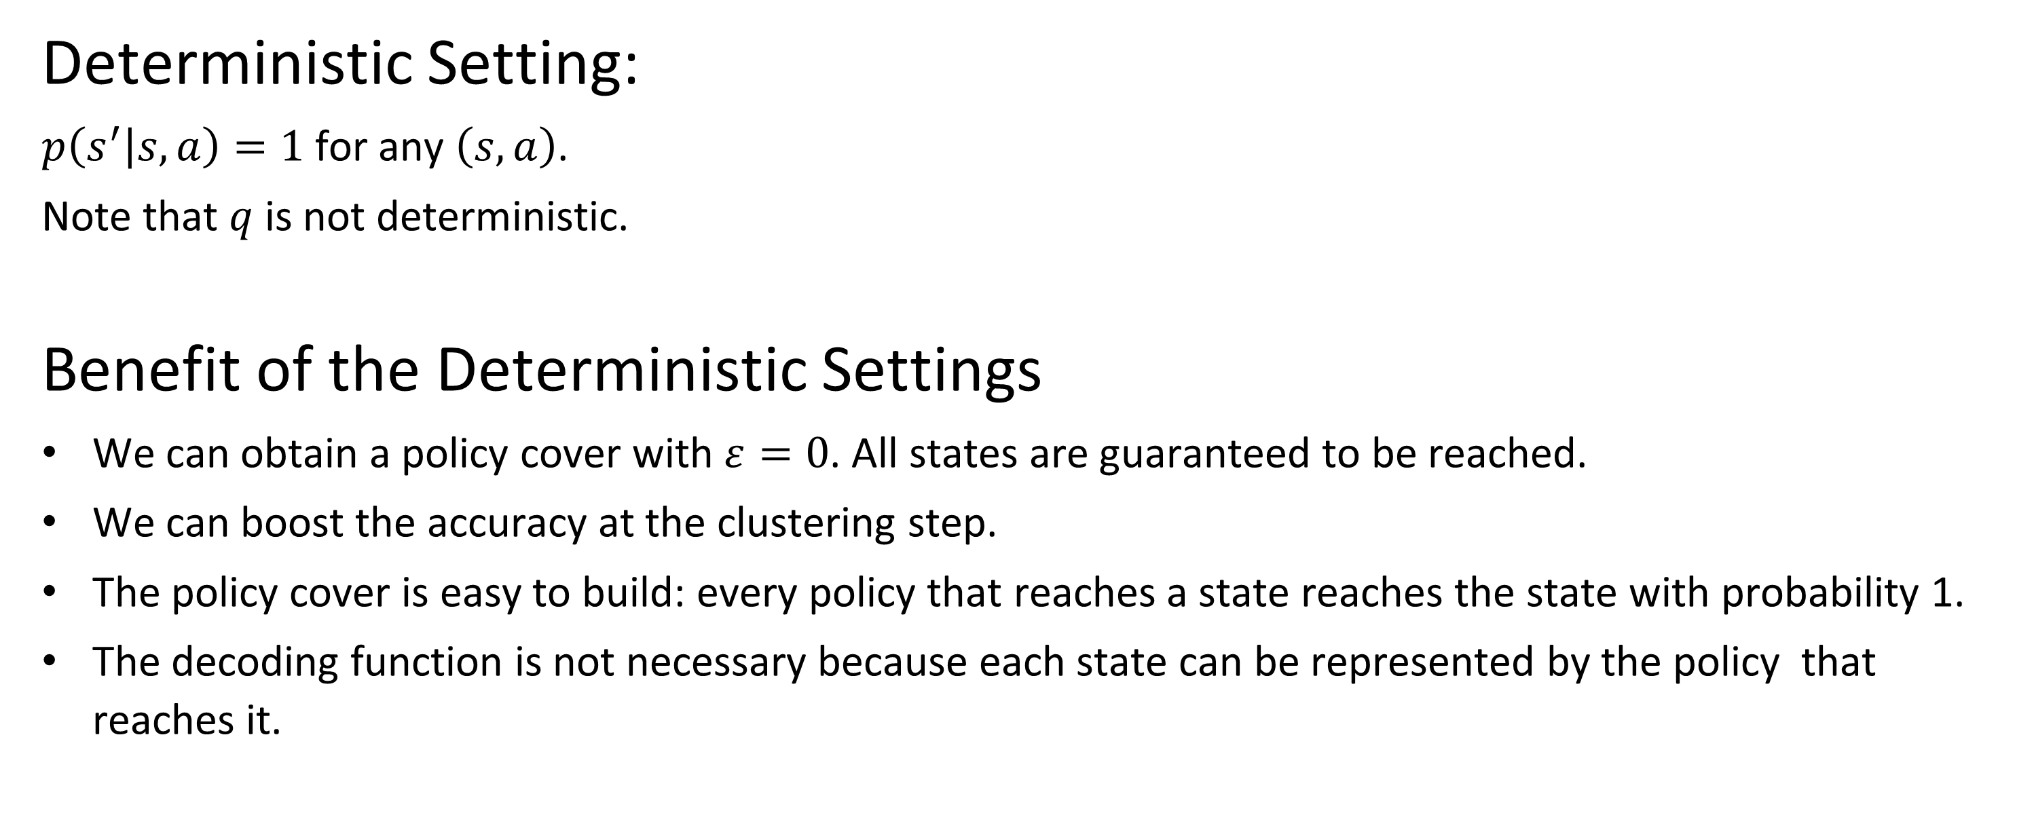
Special Case: Deterministic BMDPs
Deterministic Setting:
$p\left(s^{′} | s,a\right)=1$ for any $\left(s,a\right)$.
Note that $q$ is not deterministic.
Benefit of the Deterministic Settings
We can obtain a policy cover with $ε=0$. All states are guaranteed to be reached.
We can boost the accuracy at the clustering step.
The policy cover is easy to build: every policy that reaches a state reaches the state with probability 1.
The decoding function is not necessary because each state can be represented by the policy that reaches it.

Slide 27
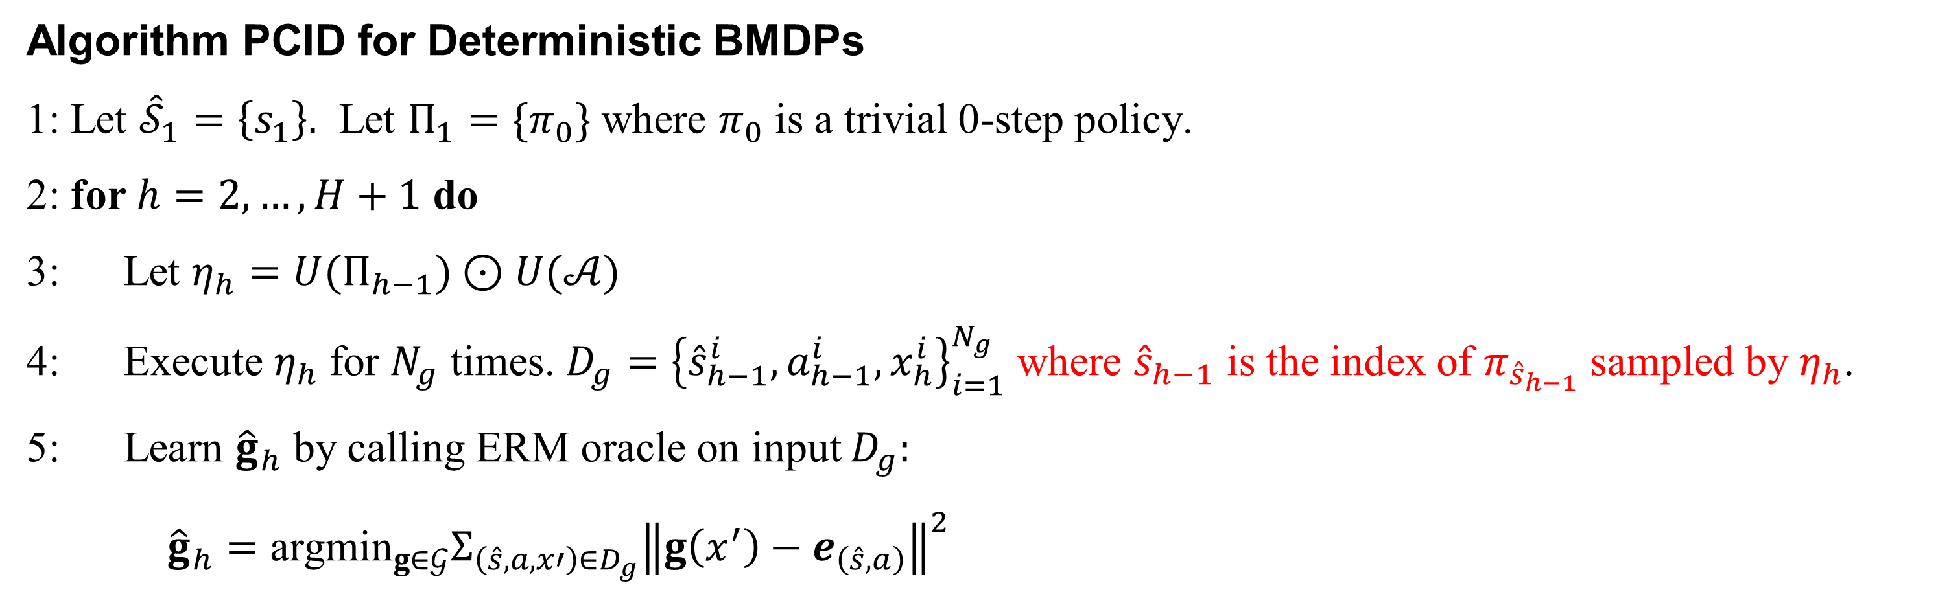
Special Case: Deterministic BMDPs
Algorithm PCID for Deterministic BMDPs
1: Let ${\hat{𝒮}}_{1}=\left\{s_{1}\right\}.$ Let $Π_{1}=\{π_{0}\}$ where $π_{0}$ is a trivial 0-step policy.
2: for $h=2,…,H+1$ do
3: Let $η_{h}=U(Π_{h−1})⊙U(𝒜)$
4: Execute $η_{h}$ for $N_{g}$ times. $D_{g}={\left\{{\hat{s}}_{h−1}^{i}, a_{h−1}^{i},x_{h}^{i}\right\}}_{i=1}^{N_{g}}$ where ${\hat{s}}_{h−1}$ is the index of $π_{{\hat{s}}_{h−1}}$ sampled by $η_{h}$.
5: Learn ${\hat{g}}_{h}$ by calling ERM oracle on input $D_{g}:$
${\hat{g}}_{h}={\text{argmin}}_{g∈𝒢}Σ_{\left(\hat{s},a,x′\right)∈D_{g}}{\left\|g\left(x^{′}\right)−e_{\left(\hat{s},a\right)}\right\|}^{2}$

Slide 28
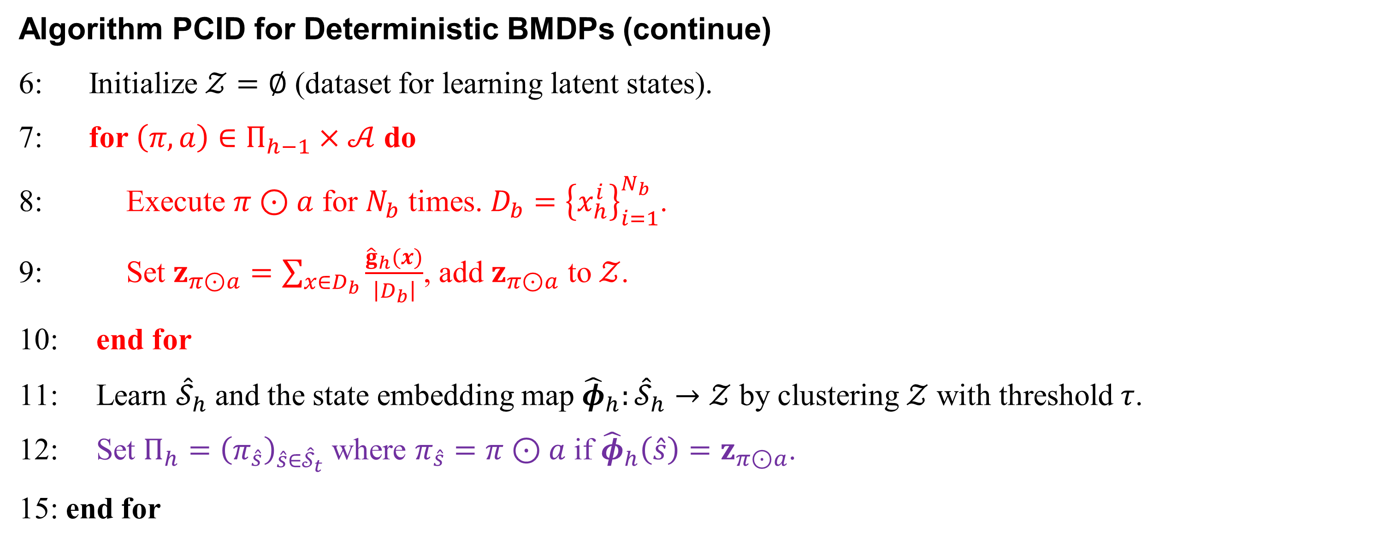
Special Case: Deterministic BMDPs
Algorithm PCID for Deterministic BMDPs (continue)
6: Initialize $𝒵=∅$ (dataset for learning latent states).
7: for $\left(π,a\right)∈Π_{h−1}×𝒜$ do
8: Execute $π⊙a$ for $N_{b}$ times. $D_{b}={\left\{x_{h}^{i}\right\}}_{i=1}^{N_{b}}$.
9: Set $z_{π⊙a}=\sum_{x∈D_{b}}{\frac{{\hat{g}}_{h}(x)}{\left|D_{b}\right|}}$, add $z_{π⊙a}$ to $𝒵$.
10: end for
11: Learn ${\hat{𝒮}}_{h}$ and the state embedding map ${\hat{φ}}_{h}:{\hat{𝒮}}_{h}→𝒵$ by clustering $𝒵$ with threshold $τ$.
12: Set $Π_{h}={\left(π_{\hat{s}}\right)}_{\hat{s}∈{\hat{𝒮}}_{t}}$ where $π_{\hat{s}}=π⊙a$ if ${\hat{φ}}_{h}\left(\hat{s}\right)=z_{π⊙a}$.
15: end for

Slide 29
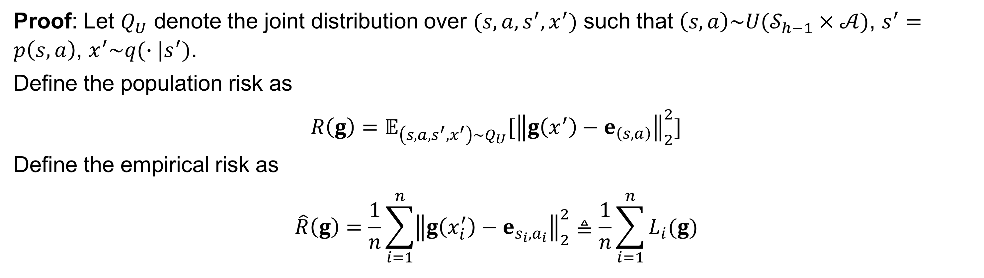
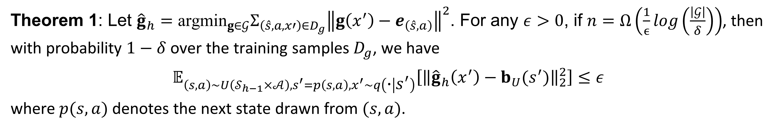
Sample Complexity for Deterministic BMDPs
Theorem 1: Let ${\hat{g}}_{h}={\text{argmin}}_{g∈𝒢}Σ_{\left(\hat{s},a,x′\right)∈D_{g}}{\left\|g\left(x^{′}\right)−e_{\left(\hat{s},a\right)}\right\|}^{2}$. For any $ε>0$, if $n=Ω\left(\frac{1}{ϵ}\log\left(\frac{\left|𝒢\right|}{δ}\right)\right)$, then with probability $1−δ$ over the training samples $D_{g}$, we have
$$𝔼_{\left(s,a\right)\sim U\left(𝒮_{h−1}×𝒜\right),s^{′}=p\left(s,a\right),x^{′}\sim q\left(∙ | s^{′}\right)}\left[{\left\|{\hat{g}}_{h}\left(x^{′}\right)−b_{U}(s^{′})\right\|}_{2}^{2}\right]≤ε$$
where $p(s,a)$ denotes the next state drawn from $(s,a)$.
Proof: Let $Q_{U}$ denote the joint distribution over $(s, a,s^{′},x^{′})$ such that $\left(s,a\right)\sim U(𝒮_{h−1}×𝒜)$, $s^{′}=p\left(s,a\right)$, $x^{′}\sim q(∙|s^{′})$.
Define the population risk as
$$R\left(g\right)=𝔼_{\left(s,a,s^{′},x^{′}\right)\sim Q_{U}}[{\left\|g\left(x^{′}\right)−e_{\left(s,a\right)}\right\|}_{2}^{2}]$$
Define the empirical risk as
$$\hat{R}\left(g\right)=\frac{1}{n}\sum_{i=1}^{n}{{\left\|g\left(x_{i}^{′}\right)−e_{s_{i},a_{i}}\right\|}_{2}^{2}≜\frac{1}{n}\sum_{i=1}^{n}{L_{i}(g)}}$$

Slide 30
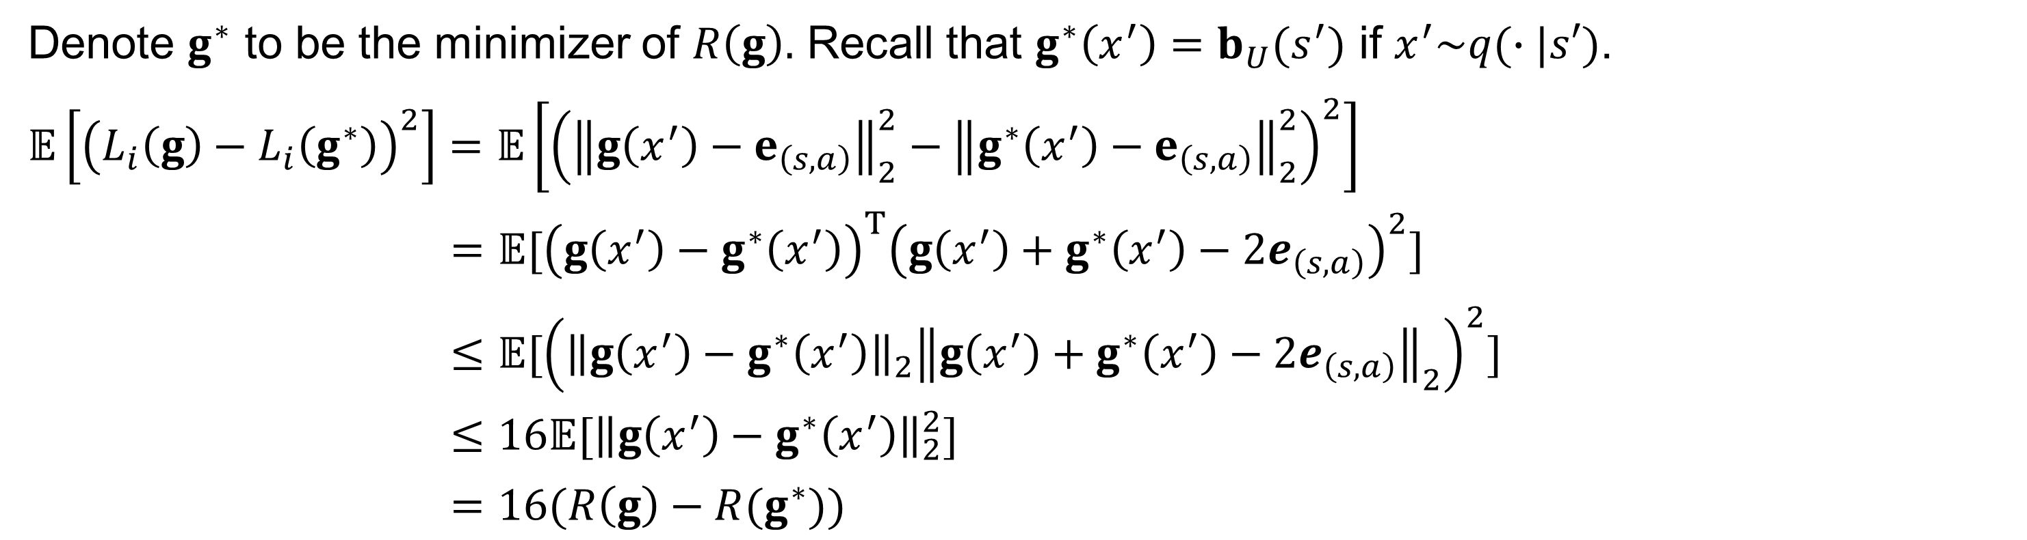
Sample Complexity for Deterministic BMDPs
Denote $g^{∗}$ to be the minimizer of $R\left(g\right).$ Recall that $g^{∗}\left(x^{′}\right)=b_{U}(s^{′})$ if $x^{′}\sim q(∙|s′)$.
$𝔼\left[{\left(L_{i}\left(g\right)−L_{i}\left(g^{∗}\right)\right)}^{2}\right]=𝔼\left[{\left({\left\|g\left(x^{′}\right)−e_{\left(s,a\right)}\right\|}_{2}^{2}−{\left\|g^{∗}\left(x^{′}\right)−e_{\left(s,a\right)}\right\|}_{2}^{2}\right)}^{2}\right]$
$=𝔼[{\left(g\left(x^{′}\right)−g^{∗}\left(x^{′}\right)\right)}^{T}{\left(g\left(x^{′}\right)+g^{∗}\left(x^{′}\right)−2e_{\left(s,a\right)}\right)}^{2}]$
$≤𝔼[{\left({\left\|g\left(x^{′}\right)−g^{∗}\left(x^{′}\right)\right\|}_{2}{\left\|g\left(x^{′}\right)+g^{∗}\left(x^{′}\right)−2e_{\left(s,a\right)}\right\|}_{2}\right)}^{2}]$
$≤16𝔼[{\left\|g\left(x^{′}\right)−g^{∗}\left(x^{′}\right)\right\|}_{2}^{2}]$
$=16(R\left(g\right)−R(g^{∗}))$
Notes:
Need to explain some of the equations on the blackboard

Slide 31
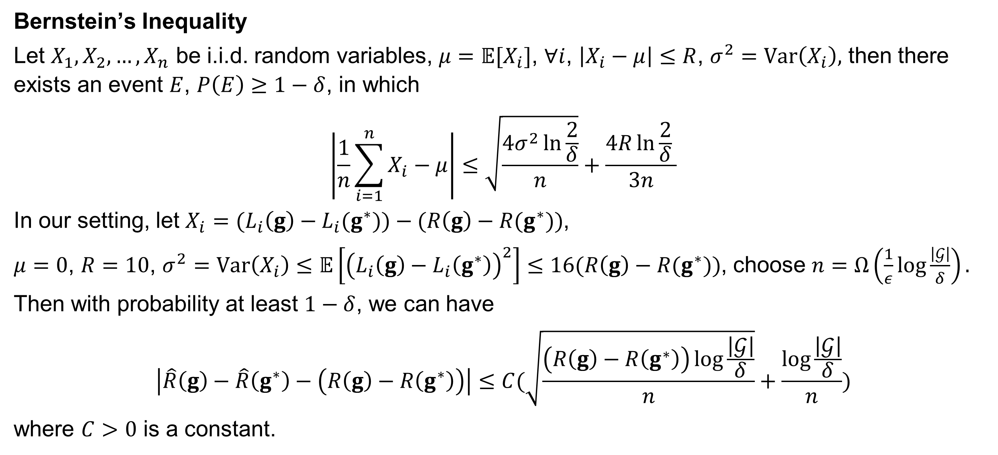
Sample Complexity for Deterministic BMDPs
Bernstein’s Inequality
Let $X_{1},X_{2},…,X_{n}$ be i.i.d. random variables, $μ=𝔼[X_{i}]$, $∀i$, $\left|X_{i}−μ\right|≤R$, $σ^{2}=Var\left(X_{i}\right),$ then there exists an event $E$, $P\left(E\right)≥1−δ$, in which
$$\left|\frac{1}{n}\sum_{i=1}^{n}{X_{i}−μ}\right|≤\sqrt{\frac{4σ^{2}\ln{\frac{2}{δ}}}{n}}+\frac{4R\ln{\frac{2}{δ}} }{3n}$$
In our setting, let $X_{i}={(L}_{i}\left(g\right)−L_{i}(g^{∗}))−(R\left(g\right)−R(g^{∗}))$,
$μ=0$, $R=10$, $σ^{2}=Var\left(X_{i}\right)≤$ $𝔼\left[{\left(L_{i}\left(g\right)−L_{i}\left(g^{∗}\right)\right)}^{2}\right]≤16(R\left(g\right)−R(g^{∗}))$, choose $n=Ω\left(\frac{1}{ε}\log{\frac{\left|𝒢\right|}{δ}}\right).$
Then with probability at least $1−δ$, we can have
$$\left|\hat{R}\left(g\right)−\hat{R}\left(g^{∗}\right)−\left(R\left(g\right)−R\left(g^{∗}\right)\right)\right|≤C(\sqrt{\frac{\left(R\left(g\right)−R\left(g^{∗}\right)\right)\log{\frac{\left|𝒢\right|}{δ}}}{n}}+\frac{\log{\frac{\left|𝒢\right|}{δ}}}{n})$$
where $C>0$ is a constant.

Slide 32
Experiments

Slide 33
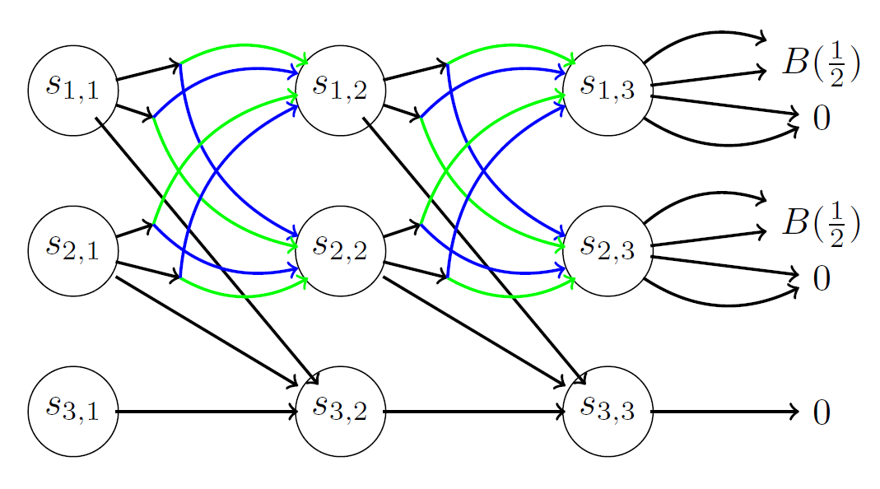
Environment
Combination Lock
Figure from the original paper

Slide 34
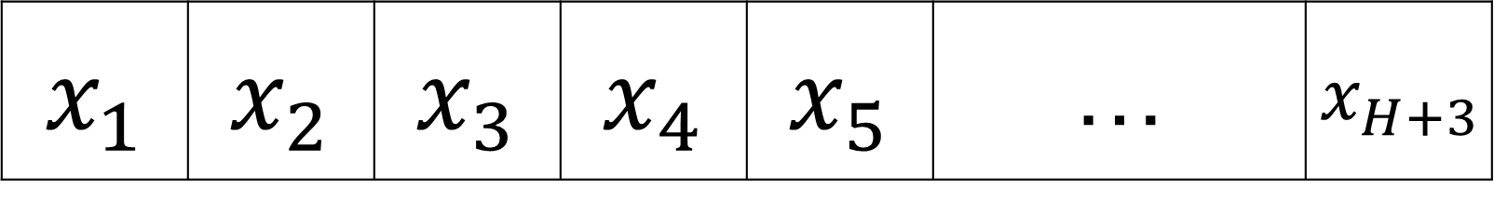
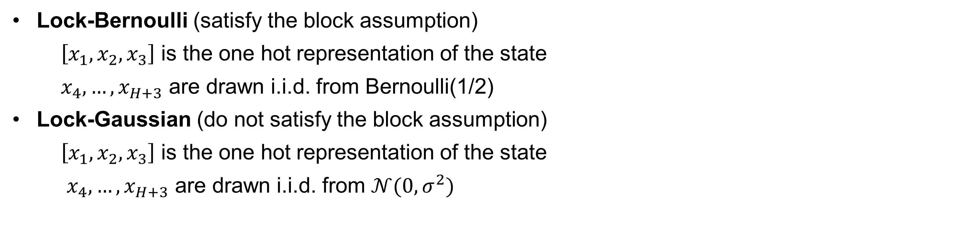
Algorithms
Baseline: Q-Learning
Skyline: ORACLE-Q (Jin et al., 2018)
$$x_{1}$$ | $$x_{2}$$ | $$x_{3}$$ | $$x_{4}$$ | $$x_{5}$$ | … | $$x_{H+3}$$
Lock-Bernoulli (satisfy the block assumption)
$\left[x_{1},x_{2},x_{3}\right]$ is the one hot representation of the state
$x_{4},…,x_{H+3}$ are drawn i.i.d. from Bernoulli(1/2)
Lock-Gaussian (do not satisfy the block assumption)
$\left[x_{1},x_{2},x_{3}\right]$ is the one hot representation of the state
$x_{4},…,x_{H+3}$ are drawn i.i.d. from $𝒩(0,σ^{2})$
Jin, Chi, et al. "Is Q-learning provably efficient?." arXiv preprint arXiv:1807.03765 (2018).

Slide 35

Results

