Slide 1
CSC 588 Machine learning theory
Chicheng Zhang
University of Arizona

Slide 2
Logistics info
Instructor: Chicheng Zhang (chichengz@cs.arizona.edu)
Office Hours: TBD, Gould-Simpson 720
Class website: https://zcc1307.github.io/courses/csc588sp22/index.html

Slide 3
What is this course about?
Providing theoretical foundations for algorithm design in machine learning, using rigorous math tools
Specifically, establish theoretical guarantees of machine learning algorithms in terms of their:
Data efficiency (sample complexity, test error rate)
Computational efficiency (time / space complexity)
…

Slide 4
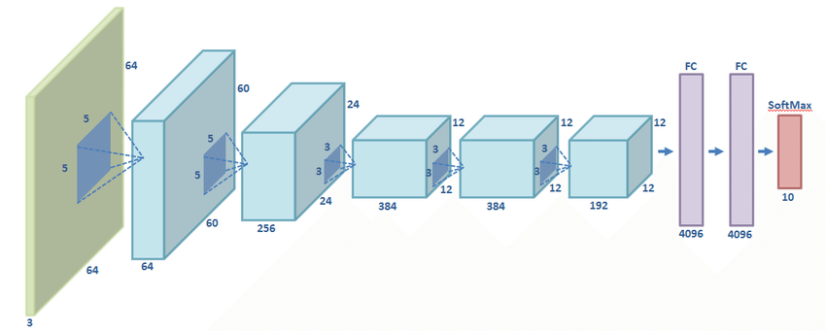
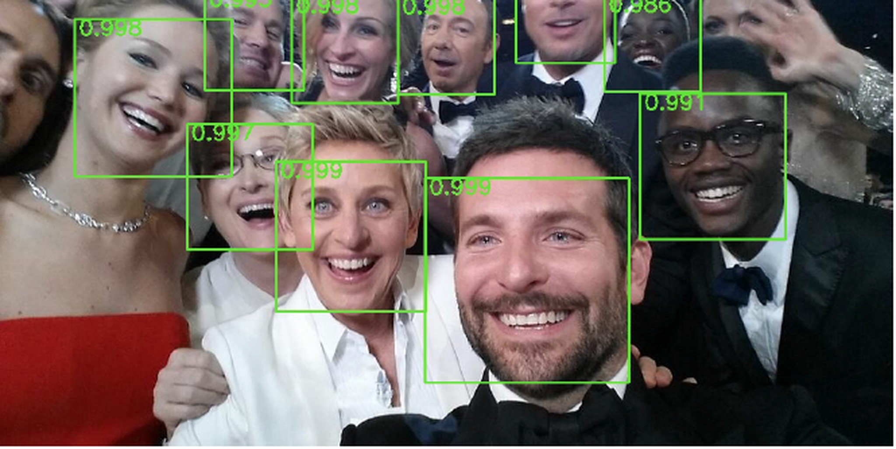

Where can machine learning theory be useful?
Explain the success of machine learning practice
E.g. understanding the success in learning using overparametrized neural networks (e.g Arora, Du, Hu, Li & Wang, 2019)
Spur the development of practical machine learning algorithms
Boosting (Freund & Schapire, 1997)
LinUCB (Li, Chu, Langford & Schapire, 2010)

Slide 5
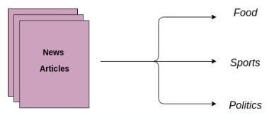
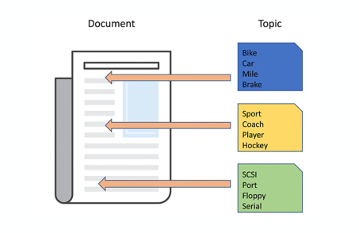

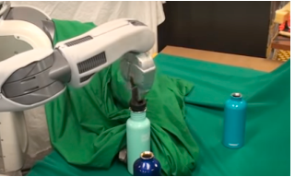
Landscape of machine learning problems
Offline (batch / statistical) learning
Supervised
Unsupervised
Semi-supervised
Online / interactive learning
Online classification / regression
Reinforcement learning (bandits, learning in MDPs)
Imitation learning
…
The focus of this course

Slide 6
Topics covered in this course
Part 1: statistical learning
The probably approximately correct (PAC) learning model
Complexity measures: VC dimension, Rademacher complexity
Practical algorithms from theory - SVM, boosting and their guarantees
Model selection, regularization, stability, generalization
Part 2: interactive learning
Full-information online learning, online convex optimization
Online bandit learning
Learning in Markov Decision Processes

Slide 7
Prerequisite knowledge
Basic multivariate calculus
Linear algebra
Probability
Basic programming
Additional knowledge that can be useful (not strictly required):
machine learning algorithms (e.g. CSC 580, 535, MATH 574, ..)
theoretical computer science (e.g. CSC 545, 573)
Optimization (e.g. SIE 545)
Statistics (e.g. MATH 466, 566, 567, ..)

Slide 8
Evaluation
Homework: 40%
Total 5 assignments (including calibration), once every ~3 weeks
Project: 30%
Scribe notes: 10% (in LaTeX); sign up sheet
Final exam: 20%
Be sure to read the syllabus for late homework policy details!

Slide 9
Academic integrity
Discussions on HW problems are allowed, but only at a high level
your solutions have to be in your own words
cite the people you have discussions with
do not share program code / latex files
Don’t cheat - it wastes everyone’s time
https://deanofstudents.arizona.edu/policies/code-academic-integrity

Slide 10
Project information
Groups of 1-3
Can be one of the following types:
Literature survey
Implementation
Research
Advance state of the art on existing learning theory problems
Formulate new learning models and propose solutions
More details in “Project” page of course website

Slide 11
Project timeline
Proposal: Mar 15
Mid-project progress report: Apr 5
Final presentation: Apr 28 and May 3
Final report (4 pages, in LaTeX): May 3 and Apr 28

Slide 12
Project: best practices
Choose a good topic
must be relevant to learning theory; if unsure, check with me
a list of project ideas is available on class website
Clarity
spend time carefully setting up the problem
hide unnecessary details
literature survey: discuss relationship b/w papers
Implementation: discuss how experiments help (in)validate theory
Goal: teach your classmates and me something new

Slide 13
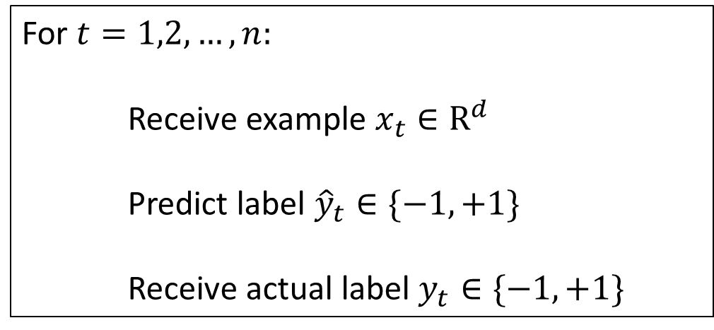
Learning theory: an example
Online learning and the Perceptron algorithm
Example:
For $t=1,2,…,n:$
Receive example $x_{t}∈R^{d}$
Predict label ${\hat{y}}_{t}∈\{−1,+1\}$
Receive actual label $y_{t}∈\{−1,+1\}$
 | free | offer | lecture | cs | Spam?
Email 1 | 1 | 1 | 0 | 0 | +1
Email 2 | 0 | 0 | 1 | 1 | -1

Slide 14

Learning theory: an example (cont’d)
The Perceptron algorithm (Rosenblatt, 1958)
Initialize $w_{1}←(0, …,0)$
For $t=1,2,…,n:$
Receive example $x_{t}∈R^{d}$
Predict label ${\hat{y}}_{t}=sign(w_{t}⋅x_{t})$
Receive actual label $y_{t}∈\{−1,+1\}$
Update: if ${\hat{y}}_{t}=y_{t}$, $w_{t+1}←w_{t};$
otherwise, $w_{t+1}←w_{t}+y_{t}x_{t}$.
 | free | offer | lecture | cs | Spam?
Email 1 | 1 | 1 | 0 | 0 | +1
Email 2 | 0 | 0 | 1 | 1 | -1
Notes:
We use the convention that sign(0)=-1

Slide 15
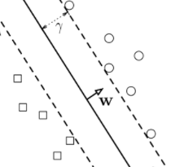
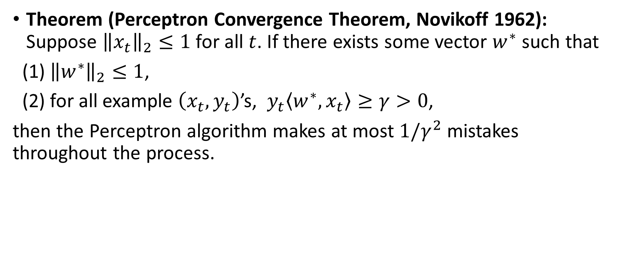
Learning theory: an example (cont’d)
Theorem (Perceptron Convergence Theorem, Novikoff 1962): Suppose ${\left\|x_{t}\right\|}_{2}≤1$ for all $t$. If there exists some vector $w^{∗}$ such that
(1) ${\left\|w^{∗}\right\|}_{2}≤1$,
(2) for all example $\left(x_{t},y_{t}\right)$’s, $y_{t}\left\langle w^{∗},x_{t}\right\rangle ≥γ>0$,
then the Perceptron algorithm makes at most $1/γ^{2}$ mistakes throughout the process.

Slide 16
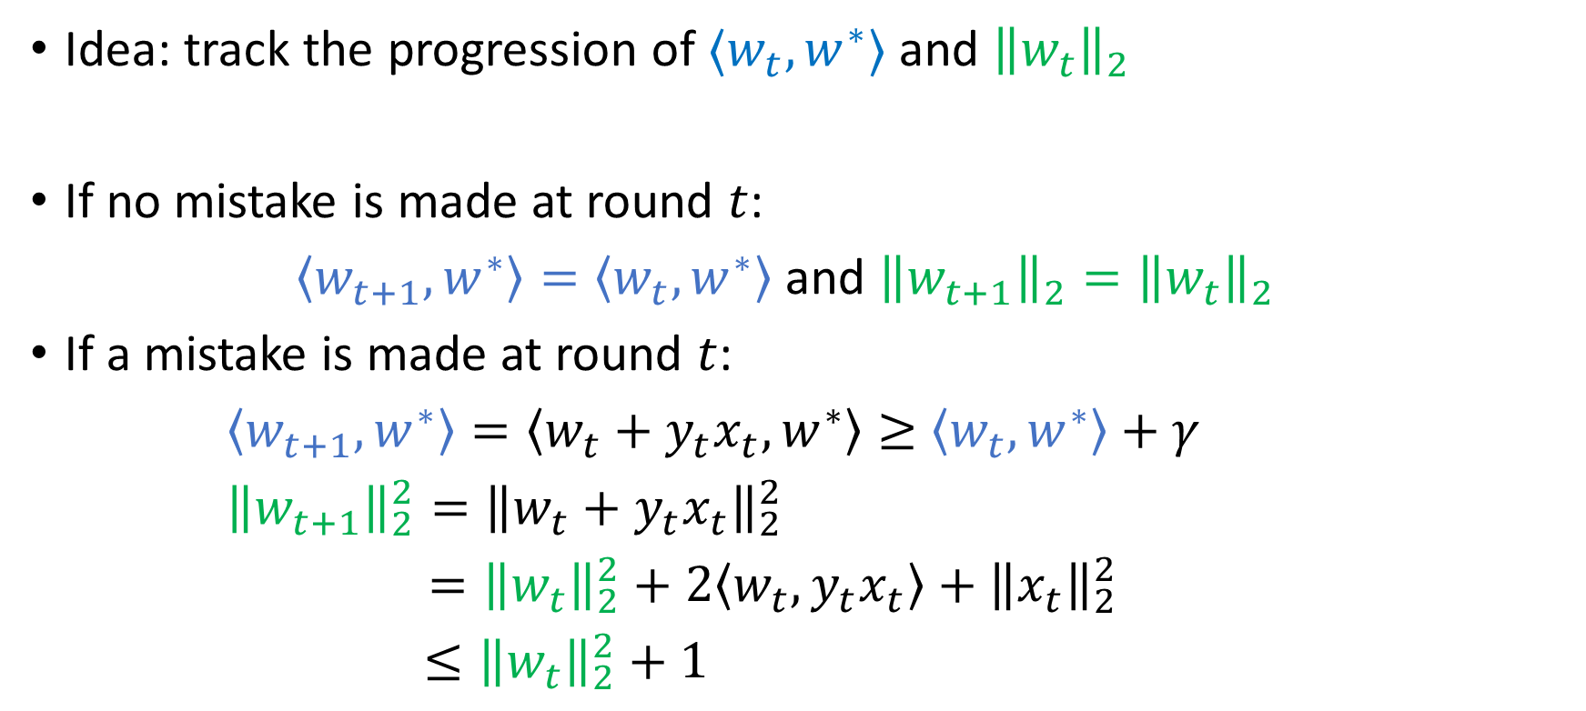
Proof of Perceptron Convergence Theorem
Idea: track the progression of $⟨w_{t},w^{∗}⟩$ and ${\left\|w_{t}\right\|}_{2}$
If no mistake is made at round $t$:
$\left\langle w_{t+1},w^{∗}\right\rangle =\left\langle w_{t},w^{∗}\right\rangle$ and ${\left\|w_{t+1}\right\|}_{2}={\left\|w_{t}\right\|}_{2}$
If a mistake is made at round $t$:
$\left\langle w_{t+1},w^{∗}\right\rangle =\left\langle w_{t}+y_{t}x_{t},w^{∗}\right\rangle ≥$ $\left\langle w_{t},w^{∗}\right\rangle +γ$
${\left\|w_{t+1}\right\|}_{2}^{2}={\left\|w_{t}+y_{t}x_{t}\right\|}_{2}^{2}$
$={\left\|w_{t}\right\|}_{2}^{2}+2\left\langle w_{t},y_{t}x_{t}\right\rangle +{\left\|x_{t}\right\|}_{2}^{2}$
$≤{\left\|w_{t}\right\|}_{2}^{2}+1$

Slide 17

Proof of Perceptron Convergence Theorem
Therefore, if a total of $m$ mistakes are made up to time step $t$, then:
$\left\langle w_{t+1},w^{∗}\right\rangle ≥m γ,$ and $\left\|w_{t+1}\right\|≤\sqrt{m}$
$$\left\|w_{t+1}\right\|$$
$$⟨w_{t+1},w^{∗}⟩$$
#mistakes up to timestep $t$

Slide 18
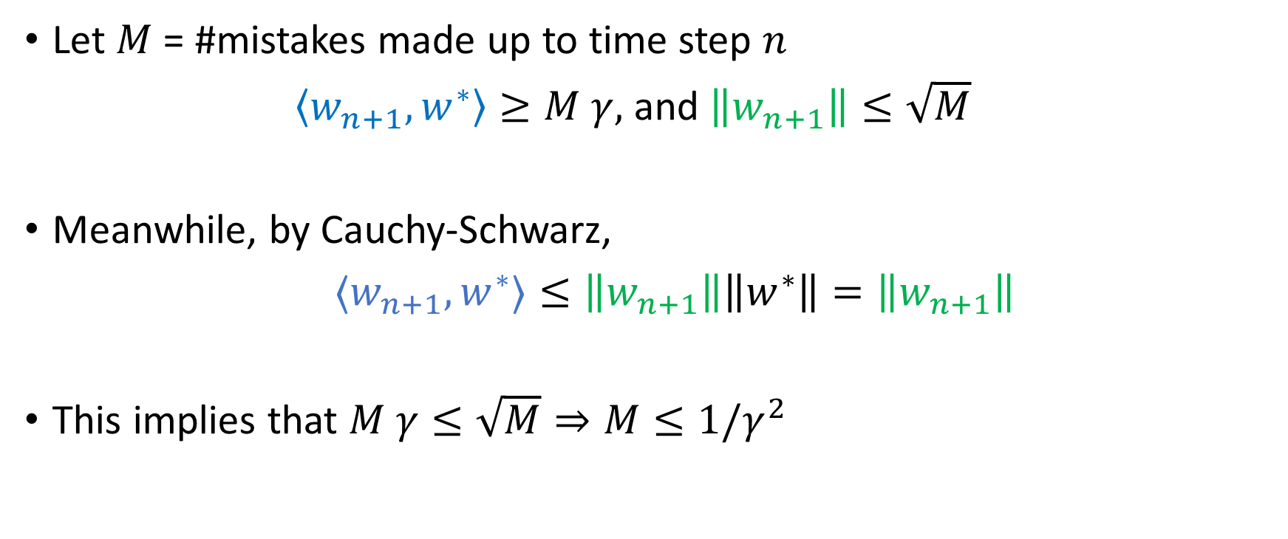
Proof of Perceptron Convergence Theorem
Let $M$ = #mistakes made up to time step $n$
$\left\langle w_{n+1},w^{∗}\right\rangle ≥M γ,$ and $\left\|w_{n+1}\right\|≤\sqrt{M}$
Meanwhile, by Cauchy-Schwarz,
${⟨w}_{n+1},w^{∗}⟩≤\left\|w_{n+1}\right\|\left\|w^{∗}\right\|=\left\|w_{n+1}\right\|$
This implies that $M γ≤\sqrt{M}⇒M≤1/γ^{2}$

Slide 19
Thank you!

Slide 20
Landscapes of machine learning problems
Offline (batch) learning
Supervised
Unsupervised
Semi-supervised
Online / interactive learning
Online classification / regression
Reinforcement learning (bandits, learning in MDPs)
Imitation learning
…
The focus of this course

