Slide 1
Deeply AggreVaTeD: Differentiable Imitation Learning for Sequential Prediction
Author: Wen Sun, Arun Venkatraman, Geoffrey J. Gordon, Byron Boots, and J. Andrew Bagnell
Presenter: Wenhan Zhang

Slide 2
Control & Sequential Decision Making
Huge Data

Slide 3
Control & Sequential Decision Making
Classic Exploration & Exploitation
(e.g., epsilon greedy, upper confidence bound)
Inefficient
Exploration under Teacher Guidance
(i.e., Imitation Learning)
More sample efficient

Slide 4
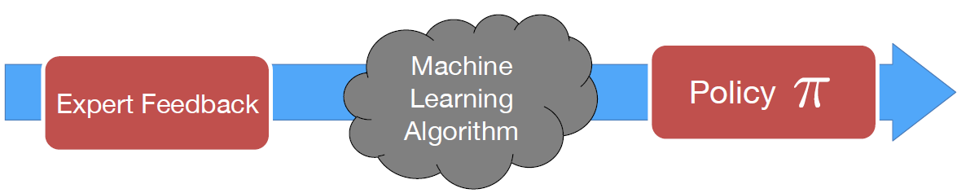
Imitation Learning
SVM
Random Forest
Kernel Estimator
Deep Networks
…
Maps states to actions

Slide 5
Experts Available during Training
Human
Planner & Controller
(robotics)
Search Algorithm
as expert
Ground Truth
Labels + Utility
(NLP)

Slide 6
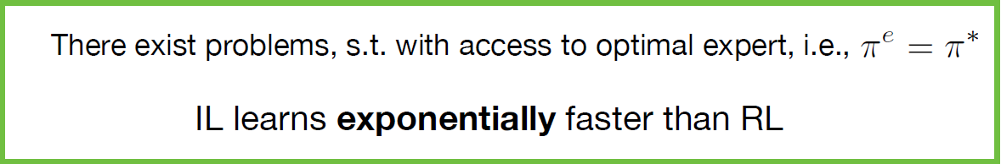
This Work:
Introduce an efficient imitation learning algorithm
Employ modern neural nets
Train efficiently by gradient descent
Less sensitive to local optimality compared to DAgger (Data Aggregation) and AggreVaTe (Aggregate with Values)
Show imitation learning is more sample efficient (e.g., learns faster) than general reinforcement learning

Slide 7
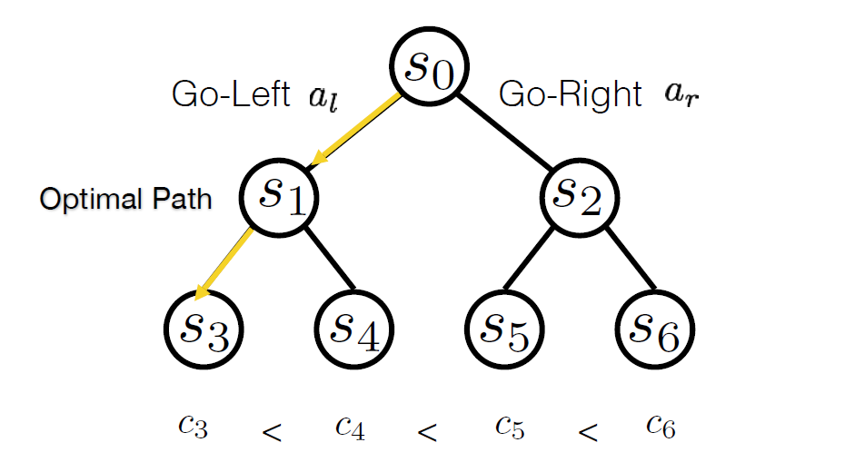
Consider a simple, tree like MDP

Slide 8
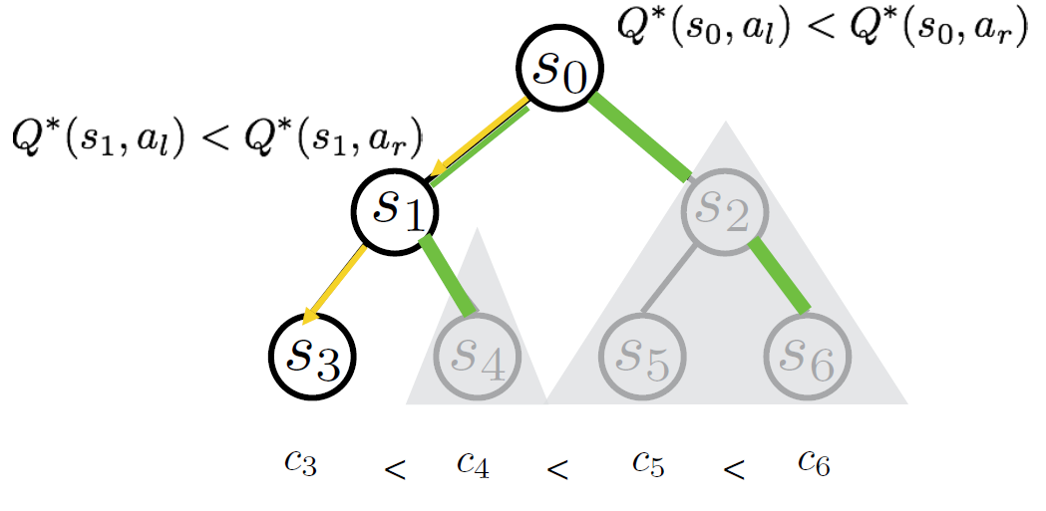
Expert tells us which action is better
Halving: Eliminate half of the nodes at every iteration

Slide 9
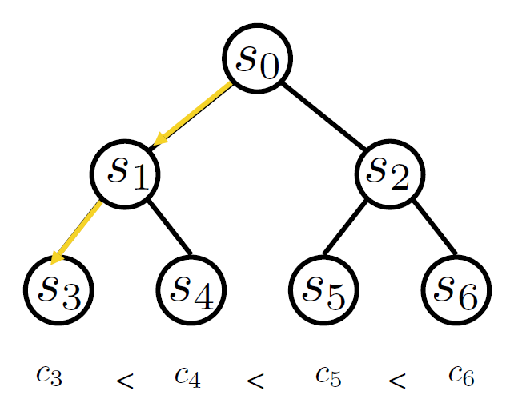
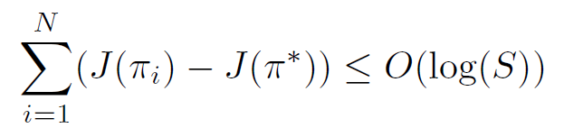
In time logarithmic in #states, we know an optimal policy
The cumulative regret of the entire learning process is bounded as:

Slide 10

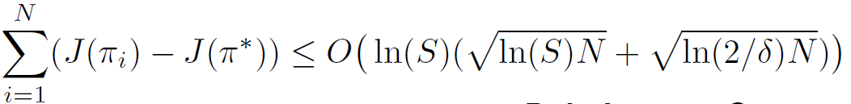
In time logarithmic in #states, we know an optimal policy
Now if we can only query unbiased but noisy
The cumulative regret of the entire learning process is bounded as:

Slide 11
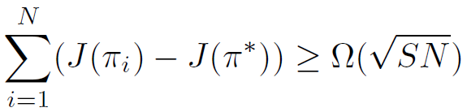
For pure RL
The cumulative regret of the entire learning process is bounded as:

Slide 12
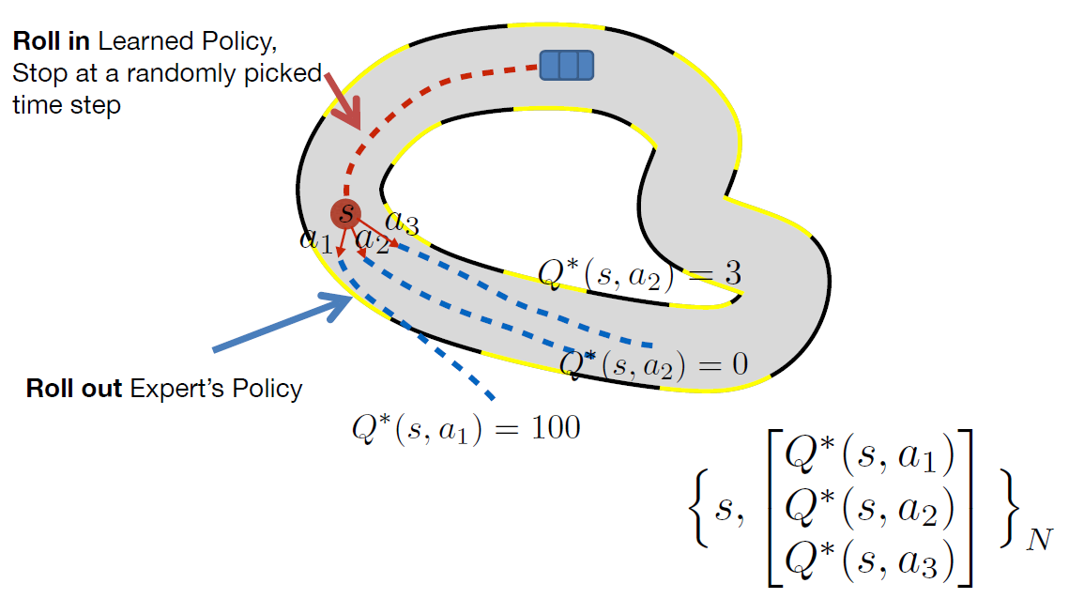
Example: AggreVaTe

Slide 13
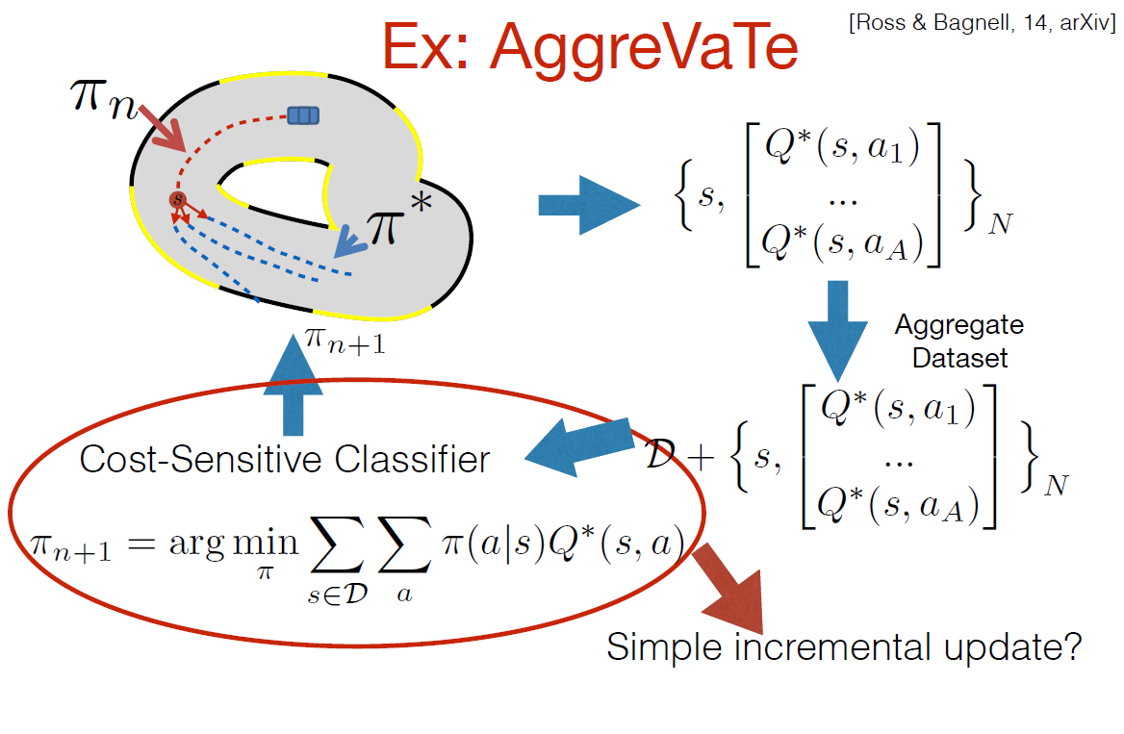

Slide 14
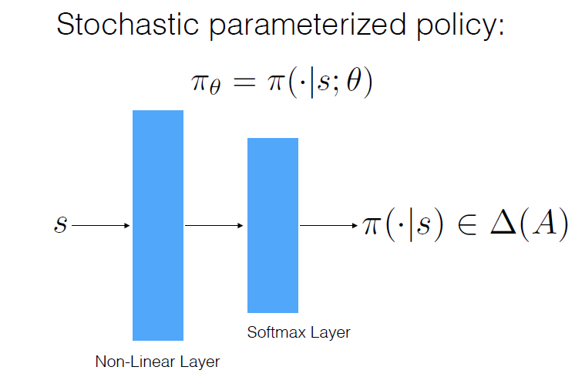
Towards Differentiable AggreVaTe (AggreVaTeD)

Slide 15
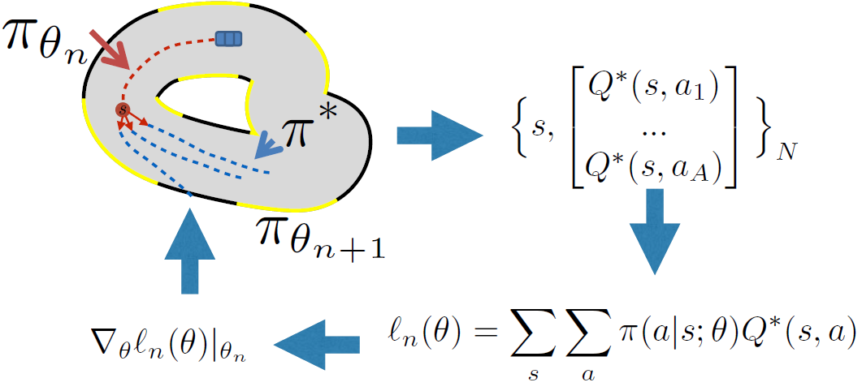
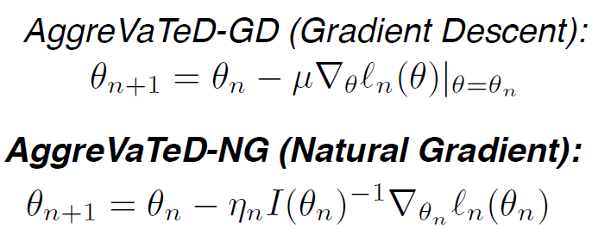
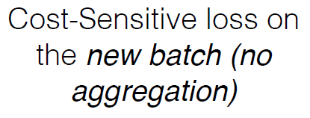
Differentiable AggreVaTe (AggreVaTeD)

Slide 16
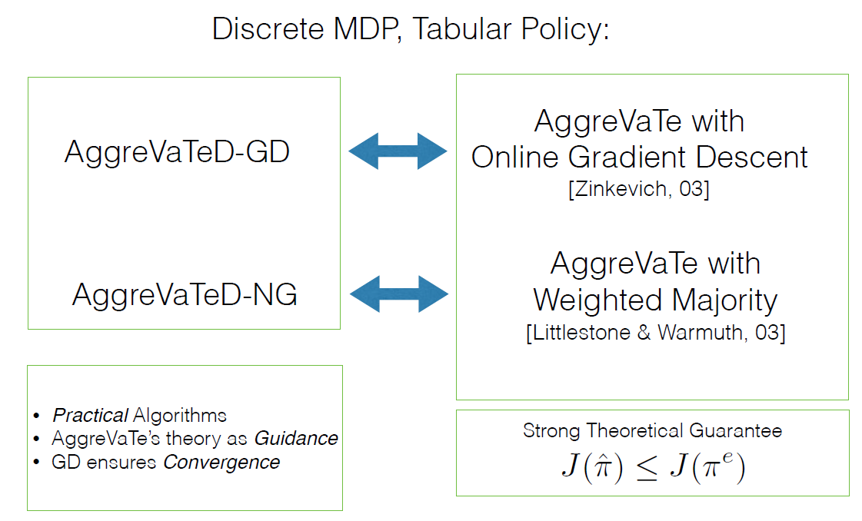
Differentiable AggreVaTe (AggreVaTeD)

Slide 17
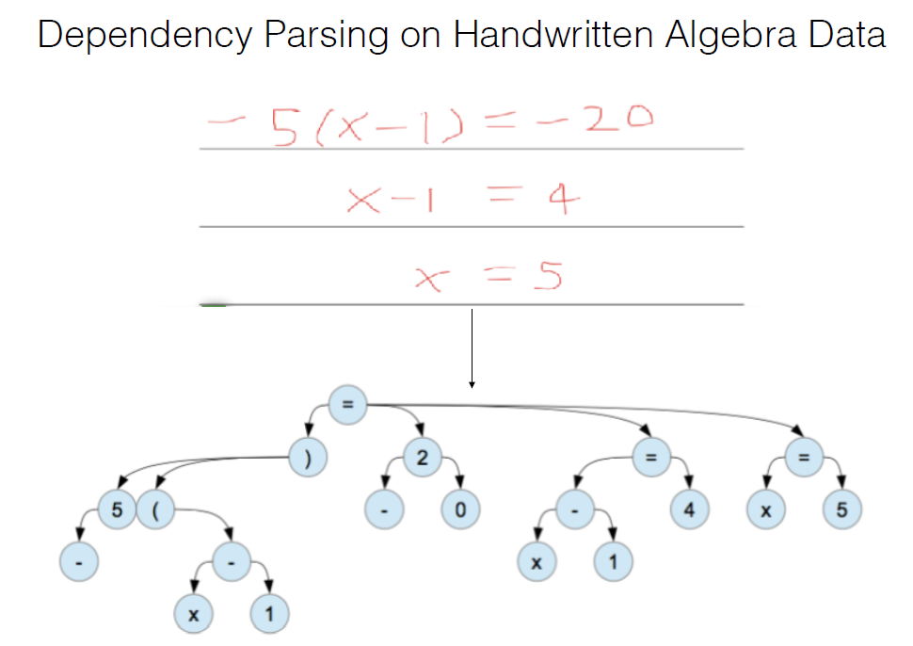
Dependency Parsing

Slide 18
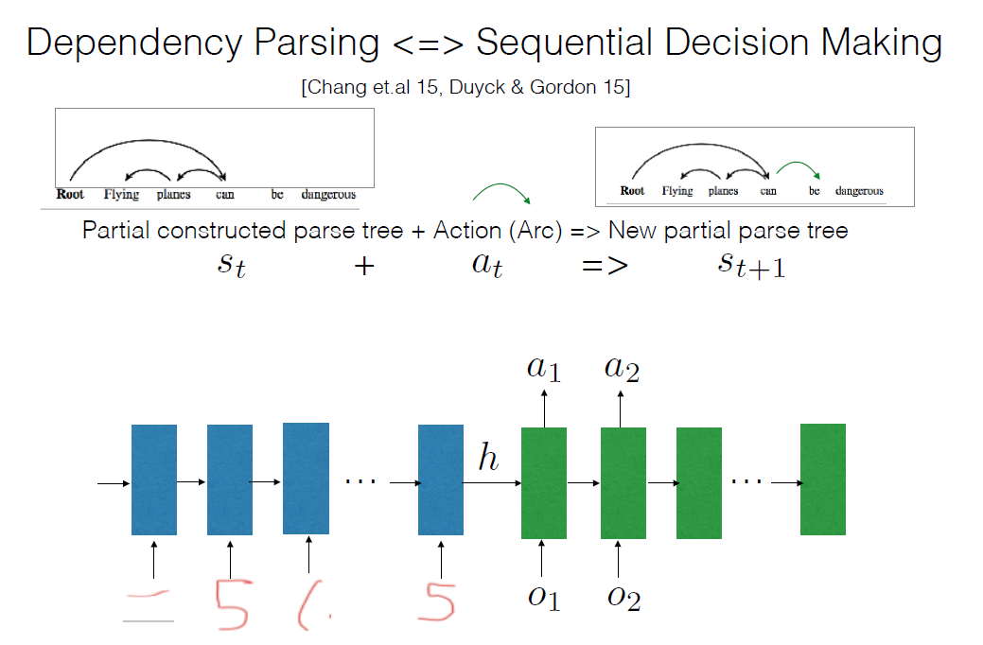
Dependency Parsing

Slide 19
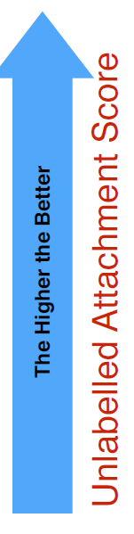
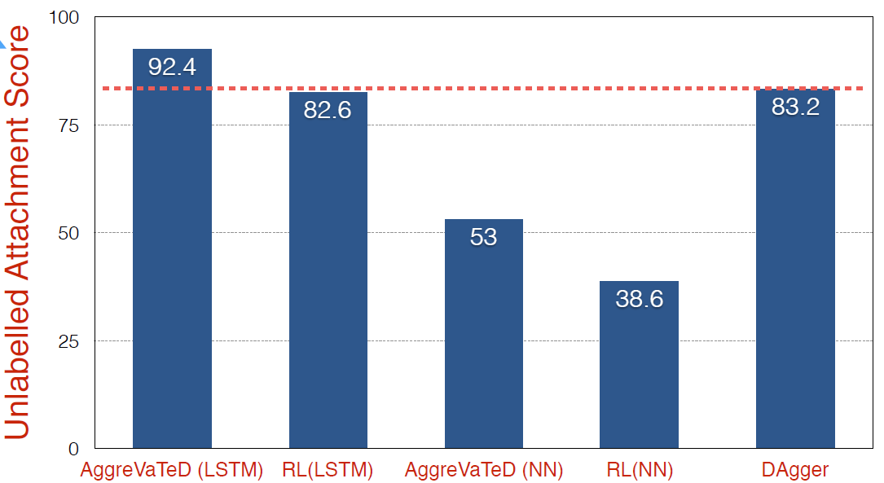
Performance of Aggravated, RL, and DAgger

Slide 20
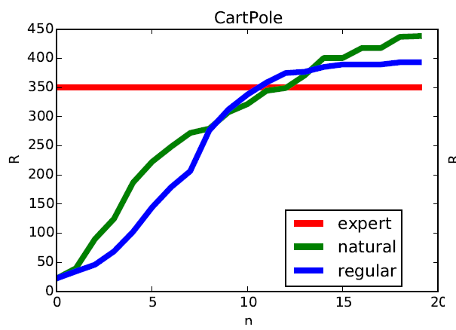
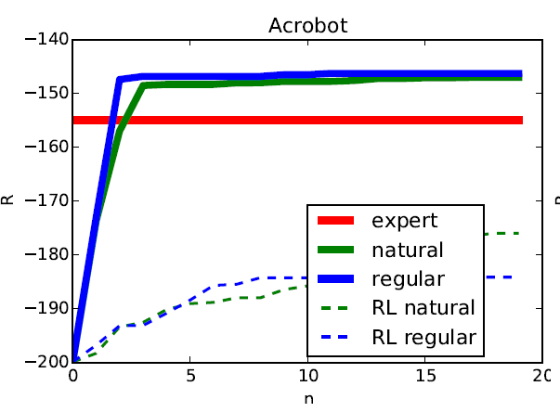
It Can Outperform Expert
CartPole and Acrobot

Slide 21
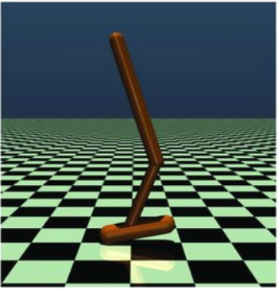
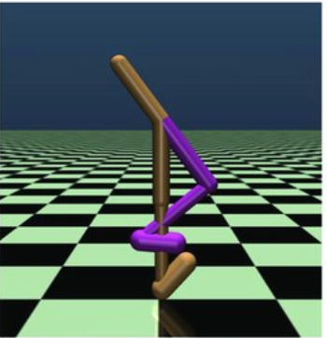
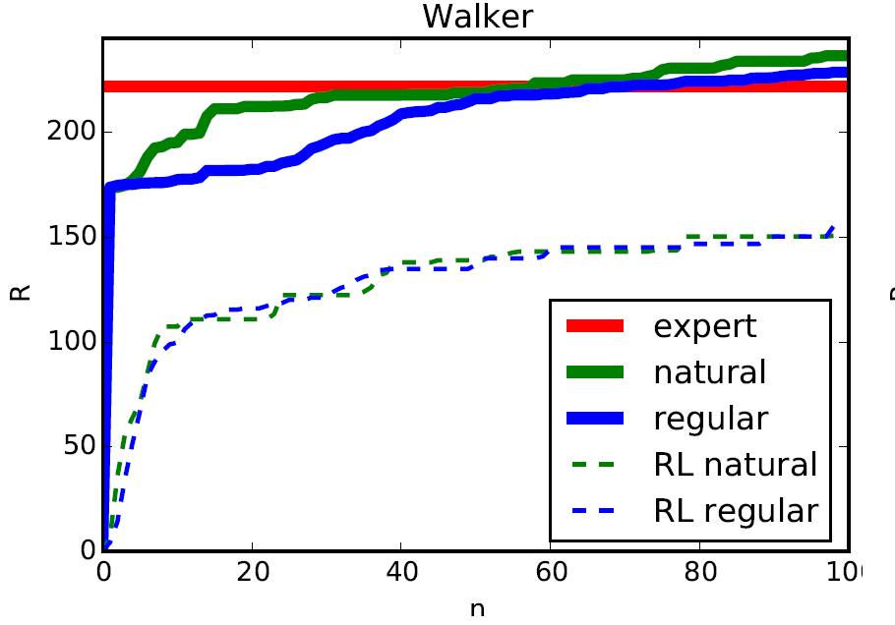
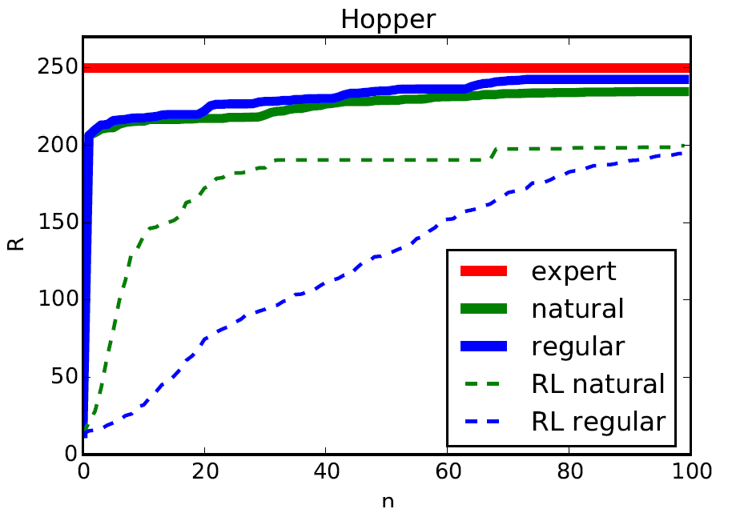
Experiments
Walker and Hopper

Slide 22
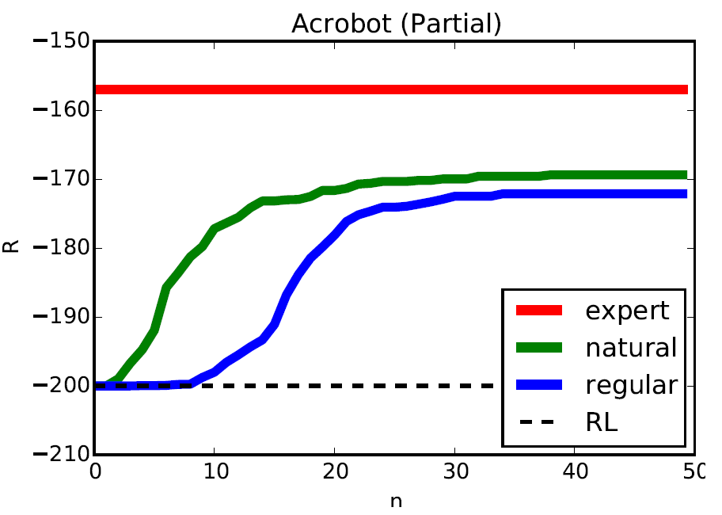
Partial Observable Acrobot
Observe positions of two links

Slide 23

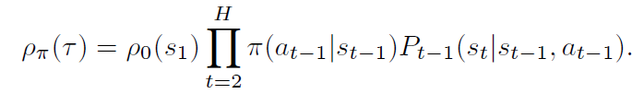
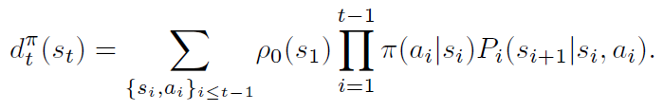
Problem Formulations
Problem is formulated as a finite-horizon Markov Decision Process (MDP):
The distribution of trajectories is defined as:
The distribution of states is defined as:

Slide 24



Problem Formulations (cont.)
The average cost of the policy is defined as:
The state-action value (i.e., cost-to-go) is defined as:
The cumulative regret of the entire learning process is defined as:

Slide 25
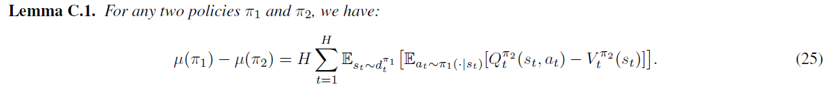
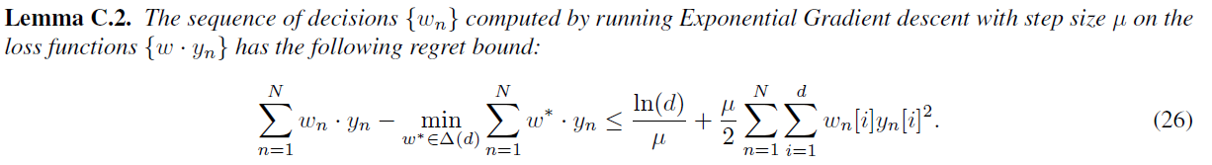
Preliminary Knowledge
Performance Difference Lemma:
The analysis of Weighted Majority Algorithm:

Slide 26
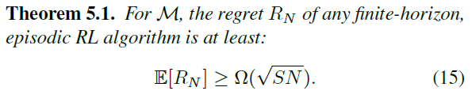
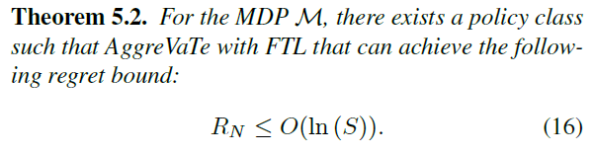
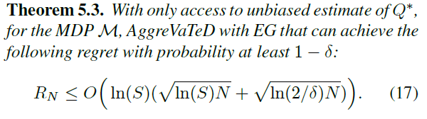
Theoretical Results

Slide 27
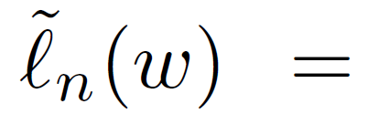



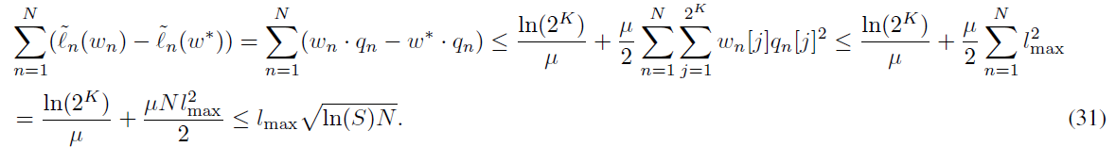
Proof:
We define the policy class as the convex hull of the base policies：
Let us define：
s.t.
Then we reformulate it as：
By using Lemma C.2, we have：

Slide 28

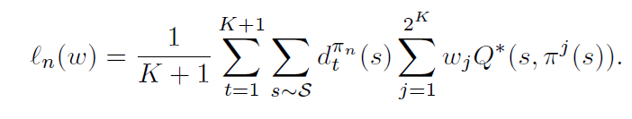




Proof (Cont.):
Let us define as follows ：
Note that：
Hence by Azuma-Heoffding inequality:
Combine the above inequality using union bound:

Slide 29

Proof (Cont.):
Now let us apply the Performance Difference Lemma (Lemma C.1)
rearrange terms we get:
Q.E.D.

Slide 30
Conclusions
Both in theory and in experiments, we show that with access to experts, IL can be much more efficient than RL.
Can leverage IL instead of RL to solve sequential prediction tasks.
AggraVaTeD is one way to take advantage of modern neural networks for IL

Slide 31
Questions?

