Slide 1
Is Q-learning Provably Efficient?
Author: Chi Jin, Zeyuan Allen-Zhu, Sebastien Bubeck, Michel I. Jordan
Presenter: Yinan Li

Slide 2
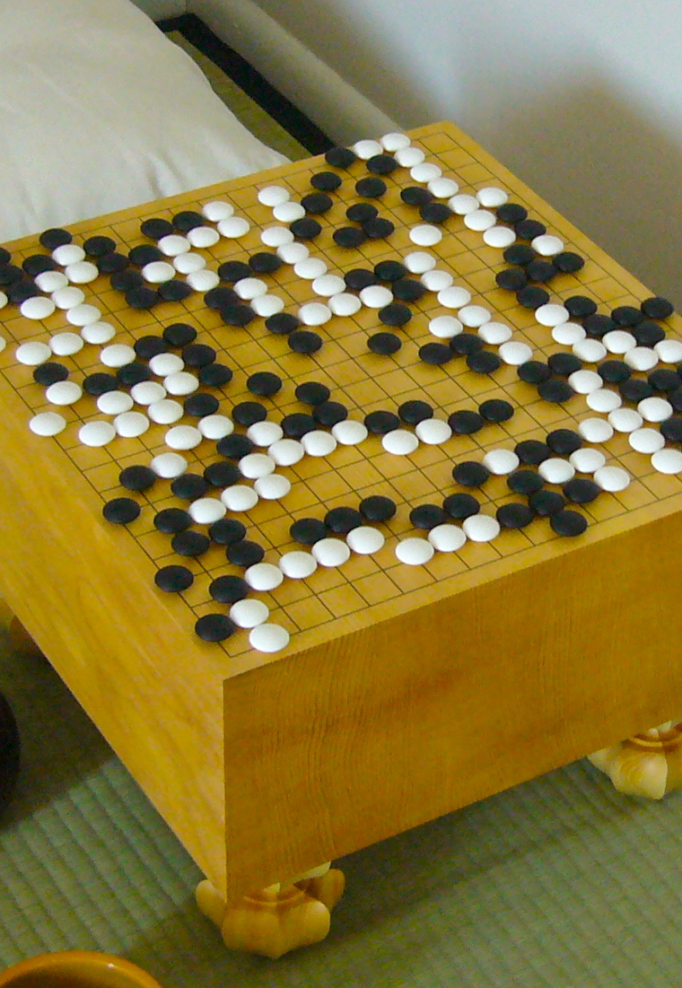

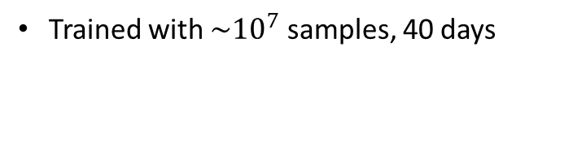
The goal in RL
Maximize the cumulative rewards via interacting with an unknown environment
Design efficient algorithm to learn good policies with fewer samples
Trained with $\sim {10}^{7}$ samples, 40 days

Slide 3
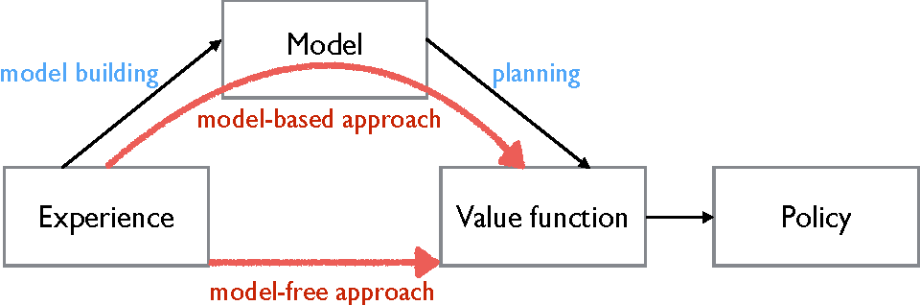
Model-based vs. Model-free
Model-based algorithm:
Value iteration or policy iteration using empirical transition matrix
Form a policy based on learned model
Model-free algorithm:
Directly update the value function or the policy
Q-learning
Notes:
Policy gradient methods

Slide 4
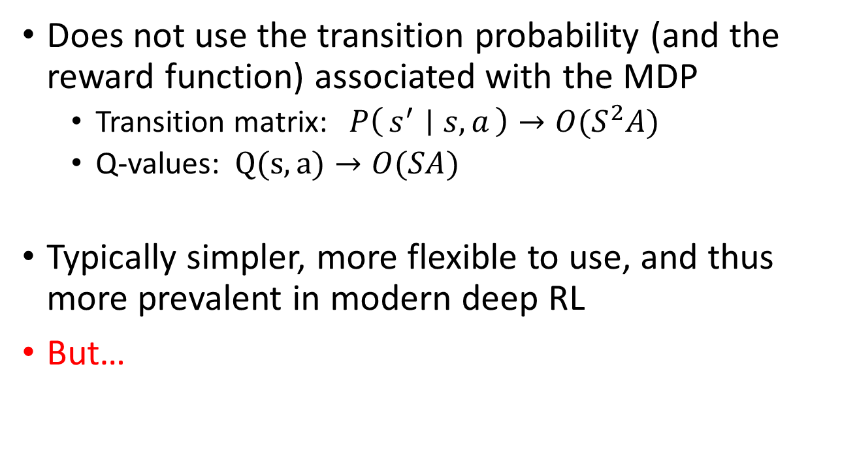
Model-free algorithm
Does not use the transition probability (and the reward function) associated with the MDP
Transition matrix: $P\left(s^{′} ∣ s,a\right)→O(S^{2}A)$
Q-values: $Q(s,a)→O(SA)$
Typically simpler, more flexible to use, and thus more prevalent in modern deep RL
But…

Slide 5
Model-free algorithm
Empirical work suggested that model-free algorithms may require more samples to learn
Can model-free algorithms be made sample efficient?
Remains unsolved even in the basic scenario with finite many states and actions
Life is easier with a simulator

Slide 6
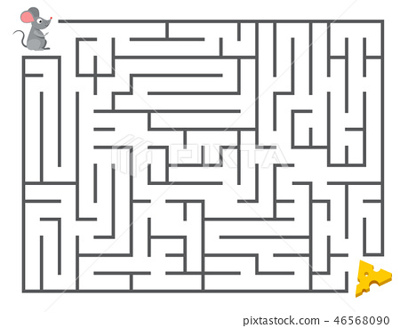
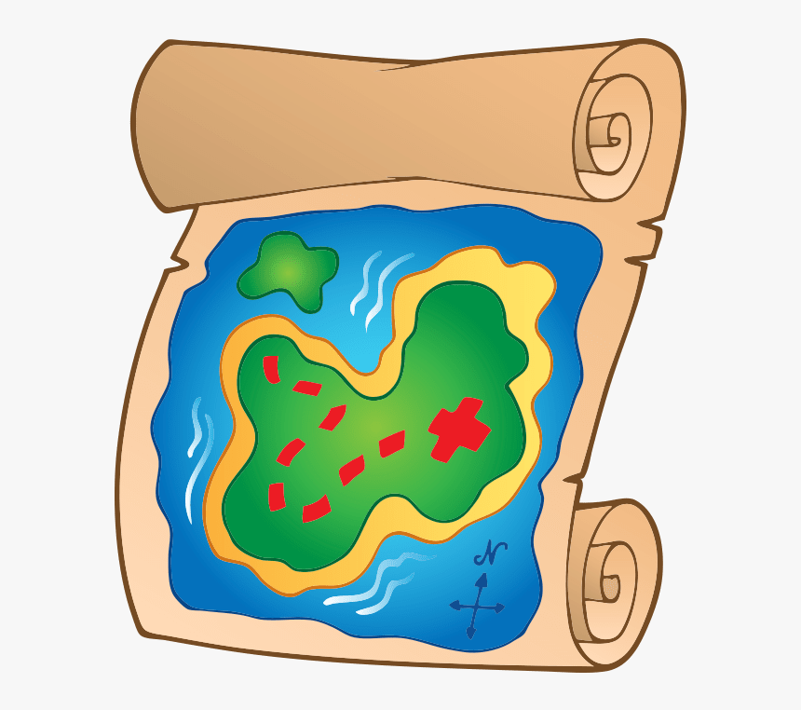



Model-free algorithm with simulator
Map map tell me…
$$s′$$
$$(s,a)$$
r

Slide 7

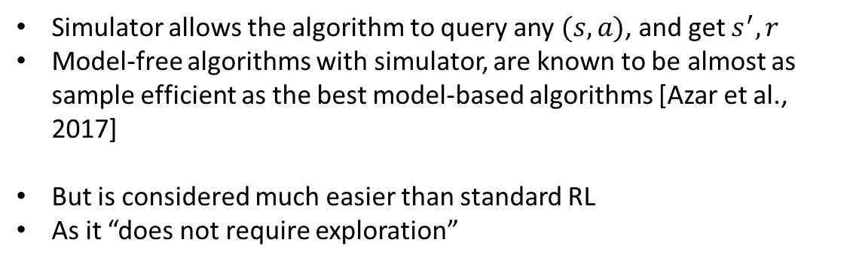

Model-free algorithm with simulator
$$s′$$
$$(s,a)$$
r
Simulator allows the algorithm to query any $(s,a)$, and get $s^{′}, r$
Model-free algorithms with simulator, are known to be almost as sample efficient as the best model-based algorithms [Azar et al., 2017]
But is considered much easier than standard RL
As it “does not require exploration”

Slide 8
Model-free algorithm without simulator
Where should I go???

Slide 9
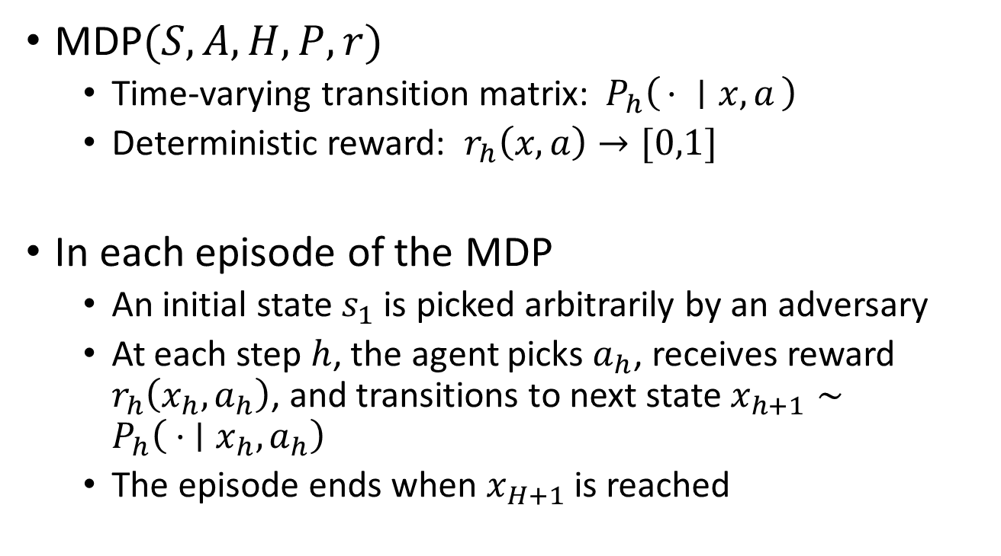
Tabular episodic MDP
MDP$(S,A,H,P,r)$
Time-varying transition matrix: $P_{h}\left(⋅ ∣ x,a\right)$
Deterministic reward: $r_{h}\left(x,a\right)→[0,1]$
In each episode of the MDP
An initial state $s_{1}$ is picked arbitrarily by an adversary
At each step $h$, the agent picks $a_{h}$, receives reward $r_{h}\left(x_{h},a_{h}\right)$, and transitions to next state $x_{h+1}∼P_{h}\left({ ⋅ ∣x}_{h},a_{h}\right)$
The episode ends when $x_{H+1}$ is reached

Slide 10


Tabular episodic MDP
K episodes
The agent choose a policy $π_{k}$before starting the k-th episode

Slide 11
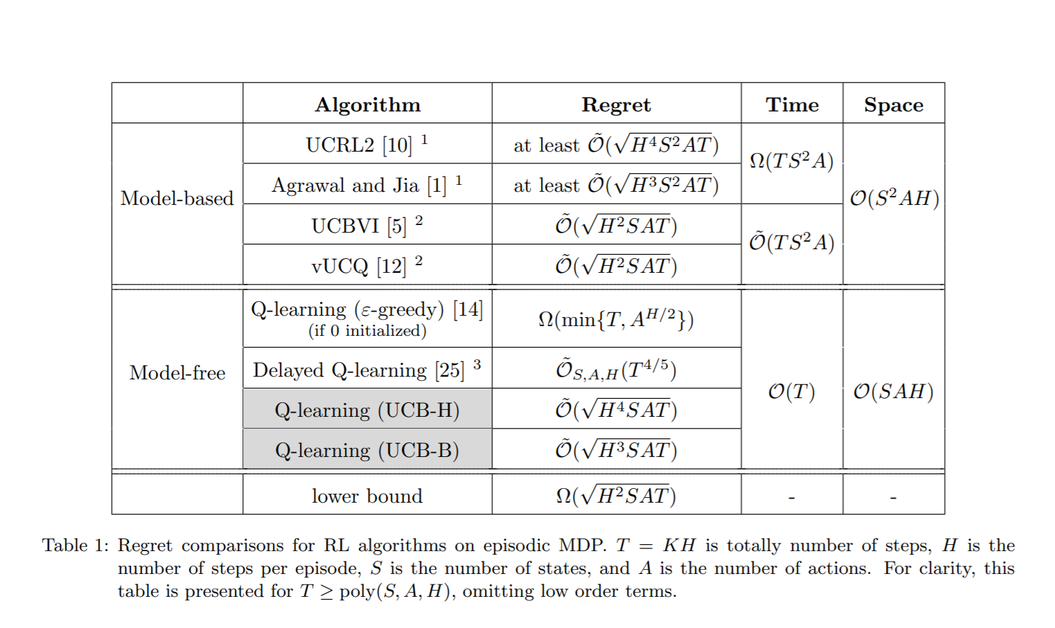
A summary of the results

Slide 12
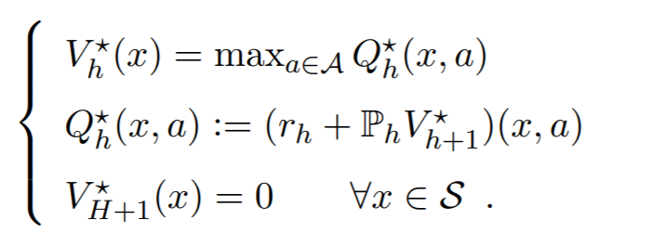


Q-learning
Bellman optimality equation
Q-learning with $ε$-greedy
w.p. $1−ε$, take the greedy action
w.p. $ε$, take an action uniformly at random
Observe $x_{h+1}$
Update the Q-value
Is this algorithm sample efficient?

Slide 13
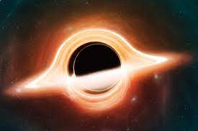















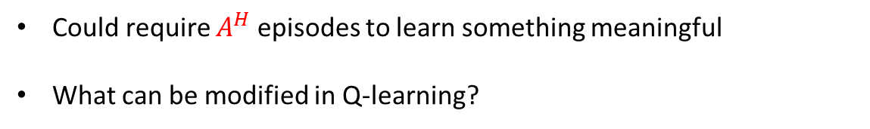



Q-learning
Q-learning with $ε$-greedy can be super inefficient!
Can take exponentially many episodes to learn
Combination lock
$$A$$
$$A$$
$$s_{1}$$
$$s_{1}$$
$$s_{1}$$
…$s_{1}$ is like a black hole
$${A\backslash \{a}^{∗}\}$$
$${A\backslash \{a}^{∗}\}$$
$${A\backslash \{a}^{∗}\}$$
The only arrow with reward 1,
All others with reward 0
$$s_{0}$$
$$s_{0}$$
$$s_{0}$$
$$s_{0}$$
$$a^{∗}$$
$$a^{∗}$$
$$a^{∗}$$
Could require $A^{H}$ episodes to learn something meaningful
What can be modified in Q-learning?

Slide 14

Q-learning
We could alter…
Exploration strategy
Learning rate $α$

Slide 15
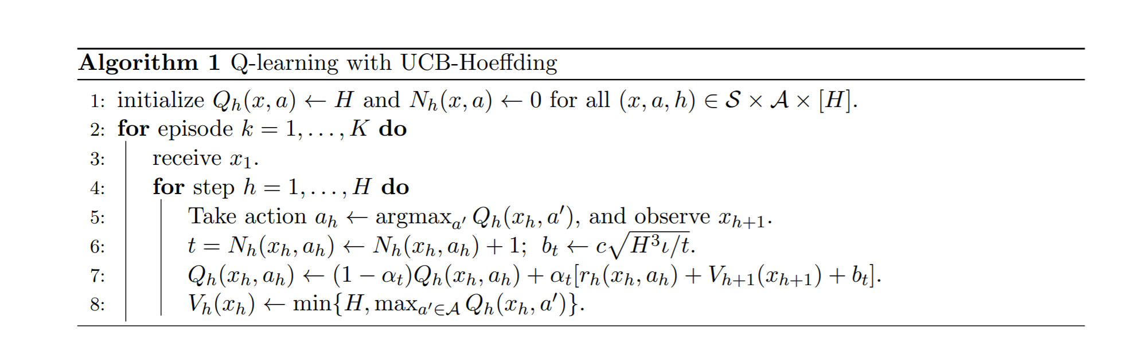
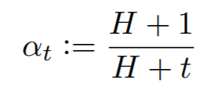
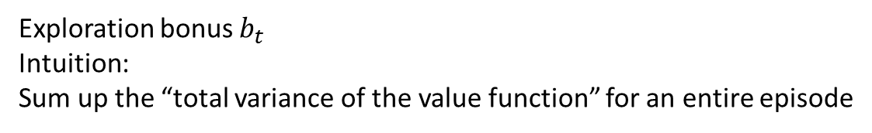
Q-learning with UCB-H
Exploration bonus $b_{t}$
Intuition:
Sum up the “total variance of the value function” for an entire episode
Learning rate:

Slide 16
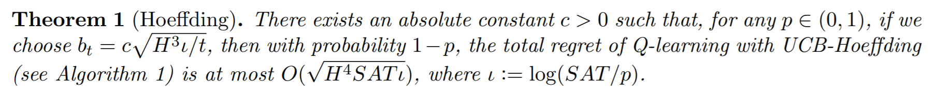

Q-learning with UCB-H
$O(\sqrt{T} )$ regret, optimal in terms of the dependence on T
First model-free algorithm with $O(\sqrt{T})$ regret, without a simulator
$H$ worse than best model-based algorithms, UCBVI
With UCB-B, only $\sqrt{H}$worse
Advantage over model-based algorithms in time and space complexities

Slide 17


Q-learning
We could alter…
Exploration strategy
Learning rate $α$
Design Upper Confidence Bound
Favoring later updates

Slide 18
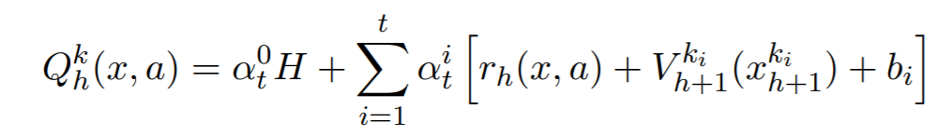
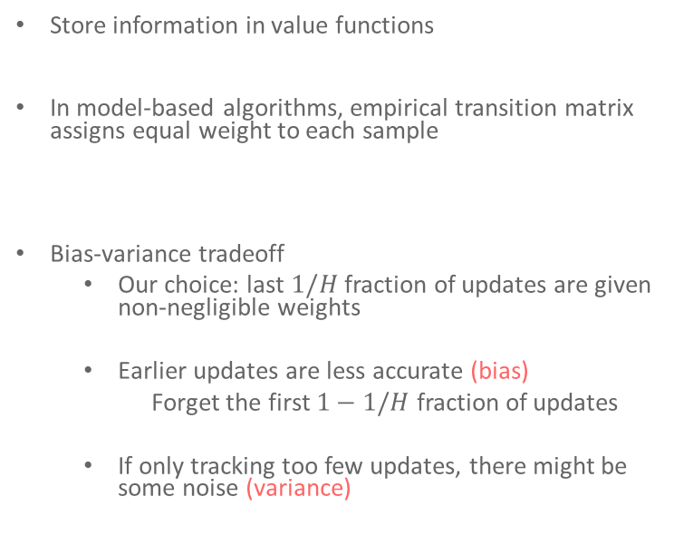
Favoring later updates
Store information in value functions
In model-based algorithms, empirical transition matrix assigns equal weight to each sample
Bias-variance tradeoff
Our choice: last $1/H$ fraction of updates are given non-negligible weights
Earlier updates are less accurate (bias)
Forget the first $1−1/H$ fraction of updates
If only tracking too few updates, there might be some noise (variance)

Slide 19
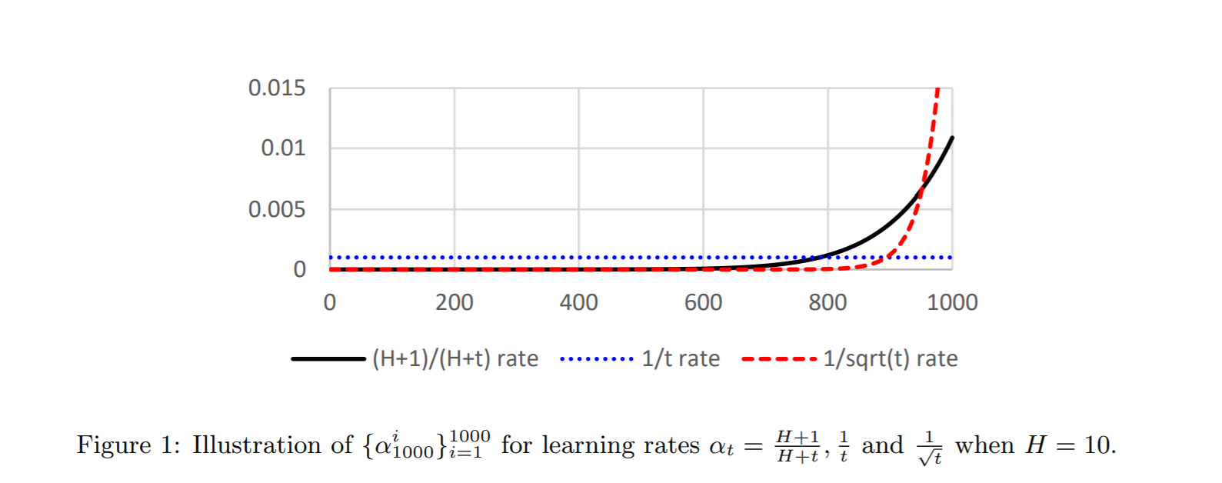
Favoring later updates

Slide 20
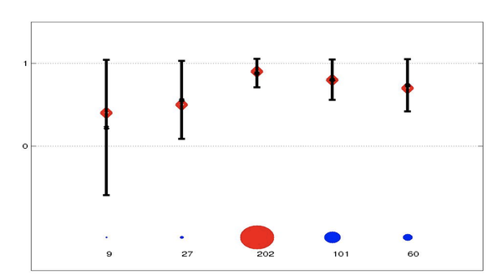
Design Upper Confidence Bound
We want our UCB (exploration bonus) to be:
Optimistic
Sharp

Slide 21
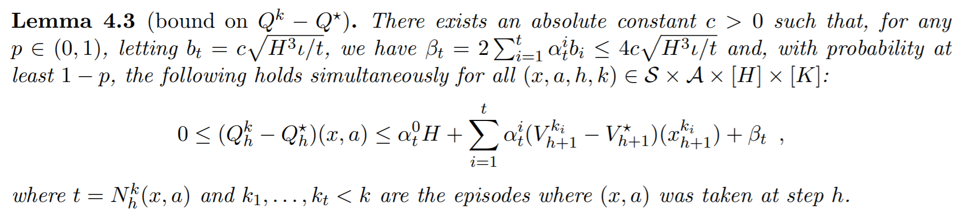


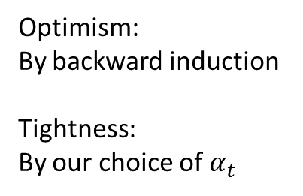
Design Upper Confidence Bound
Optimism:
By backward induction
Tightness:
By our choice of $α_{t}$

Slide 22


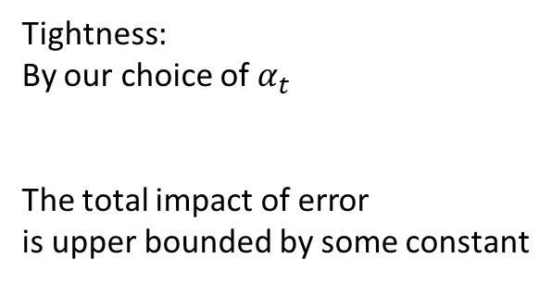
Design Upper Confidence Bound
Tightness:
By our choice of $α_{t}$
The total impact of error
is upper bounded by some constant

Slide 23
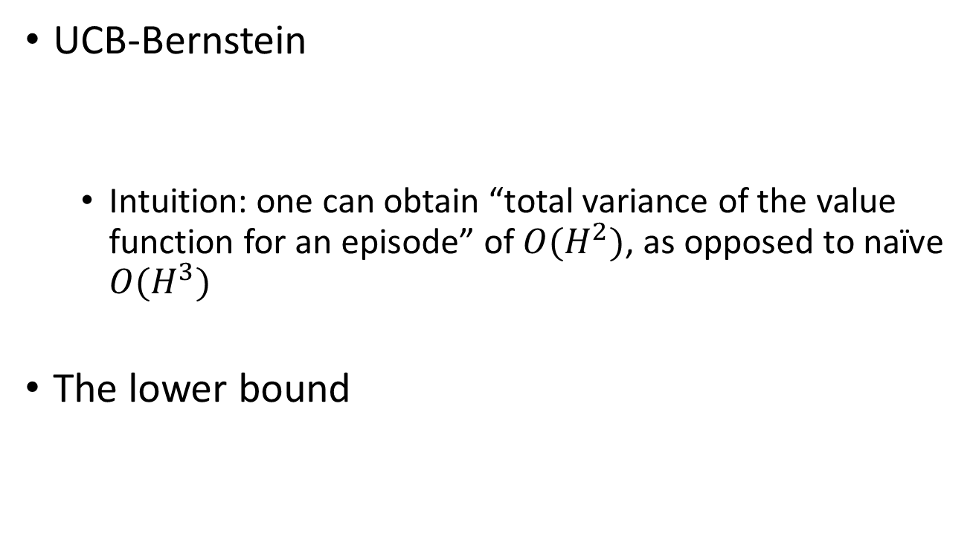
Discussions
UCB-Bernstein
Intuition: one can obtain “total variance of the value function for an episode” of $O(H^{2})$, as opposed to naïve $O(H^{3})$
The lower bound
Notes:
This empirical variance can be computed in an online fashion without increasing the space complexity of Q-learning

Slide 24

Discussions
UCB-Advantage [Zhang et al., 2020]
This matches the lower bound up to logarithmic factors
Notes:
This empirical variance can be computed in an online fashion without increasing the space complexity of Q-learning

Slide 25
Questions?

