Slide 1
Toward the Fundamental Limits of Imitation Learning Conference on Neural Information Processing Systems (2020)
Nived Rajaraman
University of California, Berkeley
Lin F. Yang
University of California, Los Angeles
Jiantao Jiao
University of California, Berkeley
Kannan Ramchandran
University of California, Berkeley
11/02/2021
Presenter: Yichen Li

Slide 2
AGENDA
Background Introduction
Compounding Error in Imitation Learning (IL)
Basic Settings
Results Overview
Lower Bound Results
Upper Bound Results

Slide 3
Background Introduction
Notes:
10

Slide 4
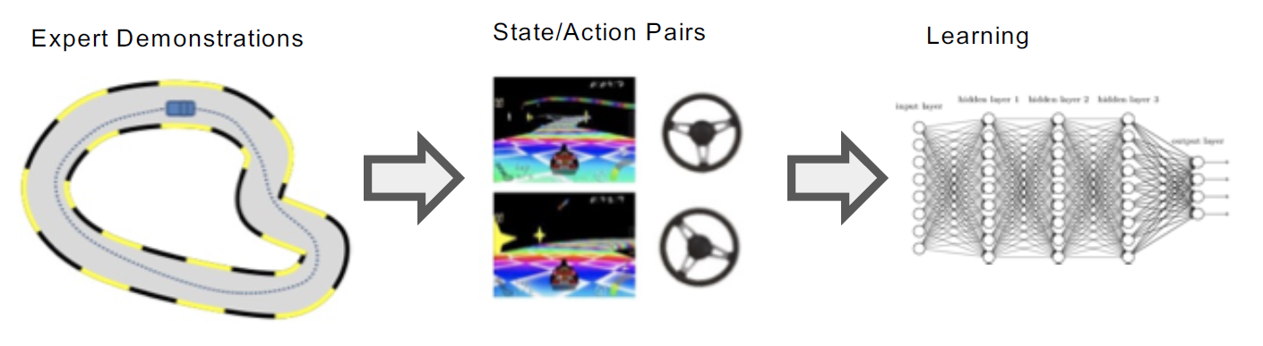
Toward the Fundamental Limits of Imitation Learning
What is Imitation Learning (IL) ?
Given: demonstrations or demonstrator (expert)
Goal: train a policy to mimic demonstrations

Slide 5
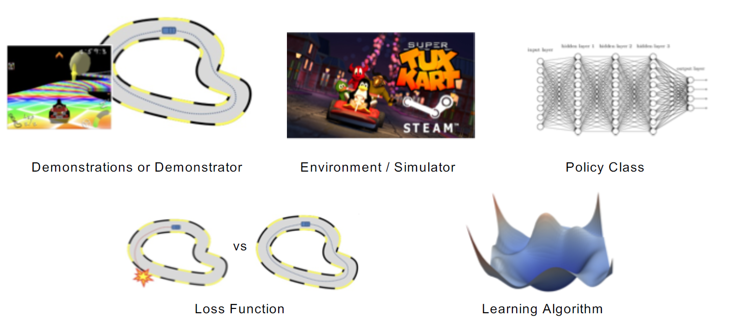
Ingredients of Imitation Learning

Slide 6
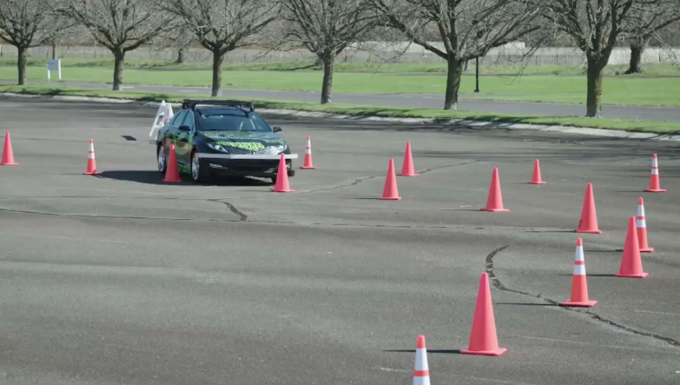
Why Imitation Learning?
In many practical reinforcement learning problems, manually designing reward functions that are accurate is usually challenging.
Say for example the task of driving a car.
1. It is fairly easy for human to demonstrate the act of driving.
2. We already have large datasets of experts’ demonstrations.

Slide 7
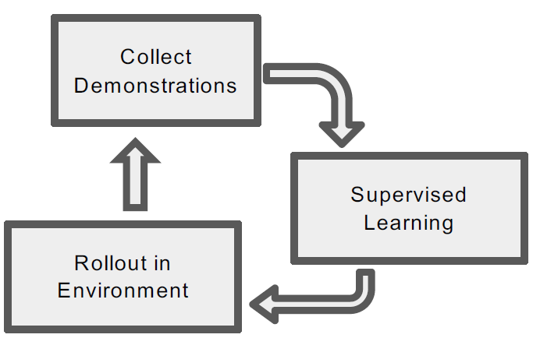
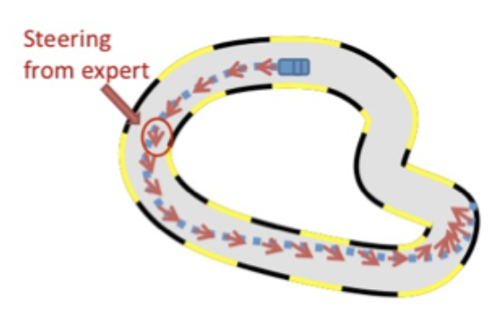
Types of Imitation Learning
IL with No-Interaction: Reduction to Supervised Learning.
Interactive IL: Data collected by the learner and annotated by the expert.

Slide 8
Types of Imitation Learning: Comparison
 | Direct Policy Learning | Access to Environment | Interactive Demonstrator | Pre-collected Demonstrations
No-Interaction IL | Yes | No | No | Yes
Interactive IL | Yes | Yes | Yes | Optional
Non-Interactive IL
Interactive IL

Slide 9
Compounding Error in Imitation Learning
Notes:
10

Slide 10
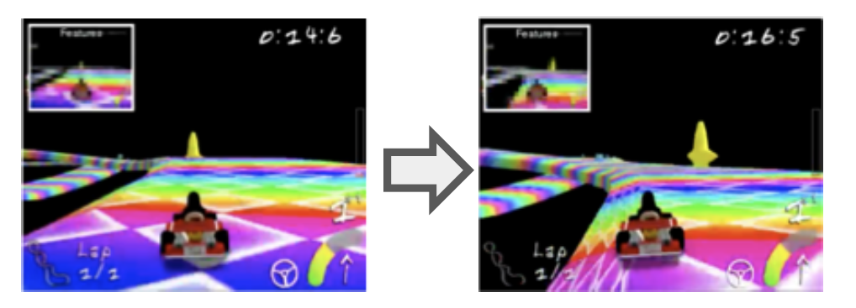
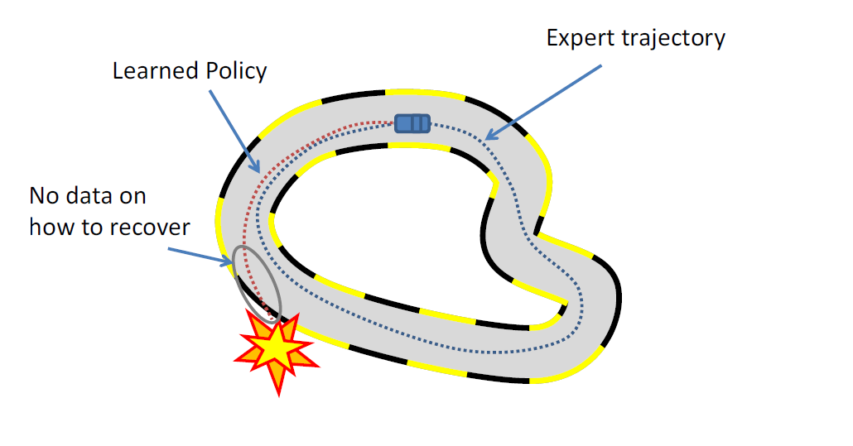
Compounding Error
Mistake -> Unseen States -> More Errors
Inability to Recover

Slide 11
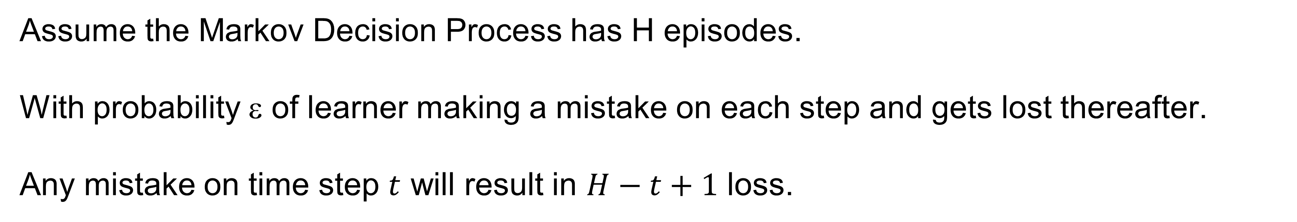
The $H^{2}$ Compounding Error
Assume the Markov Decision Process has H episodes.
With probability ε of learner making a mistake on each step and gets lost thereafter.
Any mistake on time step $t$ will result in $H−t+1$ loss.
$εH$ +$ε\left(1−ε\right)\left(H−1\right)+ε{\left(1−ε\right)}^{2}\left(H−2\right)+ ⋯+ε{\left(1−ε\right)}^{H−1}=Θ({εH}^{2})$
$εH$ +$ε\left(1−ε\right)\left(H−1\right)+ ⋯+ε{\left(1−ε\right)}^{H−1}<εH+εH+…+εH=O({εH}^{2})$
H

Slide 12
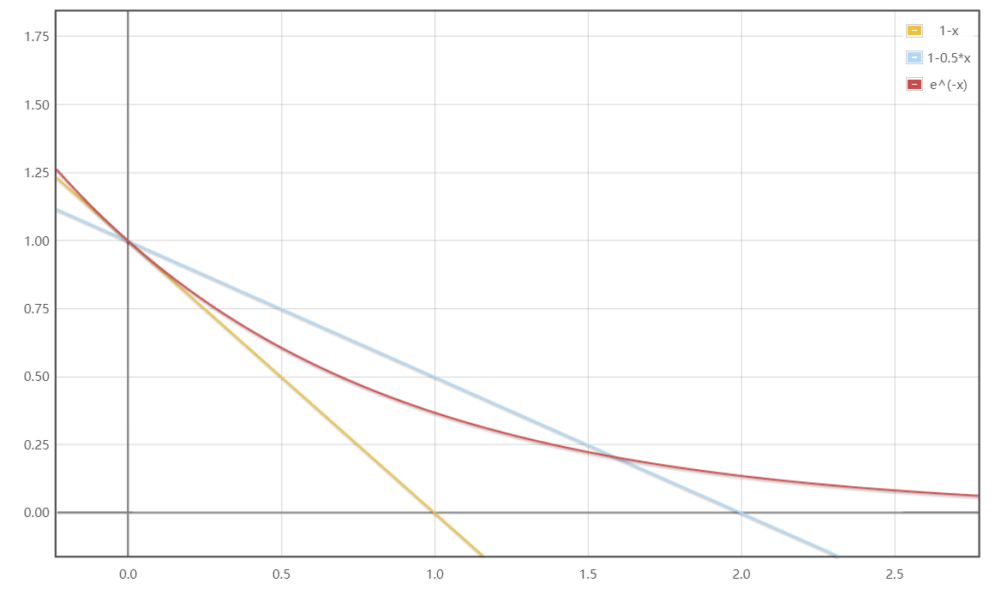
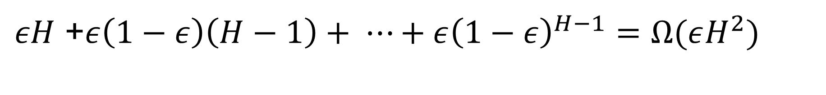

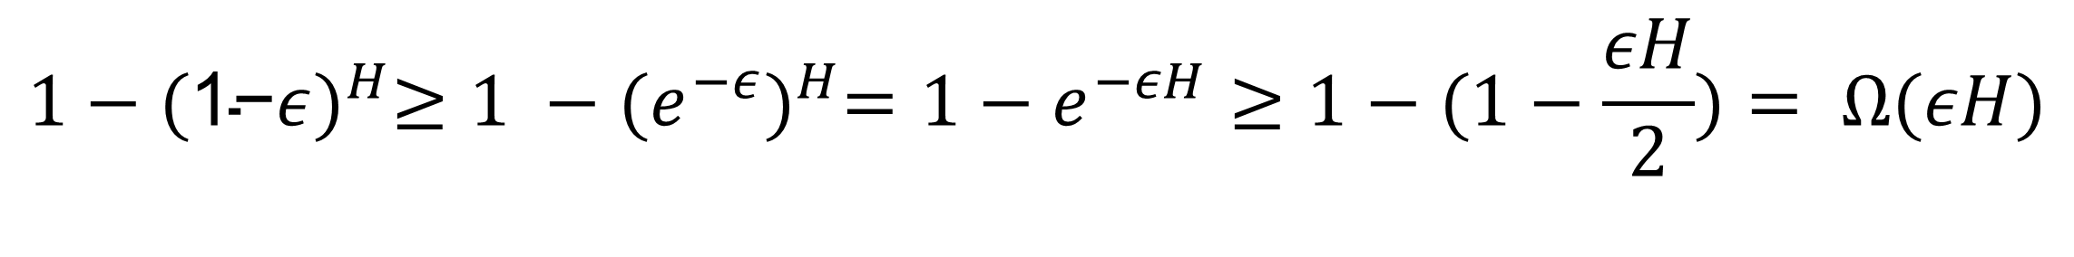
The $H^{2}$ Compounding Error: Lower Bound
$εH$ +$ε\left(1−ε\right)\left(H−1\right)+ ⋯+ε{\left(1−ε\right)}^{H−1}$
$>εH \text{+}ε\left(1−ε\right)\left(H−1\right)+$ $⋯+ε{\left(1−ε\right)}^{\frac{H}{2}}(H−H/2)$
$>\frac{Hε}{2}(\text{1}\text{+}\left(1−ε\right)+$ $⋯+{\left(1−ε\right)}^{\frac{H}{2}})$
$$=\frac{Hε}{2}\left(\frac{1−{\left(1−ε\right)}^{\frac{H+1}{2}}}{1−\left(1−ε\right)}\right)=\frac{H}{2}(1−{\left(1−ε\right)}^{\frac{H+1}{2}})$$
Geometric Series
Useful Inequality: $1−\frac{x}{2}≥e^{−x}≥1−x$
$$1−{\text{(}\text{1−}ε)}^{H}≥1 −{\text{(}e^{−ε})}^{H}=1−e^{−εH}≥1−(1−\frac{εH}{2})= Ω(εH)$$
$εH$ +$ε\left(1−ε\right)\left(H−1\right)+ ⋯+ε{\left(1−ε\right)}^{H−1}=Ω(εH^{2})$

Slide 13
Basic Settings
Notes:
10

Slide 14











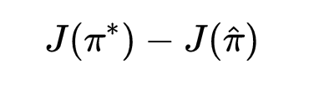
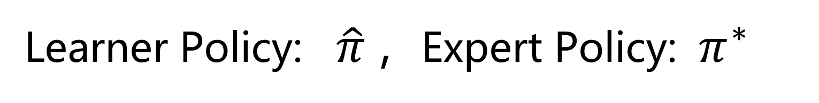
Basic Settings
Tabular Episodic MDP:
Episode Length:
State Space:
Action Space:
Initial Distribution:
Never Revealed to the Learner
Transition Dynamics:
Hidden Reward Function: ,
Non-Stationary Policy Class : ,
Expected Cumulative Reward:
Learner Policy: $\hat{π}$ , Expert Policy: $π^{∗}$
Suboptimality:

Slide 15

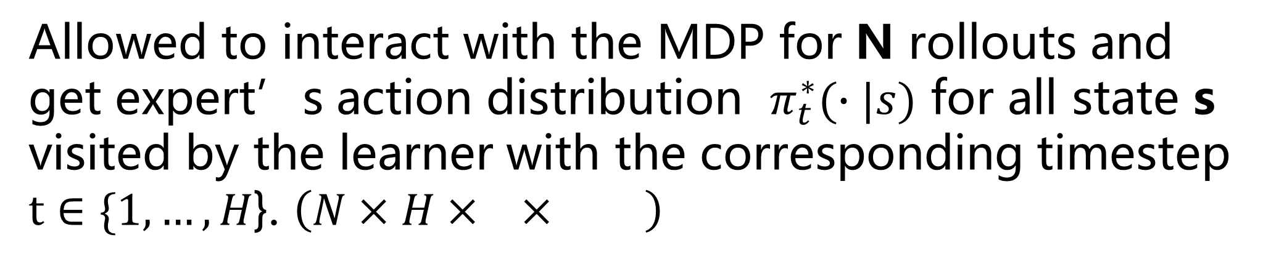
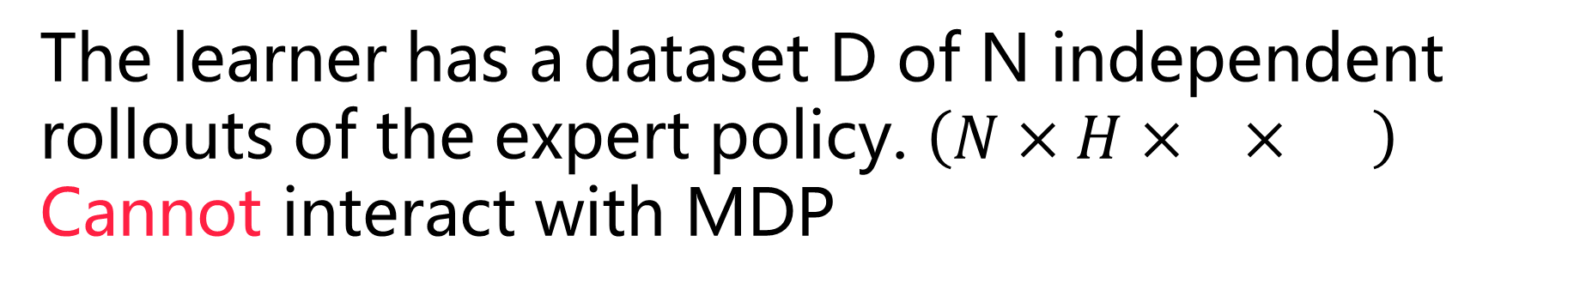
Basic Settings
Tabular Episodic MDP:
What kind of data? 3 Settings
Basic No-interaction
The learner has a dataset D of N independent rollouts of the expert policy. $\left(N×H× × \right)$
Cannot interact with MDP
No-interaction
Known-Transition
Extra
Interactive:
The learner no longer has expert demonstrations.
Allowed to interact with the MDP for N rollouts and get expert’s action distribution $π_{t}^{∗}(∙|s)$ for all state s visited by the learner with the corresponding timestep $t∈\{1,…,H\text{\}}$. $\left(N×H× × \right)$

Slide 16
Basic Settings
Basic No-Interaction
What kind of data? 3 Settings
Known-Transition (No-Interaction)
Interactive
What kind of expert? Deterministic/Stochastic
Deterministic: $Π_{det}$ where ,
Stochastic: $Π_{sto}$ where ,
The goal for the learner is to learn a policy that has reward comparable to the expert.

Slide 17
Results Overview

Slide 18
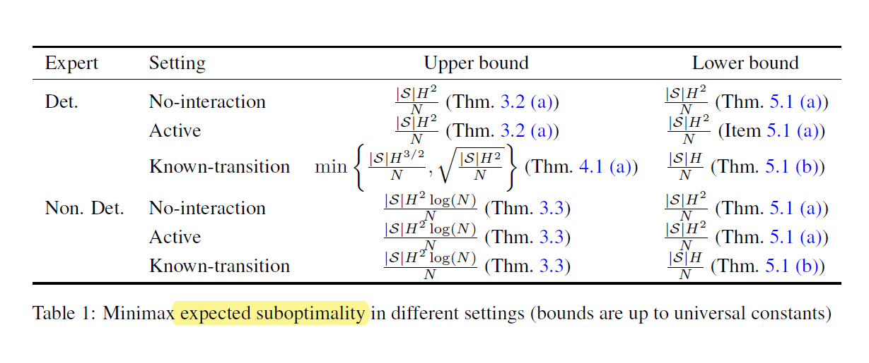

Results Overview
Interactive
Interactive
Also, high probability upper bound for the case of no-interaction with deterministic expert is provided.

Slide 19
Lower Bound Results

Slide 20
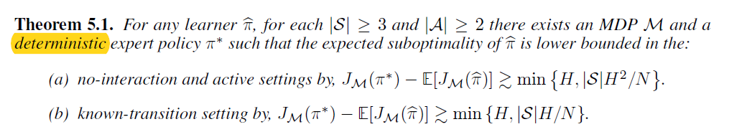
Lower Bound Results
/
interactive
Observation: Since deterministic policy class can be seen as a special subset of stochastic policy class, Theorem 5.1 directly extends to the case of stochastic expert policy.
Key intuition: on states which were never seen, the learner has no prior knowledge about the expert’s policy.

Slide 21

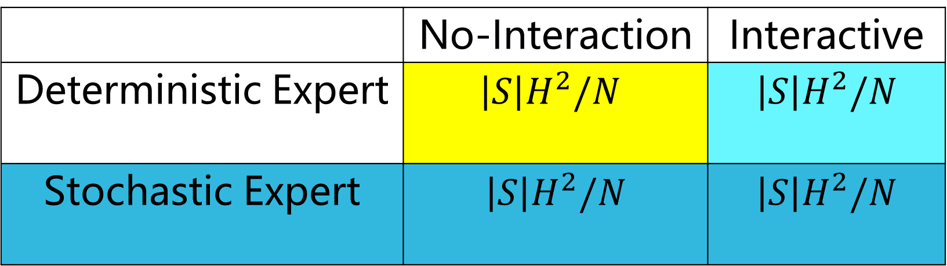
Lower Bound Results
interactive
 | No-Interaction | Interactive
Deterministic Expert | $$\left|S\right|H^{2}/N$$ | $$\left|S\right|H^{2}/N$$
Stochastic Expert | $$\left|S\right|H^{2}/N$$ | $$\left|S\right|H^{2}/N$$
Extension from No-Interaction Case
Extension from Deterministic Case
No algorithm can beat the $H^{2}$ barrier without additional assumptions

Slide 22

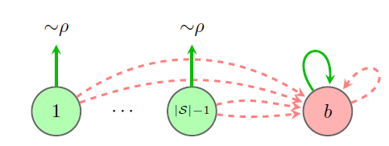


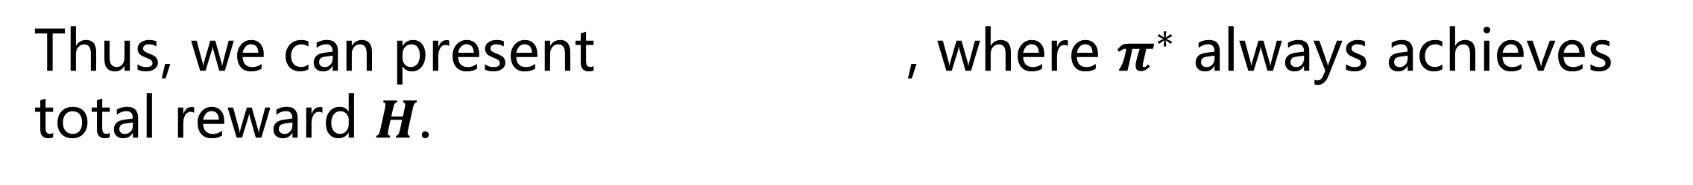
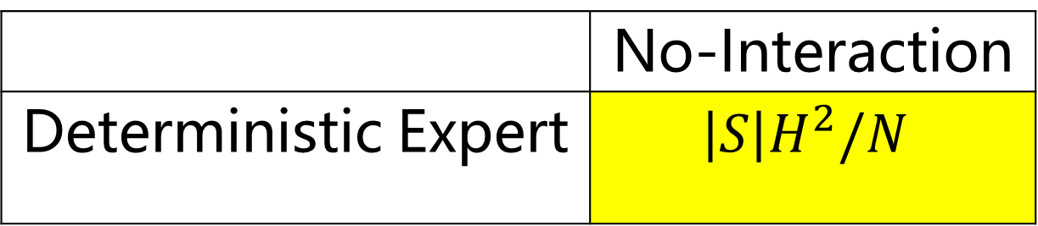
Lower Bound Proof
: | |-1 good states and one absorbing bad state
 | No-Interaction
Deterministic Expert | $$\left|S\right|H^{2}/N$$
: | |-1 Bad actions and only one correct action
Correct Action
Wrong Action
The MDP is fixed given $N,S,A,H$ and deterministic policy $π^{∗}$.
Thus, we can present , where $π^{∗}$ always achieves total reward $H$.

Slide 23

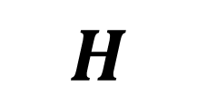
Lower Bound Proof (No-Interaction Deterministic Expert)
Other Definitions:
$π^{∗}, ∀$
$$H$$
5
4
3
2
1
S1 S2 Sb

Slide 24


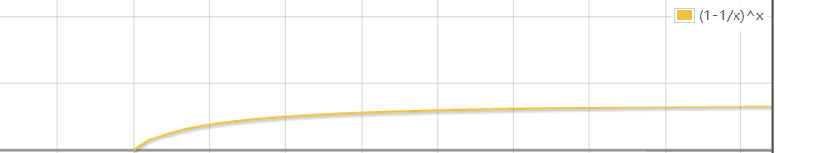
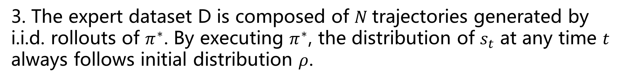

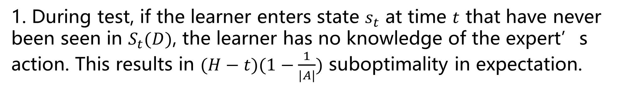
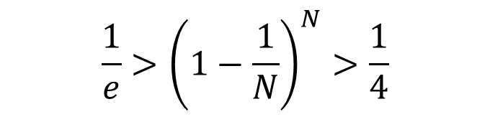
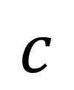

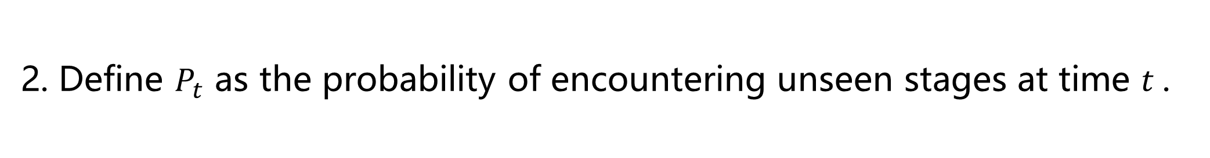
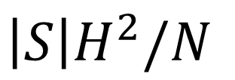
Lower Bound Proof (No-Interaction Deterministic Expert)
Proof Sketch:
1. During test, if the learner enters state $s_{t}$ at time $t$ that have never been seen in $S_{t}(D)$, the learner has no knowledge of the expert’s action. This results in $(H−t)(1−\frac{1}{|A|})$ suboptimality in expectation.
2. Define $P_{t}$ as the probability of encountering unseen stages at time $t$.
$$c$$
$$H$$
5
4
3
2
1
3. The expert dataset D is composed of $N$trajectories generated by i.i.d. rollouts of $π^{∗}$. By executing $π^{∗}$, the distribution of $s_{t}$ at any time $t$ always follows initial distribution $ρ$.
S1 S2 Sb
$H^{2}$
$$\left|S\right|H^{2}/N$$
$${\frac{1}{e}>\left(1−\frac{1}{N}\right)}^{N}>\frac{1}{4}$$

Slide 25
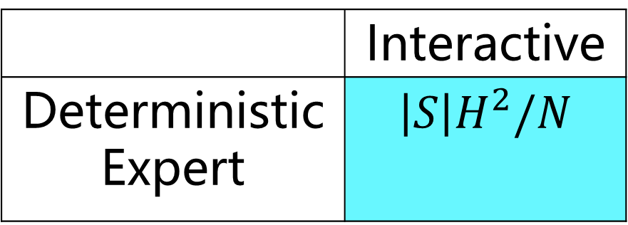
Lower Bound Proof (Interactive Deterministic Expert)
 | Interactive
Deterministic Expert | $$\left|S\right|H^{2}/N$$
If the expert’s action is not followed at any state, the learner is transitioned to b with probability 1. Since then, the learner can no longer get any meaningful information.
The most informative dataset the learner can collect is following the expert. This equals N trajectories been provided in advance.
This reduces the interactive case to the no-interaction case.

Slide 26
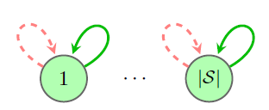

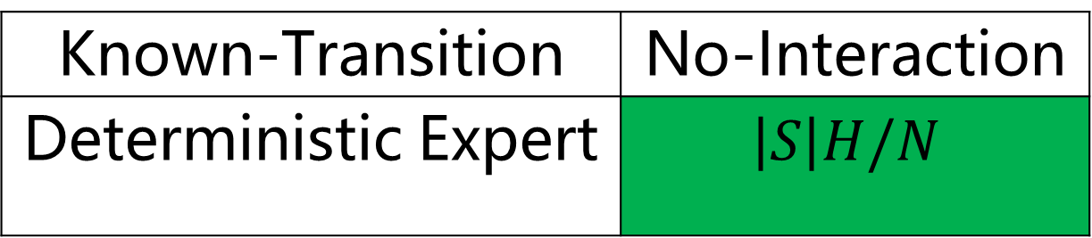
Known-Transition Setting
: | | absorbing states.
Known-Transition | No-Interaction
Deterministic Expert | $$\left|S\right|H/N$$
: | |-1 Bad actions and only one correct action
$$π^{∗}, ∀$$
The MDP is fixed given $N,S,A,H$ and deterministic policy $π^{∗}$ .
$π^{∗}$ always achieves total reward $H$.

Slide 27


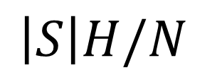

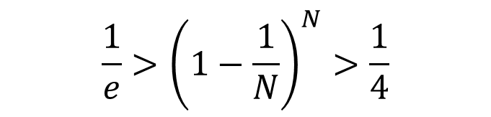
Lower Bound Proof for Known-Transition Setting
Proof Sketch:
$$H$$
5
4
3
2
1
1. If entering a starting state that have never been seen before, this
will result in error in expectation.
2. Since $D$ consists $N$ i.i.d. drawing of $ρ$.
The probability of this case happens is
S1 S2 S3
$$H$$
$$\left|S\right|H/N$$
$${\frac{1}{e}>\left(1−\frac{1}{N}\right)}^{N}>\frac{1}{4}$$

Slide 28
Upper Bound Results

Slide 29
Upper Bound Results
Algorithm
Behavior Cloning
MIMIC-MD
MIMIC-EMP

Slide 30

Upper Bound for No-Interaction IL with Deterministic Expert
Basic Settings:
$π^{∗}∈Π_{det}$ where $∀ π∈$ $Π_{det}$, ,
Hidden Reward Function: ,
Expert dataset $D$ is composed of $N$trajectories generated by i.i.d. rollouts of $π^{∗}$.
Behavior Cloning Algorithm: given data set $D$ , returns any $π∈Π_{mimic}\left(D\right).$

Slide 31


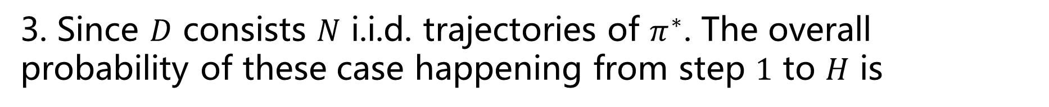
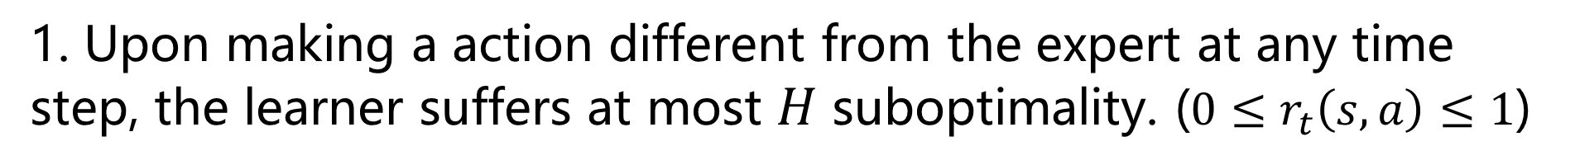


Upper Bound for No-Interaction IL with Deterministic Expert
Proof Sketch:
1. Upon making a action different from the expert at any time step, the learner suffers at most $H$ suboptimality. (${0≤r}_{t}\left(s,a\right)≤1$)
2. By the definition of $\hat{π}$, the only possible case of $\hat{π}$ making different decision is $s_{t}∉S_{t}\left(D\right)$.
3. Since $D$ consists $N$ i.i.d. trajectories of $π^{∗}$. The overall probability of these case happening from step $1$ to $H$ is
$$H$$
$$|S|$$

Slide 32
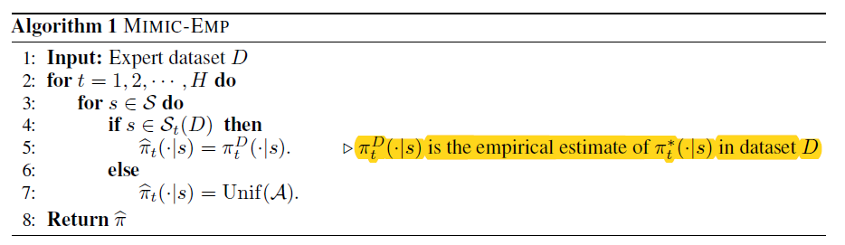
Upper Bound for No-Interaction IL with Stochastic Expert
Basic Settings:
$π^{∗}∈Π_{sto}$ where $∀ π∈$ $Π_{sto}$, ,
Expert dataset $D$ is composed of $N$trajectories generated by i.i.d. rollouts of $π^{∗}$.

Slide 33
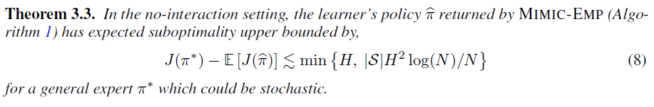
Upper Bound for Interactive IL with Deterministic Expert
Proof Sketch:
1. In test, even if the state $S_{t}$ is only seen once in $S_{t}\left(D\right)$ in the form of ${(S}_{t},a)$. The expected reward for $π^{∗}$ and $\hat{π}$ are the same. (Unbiased Estimator)
2. If the state $S_{t}$ is unseen from $S_{t}\left(D\right)$. The learner makes uniform guess and has at most suboptimality in expectation.
3. The probability of state $S_{t}$ unseen in $S_{t}\left(D\right)$ and encountered in test can be bounded by $\frac{log⁡(N)}{N}$ . And the number of state $S_{t}$ is $H\left|S\right|$.

Slide 34
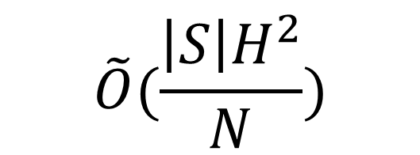
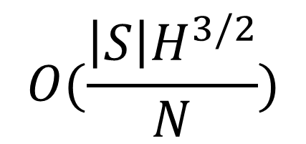


Summary
In this work, the authors studied IL in Episodic and tabular MDP under different settings.
Basic No-Interaction
Deterministic
Data
Known-Transition (No-Interaction)
Expert
(N rollouts)
Interactive
Stochastic
$$O(\frac{\left|S\right|H^{2}}{N})$$
Unknown-Transition
Lower Bound
$$O(\frac{\left|S\right|H}{N})$$
Known-Transition
$$\tilde{O}(\frac{\left|S\right|H^{2}}{N})$$
No-Interaction
Upper Bound
(No-Interaction)
Known-Transition
(No-Interaction, Deterministic)
$$O(\frac{\left|S\right|H^{3/2}}{N})$$

Slide 35
Open Questions
How to bridge the gap between the upper and lower bounds in the known-transition setting?
How much improvement is possible when the learner is allowed to interact with the MDP a finite number of times?
How to extend these results beyond the tabular setting?

Slide 36
QUESTIONS & DISCUSSION
Thank You for Listening!
Notes:
17

