Slide 1
Reward-Free Exploration for Reinforcement Learning
Chi Jin, Akshay Krishnamurthy, Max Simchowitz, Tiancheng Yu
Presenter: Yangzi Lu
11/16/2021

Slide 2
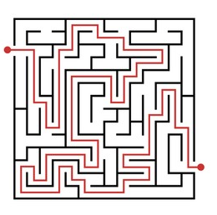

Introduction
Exploration is the most significant challenge in RL.
A random strategy can take exponential time
[Li, 2012]
Standard algorithms employ randomization or its variants.
Some strategy are sample-efficient, but reward functions are often altered to encourage some desired behaviors by trial and error
$${𝒪(3}^{n})$$
Notes:
Exploration is widely regarded as the most significant challenge in RL. Because the agent may have to take precise sequences of actions to reach states with high reward. And a random strategy can take exponential time to reach the corner where the agent can accumulate high reward. This is proved in this paper. Here is an intuitive example, there is a maze and a robot who takes a random walk strategy. The reward is only given when the robot successfully exits the maze. So the robot has to take the right action at each intersection along the way. It turns out that it can take exponential time.
And in practice, all of the standard algorithms employ simple randomization or its variants, and then results extremely high sample complexity.
On the other hand, there are some complex exploration strategies that are provably sample efficient. However, in practice, reward functions are often modified to encourage some desired behaviors by trial and error. In this case, executing the same RL algorithm with different reward can still be sample inefficient.

Slide 3
Introduction
In the setting of:
Same environment, different reward functions
High sample complexity
Proposal:
First collect a dataset with good coverage, then apply a “Batch-RL” algorithm.
Many algorithms can compute near optimal policies from previously collected data
But prior works didn’t show how to get such dataset
Notes:
In the setting of with same environment but different reward functions, if we run the standard RL algorithm, that will result in high sample complexity.
One possible solution to avoid the high sample complexity is to first collect a dataset with good coverage over all possible scenarios in the environment, then apply a “Batch-RL” algorithm. As we know that many algorithms can compute near optimal policies from previously collected data that has good coverage. So the only question left is how to find a sufficiently good enough data. But, unfortunately, the prior works doesn’t show how to get such a good coverage data.

Slide 4
Introduction
Proposal:
First collect a dataset with good coverage, then apply a “Batch-RL” algorithm.
This paper:
Develop an end-to-end instantiation of this proposal.
In particular, collect sufficient information without using any reward.
Notes:
So this paper is trying to develop an end-to-end instantiation of this proposal. In particular, this paper aims to collect sufficient information without using any reward.

Slide 5






“reward-free RL” paradigm
$$r_{1}$$
Environment
$$π_{1}$$
$$r_{2}$$
Reward-free
MDP
Dataset
$$π_{2}$$
$$r_{3}$$
$$π_{3}$$
Exploration
Planning
Notes:
First, they adopt this “reward-free RL” paradigm. In this paradigm, we have two phases. In the exploration phase, the reward-free MDP interacts with environment without a reward function and collects trajectories. Then in planning phase, for any given reward functions, we can compute optimal policy with the dataset collected in the exploration phase.
The result here is quite strong. The dataset collected by this algorithm is sufficient to compute an optimal policy with no further data needed for any number of reward functions. In contrast, if we use standard RL algorithm, we have to collect additional trajectories for each reward function, which could be very sample inefficient.

Slide 6

Contributions
An algorithm such that
Collects a data set with sufficiently good coverage after conducting $\tilde{𝒪}\left(\frac{S^{2}Apoly\left(H\right)}{ε^{2}}\right)$ episodes of exploration,
and can find an $ε$-optimal policy with any given reward functions.
Notes:
Based on the paradigm, they give an algorithm which in exploration phase, after conducting ˜O() episodes, collects a data set with sufficiently good coverage to enable application of standard Batch-RL solvers. And in the planning phase, with a given reward function r, they can find an epsilon-optimal policy, using the dataset alone and no additional data collection. And it holds for all possible reward functions.

Slide 7
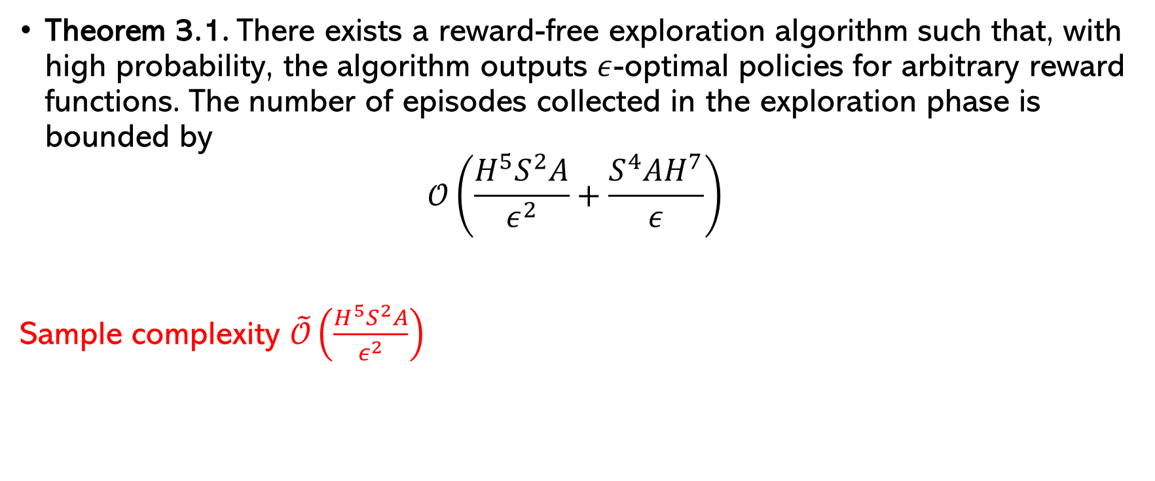
Main Result
Theorem 3.1. There exists a reward-free exploration algorithm such that, with high probability, the algorithm outputs $ε$-optimal policies for arbitrary reward functions. The number of episodes collected in the exploration phase is bounded by
$$𝒪\left(\frac{H^{5}S^{2}A}{ε^{2}}+\frac{S^{4}AH^{7}}{ε}\right)$$
Sample complexity $\tilde{𝒪}\left(\frac{H^{5}S^{2}A}{ε^{2}}\right)$
Notes:
It states that the reward free exploration algorithm has the sample complexity O() ignoring the lower order terms. In other words, after this many episodes interacting with the MDP, the algorithm can compute epsilon-optimal policies for arbitrarily many reward functions.

Slide 8
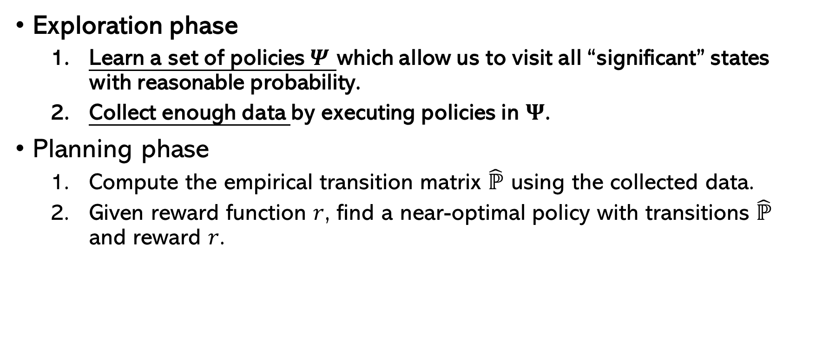
Algorithm Overview
Exploration phase
Learn a set of policies $Ψ$ which allow us to visit all “significant” states with reasonable probability.
Collect enough data by executing policies in $Ψ$.
Planning phase
Compute the empirical transition matrix $\hat{ℙ}$ using the collected data.
Given reward function $r$, find a near-optimal policy with transitions $\hat{ℙ}$ and reward $r$.

Slide 9
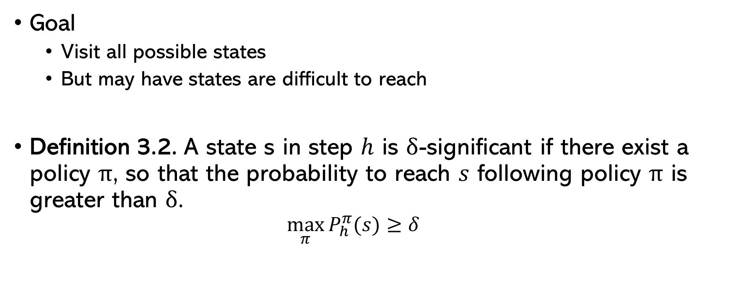
Exploration Phase
Goal
Visit all possible states
But may have states are difficult to reach
Definition 3.2. A state s in step $h$ is $δ$-significant if there exist a policy $π$, so that the probability to reach $s$ following policy $π$ is greater than $δ$.
$$\max_{π}{P_{h}^{π}(s)≥δ}$$
Notes:
The goal of exploration is to visit all possible state so that the agent can collect enough data to find the optimal policy. However, unlike the multi-bandit setting where agent can choose any arm to pull, it is possible that some states are very difficult to reach no matter what policy is taken. In such cases, we cannot learn the transition operator to high accuracy uniformly over the environment, simply because we cannot reach these states to collect enough data.
In our settings, with limited number of samples, we hope to visit all significant states. On the other hand, since insignificant states can be rarely visited no matter what policy is used, they will not significantly contribute to reward optimization. In other words, it is unlikely that the optimal policy would visit these insignificant states. Thus, for finding near-optimal policies, it is sufficient to visit all significant states.

Slide 10
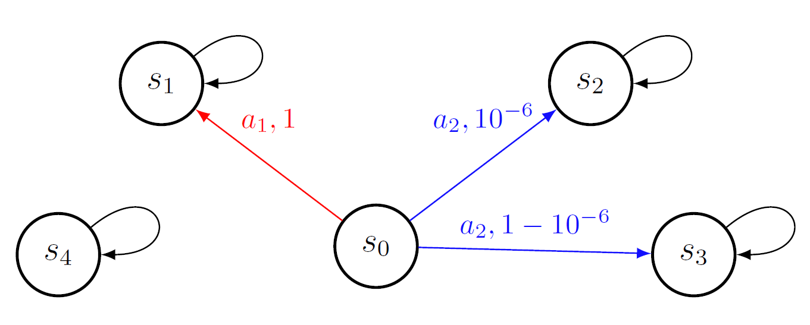

Exploration Phase
Illustration of significant states
$$δ={10}^{−5}$$
Notes:
Here is an example to illustrate the significant states and insignificant states. We have 5 states, where $s_{0}$ is the initial state. Only at state 0 the agent can transit to other states. From other states the agent doesn’t move no mater what action the agent takes. You can see there are self loops on these states. The red arrow represents the action 1 is taken and blue ones if action 2 is taken. The number on the arrow is the transition probability. In this example, the state 4 is insignificant because it can never be reached. If we choose delta to be ${10}^{−5}$, state 2 is also delta insignificant because the best policy to reach state 2 is by taking action 2 at state 0. and the probability is less than delta. Therefore, only state 1 and 3 are delta significant.

Slide 11
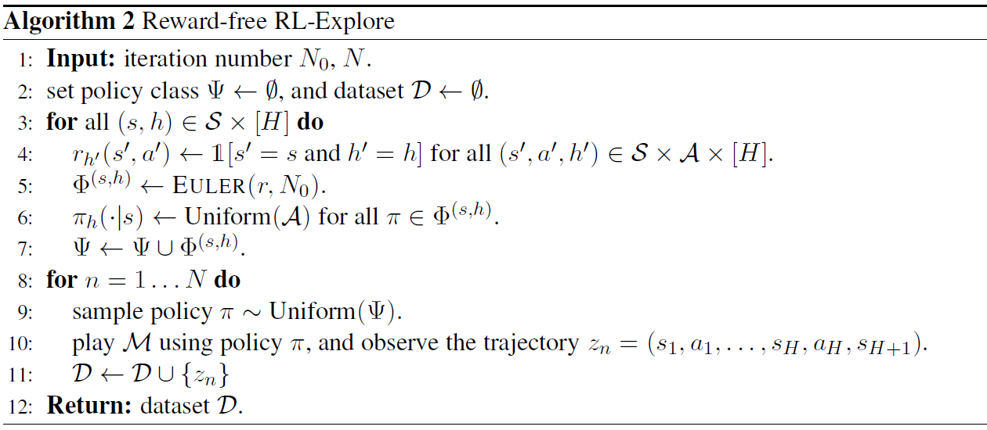
Exploration Phase
EULER: Episodic Upper Lower Exploration in Reinforcement Learning [Zanette and Brunskill, 2019]
Notes:
Here is the actual algorithm for the exploration phase. The first step is the agent learns a set of exploration policies which is line 3-7. The strategy here is to first learn the best policies to reach each state individually, and then combine them.
For each state s at step h, at line 4, it first creates a reward function r that always returns 0 except for state s at step h. the reason it is designed this way is the optimal policy outputted with this reward is the policy that maximized the probability to reach (s,h).
Then at line 5, it simulates a MDP using EULER algorithm. The EULER algorithm is called Episodic Upper Lower Exploration in Reinforcement learning which uses the paradigm of “optimism under uncertainty” to conduct exploration. It will return a set of policy to reach state s at step h.
since the best policy to reach (s, h) is only meaningful at steps before h, The algorithm then alter the policy for state s at step h to be Uniform(A) to ensure good probability of choosing all actions for this state. And line 7 is simple combination.
The second step is much more straight-forward. It uniformly picks a policy from the policy set collected from the last step, executes it with an MDP and collects trajectories.

Slide 12
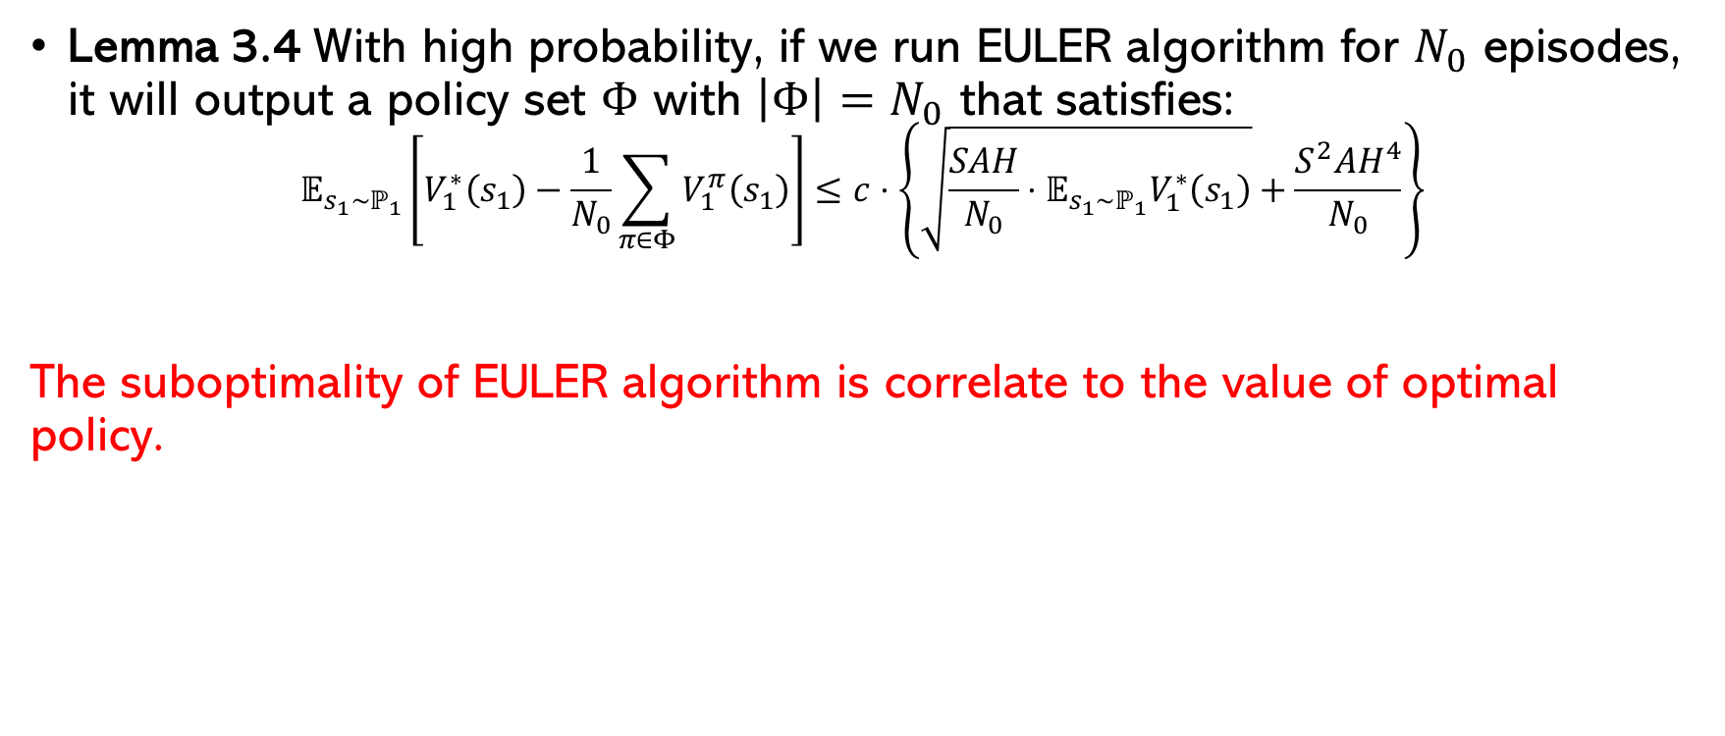
Exploration Phase
Lemma 3.4 With high probability, if we run EULER algorithm for $N_{0}$ episodes, it will output a policy set $Φ$ with $\left|Φ\right|=N_{0}$ that satisfies:
$$𝔼_{s_{1}∼ℙ_{1}}\left[V_{1}^{∗}\left(s_{1}\right)−\frac{1}{N_{0}}\sum_{π∈Φ}{V_{1}^{π}\left(s_{1}\right)}\right]≤c⋅\left\{\sqrt{\frac{SAH}{N_{0}}⋅𝔼_{s_{1}∼ℙ_{1}}V_{1}^{∗}\left(s_{1}\right)}+\frac{S^{2}AH^{4}}{N_{0}}\right\}$$
The suboptimality of EULER algorithm is correlate to the value of optimal policy.
Notes:
Actually, any RL algorithms with PAC or regret guarantees can be used to find this optimal policy. In particular, EULER algorithm is used because its theoretical guarantee is useful for proving the coverage guarantee provided by the algorithm we just showed.
This guarantee is saying that the suboptimality of EULER algorithm is correlate to the value of optimal policy. In other words, even the value of optimal policy is low, the output policy set is still closed to the optimal policy. especially helpful in dealing with those states that are still significant but their maximum reaching probability is low. This is the key to get the main result. We are not getting into detail of the proof since that is out of the scope of this paper.

Slide 13
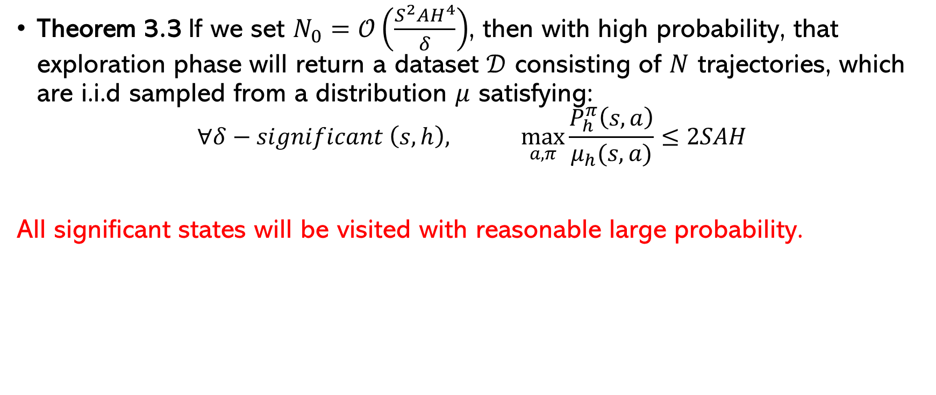
Exploration Phase
Theorem 3.3 If we set $N_{0}=𝒪\left(\frac{S^{2}AH^{4}}{δ}\right)$, then with high probability, that exploration phase will return a dataset $𝒟$ consisting of $N$ trajectories, which are i.i.d sampled from a distribution $μ$ satisfying:
$$∀δ−significant \left(s,h\right), \max_{a,π}{\frac{P_{h}^{π}\left(s,a\right)}{μ_{h}(s,a)}≤2SAH}$$
All significant states will be visited with reasonable large probability.
Notes:
Now we are ready to show the coverage guarantee exploration algorithm provided. This theorem claims that using the reward free exploration Algorithm, we can collect data from an underlying distribution \mu, which ensures that for policy π, the ratio Pπ h (s, a)/μh(s, a) will be upper bounded for any significant state and action. That is saying that all significant states will be visited with reasonable amount of probability.
Notice as δ becomes smaller, there will be more significant states. As a result, we need to take larger N0.

Slide 14
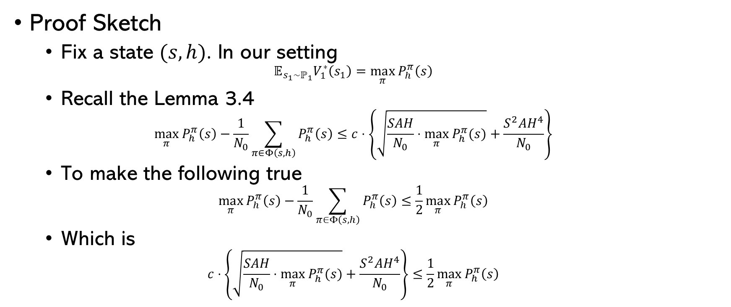
Exploration Phase
Proof Sketch
Fix a state $(s,h)$. In our setting
$$𝔼_{s_{1}∼ℙ_{1}}V_{1}^{∗}\left(s_{1}\right)=\max_{π}{P_{h}^{π}\left(s\right)}$$
Recall the Lemma 3.4
$$\max_{π}{P_{h}^{π}\left(s\right)}−\frac{1}{N_{0}}\sum_{π∈Φ\left(s,h\right)}{P_{h}^{π}\left(s\right)}≤c⋅\left\{\sqrt{\frac{SAH}{N_{0}}⋅\max_{π}{P_{h}^{π}(s)}}+\frac{S^{2}AH^{4}}{N_{0}}\right\}$$
To make the following true
$$\max_{π}{P_{h}^{π}\left(s\right)}−\frac{1}{N_{0}}\sum_{π∈Φ\left(s,h\right)}{P_{h}^{π}\left(s\right)}≤\frac{1}{2}\max_{π}{P_{h}^{π}\left(s\right)}$$
Which is
$$c⋅\left\{\sqrt{\frac{SAH}{N_{0}}⋅\max_{π}{P_{h}^{π}(s)}}+\frac{S^{2}AH^{4}}{N_{0}}\right\}≤\frac{1}{2}\max_{π}{P_{h}^{π}\left(s\right)}$$
Notes:
Here’s the idea of proving Theorem 3.3. First, fix a state (s,h) pair. In our setting, the algorithm says that the value of optimal policy at state s is equal to the maximum probability of reaching state s.
Recall the Lemma 3.4 which is the theoretical guarantee of EULER algorithm.
Then we want to make this to be upper bounded by one half of the maximum probability.
For a sufficient small constant c1, we need to let each part to be upper bounded. And solving these two inequalities for N0, it turns out that the second part will dominate the result. Which is …

Slide 15
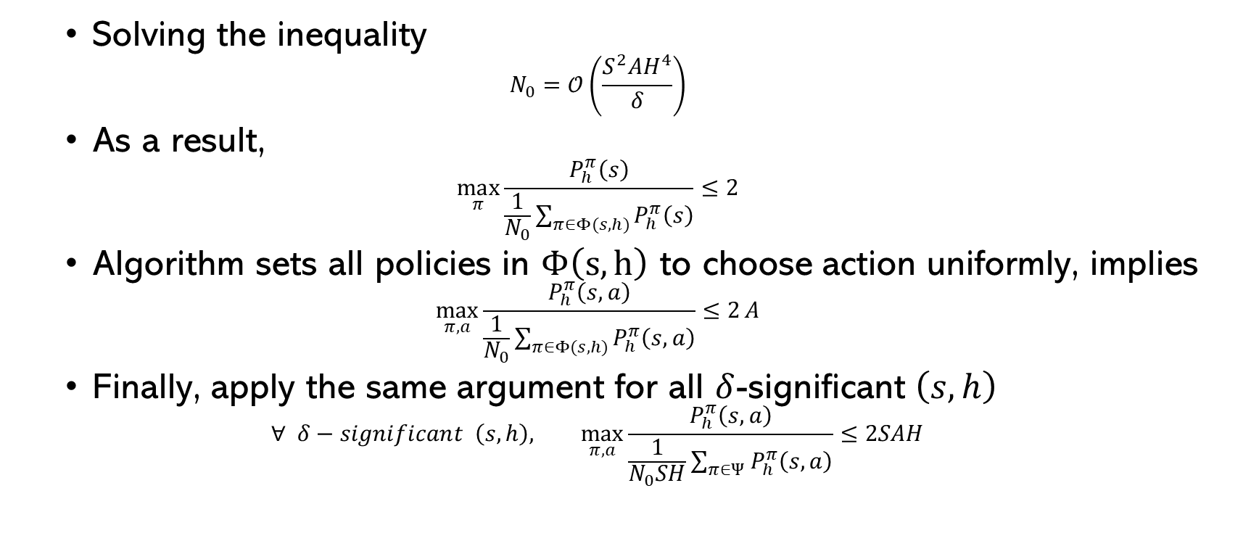
Exploration Phase
Solving the inequality
$$N_{0}=𝒪\left(\frac{S^{2}AH^{4}}{δ}\right)$$
As a result,
$$\max_{π}{\frac{P_{h}^{π}\left(s\right)}{\frac{1}{N_{0}}\sum_{π∈Φ(s,h)}{P_{h}^{π}\left(s\right)}}≤2}$$
Algorithm sets all policies in $Φ\left(s,h\right)$ to choose action uniformly, implies
$$\max_{π,a}{\frac{P_{h}^{π}\left(s,a\right)}{\frac{1}{N_{0}}\sum_{π∈Φ(s,h)}{P_{h}^{π}\left(s,a\right)}}≤2}A$$
Finally, apply the same argument for all $δ$-significant $\left(s,h\right)$
$$∀ δ−significant \left(s,h\right),\max_{π,a}{\frac{P_{h}^{π}\left(s,a\right)}{\frac{1}{N_{0}SH}\sum_{π∈Ψ}{P_{h}^{π}\left(s,a\right)}}≤2SAH}$$
Notes:
N0 is in the order of this. In other words, when N0 is equal to this, it is sufficient to make that true.
Then re-arrange the terms, we will have the maximum ratio of this is at most 2.
Finally, applying the same argument as above for all \delta-significant (s,h) pair which gives the actual result.

Slide 16
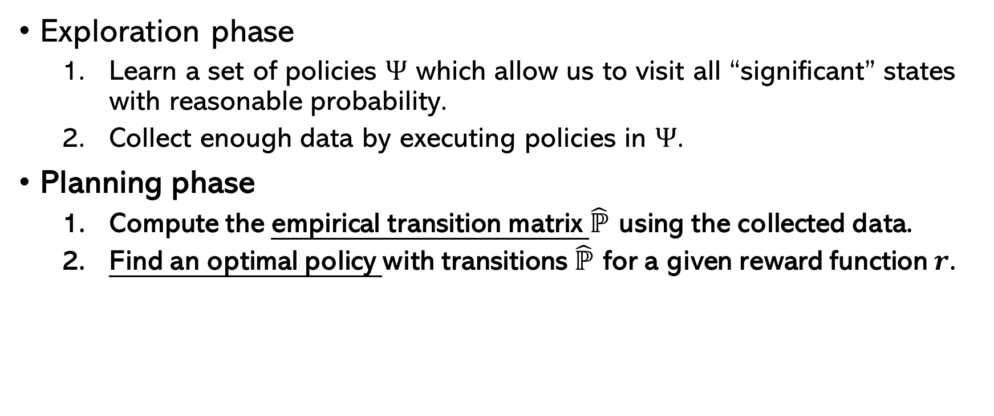
Algorithm Overview
Exploration phase
Learn a set of policies $Ψ$ which allow us to visit all “significant” states with reasonable probability.
Collect enough data by executing policies in $Ψ$.
Planning phase
Compute the empirical transition matrix $\hat{ℙ}$ using the collected data.
Find an optimal policy with transitions $\hat{ℙ}$ for a given reward function $r$.
Notes:
So now we are done with the exploration phase. Let's then look at the planning phase.

Slide 17
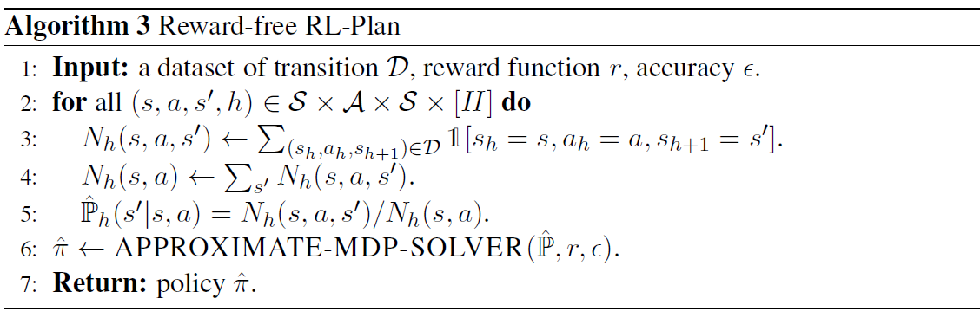
Planning Phase
Notes:
In planning phase, the agent is given the dataset D collected in the exploration phase, the reward function r, and accuracy epsilon. And its goal is to find an epsilon-optimal policy.
Algorithm 3 proceeds with two steps. Line 2-5 use counts based on dataset D to estimate the empirical transition matrix ˆP. Then, algorithm 3 calls an approximate MDP solver to find the epsilon-optimal policy. The MDP solver can be any algorithm that finds epsilon-optimal policy for MDP with known transition matrix and reward.

Slide 18
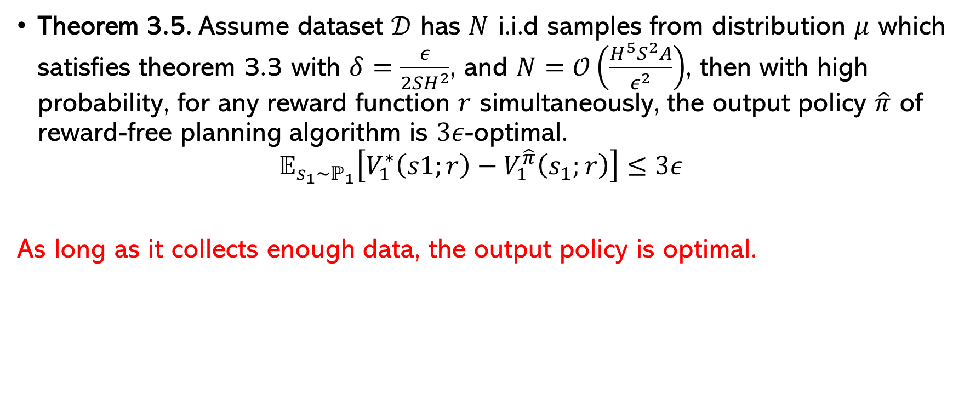
Planning Phase
Theorem 3.5. Assume dataset $𝒟$ has $N$ i.i.d samples from distribution $μ$ which satisfies theorem 3.3 with $δ=\frac{ε}{2SH^{2}}$, and $N=𝒪\left(\frac{H^{5}S^{2}A}{ε^{2}}\right)$, then with high probability, for any reward function $r$ simultaneously, the output policy $\hat{π}$ of reward-free planning algorithm is $3ε$-optimal.
$$𝔼_{s_{1}∼ℙ_{1}}\left[V_{1}^{∗}\left(s1;r\right)−V_{1}^{\hat{π}}\left(s_{1};r\right)\right]≤3ε$$
As long as it collects enough data, the output policy is optimal.
Notes:
Now lets state the guarantee for the planning Algorithm. it is saying that as long as it collects sufficiently large number of data in the exploration phase, the output policy \pi \hat is not only a near optimal policy for the estimated MDP with empirical transition p \hat, but also a near optimal policy for the true MDP.

Slide 19
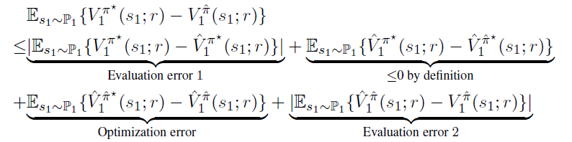

Planning Phase
Proof Sketch
Denote optimal policy of $M(ℙ,r)$ and $\hat{M}(\hat{ℙ},r)$ by $π^{∗}$ and ${\hat{π}}^{∗}$
Notes:
First, we denote optimal policy of $MDP(ℙ,r)$ and $MDP(\hat{ℙ},r)$ by $π^{∗}$ and ${\hat{π}}^{∗}$. Here we use the same strategy as we did in class, adding terms and regrouping them.
The evaluation error is bounded by epsilon.
By definition, we observe that ${\hat{π}}^{∗}$ is the optimal policy for $\hat{M}$, so this is less than 0.
The optimization error is bounded by epsilon as well by assumption. (assuming the MDP solver used in planning phase can find epsilon optimal policy)
Thus, adding them all together, the LHS is upper bounded by 3 epsilon which finish the proof.
The mechanism behind theorem 3.5 is that: by sufficient large number of exploring data, we ensure that the empirical transition P \hat and the true transition P are close so that the near optimal policy for the estimated MDP is also near optimal for the true MDP.
(the idea to bounded evaluation error is that first applying the simulation lemma. Since the reward function are the same, the result will be the difference between transition P and P\hat times V. Then decompose it into parts, one is the significant states and the other is insignificant states. Then we can bound these two terms individually and then combine them which turns out to be epsilon.)

Slide 20
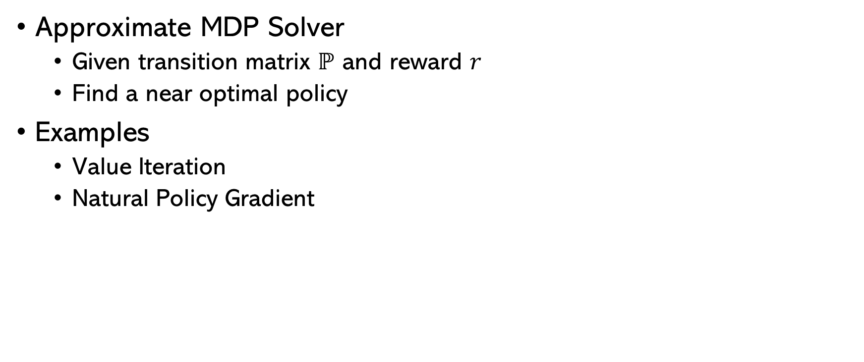
Planning Phase
Approximate MDP Solver
Given transition matrix $ℙ$ and reward $r$
Find a near optimal policy
Examples
Value Iteration
Natural Policy Gradient
Notes:
Approximate MDP solvers aim to find a near-optimal policy with given transition matrix and reward function. The simplest way to achieve this is using value iteration. It solves the Bellman optimality equation, and then induces the greedy policy. Another example is the natural policy gradient algorithm.

Slide 21
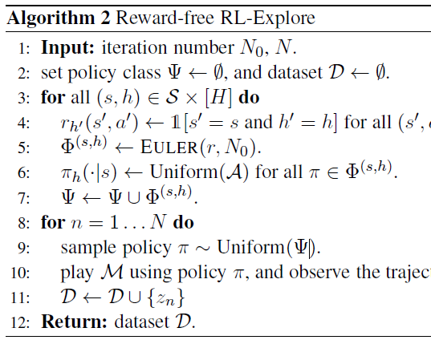

Proof for Main Result
Conclude main result
from theorem 3.5, $N=𝒪\left(\frac{H^{5}S^{2}A}{ε^{2}}\right)$
from theorem 3.3, $N_{0}=𝒪\left(\frac{S^{3}AH^{6}}{ε}\right)$ $×SH$
Main result
$𝒪\left(\frac{H^{5}S^{2}A}{ε^{2}}+\frac{S^{4}AH^{7}}{ε}\right)$
Notes:
From theorem 3.5, we have $N≥\frac{cH^{5}S^{2}Al }{ε^{2}}$. Recall the exploration algorithm, N is representing the number of iteration for collecting data in step 2. so that gives the first term in the main result.
From theorem 3.3, we have $N_{0}≥\frac{cS^{3}AH^{6}l^{3}}{ε}$. N0 is the number of iteration for the EULER algorithm, and we need to run EULER algorithm for each (s,h) pair. Therefore, finding the policy set \psi in the first step requires N0 times SH iterations, which gives the second term.

Slide 22
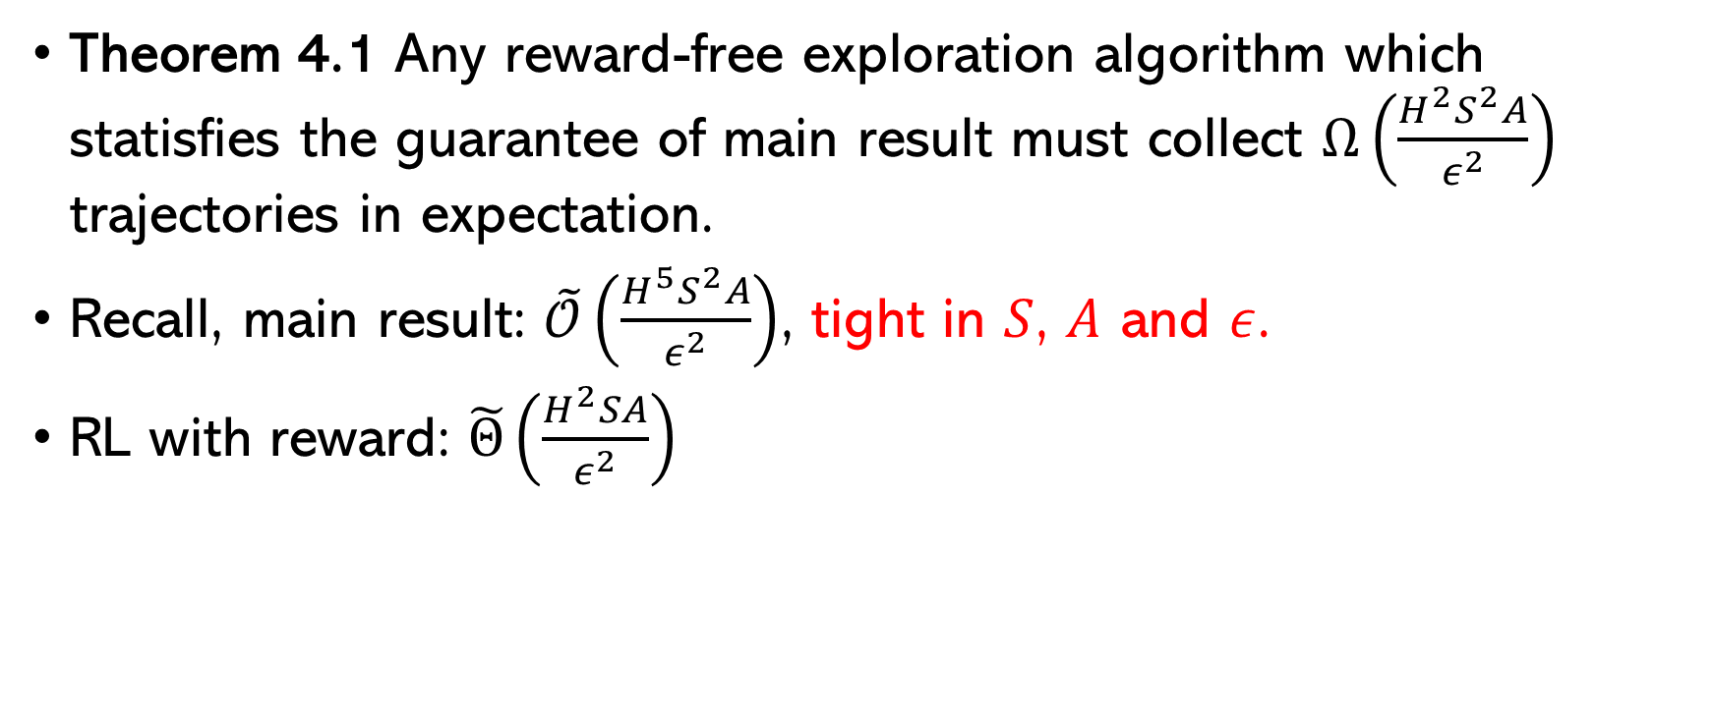
Lower Bound
Theorem 4.1 Any reward-free exploration algorithm which statisfies the guarantee of main result must collect $Ω\left(\frac{H^{2}S^{2}A}{ε^{2}}\right)$ trajectories in expectation.
Recall, main result: $\tilde{𝒪}\left(\frac{H^{5}S^{2}A}{ε^{2}}\right)$, tight in $S$, $A$ and $ε$.
RL with reward: $\tilde{Θ}\left(\frac{H^{2}SA}{ε^{2}}\right)$
Notes:
Recall, the main result shows an upper bound for the sample complexity. In particular, this lower bound shows that the main result is tight in S, A and \epsilon.
Note that the RL with pre-specified reward has sample complexity of (), which means the sample complexity of reward free is only a factor of S larger.

Slide 23
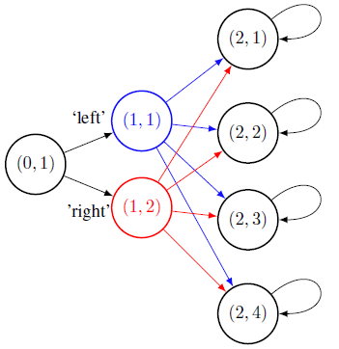

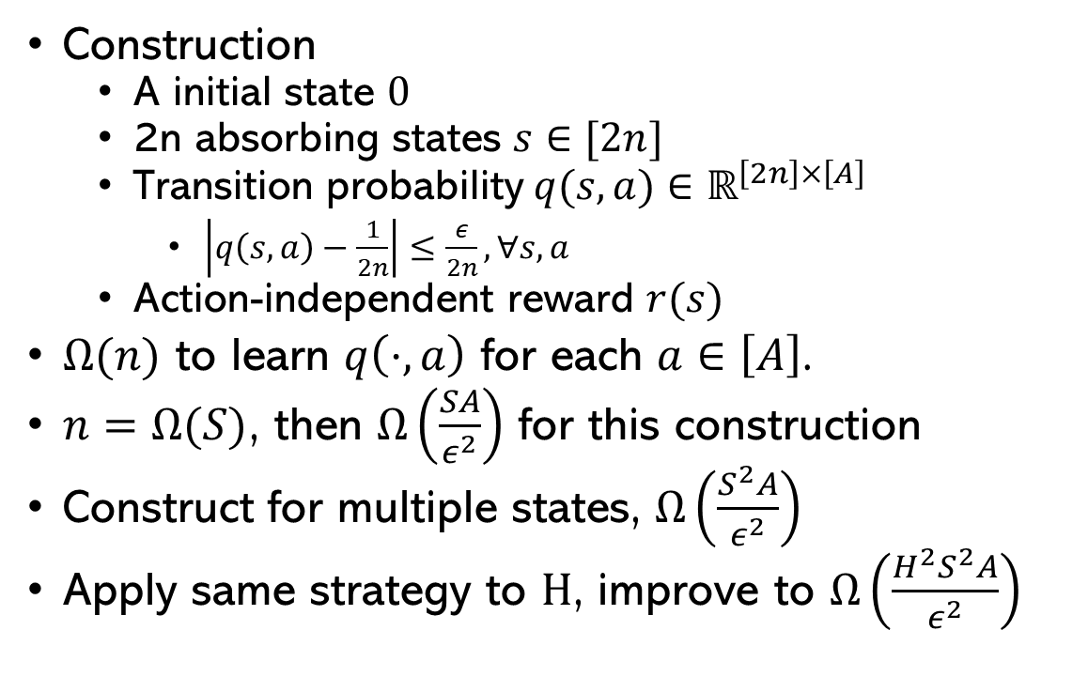






Lower Bound
Construction
A initial state $0$
2n absorbing states $s∈[2n]$
Transition probability$q(s,a)∈ℝ^{\left[2n\right]×\left[A\right]}$
$\left|q\left(s,a\right)−\frac{1}{2n}\right|≤\frac{ε}{2n}, ∀s,a$
Action-independent reward $r(s)$
$Ω(n)$ to learn $q\left(⋅,a\right)$ for each $a∈\left[A\right]$.
$n=Ω(S)$, then $Ω\left(\frac{SA}{ε^{2}}\right)$ for this construction
Construct for multiple states, $Ω\left(\frac{S^{2}A}{ε^{2}}\right)$
Apply same strategy to $H$, improve to $Ω\left(\frac{H^{2}S^{2}A}{ε^{2}}\right)$
$$s_{1}$$
$$q\left(s_{1},a_{1}\right)$$
$$a_{1}$$
$$s_{2}$$
0
$$a_{2}$$
$$s_{3}$$
$$s_{4}$$
Notes:
The lower bound is proved by using construction. Here is an instance for a single state. So we have a initial state…
Where q(s,a) is the transition probability to state s by taking action a at state 0. we restrict the transition probability to be close to uniform, so that all states could be visited with roughly same probability.
Then we observe that this construction requires the learner to learn the transition probabilities in total-variation distance for each $a∈A$.

Slide 24
Reference
Lihong Li. Sample complexity bounds of exploration.
Ronen I Brafman and Moshe Tennenholtz. R-max-a general polynomial time algorithm for near-optimal reinforcement learning.
Simon S Du, Akshay Krishnamurthy, Nan Jiang, Alekh Agarwal, Miroslav Dud´ık, and John Langford. Provably efficient rl with rich observations via latent state decoding.
Dipendra Misra, Mikael Henaff, Akshay Krishnamurthy, and John Langford. Kinematic state abstraction and provably efficient rich-observation reinforcement learning. arXiv preprint arXiv:1911.05815, 2019.
Elad Hazan, Sham M Kakade, Karan Singh, and Abby Van Soest. Provably efficient maximum entropy exploration.
Andrea Zanette and Emma Brunskill. Tighter problem-dependent regret bounds in reinforcement learning without domain knowledge using value function bounds.
Alekh Agarwal, Sham M Kakade, Jason D Lee, and Gaurav Mahajan. Optimality and approximation with policy gradient methods in markov decision processes. arXiv preprint arXiv:1908.00261, 2019

