Slide 1
Online Learning in Unknown Markov Games
Authors: Yi Tian, Yuanhao Wang, Tiancheng Yu, Suvrit Sra
Presenter: Junfeng Xu
11/15/2024

Slide 2
Introduction
Multi-agent reinforcement learning (MARL) focuses on decision-making with multiple agents in a shared environment.
Recent success in applications like Go, video games, Poker, autonomous driving.
Importance of Markov Games:
Used as the computational model for MARL studies.
Extends Markov Decision Processes (MDPs) (Puterman, 2014) to multi-agent settings.
Allows modeling of competitive and collaborative interactions in MARL.

Slide 3
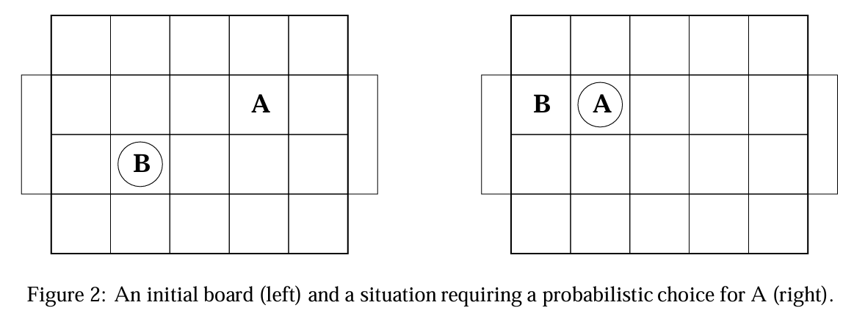
Markov Games Background
Markov Games (MGs): Key Components
States: Represent all possible configurations of the environment.
Actions: Players’ available moves, affecting game outcomes.
Transition Function: Defines state changes based on actions.
Rewards: Quantify outcomes for players based on actions.
*Figure 2 from [Littman 94]

Slide 4
Markov Games Background (Cont.)
Offline(Self-play)
We control both/all players
In a pre-set environment (e.g., Simulator)
Online
We can only control one player and treat other players as opponents.
Informed vs Unknown
Learning in unknown MGs is harder, more general, and potentially of greater practical relevance than informed MGs.
*Figure 2 from [Littman 94]

Slide 5
Challenges in Unknown Markov Games
Main Challenges in Unknown MGs:
Sample Efficiency: Requires enough exploration without observing all opponent actions.
Lack of Opponent Observations: Increases difficulty of learning dynamics.
Multi-Agent Complexity: Each player affects state transitions, complicating predictions.
How this paper addresses these:
Uses optimism to compensate for missing data.
Avoids complex Q-tables, focusing on value functions.

Slide 6
Problem Definition
Objective: Minimize regret in unknown Markov Games
Regret: Difference between cumulative reward of optimal policy vs. the learning algorithm.
Key Research Questions:
Is sublinear regret achievable with unobservable opponent actions?
Can the regret be made independent of opponents' action space size, thus enabling scalability?

Slide 7
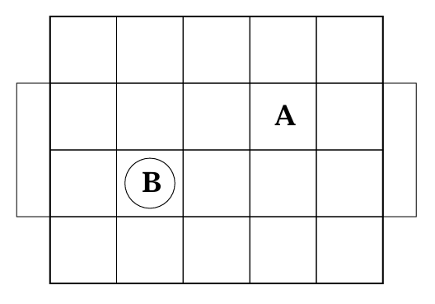
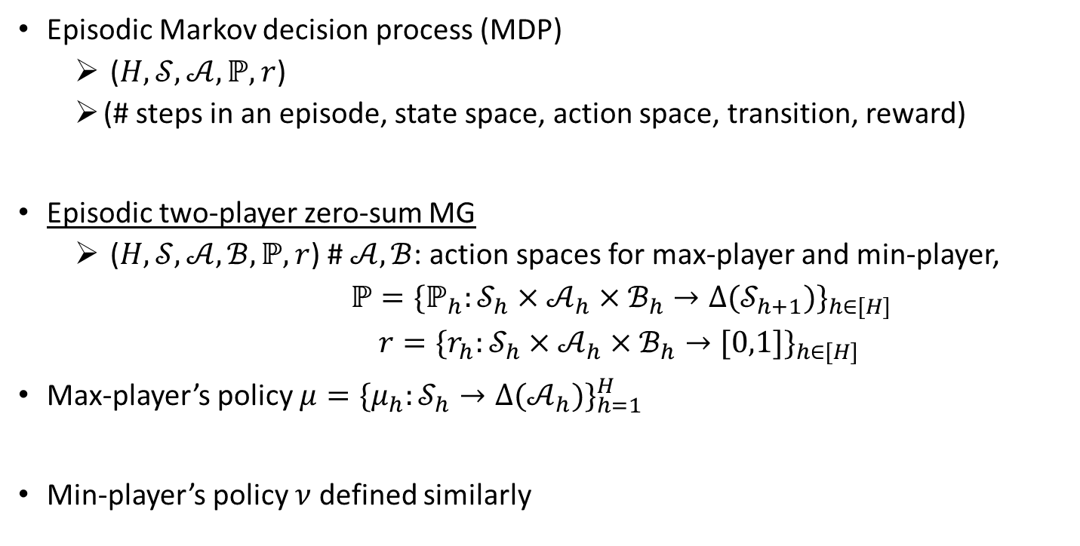
Markov Games Setup (model)
Episodic Markov decision process (MDP)
($H,𝒮,𝒜,ℙ,r$)
(# steps in an episode, state space, action space, transition, reward)
Episodic two-player zero-sum MG
($H,𝒮,𝒜,ℬ,ℙ,r$) # $𝒜,ℬ$: action spaces for max-player and min-player,
$ℙ{=\{ℙ_{h}:𝒮_{h}×𝒜_{h}×ℬ_{h}→Δ(𝒮_{h+1})\}}_{h∈[H]}$
${r=\{r_{h}:𝒮_{h}×𝒜_{h}×ℬ_{h}→[0,1]\}}_{h∈[H]}$
Max-player’s policy ${μ=\{μ_{h}:𝒮_{h}→Δ(𝒜_{h})\}}_{h=1}^{H}$
Min-player’s policy $ν$ defined similarly

Slide 8


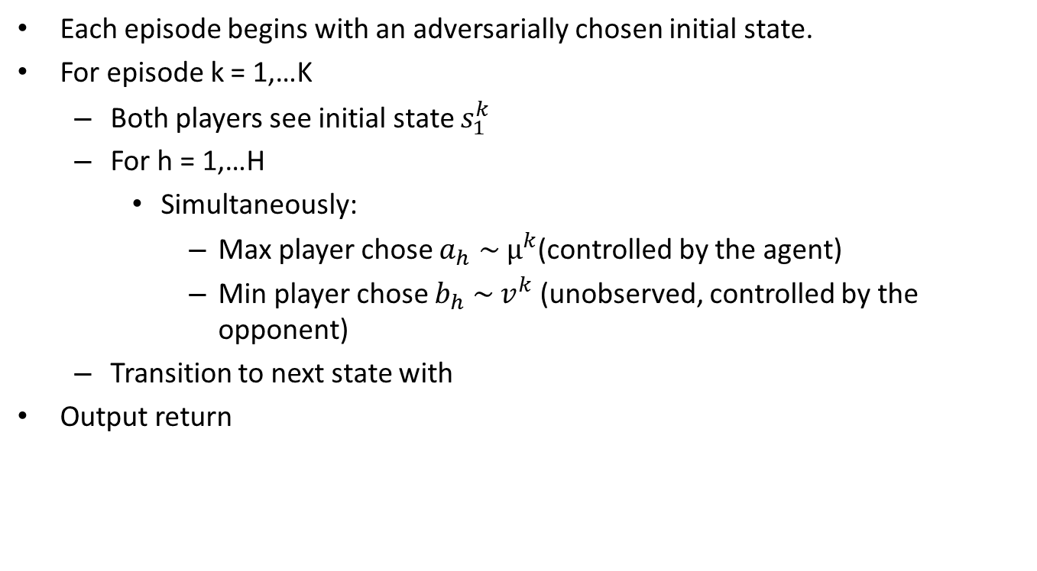
Markov Games Setup (Interaction protocol)
Each episode begins with an adversarially chosen initial state​.
For episode k = 1,…K
Both players see initial state $s_{1}^{k}$
For h = 1,…H
Simultaneously:
Max player chose $a_{h} \sim μ^{k}$(controlled by the agent)
Min player chose $b_{h} \sim v^{k}$(unobserved, controlled by the opponent)
Transition to next state with
Output return

Slide 9
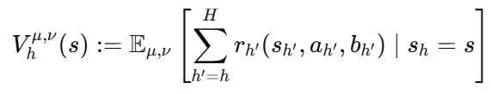
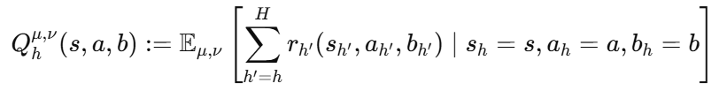
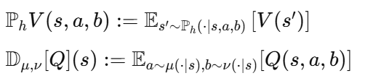


Markov Games Setup (Value functions)
State value function and Q-value function:
Operators for compactness of notation:
Bellman equations:

Slide 10




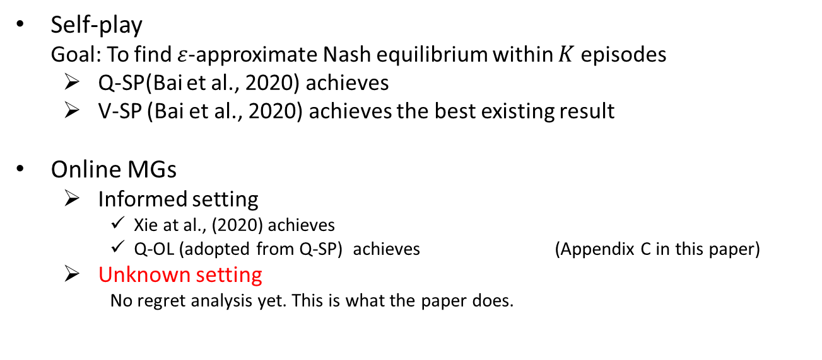
Related Work
Self-play
Goal: To find $ε$-approximate Nash equilibrium within $K$ episodes
Q-SP(Bai et al., 2020) achieves
V-SP (Bai et al., 2020) achieves the best existing result
Online MGs
Informed setting
Xie at al., (2020) achieves
Q-OL (adopted from Q-SP) achieves (Appendix C in this paper)
Unknown setting
No regret analysis yet. This is what the paper does.

Slide 11

Problem Setup
Goal: Maximize cumulative return, or equivalently, minimize regret in an online setting.
Conventional regret definition:
In unknown MGs, the problem is statistically hard.

Slide 12


Statistical hardness
We want to justify the usage of the weaker notion of Regret(K).
Challenges with Competing Against Best Fixed Policy (Regret’(K)):
Competing with Best Policy in Hindsight is statistically hard.
Regret in this case grows linearly in 𝐾 or exponentially in 𝐻.
Result: Achieving sublinear regret against the best policy in hindsight is computationally and statistically intractable.
Theoretical Lower Bound:
The worst-case regret is bounded below as:
Any algorithm must suffer linear regret unless

Slide 13
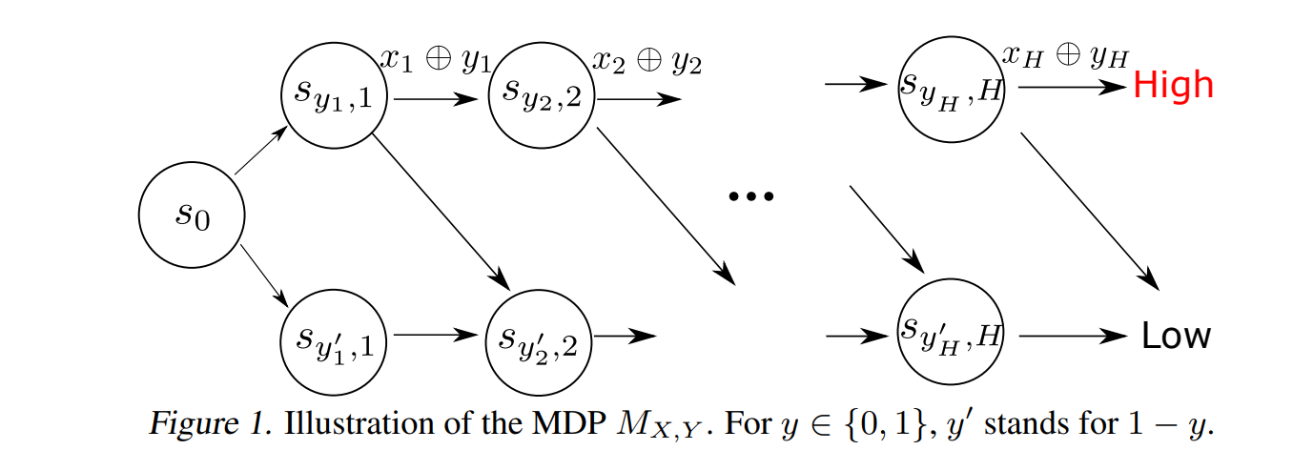

Sketch of Proof: Statistical Hardness
Inspired by “combination lock” (Du et al., 2019).
Achieve high reward requires guessing every bit of $X$ correctly
The problem as hard as multi-armed bandit problem with $2^{H}$ arms.

Slide 14
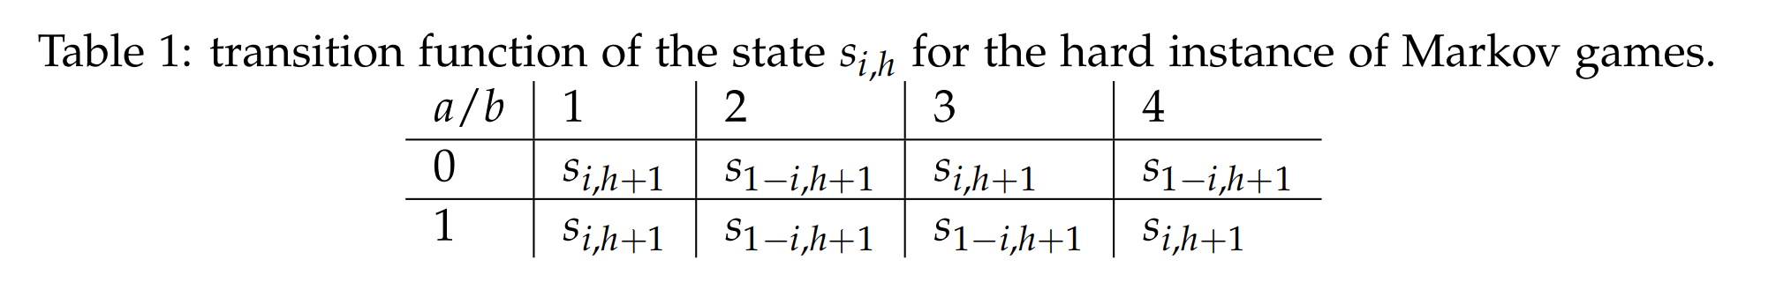
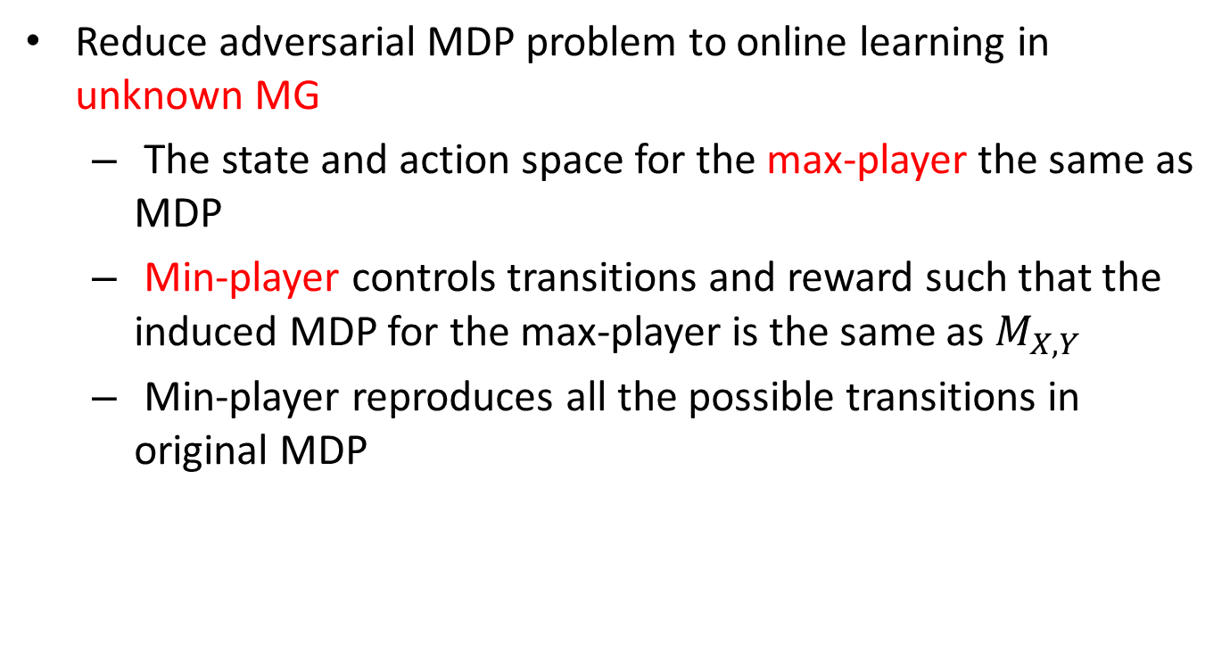
Proof Sketch of Statistical Hardness (Cont.)
Reduce adversarial MDP problem to online learning in unknown MG
The state and action space for the max-player the same as MDP
Min-player controls transitions and reward such that the induced MDP for the max-player is the same as $M_{X,Y}$
Min-player reproduces all the possible transitions in original MDP

Slide 15


Problem Setup (re-visit)
Goal: Maximize cumulative return, or equivalently, minimize regret in an online setting.
Conventional regret definition:
By using
More modest goal in this paper:

Slide 16
The V-ol Algorithm
V-ol: a variant of V-Learning algorithms.
assigns higher exploration value to actions that haven’t been fully explored
The agent updates its policy based on these optimistic value estimates
Key advantages of this approach:
V-OL doesn’t need opponent actions to be observable.
V-OL is computationally efficient and scalable

Slide 17
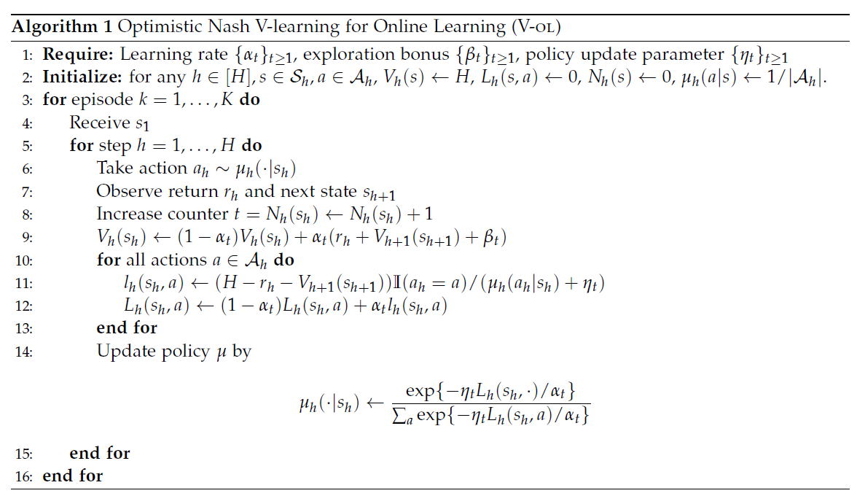
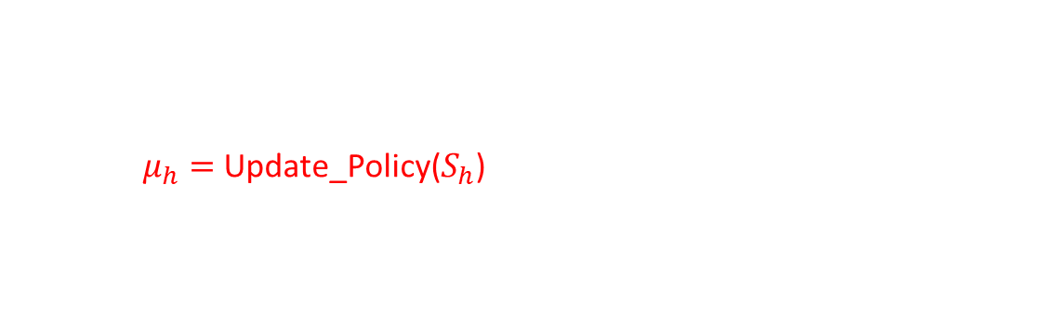
Algorithm Pseudo code
$μ_{h}=$Update_Policy($S_{h}$)

Slide 18
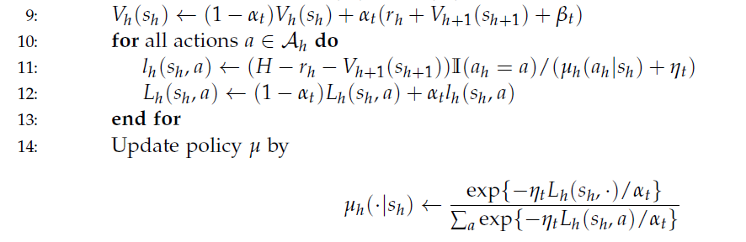

Algorithm Pseudo code (cont.)
Subroutine: Update_Policy($S_{h}$) {
return $μ_{h}$
}
Note: $μ$ prompts small loss L

Slide 19


Favoring more recent samples
To solve the problem of V-learning may only have a linear in K regret bound (V-sp)
Giving more weight to more recent samples
hyperparameters for V-sp:
For V-ol:
G is used to tune how much to favor recent samples

Slide 20


Regret Guarantees
With the hyperparameters from last slide
The regret in K episodes:
We got with proper G value:

Slide 21

Regret and Efficiency Analysis
Achieving Sublinear Regret with V-OL
Regret Bound:
Not dependent on opponents’ action space size B, particularly large B.
Importance:
Key contribution for scalability in multi-agent learning scenarios.
The first algorithm to achieve these results in unknown Markov Games.

Slide 22
Comparison with Prior Work
Q-Learning-based Approaches (V-sp):
Q-learning methods require observing opponent actions to maintain the Q-table, limiting applicability.
learning a Q-value function results in a regret or sample complexity that depends on its size SAB (B is the opponent’s action space)
Advantages of V-ol:
Independent of opponent action space size.
Works with unobserved opponent actions.

Slide 23

Extensions to Multi-Player General-Sum Games
Multi-Player and General-Sum Game Extensions:
V-OL applies to games with more than two players and mixed objectives.
Generalized regret bound is independent of opponents' combined action space.
Implications:
In a multi-player setting, action space B grows exponentially in the number of opponents
Regret not dependent on B is significant.

Slide 24

Future Work
Areas for Future Research:
Tightening the Regret Bound: Target O($K^{\frac{1}{2}}$) for even more efficient performance.
Extending V-ol to achieve sublinear regret for adversarial reward MDPs with bandit feedback.

Slide 25
Conclusion
Key Takeaways:
V-OL introduces a novel, scalable approach to learning in unknown Markov Games.
Achieves sublinear regret independently of opponent’s action space.

Slide 26
Questions?

