Slide 1
Crowd Simulation
Zhicheng Chen

Slide 2
Introduction
Increasing proportion of people living in urban.
A crowd forms when a large amount of people gathers in a limited space.

Slide 3
Related Work and Resources
Related works
待定
Resources
Recast
Detour

Slide 4
Observations of Real-life Crowd Videos
Pair Walking
People in a small group are more likely to stay side by side
Queue up Behavior
People line up and slowly move forward in the line.
The maximum number of people in each row of the waiting line is 2
Security Checking Behavior
Each people has two security processes to finish before entering the building

Slide 5
Foundation Architecture and Scenario
Architecture:
Open source state of art navigation mesh construction toolset called Recastnavigation to achieve static avoidance and shortest path calculation.
Path-finding and spatial reasoning toolkit Detour to achieve dynamic avoidance among agents in the path and to completed calculation of each frame of the simulation.

Slide 6
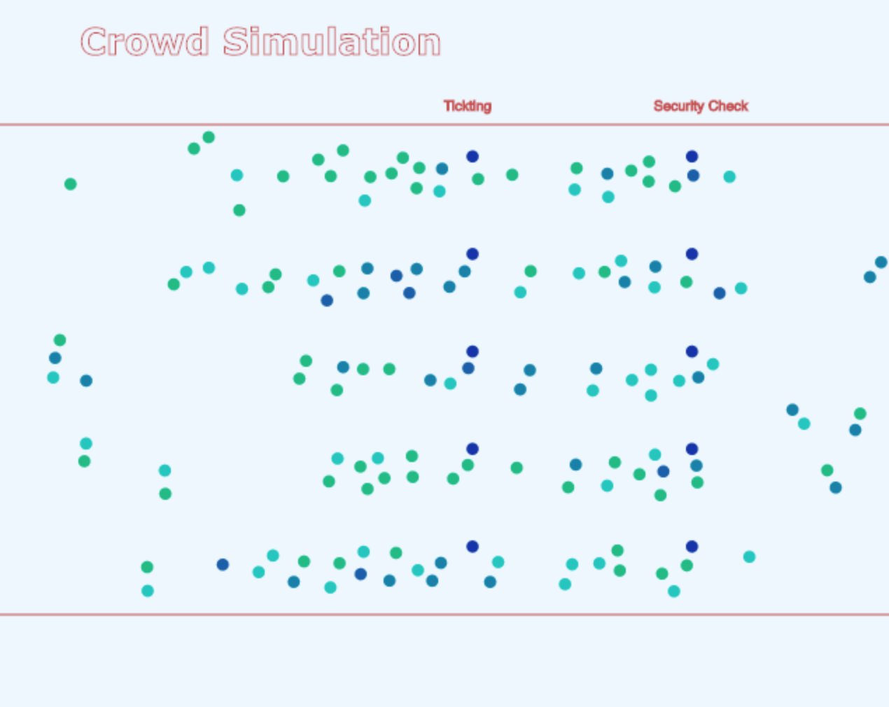
Foundation Architecture and Scenario
Scenario:

Slide 7
Environment Implementation and Setup
Input Data Initialization
Environment Initialization

Slide 8
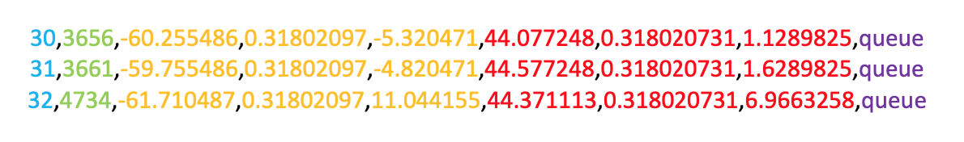
Environment Implementation and Setup
Input Data Initialization
Input file determines the basic scene information.
Agent id
Agent start time
Start position
End position
Behavior mode
Appearance Feature of Upcoming Agents

Slide 9
Environment Implementation and Setup
Environment Initialization
Gates initialization
Agent pair relationship initialization
Agent’s checking time initialization
Agent’s anxiety initialization
Agents pick gate

Slide 10
Agent Behavior Implementation
Pair walking behavior
Queue up behavior
Re-consider behavior

Slide 11
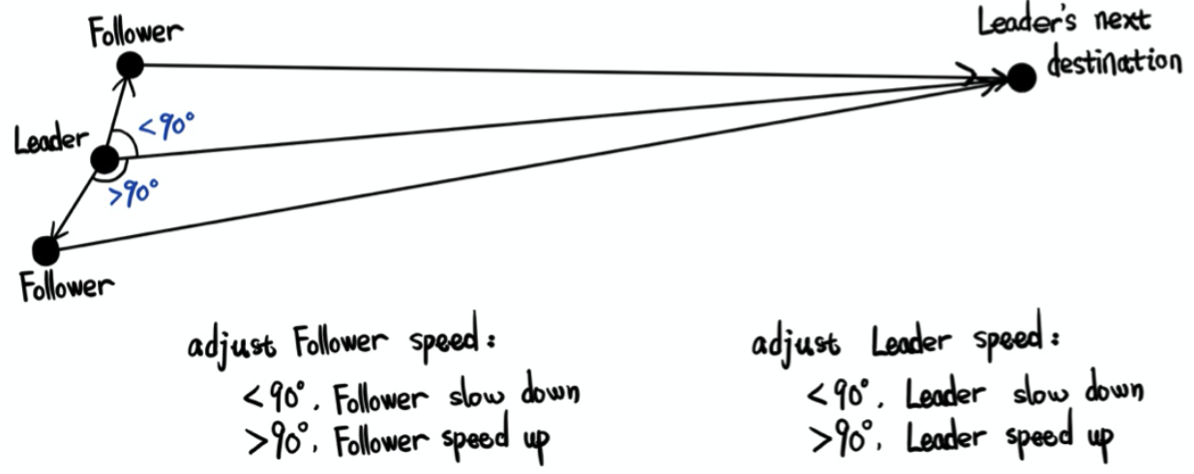
Agent Behavior Implementation
Pair walking behavior

Slide 12
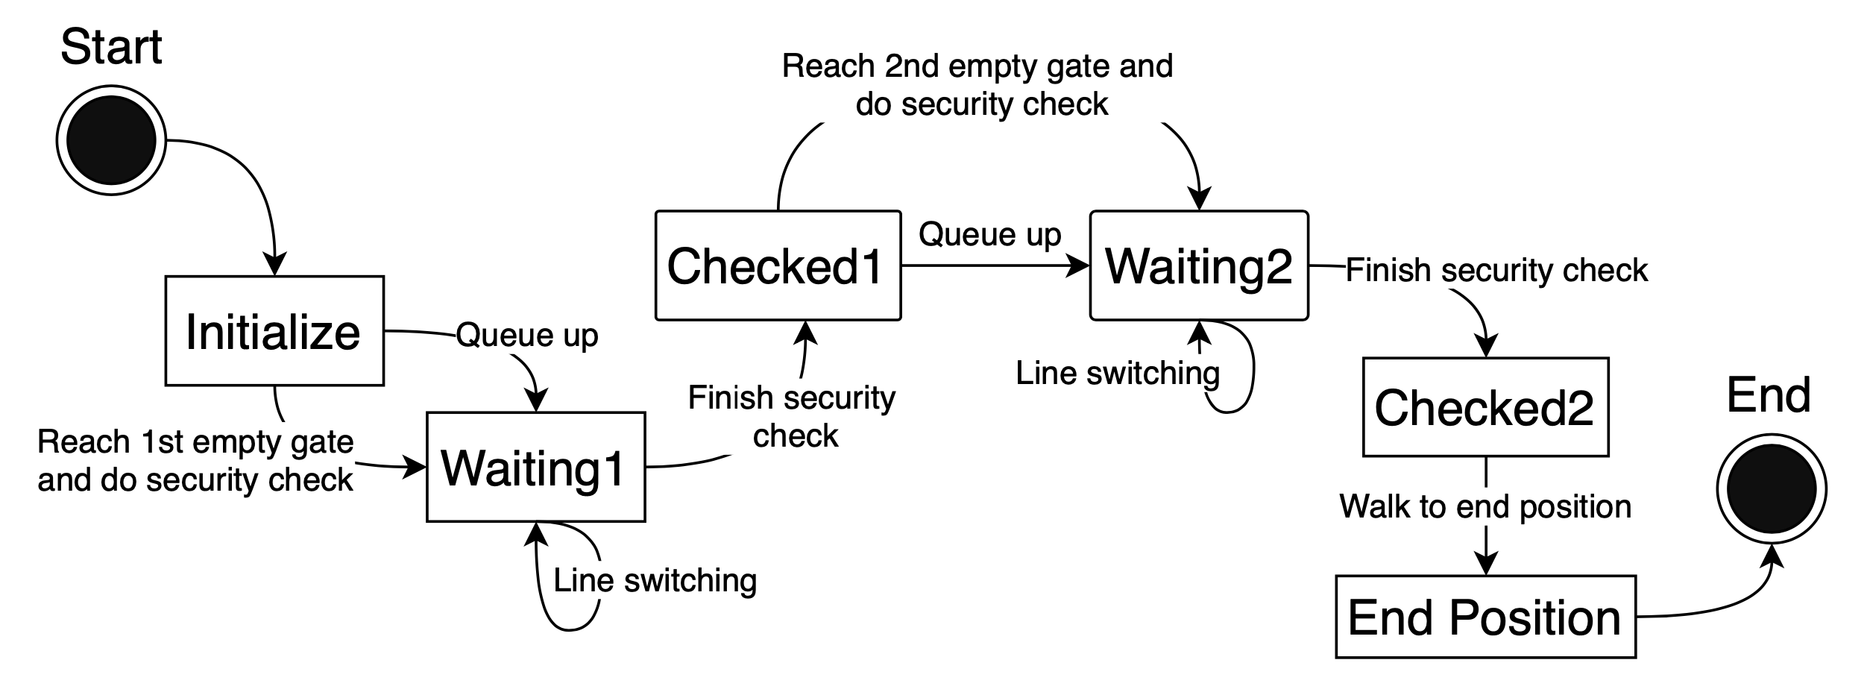
Agent Behavior Implementation
Queue up behavior

Slide 13
Agent Behavior Implementation
Re-consider behavior
Agents make line switching decision based on anxiety degree.
Anxiety update process:
Agents queue up in waiting line.
Agents compare their current position to the tail position of left or right waiting line.
Agents increase anxiety degree if they satisfy their own line. Otherwise, the anxiety degree remain.

Slide 14
Evaluation
Input data evaluation
Behavior evaluation

Slide 15
Evaluation
Input data evaluation
Agents’ basic input data follow specific pattern.

Slide 16
Evaluation
Behavior evaluation
Agents in pair relationship do pair walking.
Agents adjust their speed to stay side by side.
Agents do two processes of security check before walking to their final destinations.
Agents queue up and form waiting line.
Waiting lines have one or two agents in each row.
Agents stop if no room between gate lines.
Agents leave and move to a shorter waiting line.
Agents could change their target line before lining up.

Slide 17
Future work

Slide 18
Thank you

