Slide 1
Outer Circles 1
Outer Circles 2
Inner Circles
Inner lines
Stanchion Lines

Slide 2
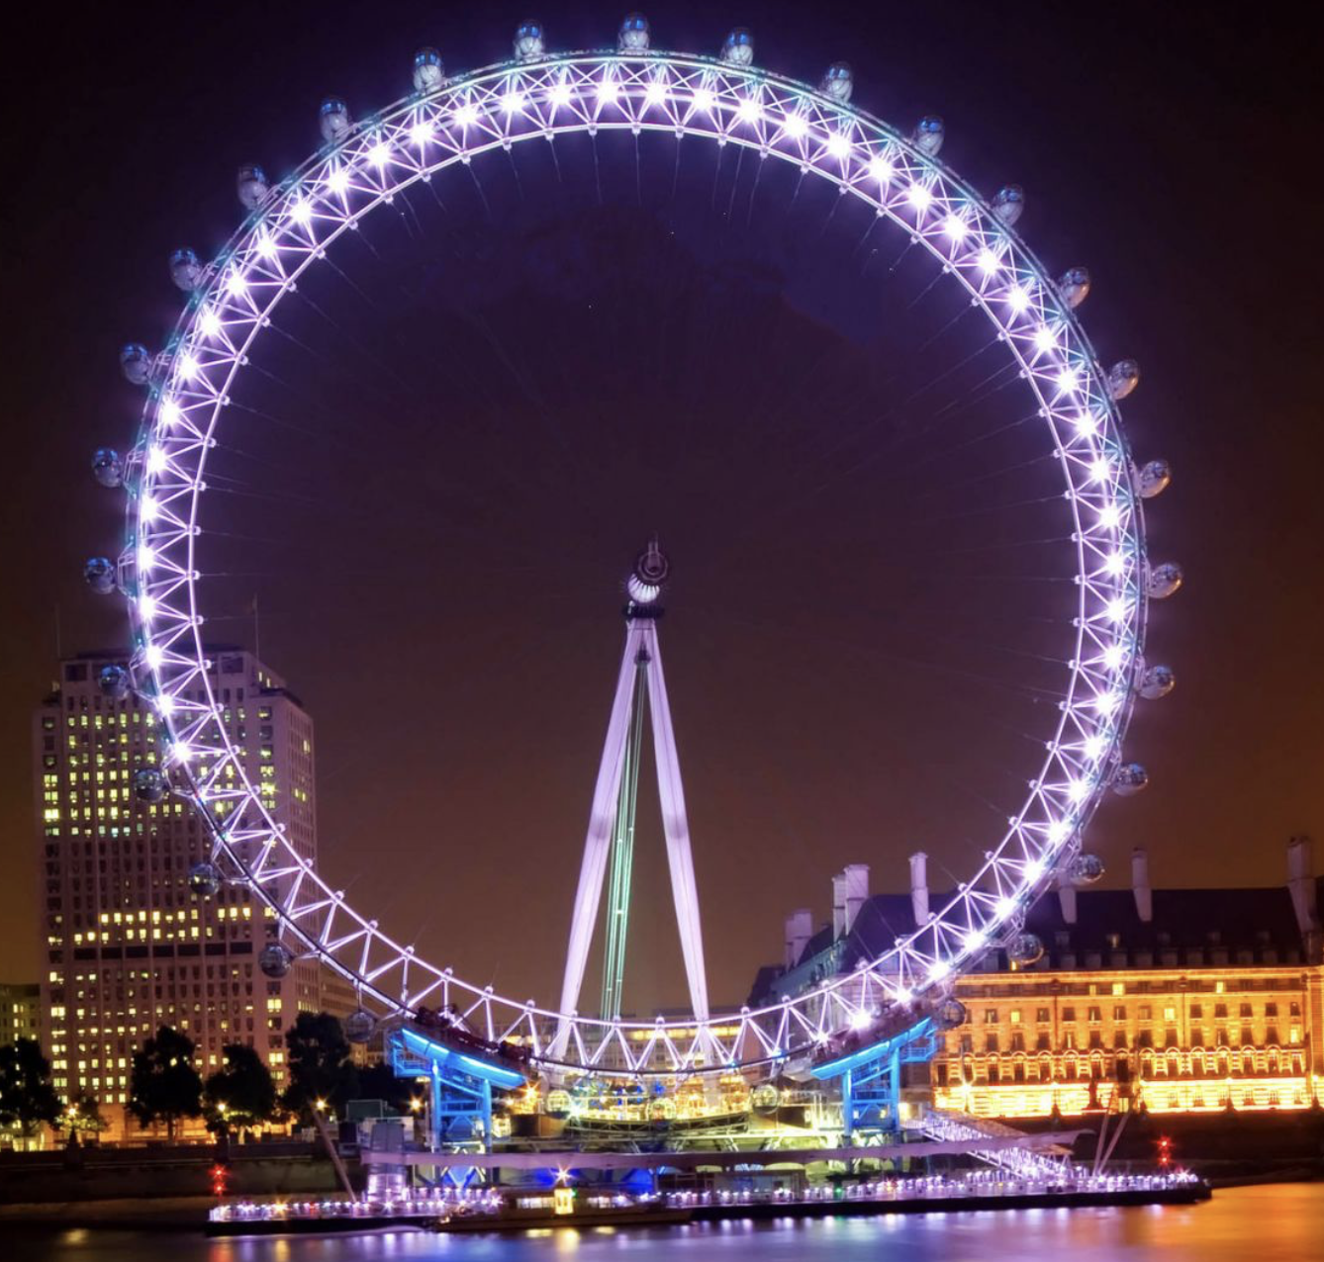
Outer Circles 1
Outer Circles 2
Inner Circles
Stanchion
Lines
Inner lines

