Slide 1
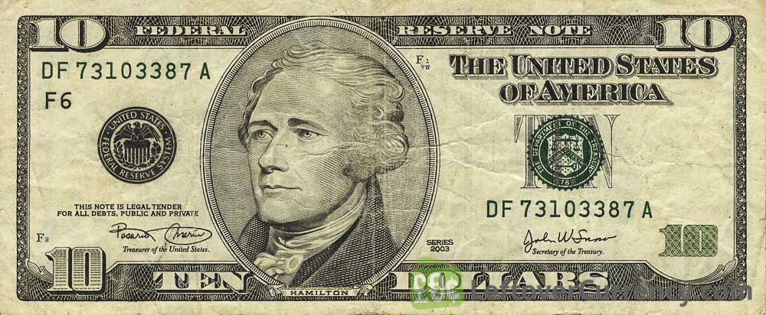
+$10

Slide 2
-$10

Slide 3
$0

