Slide 1
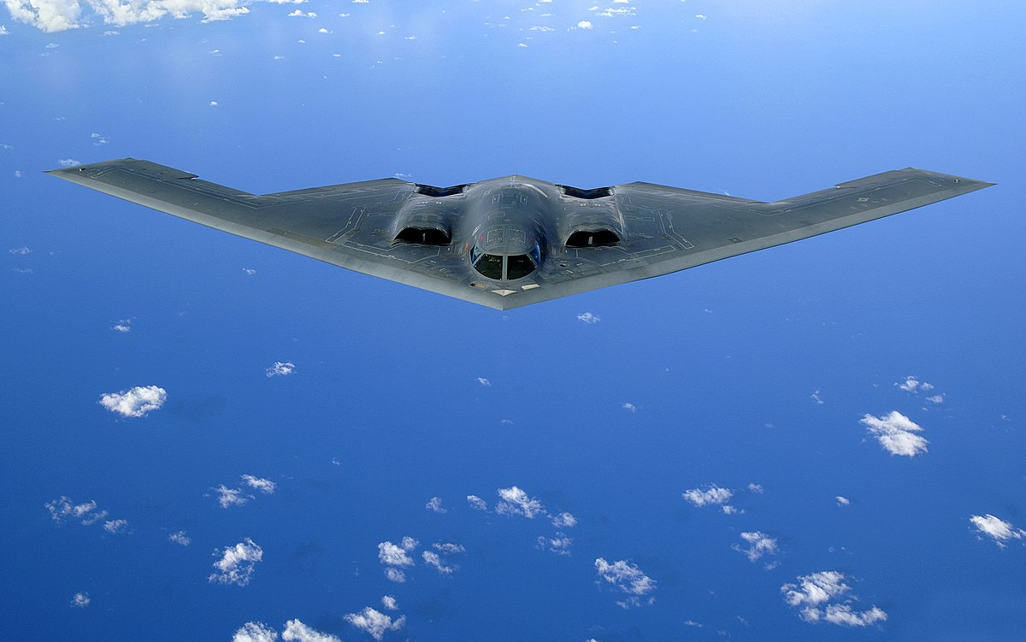
Performance of Defence Stocks During Geopolitical Crises
Akram S. Sadek

Slide 2
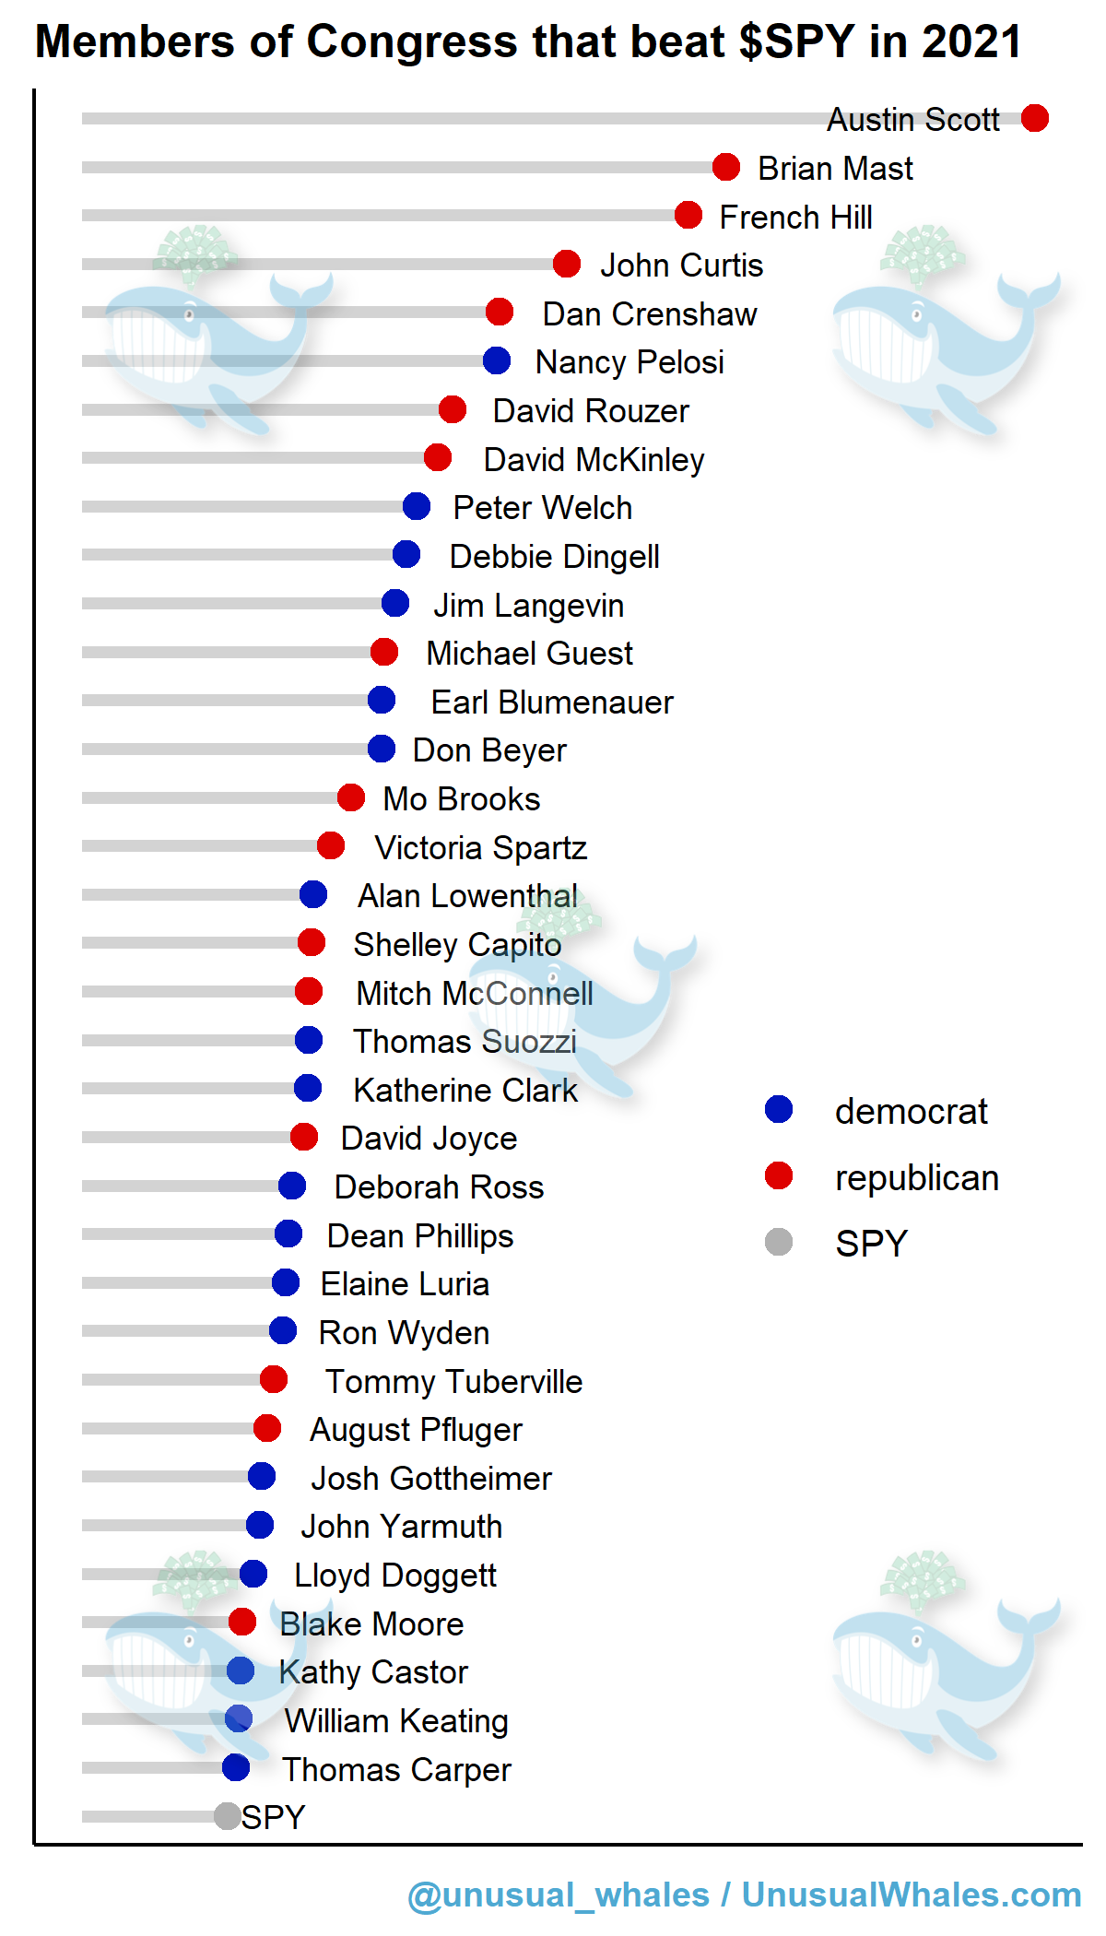
Defence – Opportunity for Investment?
“Defense stocks double the S&P 500’s
return six months after Middle East
turmoil, history shows”
- CNBC
“REVEALED: Lawmakers MASSIVELY Beat Stock Market in 2021”
- Breaking Points

Slide 3
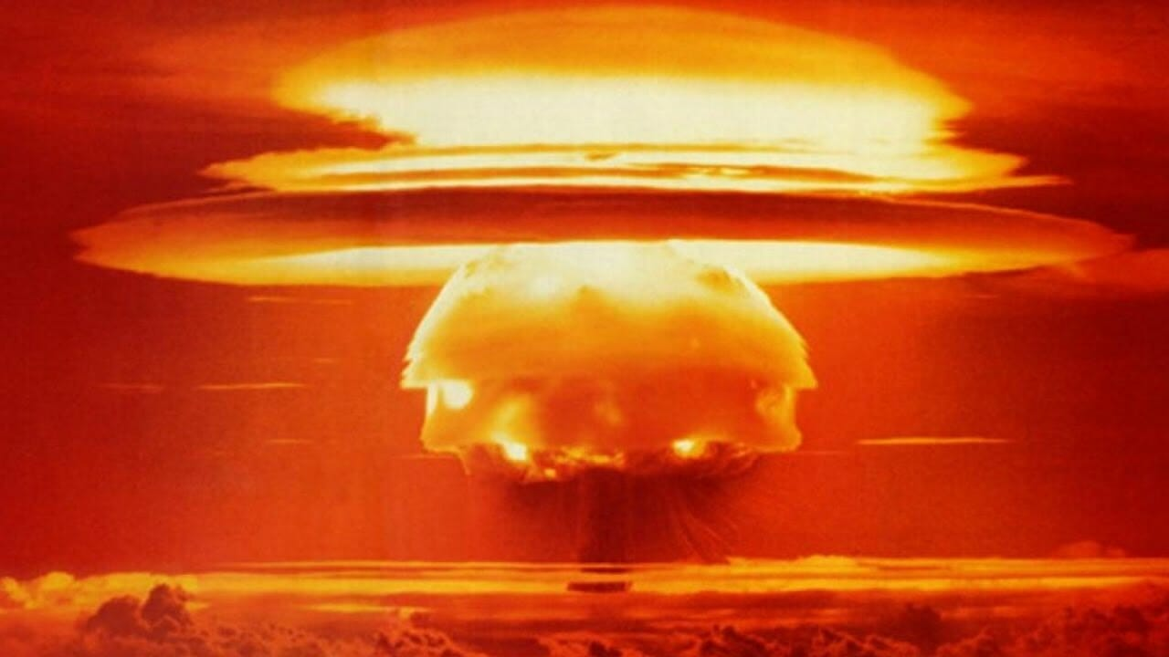
Investing in Sin
Studies show ‘sin’ stocks outperform the market
Stricter accounting principles
Why do investors avoid defence stocks?

Slide 4
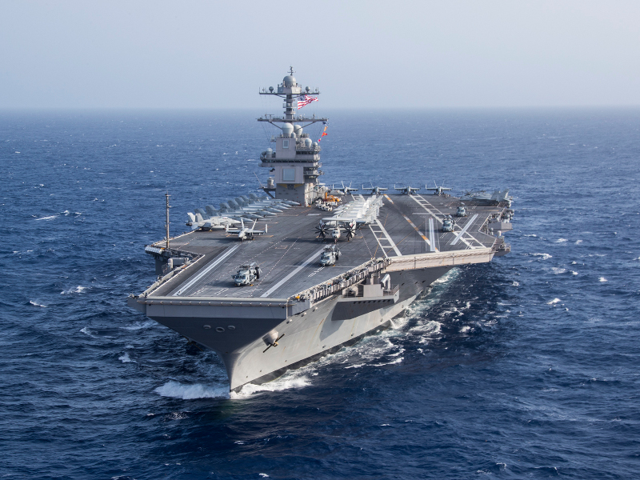
Investing in Sin
“...the defensive form of war is not a simple shield, but a shield made up of well directed blows.”
On War, Clausewitz (1832)
Defence stocks...
or war stocks?

Slide 5
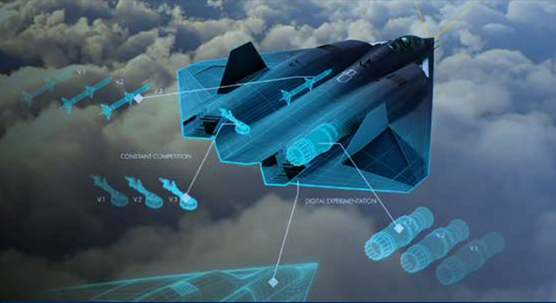
Investing in Innovation
Defence industry is critical to innovation and technology development
Innovation has suffered since the United States has become a unipolar power

Slide 6
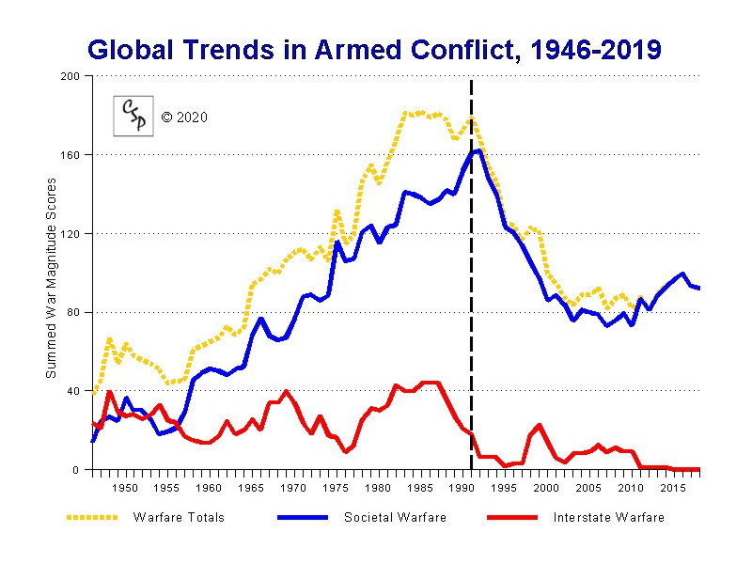
Is Defence Stock Performance Tied to Conflict and Geopolitics?
Can analysis and foresight
...or foreknowledge
maximise returns?
Compare defence stocks to tech stocks, S&P500, gold, oil, bonds

Slide 7




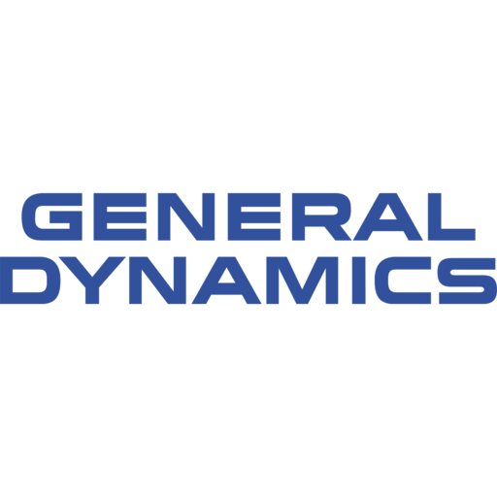

The Big Five
Lockheed-Martin (LMT)
Northrop Grumman (NOC)
Raytheon Technologies (RTX)
General Dynamics (GD)
Boeing (BA) – 60% civilian / 40% defence
BAE Systems (BA.L)

Slide 8
Time Periods Analysed
Fall of Communism 9 Nov 1989 – 1 Aug 1990
First Iraq War 2 Aug 1990 – 28 Feb 1991
Invasion of Afghanistan 17 Sep 2001 – 28 Dec 2014
Second Iraq War 12 Sep 2002 – 30 Apr 2009
Tensions with Russia 11 Oct 2021 – present
& China

Slide 9
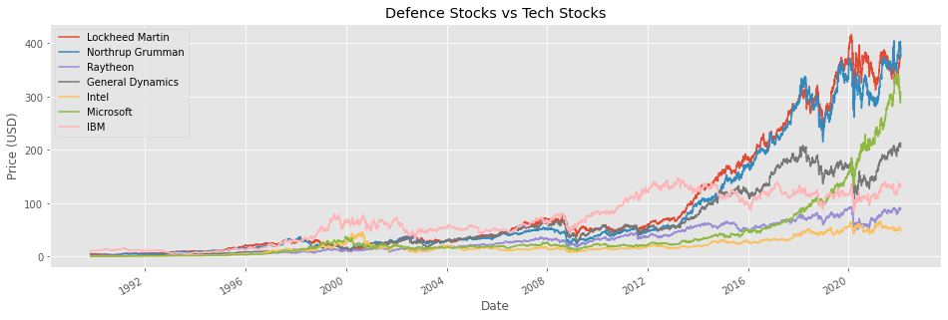
Macroscopic Trends

Slide 10
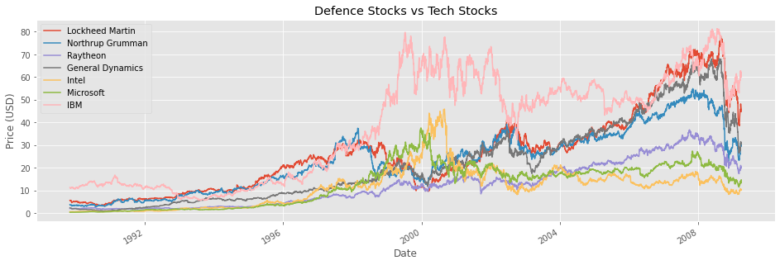
Macroscopic Trends

Slide 11
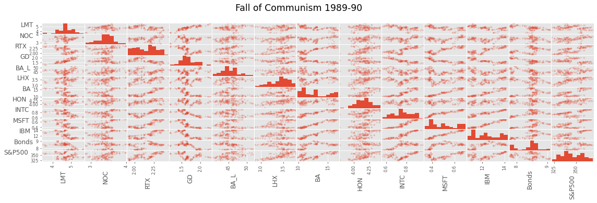
Scatter Matrix

Slide 12
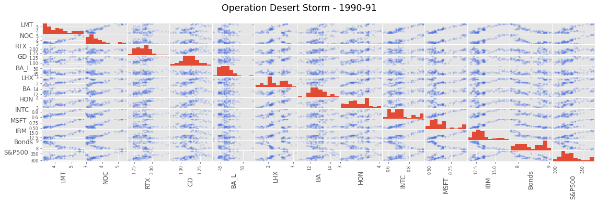
Scatter Matrix

Slide 13
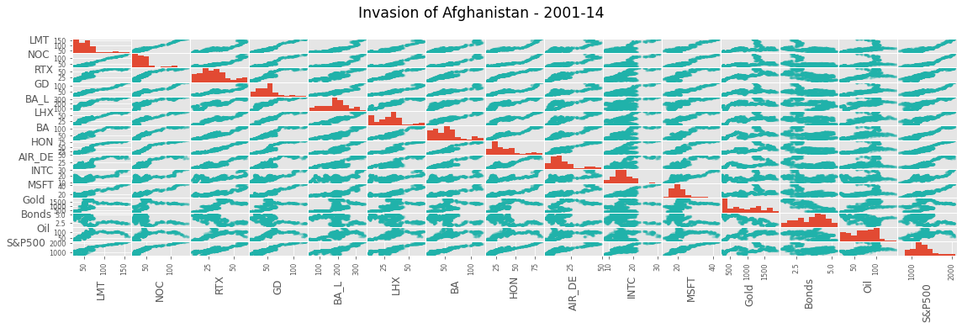
Scatter Matrix

Slide 14
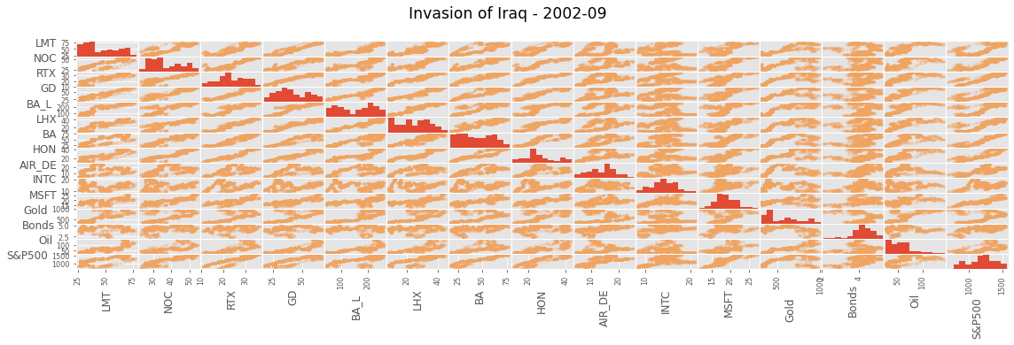
Scatter Matrix

Slide 15
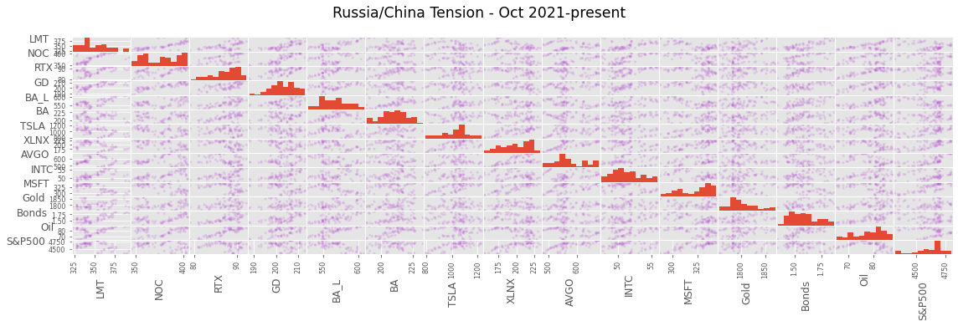
Scatter Matrix

Slide 16
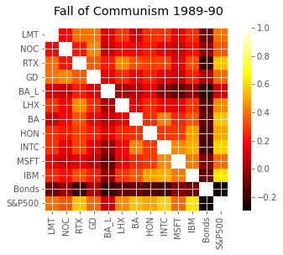
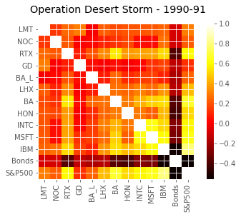
Correlation Heat Map

Slide 17
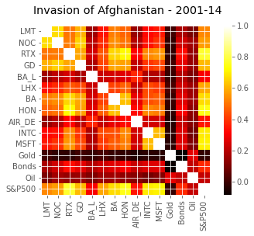
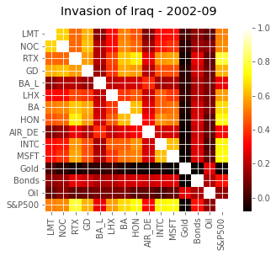
Correlation Heat Map

Slide 18
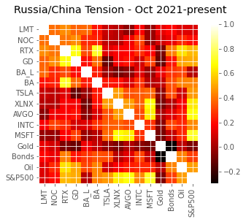
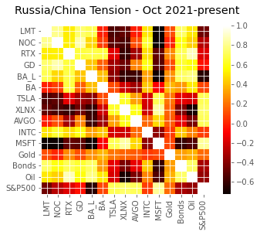
Correlation Heat Map

Slide 19
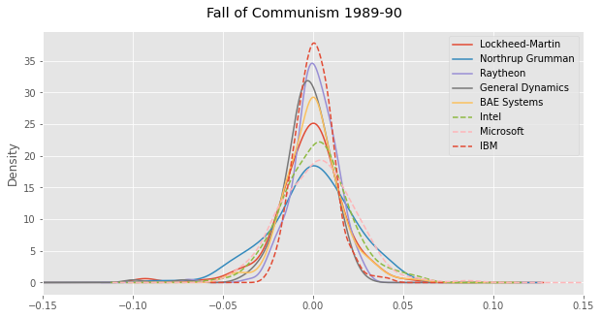
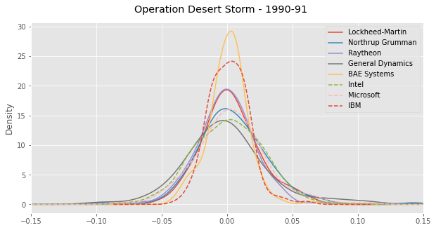
Volatility

Slide 20
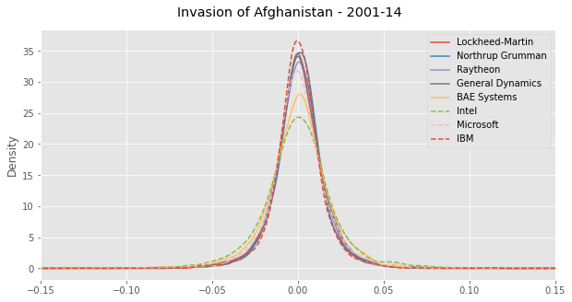
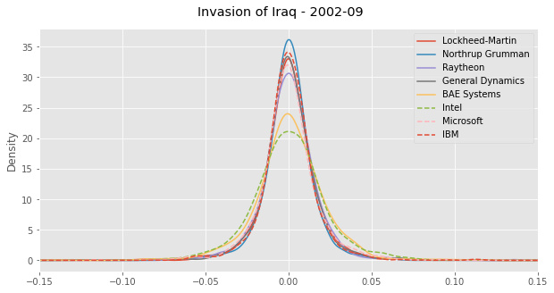
Volatility

Slide 21
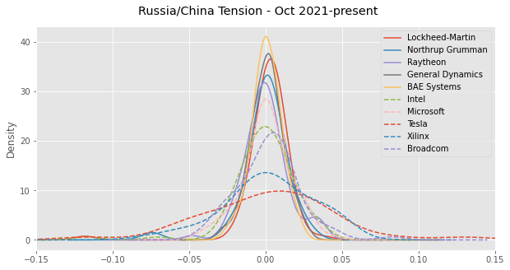
Volatility

Slide 22
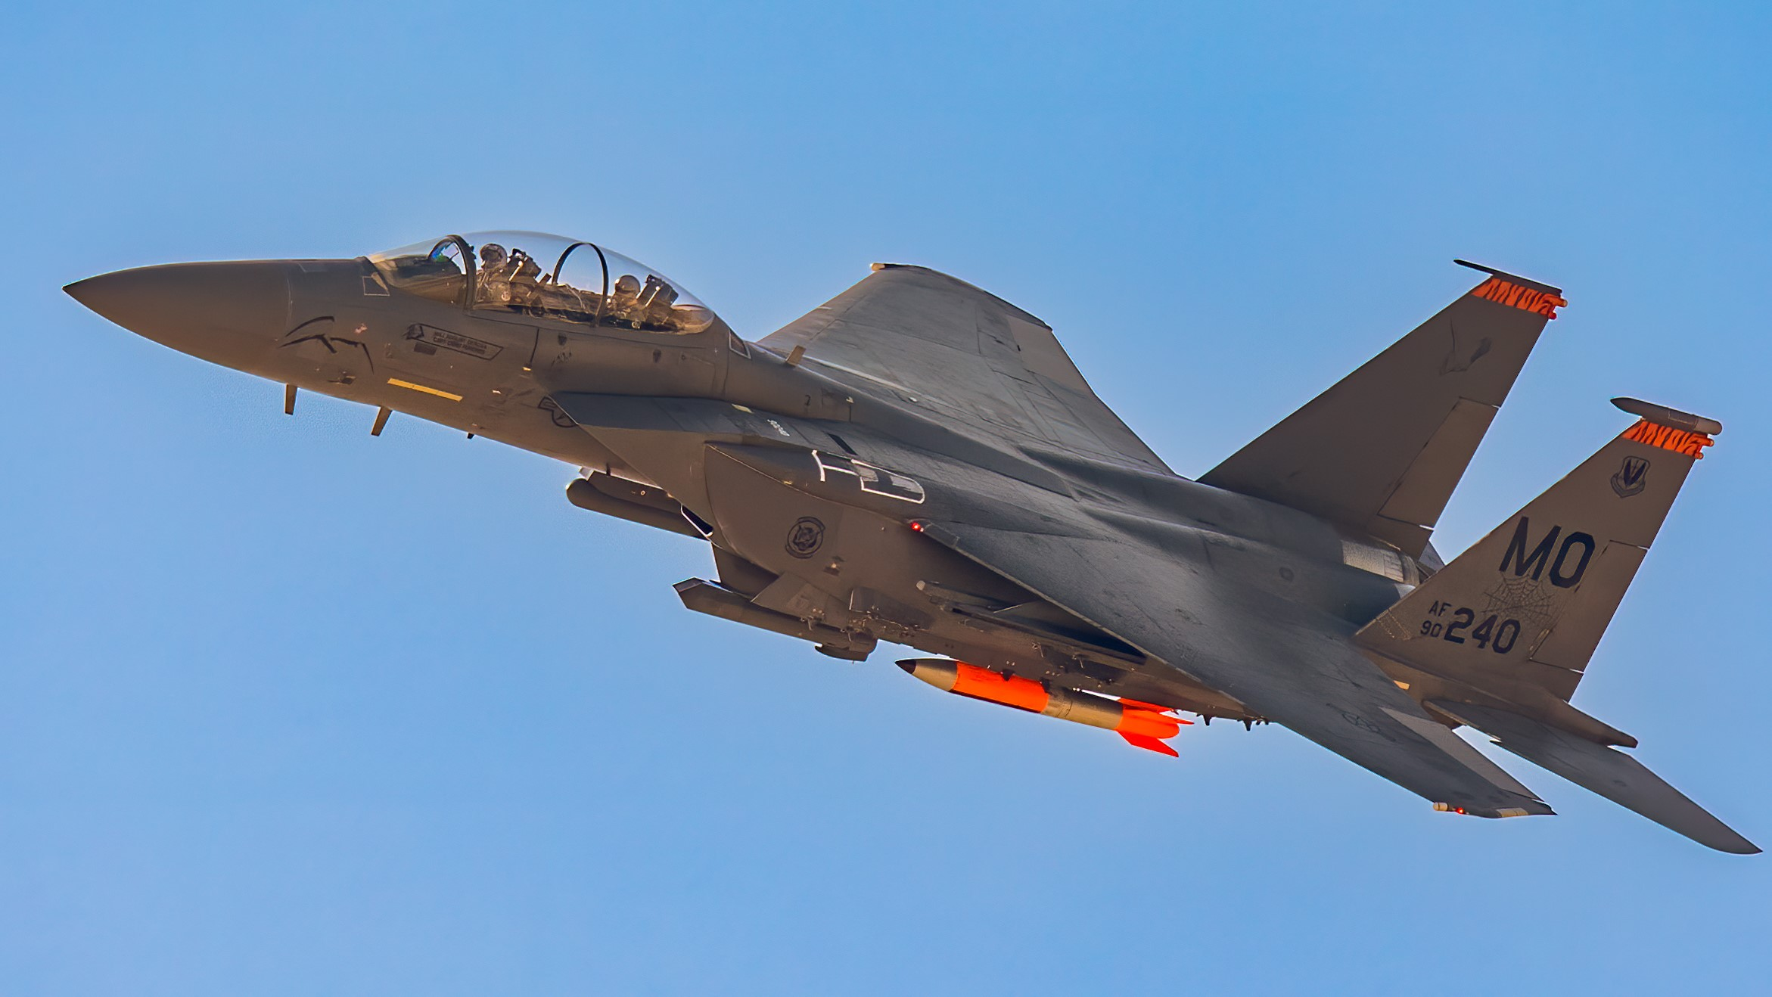
Conclusion
During geopolitical conflict, defence stocks can outperform the market
$10,000 invested during Afghanistan conflict:
Lockheed-Martin → $62,612
S&P500 → $25,399
Low volatility
High dividend yield
Predictable positive performance during conflict

