Slide 1

The Impact of Cryptocurrency on Global Economic Stability
Akram S. Sadek

Slide 2


Cryptocurrency – Force for Good?
“Is the cryptocurrency trading boom creating a new generation of addicts? ”
- The Guardian
“Cryptocurrency: rise of decentralised finance sparks ‘dirty money’ fears!”
- The Financial Times
“The ticking time bomb of cryptocurrencies”
- The Guardian

Slide 3
Cryptocurrency – Risk to Stability
“Crypto Boom Poses New Challenges to Financial Stability”
- IMF
“Drop bitcoin as legal tender, IMF urges El Salvador”
- CNBC
“Russian central bank proposes ban on cryptocurrencies, citing threat to financial stability”
- The Hill

Slide 4
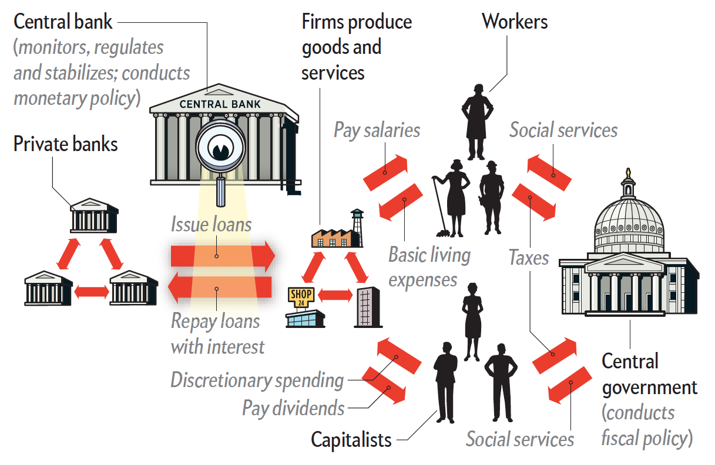
Fractional Banking
Central bank prints money
Lends money to private banks
Private banks lend to businesses
Money repaid destroys printed capital
Only interest remains

Slide 5
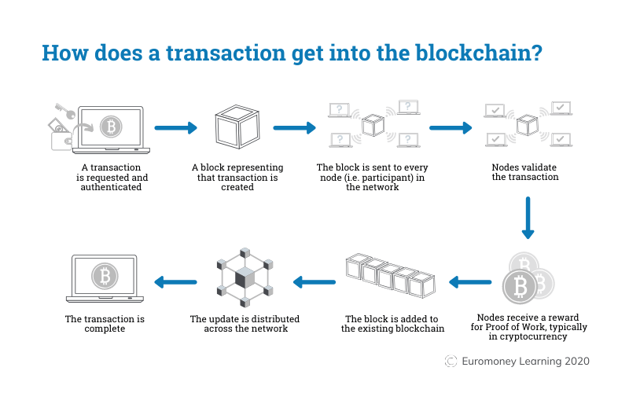
Blockchain

Slide 6
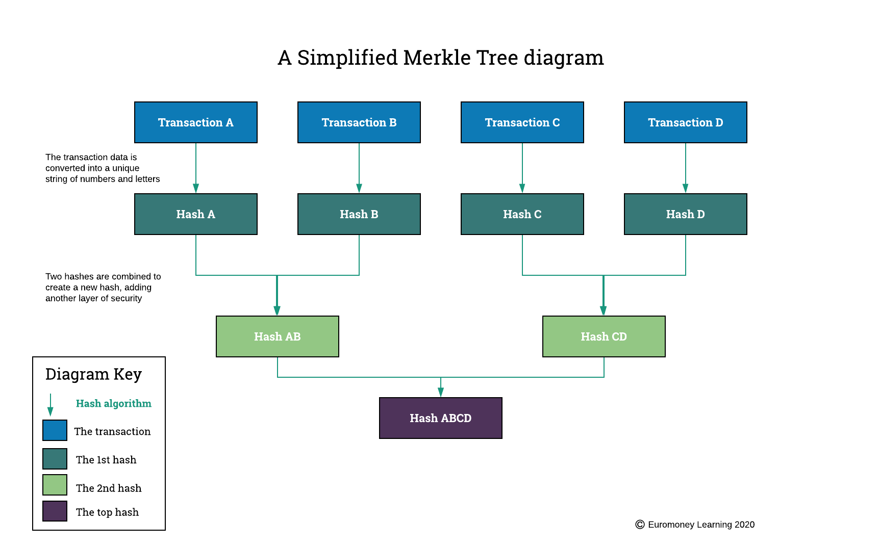
Blockchain

Slide 7
Cryptocurrency Risks
Migration from decentralized network to a centralized one
Theft through taking control of over 51% of nodes
Hacking (quantum computing)
Vulnerability of electronic networks

Slide 8
How Might Cryptocurrency Affect the Wider Economy?
Size – Market Capitalisation
Interconnectivity with Mainstream Markets - Correlation
Volatility

Slide 9






Cryptocurrencies
Bitcoin (BTC)
Ethereum (ETH)
Binance (BNB)
Cardano (ADA)
Solana (SOL)
XRP (XRP)
Stable Coins – Tether, TrueUSD

Slide 10
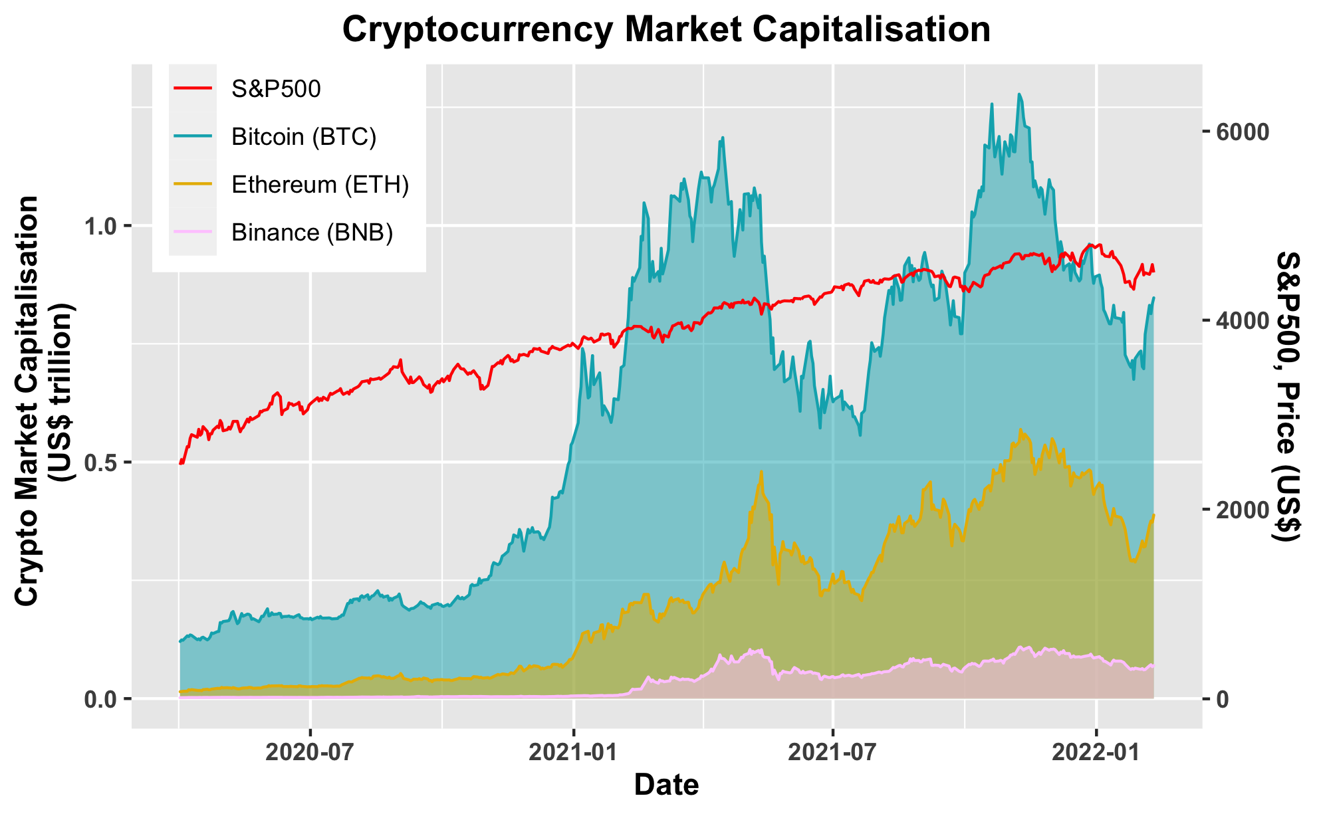
Market Capitalisation

Slide 11
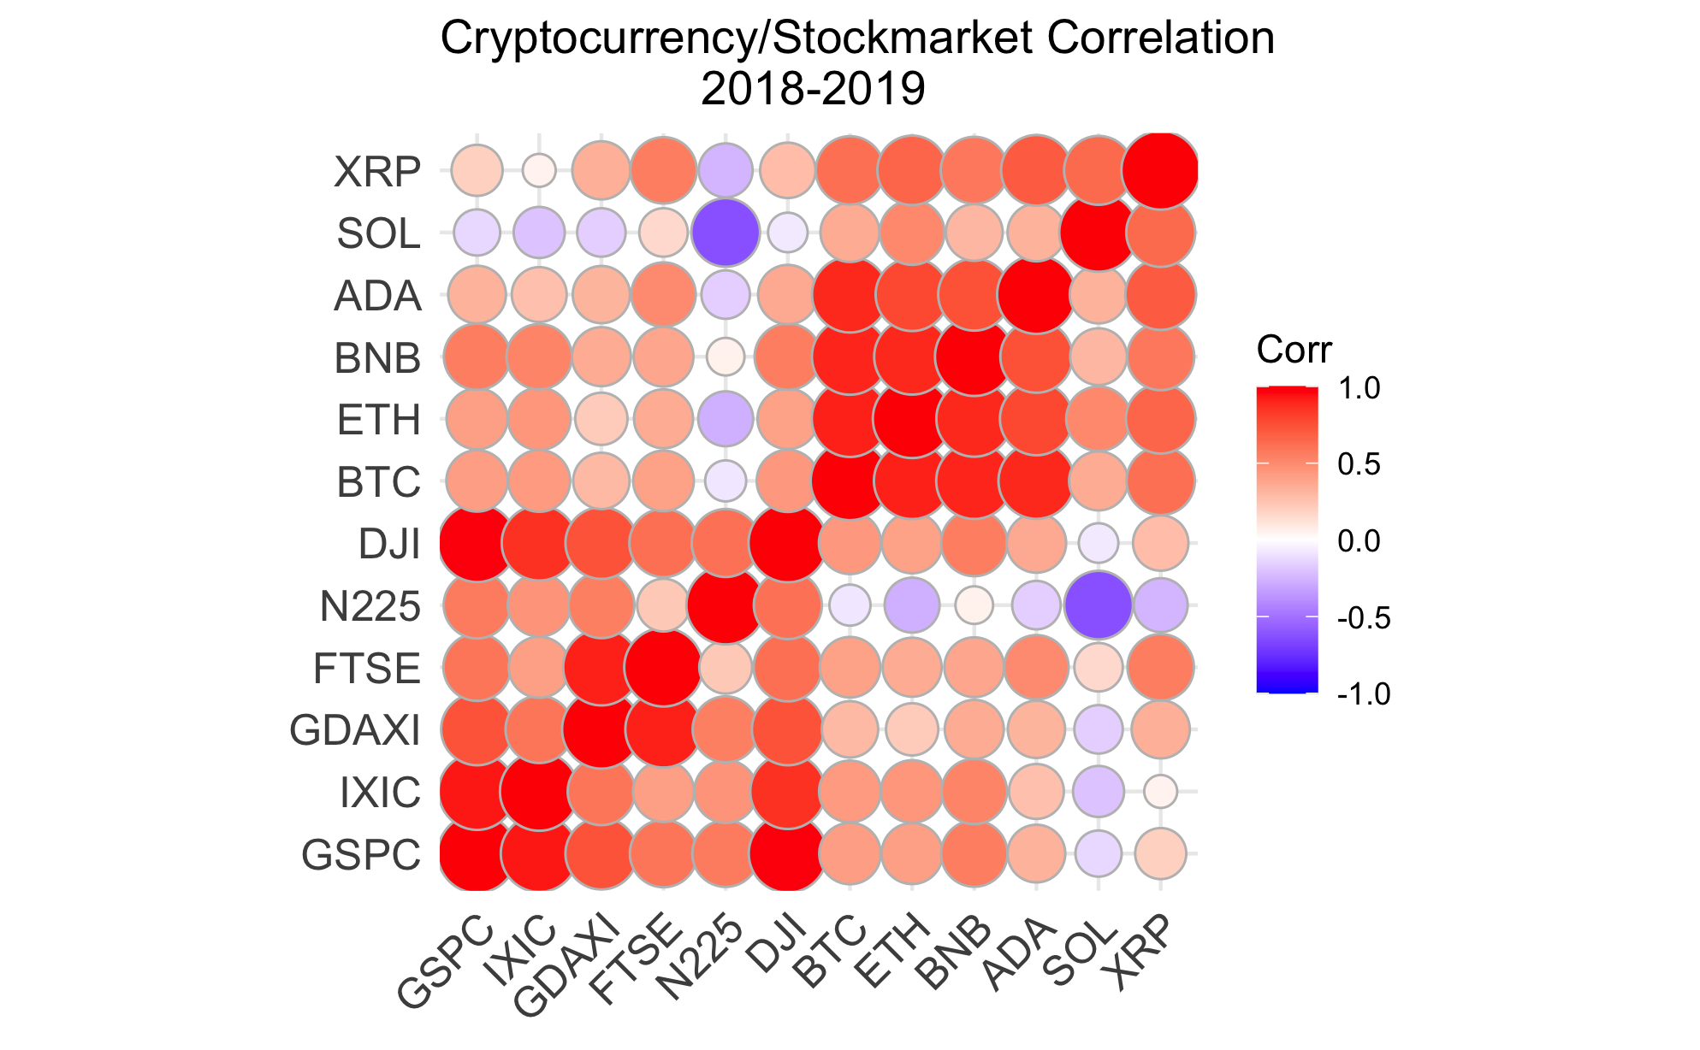
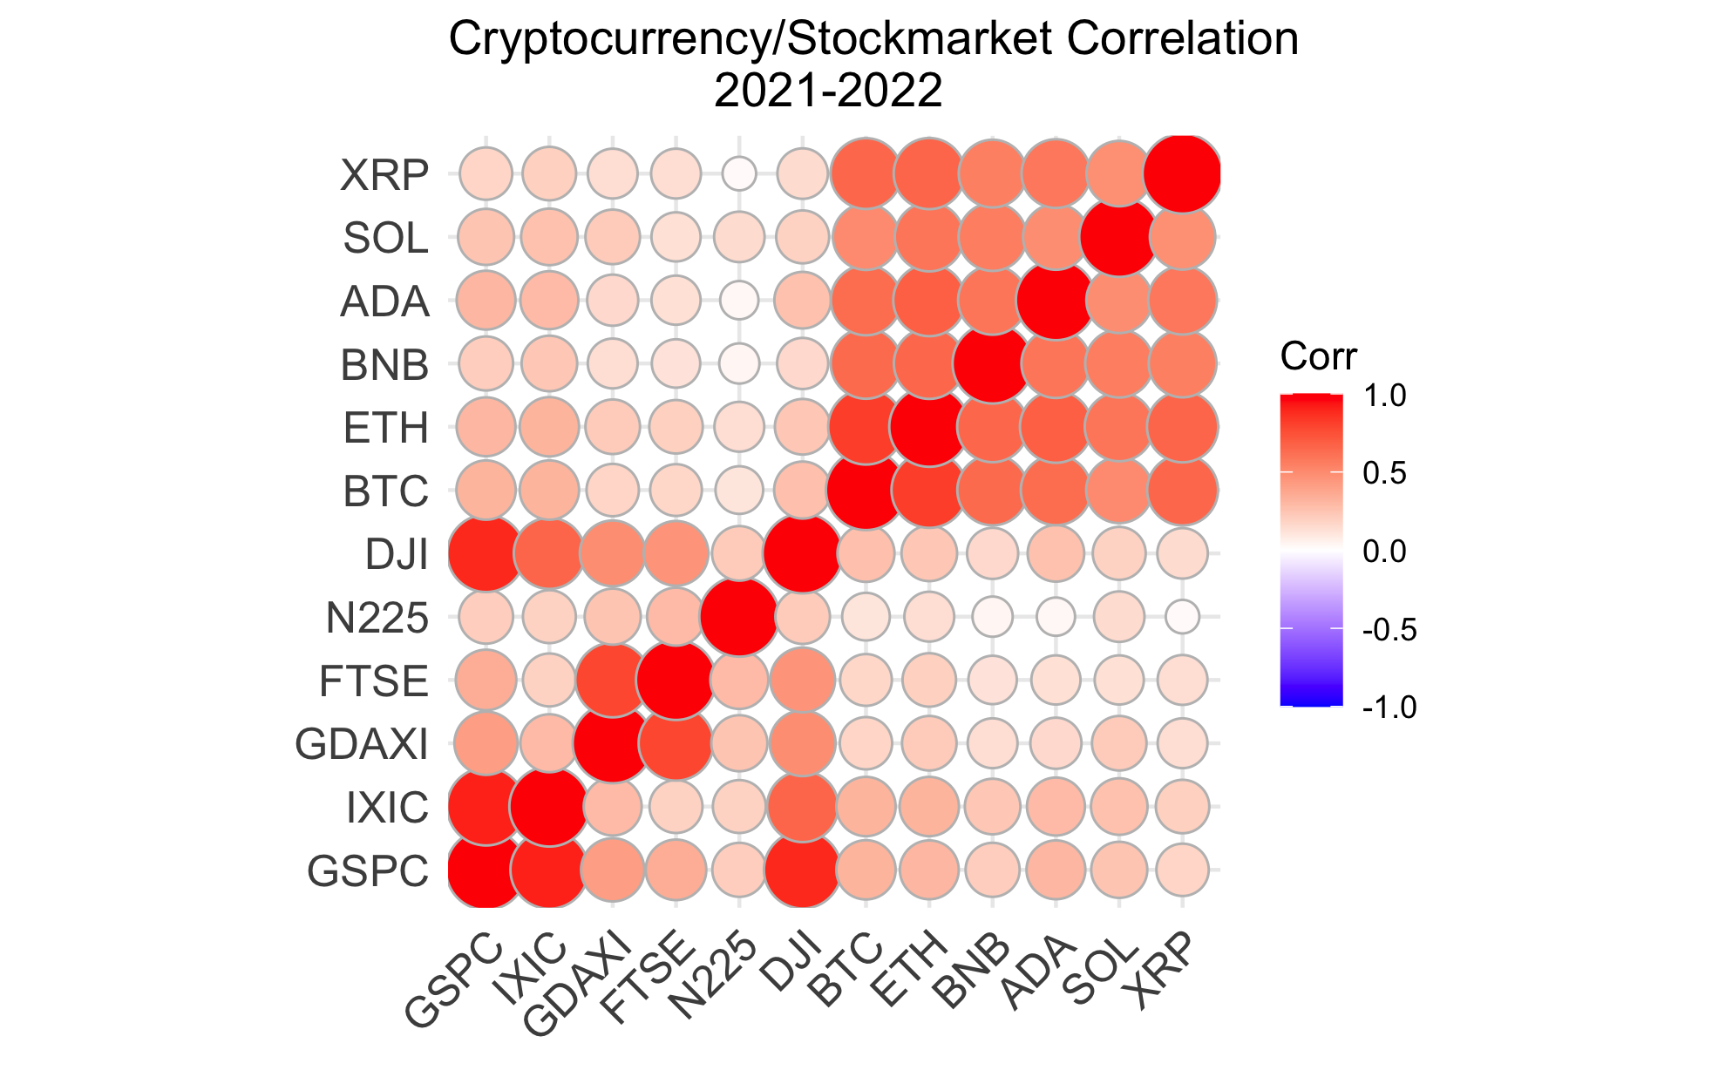
Correlation with Markets

Slide 12
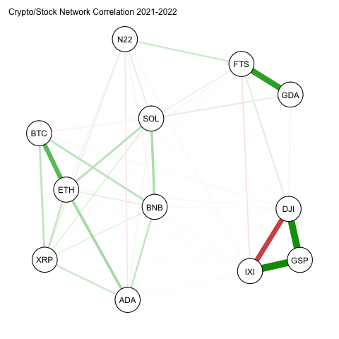
Interconnectivity

Slide 13
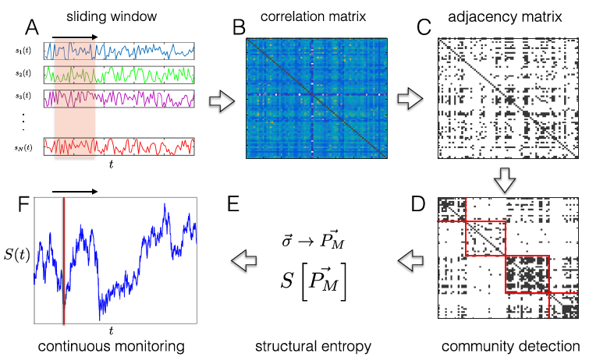
Structural Entropy

Slide 14

von Neumann Entropy
Shannon Entropy $S=−\sum_{i}{p_{i}\log{p_{i}}}$
Density Matrix $ρ=\sum_{i}{p_{i}\left.{|ψ}_{i}\right\rangle \left\langle ψ_{i}|\right.}$
von Neumann Entropy $S=−tr(ρ\log{ρ})$
Pearson correlation matrix is a density matrix:
$$ρ=\frac{R}{N}$$

Slide 15
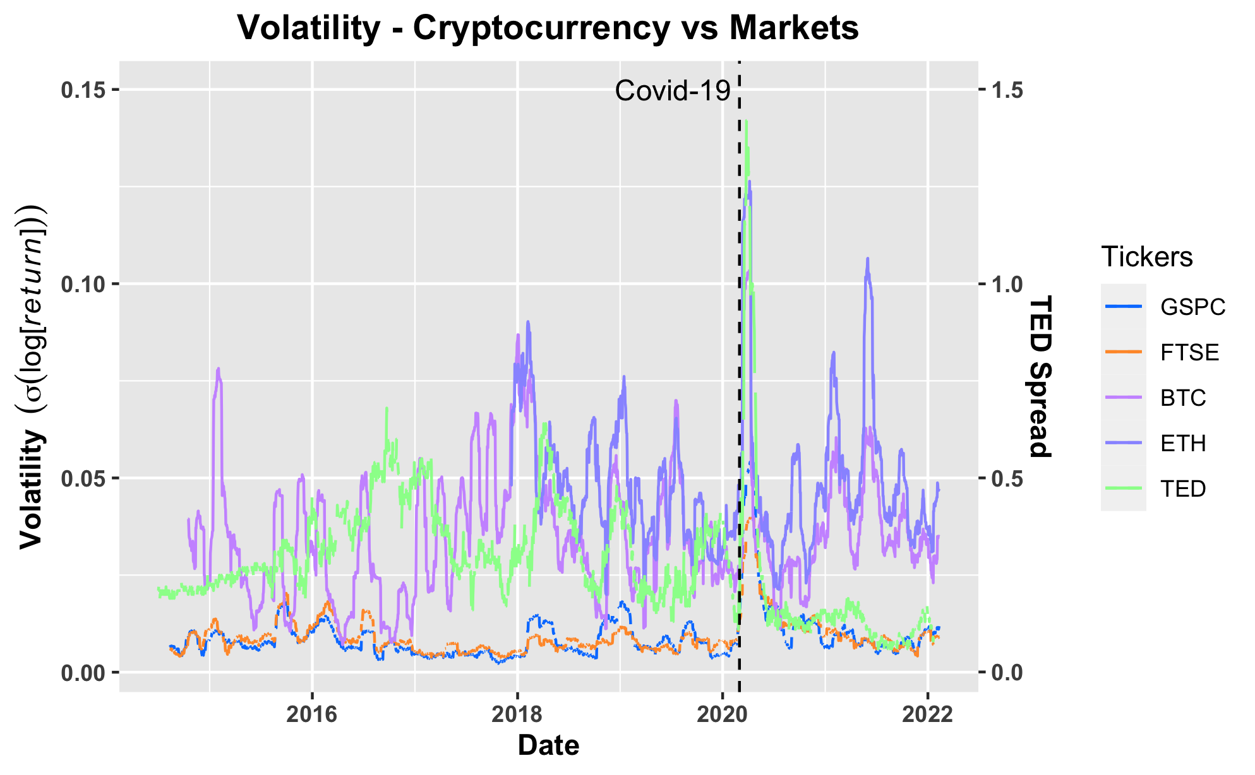
Volatility

Slide 16
Conclusion
Total cryptocurrency market cap is about the same as UK GDP - $3.2 trillion
Total market cap of mortgage securities involved in 2008 crisis - $1.2 trillion
Market capitalization is high enough to cause worry
Interconnectivity with markets is increasing – probably not yet sufficient to induce a crisis
Extreme volatility

Slide 17
Acknowledgements
Assaf Almog & Erez Shmueli, “Structural Entropy: Monitoring Correlation-Based Networks Over Time With Application to Financial Markets”, Scientific Reports (2019)
H. Felippe et. al., “The von Neumann entropy for the Pearson correlation matrix: A test of the entropic brain hypothesis”, arXiv:2106.05379 (2021)
A. Lipton & A. Pentland, “Breaking the Bank”, Scientific American (2018)
https://wallpaperaccess.com/blockchain-4k
https://nasaspaceflight.com
https://www.euromoney.com/learning/blockchain-explained/

