Slide 1
Distributed Systems [Fall 2013]
Course Review

Slide 2
Final Exam
December 19, 4:10-6:10 PM
MAT 417
Open book/notes
Textbook or printings of the slides
No any other kinds of materials are allowed
Notes:
The final exam will be similar to the take home quiz/assignment, but will be shorter, including the materials from after the assignment.

Slide 3
What we have learnt so far…
Concepts and Theories
Distributed Algorithms
System Issues
Some protocols

Slide 4
Distributed System Models
Client-server
SMTP, Telnet, SSH…
Thin client
Diskless nodes, X11
Peer to peer
BitTorrent
Grid
Many projects from www.distributed.net
Notes:
A grid computer is multiple number of same class of computers clustered together. A grid computer is connected through a super fast network and share the devices like disk drives, mass storage, printers and RAM Grid Computing is a cost efficient solution with respect to Super Computing OS has capability of parallelism.

Slide 5
Processes, Threads and Coordination
Process: an execution stream (or program) in the context of a particular process state
Threads: separate streams of executions that share an address space.
Lightweight Processes

Slide 6
Processes
Have separate address space.
Use fork() system call to create and exec() execute a different program.
Need some mechanism to do inter-process communication.
Signal, Pipe, Socket, Shared memory, Message queue…
Clipboard ( yes, clipboard)

Slide 7
Threads
Have shared address space.
Also have some per-thread state – PC and other registers, stack.
Use pthread_create() to create a thread.
No need to use IPC
Data are already shared.

Slide 8
Multi-threaded Program in Network Programming
Exploit multiple (core) CPUs.
Fast context switching overhead.
Exploit I/O concurrency
If a thread blocks on I/O, other threads carry on.
Deal with multiple client connections.

Slide 9
Problems with Multi-threaded Program
Creating a thread for each request is expensive.
If too many requests come in, the memory will be used up.

Slide 10
Thread Pool
Like the concept of connection pool.
Create a fixed number of threads on startup.
Dispatcher thread waits for request.
For each request, choose an idle worker thread.
When the worker thread is done, it goes back to the pool.

Slide 11
Synchronization
Mutex lock protects critical section.
pthread_mutex_lock()
pthread_mutex_unlock()
Conditional Variable avoid busy waiting and repeatedly using locks.
pthread_cond_wait()

Slide 12
Why Conditional Variable
Some operations on shared data structures can only be done when certain condition is met.
E.g. dequeue can only be done when the queue is not empty.
Possible solution: repetitive lock-and-test.
DEQUEUE ENQUEUE
try_again: lock (queue_mutex);
lock (queue_mutex); enqueue ();
if (queue is empty) { unlock (queue_mutex);
unlock (queue_mutex);
goto try_again;
}
dequeue ();
unlock (queue_mutex);
Problem: repetitive locking and unlocking is costly

Slide 13
Conditional Variables
Typical operations on a condition variable (used with a lock):
wait: waiting on the condition variable
signal: waking up one waiting thread to run.
DEQUEUE
lock (queue_mutex);
while (queue is empty) wait (queue_mutex, nonempty_cond);
dequeue ();
unlock (queue_mutex);
ENQUEUE
lock (queue_mutex);
enqueue ();
signal (nonempty_cond);
unlock (queue_mutex);

Slide 14
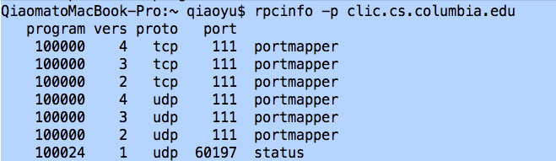
RPC
A remote procedure call that looks like a local one.
Commonly used today:

Slide 15
RPC Architecture
Create stub functions to make RPC appear to the user that the call is local.
Stub function contains the function’s interface.
Client side composes a RPC request and send to the server
Server side executes the procedure and sends back the result.
Client side returns the result to the caller.

Slide 16
Marshaling and Unmarshaling
Incompatibility problems:
Different bytes ordering
Different sizes of integer
Different float number representations
Different character sets
Different alignments
...

Slide 17
Marshaling and Unmarshaling
Marshaling convert the data to make transfers across platform
Unmarshaling is the opposite – construct the object from the data received.
Sometimes referred to as serialize and desterilize.

Slide 18
RPC Semantics
Communication and machines may fail.
Most RPC systems will offer either
at least once semantics
or at most once semantics (such as YFS RPC)
No such thing as exactly once semantics

Slide 19
More Issues with RPC
RPC is slower, a lot slower…
Security
Authentication, encryption, etc.

Slide 20
Clock Synchronization – Why?
Temporal ordering of events produced by concurrent processes
Synchronization between senders and receivers of messages
Coordination of joint activity
Serialization of concurrent access for shared objects

Slide 21
Clock Synchronization
Real world clock
Cristian’s Algorithm
Berkeley Algorithm
Logical clock
Lamport Logical Clock

Slide 22
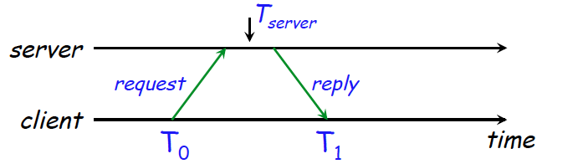
Cristian’s Algorithm
Request time, get reply
– Measure actual round-trip time d
Request Sent: T0
Reply received: T1

Slide 23
Cristian’s Algorithm
The client sets time to
Error bound

Slide 24
The Berkeley Algorithm
Gusella & Zatti, 1989
Assumes no machine has an accurate time source
Obtains average from participating computers
Synchronizes all clocks to average
Can discard outliers

Slide 25
Berkeley Algorithm
Machines run time dæmon
Process that implements protocol
One machine is elected (or designated) as the server (master)
Others are slaves
Algorithm has provisions for ignoring readings from clocks whose skew is too great
Compute a fault-tolerant average
If master fails
Any slave can take over

Slide 26
Network Time Protocol, NTP
1991, 1992
Internet Standard, version 3: RFC 1305
Synchronization similar to Cristian’s alg.
All messages delivered unreliably with UDP
Use a stratum structure

Slide 27

NTP – An example
Columbia NTP server
Stratum Two

Slide 28
Problems with Real Synchronization
Clocks are never exactly synchronized
More often than not, distributed systems do not need real time, but *some* time that every machine in a protocol agrees upon!

Slide 29
Logical Time
What does “Concurrent” Mean?
Happening at the same time? NO.
There is nothing called simultaneous in the physical world.
Concurrency means the absence of causal order.

Slide 30
Sequential and Concurrent Events
Sequential = Totally ordered in time.
Total ordering is feasible in a single process that has only one clock. This is not true in a distributed system.
Two issues are important here:
How to synchronize physical clocks ?
Can we define sequential and concurrent events without using physical clocks?

Slide 31
Causality
Causality helps identify sequential and concurrent events without using physical clocks.
Joke → Re: joke
→ implies causally ordered before or happened before

Slide 32
Causality
Rule 1.
If a, b are two events in a single process P, and the time of a is less than the time of b then a→ b.
Rule 2.
If a = sending a message, and b = receipt of that message, then a → b.
Rule 3.
a → b ∧ b → c ⇒ a → c

Slide 33
Lamport Clocks
Lamport clock assigns logical timestamps to
events consistent with “happens before” ordering
All hosts use a counter (clock) with initial value of zero
The counter is incremented by and assigned to each event, as its timestamp.
A send(message) event carries its timestamp
For a receive(message) event the counter is updated by Max(receiver.counter, message.timestamp) + 1

Slide 34
Distributed Mutex: Coordination
Five algorithms discussed
None of the algorithms is perfect…

Slide 35
Distributed Mutex: Coordination
Safety - At most one process may execute in CS at any time.
No deadlock too.
Liveness – Every request for a CS is eventually granted
This is called progress.
Fairness – Requests are granted in FIFO order and bounded wait

Slide 36
Centralized Lock Server
A central coordinator
Grants permission to enter CS &
keeps a queue of requests to enter the CS.
Ensures only one thread at a time can access the CS.

Slide 37
Centralized Lock Server
• To enter critical section:
– send REQUEST to central server
–wait for permission from server
• To leave:
– send RELEASE to central server
• Server:
– Has an internal queue of all REQUESTs it’s received
but to which it hasn’t yet sent OK
– Delays sending OK back to process until process is at head of queue

Slide 38
Centralized Lock Server
The lock server implementation in YFS
Safety, liveness and order are guaranteed
It takes 3 messages per entry/exit operation.
Client delay: one round trip time
request + grant
The coordinator becomes performance bottleneck and single point of failure
This is bad

Slide 39
Token Ring Approach
Processes are organized in a logical ring
p（i） has a communication channel to p(i+1)mod N
Operations:
Only the process holding the token can enter the CS.
To exit the CS, the process sends the token onto its neighbor. If a process does not require to enter the CS when it receives the token, it forwards the token to the next neighbor.

Slide 40
Token Ring Approach
Safety & liveness are guaranteed, but ordering is not.
Client delay
0 to N message transmissions.

Slide 41
A shared priority queue
Each process i locally maintains Q(i) , part of a shared priority queue
To run critical section, must have replies from all other processes AND be at the front of Q(i)
When you have all replies:
#1: All other processes are aware of your request
#2: You are aware of any earlier requests for the mutex

Slide 42
A shared priority queue
FIFO fairness.
Client Delay: 3(N-1)
(N-1 requests + N-1 ack + N-1 release)
Very unreliable - any process failure halts progress

Slide 43
Ricart & Agrawala’s algorithm
An improved version of Lamport’s shared priority queue
1. Broadcast a timestamped request to all.
2. Upon receiving a request, send ack if
You do not want to enter your CS, or
You are trying to enter your CS, but your timestamp is higher than that of the sender. (If you are in CS, then buffer the request)
3. Enter CS, when you receive ack from all.
4. Upon exit from CS, send ack to each pending request before making a new request.
(No release message is necessary. No priority queue needed)

Slide 44
Ricart & Agrawala’s algorithm
Safety: Prove that at most one process can be in CS.
Fairness: Prove that FIFO fairness holds even if channels are not FIFO
Not reliable
Message complexity = 2(N-1)
(N-1 requests + N-1 acks - no release message)

Slide 45
Majority rules
Instead of collecting REPLYs, collect VOTEs
Can progress with as many as N/2 – 1 failed processes
Not fair
Deadlock!
No guarantee that anyone receives a majority of votes

Slide 46
DFS
Networked file systems with a single-server architecture
Their goals:
Have a consistent namespace for files across computers
Let authorized users access their files from any computer
That’s why you have the identical files in all CLIC machines.

Slide 47
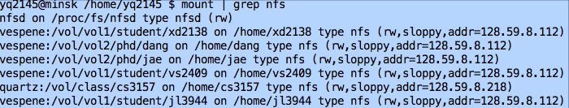
SUN NFS
• NFS provides transparent, remote file access
• Simple, portable, really popular
– (it’s gotten a little more complex over time)
• Weak consistency semantics
• Requires hefty server resources to scale (flush-onclose, server queried for lots of operations)

Slide 48
SUN NFS
NFS V1-V3 are stateless
NFS V4 is stateful

Slide 49
AFS
Developed at CMU (~1985), commercial product by Transarc (part of OSF/DCE)
Segment network into clusters, with one file server per cluster
Dynamic reconfigurations to balance load
Stateful protocol + aggressive caching
Servers participate in client cache management
Entire files are cached on disk

Slide 50

File System
1. Machine failures are the norm
– 1000s of components
– Bugs, human errors, failures of memory, disk, connectors, networking, and power supplies
– Monitoring, error detection, fault tolerance, automatic recovery must be integral parts of a design
2. Design for big-data workloads
– Search, ads, Web analytics, Map/Reduce, …

Slide 51
GFS
• A GFS cluster
– A single master
– Many chunkservers
• Accessed by many clients
• A file
– Divided into fixed-sized chunks (similar to FS blocks)
• Labeled with 64-bit unique global IDs (called handles) • Stored at chunkservers
• 3-way replicated across chunkservers
• Master keeps track of metadata (e.g., which chunks belong to which files)

Slide 52
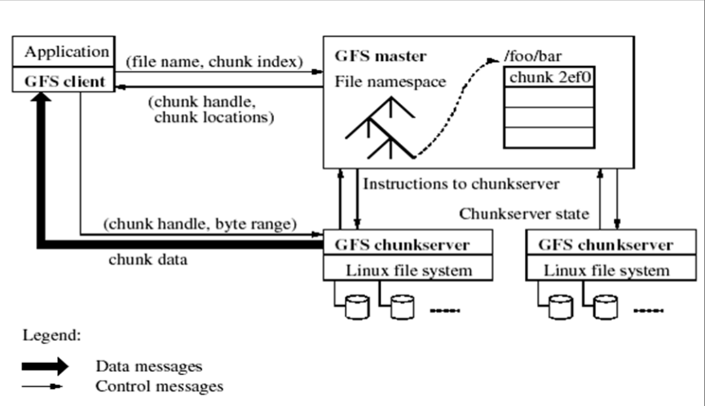
GFS

Slide 53
Consistency Models
Replicated data a huge theme in distributed systems
For performance and fault tolerance
Often easier to replicate data than computation
Caches in NFS
Involves sophisticated optimizations for performance
How do we know it is correct?

Slide 54
Distributed Shared Memory
(Reminder) Two models for communication in distributed systems:
message passing
shared memory
Shared memory is often thought more intuitive to write parallel programs than message passing
Each node can access a common address space.

Slide 55
Naïve DSM
Assume each host has a local copy of all of memory
Reads are local, so they are very fast
Send write msg to each other host
But don't wait

Slide 56
Naïve DSM – Example 1
Simple mutual exclusion
algorithm, for locking.
x and y start as zero on both
CPUs
Intuitive explanation for why
this should "work":
If CPU0 sees y == 0, CPU1
can't have reached "y = 1",
so CPU1 must see x == 1, so it won't execute critical section.
Perhaps neither will enter, but never both
CPU 0:
x = 1;
if (y == 0)
enter_cs();
CPU 1:
y = 1;
if ( x == 0)
enter_cs();

Slide 57
Problems 1
Maybe both will enter CS
CPU0 sends write x=1 msg, reads local y=0
CPU1 reads local x=0 before write msg arrives
Local memory and slow writes cause disagreement about r/w order
CPU0 thinks its x=1 was before CPU1's read of x
CPU1 thinks its read of x was before arrival of x=1 so both can enter the critical section!

Slide 58
Naïve DSM – Example 2
CPU0:
v0 = f0();
done0 = true;
CPU1:
while(!done0)
;
v1 = f1(v0);
done1 = true;
CPU2:
while(!done1)
;
v2 = f2(v0, v1);
CPU2 should execute f2() with results from CPU0 and CPU1
Waiting for CPU1 implies waiting for CPU0

Slide 59
Problem 2
CPU0's writes of v0 and done0 may be interchanged by network
Leaving v0 unset but done0=true
But assume each CPU sees each other's writes in issue order
Yet another problem:
CPU2 sees CPU1's writes before CPU0's writes
i.e. CPU2 and CPU1 disagree on order of CPU0 and CPU1 writes

Slide 60
Consistency Models
There are no "right" or "wrong" models
A model may make it harder or easier to program
i.e. lead to more or less intuitive results
A model may be harder or easier to implement efficiently

Slide 61
Strict Consistency
Each instruction is stamped with the wall-clock time at which it started across all CPUs
Rule 1: Load gets value of most recent previous Set to same address
Rule 2: each CPU's instructions have time-stamps in execution order
Essentially the same as on uniprocessor

Slide 62
Property of Strict Consistency
Very intuitive behavior
But …
Not efficiently enough

Slide 63
Sequential Consistency
Is an execution (a set of operations) correct?
There must be some total order of operations such that
Rule 1. All CPUs see results consistent with that total order i.e. reads see most recent write in the total order
Rule 2. Each CPU's instructions appear in-order in the total order

Slide 64
Implementing Sequential Consistency
1. Each CPU to execute reads/writes in program order, one at a time
2. Each memory location to execute reads/writes in arrival order, one at a time
Proof in Lamport 1979

Slide 65
In what sense is sequential looser than strict?
I.e. what are we giving up?
I.e. what programs will break?
Answer: sequential consistency doesn't let you reason about timing.
You *can* reason based on per-CPU instruction order and observed values:

Slide 66
An Example
CPU0: w(x)0 w(x)1
CPU1: w(y)0 w(y)2
CPU2: r(y)? r(x)?
Strict consistency requires r(y)2 r(x)1
But sequential consistency allows either or both to read as 0

Slide 67
Causal Consistency
Causal consistency: Any execution is the same as if all causally-related read/write ops were executed in an order that reflects their causality
– All concurrent ops may be seen in different orders

Slide 68
Eventual Consistency
Allow stale reads, but ensure that reads will eventually reflect previously written values
Even after very long times
Doesn’t order concurrent writes as they are executed, which might create conflicts later: which write was first?
Used in Amazon’s Dynamo, a key/value store
– Plus a lot of academic systems
– Plus file synchronization

Slide 69
Transactions
ACID Properties:
Atomicity: none or exactly once (2PC)
Consistency: A transaction produces consistent results only; otherwise it aborts.
Isolation: A program running under transaction protection must behave exactly as it would in single-user mode. (2PL)
Durability: The results of transactions having completed successfully must not be forgotten by the system

Slide 70
2-Phase Lock (2PL)
Phase 1: acquire locks
Phase 2: release locks
You may not get any more locks after you
release any locks
Typically implemented by not allowing explicit unlock calls
Locks automatically released on commit/abort

Slide 71
2PL deadlocks
t1.lock(foo); t1.lock(bar);
t2.lock(bar); t2.lock(foo);
To overcome this issue
Each transaction can get all its locks at once
Each transaction can get all its locks in a predefined order

Slide 72
2PL Deadlock
However, they are impartial as transactions often do not know which locks they will need in the future
Automatically abort all long-running transactions

Slide 73
Two-phase Commit (2PC)
Distributed transaction protocol.
Phase 1: Voting
– Each participant prepares to commit, and votes on whether or not it can commit
Phase 2: Committing
– Each participant actually commits or aborts

Slide 74
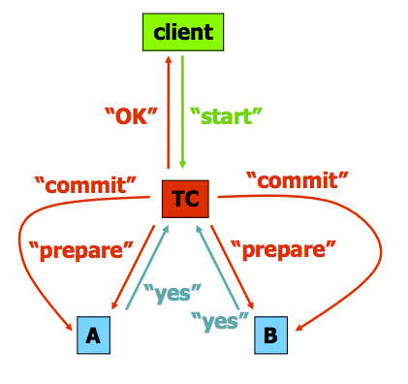
Two-phase Commit
TC sends “prepare” messages to A and B
A and B respond, saying whether they’re willing to commit
If both say “yes,” TC sends “commit” messages
If either says “no,” TC sends “abort” messages
A and B “decide to commit” if they receive a commit message.

Slide 75
The Voting Phase
• Coordinator asks each participant: canCommit?(T)
• Participants must prepare to commit using permanent storage before answering yes
– Objects are still locked
– Once a participant votes “yes”, it is not allowed to cause an abort
• Outcome of T is uncertain until doCommit or doAbort
– Other participants might still cause an abort

Slide 76
The commit phase
The coordinator collects all votes
– If unanimous “yes”, causes commit
– If any participant voted “no”, causes abort
The fate of the transaction is decided atomically at the coordinator, once all participants vote
Coordinator records fate using permanent storage
Then broadcasts doCommit or doAbort to participants

Slide 77
Timeout Actions
Participant waiting for vote request → abort
Coordinate wait → abort
Participant wait (tricky)
Coordinate may send others “commit” then crash
Coordinate may send others “abort” then crash
No way to tell which is the case, have to wait (blocked)
Uncertain state: must wait until coordinator recovers (time between all participant vote & coordinator recovery)
2PC is safe, but not live.

Slide 78
Three-phase Commit (3PC)
Reduce uncertainty period of 2PC
Avoid blocking as long as majority of processors can agree on the action

Slide 79
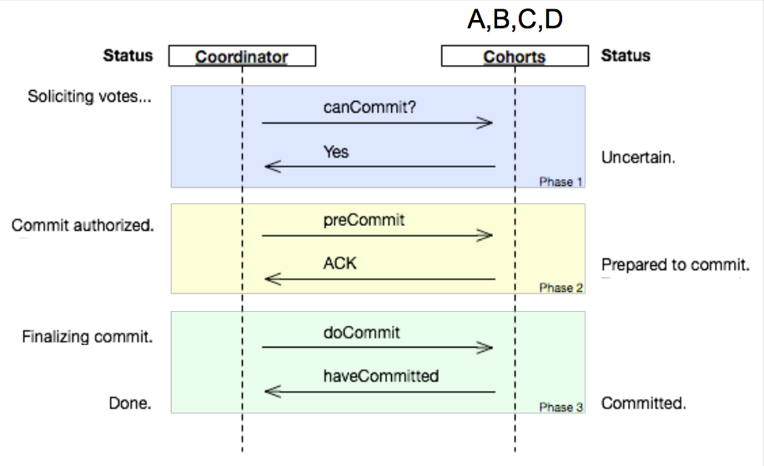
Three-phase commit

Slide 80
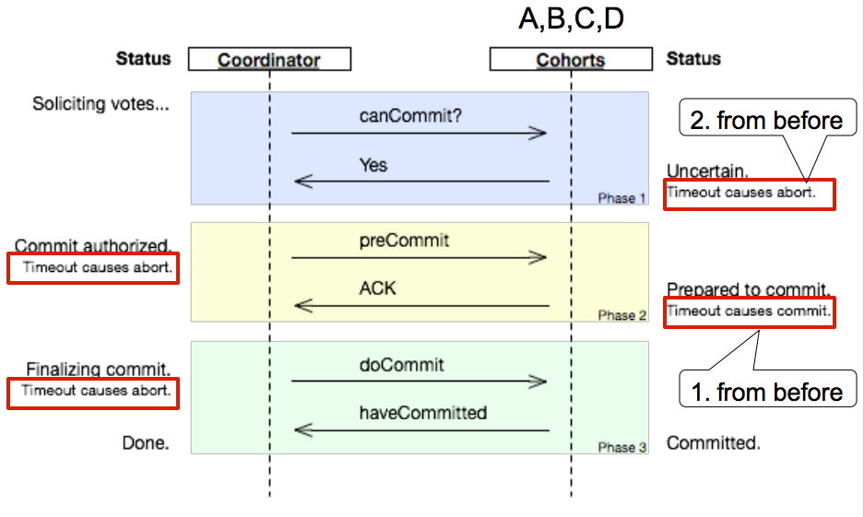
Three-phase Commit

Slide 81
Three-phase Commit
3PC is live, but not safe.
It is impossible to design a protocol that’s both safe and live in the most general case.

Slide 82
Terminologies
Mean time to failure (MTTF)
Mean time to repair (MTTR)
Availability = MTTF / (MTTF + MTTR)
Mean time between failure: MTBF = MTTF + MTTR
Example:
Suppose OS crashes once per month, takes 10min to reboot
MTTF = 30 days = 720 hours = 43,200 minutes
MTTR = 10 minutes
Availability = 43,200 / 43,210 = 0.997 (“~3 nines”)
That’s 2 hours downtime per year

Slide 83
Disk Failure
Whole disk failure (power supply, electronics, motor, etc.)
– Sector errors - soft or hard
Read or write to the wrong place (e.g., disk is bumped during operation)
• Can fail to read or write if head is too high, coating on disk bad, etc.
• Disk head can hit the disk and scratch it.

Slide 84
Checksums and Hashes
Checksums: Usually guard against accidental modification
Weak but fast & easy
Cryptographic hash functions: Usually more expensive, guard against malicious modification

Slide 85
RAID (Redundant Array of Independent Disks)
RAID 0
No redundancy; improves performance.
RAID 1
Store a strong checksum with the data to catch “all” errors and then fix all errors you can
RAID {2..6}

Slide 86
Write-Ahead Logging
Keep a separate on-disk log of all operations
Log first, and then do IO
The tail of the log can be kept in memory until a transaction commits
or a buffer page is flushed to disk

Slide 87
Recovering from Simple Failures
If we can read the log…
Redo all (usually) transactions (forward)
Use new-value in byte-level update records
Undo uncommitted transactions (backward)
Use old-value in byte-level update records
It may take a long time to start the system after crashes…

Slide 88
Paxos
• The only known completely-safe and largely-live agreement protocol
• Lets all nodes agree on the same value despite node failures, network failures, and delays
– Only blocks in exceptional circumstances that are vanishingly rare in practice
• Extremely useful, e.g.:
– nodes agree that client X gets a lock
– nodes agree that Y is the primary
– nodes agree that Z should be the next operation to be executed

Slide 89
Paxos
Safety
– If agreement is reached, everyone agrees on the same value
– The value agreed upon was proposed by some node
• Fault tolerance (i.e., as-good-as-it-gets liveness)
– If less than half the nodes fail, the rest nodes reach agreement eventually
No guaranteed termination (i.e., imperfect liveness)
– Paxos may not always converge on a value, but only in very degenerate cases that are improbable in the real world
• Ah, and lots of awesomeness
– Basic idea is obvious in retrospect, but details are complex!

Slide 90
Chubby
What is Chubby?
– Lock service in a loosely-coupled distributed system
Client interface similar to:
Whole-file advisory locks (think .lck files)
Notification of various events (e.g., file modifications, think inotify)
Primary goals: reliability, availability, easy-to-understand semantics

Slide 91
Bigtable
A distributed storage system for (semi-)structured data
Scalable
Thousands of servers
Terabytes of in-memory data
Petabyte of disk-based data
Millions of reads/writes per second, efficient scans
Self-managing
Servers can be added/removed dynamically
Servers adjust to load imbalance
Extremely popular at Google (as of 2008)
The bigtable paper has been cited by 1560! (OSDI 06)

Slide 92
Slides Ack
Some materials from:
Jingyu Zhou
https://jingyu.dyndns.org/~jzhou/courses/S11.distributed/
https://jingyu.dyndns.org/~jzhou/courses/S11.distributed.grad/

