Slide 1
Some Prolog
Prolog is a logic programming language
Used for implementing logical representations and for drawing inference
We will do:
  Some examples of Prolog for motivation
  Generalized Modus Ponens, Unification, Resolution
  Wumpus World in Prolog

Slide 2
Inference in First-Order Logic
Need to add new logic rules above those in Propositional Logic
  Universal Elimination
  Existential Elimination
  (Person1 does not exist elsewhere in KB)
  Existential Introduction

Slide 3
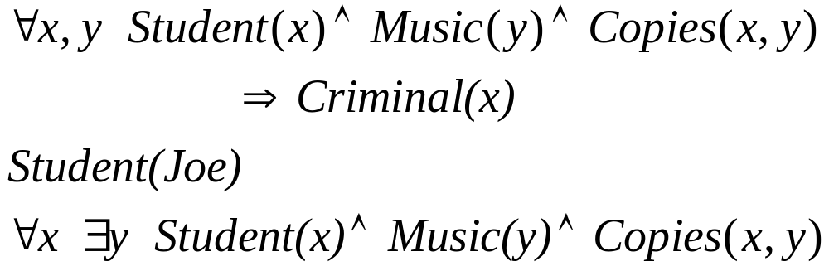
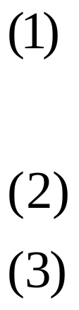
Example of inference rules
  “It is illegal for students to copy music.”
  “Joe is a student.”
  “Every student copies music.”
  Is Joe a criminal?
Knowledge Base:

Slide 4
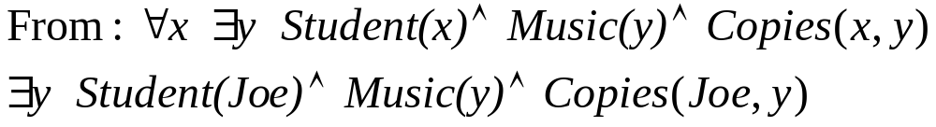
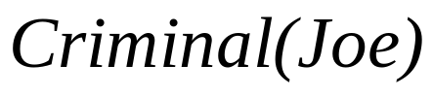
Example cont...
Universal Elimination
Existential Elimination
Modus Ponens
Example partially borrowed from http://sern.ucalgary.ca/courses/CPSC/533/W99/presentations/L1_9A_Chow_Low/main.html

Slide 5
How could we build an inference engine?
Software system to try all inferences to test for Criminal(Joe)
  A very common behavior is to do:
    And-Introduction
    Universal Elimination
    Modus Ponens

Slide 6
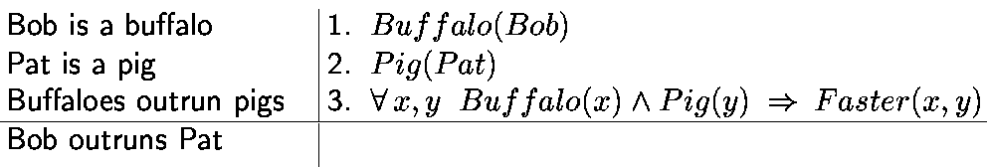
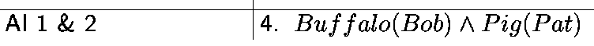
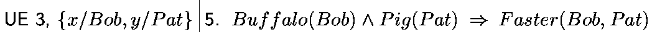
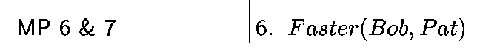
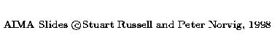
Example of this set of inferences
4 & 5
Generalized Modus Ponens does this in one shot

Slide 7
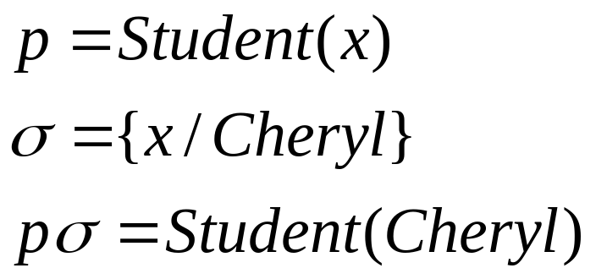
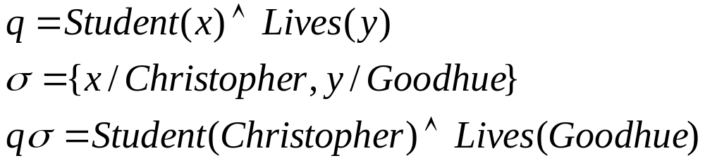
Substitution
A substitution σ in a sentence binds variables to particular values
Examples:

Slide 8
Unification
A substitution σ unifies sentences p and q if pσ = qσ.
p | q | σ
Knows(John,x) | Knows(John,Jane)
Knows(John,x) | Knows(y,Phil)
Knows(John,x) | Knows(y,Mother(y))

Slide 9
Unification
p | q | σ
Knows(John,x) | Knows(John,Jane) | {x/Jane}
Knows(John,x) | Knows(y,Phil) | {x/Phil,y/John}
Knows(John,x) | Knows(y,Mother(y)) | {y/John, x/Mother(John)}
Use unification in drawing inferences: unify premises of rule with known facts, then apply to conclusion
  If we know q, and Knows(John,x) → Likes(John,x)
  Conclude
    Likes(John, Jane)
    Likes(John, Phil)
    Likes(John, Mother(John))

Slide 10
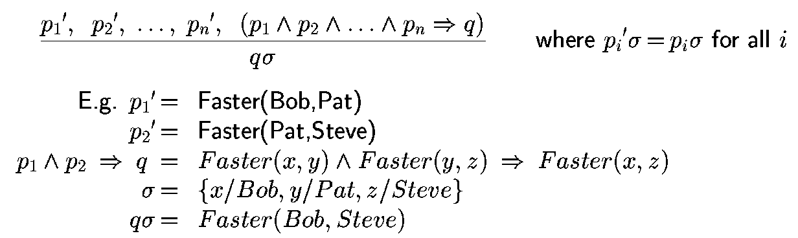
Generalized Modus Ponens
Two mechanisms for applying binding to Generalized Modus Ponens
  Forward chaining
  Backward chaining

Slide 11
Forward chaining
Start with the data (facts) and draw conclusions
When a new fact p is added to the KB:
  For each rule such that p unifies with a premise
    if the other premises are known
      add the conclusion to the KB and continue chaining

Slide 12
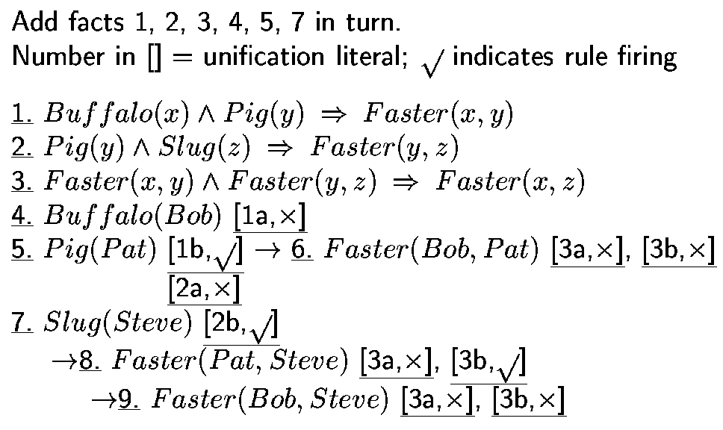
Forward Chaining Example

Slide 13
Backward Chaining
Start with the query, and try to find facts to support it
When a query q is asked:
  If a matching fact q’ is known, return unifier
  For each rule whose consequent q’ matches q
    attempt to prove each premise of the rule by backward chaining
Prolog does backward chaining

Slide 14
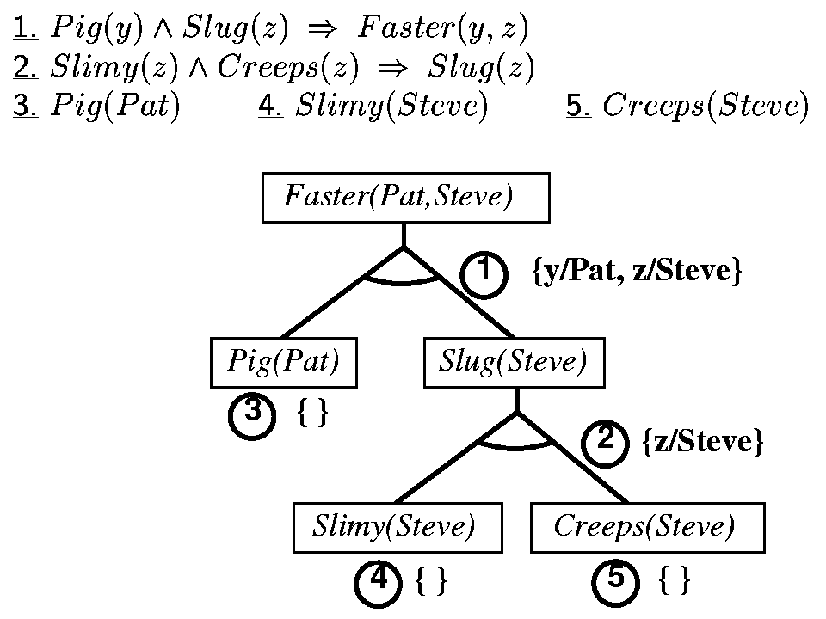
Backward Chaining Example

Slide 15
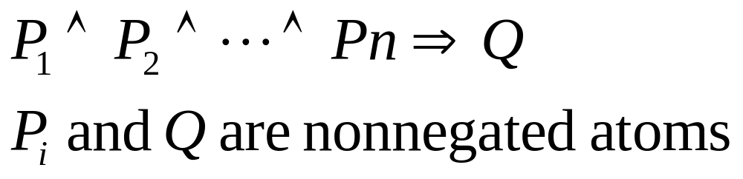
Completeness in first-order logic
A procedure is complete if and only if every sentence α entailed by KB can be derived using that procedure
Forward and backward chaining are complete for Horn clause KBs, but not in general

Slide 16
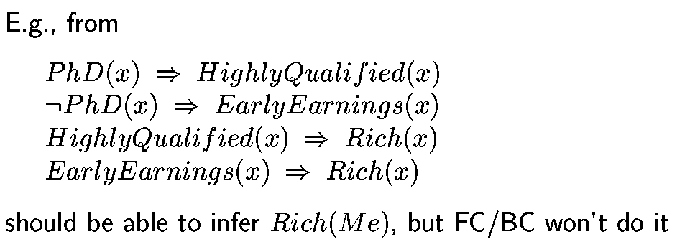
Example

Slide 17
Resolution
Resolution is a complete inference procedure for first order logic
Any sentence α entailed by KB can be derived with resolution
Catch: proof procedure can run for an unspecified amount of time
  At any given moment, if proof is not done, don’t know if infinitely looping or about to give an answer
  Cannot always prove that a sentence α is not entailed by KB
  First-order logic is semidecidable

Slide 18
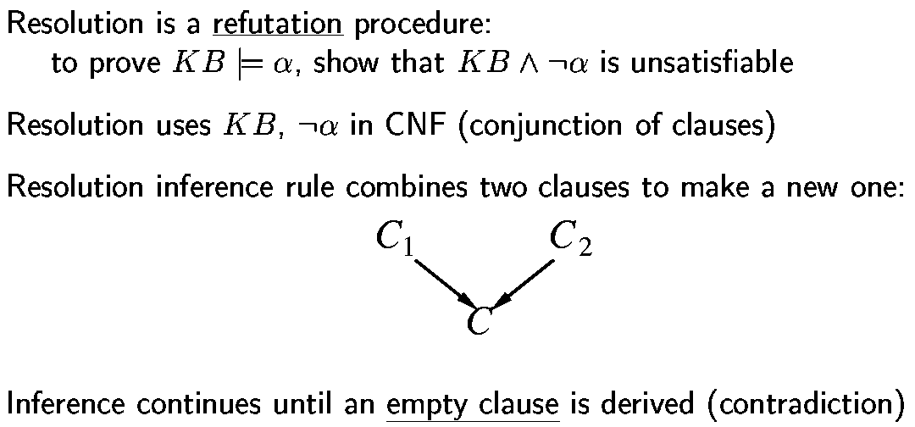
Resolution

Slide 19
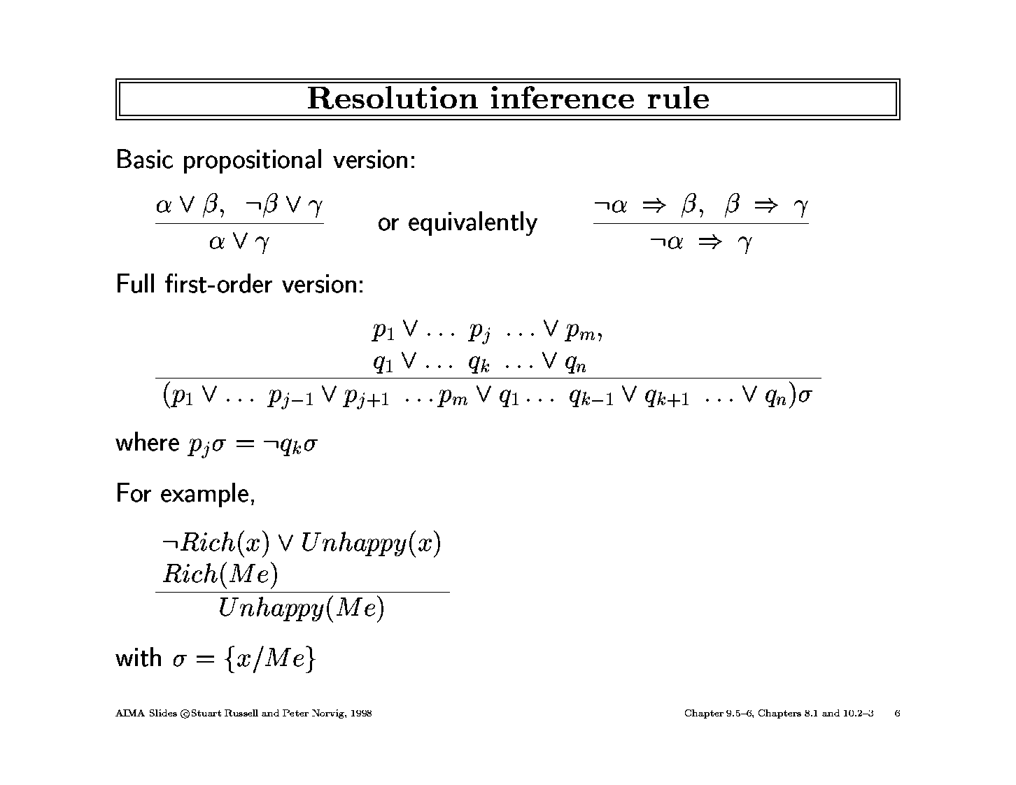
Resolution Inference Rule

Slide 20
Resolution Inference Rule
In order to use resolution, all sentences must be in conjunctive normal form
  bunch of sub-sentences connected by “and”

Slide 21
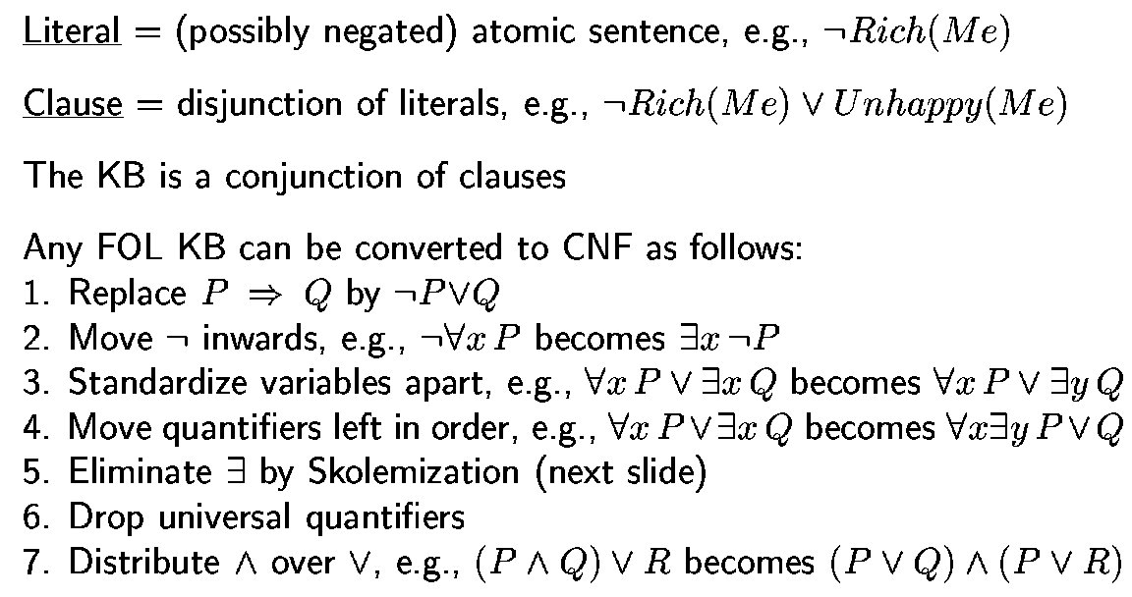
Converting to Conjunctive Normal Form (briefly)

Slide 22
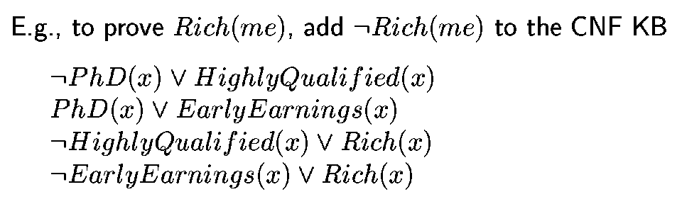
Example: Using Resolution to solve problem

Slide 23
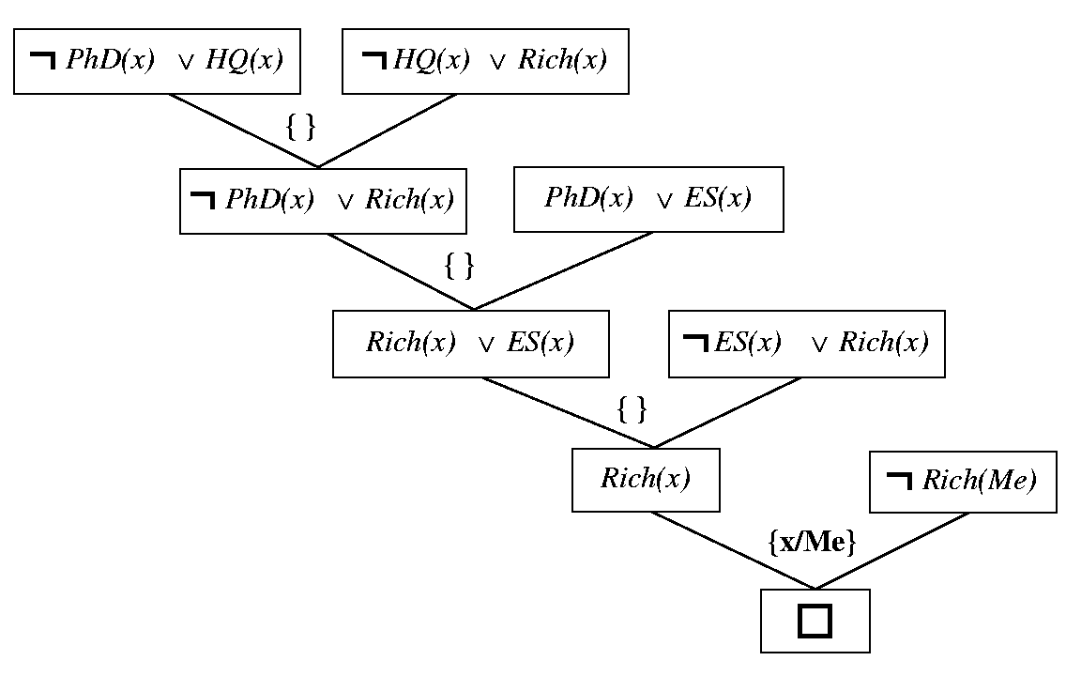
Sample Resolution Proof

Slide 24
What about Prolog? (10.3)
Only Horn clause sentences
  semicolon (“or”) ok if equivalent to Horn clause
Negation as failure: not P is considered proved if system failes to prove P
Backward chaining with depth-first search
Order of search is first to last, left to right
Built in predicates for arithmetic
  X is Y*Z+3
Depth-first search could result in infinite looping

Slide 25
Some more Prolog
Bounded depth first search
Cut

Slide 26
Theorem Provers (10.4)
Theorem provers are different from logic programming languages
  Handle all first-order logic, not just Horn clauses
  Can write logic in any order, no control issue

Slide 27
Sample theorem prover: Otter
Define facts (set of support)
Define usable axioms (basic background)
Define rules (rewrites or demodulators)
Heuristic function to control search
  Sample heuristic: small and simple statements are better
OTTER works by doing best first search
http://www-unix.mcs.anl.gov/AR/sobb/
  Boolean algebras

