Slide 1
Game-Playing & Adversarial Search
This lecture topic:
Game-Playing & Adversarial Search (two lectures)
Chapter 5.1-5.5
Next lecture topic:
Constraint Satisfaction Problems (two lectures)
Chapter 6.1-6.4, except 6.3.3
(Please read lecture topic material before and after each lecture on that topic)

Slide 2
Overview
Minimax Search with Perfect Decisions
  Impractical in most cases, but theoretical basis for analysis
Minimax Search with Cut-off
  Replace terminal leaf utility by heuristic evaluation function
Alpha-Beta Pruning
  The fact of the adversary leads to an advantage in search!
Practical Considerations
  Redundant path elimination, look-up tables, etc.
Game Search with Chance
  Expectiminimax search

Slide 3
You Will Be Expected to Know
Basic definitions (section 5.1)
Minimax optimal game search (5.2)
Alpha-beta pruning (5.3)
Evaluation functions, cutting off search (5.4.1, 5.4.2)
Expectiminimax (5.5)

Slide 4
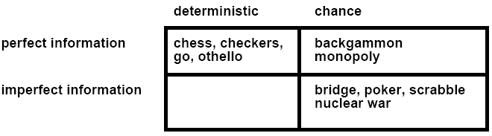
Types of Games
battleship
Kriegspiel
Not Considered: Physical games like tennis, croquet, ice hockey, etc.
(but see “robot soccer” http://www.robocup.org/)

Slide 5
Typical assumptions
Two agents whose actions alternate
Utility values for each agent are the opposite of the other
  This creates the adversarial situation
Fully observable environments
In game theory terms:
  “Deterministic, turn-taking, zero-sum games of perfect information”
Generalizes to stochastic games, multiple players, non zero-sum, etc.
Compare to, e.g., “Prisoner’s Dilemma” (p. 666-668, R&N 3rd ed.)
  “Deterministic, NON-turn-taking, NON-zero-sum game of IMperfect information”

Slide 6

Game tree (2-player, deterministic, turns)
How do we search this tree to find the optimal move?

Slide 7
Search versus Games
Search – no adversary
  Solution is (heuristic) method for finding goal
  Heuristics and CSP techniques can find optimal solution
  Evaluation function: estimate of cost from start to goal through given node
  Examples: path planning, scheduling activities
Games – adversary
  Solution is strategy
    strategy specifies move for every possible opponent reply.
  Time limits force an approximate solution
  Evaluation function: evaluate “goodness” of game position
  Examples: chess, checkers, Othello, backgammon

Slide 8
Games as Search
Two players: MAX and MIN
MAX moves first and they take turns until the game is over
  Winner gets reward, loser gets penalty.
  “Zero sum” means the sum of the reward and the penalty is a constant.
Formal definition as a search problem:
  Initial state: Set-up specified by the rules, e.g., initial board configuration of chess.
  Player(s): Defines which player has the move in a state.
  Actions(s): Returns the set of legal moves in a state.
  Result(s,a): Transition model defines the result of a move.
  (2nd ed.: Successor function: list of (move,state) pairs specifying legal moves.)
  Terminal-Test(s): Is the game finished? True if finished, false otherwise.
  Utility function(s,p): Gives numerical value of terminal state s for player p.
    E.g., win (+1), lose (-1), and draw (0) in tic-tac-toe.
    E.g., win (+1), lose (0), and draw (1/2) in chess.
MAX uses search tree to determine next move.

Slide 9
An optimal procedure: The Min-Max method
Designed to find the optimal strategy for Max and find best move:
1. Generate the whole game tree, down to the leaves.
2. Apply utility (payoff) function to each leaf.
3. Back-up values from leaves through branch nodes:
  a Max node computes the Max of its child values
  a Min node computes the Min of its child values
4. At root: choose the move leading to the child of highest value.

Slide 10
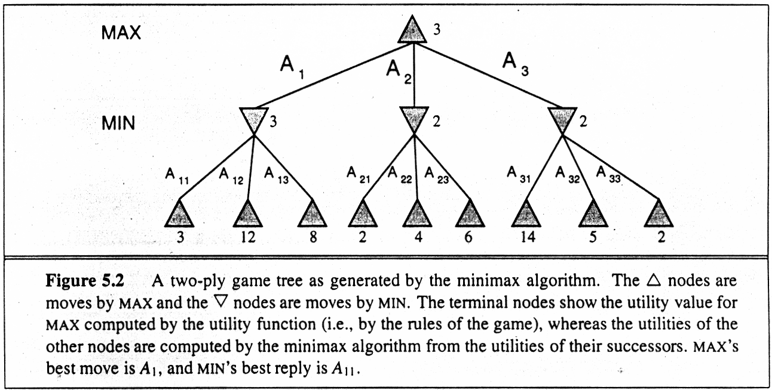
Game Trees

Slide 11
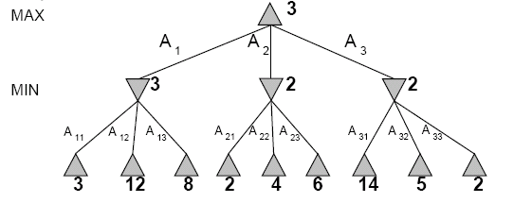
Two-Ply Game Tree

Slide 12
Two-Ply Game Tree

Slide 13
Two-Ply Game Tree
Minimax maximizes the utility for the worst-case outcome for max
The minimax decision

Slide 14
Pseudocode for Minimax Algorithm
function MINIMAX-DECISION(state) returns an action
inputs: state, current state in game
return arg max_{a∈ACTIONS(state)} MIN-VALUE(Result(state,a))
function MAX-VALUE(state) returns a utility value
if TERMINAL-TEST(state) then return UTILITY(state)
v ← −∞
for a in ACTIONS(state) do
v ← MAX(v,MIN-VALUE(Result(state,a)))
return v
function MIN-VALUE(state) returns a utility value
if TERMINAL-TEST(state) then return UTILITY(state)
v ← +∞
for a in ACTIONS(state) do
v ← MIN(v,MAX-VALUE(Result(state,a)))
return v

Slide 15
Properties of minimax
Complete?
  Yes (if tree is finite).
Optimal?
  Yes (against an optimal opponent).
    No. (Why not?)
Time complexity?
  O(b^{m})
Space complexity?
  O(bm) (depth-first search, generate all actions at once)
  O(m) (backtracking search, generate actions one at a time)
  Can it be beaten by an opponent playing sub-optimally?

Slide 16
Game Tree Size
Tic-Tac-Toe
  b ≈ 5 legal actions per state on average, total of 9 plies in game.
    “ply” = one action by one player, “move” = two plies.
  5⁹ = 1,953,125
  9! = 362,880 (Computer goes first)
  8! = 40,320 (Computer goes second)
  → exact solution quite reasonable
Chess
  b ≈ 35 (approximate average branching factor)
  d ≈ 100 (depth of game tree for “typical” game)
  b^{d} ≈ 35¹⁰⁰ ≈ 10¹⁵⁴ nodes!!
  → exact solution completely infeasible
It is usually impossible to develop the whole search tree.

Slide 17
(Static) Heuristic Evaluation Functions
An Evaluation Function:
  Estimates how good the current board configuration is for a player.
  Typically, evaluate how good it is for the player, how good it is for the opponent, then subtract the opponent’s score from the player’s.
  Often called “static” because it is called on a static board position.
  Othello: Number of white pieces - Number of black pieces
  Chess: Value of all white pieces - Value of all black pieces
Typical values from -infinity (loss) to +infinity (win) or [-1, +1].
If the board evaluation is X for a player, it’s -X for the opponent
  “Zero-sum game”

Slide 18
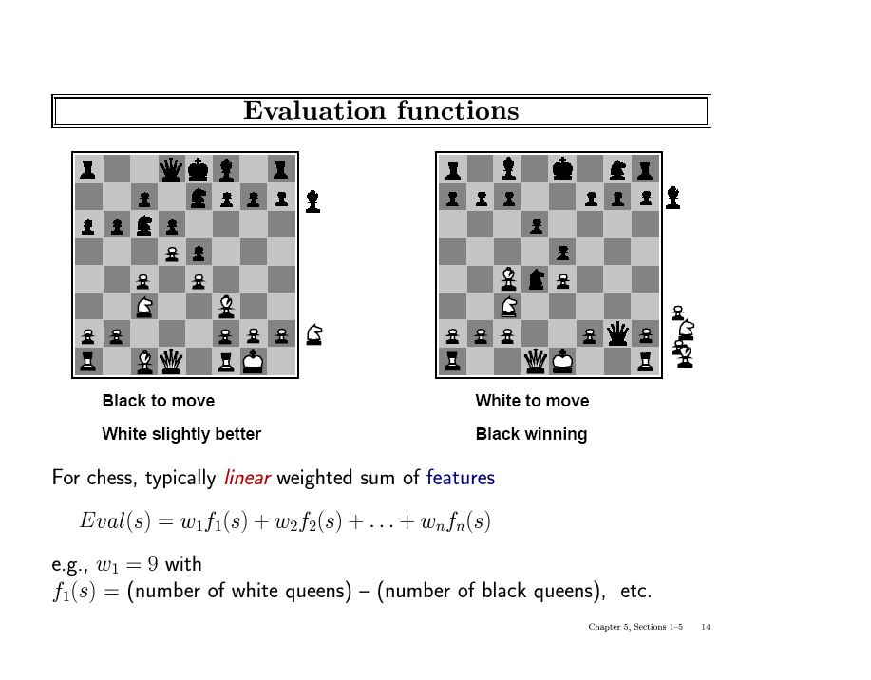

Slide 19
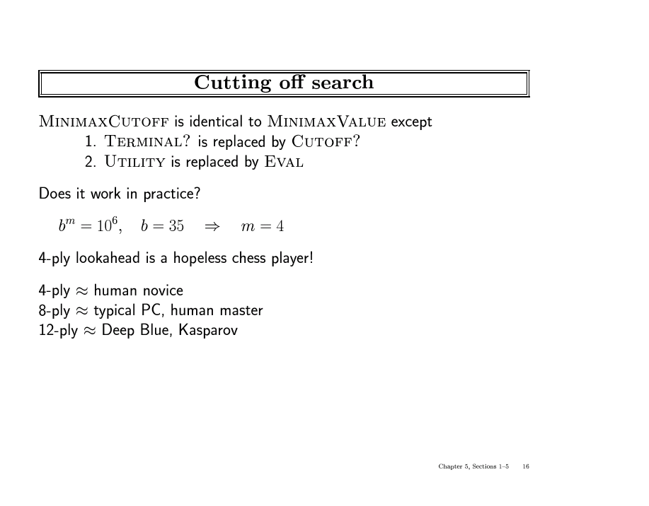

Slide 20
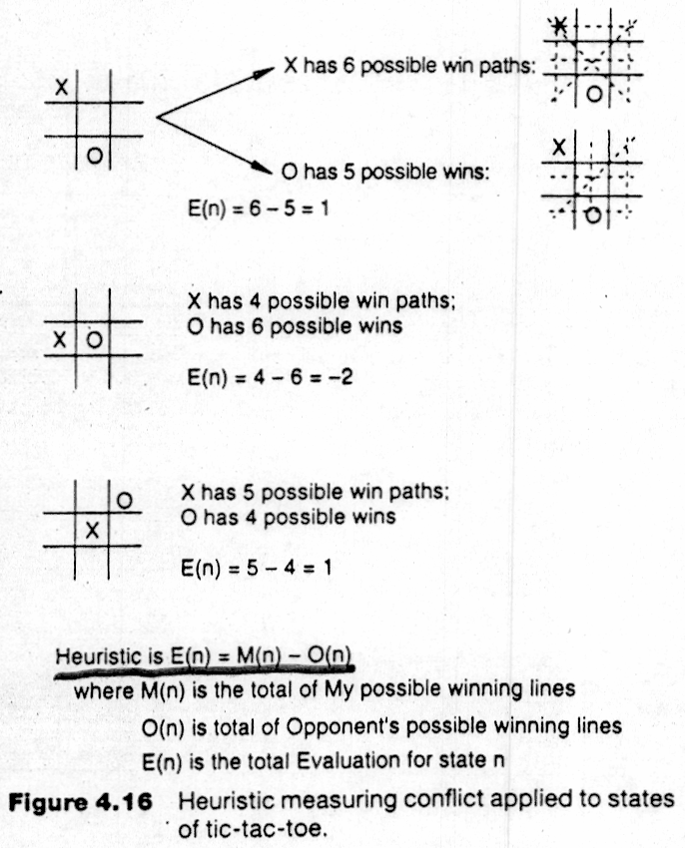
Applying MiniMax to tic-tac-toe
The static heuristic evaluation function

Slide 21
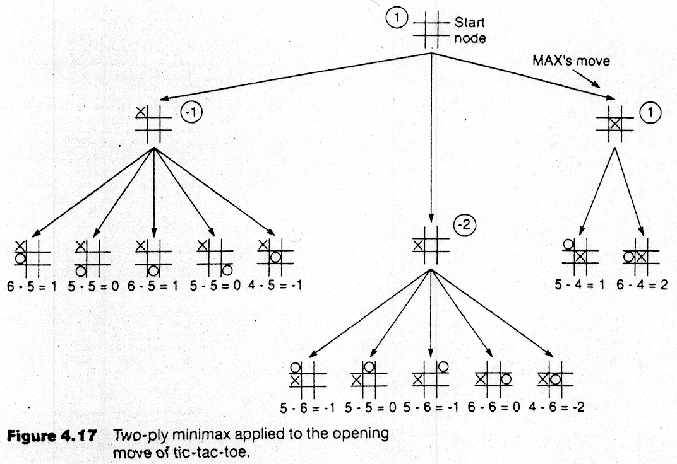
Backup Values

Slide 22
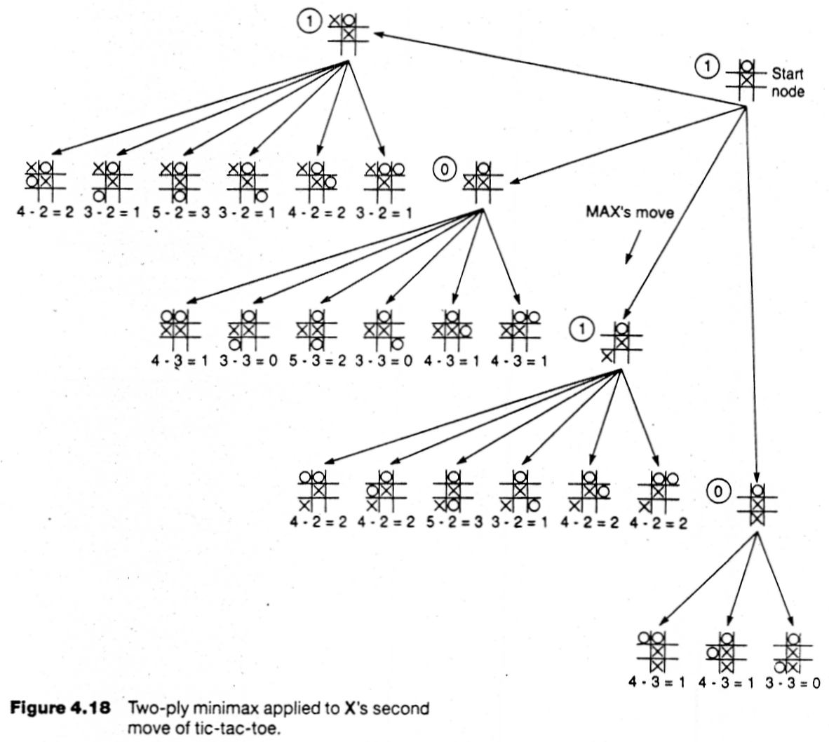

Slide 23
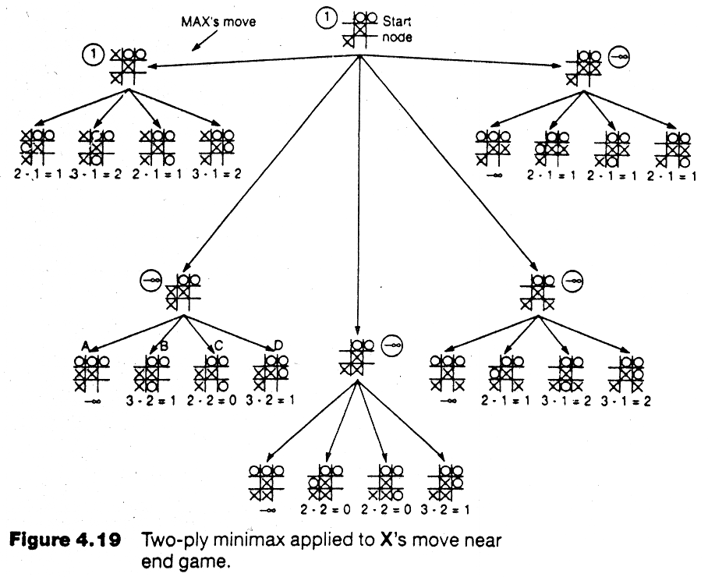

Slide 24
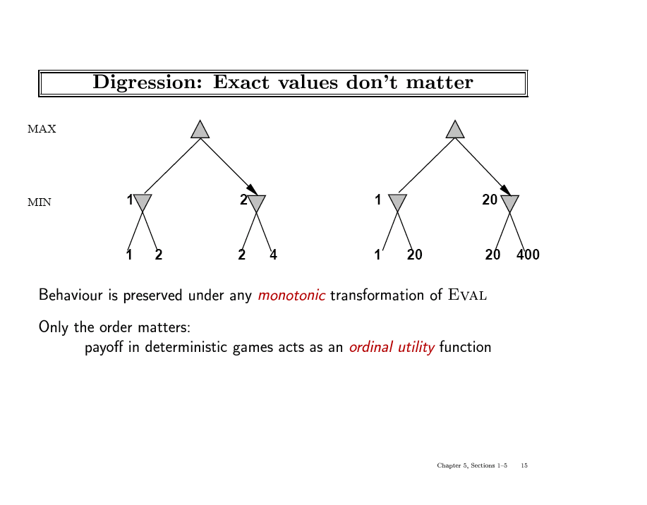

Slide 25
Alpha-Beta Pruning
Exploiting the Fact of an Adversary
If a position is provably bad:
  It is NO USE expending search time to find out exactly how bad
If the adversary can force a bad position:
  It is NO USE expending search time to find out the good positions that the adversary won’t let you achieve anyway
Bad = not better than we already know we can achieve elsewhere.
Contrast normal search:
  ANY node might be a winner.
  ALL nodes must be considered.
  (A* avoids this through knowledge, i.e., heuristics)

Slide 26
Tic-Tac-Toe Example with Alpha-Beta Pruning
Backup Values

Slide 27
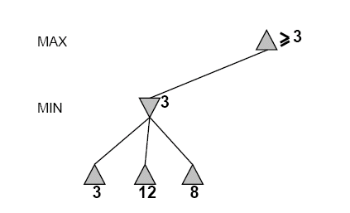
Another Alpha-Beta Example
Do DF-search until first leaf
Range of possible values
[-∞,+∞]
[-∞, +∞]

Slide 28
Alpha-Beta Example (continued)
[-∞,+∞]
[-∞,3]

Slide 29
Alpha-Beta Example (continued)
[-∞,+∞]
[-∞,3]

Slide 30
Alpha-Beta Example (continued)
[3,+∞]
[3,3]

Slide 31
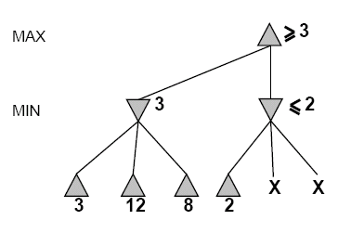
Alpha-Beta Example (continued)
[3,+∞]
This node is
worse for MAX
[3,3]
[-∞,2]

Slide 32
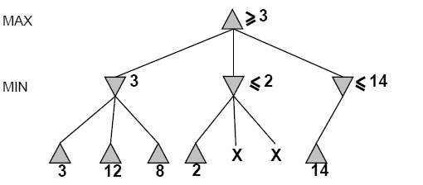
Alpha-Beta Example (continued)
[3,14]
,
[3,3]
[-∞,2]
[-∞,14]

Slide 33
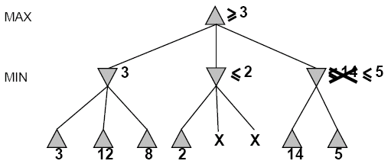

Alpha-Beta Example (continued)
[3,5]
,
[3,3]
[−∞,2]
[-∞,5]

Slide 34
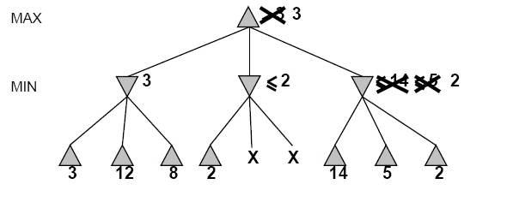
Alpha-Beta Example (continued)
[3,3]
[3,3]
[−∞,2]
[2,2]

Slide 35
Alpha-Beta Example (continued)
[3,3]
[3,3]
[-∞,2]
[2,2]

Slide 36
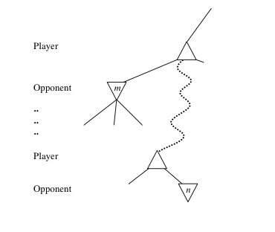
General alpha-beta pruning
Consider a node n in the tree ---
If player has a better choice at:
  Parent node of n
  Or any choice point further up
Then n will never be reached in play.
Hence, when that much is known about n, it can be pruned.

Slide 37
Alpha-beta Algorithm
Depth first search
  only considers nodes along a single path from root at any time
α = highest-value choice found at any choice point of path for MAX
(initially, α = −infinity)
β = lowest-value choice found at any choice point of path for MIN
(initially, β = +infinity)
Pass current values of α and β down to child nodes during search.
Update values of α and β during search:
  MAX updates α at MAX nodes
  MIN updates β at MIN nodes
Prune remaining branches at a node when α ≥ β

Slide 38
When to Prune
Prune whenever α ≥ β.
  Prune below a Max node whose alpha value becomes greater than or equal to the beta value of its ancestors.
    Max nodes update alpha based on children’s returned values.
  Prune below a Min node whose beta value becomes less than or equal to the alpha value of its ancestors.
    Min nodes update beta based on children’s returned values.

Slide 39
Pseudocode for Alpha-Beta Algorithm
function ALPHA-BETA-SEARCH(state) returns an action
inputs: state, current state in game
v←MAX-VALUE(state, - ∞ , +∞)
return the action in SUCCESSORS(state) with value v

Slide 40
Pseudocode for Alpha-Beta Algorithm
function ALPHA-BETA-SEARCH(state) returns an action
inputs: state, current state in game
v←MAX-VALUE(state, - ∞ , +∞)
return the action in ACTIONS(state) with value v
function MAX-VALUE(state,α , β) returns a utility value
if TERMINAL-TEST(state) then return UTILITY(state)
v ← - ∞
for a in ACTIONS(state) do
v ← MAX(v,MIN-VALUE(Result(s,a), α , β))
if v ≥ β then return v
α ← MAX(α ,v)
return v
(MIN-VALUE is defined analogously)

Slide 41
Alpha-Beta Example Revisited
Do DF-search until first leaf
α, β, initial values
α=−∞
β =+∞
α, β, passed to kids
α=−∞
β =+∞

Slide 42
Alpha-Beta Example (continued)
α=−∞
β =+∞
α=−∞
β =3
MIN updates β, based on kids

Slide 43
Alpha-Beta Example (continued)
α=−∞
β =+∞
α=−∞
β =3
MIN updates β, based on kids.
No change.

Slide 44
Alpha-Beta Example (continued)
MAX updates α, based on kids.
α=3
β =+∞
3 is returned
as node value.

Slide 45
Alpha-Beta Example (continued)
α=3
β =+∞
α, β, passed to kids
α=3
β =+∞

Slide 46
Alpha-Beta Example (continued)
α=3
β =+∞
MIN updates β,
based on kids.
α=3
β =2

Slide 47
Alpha-Beta Example (continued)
α=3
β =+∞
α=3
β =2
α ≥ β,
so prune.

Slide 48
Alpha-Beta Example (continued)
MAX updates α, based on kids.
No change.
α=3
β =+∞
2 is returned
as node value.

Slide 49
Alpha-Beta Example (continued)
α=3
β =+∞
,
α, β, passed to kids
α=3
β =+∞

Slide 50
Alpha-Beta Example (continued)
α=3
β =+∞
,
MIN updates β,
based on kids.
α=3
β =14

Slide 51
Alpha-Beta Example (continued)
α=3
β =+∞
,
MIN updates β,
based on kids.
α=3
β =5

Slide 52
Alpha-Beta Example (continued)
α=3
β =+∞
2 is returned
as node value.
2

Slide 53
Alpha-Beta Example (continued)
Max calculates the same node value, and makes the same move!
2

Slide 54
Effectiveness of Alpha-Beta Search
Worst-Case
  branches are ordered so that no pruning takes place. In this case alpha-beta gives no improvement over exhaustive search
Best-Case
  each player’s best move is the left-most child (i.e., evaluated first)
  in practice, performance is closer to best rather than worst-case
  E.g., sort moves by the remembered move values found last time.
  E.g., expand captures first, then threats, then forward moves, etc.
  E.g., run Iterative Deepening search, sort by value last iteration.
In practice often get O(b^{(d/2)}) rather than O(b^{d})
  this is the same as having a branching factor of sqrt(b),
    (sqrt(b))^{d} = b^{(d/2)},i.e., we effectively go from b to square root of b
  e.g., in chess go from b ~ 35 to b ~ 6
    this permits much deeper search in the same amount of time

Slide 55
Final Comments about Alpha-Beta Pruning
Pruning does not affect final results
Entire subtrees can be pruned.
Good move ordering improves effectiveness of pruning
Repeated states are again possible.
  Store them in memory = transposition table

Slide 56
Example
-which nodes can be pruned?
5
6
3
4
1
2
7
8

Slide 57
Answer to Example
-which nodes can be pruned?
Max
Min
Max
5
6
3
4
1
2
7
8
Answer: NONE! Because the most favorable nodes for both are explored last (i.e., in the diagram, are on the right-hand side).

Slide 58
Second Example
(the exact mirror image of the first example)
-which nodes can be pruned?
3
4
6
5
8
7
2
1

Slide 59
Answer to Second Example
(the exact mirror image of the first example)
-which nodes can be pruned?
Max
Min
Max
3
4
6
5
8
7
2
1
Answer: LOTS! Because the most favorable nodes for both are explored first (i.e., in the diagram, are on the left-hand side).

Slide 60
Iterative (Progressive) Deepening
In real games, there is usually a time limit T on making a move
How do we take this into account?
using alpha-beta we cannot use “partial” results with any confidence unless the full breadth of the tree has been searched
  So, we could be conservative and set a conservative depth-limit which guarantees that we will find a move in time < T
    disadvantage is that we may finish early, could do more search
In practice, iterative deepening search (IDS) is used
  IDS runs depth-first search with an increasing depth-limit
  when the clock runs out we use the solution found at the previous depth limit

Slide 61
Heuristics and Game Tree Search: limited horizon
The Horizon Effect
  sometimes there’s a major “effect” (such as a piece being captured) which is just “below” the depth to which the tree has been expanded.
  the computer cannot see that this major event could happen because it has a “limited horizon”.
  there are heuristics to try to follow certain branches more deeply to detect such important events
  this helps to avoid catastrophic losses due to “short-sightedness”
Heuristics for Tree Exploration
  it may be better to explore some branches more deeply in the allotted time
  various heuristics exist to identify “promising” branches

Slide 62
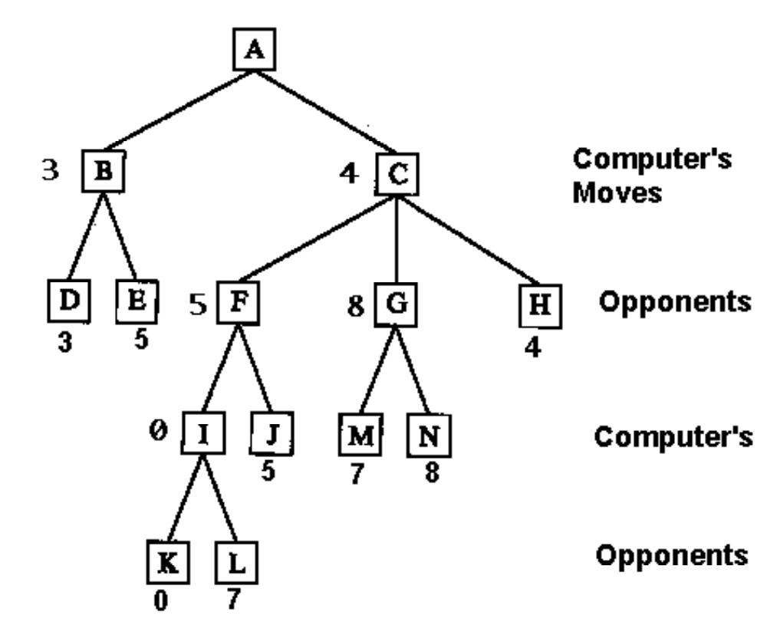
Deeper Game Trees

Slide 63
Eliminate Redundant Nodes
On average, each board position appears in the search tree approximately ~10¹⁵⁰ / ~10⁴⁰ ≈ 10¹⁰⁰ times.
  => Vastly redundant search effort.
Can’t remember all nodes (too many).
  => Can’t eliminate all redundant nodes.
However, some short move sequences provably lead to a redundant position.
  These can be deleted dynamically with no memory cost
Example:
  P-QR4 P-QR4; 2. P-KR4 P-KR4
  leads to the same position as
  1. P-QR4 P-KR4; 2. P-KR4 P-QR4

Slide 64
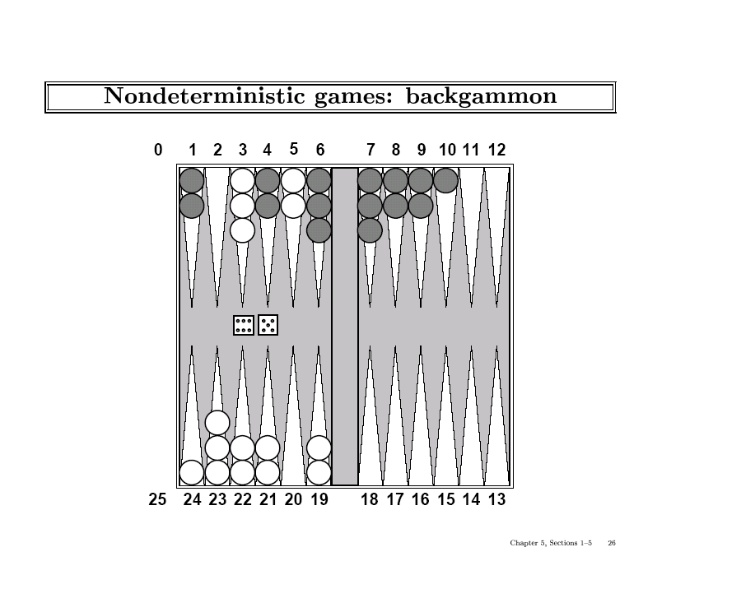

Slide 65
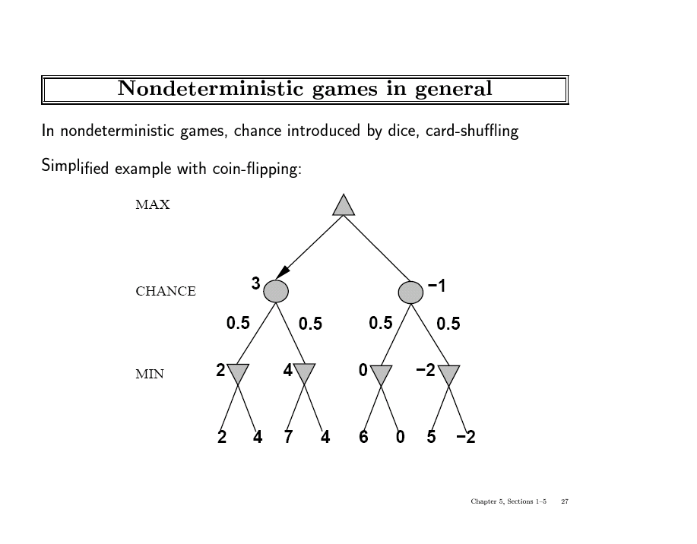

Slide 66
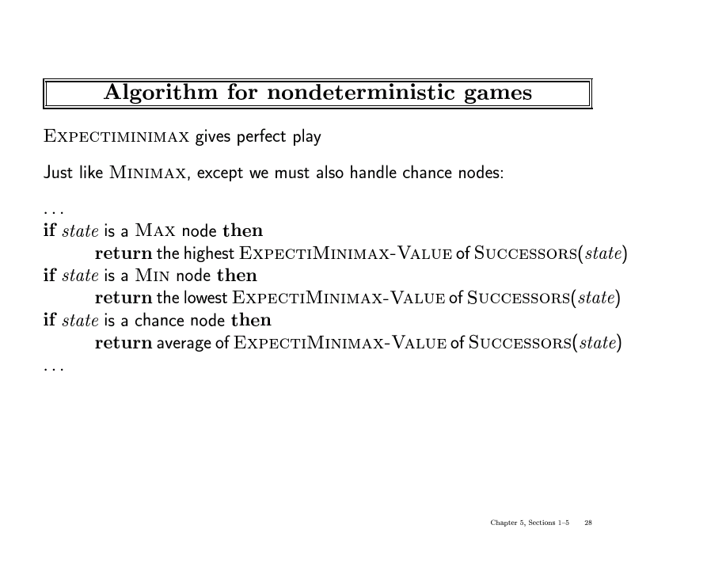

Slide 67
The State of Play
Checkers:
  Chinook ended 40-year-reign of human world champion Marion Tinsley in 1994.
Chess:
  Deep Blue defeated human world champion Garry Kasparov in a six-game match in 1997.
Othello:
  human champions refuse to compete against computers: they are too good.
Go:
  human champions refuse to compete against computers: they are too bad
  b > 300 (!)
See (e.g.) http://www.cs.ualberta.ca/~games/ for more information

Slide 68
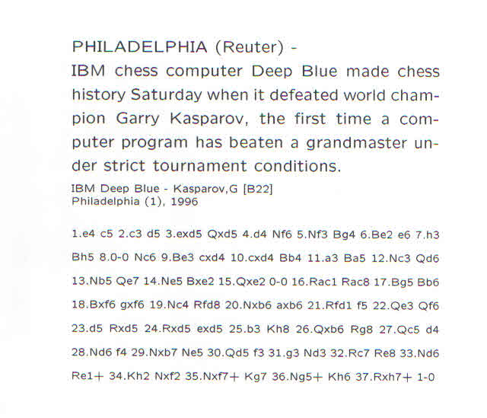

Slide 69
Deep Blue
1957: Herbert Simon
  “within 10 years a computer will beat the world chess champion”
1997: Deep Blue beats Kasparov
Parallel machine with 30 processors for “software” and 480 VLSI processors for “hardware search”
Searched 126 million nodes per second on average
  Generated up to 30 billion positions per move
  Reached depth 14 routinely
Uses iterative-deepening alpha-beta search with transpositioning
  Can explore beyond depth-limit for interesting moves

Slide 70
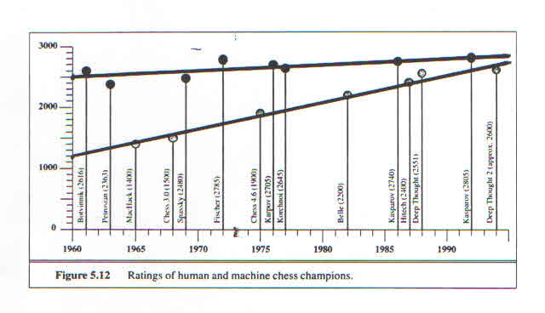
Moore’s Law in Action?

Slide 71
Summary
Game playing is best modeled as a search problem
Game trees represent alternate computer/opponent moves
Evaluation functions estimate the quality of a given board configuration for the Max player.
Minimax is a procedure which chooses moves by assuming that the opponent will always choose the move which is best for them
Alpha-Beta is a procedure which can prune large parts of the search tree and allow search to go deeper
For many well-known games, computer algorithms based on heuristic search match or out-perform human world experts.

