Slide 1
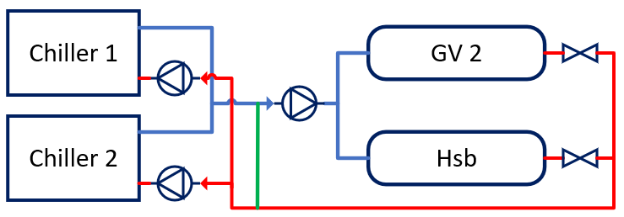
gv2 pipeline and heat-exchanger
Evaporator
pumps
Valves
Distribution
pumps
hsb pipeline and heat-exchanger
Common pipe
Incasol – Europa (ICE) pipeline

