Slide 1
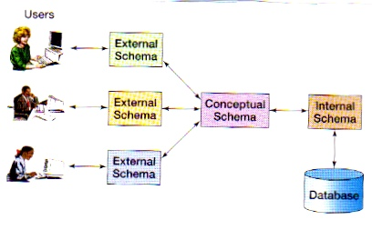
Database System principles
Yuan Xiaojie，Shen wei
Dept. of Computer Science and technology, Nankai University
Slides adapted from material by Profs. Jeff Ullman (Stanford) and Art Keller (UCSC)

Slide 2
Course Goals & Content
cover mostly relational databases
  how to design and create such databases
  how to use them (via SQL query language)
  how to implement them (only briefly)
will touch on some advanced issues
  data warehouse, data mining

Slide 3
Outline
Introduction to DBMSs (Yuan)
The Entity Relationship model (Shen)
The Relational Model (Shen)
SQL: Introduction (Shen)
SQL: Advanced (Shen)
DB Schema Design (Yuan)
Relation Algebra & Query Processing (Yuan)
Query Processing (Yuan)
Concurrency Control (Yuan)

Slide 4
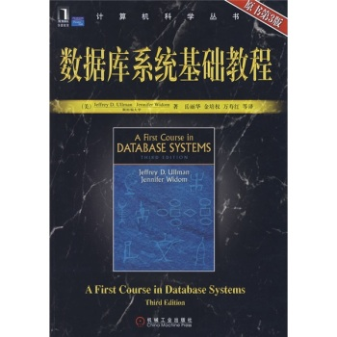
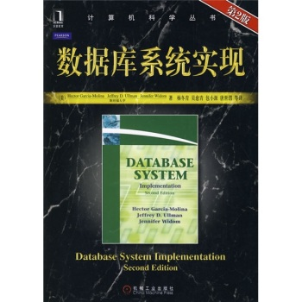
Textbook
“A First Course in Database System”, Jeffrey D.Ullman, Jennifer Widom
  翻译版，《数据库系统基础教程》原书第三版, 机械工业出版社（本科教材）
“Database System Implementation”,Hector Garcia-Molina, Jeffrey D.Ullman, …
  翻译版，《数据库系统实现》第二版, 机械工业出版社（本科参考、研究生教材）

Slide 5
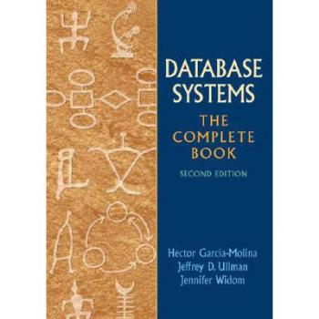
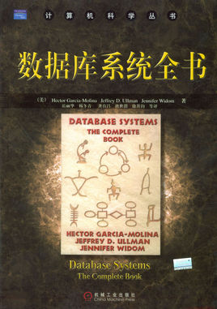
Textbook
Database Systems: The Complete Book, Hector Garcia-Molina, Jeffrey D. Ullman, and Jennifer Widom, Prentice Hall, 2008.
这本书的网址是http://infolab.stanford.edu/~ullman/dscb.html
原版很贵
已不出版

Slide 6
Stanford Database Courses
Fall, Spring
CS 145
A First Course in Database System
Winter
CS 245
Database System Principles
CS 346
CS 345
CS 347
CS 395
CS 545
DB Systems Implementation
Advanced Topics
TP + DDBs
Independent DB Project
DB Seminar
Fall
Spring
Spring
All
Fall, Spring

Slide 7
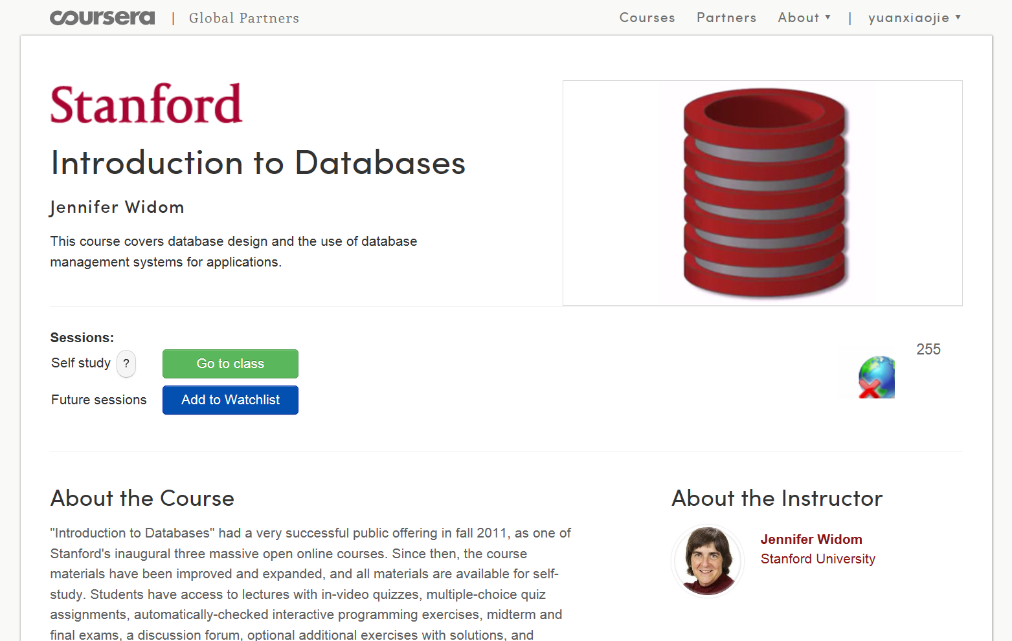

https://www.coursera.org/course/db

Slide 8
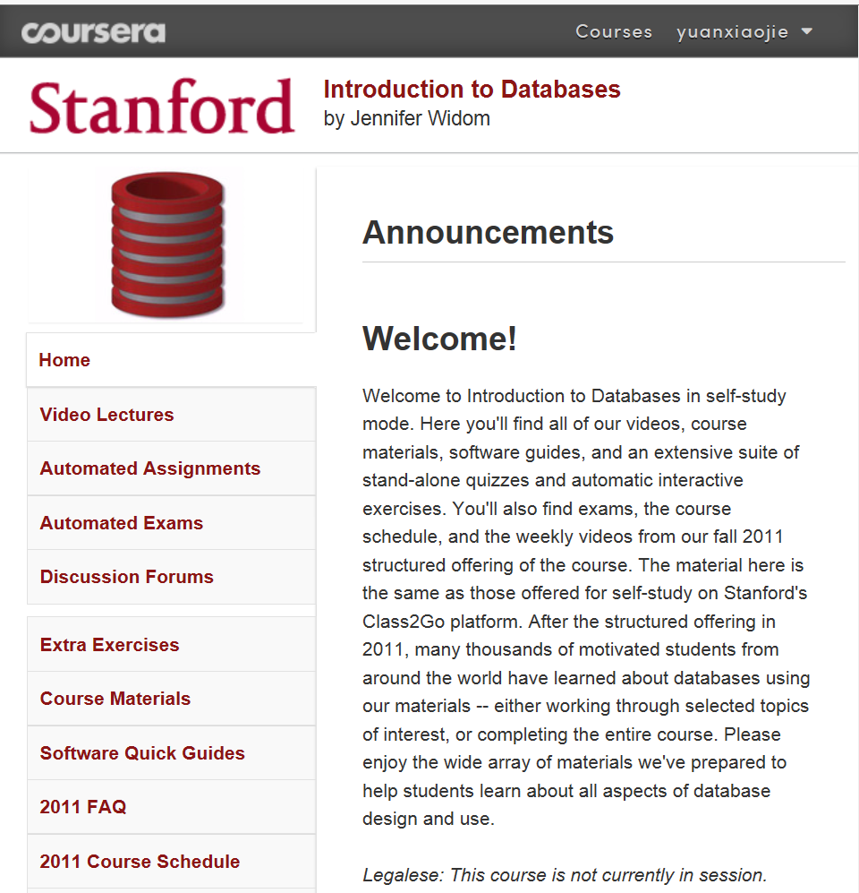
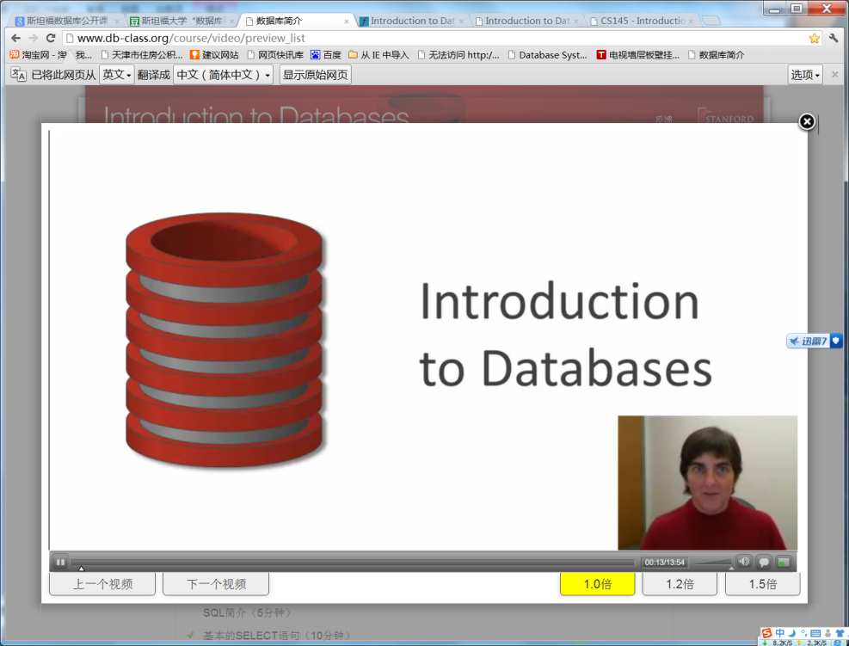
View Video Lectures
Professor Jennifer Widom is the Fletcher Jones Professor and Chair of the Computer Science Department at Stanford University

Slide 9
Course Format
For all students
  two 70-min lectures / week (If you have conflicts, do let us know in advance, 5% )
  some homeworks（Will be collected at the beginning of class on the due date, No late homework will be accepted, 10%）
  projects (15%)
  Midterm Examination( 10%, SQL, Computer)
  Final Examination {Closed Book} (60%)

Slide 10
Today’s Lecture
Introduction
  Motivating example
  How do DBMSs work? DDL, DML, views.
  Fundamental concepts
  DBMS users
  Overall system architecture
  Steps in Building a DB Application
  Conclusions

Slide 11
Definitions
‘DBMS’ = ‘Data Base Management System’:
is a piece of software designed to store and
Manage databases
  the (commercial) system, like: DB2, Oracle, MS SQL-server, ...
‘Database system’: DBMS + data + application programs

Slide 12
A Motivating Example
Suppose we are building a system to store the information about:
  students
  courses
  professors
  who takes what, who teaches what
为什么需要DBMS？

Slide 13
采用文件系统实现存储功能是否可行？
文件系统是否可以完成数据库的存储功能？
利用C++编写数据存储程序样例
#include <fstream.h>
struct Date{int iMonth,iDay,iYear;};
void main()
{
Date dt={6,10,92};
ofstream datafile("ata.dat",ios::binary);
datafile.write((char *)&dt,sizeof dt);
}

Slide 14
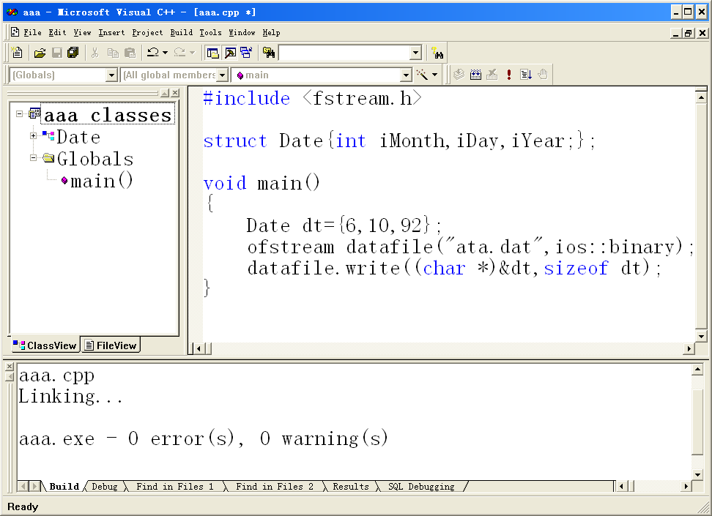
ata.dat: 06 00 00 00 0A 00 00 00 5C 00 00 00

Slide 15
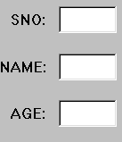
利用文件系统存储数据
CStudent派生于 CRecordSet
STUDENT数据源
CStudentDlg派生于CDialog
对话框控件
m_sno
m_name
m_age
m_sno
m_name
m_age
Requery()
Update()
=
UpdateData()

Slide 16
Application Requirements
store the data for a long period of time
  large amounts (100s of GB)
  protect against crashes
  protect against unauthorized use
allow users to query/update:
  who teaches “CS 173”
  enroll “Mary” in “CS 311”
allow several (100s, 1000s) users to access the data simultaneously
allow administrators to change the schema
  add information about TAs

Slide 17
Trying Without a DBMS
Why Direct Implementation Won’t Work:
Storing data: file system is limited
  size less than 4GB (on 32 bits machines)
  when system crashes we may loose data
  password-based authorization insufficient
Query/update:
  need to write a new C++/Java program for every new query
  need to worry about performance

Slide 18
Concurrency: limited protection
  need to worry about interfering with other users
  need to offer different views to different users (e.g. registrar, students, professors)
Schema change:
  entails changing file formats
  need to rewrite virtually all applications
Better let a database system handle it

Slide 19
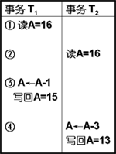
建立自己数据库所面临的问题
元数据(metadata)，关于数据的数据
创建自己的C++数据库时，需要在自己的源代码中定义元数据，使得任何想使用这些数据的人不得不访问你的源代码
用于处理文件封锁和开锁的源代码会相当复杂
采用数据库管理系统(DBMS)是最佳选择

Slide 20
Detailed outline
Introduction
  Motivating example
  How do DBMSs work? DDL, DML, views.
  Fundamental concepts
  DBMS users
  Overall system architecture
  Steps in Building a DB Application
  Conclusions

Slide 21



How do DBs work?
我的卡还有多少钱？
谁选修了数据库课程？
我要买上海的飞机票？
A well-designed DBMS makes many people happy!
DBMS
data
meta-data = catalog = data dictionary

Slide 22

DBMS应该怎样构造？
银行系统
  数据项有：姓名、地址、帐号、存款、结余等
  基本操作：查询、更新、转帐等
  不能出现任何错误：并发操作、支取现金等
订票系统
  数据项有：航班信息、机票信息、预定信息等
  基本操作：查询时间、票价、座位等，更新信息等
  并发访问处理，系统崩溃处理，防止信息丢失等

Slide 23
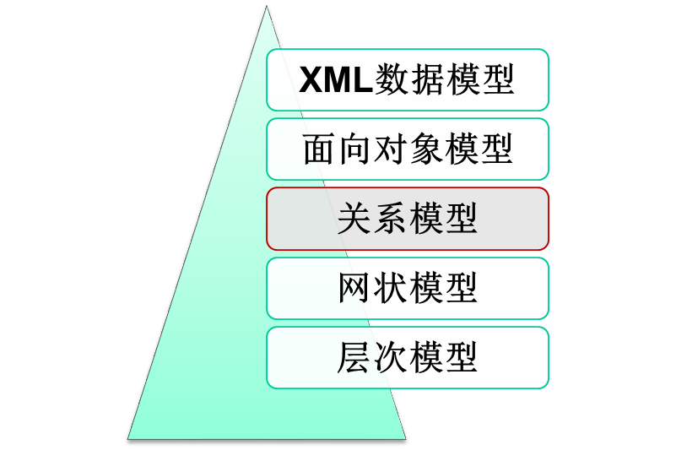
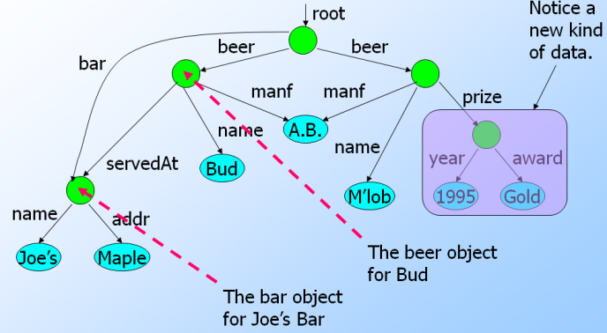
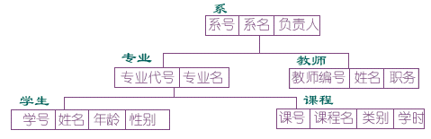
数据项存储-数据模型
数据库中的数据是按照一定的逻辑结构存放的，这种结构是用数据模型来表示的

Slide 24
An Example of a Relation
Table name
Attribute names
student
学号 | 姓名 | 出生日期 | 所属学院
20161001 | 张三 | 1994.8.5 | 计控
20162023 | 李四 | 1995.6.7 | 数学
20164512 | 王五 | 1994.11.15 | 金融
… | … | … | …
tuples
course
takes
课号 | 课名 | 学分
1001 | 数据库 | 3
1002 | 英语 | 4
1006 | 操作系统 | 3
… | … | …
课号 | 学号 | 成绩
1001 | 20161001 | 95
1002 | 20161001 | 70
1001 | 20164512 | 80
… | … | …
Notes:
a relation is a table
each row is a tuple representing information about a movie
attribute

Slide 25
How do RDBMS work? - SQL
SQL（Structured Query Language）
create table student
(学号 char(8) primary key,
姓名 char(8),
出生日期 date,
所属学院 varchar(30))
DDL 数据定义语言
insert into student values('20161001','张三','1994.08.05','计控')
insert into student values('20162023','李四','1995.06.07','数学')
insert into student values('20164512','王五','1994.11.15','金融')
DML
数据操作语言
学号 | 姓名 | 出生日期 | 所属学院
20161001 | 张三 | 1994.8.5 | 计控
20162023 | 李四 | 1995.6.7 | 数学
20164512 | 王五 | 1994.11.15 | 金融
… | … | … | …

Slide 26
SQL-支持任何复杂查询和更新操作
Example：
select 学号 from student
where not exists
(select * from course
where not exists
(select * from takes
where takes.课号=course.课号
and takes.学号=student.学号))
学号 | 姓名 | 出生日期 | 所属学院
20161001 | 张三 | 1994.8.5 | 计控
20162023 | 李四 | 1995.6.7 | 数学
20164512 | 王五 | 1994.11.15 | 金融
… | … | … | …
课号 | 学号 | 成绩
1001 | 20161001 | 95
1002 | 20161001 | 70
1001 | 20164512 | 80
… | … | …
课号 | 课名 | 学分
1001 | 数据库 | 3
1002 | 英语 | 4
1006 | 操作系统 | 3
… | … | …
查找选修了全部课程的学生学号

Slide 27
Detailed outline
Introduction
  Motivating example
  How do DBMSs work? DDL, DML, views.
  Fundamental concepts
  DBMS users
  Overall system architecture
  Steps in Building a DB Application
  Conclusions

Slide 28
Fundamental concepts
3-level architecture
logical data independence
physical data independence

Slide 29

3-level architecture

Slide 30
Levels of Abstraction
  Physical level（物理模式、内模式、存储模式）
    how are these tables stored, how many bytes/attribute etc，indices, hash, …
  Logical level（模式、逻辑模式）
describes data stored in database, and the relationships among the data.
    STUDENT(学号, 姓名, 出生日期, 所属学院)
    TAKES (学号, 课号, 成绩)
  View level（外模式、子模式、用户模式）
application programs hide details of data types. Views can also hide information (e.g., salary) for security purposes.

Slide 31
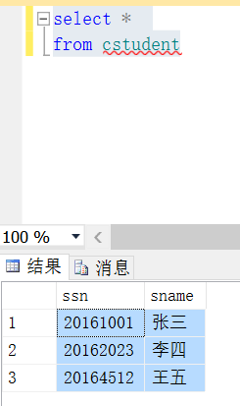
view level example
view level, eg:
create view cstudent(ssn,sname)
as select 学号,姓名
from student;
视图的优点：
限制表中特定列和行的使用
隐藏复杂查询的细节
提供安全保证

Slide 32
3-level architecture
-> hence, physical and logical data independence:
Logical data independence(逻辑独立性)
  can add (drop) column; add/drop table
Physical data independence(物理独立性)
  can add index; change record order

Slide 33
Detailed outline
Introduction
  Motivating example
  How do DBMSs work? DDL, DML, views.
  Fundamental concepts
  DBMS users
  Overall system architecture
  Steps in Building a DB Application
  Conclusions

Slide 34
Database users
‘naive’ users
casual users
application programmers
[ DBA (Data base administrator)]

Slide 35
Casual users
select *
from student
DBMS
and meta-data =
catalog
data

Slide 36
‘’Naïve‘’ users
Pictorially:
app. (eg.,
report generator)
DBMS
and meta-data =
catalog
data

Slide 37

App. programmers
Authors of applications
(like the ‘report generator’)
app. (eg., report generator)
DBMS
and meta-data =
catalog
data

Slide 38

DB Administrator (DBA)
Duties?
DBMS
and meta-data =
catalog
data

Slide 39
DB Administrator (DBA)
Duties?
DBMS
and meta-data =
catalog
data

Slide 40
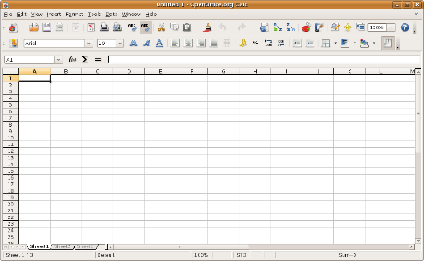
DB Administrator (DBA)
schema definition (‘logical’ level)
physical schema (storage structure, access methods
schema modifications
granting authorizations
integrity constraint specification

Slide 41
Detailed outline
Introduction
  Motivating example
  How do DBMSs work? DDL, DML, views.
  Fundamental concepts
  DBMS users
  Overall system architecture
  Steps in Building a DB Application
  Conclusions

Slide 42
Overall system architecture
[Users]
DBMS
  query processor
  storage manager
[Files]

Slide 43
naive
app. pgmr
casual
DBA
users
emb. DML
DML proc.
DDL int.
app. pgm(o)
query eval.
query proc.
trans. mgr
buff. mgr
file mgr
storage mgr.
data
meta-data

Slide 44
Overall system architecture
query processor
  DML compiler
  embedded DML pre-compiler
  DDL interpreter
  Query evaluation engine
storage manager
  authorization and integrity manager
  transaction manager
  buffer manager
  file manager

Slide 45
Overall system architecture (cont’d)
Files
  data files
  data dictionary = catalog (= meta-data)
  indices
  statistical data

Slide 46
Some examples:
DBA doing a DDL (data definition language) operation, eg.,
  create table student ...

Slide 47
naive
app. pgmr
casual
DBA
users
emb. DML
DML proc.
DDL int.
app. pgm(o)
query eval.
query proc.
trans. mgr
buff. mgr
file mgr
storage mgr.
data
meta-data

Slide 48
Some examples:
casual user, asking for an update, eg.:
  update student
  set name to ‘smith’
  where ssn = ‘345’

Slide 49
naive
app. pgmr
casual
DBA
users
emb. DML
DML proc.
DDL int.
app. pgm(o)
query eval.
query proc.
trans. mgr
buff. mgr
file mgr
storage mgr.
meta-data
data

Slide 50
naive
app. pgmr
casual
DBA
users
emb. DML
DML proc.
DDL int.
app. pgm(o)
query eval.
query proc.
trans. mgr
buff. mgr
file mgr
storage mgr.
data
meta-data

Slide 51
users
naive
app. pgmr
casual
DBA
emb. DML
DML proc.
DDL int.
app. pgm(o)
query eval.
query proc.
trans. mgr
buff. mgr
file mgr
storage mgr.
meta-data
data

Slide 52
Some examples:
app. programmer, creating a report, eg
  main(){
  ....
  exec sql “select * from student”
  ...
  }

Slide 53
naive
app. pgmr
casual
DBA
users
pgm (src)
emb. DML
DML proc.
DDL int.
app. pgm(o)
query eval.
query proc.
trans. mgr
buff. mgr
file mgr
storage mgr.
meta-data
data

Slide 54
Some examples:
‘naive’ user, running the previous app.

Slide 55
naive
app. pgmr
casual
DBA
users
pgm (src)
emb. DML
DML proc.
DDL int.
app. pgm(o)
query eval.
query proc.
trans. mgr
buff. mgr
file mgr
storage mgr.
meta-data
data

Slide 56
Detailed outline
Introduction
  Motivating example
  How do DBMSs work? DDL, DML, views.
  Fundamental concepts
  DBMS users
  Overall system architecture
  Steps in Building a DB Application
  Conclusions

Slide 57
Steps in Building a DB Application
Suppose you are working on database project
Step 0: pick an application domain
  we will talk about this later
Step 1: conceptual design
  discuss with your team mates what to model in the application domain
  need a modeling language to express what you want
  ER model is the most popular such language
  output: an ER diagram of the app. domain

Slide 58
Conceptual Modeling
name
category
name
cid
ssn
Takes
Course
Student
quarter
Advises
Teaches
Professor
address
name
field

Slide 59
Steps in Building a DB Application
Step 2: pick a type of DBMS
  relational DBMS is most popular and is our focus
Step 3: translate ER design to a relational schema
  use a set of rules to translate from ER to rel. schema
  use a set of schema refinement rules to transform the above rel. schema into a good rel. schema
At this point
  you have a good relational schema on paper

Slide 60
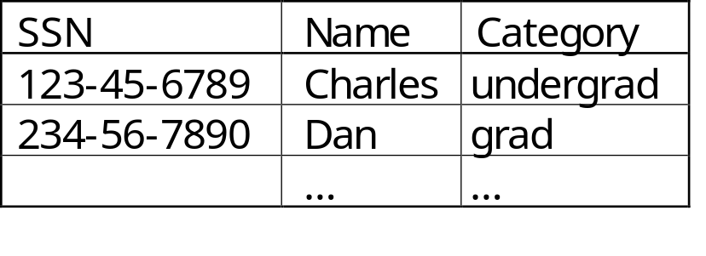
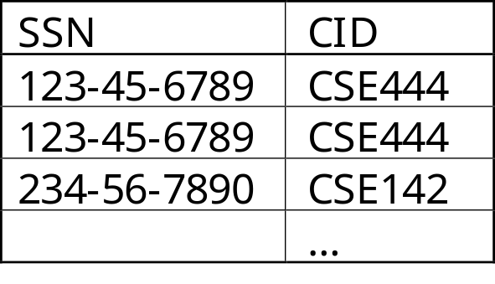
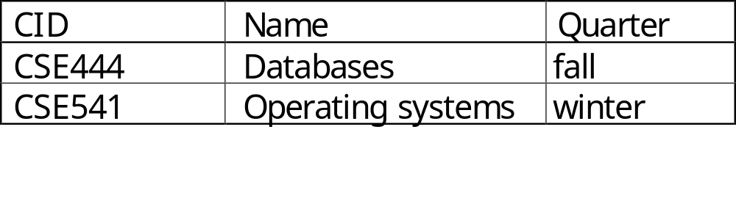
Schema Design and Implementation
Tables:
Separates the logical view from the physical view of the data.
Students:
Takes:
Courses:

Slide 61
Steps in Building a DB Application
Subsequent steps include
  implement your relational DBMS using a "database programming language" called SQL
  ordinary users cannot interact with the database directly
  and the database also cannot do everything you want
  hence write your application program in C++, Java, ASP, etc to handle the interaction and take care of things that the database cannot do
So, the first thing we should start with is to learn ER model ... Next lecture by ShenWei

Slide 62
Querying a Database
Find all courses that “Mary” takes
S(tructured) Q(uery) L(anguage)
Query processor figures out how to answer the query efficiently.
select C.name
from Students S, Takes T, Courses C
where S.name = “Mary” and
S.ssn = T.ssn and T.cid = C.cid

Slide 63
Main vendors/products
Commercial
Oracle
IBM/DB2
MS SQL-server
Sybase
(MS Access,
...)
Open source
Postgres (UCB)
mySQL/mariaDB
sqlite (sqlite.org)
(www.acm.org/sigmod)

Slide 64
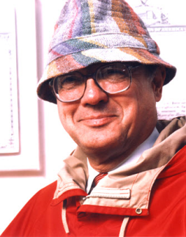
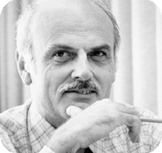
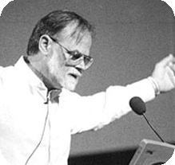
数据库领域图灵奖简介
1973年,Charles W.Bachman,网状数据库之父
  主持设计与开发了最早的网状数据库系统IDS
  推动和促成了数据库标准的制定
1981年,Edgar Frank Codd,关系数据库之父
  A relational Model of Data for Large Shared Data Banks
1998年,James Gray, 数据库技术和事务处理专家
  完整性、安全性、并发性、故障恢复

Slide 65
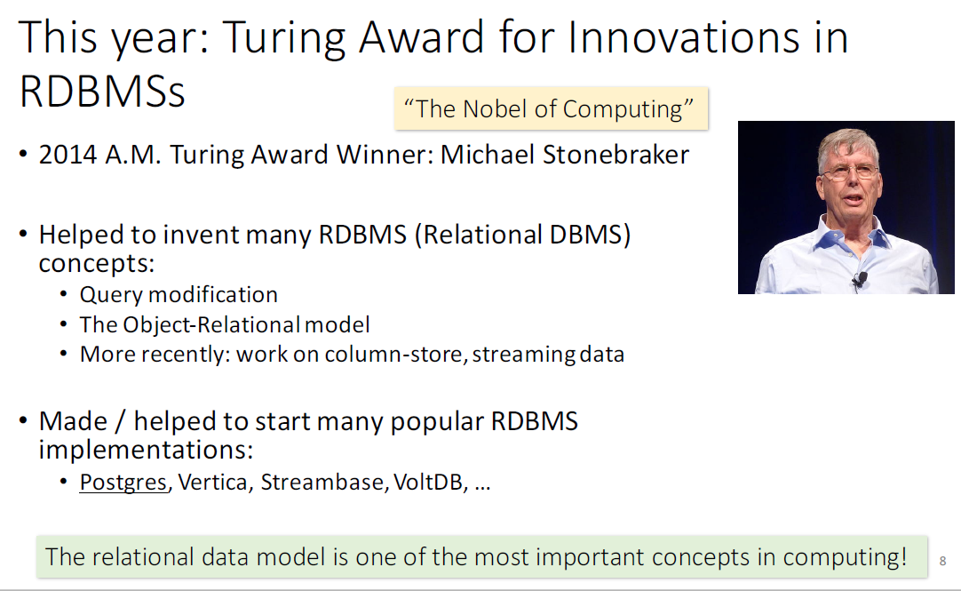
数据库领域图灵奖简介

Slide 66
Today’s Lecture
Introduction
  Motivating example
  How do DBMSs work? DDL, DML, views.
  Fundamental concepts
  DBMS users
  Overall system architecture
  Steps in Building a DB Application
  Conclusions

Slide 67




The world is increasingly driven by data…
This class teaches the basics of how to use & manage data.

