Slide 1
Concurrency Control
T1 T2 … Tn
How to prevent harmful interference btw transactions?
DB
(consistency
constraints)
=> scheduling techniques based on
- locks
- timestamps and
validation

Slide 2
Example:
Constraint: A=B
T1: Read(A) T2: Read(A)
A ← A+100 A ← A×2
Write(A) Write(A)
Read(B) Read(B)
B ← B+100 B ← B×2
Write(B) Write(B)

Slide 3
Correctness depends on scheduling of transactions
A schedule
- Chronological (possibly interleaving) order in which actions of transactions are executed
- A correct schedule is equivalent to executing transactions one-at-a-time in some order
Notes:
时间表
- 按时间顺序（可能交错）执行交易操作的顺序
- 正确的时间表等同于以某种顺序一次执行事务

Slide 4
Schedule A
A B
25 25
125
125
250
250
250 250
T1 T2
Read(A); A ← A+100;
Write(A);
Read(B); B ← B+100;
Write(B);
Read(A);A ← A×2;
Write(A);
Read(B);B ← B×2;
Write(B);
OK

Slide 5
Schedule B
A B
25 25
50
50
150
150
150 150
T1 T2
Read(A);A ← A×2;
Write(A);
Read(B);B ← B×2;
Write(B);
Read(A); A ← A+100;
Write(A);
Read(B); B ← B+100;
Write(B);
OK

Slide 6
Schedule C
A B
25 25
125
250
125
250
250 250
T1 T2
Read(A); A ← A+100
Write(A);
Read(A);A ← A×2;
Write(A);
Read(B); B ← B+100;
Write(B);
Read(B);B ← B×2;
Write(B);
OK
Notes:
R1(A)W1(A)R2(A)W2(A)R1(B)W1(B)R2(B)W2(B)

Slide 7
Schedule D
A B
25 25
125
250
50
150
250 150
T1 T2
Read(A); A ← A+100;
Write(A);
Read(A);A ← A×2;
Write(A);
Read(B);B ← B×2;
Write(B);
Read(B); B ← B+100;
Write(B);
Constraint violation!
Notes:
R1(A)W1(A)R2(A)W2(A) R2(B)W2(2)R1(B)W1(B) 成环：出现问题 调度器中不会出现这种情况

Slide 8
Schedule E
Same as Schedule D
but with new T2’
A B
25 25
125
125
25
125
125 125
T1 T2’
Read(A); A ← A+100;
Write(A);
Read(A);A ← A×1;
Write(A);
Read(B);B ← B×1;
Write(B);
Read(B); B ← B+100;
Write(B);
OK

Slide 9
Want schedules that are “good”, regardless of
  initial state (<−> “good” in any DB state) and
  transaction semantics
Only look at order of READs and WRITEs
  Note: transactions see values in buffers, not on disk => this time ignore INPUT/OUTPUTs
Example: Sa (Schedule a) =
r1(A)w1(A)r1(B)w1(B) r2(A)w2(A) r2(B)w2(B)
T1 T2
Notes:
忽略初值 忽略语义
等价于串行调度 不可串行的调度：破坏数据库一致性

Slide 10
A schedule is serial, if actions of transactions are not interleaved
  e.g., (T1, T2) or (T2, T1)
  A serial schedule obviously maintains consistency (assuming correctness of individual transactions)
Could we reorder a schedule into an equivalent serial schedule?
  Actions conflict, if swapping them may change the meaning of a schedule: 冲突:调换后影响语义
    any two actions of a single transaction 同一事务的两个动作冲突 r1(A)&W2(A)
    two actions on a common DB element A, one of which is WRITE(A)
Notes:
W1(A) R2(A)
W1(A) W2(A)
冲突动作：同一事物的任何两个动作；对同一元素的写

Slide 11
Example:
Sc=r1(A)w1(A)r2(A)w2(A)r1(B)w1(B)r2(B)w2(B)
(of swapping non-conflicting actions)
r1(B) w2(A)
r1(B)r2(A)
w1(B)w2(A)
Sc’=r1(A)w1(A) r1(B)w1(B)r2(A)w2(A)r2(B)w2(B)
T1 T2
Notes:
判断是否冲突: 换一下，是否影响语义

Slide 12
However, for Sd:
Sd=r1(A)w1(A)r2(A)w2(A)r2(B)w2(B)r1(B)w1(B)
Sd cannot be rearranged into a serial schedule
Sd is not “equivalent” to
any serial schedule
Sd is “bad”

Slide 13
Concepts
Transaction: sequence of ri(x), wi(x) actions
Conflicting actions: r_{h}(A) w_{h}(A) w_{h}(A)
w_{k}(A) r_{k}(A) w_{k}(A)
If schedule S contains conflicting actions
…, p_{h}(A), …, q_{k}(A), ... [i.e., one of p, q is w],
transaction T_{h} must precede T_{k} in a corresponding serial schedule. Denote this by T_{h} −> T_{k}

Slide 14
Returning to Sc
Sc=r1(A)w1(A)r2(A)w2(A)r1(B)w1(B)r2(B)w2(B)
T1 → T2 T1 → T2
No cycles ⇒ Sc is “equivalent” to a
serial schedule
(in this case T1,T2)

Slide 15
Definition
S1, S2 are conflict equivalent schedules
if S1 can be transformed into S2 by a series of swaps on non-conflicting actions.
(=> effect of both S1 and S2 on the DB is the same)

Slide 16
Definition
A schedule is conflict serializable if it is conflict equivalent to some serial schedule.
NB: Conflict serializability is a sufficient (but not a necessary) condition for serializability (equivalence to some serial schedule)
Easier to enforce than serializability, therefore generally assured by commercial systems
Notes:
冲突可串行化调度

Slide 17
Precedence graph P(S) (S is schedule)
Nodes: transactions T1, T2, ... in S
Arcs: Ti → Tj for i ≠ j whenever
- pi(A), qj(A) are conflicting actions in S,
(same element A, at least one of actions is a write)
- action pi(A) precedes qj(A) in S
Notes:
优先图
顶点：事务(A),
边：Pi

Slide 18
Exercise:
What is P(S) for
S = w3(A) w2(C) r1(A) w1(B) r1(C) w2(A) r4(A) w4(D)
Is S serializable?

Slide 19
Lemma Let S1, S2 be schedules for the same set of transactions
S1, S2 conflict equivalent ⇒ P(S1)=P(S2)
Proof:
Assume P(S1) ≠ P(S2)
⇒ ∃ Ti: Ti → Tj in P(S1) and not in P(S2 )
⇒ S1 = …pi(A)... qj(A)… pi, qj
S2 = …qj(A)…pi(A)... conflict
⇒ S1, S2 not conflict equivalent
Notes:
冲突等价，则优先图一样

Slide 20
Note: P(S1)=P(S2) ⇒ S1, S2 conflict equivalent
Counter example:
S1= w1(A) r2(A) w2(B) r1(B)
S2= r2(A) w1(A) r1(B) w2(B)
Notes:
如果优先图一样，且没有环，则可证明

Slide 21
Theorem I
P(S1) acyclic ⇐⇒ S1 conflict serializable
(⇐) Assume S1 is conflict serializable
⇒ ∃ serial Ss: Ss, S1 conflict equivalent
⇒ P(Ss) = P(S1) [<− Lemma]
⇒ P(S1) acyclic since P(Ss) is acyclic
Notes:
如果S1是冲突可串行化，则优先图无环

Slide 22
Theorem (cont.)
P(S1) acyclic ⇐⇒ S1 conflict serializable
T2
(⇒) Assume P(S1) is acyclic
Transform S1 as follows:
(1) Take T1 to be transaction with no incoming arcs
(2) Move all T1 actions to the front
S1 = …… qj(X) …… p1(A) …
(3) we now have S1 = < T1 actions ><... rest ...>
(4) repeat above steps to serialize rest!
T1
T4
T3

Slide 23
How to enforce serializable schedules?
Option 1: (Optimistic strategy)
Run system, recording P(S); At end of day, check P(S) for cycles, and declare if execution was good

Slide 24
How to enforce serializable schedules?
Option 2: (Pessimistic strategy)
Prevent occurrence of cycles in P(S)
T1 T2 ….. Tn
Scheduler
DB

Slide 25
A locking protocol
Two new actions:
lock (exclusive): l_{j}(A)
unlock: u_{j}(A)
Tj Ti
lock
table
scheduler

Slide 26
Rule #1: Well-formed transactions
Ti: … li(A) … pi(A) … ui(A) ...
Lock elements (A) before accessing them
(pi is a read or a write)
Eventually, release the locks (ui(A))
Notes:
在读写之前每一个事务都得加锁，该事务的所有动作做完之后再解锁

Slide 27
Rule #2 Legal scheduler
S = …….. li(A) ………... ui(A) ……...
no lj(A) for i ≠ j
At most one transaction Ti can hold a lock on any element A
Notes:
合法调度
在对一个事务枷锁解锁之间，其他事务不能上锁

Slide 28
Exercise:
What schedules are legal?
What transactions are well-formed?
  S1 = l1(A)l1(B)r1(A)w1(B)l2(B)u1(A)u1(B)
  r2(B)w2(B)u2(B)l3(B)r3(B)u3(B)
  S2 = l1(A)r1(A)w1(B)u1(A)u1(B)
  l2(B)r2(B)w2(B)l3(B)r3(B)u3(B)
  S3 = l1(A)r1(A)u1(A)l1(B)w1(B)u1(B)
  l2(B)r2(B)w2(B)u2(B)l3(B)r3(B)u3(B)

Slide 29
Schedule F (with simple locking)
A B
T1 T2
l1(A);Read(A)
A:=A+100;Write(A);u1(A) l2(A);Read(A)
A:=Ax2;Write(A); u2(A)
l2(B); Read(B)
B:=Bx2;Write(B); u2(B)
l1(B); Read(B)
B:=B+100;Write(B); u1(B)
25 25
125
250
50
150
250 150
Constraint violation!

Slide 30
Simple-minded locking not sufficient to ensure serializability (i.e., correctness)!
−> More advanced protocol known as "two phase locking"

Slide 31
Rule #3 Two phase locking (2PL) for transactions
Ti = ……. li(A) ………... ui(A) ……...
no unlocks no locks
All lock requests of a transaction have to precede its unlock requests

Slide 32
# locks
held by
Ti
Time
Growing Shrinking
Phase Phase

Slide 33
Schedule G (with 2PL)
T1 T2
l1(A); Read(A)
A:=A+100;Write(A)
l1(B); u1(A);
l1(A); Read(A)
A:=Ax2;Write(A);l2(B)
delayed
Read(B);B:=B+100
Write(B); u1(B);
l2(B); u2(A);Read(B)
B:=Bx2;Write(B); u2(B);

Slide 34
Schedule H (T2 reversed)
T1 T2
l1(A); Read(A) l2(B); Read(B)
A A+100;Write(A) B Bx2;Write(B)
l2(B) l2(A)
delayed
delayed
Neither proceeds: a deadlock
  System must rollback (= abort & restart) at least one of T1, T2

Slide 35
Next step:
Show that Rules #1,2,3 ⇒ conflict
(2PL) serializable
schedule

Slide 36
To help in proof:
Definition Shrink(Ti) = SH(Ti) = first unlock action of Ti
# locks
held by
Ti
T2
T1
Time
SH(T2)
SH(T1)

Slide 37
Lemma Let S be a 2PL schedule.
Ti → Tj in P(S) ⇒ SH(Ti) <_{S} SH(Tj)
Proof of lemma:
Ti → Tj means that
S = … pi(A) … qj (A) …; p,q conflict
By rules 1,2:
S = … pi(A) … ui(A) … lj(A) ... qj(A) …
By rule 3: SH(Ti) SH(Tj)
So, SH(Ti) <_{S} SH(Tj)

Slide 38
Theorem II Rules #1,2,3 conflict
(that is, 2PL) ⇒ serializable schedule
Proof: Let S be a 2PL schedule.
Assume P(S) has cycle
T1 → T2 →…. Tn → T1
By Lemma: SH(T1) < SH(T2) < ... < SH(T1)
Impossible, so P(S) acyclic
⇒ S is conflict serializable (by Th. I)
Notes:
反证法证明优先图中无环
假设有环

Slide 39
Beyond this simple 2PL protocol, it is all a matter of improving performance and allowing more concurrency….
  Shared locks
  Multiple granularity
  Inserts, deletes and phantoms
  Other types of C.C. mechanisms
    Timestamping
    Validation

Slide 40
Shared locks
So far only exclusive locks:
S = ...l1(A) r1(A) u1(A) … l2(A) r2(A) u2(A) …
Do not conflict −> locking unnecessary
Instead, use shared locks (S) for reading:
S=... ls1(A) r1(A) ls2(A) r2(A) …. u1(A)u2(A)

Slide 41
Write actions conflict −> use exclusive (X) locks for writing
Lock actions:
l-mk(A): lock A in mode m (S or X) for T_{k}
uk(A): release (whatever) lock(s) held by
transaction Tk on element A
Notes:
M:写锁 s 锁

Slide 42
Rule #1 Well-formed transactions
Ti =... l-S1(A) … r1(A) … u1(A) …
Ti =... l-X1(A) … w1(A) … u1(A) …
Request
  an S-lock for reading
  an X-lock for writing
Release the locks eventually

Slide 43
Option 2: Upgrade
(E.g., need to read, but don’t know if will write…)
Ti=... l-S1(A) … r1(A) ... l-X1(A) …w1(A) ...u(A)…
What about transactions that first read and later write the same element?
Option 1: Request exclusive lock
Ti = ...l-X1(A) … r1(A) ... w1(A) ... u1(A) …
Think as getting
2nd lock on A

Slide 44
Rule #2 Legal scheduler
S = ....l-Si(A) … … ui(A) …
no l-Xj(A) for j ≠ i
S = ... l-Xi(A) … … ui(A) …
no l-Xj(A) for j ≠ i
no l-Sj(A) for j ≠ i

Slide 45
A way to summarize Rule #2
Lock requested
by some Tj
Compatibility matrix:
S X
S true false
X false false
Locks already
held by some Ti
True <=> OK to give a new lock of requested kind

Slide 46
Rule # 3 (2PL)
Only change to previous:
Lock upgrades
S(A) → {S(A), X(A)} or
S(A) → X(A)
are allowed only in the growing phase

Slide 47
Proof: Similar to the X locks case
Theorem Rules 1,2,3 ⇒ Conf.serializable
for S/X locks schedules
Lock types beyond S/X
Examples:
(1) update lock
(2) increment lock (see the textbook)

Slide 48
Update locks
A common deadlock problem with upgrades:
T1 T2
l-S1(A)
l-S2(A)
l-X1(A)
l-X2(A)
--- Deadlock ---

Slide 49
Solution
If Ti wants to read A and knows it
may later want to write A, it requests an
update lock (not shared)

Slide 50
New request
Comp S X U
S T F T
X F F F
U F F F
Lock
already
held in
As before

Slide 51
A common deadlock problem with update:
T1 T2
l-u1(A);r1(A)
l-u2(A)被拒绝
l-X1(A);w1(A);u1(A)
l-u2(A);r2(A);
l-X2(A);w2(A);u2(A)

Slide 52
Note: object A may be locked in different modes at the same time...
S1=...l-S1(A)…l-S2(A)…l-U3(A)…
To grant a lock in mode m, mode m must be compatible with all currently held locks on object

Slide 53
活锁和死锁
封锁技术可以有效地解决并行操作的一致性问题，但也带来一些新的问题
死锁
活锁

Slide 54
活锁
事务T1封锁了数据R
事务T2又请求封锁R，于是T2等待。
T3也请求封锁R，当T1释放了R上的封锁之后系统首先批准了T3的请求，T2仍然等待。
T4又请求封锁R，当T3释放了R上的封锁之后系统又批准了T4的请求……
T2有可能永远等待，这就是活锁的情形

Slide 55
避免活锁的策略
避免活锁：采用先来先服务的策略
  当多个事务请求封锁同一数据对象时，按请求封锁的先后次序对这些事务排队，该数据对象上的锁一旦释放，首先批准申请队列中第一个事务获得锁

Slide 56
死锁
事务T1封锁了数据R1
T2封锁了数据R2
T1又请求封锁R2，因T2已封锁了R2，于是T1等待T2释放R2上的锁
接着T2又申请封锁R1，因T1已封锁了R1，T2也只能等待T1释放R1上的锁
这样T1在等待T2，而T2又在等待T1，T1和T2两个事务永远不能结束，形成死锁

Slide 57
解决死锁的方法
预防死锁 、死锁的诊断与解除
产生死锁的原因是两个或多个事务都已封锁了一些数据对象，然后又都请求对已为其他事务封锁的数据对象加锁，从而出现死等待。预防死锁的发生就是要破坏产生死锁的条件

Slide 58
死锁的预防
一次封锁法
  要求每个事务必须一次将所有要使用的数据全部加锁，否则就不能继续执行
  存在的问题:降低系统并发度 、难于事先精确确定封锁对象
顺序封锁法
  顺序封锁法是预先对数据对象规定一个封锁顺序，所有事务都按这个顺序实行封锁。
  顺序封锁法存在的问题:维护成本高、难以实现

Slide 59
死锁的诊断
超时法
  如果一个事务的等待时间超过了规定的时限，就认为发生了死锁。优点：实现简单；缺点 ：有可能误判死锁，时限若设置得太长，死锁发生后不能及时发现
等待图法
  用事务等待图动态反映所有事务的等待情况，并发控制子系统周期性地（比如每隔数秒）生成事务等待图，检测事务。如果发现图中存在回路，则表示系统中出现了死锁。

Slide 60
死锁的解除
选择一个处理死锁代价最小的事务，将其撤消
释放此事务持有的所有的锁，使其它事务能继续运行下去

Slide 61
How does locking work in practice?
Every system is different
(E.g., may not even provide
CONFLICT-SERIALIZABLE schedules)
Here is one (simplified) way ...

Slide 62
Sample Locking System:
(1) Don’t trust transactions to
request/release locks
(2) Do not release locks until transaction commits/aborts:
#
locks
time

Slide 63
        Ti
        Read(A),Write(B)
        l(A),Read(A), l(B),Write(B)…
        Read(A),Write(B)
Scheduler, part I
Insert appropriate lock requests
lock
table
Scheduler, part II
Execute or delay,
based on existing locks
DB

Slide 64
Lock table Conceptually
If null, object is unlocked
A
Λ
B
Lock info for B
C
Lock info for C
Every possible object
Λ
...

Slide 65
But use hash table:
...
A
If object not found in hash table, it is unlocked
A
Lock info for A
h
...

Slide 66
Lock info for A - example
tran mode wait? Nxt T_link
Element: A
Group mode: U
Waiting: yes
List:
T1
S
no
T2
U
no
T3
X
yes
Λ
To other
lock table
entries of
transaction T3

Slide 67
What are the objects we lock?
?
Relation A
Tuple A
Disk
block
A
Tuple B
Relation B
Tuple C
Disk
block
B
...
...
...
DB
DB
DB

Slide 68
Locking works in any case, but should we choose small or large objects?
If we lock large objects (e.g., Relations)
  Need few locks
  Get low concurrency
If we lock small objects (e.g., tuples,fields)
  Need more locks (=> overhead higher)
  Get more concurrency

Slide 69
We can have it both ways!!
Ask any janitor to give you the solution...
Stall 1
Stall 2
Stall 3
Stall 4
restroom
hall

Slide 70
Warning Protocol
Hierarchically nesting elements (e.g. relation/block/tuple) can be locked with intention locks IS and IX
Idea
  start locking at the root (relation) level
  to place an S or X lock on a subelement, first place a corresponding intention lock IS or IX the element itself
    Warns others: "I'll be reading/writing some subelement of this element"

Slide 71
Example (T₁ reads t₂, T₂ reads R1)
T1(IS)
, T2(S)
R1
t1
t4
t2
t3
T1(S)

Slide 72
Example (T₁ reads t₂, T₂ writes to t₄)
T1(IS)
, T2(IX)
R1
t1
t4
t2
t3
T1(S)
T2(X)

Slide 73
Compatibility of multiple granularity locks
Comp Requestor
IS IX S X
IS
Holder IX
S
X
As before
T
T
T
F
T
T
F
F
T
F
T
F
F
F
F
F

Slide 74
Parent Child can be
locked in locked in
IS
IX
S
X
P
IS, S
IS, S, IX, X
[S, IS; not necessary]
none
C

Slide 75
Rules
(1) Follow multiple granularity comp function
(2) Lock root of tree first, any mode
(3) Node Q can be locked by Ti in S or IS only if
parent(Q) can be locked by Ti in IX or IS
(4) Node Q can be locked by Ti in X,IX only
if parent(Q) locked by Ti in IX
(5) Ti is two-phase
(6) Ti can unlock node Q only if none of Q’s
children are locked by Ti

Slide 76
Exercise:
Can T2 write element f2.2?
What locks will T2 get?
T1(IX)
R1
t1
T1(IX)
t2
t4
t3
f2.1
f2.2
f3.1
f3.2
T1(X)

Slide 77
Exercise:
Can T2 write element f2.2?
What locks will T2 get?
T1(IX)
R1
t1
T1(X)
t2
t4
t3
f2.1
f2.2
f3.1
f3.2

Slide 78
Exercise:
Can T2 write element f3.1?
What locks will T2 get?
T1(IS)
R1
t1
T1(S)
t2
t4
t3
f2.1
f2.2
f3.1
f3.2

Slide 79
Exercise:
Can T2 read element f2.2?
What locks will T2 get?
T1(S,IX)
R1
t1
T1(IX)
t2
t4
t3
f2.1
f2.2
f3.1
f3.2
T1(X)

Slide 80
Exercise:
Can T2 write element f2.2?
What locks will T2 get?
T1(S,IX)
R1
t1
T1(IX)
t2
t4
t3
f2.1
f2.2
f3.1
f3.2
T1(X)

Slide 81
Deletions similar to writes:
Get an exclusive lock on A before deleting A
Insertions more problematic:
  possible to lock only existing elements
Phantom tuples:
  tuples that should have been locked, but did not exist when the locks were taken

Slide 82
Phantom tuples
Example: relation R (E#,name,…)
constraint: E# is key
use tuple locking
R E# Name FInit ….
t1 55 Bush G
t2 75 Clinton W

Slide 83
T1: Insert <99,Gore,A, …> into R
T2: Insert <99,Bush,G,…> into R
T1 T2
l-S1(t1) l-S2(t1)
l-S1(t2) l-S2(t2)
Check Constraint Check Constraint
Insert [99,Gore,A,..]
Insert [99,Bush,G,..]
...
...

Slide 84
Solution
Use multiple granularity tree
Before insert of node Q,
lock parent(Q) in
X mode
R1
t1
t2
t3
Notes:
解决这种情况：锁父节点

Slide 85
Back to example
T1: Insert<99,Gore,A> T2: Insert<99,Bush,G>
T1 T2
l-X1(R)
Check constraint
Insert<99,Gore,A>
u1(R)
l-X2(R)
Check constraint
Oops! e# = 99 already in R!
L-X2(R)
delayed

Slide 86
Validation
Lock-based concurrency control is pessimistic: non-serializable schedules are prevented in advance
Another, optimistic strategy:
  allow transaction Ti access data without locks, but record elements read or written by Ti (in read and write sets RS(Ti) and WS(Ti))
  at the end validate that the actions correspond to some serial schedule

Slide 87
Validation
Transactions have 3 phases:
(1) Read
  all accessed DB elements read
  writes to temporary storage (no locking)
(2) Validate
  check if schedule so far is serializable;
  if yes, then ...
(3) Write
  write updated elements to DB

Slide 88
Key idea
Make validation an atomic operation
  i.e., validate a single transaction at a time
If T1, T2, T3, … is validation order, then resulting schedule will be conflict equivalent to Ss = T1 T2 T3...

Slide 89
To implement validation, system maintains two sets of transactions:
FIN = transactions that have finished phase 3 (writing, and are
completed)
VAL = transactions that have successfully finished phase 2 (validation), but not yet
completed

Slide 90
Example of what validation must prevent:
RS(T2)={B} RS(T3)={A,B}
WS(T2)={B,D} WS(T3)={C}
∩
≠ φ
T2
start
T3
start
T2
validated
T3
validating
time
T2 may have written B after T3 read B,
contradicting the assumed serial order
(T2, T3)
−> T3 is rolled back

Slide 91
Example of what validation must prevent:
allow
RS(T2)={B} RS(T3)={A, B}
WS(T2)={B,D} WS(T3)={C}
∩
≠ φ
T2
start
T3
start
T2
validated
T3
validated
T2
finish
phase 3
T3
start
time

Slide 92
Another thing validation must prevent:
RS(T2)={A} RS(T3)={A,B}
WS(T2)={D,E} WS(T3)={C,D}
∩
≠ φ
T2
validated
T3
validating
finish
T2
time
BAD: w3(D) w2(D)

Slide 93
Another thing validation must prevent:
allow
RS(T2)={A} RS(T3)={A,B}
WS(T2)={D,E} WS(T3)={C, D}
∩
≠ φ
T2
validated
T3
validated
finish
T2
finish
T2
time

Slide 94
Validation rules for Tj:
(1) When Tj starts phase 1 (reading DB):
Ignore(Tj) ← FIN; // Transactions that
// do not affect the validation of Tj
(2) At Validation of Tj:
if Validates(Tj) then
VAL ← VAL U {Tj};
do the write phase;
FIN ←FIN U {Tj};
VAL ← VAL - {Tj};

Slide 95
Validates(Tj): // returns True if Tj validates
for each U ∈ VAL do
if ( WS(U) ∩ RS(Tj) ≠ ∅ or
WS(U) ∩ WS(Tj) ≠ ∅) then
return False;
end for;
for each U ∈ FIN - Ignore(Tj) do
if ( WS(U) ∩ RS(Tj) ≠ ∅) then
return False;
end for;
return True;

Slide 96
Exercise: Validation of U, T, V and W
start
validate
finish
U: RS(U)={B}
WS(U)={D}
W: RS(W)={A,D}
WS(W)={A,C}
2.
3.
1.
4.
T: RS(T)={A,B}
WS(T)={A,C}
V: RS(V)={B}
WS(V)={D,E}

Slide 97
Validation is useful in some cases:
- If interaction among transactions low
−> rollbacks rare
- If system resources are plentiful
- slightly more bookkeeping than for locking
- If there are real-time constraints
- causes no delays for transactions

Slide 98
Summary
Have studied C.C. mechanisms used in practice
- 2 PL
- Multiple granularity
- Validation

Slide 99
并发控制概述
事务ACID特性可能遭到破坏的原因之一是多个事务对数据库的并发操作
DBMS需要对并发操作进行正确的调度，这是DBMS中并发控制机制的责任
T1 T2 …Tn
DB
(consistency
constraints)

Slide 100
事务的特性（ACID）
原子性（Atomicity）
一致性（Consistency）
隔离性（Isolation）
持续性（Durability）
Notes:
事务的四大特性ACID（事务的结束单元，提交和回来）
原子性
一致性：当你执行一个正确的事务时，使数据库从一个正确的状态停在另一个正确的状态
隔离性：事务内部不受其他干扰
持续性：事务一旦提交，不能rollback

Slide 101
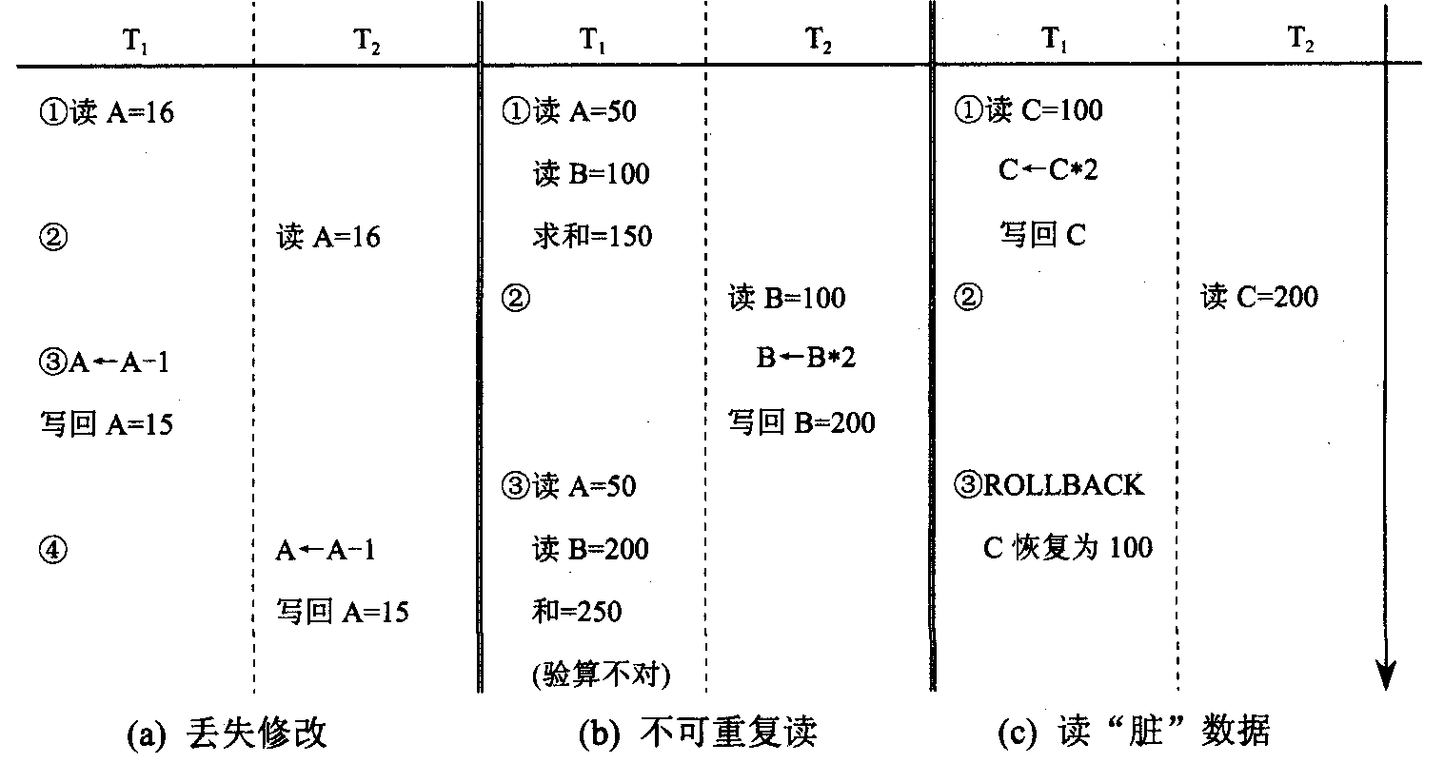
三种数据不一致性

Slide 102
封锁(Locking)
封锁是实现并发控制的一个非常重要的技术
封锁就是事务T在对某个数据对象操作之前，先向系统发出请求，对其加锁。在事务T释放它的锁之前，其他的事务不能更新此数据对象

Slide 103
封锁类型
排它锁(Exclusive Locks ，简称X锁或写锁)
  若事务T对数据对象A加上X锁，则只允许T读取和修改A，其他任何事务都不能再对A加任何类型的锁，直到T释放A上的锁。
共享锁(Share Locks，简称S锁或读锁)
  若事务T对数据对象A加上S锁，则事务T可以读A但不能修改A，其他事务只能再对A加S锁，而不能加X锁，直到T释放A上的S锁。

Slide 104
封锁类型的相容矩阵
T₂
Comp S X —
S
X
—
T₁
T
F
T
F
F
T
T
T
T

Slide 105
封锁协议
对数据对象加锁时，需要约定一些规则，例如何时申请X锁或S锁、持锁时间、何时释放等，称这些规则为封锁协议(Locking Protocol)
对封锁方式规定不同的规则，就形成了各种不同的封锁协议
不同级别的封锁协议达到的系统一致性是不同的

Slide 106
一级封锁协议
事务T在修改数据R之前必须先对其加X锁，直到事务结束才释放
一级封锁协议可防止丢失修改，并保证事务T是可恢复的
在一级封锁协议中，不能保证可重复读和不读“脏”数据

Slide 107
二级封锁协议
一级封锁协议加上事务T在读取数据R之前必须先对其加S锁，读完后即可释放S锁
在二级封锁协议中，由于读完数据后即可释放S锁，所以它不能保证可重复读

Slide 108
三级封锁协议
一级封锁协议加上事务T在读取数据R之前必须先对其加S锁，直到事务结束才释放
三级封锁协议除防止了丢失修改和不读“脏”数据外，还进一步防止了不可重复读

Slide 109
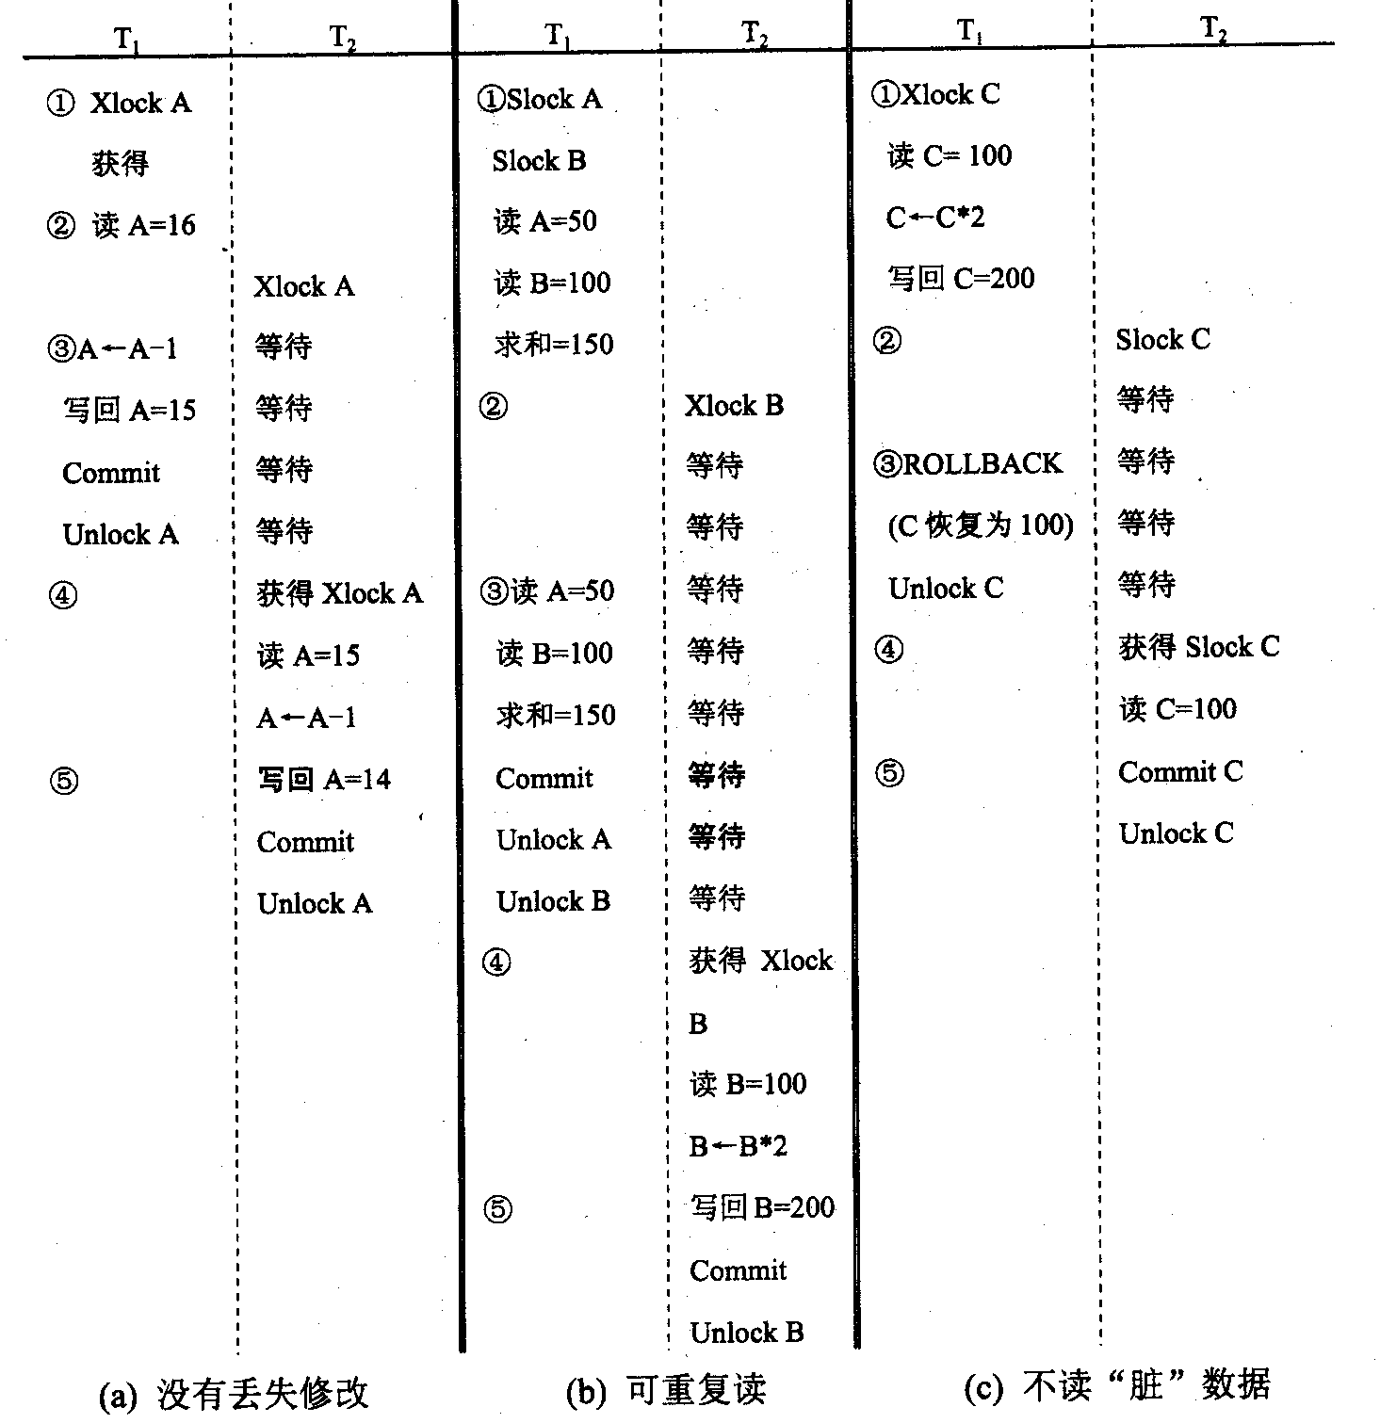

Slide 110
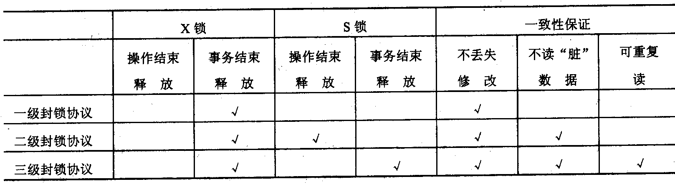
不同级别的封锁协议

Slide 111
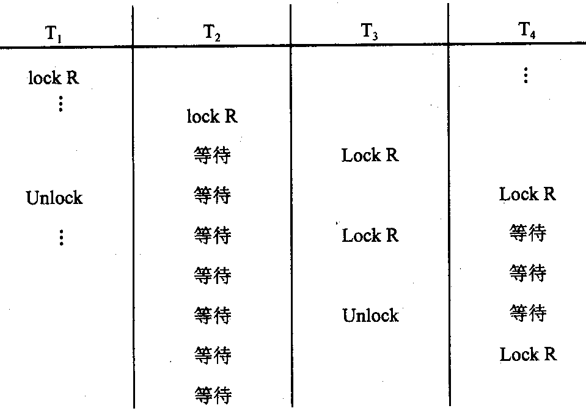
活 锁
避免活锁的简单方法是采用先来先服务的策略

Slide 112
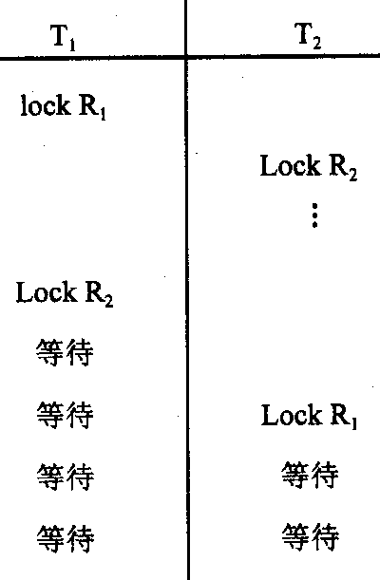
死 锁
解决死锁主要有两种方法
  采取一定措施来预防死锁的发生
  采用一定手段定期诊断系统中有无死锁，若有则解除之

Slide 113
死锁的预防
一次封锁法
  要求每个事务必须一次将所有要使用的数据全部加锁，否则就不能继续执行
顺序封锁法
  预先将数据对象规定一个封锁顺序，所有事务都按这个顺序实行封锁

Slide 114
死锁的诊断与解除
超时法
  事务的等待时间超过了规定的时限，就认为发生了死锁
  可能误判死锁
  时限若设置得太长，死锁发生后不能及时发现
等待图法
  并发控制子系统周期性地检测事务等待图，如果发现图中存在回路，则表示系统中出现了死锁
解除死锁的方法是选择一个处理死锁代价最小的事务，将其撤消，释放此事务持有的所有的锁，使其他事务得以继续运行下去

Slide 115
并发调度的可串行性
多个事务的并发执行是正确的，当且仅当其结果与按某一次序串行地执行它们时的结果相同，则称这种调度策略为可串行化(Serializable)
可串行化是并发事务正确性的准则
一个给定的并发调度，当且仅当它是可串行化的，才认为是正确的调度

