Slide 1
Schema Design and Refinement
We have designed ER diagram, and translated it into a relational db schema R = set of R1, R2, ...
Now what?
We can do the following
  specify all relevant constraints over R
  implement R in SQL
  start using it, making sure the constraints always remain valid
However, R may not be well-designed, thus causing us a lot of problems

Slide 2
Example of Bad Design
Persons with several phones:
Name SSN Phone Number
Fred 123-321-99 (201) 555-1234
Fred 123-321-99 (206) 572-4312
Joe 909-438-44 (908) 464-0028
Joe 909-438-44 (212) 555-4000
Problems (also called “Anomalies”异常):
Redundancy = repetition of data
update anomalies = update one item and forget others
= inconsistencies
deletion anomalies = delete many items,
delete one item, loose other information
insertion anomalies = can't insert one item without inserting others

Slide 3
Better Designs Exist
Break the relation into two:
SSN Name
123-321-99 Fred
909-438-44 Joe
SSN Phone Number
123-321-99 (201) 555-1234
123-321-99 (206) 572-4312
909-438-44 (908) 464-0028
909-438-44 (212) 555-4000

Slide 4
模式设计的重要性
建立一个描述学生情况的数据库，已知对象有：
学生（用学号SNO描述）
系（用系名SDEPT描述）
系负责人（用其姓名MN描述）
课程（用课程名CNAME描述）
成绩（G）
SNO
CNAME
SDEPT
MN
G

Slide 5
模式设计的重要性
1、S(SNO, SEDPT, MN, CNAME, G)
2、S(SNO, CNAME, G) D(DEPT, MN)
3、S(SNO, CNAME, G) SD(SNO, SDEPT, MN)
4、S(SNO, CNAME, G) SD(SNO, SDEPT)
SM(SNO, MN)
5、S(SNO, CNAME, G) SD(SNO, SDEPT)
DM(SDEPT, MN)
关键解决插入异常、删除异常和冗余太大的问题

Slide 6
How do We Obtain a Good Design?
Start with the original db schema R
Transform it until we get a good design R*
Desirable properties for R*
  must preserve the information of R
  must have minimal amount of redundancy
  must be dependency-preserving
    if R is associated with a set of constraints C, then it should be easy to also check C over R*
  (must also give good query performance)

Slide 7
OK, But ...
How do we recognize a good design R*?
How do we transform R into R*?
Answers: use normal forms

Slide 8
Normal Forms(范式)
DB gurus have developed many normal forms
Most important ones
  Boyce-Codd, 3rd, and 4th normal forms
If R* is in one of these forms, then R* is guaranteed to achieve certain good properties
  e.g., if R* is in Boyce-Codd NF, it is guaranteed to not have certain types of redundancy
DB gurus have also developed algorithms to transform R into R* that is in some of these normal forms
Notes:
数据库大师已经开发出许多常规形式
最重要的
博伊斯 - 科德，第三和第四正常形式
如果R *处于这些形式之一，则R *保证达到某些良好性能
例如，如果R *在Boyce-Codd NF中，则保证不具有某些类型的冗余
数据库大师们还开发了将R转换为R *的算法，这些R *都是这些正常形式中的一部分

Slide 9
Normal Forms (cont.)
DB gurus have also discussed trade-offs among normal forms
Thus, all we have to do is
  learn these forms
  transform R into R* in one of these forms
  carefully evaluate the trade-offs
Many of these normal forms are defined based on various constraints
  functional dependencies and keys
Notes:
DB大师们也讨论了正常形式之间的权衡
因此，我们所要做的就是
学习这些形式
以这些形式之一将R转换为R *
仔细评估权衡
这些正常形式中的许多是基于各种限制来定义的
函数依赖和键

Slide 10
Our Attack Plan
Motivation
Functional dependencies & keys
Reasoning with FDs and keys
Desirable properties of schema refinement
Various normal forms and the trade-offs
  BCNF, 3rd normal form, 4th normal form, etc.
Putting all together: how to design DB schema

Slide 11
Functional Dependencies
A form of constraint (hence, part of the schema)
Finding them is part of the database design
Used heavily in schema refinement
Definition:
If two tuples agree on the attributes
A , A , … A
1
2
n
then they must also agree on the attributes
B , B , … B
1
2
m
Formally:
A , A , … A
B , B , … B
1
2
n
1
2
m
Notes:
函数依赖
一种约束形式（因此，模式的一部分）
找到它们是数据库设计的一部分
在架构细化中大量使用

Slide 12
Examples
EmpID Name, Phone, Position
Position Phone
but Phone Position
EmpID
Name
Phone
Position
E0045
Smith
1234
Clerk
E1847
John
9876
Salesrep
E1111
Smith
9876
Salesrep
E9999
Mary
1234
lawyer
注意：在数据库开发过程中，函数依赖（FDs）一般是用户给出的领域知识描述。如果从已有数据中找寻FDs，属于知识发现或数据挖掘。

Slide 13
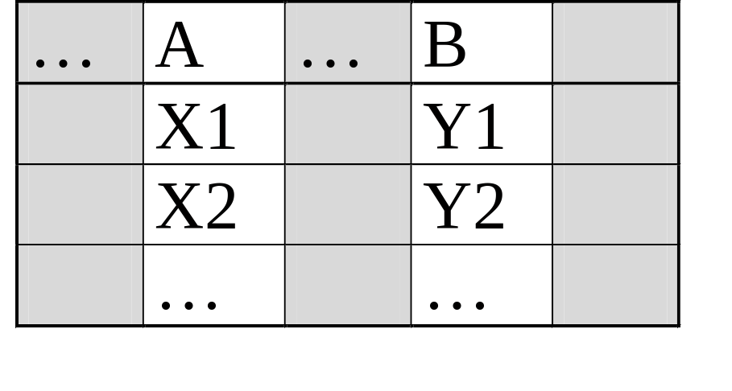
In General
To check A B, erase all other columns
check if the remaining relation is many-one (called functional in mathematics)

Slide 14
思考
If AB->C then A->C，B->C ？
If A->BC then A->B，A->C ？
If A->B and B->C then A->C ？

Slide 15
Relation Keys
After defining FDs, we can now define keys
Key of a relation R is a set of attributes that
  functionally determines all attributes of R
  none of its subsets determines all attributes of R
Superkey
  a set of attributes that contains a key
We will need to know the keys of the relations in a DB schema, so that we can refine the schema
Notes:
定义了FD后，我们现在可以定义键
关系R的键是一组属性
功能上确定R的所有属性
它的子集都没有确定R的所有属性
超键：
一组包含键的属性
我们需要知道数据库模式中关系的键，以便我们可以优化模式

Slide 16
Finding the Keys of a Relation
Given a relation constructed from an E/R diagram, what is its key?
Rules:
1. If the relation comes from an entity set,
the key of the relation is the set of attributes which is the
key of the entity set.
Person
Person(address, name, ssn)
address
name
ssn

Slide 17
Finding the Keys
Rules:
2. If the relation comes from a many-many relationship, the key of the relation is the set of all attribute keys in the relations corresponding to the entity sets
name
buys
Product
Person
price
name
ssn
date
buys(name, ssn, date)

Slide 18
Finding the Keys
But: if there is an arrow from the relationship to E, then
we don’t need the key of E as part of the relation key.
Product
sname
name
Purchase
Store
card-no
Payment Method
Person
ssn
Purchase(name , sname, ssn, card-no)
Notes:
注意看加粗部分，然后理解

Slide 19
Finding the Keys
More rules:
Many-one, one-many, one-one relationships
Multi-way relationships
Weak entity sets
(Try to find them yourself, check book)

Slide 20
Reasoning with FDs
1) closure of FD sets
2) closure of attribute sets

Slide 21
Closure of FD sets
（函数依赖集合的闭包）
Given a relation schema R & a set S of FDs
  is the FD f logically implied by S?
Example
  R = {A,B,C,G,H,I}
  S = A ➔B, A ➔C, CG ➔ H, CG ➔ I, B ➔ H
  would A ➔ H be logically implied?
  yes (you can prove this, using the definition of FD)
Closure of S: S+ = all FDs logically implied by S
How to compute S+?
  we can use Armstrong's axioms
Notes:
S的闭包： S的所有函数依赖可以推出

Slide 22
Armstrong's Axioms
Reflexivity rule（反身性）
  A1A2...An ➔ a subset of A1A2...An
Augmentation rule（扩充规则）
  A1A2...An ➔ B1B2...Bm, then
  A1A2...An C1C2..Ck ➔ B1B2...Bm C1C2...Ck
Transitivity rule（传递性规则）
  A1A2...An ➔ B1B2...Bm and
  B1B2...Bm ➔ C1C2...Ck, then
  A1A2...An ➔ C1C2...Ck
Notes:
该定理用来计算S的闭包

Slide 23
Additional Rules
Union rule
  X ➔ Y and X ➔ Z, then X ➔ YZ
  (X, Y, Z are sets of attributes)
Decomposition rule
  X ➔ YZ, then X ➔ Y and X ➔ Z
Pseudo-transitivity rule
  X ➔ Y and YZ ➔ U, then XZ ➔ U
These rules can be inferred from Armstrong's axioms
Notes:
·合并规则
X ➔ Y and X ➔ Z, then X ➔ YZ
分解规则
X ➔ YZ, then X ➔ Y and X ➔ Z
伪传递性规则
X ➔ Y and YZ ➔ U, then XZ ➔ U

Slide 24
Inferring S+ using Armstrong's Axioms
S⁺ = S
Loop
  foreach f in S, apply reflexivity and augment. rules
  add the new FDs to S⁺
  foreach pair of FDs in S, apply the transitivity rule
  add the new FD to S⁺
Until S⁺ does not change any further

Slide 25
Closure of a Set of Attributes
Given a set of attributes {A1, …, An} and a set of dependencies S.
Problem: find all attributes B such that:
any relation which satisfies S also satisfies:
A1, …, An B
The closure of {A1, …, An}, denoted {A1, …, An} ,
is the set of all such attributes B
We will discuss the motivations for attribute closures soon
+
Notes:
给定一组属性{A1，...，An}和一组依赖关系S.
问题：找到所有属性B，使得：
任何满足S的关系也满足：
A1……An，-》B

Slide 26
Algorithm to Compute Closure
Start with X={A1, …, An}.
Repeat until X doesn’t change do:
if B₁,B₂, …, B_{n} C is in S, and
B₁,B₂, …, B_{n} are all in X, and
C is not in X
then
add C to X.

Slide 27
Example
A B C
A D E
B D
A F B
Closure of {A,B}: X = {A, B, C, D, E}
Closure of {A, F}: X = {A, F, B, D, C, E}

Slide 28
How to find key?
Key of a relation R is a set of attributes that
  functionally determines all attributes of R
  none of its subsets determines all attributes of R
已知R(A,B,C,D,E,…)，R的码是这样一组属性集合S，S的闭包含有R的所有属性，S的子集不能包含R的所有属性。
求码的启发式算法：
不在任何函数依赖右边出现的属性必是码的一部分

Slide 29
Usage for Attribute Closure
Test if X is a superkey
  compute X+, and check if X+ contains all attrs of R
Check if X ➔ Y holds
  by checking if Y is contained in X+
Another way to compute closure S⁺ of FDs
  for each subset of attributes X in relation R, compute X⁺
  for each subset of attributes Y in X⁺, output the FD
  X ➔ Y
Notes:
测试X是否是超级键
计算X +，并检查X +是否包含R的所有属性
检查X➔Y是否成立
通过检查Y是否包含在X +中
计算FD的闭包S +的另一种方法
对于关系R中属性X的每个子集，计算X +
对于X +中的每个属性Y子集，输出FD？X？Y

Slide 30
1) minimize redundancy
2) avoid info loss
3) preserve dependency
4) ensure good query performance
Desirable Properties of
Schema Refinement

Slide 31
Relational Schema Design
(or Logical Design)
Conceptual Model:
name
buys
Product
Person
price
name
ssn
Relational Model:
- create tables
- specify FD’s
- find keys
Normalization
- use FDs to
decompose tables
to achieve better design

Slide 32
Recall: Relation Decomposition
The original relation schema
Name SSN Phone Number
Fred 123-321-99 (201) 555-1234
Fred 123-321-99 (206) 572-4312
Joe 909-438-44 (908) 464-0028
Joe 909-438-44 (212) 555-4000

Slide 33
Relation Decomposition (cont.)
Break the relation into two:
SSN Name
123-321-99 Fred
909-438-44 Joe
SSN Phone Number
123-321-99 (201) 555-1234
123-321-99 (206) 572-4312
909-438-44 (908) 464-0028
909-438-44 (212) 555-4000
Desirable Property #1: Minimize redundancy

Slide 34
Decompositions in General
Let R be a relation with attributes
A , A , … A
1
2
n
Create two relations R1 and R2 with attributes
B , B , … B
C , C , … C
1
2
m
1
2
t
Such that:
B , B , … B
∪
C , C , … C
=
A , A , … A
1
2
m
1
2
t
1
2
n
And
-- R1 is the projection of R on
-- R2 is the projection of R on
B , B , … B
1
2
m
C , C , … C
1
2
t

Slide 35
Certain Decomposition May Cause Problems
Name
Price
Category
Gizmo
19.99
Gadget
OneClick
24.99
Camera
DoubleClick
29.99
Camera
Decompose on : Name, Category and Price, Category
Name
Category
Price
Category
Gizmo
Gadget
19.99
Gadget
OneClick
Camera
24.99
Camera
DoubleClick
Camera
29.99
Camera
Name
Price
Category
Gizmo
19.99
Gadget
When we put it back:
OneClick
24.99
Camera
OneClick
29.99
Camera
Cannot recover information
DoubleClick
24.99
Camera
DoubleClick
29.99
Camera

Slide 36
Lossless Decompositions（无损分解）
A decomposition is lossless if we can recover:
R(A,B,C)
R1(A,B) R2(A,C)
R’(A,B,C) should be the same as
R(A,B,C)
Decompose
Recover
R’ is in general larger than R. Must ensure R’ = R
Desirable Property #2: Lossless decomposition

Slide 37
Put Another Way: "Lossless" Joins
The main idea: if you decompose a relation schema, then join the parts of an instance via a natural join, you might get more rows than you started with, i.e., spurious tuples
  This is bad!
  Called a "lossy join".
Goal: decompositions which produce only "lossless" joins
  "non-additive" join is more descriptive
Notes:
主要思想：如果你分解一个关系模式，然后通过一个自然连接加入一个实例的部分，你可能会得到比你刚开始时更多的行，即假元组
这不好！
称为“有损连接”。
目标：仅产生“无损”连接的分解
“非加法”连接更具描述性

Slide 38
Dependency Preserving
（保持函数依赖）
Given a relation R and a set of FDs S
Suppose we decompose R into R1 and R2
Suppose
  R1 has a set of FDs S1
  R2 has a set of FDs S2
  S1 and S2 are computed from S
We say the decomposition is dependency preserving if by enforcing S1 over R1 and S2 over R2, we can enforce S over R
(S1 ∪S2)⁺ = S⁺

Slide 39
An Example
Unit Company Product
FD’s: Unit → Company; Company, Product → Unit
So, there is a BCNF violation, and we decompose.
Unit Company
Unit → Company
Unit Product
No FDs

Slide 40
So What’s the Problem?
Unit Company
Unit Product
Galaga99 UI Galaga99 databases
Bingo UI Bingo databases
No problem so far. All local FD’s are satisfied.
Let’s put all the data back into a single table again:
Unit Company Product
Galaga99 UI databases
Bingo UI databases
Violates the dependency: company, product -> unit!

Slide 41
Preserving FDs
What if, when a relation is decomposed, the X of an X→Y ends up only in one of the new relations and the Y ends up only in another?
Such a decomposition is not “dependency-preserving.”
Desirable Property #3: always have FD-preserving decompositions
We will talk about "Desirable Property #4: Ensure Good Query Performance" later

Slide 42
Review
When decomposing a relation R, we want to decomposition to
  minimize redundancy
  avoid info loss
  preserve dependencies (i.e., constraints)
  ensure good query performance
These objectives can be conflicting
Various normal forms achieve parts of the objectives
Notes:
分解关系R时，我们想分解为
最小化冗余
避免信息丢失
保留依赖性（即约束）
确保良好的查询性能
这些目标可能相互冲突
各种正常形式实现部分目标

Slide 43
Normal Forms
First Normal Form = all attributes are atomic
Second Normal Form (2NF) = old and obsolete
Boyce Codd Normal Form (BCNF)
Third Normal Form (3NF)
Fourth Normal Form (4NF)
Others...
Notes:
第一范式=所有属性都是原子的
第二范式（2NF）=旧的和过时的
博伊斯科德范式（BCNF）
第三范式（3NF）
第四范式（4NF）

Slide 44
Recall: What We Want to Do with Normal Forms
Take a relation schema…
Test it against a normalization criterion…
If it passes, fine!
  Maybe test again with a higher criterion
If it fails, decompose into smaller relations
  Each of them will pass the test
  Each can then be tested with a higher criterion

Slide 45
Boyce-Codd Normal Form
A relation R is in BCNF if and only if:
Whenever there is a nontrivial FD
for R , it is the case that { }
is a super-key for R.
  Remember: nontrivial means A is not a member of set X.(X-> A)
  Remember, a superkey is any superset of a key (not necessarily a proper superset).
A , A , … A
B
1
2
n
A , A , … A
1
2
n
In English (though a bit vague):
Whenever a set of attributes of R is determining another attribute,
it should determine all attributes of R.
Notes:
关系R是BCNF 当且仅当 非平凡函数依赖A1,A2,…,An->B ,箭头左边是超键

Slide 46
Example
Name SSN Phone Number
Fred 123-321-99 (201) 555-1234
Fred 123-321-99 (206) 572-4312
Joe 909-438-44 (908) 464-0028
Joe 909-438-44 (212) 555-4000
What are the dependencies?
SSN Name
What are the keys?
Is it in BCNF?

Slide 47
Decompose it into BCNF
SSN Name
123-321-99 Fred
909-438-44 Joe
SSN Name
SSN Phone Number
123-321-99 (201) 555-1234
123-321-99 (206) 572-4312
909-438-44 (908) 464-0028
909-438-44 (212) 555-4000

Slide 48
Decomposition into BCNF
Given: relation R with FD’s F.
Look among the given FD’s for a BCNF violation X ->B.
  If any FD following from F violates BCNF, then there will surely be an FD in F itself that violates BCNF.
Compute X ⁺.
  Not all attributes, or else X is a superkey.

Slide 49
Decompose R Using X -> B
Replace R by relations with schemas:
  R₁ = X ⁺.
  R₂ = R – (X ⁺ - X ).
Project given FD’s F onto the two new relations.
  Compute the closure of F = all nontrivial FD’s that follow from F.
  Use only those FD’s whose attributes are all in R₁ or all in R₂.

Slide 50
Decomposition Picture
R₁
R-X ⁺
X
X ⁺-X
R₂
R

Slide 51
BCNF Decomposition
Find a dependency that violates the BCNF condition:
A , A , … A
B , B , … B
1
2
n
1
2
m
Heuristics: choose B , B , … B “as large as possible”
1
2
m
Decompose:
Continue until
there are no
BCNF violations
left.
Others
A’s
B’s
Any
2-attribute
relation is
in BCNF.
R1
R2

Slide 52
Example Decomposition
Person:
Name SSN Age EyeColor PhoneNumber
Functional dependencies:
SSN Name, Age, Eye Color
BNCF: Person1(SSN, Name, Age, EyeColor),
Person2(SSN, PhoneNumber)
What if we also had an attribute Draft-worthy, and the FD:
Age Draft-worthy

Slide 53
Example
Drinkers(name, addr, beersLiked, manf, favBeer)
F = name->addr, name -> favBeer, beersLiked->manf
Pick BCNF violation name->addr.
Close the left side: {name}⁺ = {name, addr, favBeer}.
Decomposed relations:
  Drinkers1(name, addr, favBeer)
  Drinkers2(name, beersLiked, manf)

Slide 54
Example, Continued
We are not done; we need to check Drinkers1 and Drinkers2 for BCNF.
Projecting FD’s is complex in general, easy here.
For Drinkers1(name, addr, favBeer), relevant FD’s are name->addr and name->favBeer.
  Thus, {name} is the only key and Drinkers1 is in BCNF.

Slide 55
Example, Continued
For Drinkers2(name, beersLiked, manf), the only FD is beersLiked->manf, and the only key is {name, beersLiked}.
  Violation of BCNF.
beersLiked⁺ = {beersLiked, manf}, so we decompose Drinkers2 into:
  Drinkers3(beersLiked, manf)
  Drinkers4(name, beersLiked)

Slide 56
Example, Concluded
The resulting decomposition of Drinkers :
  Drinkers1(name, addr, favBeer)
  Drinkers3(beersLiked, manf)
  Drinkers4(name, beersLiked)
Notice: Drinkers1 tells us about drinkers, Drinkers3 tells us about beers, and Drinkers4 tells us the relationship between drinkers and the beers they like.

Slide 57
Thus,
BCNF removes certain types of redundancy
For examples of redundancy that it cannot remove, see "multivalued redundancy" later
BCNF avoids info loss
Notes:
BCNF 删除某些类型的冗余
避免信息丢失

Slide 58
However,
BCNF is not always dependency preserving
In fact, some times we cannot find a BCNF decomposition that is dependency preserving
Can handle this situation using 3NF
See next few slides for example

Slide 59
Third Normal Form - Motivation
There is one structure of FD’s that causes trouble when we decompose.
AB ->C and C ->B.
  Example: A = street address, B = city, C = zip code.
There are two keys, {A,B } and {A,C }.
C ->B is a BCNF violation, so we must decompose into AC, BC.

Slide 60
We Cannot Enforce FD’s
The problem is that if we use AC and BC as our database schema, we cannot enforce the FD AB ->C by checking FD’s in these decomposed relations.
Example with A = street, B = city, and C = zip on the next slide.

Slide 61
An Unenforceable FD
street zip
545 Tech Sq. 02138
545 Tech Sq. 02139
city zip
Cambridge 02138
Cambridge 02139
Join tuples with equal zip codes.
street city zip
545 Tech Sq. Cambridge 02138
545 Tech Sq. Cambridge 02139
Although no FD’s were violated in the decomposed relations,
FD street city -> zip is violated by the database as a whole.

Slide 62
3NF Let’s Us Avoid This Problem
3rd Normal Form (3NF) modifies the BCNF condition so we do not have to decompose in this problem situation.
An attribute is prime if it is a member of any key.
X ->A violates 3NF if and only if X is not a superkey, and also A is not prime.
Notes:
第三范式（3NF）修改了BCNF条件，所以在这种问题情况下我们不必分解。如果属性是任何键的成员，则属性为主键。X - > A违反了3NF当且仅当X不是超级键，并且A不是主键

Slide 63
Example
In our problem situation with FD’s
AB ->C and C ->B, we have keys AB and AC.
Thus A, B, and C are each prime.
Although C ->B violates BCNF, it does not violate 3NF.

Slide 64
What 3NF and BCNF Give You
There are two important properties of a decomposition:
  Recovery : it should be possible to project the original relations onto the decomposed schema, and then reconstruct the original.
  Dependency Preservation : it should be possible to check in the projected relations whether all the given FD’s are satisfied.
Notes:
分解有两个重要特性：
恢复：应该可以将原始关系投影到已分解的模式上，然后重建原始数据。
依赖性保存：应该可以检查投影关系是否满足所有给定的FD

Slide 65
3NF and BCNF, Continued
We can get (1) with a BCNF decomposition.
  Explanation needs to wait for relational algebra.
We can get both (1) and (2) with a 3NF decomposition.
But we can’t always get (1) and (2) with a BCNF decomposition.
  street-city-zip is an example.

Slide 66
Multivalued Dependencies
Fourth Normal Form
Notes:
多值依赖
第四范式

Slide 67
A New Form of Redundancy
Multivalued dependencies (MVD’s) express a condition among tuples of a relation that exists when the relation is trying to represent more than one many-many relationship.
Certain attributes are independent of one another, and their values must appear in all combinations.
Notes:
一种新的冗余形式
多值依赖关系（MVD）表示当关系试图表示一个以上多对多关系时存在的关系的元组之间的条件。
某些属性彼此独立，其值必须以所有组合出现。

Slide 68
Example
Drinkers(name, addr, phones, beersLiked)
A drinker’s phones are independent of the beers they like.
Thus, each of a drinker’s phones appears with each of the beers they like in all combinations.
This repetition is unlike FD redundancy.
  name->addr is the only FD.

Slide 69
Tuples Implied by Independence
If we have tuples:
name addr phones beersLiked
sue a p1 b1
sue a p2 b2
sue a p2 b1
sue a p1 b2
Then these tuples must also be in the relation.

Slide 70
Definition of MVD
A multivalued dependency (MVD) X ->->Y is an assertion that if two tuples of a relation agree on all the attributes of X, then their components in the set of attributes Y may be swapped, and the result will be two tuples that are also in the relation.
Notes:
多值依赖（MVD）X - > - > Y是一个断言，
如果一个关系的两个元组在X的所有属性上一致，
那么它们在属性集合Y中的元素可以被交换，结果将是关系中的两个元组。

Slide 71
Example
The name-addr-phones-beersLiked example illustrated the MVD
name->->phones
and the MVD
name ->-> beersLiked.

Slide 72
Picture of MVD X ->->Y
X Y others
equal
exchange

Slide 73
MVD Rules
Every FD is an MVD (promotion ).
  If X ->Y, then swapping Y ’s between two tuples that agree on X doesn’t change the tuples.
  Therefore, the “new” tuples are surely in the relation, and we know X ->->Y.
Complementation : If X ->->Y, and Z is all the other attributes, then X ->->Z.
Notes:
FD提升规则：每一个FD都是MVD
即如果：X->Y，则X->->Y
互补规则：
如果X->->Y，并且Z是R中不属于A和B的所有其他属性的集合
则：
X->->Z
Ps: 该规则说明，在两个具有相同X属性值的元组间交换Y和Z的效果相同

Slide 74
Splitting Doesn’t Hold
Like FD’s, we cannot generally split the left side of an MVD.
But unlike FD’s, we cannot split the right side either --- sometimes you have to leave several attributes on the right side.
Notes:
分裂不成立
像FD一样，我们通常不能分割MVD的左侧。
但与FD不同的是，我们不能分裂右侧---有时候你必须在右侧留下几个属性。

Slide 75
Example
Drinkers(name, areaCode, phone, beersLiked, manf)
A drinker can have several phones, with the number divided between areaCode and phone (last 7 digits).
A drinker can like several beers, each with its own manufacturer.
Notes:
Drinkers(name, areaCode, phone, beersLiked, manf)
饮酒者可以有几部电话，号码分为areaCode和电话（最后7位数字）。
饮酒者可以喜欢几种啤酒，每种都有自己的制造商。

Slide 76
Example, Continued
Since the areaCode-phone combinations for a drinker are independent of the beersLiked-manf combinations, we expect that the following MVD’s hold:
name ->-> areaCode phone
name ->-> beersLiked manf
Notes:
由于饮酒者的areaCode-phone组合与啤酒Liked-manf组合无关，因此我们预计以下MVD的保留：
名称 - > - > areaCode手机
名字 - > - > beersLiked manf

Slide 77
Example Data
Here is possible data satisfying these MVD’s:
name areaCode phone beersLiked manf
Sue 650 555-1111 Bud A.B.
Sue 650 555-1111 WickedAle Pete’s
Sue 415 555-9999 Bud A.B.
Sue 415 555-9999 WickedAle Pete’s
But we cannot swap area codes or phones by themselves.
That is, neither name ->-> areaCode nor name ->-> phone
holds for this relation.

Slide 78
Fourth Normal Form
The redundancy that comes from MVD’s is not removable by putting the database schema in BCNF.
There is a stronger normal form, called 4NF, that (intuitively) treats MVD’s as FD’s when it comes to decomposition, but not when determining keys of the relation.
Notes:
4NF:当涉及到分解，而不是决定关系的码时，可将MVD看作FD

Slide 79
4NF Definition
A relation R is in 4NF if whenever X ->->Y is a nontrivial MVD, then X is a superkey.
  Nontrivial means that:
    Y is not a subset of X, and
    X and Y are not, together, all the attributes.
  Note that the definition of “superkey” still depends on FD’s only.
Notes:
如果每当X - > - > Y是非平凡的MVD(多值函数依赖)，则关系R在4NF中，那么X是超级键。
非平凡意味着：
Y不是X的子集，而且
X和Y并不是所有的属性。
请注意，“superkey”的定义仍然仅取决于FD。

Slide 80
BCNF Versus 4NF
Remember that every FD X ->Y is also an MVD, X ->->Y.
Thus, if R is in 4NF, it is certainly in BCNF.
  Because any BCNF violation is a 4NF violation.
But R could be in BCNF and not 4NF, because MVD’s are “invisible” to BCNF.
Notes:
请记住，每个FD X - > Y也是一个MVD，X - > - > Y。
因此，如果R在4NF中，肯定在BCNF中。
因为任何BCNF违规是4NF违规。
但是R可能在BCNF而不是4NF，因为MVD对BCNF是“不可见的”。

Slide 81
Decomposition and 4NF
If X ->->Y is a 4NF violation for relation R, we can decompose R using the same technique as for BCNF.
  XY is one of the decomposed relations.
  All but Y – X is the other.

Slide 82
Example
Drinkers(name, addr, phones, beersLiked)
FD: name -> addr
MVD’s: name ->-> phones
name ->-> beersLiked
Key is {name, phones, beersLiked}.
All dependencies violate 4NF.

Slide 83
Example, Continued
Decompose using name -> addr:
Drinkers1(name, addr)
  In 4NF; only dependency is name -> addr.
Drinkers2(name, phones, beersLiked)
  Not in 4NF. MVD’s name ->-> phones and name ->-> beersLiked apply. No FD’s, so all three attributes form the key.

Slide 84
Example: Decompose Drinkers2
Either MVD name ->-> phones or name ->-> beersLiked tells us to decompose to:
  Drinkers3(name, phones)
  Drinkers4(name, beersLiked)

Slide 85
思考题
Relation R(A，B，C) satisfies the multi-valued dependency A→→B, and has (possibly among others) the following tuples in its current instance: (0, 1, 2), (0, 3, 4), and (1, 5, 6).
Which of the following tuples is not necessarily in the current instance of R?
(0; 1; 4) (b) (0; 3; 2) (c) (0; 5; 2) (d) None of the above.

Slide 86
The following three questions refer to a relation R(A, B, C, D,E) with functional dependencies A→B, BC→D, and E→C.
Question 1: The number of keys of R is:
(a) 1 (b) 2 (c) 8 (d) 11
Question 2: Which of the following functional dependency does not necessarily hold in R?
(a) AC → D (b) AE → C (c) BC → B (d) CE → D
Question 3: If we project R onto S(B, C, D, E), which of he following functional dependencies holds in S and also does not violate the BCNF condition for S?
(a) BC → D (b) BE → D (c) B → E (d) E → C

Slide 87
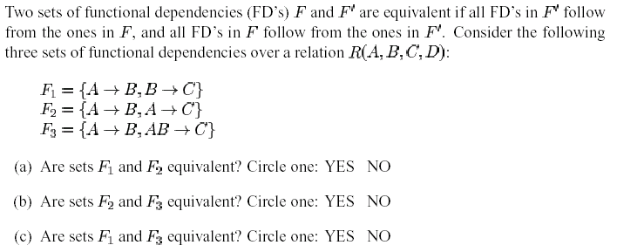

Slide 88
判断无损连接分解的算法
已知R<U,F>，U={A,B,C,D,E}
F={AB →C, C →D, D →E}
R的一个分解R1(A,B,C),R2(C,D),R3(D,E)
已知R<U,F>，U={A,B,C,D,E}
F={A→C,B→C, C →D, DE →C,CE →A}
R的一个分解R1(A,D),R2(A,B),R3(B,E),R4(C,D,E),R5(A,E)

Slide 89
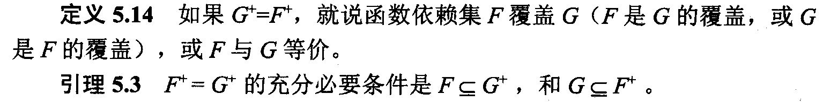
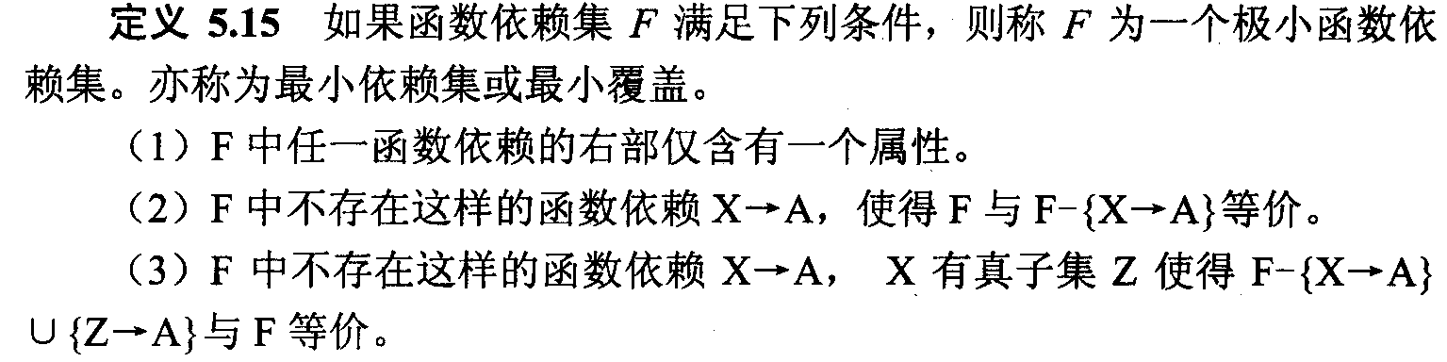
最小函数依赖集

Slide 90
举例
U={SNO, SDEPT, MN, CNAME, G}
F={SNO→SDEPT, SNO→MN, SDEPT→MN, (SNO,CNAME)→G, (SNO,SDEPT)→SDEPT}
F的最小依赖集不一定是唯一的
F={A→B, B→A, B→C, A→C, C→A}

Slide 91


First Normal Form (1NF)
All columns (fields) must be atomic
  Means : no repeating items in columns
Solution: make a separate table for each set of attributes with a primary key (parser, append query)
Customers
CustomerID
Name
Orders
OrderID
Item CustomerID
OrderDate

Slide 92
2NF
若R∈1NF，且每一个非主属性完全函数依赖于码，则R ∈2NF.
S-L-C(SNO, SDEPT, SLOC, CNO, G)
  码 ( SNO, CNO )
  非主属性 SDEPT, SLOC, G
  ( SNO, CNO ) → SDEPT
  R ∉ 2NF
不属于2NF的关系模式会产生插入异常、删除异常和修改困难
p

Slide 93
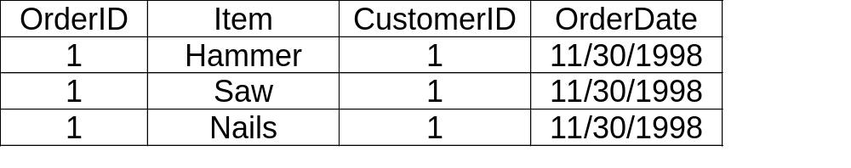
Second Normal Form (2NF)
In 1NF and every non-key column is fully dependent on the (entire) primary key
  Means : Do(es) the key field(s) imply the rest of the fields? Do we need to know both OrderID and Item to know the Customer and Date? Clue: repeating fields
Solution: Remove to a separate table (Make Table)
Orders
OrderID
CustomerID
OrderDate
OrderDetails
OrderID
Item

Slide 94
思考题
下列关系模式最高属于第几范式：
  R(ABCD), F={B→D,AB→C}
  R(ABCDE),F={AB→CE,E→AB,C→D}
  R(ABCD),F={B→D,D→B,AB→C}
  R(ABC),F={A→B,B→A,A→C}
  R(ABC),F={A→B,B→A,C→A}
  R(ABCD),F={A→C,D→B}
  R(ABCD),F={A→C,CD→B}
Notes:
key: (AB) 1NF
Key: E, (AB) 2NF
Key: (AB) (AD) 3NF
Key: A,B BCNF
Key: C 2NF
Key: A, D BCNF
Key: (AD) 1NF

Slide 95
Normalization Summary
1NF: usually part of the woodwork
2NF: usually skipped
3NF: a biggie
  always aim for this
BCNF and 4NF: tradeoffs start here
  in re: d-preserving and losslessness
5NF: You can say you've heard of it...

Slide 96
Caveat
Normalization is not the be-all and end-all of DB design
Example: suppose attributes A and B are always used together, but normalization theory says they should be in different tables.
  decomposition might produce unacceptable performance loss (extra disk reads)
Plus -- there are constraints other than FDs and MVDs

Slide 97
Current Trends
Object DBs and Object-Relational DB’s
  may permit complex attributes
  1st normal form unnecessary
Data Warehouses
  huge historical databases, seldom or never updated after creation
  joins expensive or impractical
  argues against normalization
Everyday relational DBs
  aim for BCNF, settle for 3NF

