Slide 1
关系查询语言
(Relational Query Languages )
Formal: Relational Algebra, Relational Calculus, Datalog
Practical: SQL, QUEL, QBE(Query-by-Example)
What is a relational query?
  Input: a number of relations in your database
  Output: one relation as the answer

Slide 2
关系代数（Relational Algebra）
Union, intersection, and difference
Selection: picking certain rows.
Projection: picking certain columns.
Products and joins: compositions of relations.
Renaming of relations and attributes.

Slide 3
Basic Set Operations
Union
R := R₁ ∪ R₂
Intersection
R := R₁ ∩ R₂
Difference
R := R₁ - R₂
Operands must have the same schema

Slide 4
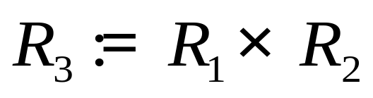
Product
  Pair each tuple t1 of R1 with each tuple t2 of R2.
  Concatenation t1t2 is a tuple of R3.
  Schema of R3 is the attributes of R1 and then R2, in order.
  But beware attribute A of the same name in R1 and R2: use R1.A and R2.A.

Slide 5
Example
R( A B C )
2 5 7
2 6 9
3 6 7
S( A B C )
2 6 9
2 8 9
3 6 7
R×S( R.A R.B R.C S.A S.B S.C )
2 5 7 2 6 9
2 5 7 2 8 9
2 5 7 3 6 9
2 6 9 2 6 9
2 6 9 2 8 9
2 6 9 3 6 7
3 6 7 2 6 9
3 6 7 2 8 9
3 6 7 3 6 7
R∪S( A B C )
2 5 7
2 6 9
3 6 7
2 8 9
R−S( A B C )
2 5 7
R∩S( A B C )
2 6 9
3 6 7

Slide 6
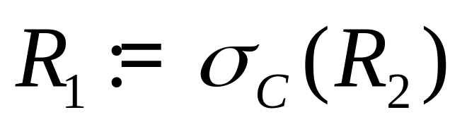
Selection
  C is a condition (as in “if” statements) that refers to attributes of R2.
  R1 is all those tuples of R2 that satisfy C.

Slide 7
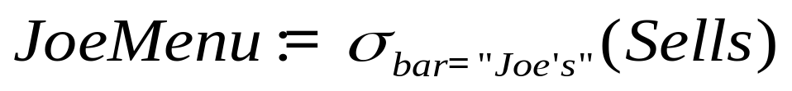
The Example of Selection
Sells
bar beer price
Joe’s Bud 2.50
Joe’s Miller 2.75
Sue’s Bud 2.50
Sue’s Miller 3.00
bar beer price
Joe’s Bud 2.50
Joe’s Miller 2.75

Slide 8
Select Operation – Example
Relation r
A
B
C
D
α
α
β
β
α
β
β
β
1
5
12
23
7
7
3
10
σ_{A=B ^ D > 5} (r)
A
B
C
D
α
β
α
β
1
23
7
10

Slide 9
Composition of Operations
Can build expressions using multiple operations
Example: σ_{A=C}(r x s)
r x s
σ_{A=C}(r x s)
A
B
C
D
E
α
α
α
α
β
β
β
β
1
1
1
1
2
2
2
2
α
β
β
γ
α
β
β
γ
10
19
20
10
10
10
20
10
a
a
b
b
a
a
b
b
A
B
C
D
E
α
β
β
1
2
2
α
β
β
10
20
20
a
a
b

Slide 10
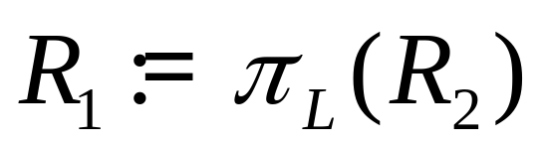
Projection
  L is a list of attributes from the schema of R2.
  R1 is constructed by looking at each tuple of R2, extracting the attributes on list L, in the order specified, and creating from those components a tuple for R1.
  Eliminate duplicate tuples, if any.

Slide 11
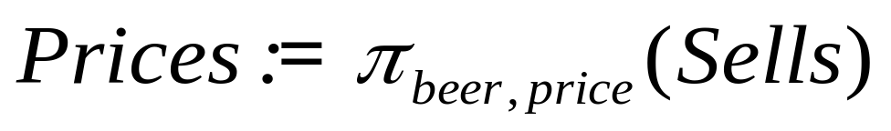
The Example of Projection
Sells
bar beer price
Joe’s Bud 2.50
Joe’s Miller 2.75
Sue’s Bud 2.50
Sue’s Miller 3.00
beer price
Bud 2.50
Miller 2.75
Miller 3.00

Slide 12
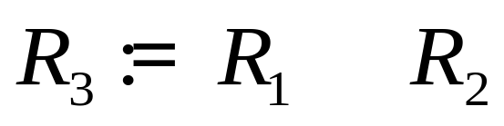

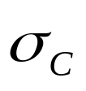
Theta-Join
_{C}
  Take the product
  Then apply to the result.
  C can be any boolean-valued condition.
  Historic versions of this operator allowed only A θ B, where θ is =, <, etc.; hence the name “theta-join.”

Slide 13
Sells( bar, beer, price ) Bars( name, addr )
Joe’s Bud 2.50 Joe’s Maple St.
Joe’s Miller 2.75 Sue’s River Rd.
Sue’s Bud 2.50
Sue’s Coors 3.00
BarInfo := Sells _{Sells.bar = Bars.name} Bars
bar, beer, price, name, addr
Joe’s Bud 2.50 Joe’s Maple St.
Joe’s Bud 2.50 Sue’s River Rd
Joe’s Miller 2.75 Joe’s Maple St.
Joe’s Miller 2.75 Sue’s River Rd.
Sue’s Bud 2.50 Joe’s Maple St.
Sue’s Bud 2.50 Sue’s River Rd.
Sue’s Coors 3.00 Joe’s Maple St.
Sue’s Coors 3.00 Sue’s River Rd.

Slide 14
Example
Sells( bar, beer, price ) Bars( name, addr )
Joe’s Bud 2.50 Joe’s Maple St.
Joe’s Miller 2.75 Sue’s River Rd.
Sue’s Bud 2.50
Sue’s Coors 3.00
BarInfo := Sells _{Sells.bar = Bars.name} Bars
BarInfo( bar, beer, price, name, addr )
Joe’s Bud 2.50 Joe’s Maple St.
Joe’s Miller 2.75 Joe’s Maple St.
Sue’s Bud 2.50 Sue’s River Rd.
Sue’s Coors 3.00 Sue’s River Rd.

Slide 15
Natural Join
A frequent type of join connects two relations by:
  Equating attributes of the same name, and
  Projecting out one copy of each pair of equated attributes.
Called natural join.
Denoted R3 := R1 R2.

Slide 16
Example
Sells( bar, beer, price ) Bars( bar, addr )
Joe’s Bud 2.50 Joe’s Maple St.
Joe’s Miller 2.75 Sue’s River Rd.
Sue’s Bud 2.50
Sue’s Coors 3.00
BarInfo := Sells Bars
Note Bars.name has become Bars.bar to make the natural
join “work.”
BarInfo( bar, beer, price, addr )
Joe’s Bud 2.50 Maple St.
Joe’s Milller 2.75 Maple St.
Sue’s Bud 2.50 River Rd.
Sue’s Coors 3.00 River Rd.

Slide 17
Renaming
The ρ operator gives a new schema to a relation.
R1 := ρ_{R1(A1,…,An)}(R2) makes R1 be a relation with attributes A1,…,An and the same tuples as R2.
Simplified notation: R1(A1,…,An) := R2.
Notes:
不要求掌握

Slide 18
Example
Bars( name, addr )
Joe’s Maple St.
Sue’s River Rd.
R(bar, addr) := Bars
R( bar, addr )
Joe’s Maple St.
Sue’s River Rd.

Slide 19
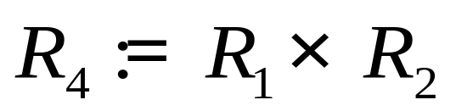
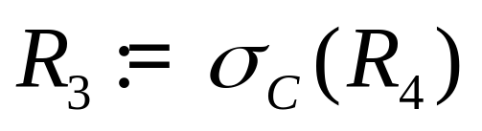
Sequences of Assignments
Create temporary relation names.
Renaming can be implied by giving relations a list of attributes.
Example: can be written:
_{C}

Slide 20
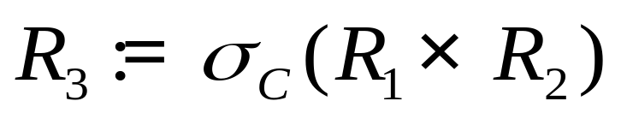
Expressions in a Single Assignment
Example:
_{C}
can be rewritten:

Slide 21
Operator Precedence
Precedence of relational operators:
    Unary operators --- select, project, rename --- have highest precedence, bind first.
    Then come products and joins.
    Then intersection.
    Finally, union and set difference bind last.
But you can always insert parentheses to force the order you desire.

Slide 22
Expression Trees
Leaves are operands --- either variables standing for relations or particular, constant relations.
Interior nodes are operators, applied to their child or children.

Slide 23
Example
Using the relations Bars(name, addr) and Sells(bar, beer, price), find the names of all the bars that are either on Maple St. or sell Bud for less than $3.

Slide 24
As a Tree:
∪
ρ_{R(name)}
π_{name}
π_{bar}
σ_{addr=“Maple St”}
σ_{price<3 AND beer=“bud”}
Bars
Sells

Slide 25
Example
Using Sells(bar, beer, price), find the bars that sell two different beers at the same price.
Strategy: by renaming, define a copy of Sells, called S(bar, beer1, price). The natural join of Sells and S consists of quadruples (bar, beer, beer1, price) such that the bar sells both beers at this price.

Slide 26
The Tree
π_{bar}
σ_{beer != beer1}
ρ_{S(bar, beer1, price)}
Sells
Sells

Slide 27
Schemas for Interior Nodes
An expression tree defines a schema for the relation associated with each interior node.
Similarly, a sequence of assignments defines a schema for each relation on the left of the := sign.

Slide 28
Schema-Defining Rules 1
For union, intersection, and difference, the schemas of the two operands must be the same, so use that schema for the result.
Selection: schema of the result is the same as the schema of the operand.
Projection: list of attributes tells us the schema.

Slide 29
Schema-Defining Rules 2
Product: the schema is the attributes of both relations.
  Use R.A, etc., to distinguish two attributes named A.
Theta-join: same as product.
Natural join: use attributes of both relations.
  Shared attribute names are merged.
Renaming: the operator tells the schema.

Slide 30
Relational Algebra on Bags
A bag is like a set, but an element may appear more than once.
  Multiset is another name for “bag.”
Example: {1,2,1,3} is a bag. {1,2,3} is also a bag that happens to be a set.
Bags also resemble lists, but order in a bag is unimportant.
  Example: {1,2,1} = {1,1,2} as bags, but [1,2,1] != [1,1,2] as lists.

Slide 31
Why Bags?
SQL, the most important query language for relational databases is actually a bag language.
  SQL will eliminate duplicates, but usually only if you ask it to do so explicitly.
Some operations, like projection, are much more efficient on bags than sets.

Slide 32
Operations on Bags
Selection applies to each tuple, so its effect on bags is like its effect on sets.
Projection also applies to each tuple, but as a bag operator, we do not eliminate duplicates.
Products and joins are done on each pair of tuples, so duplicates in bags have no effect on how we operate.

Slide 33
Example: Bag Selection
R( A, B )
1 2
5 6
1 2
A B
1 2
1 2
σ_{A+B<5} (R) =

Slide 34
Example: Bag Projection
R( A, B )
1 2
5 6
1 2
A
1
5
1
π_{A} (R) =

Slide 35
Example: Bag Product
R( A, B ) S( B, C )
1 2 3 4
5 6 7 8
1 2
A R.B S.B C
1 2 3 4
1 2 7 8
5 6 3 4
5 6 7 8
1 2 3 4
1 2 7 8
R × S =

Slide 36
Example: Bag Theta-Join
R( A, B ) S( B, C )
1 2 3 4
5 6 7 8
1 2
A R.B S.B C
1 2 3 4
1 2 7 8
5 6 7 8
1 2 3 4
1 2 7 8
R _{R.B<S.B} S =

Slide 37
Bag Union
Union, intersection, and difference need new definitions for bags.
An element appears in the union of two bags the sum of the number of times it appears in each bag.
Example: {1,2,1} ∪ {1,1,2,3,1} = {1,1,1,1,1,2,2,3}

Slide 38
Bag Intersection
An element appears in the intersection of two bags the minimum of the number of times it appears in either.
Example: {1,2,1} ∩ {1,2,3} = {1,2}.

Slide 39
Bag Difference
An element appears in the difference A – B of bags as many times as it appears in A, minus the number of times it appears in B.
  But never less than 0 times.
Example: {1,2,1,1} – {1,2,3} = {1,1}.

Slide 40
Beware: Bag Laws != Set Laws
Some, but not all algebraic laws that hold for sets also hold for bags.
Example, the commutative law for union (R ∪ S = S ∪ R ) does hold for bags.
  Since addition is commutative, adding the number of times x appears in R and S doesn’t depend on the order of R and S.

Slide 41
An Example of Inequivalence
Set union is idempotent (S ∪ S = S ).
However, for bags, if x appears n times in S, then it appears 2n times in S ∪ S.
Thus S ∪ S != S in general.

Slide 42

The Extended Algebra
DELTA (δ) = eliminate duplicates from bags.
TAU (τ) = sort tuples.
Extended projection : arithmetic, duplication of columns.
GAMMA ( ) = grouping and aggregation.
Outerjoin : avoids “dangling tuples” = tuples that do not join with anything.

Slide 43
Duplicate Elimination
R1 := δ(R2).
R1 consists of one copy of each tuple that appears in R2 one or more times.

Slide 44
Example: Duplicate Elimination
R = A B
1 2
3 4
1 2
A B
1 2
3 4
δ(R) =

Slide 45
Sorting
R1 := τ_{L} (R2).
  L is a list of some of the attributes of R2.
R1 is the list of tuples of R2 sorted first on the value of the first attribute on L, then on the second attribute of L, and so on.
  Break ties arbitrarily.
TAU is the only operator whose result is neither a set nor a bag.

Slide 46
Example: Sorting
R = A B
1 2
3 4
5 2
τ_{B} (R) = [(5,2), (1,2), (3,4)]

Slide 47
Extended Projection
Using the same π_{L} operator, we allow the list L to contain arbitrary expressions involving attributes, for example:
    Arithmetic on attributes, e.g., A+B.
    Duplicate occurrences of the same attribute.

Slide 48
Example: Extended Projection
R = A B
1 2
3 4
A+B A1 A2
3 1 1
7 3 3
π_{A+B,A,A} (R) =

Slide 49
Aggregation Operators
Aggregation operators are not operators of relational algebra.
Rather, they apply to entire columns of a table and produce a single result.
The most important examples: SUM, AVG, COUNT, MIN, and MAX.

Slide 50
Example: Aggregation
R = A B
1 3
3 4
3 2
SUM(A) = 7
COUNT(A) = 3
MAX(B) = 4
AVG(B) = 3

Slide 51
Grouping Operator
R1 := _{L} (R2). L is a list of elements that are either:
  Individual (grouping ) attributes.
  AGG(A ), where AGG is one of the aggregation operators and A is an attribute.

Slide 52
Applying GAMMA_{L}(R)
Group R according to all the grouping attributes on list L.
  That is, form one group for each distinct list of values for those attributes in R.
Within each group, compute AGG(A ) for each aggregation on list L.
Result has one tuple for each group:
  The grouping attributes and
  Their group’s aggregations.

Slide 53
Example: Grouping/Aggregation
R = A B C
1 2 3
4 5 6
1 2 5
_{A,B,AVG(C)} (R) = ??
Then, average C within
groups:
A B AVG(C)
1 2 4
4 5 6
First, group R :
A B C
1 2 3
1 2 5
4 5 6

Slide 54
Outerjoin
Suppose we join R _{C} S.
A tuple of R that has no tuple of S with which it joins is said to be dangling.
  Similarly for a tuple of S.
Outerjoin ( ) preserves dangling tuples by padding them with a special NULL symbol in the result.
∘

Slide 55
Example: Outerjoin
R = A B S = B C
1 2 2 3
4 5 6 7
(1,2) joins with (2,3), but the other two tuples
are dangling.
∘
R S = A B C
1 2 3
4 5 NULL
NULL 6 7

Slide 56







Relational algebra operators
SELECT
PROJ
*
JOIN
RENAME
UNION
INTERSECT | ∩
MINUS
TAU
DELTA
GAMMA
OUTERJOIN
∪
∘

Slide 57
Division Operation
R ÷ S
Suited to queries that include the phrase “for all”.
Let r and s be relations on schemas R and S respectively where
  R = (A₁, …, A_{m}, B₁, …, B_{n})
  S = (B₁, …, B_{n})
  The result of r ÷ s is a relation on schema R – S = (A₁, …, A_{m})
  R÷S = Π_{R-S}(r) – Π_{R-S}((Π(_{R-S}(r) × s)- Π_{R-S,S}(r))
Notes:
适合包含短语“for all”的查询。
设r和s分别是模式R和S的关系

Slide 58

除运算
S(S#,C#)
1 C1
1 C2
1 C3
1 C4
2 C1
2 C2
3 C2
4 C2
4 C3
4 C4
5 C4
CC(C#)
C1
C2
C3
C4
CA(C#)
C2
CB(C#)
C1
C2
S÷CA(S#)
1
2
3
4
S÷CB(S#)
1
2
S÷CC(S#)
1

Slide 59
综合练习
SC(S#, C#, G)
S1 C1 A
S1 C2 A
S1 C3 A
S1 C5 B
S2 C1 B
S2 C2 C
S2 C4 C
S3 C2 B
S3 C3 C
S3 C4 B
S4 C3 D
S4 C5 A
S5 C2 C
S5 C3 B
S(S#, SN, SD, SA)
S1 A CS 20
S2 B CS 21
S3 C MA 19
S4 D CI 19
S5 E MA 20
S6 F CS 22
C(C#, CN, PC#)
C1 G —
C2 H C1
C3 I C1
C4 J C2
C5 K C4

Slide 60
关系代数表达式练习
1. 查询数学系(MA)全体学生
2. 查询学生的姓名和所在的系
3. 查询年龄小于20岁的学生的学号和姓名
4. 查询选修了‘C1’课的学生学号和姓名
5. 查询至少选修了一门其直接先行课为’C1’课程的学生姓名

Slide 61
关系代数表达式练习
6. 查询选修了全部课程的学生号码和姓名
7. 将新开课<‘C6’,’Pascal’,’-’>插入到关系C中
8. 将S1学生的‘C1’课成绩改为‘B’
思考题：
查询不学‘C2’课的学生姓名和年龄

Slide 62
关系代数基本运算
人们证明了∪(并)、− (差)、× (笛卡儿积)、 σ(选择)、π(投影)五种运算构成了关系运算的最小完备集，经过它们有限次复合而构成的关系代数表达式，可以实现人们所需要的对数据库的所有查询和更新操作。
E.F.Codd把关系代数的这种处理能力称为关系完备性(Relational Completeness)。这一概念后来进一步发展为关系DBMS的一个重要评价标准

Slide 63
练习题
Consider following the relational database
Employee(employee-name,street,city)
Works(employee-name,company-name,salary)
Company(company-name,city)
Manages(employee-name,manager-name) .
For each of the following queries, give an expression in the relation algebra, the tuple relational calculus, and the domain relational calculus:
(a) Find the names and cities of residence of all employees who work for First Bank Corporation.

Slide 64
(b) Find the names, street address, and cities of residence of all emplouees who work for first Bank Corportion and earn more than $10,000 per annum.
(c) Find the names of all employees in this database who live in the same city as the company for which they work.
(d) Find the names of all employees who live in the same city and on the same street as do their managers.
(e) Find the names of all employees who earn more than every employee of Small Bank Corporation.
(f) Assume the companies may be located in several cities. Find all companies located in every city in which Small Bank Corporation is located.

Slide 65

State if the following statements are TRUE or FALSE.
    a) Consider relations R(A,B) and S(B,C) where T(R) = 5000, T(S) = 3000, and B is a primary key on S. The expected number of tuples in R S is less than or equal to 3000.
    b) Consider two relations R(A, B, C) and S(A, D, E), sharing a common attribute A. It is known that R.A is a foreign key referencing S.A, and that S.A is the primary key of relation S. Then the estimated size of R S is T(R).
Notes:
False
True

Slide 66
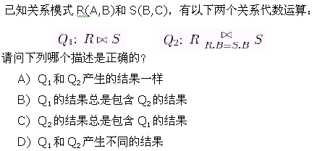

Notes:
A

