Slide 1
Crash Recovery
Major consern so far:
  How to manipulate database efficiently?
Now shift focus to:
  How to ensure correctness of database manipulation?

Slide 2
Integrity or correctness of data
Would like data to be “accurate” or “correct” at all times
EMP
Name
Age
White
Green
Gray
52
3421
1
Notes:
完整性和正确性
年龄限制（between and）

Slide 3
Integrity or consistency constraints
Predicates that the data must satisfy
Examples:
  - x is key of relation R
  - x → y holds in R
  - Domain(x) = {Red, Blue, Green}
  - no employee should make more than twice the average salary
Notes:
完整性或一致性约束
预测数据必须满足
例子：
- x是关系R的键
- x->y保存在R中（（）键满足函数依赖）
- 域（x）= {红色，蓝色，绿色}
- 任何员工的平均工资不得超过两倍

Slide 4
Definition:
Consistent state: satisfies all constraints
Consistent DB: DB in a consistent state
Notes:
一致状态：满足所有约束条件
一致的DB：DB处于一致状态（正确的数据库）

Slide 5
Constraints (as we use here) may not capture “full correctness”
Example 1 Transaction constraints
When salary is updated,
new salary > old salary
When account record is deleted,
balance = 0
In general, various policies to ensure that the DB corresponds to "real world"
Notes:
限制可能无法捕捉到“完全正确”（数据库被破坏）

Slide 6
Obs: DB cannot be consistent always!
Example: a1 + a2 +…. an = TOT (constraint)
Deposit $100 in a2: a2 ← a2 + 100
TOT ← TOT + 100
a2
TOT
.
.
.
.
.
.
50
150
150
.
.
.
.
.
.
1000
1000
1100
Notes:
触发器
最小的单元为事物
中间可能不一致，数据库不能总满足一致性

Slide 7
Transaction: collection of actions that preserve consistency
(≈ process)
Consistent DB
Consistent DB’
T
SQL: each query or modification statement
Embedded SQL: Sequence of DB operations up to COMMIT（提交） or ROLLBACK （c撤销）("abort")
Notes:
事务：收集保持一致性的操作
每个查询或修改语句
嵌入式SQL：直到COMMIT或ROLLBACK的DB操作序列（“中止”）
数据库的恢复
事务的四大特性ACID（事务的结束单元，提交和回来）
原子性
一致性：当你执行一个正确的事务时，使数据库从一个正确的状态停在另一个正确的状态
隔离性：事务内部不受其他干扰
持续性：事务一旦提交，不能rollback
Begin transaction
Select……
Update……
Select……(更新后检查是否更新正确)
commite
T 为事务正确执行

Slide 8
Big assumption:
If transaction T
starts with consistent state +
executes in isolation
⇒ T leaves consistent state
Correctness (informally)
If we stop running transactions, DB left consistent
Each transaction sees a consistent DB
Notes:
如果我们停止运行事务，DB保持一致
每笔交易都会看到一致的数据库

Slide 9
How can constraints be violated?
Transaction bug
DBMS bug
Hardware failure
e.g., disk crash alters balance of account
Simultaneous transactions accessing shared data
e.g.: T1: give 10% raise to programmers T2: change programmers ⇒ systems analysts
Notes:
交易错误
DBMS错误
硬件故障
例如，磁盘崩溃会改变帐户余额
同时访问共享数据的事务
例如：T1：给程序员提高10％T2：改变程序员系统分析员

Slide 10
How can we prevent/fix violations?
This lecture:
due to system failures only
Next: due to concurrency only
Next: due to failures and concurrency

Slide 11
Will not consider:
How to write correct transactions
How to write correct DBMS
Constraint checking & repair
That is, solutions studied here do not need to know constraints

Slide 12
Failure Model
Events Desired（想要的结果）
Undesired Expected （可以分析出原因）
Unexpected

Slide 13
Context of failure model
processor
memory disk
- volatile, - nonvolatile
disappears when
power off
CPU
D
M
Notes:
失败模型在磁盘上

Slide 14
Desired events: see product manuals….
Undesired expected events:
System failures
- SW errors, power loss
-> memory and transaction state lost
that’s it!!
Undesired Unexpected: Everything else!
Notes:
不希望的预期事件：
系统故障
- 软件错误，电力损失
- >内存和事务状态丢失

Slide 15
Undesired Unexpected: Everything else!
Examples:
Disk data is lost
Memory lost without CPU halt
Aliens attack and destroy the building….
(can protect against this by archive backups)

Slide 16
Is this model reasonable?
Approach: Add low level checks + redundancy to increase probability
that the model holds
E.g., Replicate disk storage (stable store)
Memory parity
CPU checks

Slide 17
Interacting Address Spaces:
Storage hierarchy
Memory Disk
Read(x,t)
Input(x)
t
x
x
Write(x,t)
Output(x)
Input (x): block with x from disk to buffer
Output (x): block with x from buffer to disk
Read (x,t): transaction variable t:= X; (Performs Input(x) if needed)
Write (x,t): X (in buffer) := t
Notes:
如果要改磁盘上的x元素
Input,output 和磁盘打交道
Read/write 内存

Slide 18
Note on "database elements" X:
Anything that can have value and be accessed of modified by transactions:
  a relation (or extent of an object class)
  a disk block
  a record
Easiest to use blocks as database elements
Notes:
用磁盘记录日志

Slide 19
Key problem Unfinished transaction
Example Constraint: A=B ^{(*)}
T1: A ← A × 2
B ← B × 2
^{(*)} simplification; a more realistic example: the sum of loan balances = the total debt of a bank

Slide 20
T1: Read (A,t); t ← t×2
Write (A,t);
Read (B,t); t ← t×2
Write (B,t);
Output (A);
Output (B);
failure! −> A != B
A: 8
B: 8
A: 8
B: 8
16
16
16
memory
disk
Notes:
事务未完成
磁盘上：
<T，start>
(以下二为结标志)
<T,commite>
<T,abort>
看不见结束标记，则错误
日志文件
<T,A,8>存原来的旧值，在修改数据之前，记日日志文件（先改日志文件）

Slide 21
Need atomicity: either execute all actions of a transaction or none at all
One solution: undo logging (immediate
modification)
Log: sequence of log records, recording actions of transactions T_{i}:
<T_{i}, start>: transaction has begun
<T_{i}, commit>: completed succesfully（完成）
<T_{i}, abort>: could not complete succesfully（没有成功完成回滚）
<T_{i}, X, v>: T_{i} has updated element X, whose
old value was v（Ti事务修改X之前，X的旧值）
Notes:
Undo 日志
<Ti，start>：事务已经开始
<Ti，commit>：成功完成
<Ti，abort>：无法成功完成
<Ti，X，v>：Ti更新了元素X， 旧价值是v

Slide 22
Undo logging (Immediate modification)
T1: Read (A,t); t ← t×2
Write (A,t);
Read (B,t); t ← t×2
Write (B,t);
Output (A);
Output (B);
constraint: A=B
<T1, start>
A:8
B:8
<T1, A, 8>
A:8
B:8
16
16
16
<T1, B, 8>
16
<T1, commit>
disk
log
memory
Notes:
数据库未修改完成，若提交，出了问题，数据库查询日志，将会将此问题视为完成，找不到错误

Slide 23
One “complication”
Log is first written in memory
Not written to disk on every action
memory
DB
Log
A: 8
B: 8
16
BAD STATE
# 1
A: 8 16
B: 8 16
Log:
<T1,start>
（可先在内存中存入）
<T1, A, 8>
（从内存中读取A值）
<T1, B, 8>
Notes:
Output之前，把改这行数据的，内存中的日志，放在磁盘上

Slide 24
One “complication”
Log is first written in memory
Not written to disk on every action
memory
DB
Log
A: 8
B: 8
16
A: 8 16
B: 8 16
Log:
<T1,start>
<T1, A, 8>
<T1, B, 8>
<T1, commit>
BAD STATE
# 2
...
<T1, B, 8>
<T1, commit>
Notes:
写完<T1, B, 8>
，应修改完B的值，再提交

Slide 25
Undo logging rules
(1) Generate an undo log record for every update action (with the old value)
(2) Before modifying element X on disk, any log records for X must be flushed to disk (write-ahead logging)
(3) All WRITEs of transaction T must be OUTPUT to disk before <T, commit> is flushed to log
Notes:
（1）为每个更新操作生成一个undo日志记录（使用旧值）
（2）在修改磁盘上的元素X之前，必须将任何X的日志记录刷新到磁盘（预写日志记录）
（3）在<T，commit>放在磁盘上的日志记录之前，事务T的所有WRITE都必须OUTPUT到磁盘

Slide 26
Recovery rules: Undo logging
For every Ti with <Ti, start> in log: - If <Ti,commit> or <Ti,abort>
in log, do nothing
- Else For all <Ti, X, v> in log:
write (X, v)
output (X )
Write <Ti, abort> to log
☒IS THIS CORRECT??
Notes:
如果右<T,START》且有结束标记，不做任何事情
如果没有结束标记

Slide 27
Recovery with Undo logging
constraint: A=B
T1: A ← A+1; B ← B+1;
T2: A ← A+1; B ← B+1;
log
DB on disk
A:10
B:10
11
<T1, start>
<T1, A, 10>
<T2, start>
<T2, A, 11>（看的内存）
CRASH =>
A should be restored to 10, not 11

Slide 28
Undo logging Recovery : (more precisely)
(1) Let S = set of transactions with <Ti, start> in log, but no
<Ti, commit> (or <Ti, abort>) record in log
(2) For each <Ti, X, v> in log,
in reverse order (latest → earliest) do:
- if Ti ∈ S then - write (X, v)
- output (X)
(3) For each Ti ∈ S do
- write <Ti, abort> to log
Notes:
（1）S是日志里没有提交或者撤回的事务集合
（2）对于log中的每个事务，从后往前，如果该事务在S中，则①完成写操作，并将值输入到磁盘上
（3）对于每个在S中的事务，在log中加上<Ti, abort>

Slide 29
Exercise 1
<START T>;
<T,A,10>;
<START U>;
<U,B,20>;
<T,C,30>;
<U,D,40>;
<COMMIT U>;
<T,E,50>;
<COMMIT T>.
<START U>
<COMMIT U>
<T,E,50>
<COMMIT T>

Slide 30
Exercise 2
Consider a system that uses pure undo logging. After a system crash, we find the following log entries on disk:
<START T1>;<T1,A,5>;<START T2>, <T1,B,1>; <COMMIT T1>;<T2,B,11>,<T2,C,8>,<COMMIT T2>; <START T3>;<T3,A,10>;<START T4>; <T4,A,11>, <T3,C,7>;<T4,B,22>
The last four actions in the schedule were incrementing each object by 1(e.g.<T4,A,11> was updating A to 12). How many different combinations of values of values for A,B,and C could possibly exist on disk at the time of the system crash?
Notes:
回滚后的值
A:10
B:7，8
C:22
3种

Slide 31
To discuss:
Redo logging
Undo/redo logging, why both?
Checkpointing
Media failures

Slide 32
Redo logging (deferred modification)
T1: Read(A,t); t t×2; write (A,t);
Read(B,t); t t×2; write (B,t);
Output(A); Output(B)
<T1, start>
<T1, A, 16>
<T1, B, 16>
<T1, commit>
A: 8
B: 8
output
A: 8
B: 8
16
16
16
memory
DB
LOG
Notes:
Redo日志要求comiette写完才能改数
Redo 记录心智

Slide 33
Redo logging rules
(1) For every disk update, generate a redo log record (with new value)
(2) Before modifying DB element X on disk, all log records for the transaction that (including COMMIT) must be flushed to disk
Notes:
（1）对于每个磁盘更新，生成一个重做日志记录（具有新值）
（2）在修改磁盘上的DB元素X之前，必须将所有（包括COMMIT）事务的日志记录刷新到磁盘

Slide 34
Recovery rules: Redo logging
For every Ti with <Ti, commit> in log:
  For all <Ti, X, v> in log:
  Write(X, v)
  Output(X)
This time, the last updates should remain in effect

Slide 35
Recovery with Redo Logging:
(more precisely)
(1) Let S = set of transactions with <Ti, commit> in log
(2) For each <Ti, X, v> in log, in forward order (earliest → latest) do:
- if Ti ∈ S then Write(X, v)
Output(X)
Notes:
从前向后
（1）S是日志文件里的“已提交事务”的集合
（2）对于日志里的每个事务，从前往后地做这些事：
1.如果事务在S里，则重写，并且将数据一道磁盘上去

Slide 36
Recovery is very, very SLOW !
Redo log:
First T1 wrote A,B Last
Record Committed a year ago Record
(1 year ago) --> STILL, Need to redo after crash!!
...
...
...
Crash

Slide 37
Solution: Checkpointing
(for redo-logging, simple version)
Periodically:
(1) Stop accepting new transactions
(2) Wait all transactions to finish (commit/abort)
(3) Flush all log records to disk (log)
(4) Flush all buffers to disk (DB)
(5) Write & flush a <CKPT> record on disk (log)
(6) Resume transaction processing
Notes:
定期：
（1）停止接受新的事务
（2）等待所有事务完成（提交/中止）
（3）将所有日志记录刷新到磁盘（日志）
（4）将所有缓冲区清空到磁盘（DB）
（5）写入并刷新磁盘上的<CKPT>记录（日志）
（6）恢复事务处理

Slide 38
Example: what to do at recovery?
Redo log (on disk):
<T1,A,16>
<T1,commit>
Checkpoint
<T2,B,17>
<T2,commit>
<T3,C,21>
Crash
...
...
...
...
...
...
Result of transactions completed prior to the checkpoint are stored permanently on disk
-> Redo
write(B, 17)
output(B)

Slide 39
Consider a system that uses pure redo logging. The initial database state was A=0,B=1,C=2. After a system crash, we find the following log entries on disk:
<START T1>,<T1,A,5>,<START T2>, <T1,B,1>, <COMMIT T1>,<T2,B,11>,<T2,C,8>,<COMMIT T2>, <CKPT>,<START T3>,<T3,A,10>,<START T4>, <T4,A,11>, <T3,C,7>, <T4,B,22>
How many different combinations of values for A,B, and C could possibly exist on disk at the time of the system crash?
Notes:
A：5
B：11
C：8

Slide 40
Drawbacks:
Undo logging:
  System forced to update disk at the end of transactions (may increase disk I/O)
  cannot redo recent updates to refresh a backup copy of the DB
Redo logging:
  need to keep all modified blocks in memory until commit (may lead to shortage of buffer pool)

Slide 41
Solution: Undo/redo logging!
Update record
⇒ <Ti, X, Old-X-value, New-X-value>
Provides more flexibility to order actions

Slide 42
Rules for undo/redo logging
(1) Log record
<Ti, X, old, new>
flushed to disk before writing X to disk
(2) Flush the log at commit
  Element X can be written to disk either before or after the commit of Ti

Slide 43
Undo/Redo Recovery Policy
To recover from a crash,
  redo updates by any committed transactions (in forward-order, earliest first)
  undo updates by any incomplete transactions (in backward-order, latest first)

Slide 44
Problem with Simple Checkpointing
Simple checkpointing stops the system from accepting new transactions
-> system effectively shuts down
Solution: "nonquiescent" checkpointing
  accepts new transactions during a checkpoint

Slide 45
Nonquiescent Checkpointing
Slightly different for various logging policies
Rules for undo/redo logging:
  Write log record (and flush log)
  <START CKPT T1, …, Tk>,
  where T1, …, Tk are the active transactions
  Flush to disk all dirty buffers which contain changed database elements (Corresponding log records first!)
  => Effect of writes prior to the chkpt made permanent
  Write & flush log record
  <END CKPT>

Slide 46
Non-quiescent checkpoint
L
O
G
for
undo dirty buffer
pool pages
flushed
<Start ckpt
Ti,T2,…>
<end
ckpt>
...
...
...
...

Slide 47
Examples what to do at recovery time?
no T1 commit
L
O
G
...
<T1, X,
a, a'>
...
Ckpt
T1
...
Ckpt
end
...
<T1,Y,
b, b'>
☒ Undo T1 (restore Y to b and X to a)
Notes:
Y->a
X->b

Slide 48
Example
L
O
G
...
T1
a
...
ckpt-s
T1
...
T1
b
...
ckpt-
end
...
T1
c
...
T1
cmt
...
☒ Redo T1: (redo update of elements to b and to c)
Notes:
T1完成
从CKPT-S T1 开始

Slide 49
Recovery process:
Backwards pass (end of log  latest checkpoint start)
  construct set S of committed transactions
  undo actions of transactions not in S
Undo pending transactions
  follow undo chains for transactions in
  (checkpoint active list) - S
Forward pass (latest checkpoint start  end of log)
  redo actions of transactions in set S
backward pass
start
check-
point
forward pass

Slide 50
<START T1>
<T1,A,4,5>
<START T2>
<COMMIT T1>
<T2,B,9,10>
<START CKPT(T2)>
<T2,C,14,15>
<START T3>
<T3,D,19,20>
<END CKPT>
<COMMIT T2>
<COMMIT T3>
Notes:
A: 5
B:10
C:15
D:19

Slide 51
Consider a system that uses undo-redo logging. After a system crash, we find the following log entries on disk:
<COMMIT T2>
<END CKPT>
<START T3>
<T3,A,0,10>
<START T4>
<T4,A,10,11>
<T3,C,9,7>
<T4,B,3,22>
<START T1>
<T1,A,5,0>
<START T2>
<T1,B,1,2>
<COMMIT T1>
<T2,B,2,3>
<START CKPT(T2)>
<T2,C,8,9>
How many different combinations of values for A,B, and C could possibly exist on disk at the time of the system crash? 18
Notes:
期末考提！！！！！！！！！！！！！！
1.磁盘蹦的时候A.B,C可能是多少 A:0,10,11; B: 3,22 C:8，9,7
2.哪些事务需要重做（完成的事情需要redo,未完成的事情需要undo）？
3。数据库回复完成后a,b，c,分别为多少
A:0
B:3
C:9
4。如果题目中没有END ckpt,那么磁盘崩的时候a,b,c
都有可能
5.没有end ckpt时，哪些需要redo，哪些需要undo
Undo: t3,t4
Redo:t1,t2

Slide 52
Media failure (loss of non-volatile storage)
A: 16
Disk crash!
Solution: Make copies of data!
Notes:
磁盘坏了，镜像备份

Slide 53
Solution a: Use mirrored or redundant disks
D1
D2
D3
Mirroring: copies on separate disks
  Output(X) --> three outputs
  Input(X) --> three inputs + vote
Notes:
输入：读一个
输出：写3个

Slide 54
Mirroring Disks
Two or more disks holding identical copies of data
  Optimizes: Can read blocks from whichever disk is faster. (Writing on each disk happens in parallel.)
  Enhances reliability: A single disk crash does not cause loss of data. (RAID level 1)
Notes:
镜像磁盘故障率

Slide 55
镜像磁盘故障率估算
丢失数据的可能情况是：修复第一个磁盘损坏同时，第二个磁盘也损坏了
  假设每个磁盘的平均故障时间为10年，则每年10%
  替换故障磁盘的过程花费3小时，一天的1/8，一年的1/2920.
  拷贝过程中发生故障的可能性是1/29200
  两个磁盘之一平均5年发生一次故障
  导致数据丢失的平均时间是5*29200=146000年

Slide 56
Using redundant disks
RAID (Redundant Arrays of Independent Disks)
  different versions, levels 1 - 6
  Basic idea: One of the disks is redundant holding checksums for other disks
  contents of crashed disks can be recovered from the checksums

Slide 57
RAID4
不管有多少个数据盘，仅使用一个冗余盘，冗余盘中的第i块由所有数据盘的第i块奇偶校验位组成
  盘1： 11110000
  盘2： 10101010
  盘3： 00111000
  盘4： 01100010
  RAID5，RAID6
Notes:
Raid5

Slide 58
Example #2 Redundant writes,Single reads
Keep N copies on separate disks
Output(X) --> N outputs
Input(X) --> Input one copy - if ok, done
    - else try another one
⬄ Assumes bad data can be detected

Slide 59
Solution b: Archiving
backup
database
active
database
log
If active database is lost,
  restore active database from backup (archive)
  bring up-to-date using redo entries in log

Slide 60
When can we discard the log?
db
dump
last
needed
undo
check-
point
log
not needed for
media recovery
time
not needed for undo
after system failure
not needed for
redo after system failure
Notes:
Dump 转储 从数据库备份到另一个存储设备
备完份之后，再记录日志

Slide 61
恢复的实现技术
恢复机制涉及的关键问题是：
  如何建立冗余数据；
  如何利用这些冗余数据实施数据库恢复。
建立冗余数据最常用的技术是数据转储和登录日志文件，通常在一个数据库系统中，这两种方法一起使用。

Slide 62
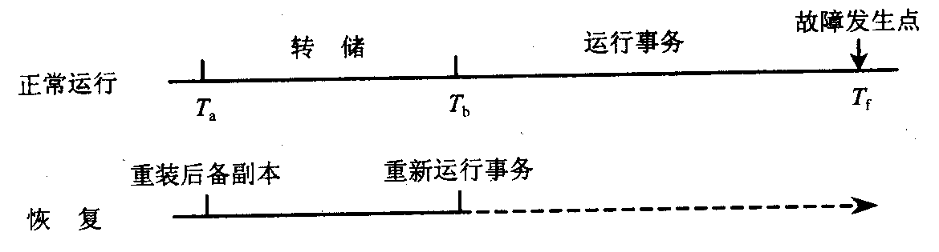
数据转储
数据转储是数据库恢复中采用的基本技术。所谓转储即DBA定期地将整个数据库复制到磁带或另一个磁盘上保存起来的过程。这些备用的数据文本称为后备副本。

Slide 63
静态转储和动态转储
静态转储是在系统中无运行事务时进行的转储操作。它会降低数据库的可用性；
动态转储是指转储期间允许对数据库进行存取或修改。它不能保证后备副本上的数据正确有效，因此建立日志文件，将转储期间各事务对数据库的修改活动登记下来。

Slide 64
海量转储和增量转储
海量转储是指每次转储全部数据库；
增量转储指每次只转储上一次转储后更新的数据。

Slide 65
登记日志文件(logging)
日志文件是用来记录事务对数据库的更新操作的文件。
日志文件主要有两种格式：以记录为单位的日志文件和以数据块为单位的日志文件。

Slide 66
以记录为单位的日志文件格式
各个事务的开始
各个事务的结束
各个事务的所有更新操作
每个日志记录的内容主要包括：
  事务标识 T1
  操作的类型（插入、删除或修改）
  操作对象 A
  更新前数据的旧值 8
  更新后数据的新值 16
Notes:
《T1,A,8,16》

Slide 67
以数据块为单位的日志文件
日志记录的内容包括：
  事务标识
  被更新的数据块

Slide 68
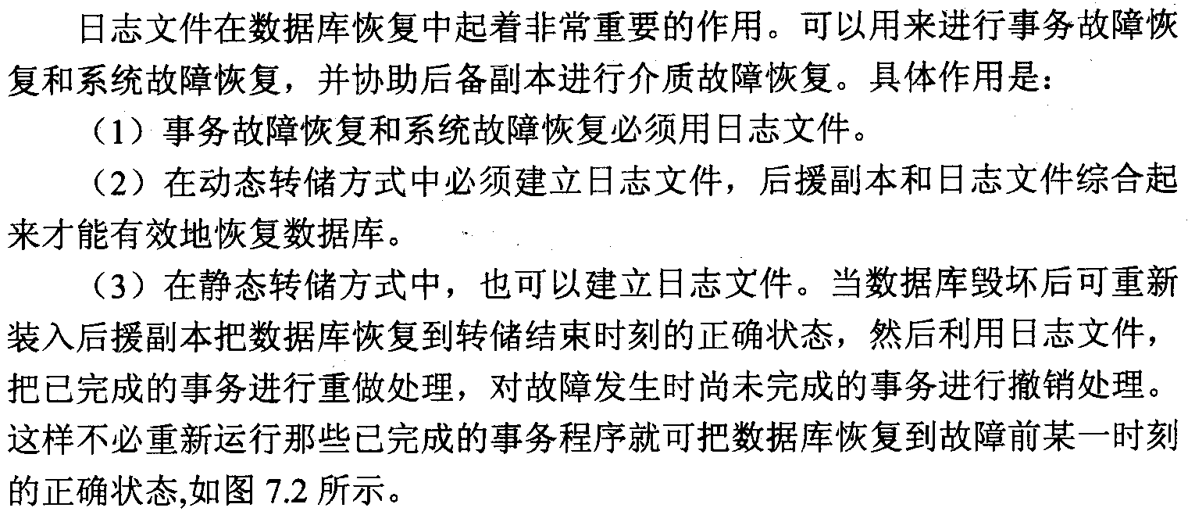
日志文件的作用

Slide 69
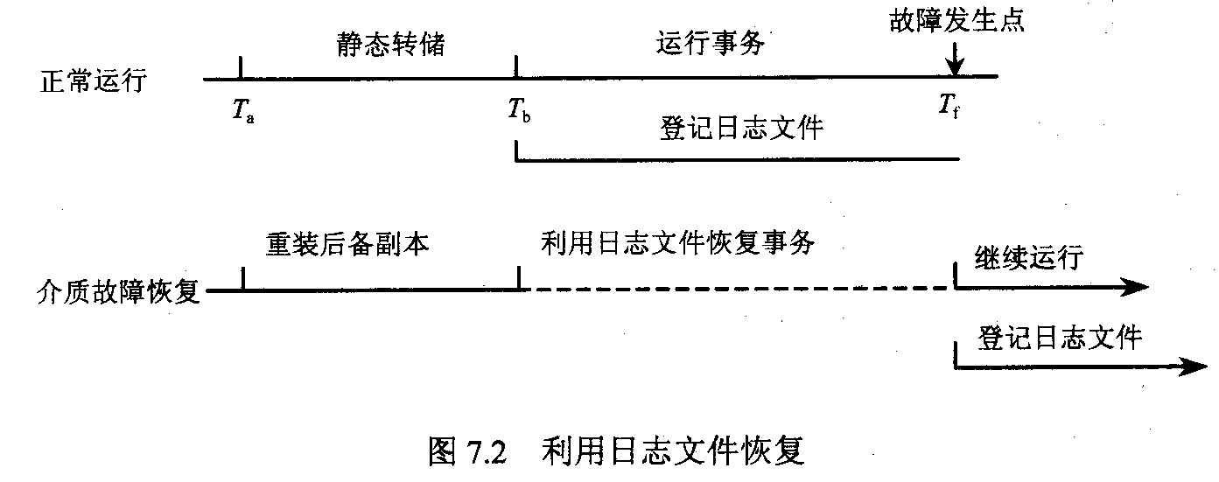

Slide 70
登记日志文件
登记日志文件必须遵循两条原则：
  登记的次序严格按并发事务执行的时间次序；
  必须先写日志文件，后写数据库。
Notes:
考试!

Slide 71
恢复策略
事务故障的恢复
系统故障的恢复
介质故障的恢复

Slide 72
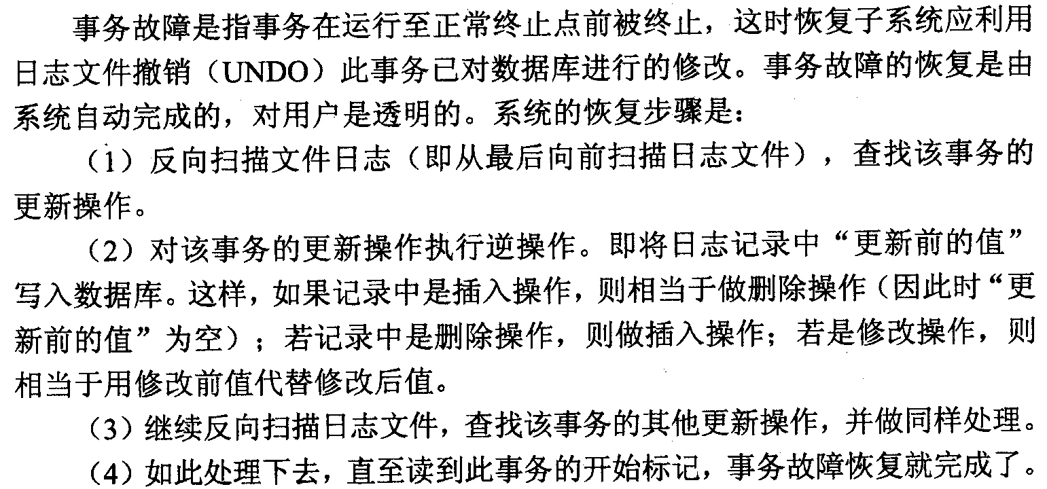
事务故障恢复步骤

Slide 73
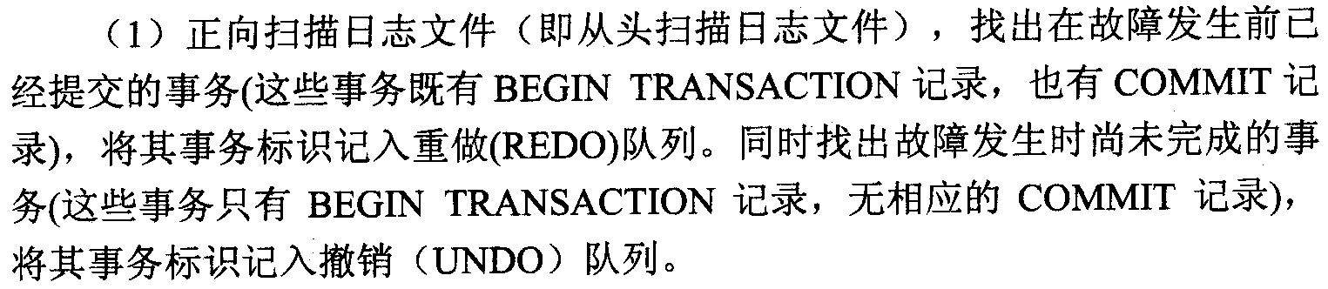
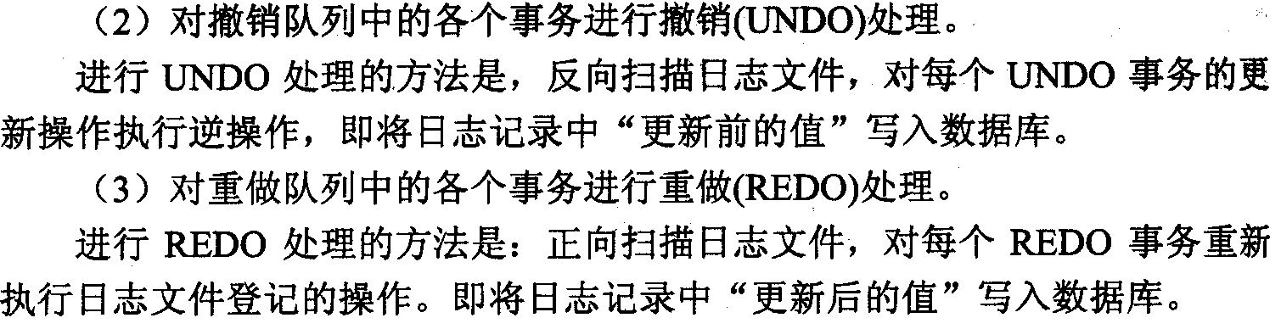
系统故障恢复步骤

Slide 74
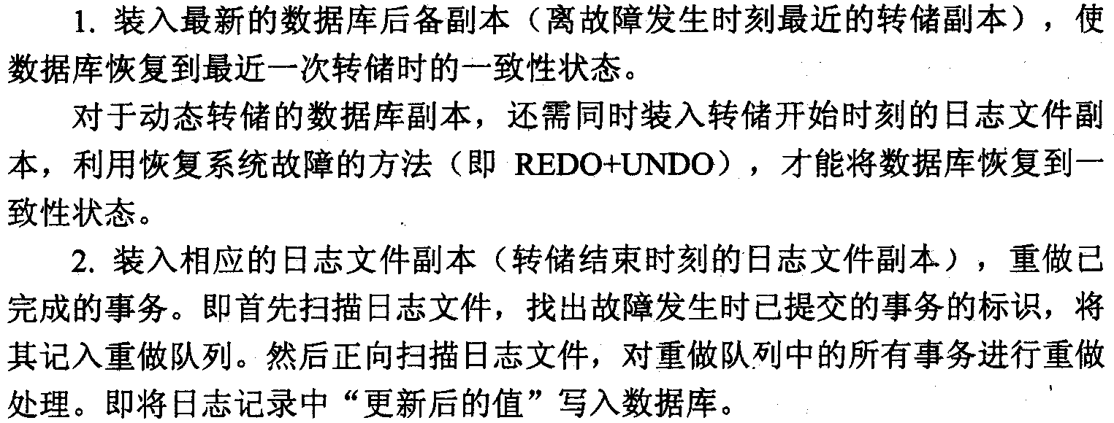
介质故障恢复步骤

Slide 75
具有检查点的恢复技术
利用日志文件恢复数据库的两个缺点：
  搜索整个日志文件将耗费大量的时间
  很多需要REDO处理的事务已经写入数据库中
在日志文件中增加一类新的记录---检查点
检查点记录的内容包括：
  建立检查点时刻所有正在执行的事务清单
  这些事务最近一个日志记录的地址

Slide 76
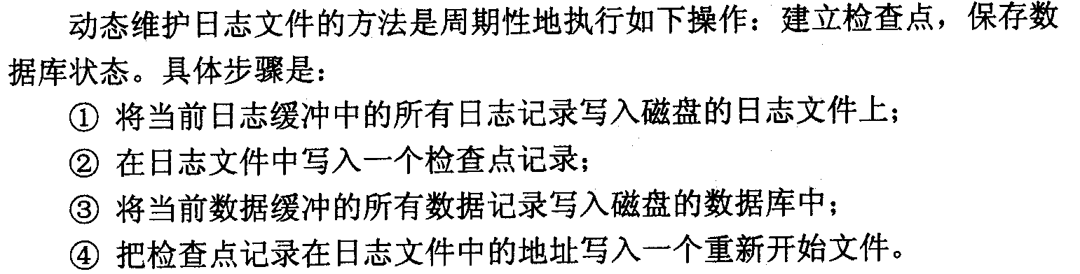
动态维护日志文件

Slide 77
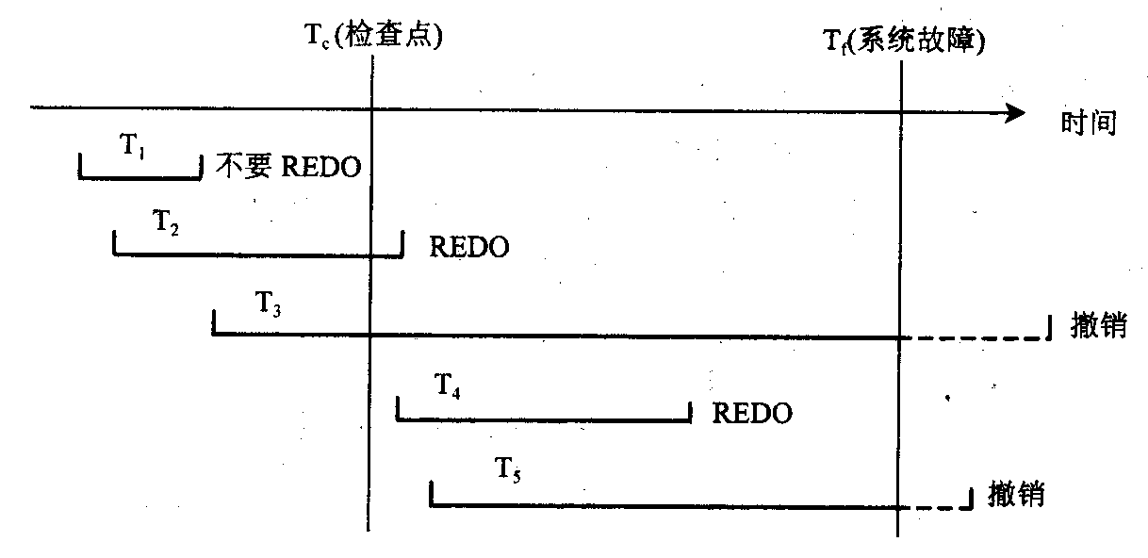
恢复子系统采取的不同策略

Slide 78
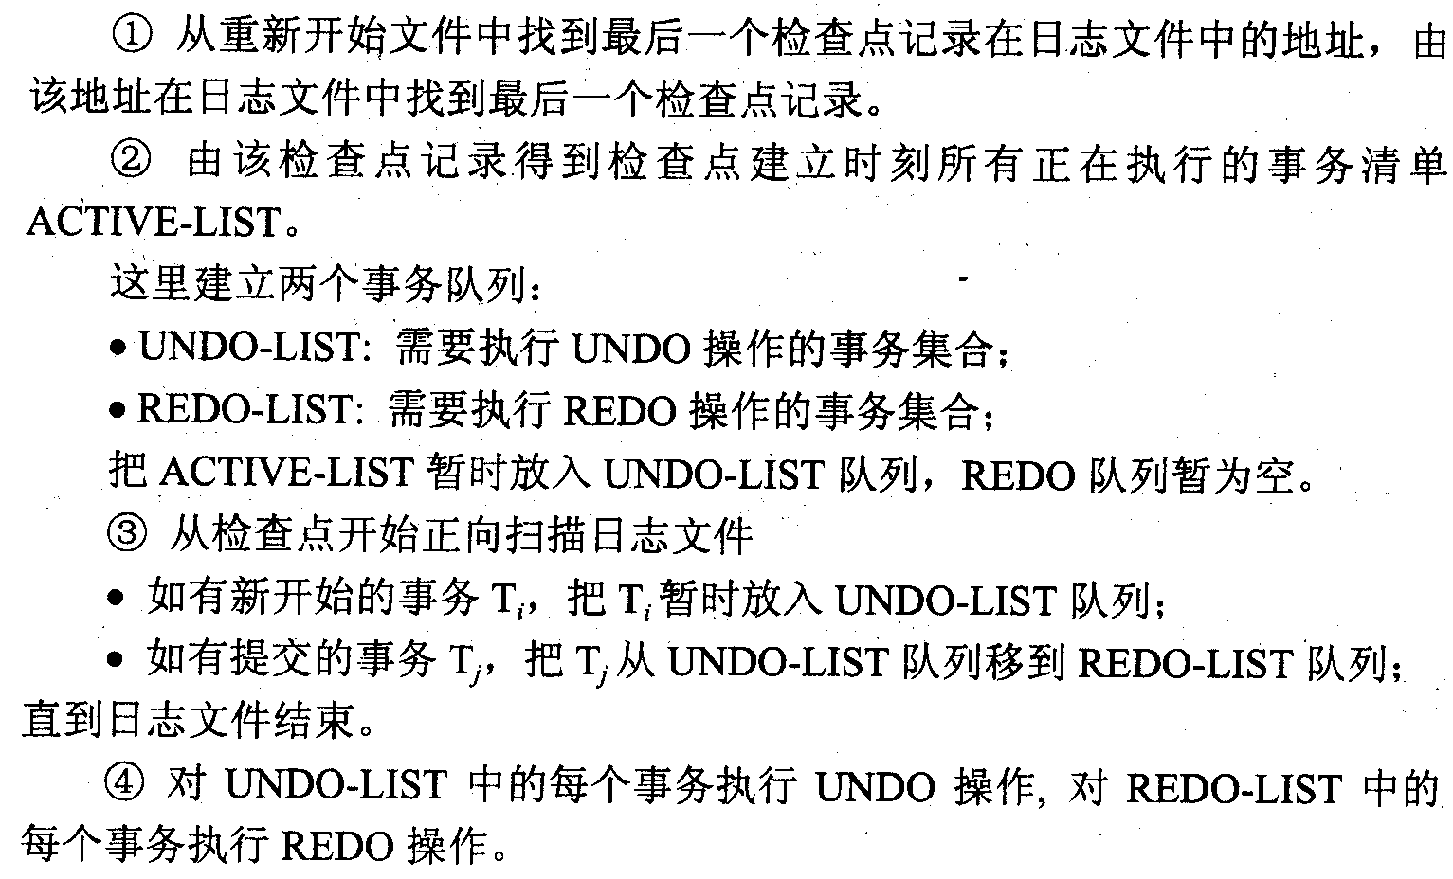
使用检查点进行恢复的步骤

Slide 79
数据库镜像
根据DBA的要求，自动把整个数据库或其中的关键数据复制到一个磁盘上。
每当主数据库更新时，DBMS自动把更新后的数据复制过去，即DBMS自动保证镜像数据与主数据的一致性。

Slide 80
Summary
Consistency of data
Recovery from system failures
  Logging (undo/redo/undo-redo), checkpoints
  Recovery: using log to reconstruct the DB
Recovery form media failures
  reducing risk through redundancy
  backups / archiving
Another source of problems:
  Concurrent transactions that access shared DB elements .... NEXT
Notes:
数据一致性
数据库恢复：undo、redo

