Slide 1
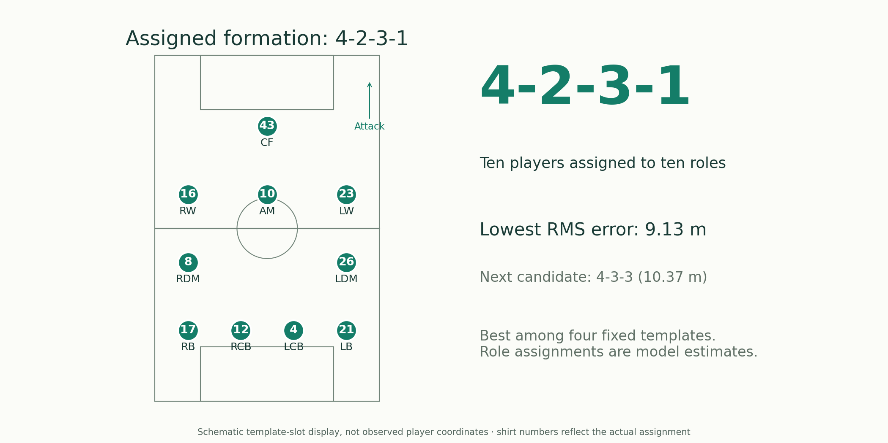
SLIDE 10 OPTION A · ROLE BOARD
Which formation best fits this shape?
Problem
Infer organization from positions rather than the team sheet.
Methods
Centroid normalization and minimum-cost template assignment.
Option A · Same players and window
A clean formation board emphasizes the assigned roles.
Shaw & Glickman: Dynamic Analysis of Team Strategy
Joris Bekkers: Elastic Formation and Position Identification
Devin Pleuler: Fixed to Fluid (2024)
Notebook: 03_formation_analysis.ipynb
1
Notes:
Best residual example from defensive 30-second windows; ten outfield players, at least 50 qualifying frames each. Four fixed templates and Hungarian squared-distance assignment. Player labels are assigned template slots, not reviewed role truth. Raw versus centered covariance ellipses appear as a small inset. RMS error is not a formation probability; not elastic EFPI inference. Alternative A: Role board. Same team, qualifying window, four candidate templates and assignment algorithm as the main deck; only the visualization differs. Role-board coordinates are schematic where shown; residual plots use observed centered medians.
Notebook: 03_formation_analysis.ipynb
https://github.com/zcochran27/tracking-data-applied-workshop/blob/main/notebooks/methods/03_formation_analysis.ipynb
Sources:
Shaw & Glickman: Dynamic Analysis of Team Strategy
https://static.capabiliaserver.com/frontend/clients/barca/wp_prod/wp-content/uploads/2020/01/83c87dfe-barca_poster_shaw.pdf
Joris Bekkers: Elastic Formation and Position Identification
https://arxiv.org/abs/2506.23843
Devin Pleuler: Fixed to Fluid (2024)
https://github.com/devinpleuler/research/blob/master/frame-by-frame-position.md

Slide 2
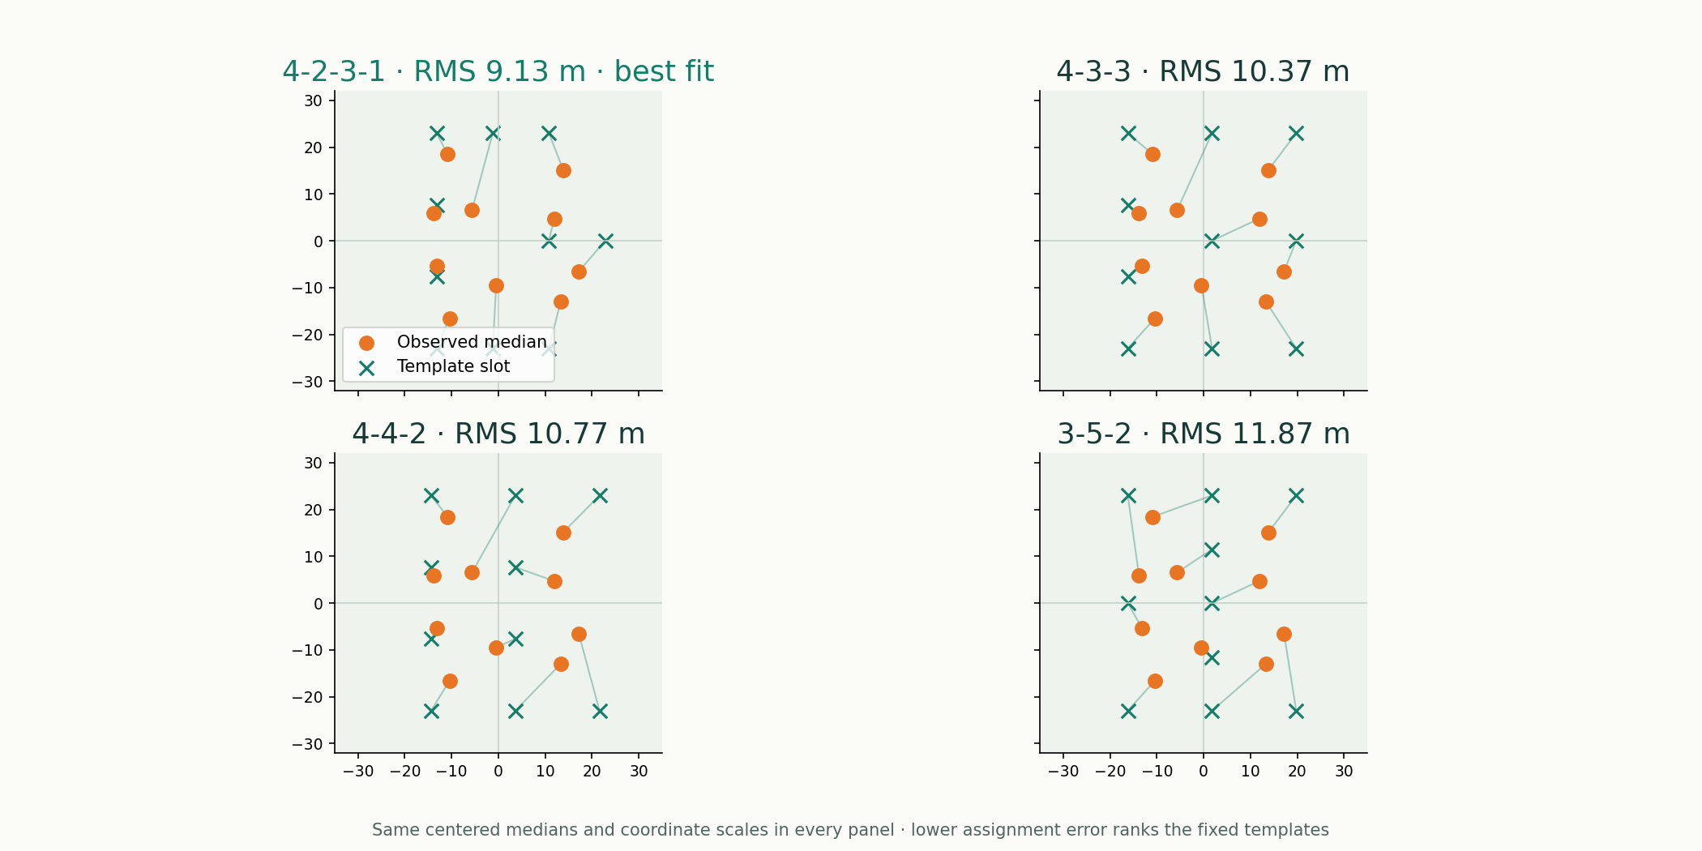
SLIDE 10 OPTION B · COMPARE TEMPLATES
Which formation best fits this shape?
Problem
Infer organization from positions rather than the team sheet.
Methods
Centroid normalization and minimum-cost template assignment.
Option B · Same players and window
Four candidate shapes show why one template fits better.
Shaw & Glickman: Dynamic Analysis of Team Strategy
Joris Bekkers: Elastic Formation and Position Identification
Devin Pleuler: Fixed to Fluid (2024)
Notebook: 03_formation_analysis.ipynb
2
Notes:
Best residual example from defensive 30-second windows; ten outfield players, at least 50 qualifying frames each. Four fixed templates and Hungarian squared-distance assignment. Player labels are assigned template slots, not reviewed role truth. Raw versus centered covariance ellipses appear as a small inset. RMS error is not a formation probability; not elastic EFPI inference. Alternative B: Compare templates. Same team, qualifying window, four candidate templates and assignment algorithm as the main deck; only the visualization differs. Role-board coordinates are schematic where shown; residual plots use observed centered medians.
Notebook: 03_formation_analysis.ipynb
https://github.com/zcochran27/tracking-data-applied-workshop/blob/main/notebooks/methods/03_formation_analysis.ipynb
Sources:
Shaw & Glickman: Dynamic Analysis of Team Strategy
https://static.capabiliaserver.com/frontend/clients/barca/wp_prod/wp-content/uploads/2020/01/83c87dfe-barca_poster_shaw.pdf
Joris Bekkers: Elastic Formation and Position Identification
https://arxiv.org/abs/2506.23843
Devin Pleuler: Fixed to Fluid (2024)
https://github.com/devinpleuler/research/blob/master/frame-by-frame-position.md

Slide 3
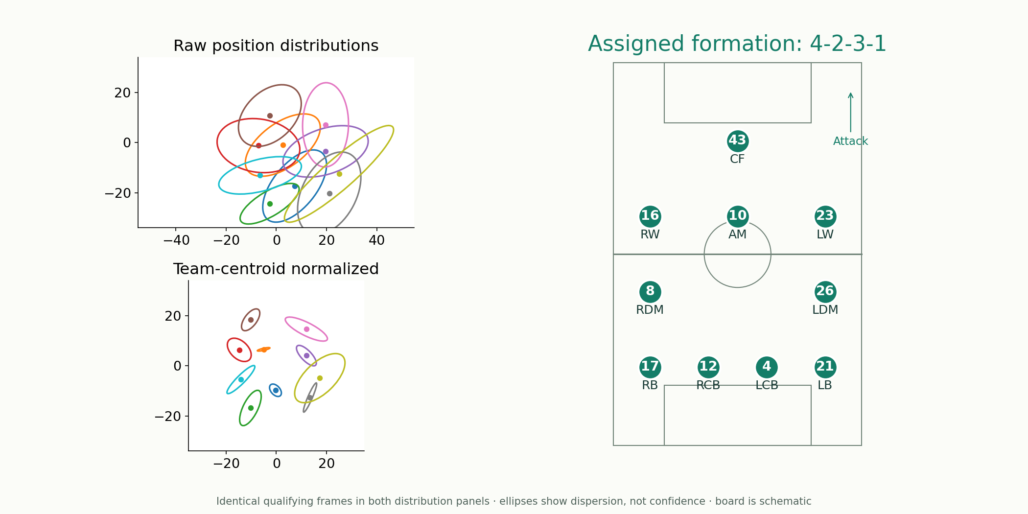
SLIDE 10 OPTION C · NORMALIZATION + RESULT
Which formation best fits this shape?
Problem
Infer organization from positions rather than the team sheet.
Methods
Centroid normalization and minimum-cost template assignment.
Option C · Same players and window
Distribution changes explain the assigned formation.
Shaw & Glickman: Dynamic Analysis of Team Strategy
Joris Bekkers: Elastic Formation and Position Identification
Devin Pleuler: Fixed to Fluid (2024)
Notebook: 03_formation_analysis.ipynb
3
Notes:
Best residual example from defensive 30-second windows; ten outfield players, at least 50 qualifying frames each. Four fixed templates and Hungarian squared-distance assignment. Player labels are assigned template slots, not reviewed role truth. Raw versus centered covariance ellipses appear as a small inset. RMS error is not a formation probability; not elastic EFPI inference. Alternative C: Normalization + result. Same team, qualifying window, four candidate templates and assignment algorithm as the main deck; only the visualization differs. Role-board coordinates are schematic where shown; residual plots use observed centered medians.
Notebook: 03_formation_analysis.ipynb
https://github.com/zcochran27/tracking-data-applied-workshop/blob/main/notebooks/methods/03_formation_analysis.ipynb
Sources:
Shaw & Glickman: Dynamic Analysis of Team Strategy
https://static.capabiliaserver.com/frontend/clients/barca/wp_prod/wp-content/uploads/2020/01/83c87dfe-barca_poster_shaw.pdf
Joris Bekkers: Elastic Formation and Position Identification
https://arxiv.org/abs/2506.23843
Devin Pleuler: Fixed to Fluid (2024)
https://github.com/devinpleuler/research/blob/master/frame-by-frame-position.md

Slide 4
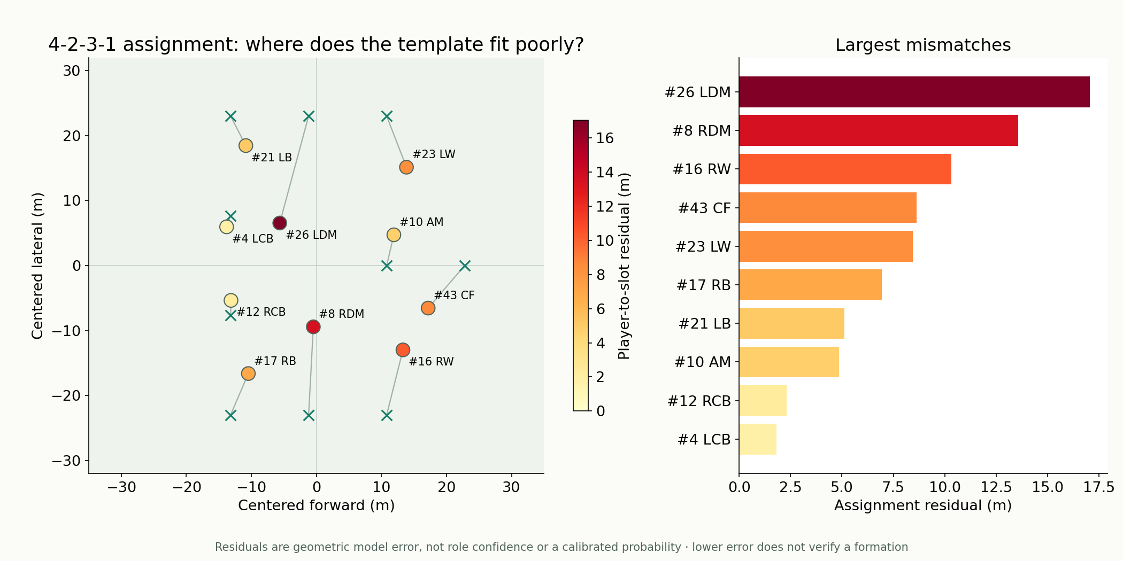
SLIDE 10 OPTION D · FIT DIAGNOSTICS
Which formation best fits this shape?
Problem
Infer organization from positions rather than the team sheet.
Methods
Centroid normalization and minimum-cost template assignment.
Option D · Same players and window
The observed shape and residuals reveal where the template struggles.
Shaw & Glickman: Dynamic Analysis of Team Strategy
Joris Bekkers: Elastic Formation and Position Identification
Devin Pleuler: Fixed to Fluid (2024)
Notebook: 03_formation_analysis.ipynb
4
Notes:
Best residual example from defensive 30-second windows; ten outfield players, at least 50 qualifying frames each. Four fixed templates and Hungarian squared-distance assignment. Player labels are assigned template slots, not reviewed role truth. Raw versus centered covariance ellipses appear as a small inset. RMS error is not a formation probability; not elastic EFPI inference. Alternative D: Fit diagnostics. Same team, qualifying window, four candidate templates and assignment algorithm as the main deck; only the visualization differs. Role-board coordinates are schematic where shown; residual plots use observed centered medians.
Notebook: 03_formation_analysis.ipynb
https://github.com/zcochran27/tracking-data-applied-workshop/blob/main/notebooks/methods/03_formation_analysis.ipynb
Sources:
Shaw & Glickman: Dynamic Analysis of Team Strategy
https://static.capabiliaserver.com/frontend/clients/barca/wp_prod/wp-content/uploads/2020/01/83c87dfe-barca_poster_shaw.pdf
Joris Bekkers: Elastic Formation and Position Identification
https://arxiv.org/abs/2506.23843
Devin Pleuler: Fixed to Fluid (2024)
https://github.com/devinpleuler/research/blob/master/frame-by-frame-position.md

