Slide 1
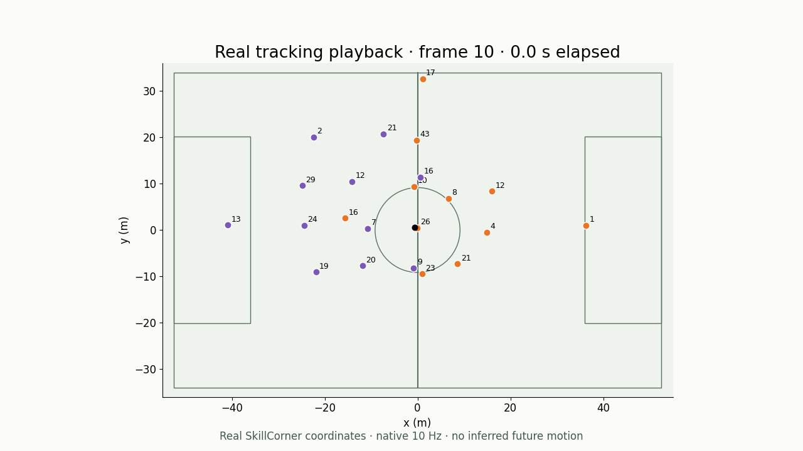
SOCCER ANALYTICS · SKILLCORNER OPEN DATA
Tracking Data Applied
Turn player and ball movement into football answers.
Problems, methods and results
Code and implementation live in the notebooks.
SkillCorner open data and schema
1
Notes:
SkillCorner open tracking, StatsBomb shot freeze frames, published research and independent teaching models are identified throughout.
Sources:
SkillCorner open data and schema
https://github.com/SkillCorner/opendata

Slide 2
What can tracking data answer?
Five avenues connect continuous movement to analytical questions.
Event detection
Who controlled the ball, and what happened?
Formation and positions
How was the team organized, and who played which role?
Match segmentation
Which phase or tactical context was the team in?
Physical metrics
How far, how fast and how explosively did players move?
Game modeling
Which spaces, actions and game states create value?
SkillCorner open data and schema
2
Notes:
User-requested introduction to all avenues. Graphs and GNNs are general modeling tools introduced within game modeling, with applications beyond EPV. No duration or audience-level framing.
Sources:
SkillCorner open data and schema
https://github.com/SkillCorner/opendata

Slide 3
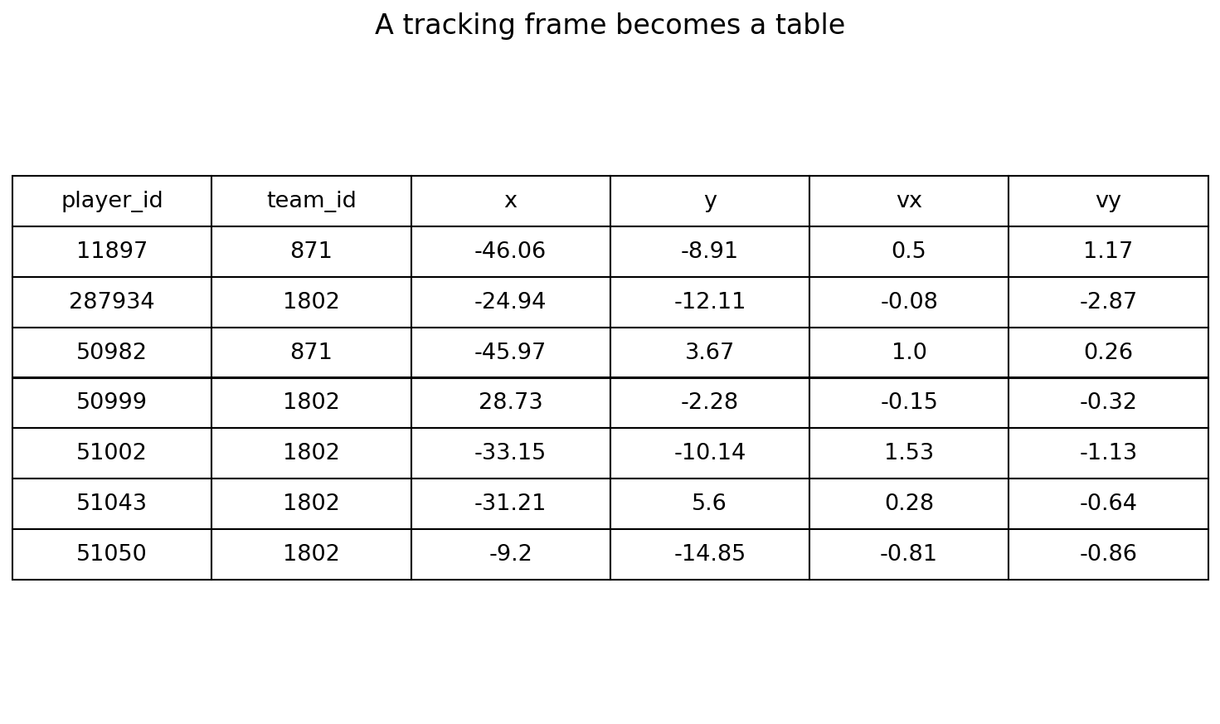
Foundations
Data and documentation
Problem
Where do coordinates, labels and metric definitions come from?
Methods
SkillCorner open data; kloppy ingestion; DataBallPy metric documentation.
Links and loaded data
Keep coordinates, supplied labels and our derived estimates distinct.
SkillCorner open data and schema
kloppy SkillCorner loader
DataBallPy covered distance
Notebook: 01_data_exploration.ipynb
3
Notes:
The opening entries are linked. Full sources are in the reading list. Real sample: Brisbane vs Perth, 21 December 2024, match 1925299.
Notebook: 01_data_exploration.ipynb
https://github.com/zcochran27/tracking-data-applied-workshop/blob/main/notebooks/methods/01_data_exploration.ipynb
Sources:
SkillCorner open data and schema
https://github.com/SkillCorner/opendata
kloppy SkillCorner loader
https://kloppy.pysport.org/reference/providers/skillcorner/
DataBallPy covered distance
https://databallpy.readthedocs.io/en/main/features/covered_distance_page.html

Slide 4
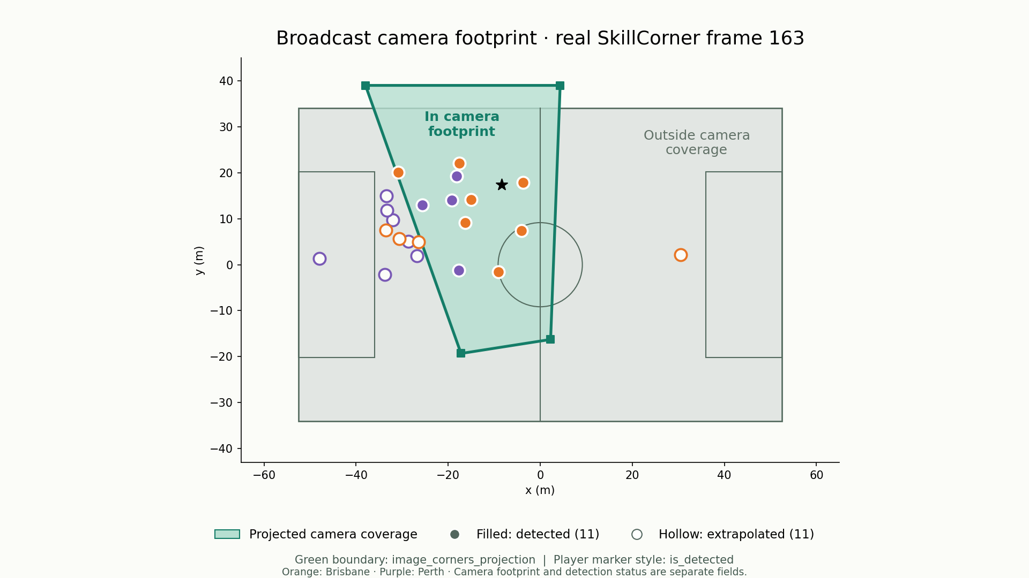
Foundations
Tracking quality and visibility
Problem
Which positions were observed on screen?
Methods
Project image corners; read each player’s is_detected flag.
11 detected · 11 extrapolated
Camera coverage and detection status are related, separate fields.
SkillCorner open data and schema
DataBallPy preprocessing
Notebook: 01_data_exploration.ipynb
4
Notes:
Actual SkillCorner frame 163. The green polygon connects top-left, bottom-left, bottom-right and top-right image_corners_projection in native metric coordinates; its fill is clipped to the pitch, while the boundary retains the actual projected corners. Green shading shows the camera footprint, gray pitch lies outside it. Player marker style comes directly from is_detected: filled detections, hollow extrapolations; orange Brisbane, purple Perth. This illustrative frame has 11 players inside/detected and 11 outside/extrapolated. Polygon membership is not substituted for detection status: occlusion or missed detections can occur inside the camera footprint. Coordinates outside camera coverage may still be supplied by extrapolation.
Notebook: 01_data_exploration.ipynb
https://github.com/zcochran27/tracking-data-applied-workshop/blob/main/notebooks/methods/01_data_exploration.ipynb
Sources:
SkillCorner open data and schema
https://github.com/SkillCorner/opendata
DataBallPy preprocessing
https://databallpy.readthedocs.io/en/main/getting_started/preprocessing_options.html

Slide 5
Foundations
Read movement in context
Problem
What does a tracking sequence reveal that one frame misses?
Methods
Animate the same player identities and ball through time.
Native 10 Hz playback
▶ Click video to play
Motion, team structure and tracking uncertainty become visible.
SkillCorner open data and schema
kloppy SkillCorner loader
Notebook: 01_data_exploration.ipynb
5
Notes:
Embedded native-rate MP4 of actual SkillCorner player and ball positions with shirt numbers. Click the movie in slideshow view. Tracking visualization, not broadcast footage.
Notebook: 01_data_exploration.ipynb
https://github.com/zcochran27/tracking-data-applied-workshop/blob/main/notebooks/methods/01_data_exploration.ipynb
Embedded video (click to play): assets/videos/tracking_playback.mp4
Embedded native-rate MP4 of actual SkillCorner player and ball positions with shirt numbers. Click the movie in slideshow view. Tracking visualization, not broadcast footage.
Sources:
SkillCorner open data and schema
https://github.com/SkillCorner/opendata
kloppy SkillCorner loader
https://kloppy.pysport.org/reference/providers/skillcorner/

Slide 6
ANALYTICAL AVENUE
Event detection
Derive motion from tracking coordinates, then combine physical measurements with rules to identify event candidates.
Ideas and detection rules
• Control: close, low, slow and sustained
• Passes: release, travel and reception
• Shots, carries, duels and pressure
• Speed = displacement / elapsed time
• Acceleration = velocity change / time
• Detection rules and video validation
Physics supplies measurements. Event definitions supply thresholds and timing rules.
6
Notes:
Start with coordinates and timestamps in metres and seconds. Player–ball distance is the Euclidean distance. Backward finite differences give velocity from displacement divided by elapsed time, speed from the velocity magnitude, and acceleration from velocity change divided by elapsed time. Compute within periods, reject gaps and missing coordinates, and inspect noise because differencing magnifies it. Combine these derived features into explicit event definitions. The control example requires the same closest player within 2 m, ball height 0–2 m, and horizontal ball speed at most 3 m/s for at least 0.3 s at 10 Hz. Pass candidates connect different same-team stable control intervals through a complete ball trajectory with at least 3 m displacement within 4 s. Acceleration is a diagnostic idea for kicks or deflections, not a gate used by the current detector. Conservative low-speed control can miss fast dribbles, aerial control or one-touch play; slow dummies can still qualify. Tune and evaluate thresholds using independent video-reviewed labels; a physical rule is not event truth.
Sources:

Slide 7
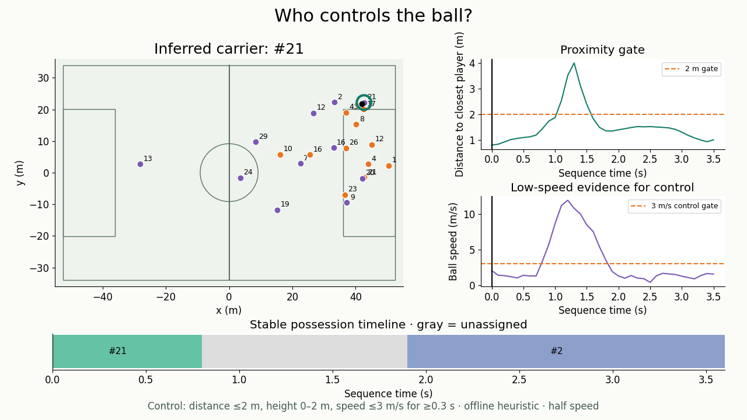
Event detection
Who controls the ball?
Problem
Identify the likely ball carrier between recorded events.
Methods
Require sustained proximity, low ball speed and low ball height.
Offline teaching heuristic
▶ Click video to play
Highlighted carrier states; uncertain intervals remain unassigned.
SkillCorner open data and schema
PathCRF: player trajectories to events (2026)
Notebook: 02_event_detection.ipynb
7
Notes:
Control candidate: same nearest player within 2 m, ball height 0–2 m and horizontal ball speed ≤3 m/s for ≥0.3 s at native 10 Hz. Velocity comes from adjacent-frame displacement divided by valid elapsed time, within a period. Missing speed, height, coordinates or frame continuity break the evidence. Video synchronizes distance, speed and stable ownership. This conservative offline heuristic reduces flyovers and fast dummies but can miss fast dribbles, aerial control and one-touch play; slow dummies can still qualify. No validated accuracy claim. Half-speed playback.
Notebook: 02_event_detection.ipynb
https://github.com/zcochran27/tracking-data-applied-workshop/blob/main/notebooks/methods/02_event_detection.ipynb
Embedded video (click to play): assets/videos/possession_physics.mp4
Control candidate: same nearest player within 2 m, ball height 0–2 m and horizontal ball speed ≤3 m/s for ≥0.3 s at native 10 Hz. Velocity comes from adjacent-frame displacement divided by valid elapsed time, within a period. Missing speed, height, coordinates or frame continuity break the evidence. Video synchronizes distance, speed and stable ownership. This conservative offline heuristic reduces flyovers and fast dummies but can miss fast dribbles, aerial control and one-touch play; slow dummies can still qualify. No validated accuracy claim. Half-speed playback.
Sources:
SkillCorner open data and schema
https://github.com/SkillCorner/opendata
PathCRF: player trajectories to events (2026)
https://github.com/hyunsungkim-ds/pathcrf

Slide 8
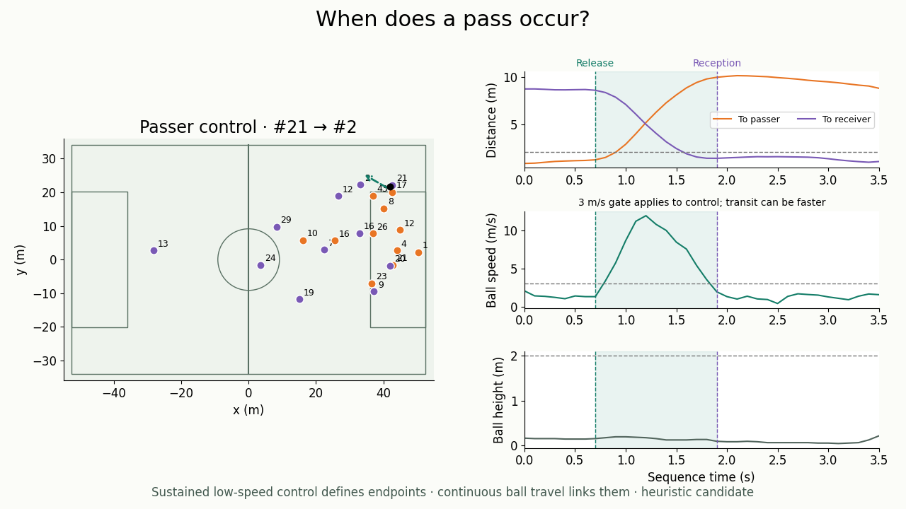
Event detection
When does a pass occur?
Problem
Separate a pass from touches, ball transit and reception.
Methods
Link same-team low-speed control intervals through continuous ball travel.
Unverified pass candidate
▶ Click video to play
Release and reception candidates align with the physics traces.
SkillCorner open data and schema
PathCRF: player trajectories to events (2026)
Notebook: 02_event_detection.ipynb
8
Notes:
Actual player–ball distances, horizontal ball speed and ball height share the clip time axis. Same-player proximity within 2 m, height 0–2 m, speed ≤3 m/s and ≥0.3 s persistence define the control endpoints. Different same-team endpoints form a pass candidate only if the intervening ball trajectory is complete, crosses no period boundary, travels at least 3 m and spans no more than 4 s. Transit can exceed the control-speed threshold. Dashed arrow and endpoints are retrospective candidates, not reviewed event truth. Acceleration is not a detection gate.
Notebook: 02_event_detection.ipynb
https://github.com/zcochran27/tracking-data-applied-workshop/blob/main/notebooks/methods/02_event_detection.ipynb
Embedded video (click to play): assets/videos/pass_control_physics.mp4
Actual player–ball distances, horizontal ball speed and ball height share the clip time axis. Same-player proximity within 2 m, height 0–2 m, speed ≤3 m/s and ≥0.3 s persistence define the control endpoints. Different same-team endpoints form a pass candidate only if the intervening ball trajectory is complete, crosses no period boundary, travels at least 3 m and spans no more than 4 s. Transit can exceed the control-speed threshold. Dashed arrow and endpoints are retrospective candidates, not reviewed event truth. Acceleration is not a detection gate.
Sources:
SkillCorner open data and schema
https://github.com/SkillCorner/opendata
PathCRF: player trajectories to events (2026)
https://github.com/hyunsungkim-ds/pathcrf

Slide 9
ANALYTICAL AVENUE
Formation and position identification
How can we describe team organization while players move and rotate?
Questions to explore
• Team shape and phase-conditioned averages
• Formation-template identification
• Player roles and positional rotations
• Role signatures from relative geometry
• Persistent formation-change candidates
• Substitutions and asymmetric shapes
Examples: formation assignments, angular signatures and change timelines
9
Notes:
How can we describe team organization while players move and rotate?
Ideas: Team shape and phase-conditioned averages; Formation-template identification; Player roles and positional rotations; Role signatures from relative geometry; Persistent formation-change candidates; Substitutions and asymmetric shapes
Sources:

Slide 10
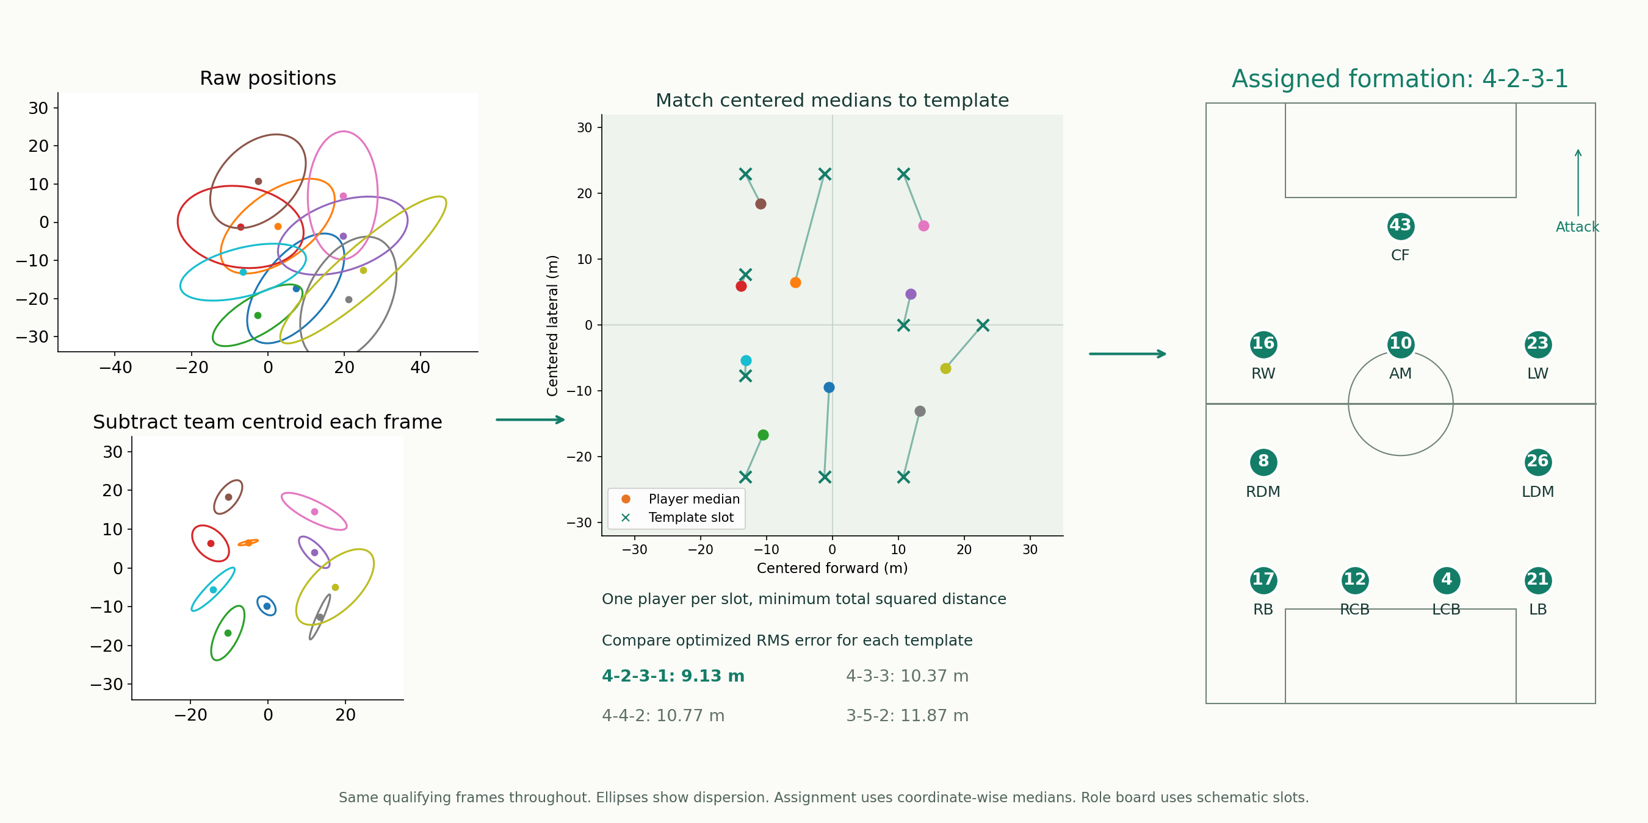
Formation and position identification
Which formation best fits this shape?
Problem
Infer organization from positions rather than the team sheet.
Methods
Center each frame, match players to template slots, then compare RMS error.
Fixed-template estimate; roles are inferred.
Minimum assignment error selects 4-2-3-1 from the four candidate templates.
Shaw & Glickman: Dynamic Analysis of Team Strategy
Joris Bekkers: Elastic Formation and Position Identification
Devin Pleuler: Fixed to Fluid (2024)
Notebook: 03_formation_analysis.ipynb
10
Notes:
Best residual example from defensive 30-second windows; ten outfield players, at least 50 qualifying frames each. Four fixed templates and Hungarian squared-distance assignment. Player labels are assigned template slots, not reviewed role truth. Raw versus centered covariance ellipses appear as a small inset. RMS error is not a formation probability; not elastic EFPI inference. Selected option C with explicit template matching. Subtract the ten outfield players’ team centroid separately in every qualifying frame, then orient attack consistently. Take coordinate-wise medians over the window. For each fixed template, the Hungarian algorithm finds a one-to-one assignment minimizing total squared Euclidean distance between the ten medians and ten template slots. Compare root mean squared assignment distance across all four candidates. Here 4-2-3-1 has 9.13 m RMS versus 10.37 m for 4-3-3. This is a geometric best fit among supplied candidates, not a validated formation label. The ellipses summarize dispersion; the dots used for matching are medians. The final board uses schematic role slots.
Notebook: 03_formation_analysis.ipynb
https://github.com/zcochran27/tracking-data-applied-workshop/blob/main/notebooks/methods/03_formation_analysis.ipynb
Sources:
Shaw & Glickman: Dynamic Analysis of Team Strategy
https://static.capabiliaserver.com/frontend/clients/barca/wp_prod/wp-content/uploads/2020/01/83c87dfe-barca_poster_shaw.pdf
Joris Bekkers: Elastic Formation and Position Identification
https://arxiv.org/abs/2506.23843
Devin Pleuler: Fixed to Fluid (2024)
https://github.com/devinpleuler/research/blob/master/frame-by-frame-position.md

Slide 11
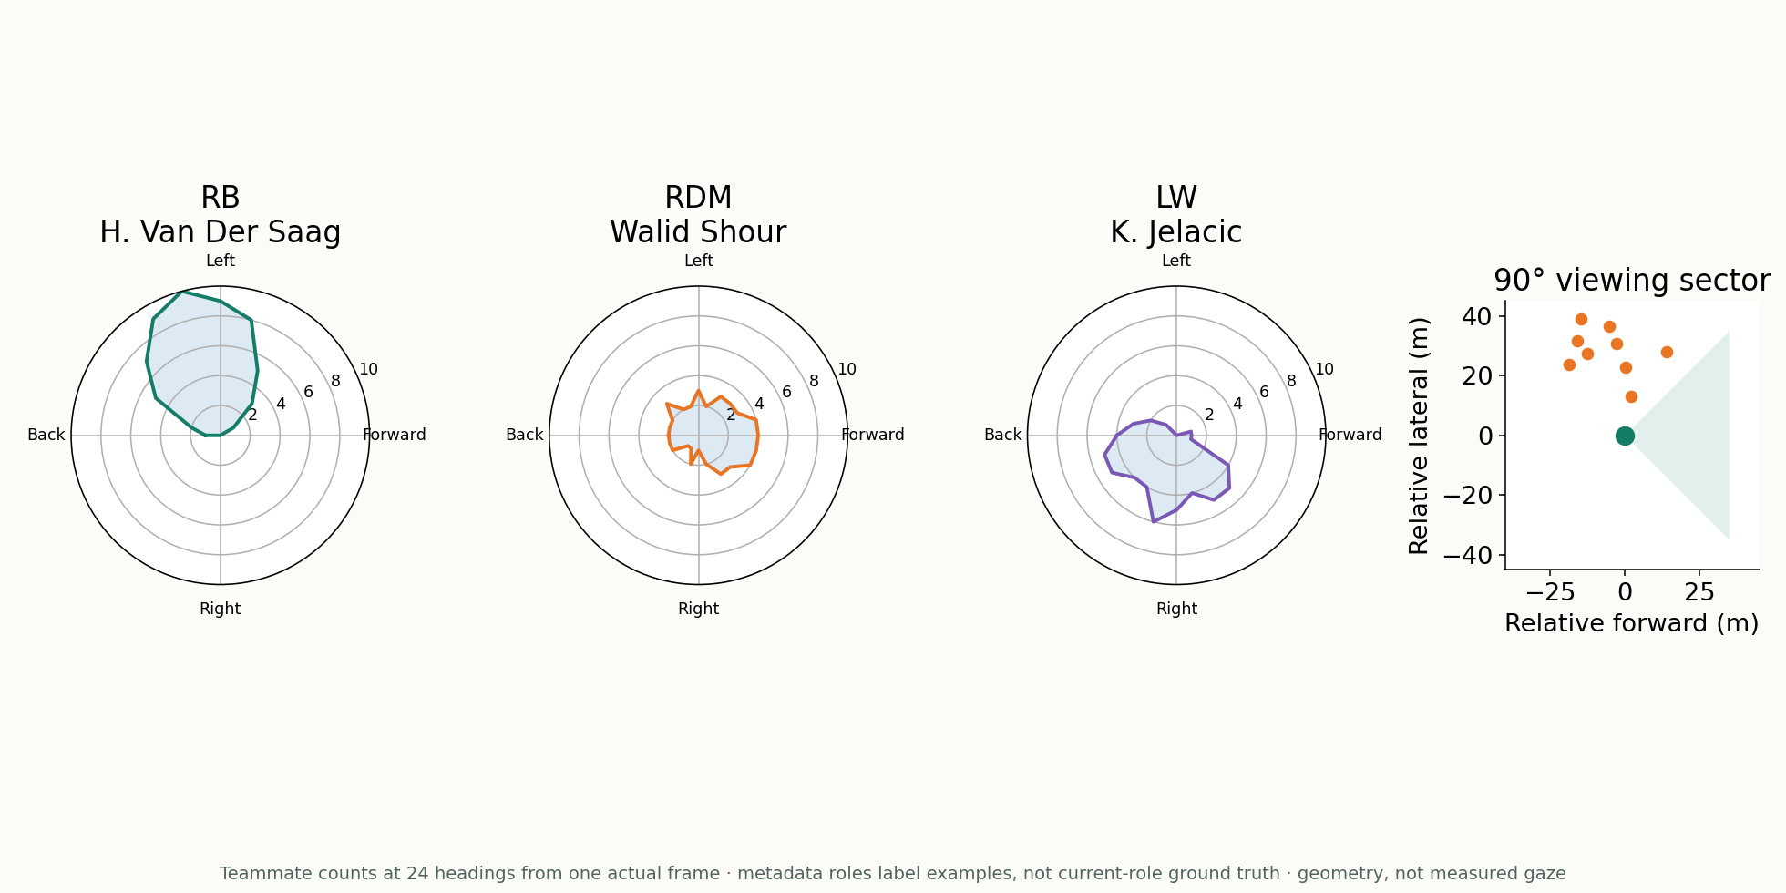
Formation and position identification
Which spatial signature describes a role?
Problem
Distinguish players by where their teammates lie around them.
Methods
Pleuler-inspired teammate counts across rotating 90° sectors.
Real geometry · metadata role labels
Contrasting angular signatures for wide, central and attacking roles.
Devin Pleuler: Fixed to Fluid (2024)
Notebook: 04_role_classification.ipynb
11
Notes:
Twenty-four attack-normalized headings; teammates only in the comparison. Sector geometry is not observed gaze or occlusion. Metadata roles label the examples, not frame-level ground truth. No real role-classifier performance is claimed; the notebook’s classifier training check remains synthetic.
Notebook: 04_role_classification.ipynb
https://github.com/zcochran27/tracking-data-applied-workshop/blob/main/notebooks/methods/04_role_classification.ipynb
Sources:
Devin Pleuler: Fixed to Fluid (2024)
https://github.com/devinpleuler/research/blob/master/frame-by-frame-position.md

Slide 12
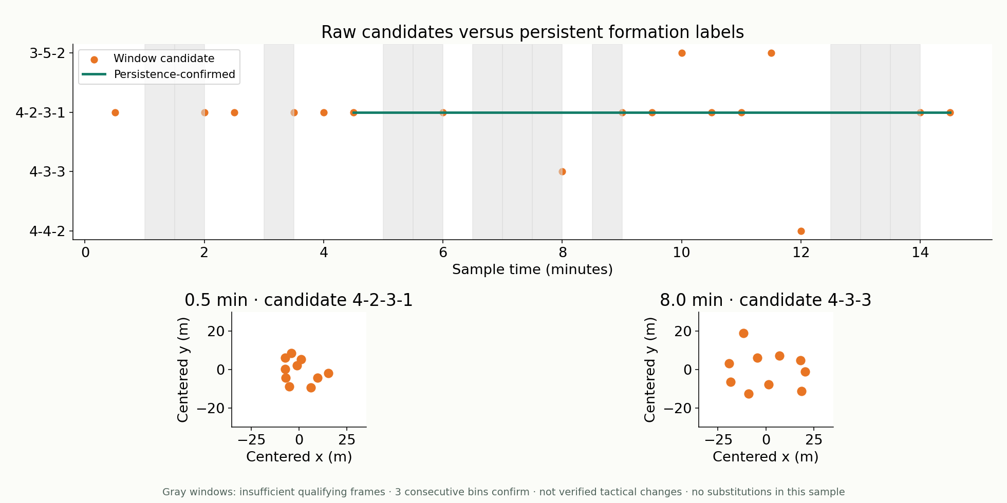
Formation and position identification
Did the formation actually change?
Problem
Separate persistent reorganization from transient shape changes.
Methods
Compare defensive windows; confirm only persistent candidates.
Candidates, not verified tactical changes
The timeline distinguishes raw candidates, confirmed labels and gaps.
Shaw & Glickman: Dynamic Analysis of Team Strategy
Joris Bekkers: Elastic Formation and Position Identification
Devin Pleuler: Fixed to Fluid (2024)
Notebook: 03_formation_analysis.ipynb
12
Notes:
Dominant timeline and before/after pitch views. Three consecutive available 30-second bins confirm a candidate; missing bins reset evidence, while the last confirmed state is retained. Gray windows are insufficient samples. No substitutions fall in this bounded sample. Differing candidates are not claimed to be verified formation changes.
Notebook: 03_formation_analysis.ipynb
https://github.com/zcochran27/tracking-data-applied-workshop/blob/main/notebooks/methods/03_formation_analysis.ipynb
Sources:
Shaw & Glickman: Dynamic Analysis of Team Strategy
https://static.capabiliaserver.com/frontend/clients/barca/wp_prod/wp-content/uploads/2020/01/83c87dfe-barca_poster_shaw.pdf
Joris Bekkers: Elastic Formation and Position Identification
https://arxiv.org/abs/2506.23843
Devin Pleuler: Fixed to Fluid (2024)
https://github.com/devinpleuler/research/blob/master/frame-by-frame-position.md

Slide 13
ANALYTICAL AVENUE
Match segmentation and phases
What tactical context should an event, shape or workload be compared within?
Questions to explore
• Possession and transition phases
• Build-up, progression and advanced play
• Defensive blocks and pressing phases
• Set pieces and interruptions
• Phase duration and boundary detection
• Context-conditioned physical/tactical summaries
Example: rule-based estimates alongside supplied SkillCorner phases
13
Notes:
What tactical context should an event, shape or workload be compared within?
Ideas: Possession and transition phases; Build-up, progression and advanced play; Defensive blocks and pressing phases; Set pieces and interruptions; Phase duration and boundary detection; Context-conditioned physical/tactical summaries
Sources:

Slide 14
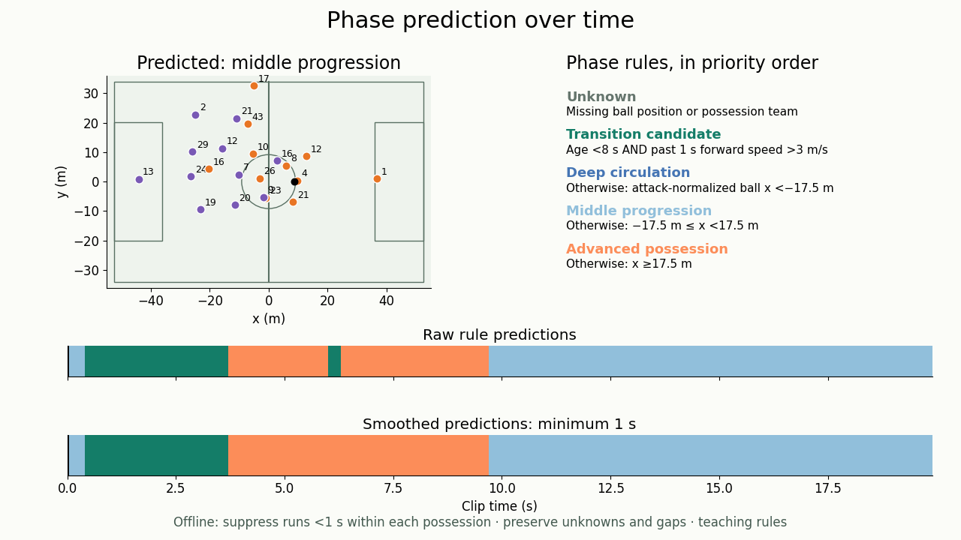
Match segmentation and phases
Phase rules and predictions over time
Problem
Segment continuous play into tactical states without brief label flickers.
Methods
Transition: age <8 s and speed >3 m/s.
Otherwise x <−17.5: deep; x <17.5: middle; else advanced.
Suppress runs <1 s.
Attack-normalized x; offline smoothing.
▶ Click video to play
Brief phase jumps disappear while sustained changes remain visible.
Augmented possession and phases framework (2025)
SkillCorner open data and schema
Notebook: 05_match_segmentation.ipynb
14
Notes:
Rules apply in priority order. Unknown when ball x is missing or possession team is unknown. Transition candidate when possession age <8 s and trailing 1 s mean forward ball speed >3 m/s (minimum five valid 10 Hz intervals). Otherwise use attack-normalized ball x: deep circulation below -17.5 m, middle progression from -17.5 to below 17.5 m, advanced possession at or above 17.5 m. Offline smoothing accepts raw runs lasting at least 1 s in each known-data block within an uninterrupted possession. Shorter runs inherit the last accepted label; leading short runs inherit the first accepted label, and a block with no accepted run remains unknown. Unknown measurements, possession/team changes, periods and tracking/frame gaps prevent smoothing across boundaries. Changes are backdated to their raw onset after future evidence confirms duration. The video shows our raw and smoothed predictions only, with the rules on screen. Thresholds are teaching assumptions; smoothing can hide genuine short transitions. No accuracy claim.
Notebook: 05_match_segmentation.ipynb
https://github.com/zcochran27/tracking-data-applied-workshop/blob/main/notebooks/methods/05_match_segmentation.ipynb
Embedded video (click to play): assets/videos/phase_predictions.mp4
Rules apply in priority order. Unknown when ball x is missing or possession team is unknown. Transition candidate when possession age <8 s and trailing 1 s mean forward ball speed >3 m/s (minimum five valid 10 Hz intervals). Otherwise use attack-normalized ball x: deep circulation below -17.5 m, middle progression from -17.5 to below 17.5 m, advanced possession at or above 17.5 m. Offline smoothing accepts raw runs lasting at least 1 s in each known-data block within an uninterrupted possession. Shorter runs inherit the last accepted label; leading short runs inherit the first accepted label, and a block with no accepted run remains unknown. Unknown measurements, possession/team changes, periods and tracking/frame gaps prevent smoothing across boundaries. Changes are backdated to their raw onset after future evidence confirms duration. The video shows our raw and smoothed predictions only, with the rules on screen. Thresholds are teaching assumptions; smoothing can hide genuine short transitions. No accuracy claim.
Sources:
Augmented possession and phases framework (2025)
https://doi.org/10.1177/22150218241290988
SkillCorner open data and schema
https://github.com/SkillCorner/opendata

Slide 15
ANALYTICAL AVENUE
Physical metrics
How much did players move, and what physical capacities did they demonstrate?
Questions to explore
• Distance and valid tracking exposure
• High-speed and sprint distance
• Sprint efforts and repeated intensity
• Acceleration and braking
• Time to high-speed running / sprint
• PSV-99 and Peak Velocity
Sample calculations and official provider definitions are labeled separately
15
Notes:
How much did players move, and what physical capacities did they demonstrate?
Ideas: Distance and valid tracking exposure; High-speed and sprint distance; Sprint efforts and repeated intensity; Acceleration and braking; Time to high-speed running / sprint; PSV-99 and Peak Velocity
Sources:

Slide 16
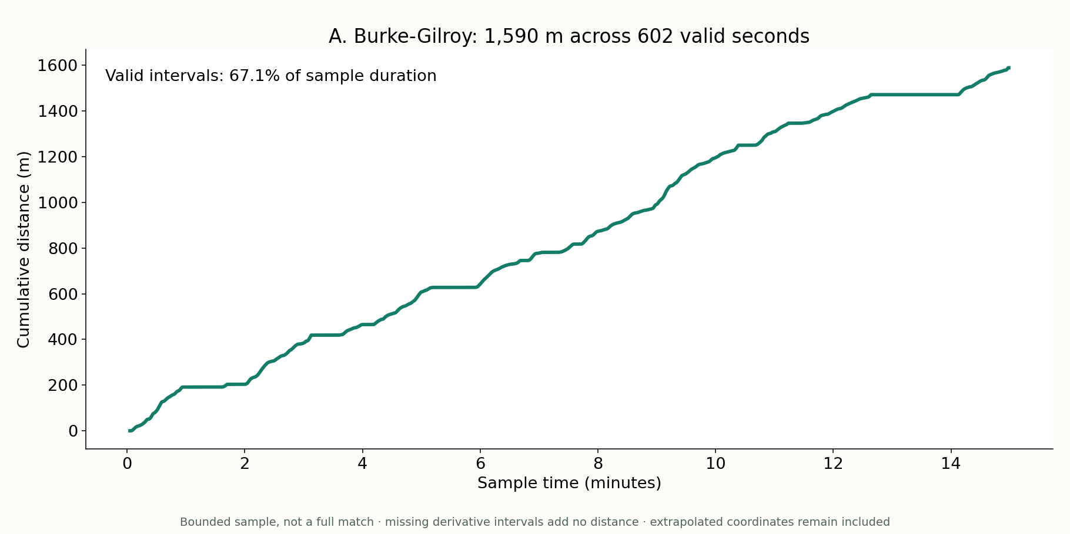
Physical metrics
How much ground did one player cover?
Problem
Measure movement volume without hiding missing intervals.
Methods
Integrate speed only across valid consecutive intervals.
Smoothed sample estimate
Cumulative distance is reported alongside the valid sample coverage.
DataBallPy covered distance
DataBallPy preprocessing
Notebook: 06_physical_metrics.ipynb
16
Notes:
Same smoothing and contiguous-segment derivative rules as notebook 06. Cumulative distance uses mean endpoint speeds and observed elapsed time. Coverage is valid integration seconds divided by bounded sample duration. Extrapolated positions may still contribute; no full-match extrapolation.
Notebook: 06_physical_metrics.ipynb
https://github.com/zcochran27/tracking-data-applied-workshop/blob/main/notebooks/methods/06_physical_metrics.ipynb
Sources:
DataBallPy covered distance
https://databallpy.readthedocs.io/en/main/features/covered_distance_page.html
DataBallPy preprocessing
https://databallpy.readthedocs.io/en/main/getting_started/preprocessing_options.html

Slide 17
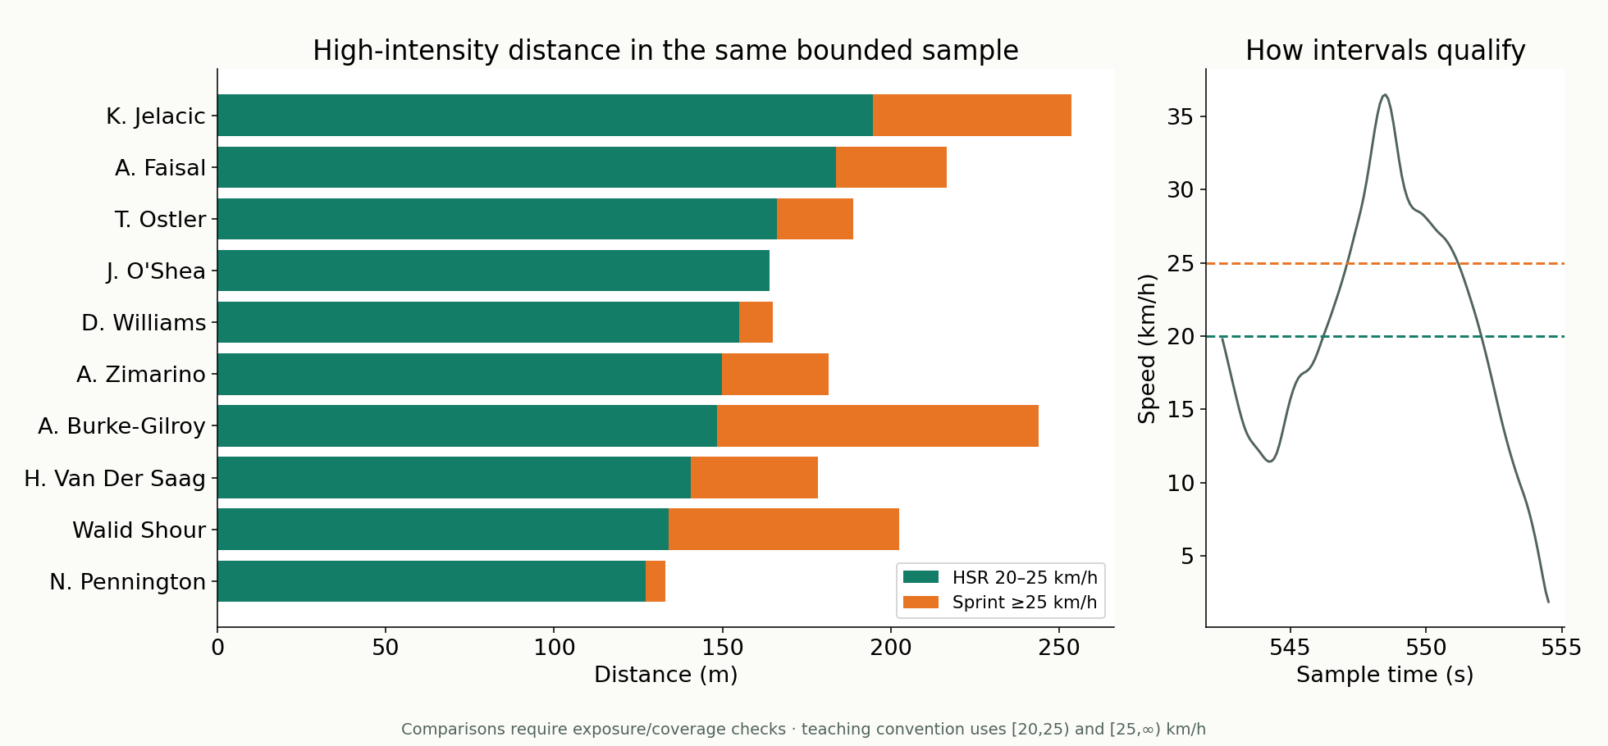
Physical metrics
Who accumulated high-intensity distance?
Problem
Separate high-speed running from total movement volume.
Methods
Integrate distances within explicitly defined speed bands.
Bounded-sample player comparison
Player comparison bars show HSR and sprint contributions.
SkillCorner physical thresholds and time-to metrics
DataBallPy covered distance
Notebook: 06_physical_metrics.ipynb
17
Notes:
Main bars: HSR [20,25) and sprint [25,infinity) km/h. Small speed trace illustrates threshold-qualified intervals. Exact equality handling is a teaching convention. Compare exposure/coverage before interpreting player rankings; these are not full-match or official production totals.
Notebook: 06_physical_metrics.ipynb
https://github.com/zcochran27/tracking-data-applied-workshop/blob/main/notebooks/methods/06_physical_metrics.ipynb
Sources:
SkillCorner physical thresholds and time-to metrics
https://skillcorner.com/us/articles/scouted-brazilian-centre-backs
DataBallPy covered distance
https://databallpy.readthedocs.io/en/main/features/covered_distance_page.html

Slide 18
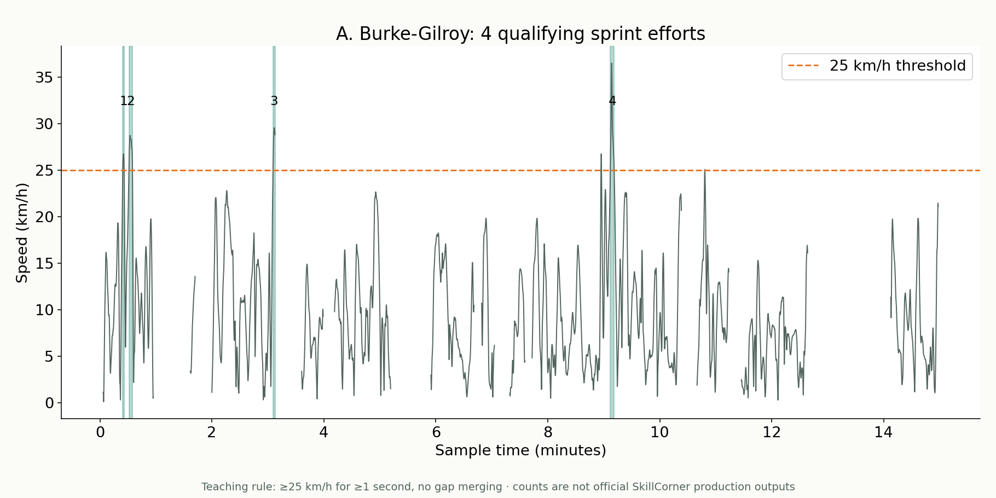
Physical metrics
How many sprint efforts qualified?
Problem
Distinguish sustained sprint efforts from brief speed spikes.
Methods
Threshold speed, minimum duration and an explicit gap rule.
Teaching effort definition
Qualifying efforts are shaded and counted on the speed trace.
SkillCorner physical thresholds and time-to metrics
DataBallPy preprocessing
Notebook: 06_physical_metrics.ipynb
18
Notes:
Uses ≥25 km/h for at least one second, with no merging across gaps. Efforts are numbered on the trace; count comes from notebook 06. These are not exact SkillCorner production effort counts.
Notebook: 06_physical_metrics.ipynb
https://github.com/zcochran27/tracking-data-applied-workshop/blob/main/notebooks/methods/06_physical_metrics.ipynb
Sources:
SkillCorner physical thresholds and time-to metrics
https://skillcorner.com/us/articles/scouted-brazilian-centre-backs
DataBallPy preprocessing
https://databallpy.readthedocs.io/en/main/getting_started/preprocessing_options.html

Slide 19
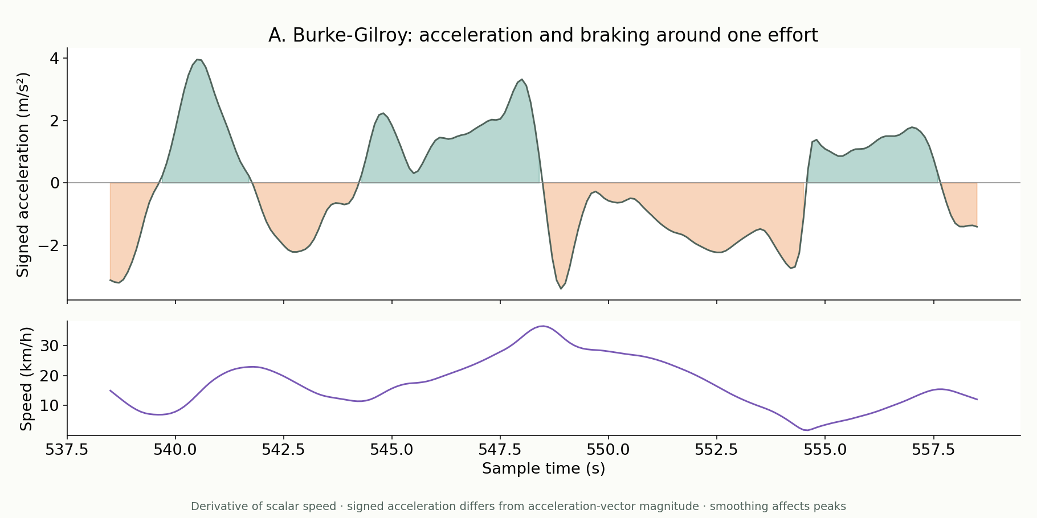
Physical metrics
When does the player accelerate or brake?
Problem
Describe speeding up and slowing down around an effort.
Methods
Differentiate smoothed scalar speed within valid segments.
Signed acceleration · m/s²
Positive bursts and braking intervals align with the speed trace.
SkillCorner explosive accelerations
DataBallPy preprocessing
Notebook: 06_physical_metrics.ipynb
19
Notes:
Large signed acceleration trace; small synchronized speed trace. This is not acceleration-vector magnitude, and highlighted positive/negative samples are not automatically production-qualified explosive efforts. Derivatives amplify noise; smoothing changes peaks.
Notebook: 06_physical_metrics.ipynb
https://github.com/zcochran27/tracking-data-applied-workshop/blob/main/notebooks/methods/06_physical_metrics.ipynb
Sources:
SkillCorner explosive accelerations
https://skillcorner.com/articles/new-feature-explosive-accelerations
DataBallPy preprocessing
https://databallpy.readthedocs.io/en/main/getting_started/preprocessing_options.html

Slide 20
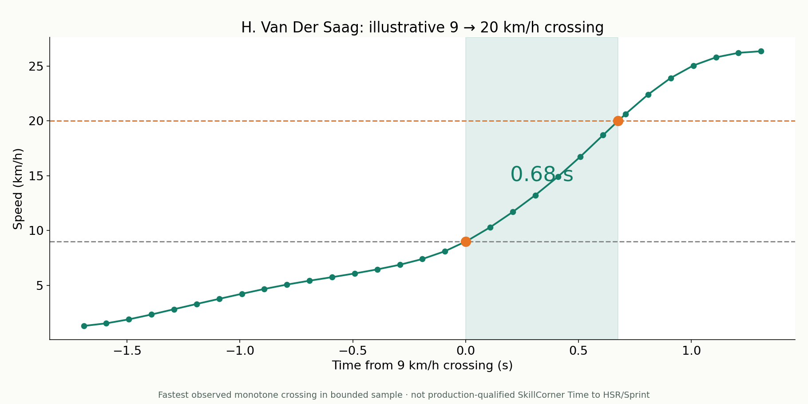
Physical metrics
How quickly does the player reach HSR?
Problem
Measure the elapsed time from 9 to 20 km/h.
Methods
Inspect and interpolate one continuous rising-speed trajectory.
Illustrative sample crossing
The observed threshold-crossing interval is visible and labeled.
SkillCorner physical thresholds and time-to metrics
SkillCorner explosive accelerations
Notebook: 06_physical_metrics.ipynb
20
Notes:
Separate slide for 9→20 km/h. Shows fastest qualifying monotone crossing found by the notebook’s sample rule. Official SkillCorner Time to HSR uses additional explosive-acceleration qualification; this slide does not reproduce that production metric.
Notebook: 06_physical_metrics.ipynb
https://github.com/zcochran27/tracking-data-applied-workshop/blob/main/notebooks/methods/06_physical_metrics.ipynb
Sources:
SkillCorner physical thresholds and time-to metrics
https://skillcorner.com/us/articles/scouted-brazilian-centre-backs
SkillCorner explosive accelerations
https://skillcorner.com/articles/new-feature-explosive-accelerations

Slide 21
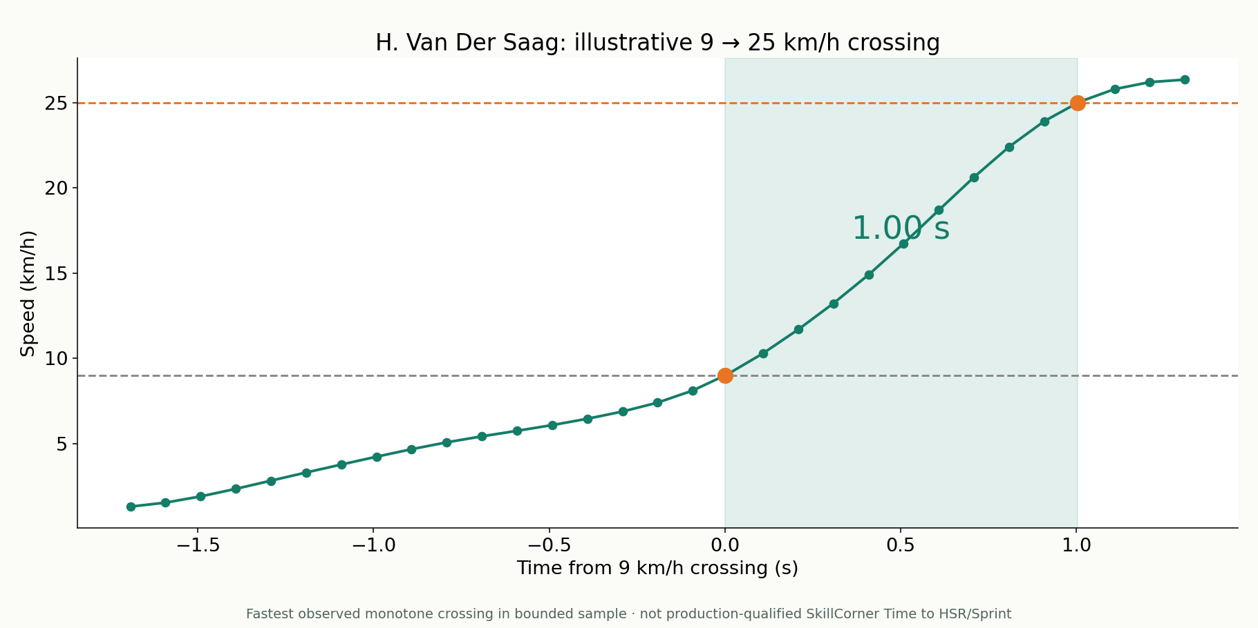
Physical metrics
How quickly does the player reach sprint speed?
Problem
Measure the elapsed time from 9 to 25 km/h.
Methods
Inspect and interpolate one continuous rising-speed trajectory.
Illustrative sample crossing
Time to sprint is distinct from the maximum speed reached.
SkillCorner physical thresholds and time-to metrics
SkillCorner explosive accelerations
Notebook: 06_physical_metrics.ipynb
21
Notes:
Separate slide for 9→25 km/h with its own actual trajectory. No official Time to Sprint or Top-3 metric is reconstructed; opportunity, qualification and filtering matter.
Notebook: 06_physical_metrics.ipynb
https://github.com/zcochran27/tracking-data-applied-workshop/blob/main/notebooks/methods/06_physical_metrics.ipynb
Sources:
SkillCorner physical thresholds and time-to metrics
https://skillcorner.com/us/articles/scouted-brazilian-centre-backs
SkillCorner explosive accelerations
https://skillcorner.com/articles/new-feature-explosive-accelerations

Slide 22
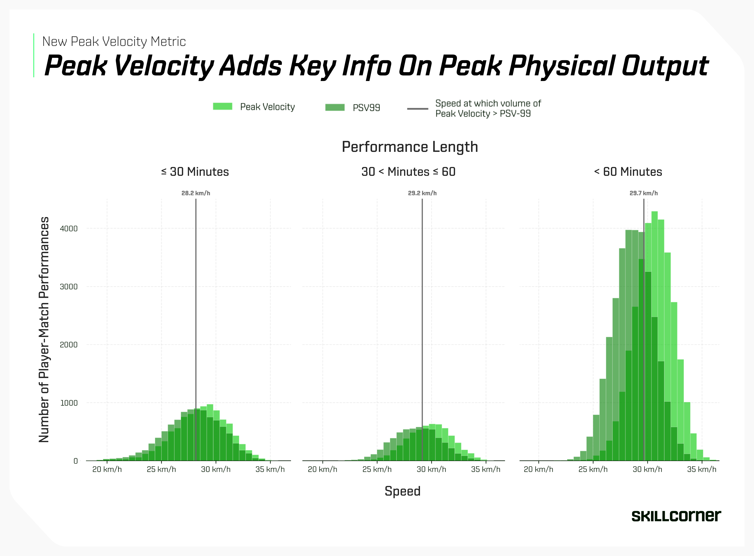
Physical metrics
PSV-99: a robust speed-capacity proxy
Problem
How can speed capacity be summarized without one noisy maximum?
Methods
SkillCorner’s 99th percentile of physical activities above 15 km/h.
Published SkillCorner example
The published example contrasts an activity-based proxy with peak speed.
SkillCorner PSV-99 and Peak Velocity
22
Notes:
Original chart from SkillCorner, Peak Velocity article, 11 June 2026. PSV-99 is described as the 99th percentile of physical activities over 15 km/h, not all frame speeds. This figure is supplied research/product communication, not our sample calculation. Retain original legend and axes.
Sources:
SkillCorner PSV-99 and Peak Velocity
https://skillcorner.com/articles/skillcorner-releases-new-peak-velocity-metric

Slide 23
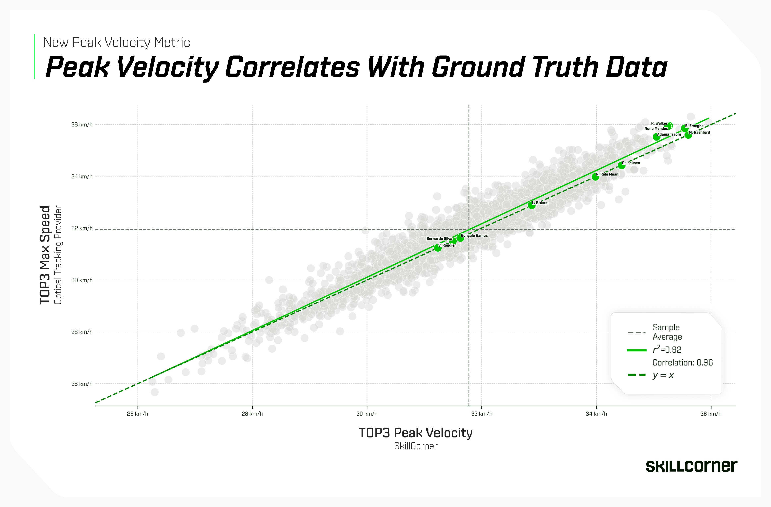
Physical metrics
Peak Velocity: absolute top-end speed
Problem
What is the highest speed a player reliably reaches?
Methods
SkillCorner’s validated maximum-speed processing.
Published provider validation
The provider’s published validation compares Peak Velocity with ground truth.
SkillCorner PSV-99 and Peak Velocity
23
Notes:
Original SkillCorner figure. Article reports correlation 0.96 / R² 0.92 when averaging each player’s top three metric values in the displayed validation. Do not generalize this validation to our smoothed sample maxima or to every competition.
Sources:
SkillCorner PSV-99 and Peak Velocity
https://skillcorner.com/articles/skillcorner-releases-new-peak-velocity-metric

Slide 24
ANALYTICAL AVENUE
Game modeling
Which locations, options and game states create or prevent scoring opportunities?
Questions to explore
• Shot quality and location value
• Control, interception and completion
• Accessible and dangerous space
• Off-ball options and run threat
• Graphs and learned relational models
• Possession value and tactical applications
Start with simpler models, then add interactions and learned value
24
Notes:
Which locations, options and game states create or prevent scoring opportunities?
Ideas: Shot quality and location value; Control, interception and completion; Accessible and dangerous space; Off-ball options and run threat; Graphs and learned relational models; Possession value and tactical applications
Sources:

Slide 25
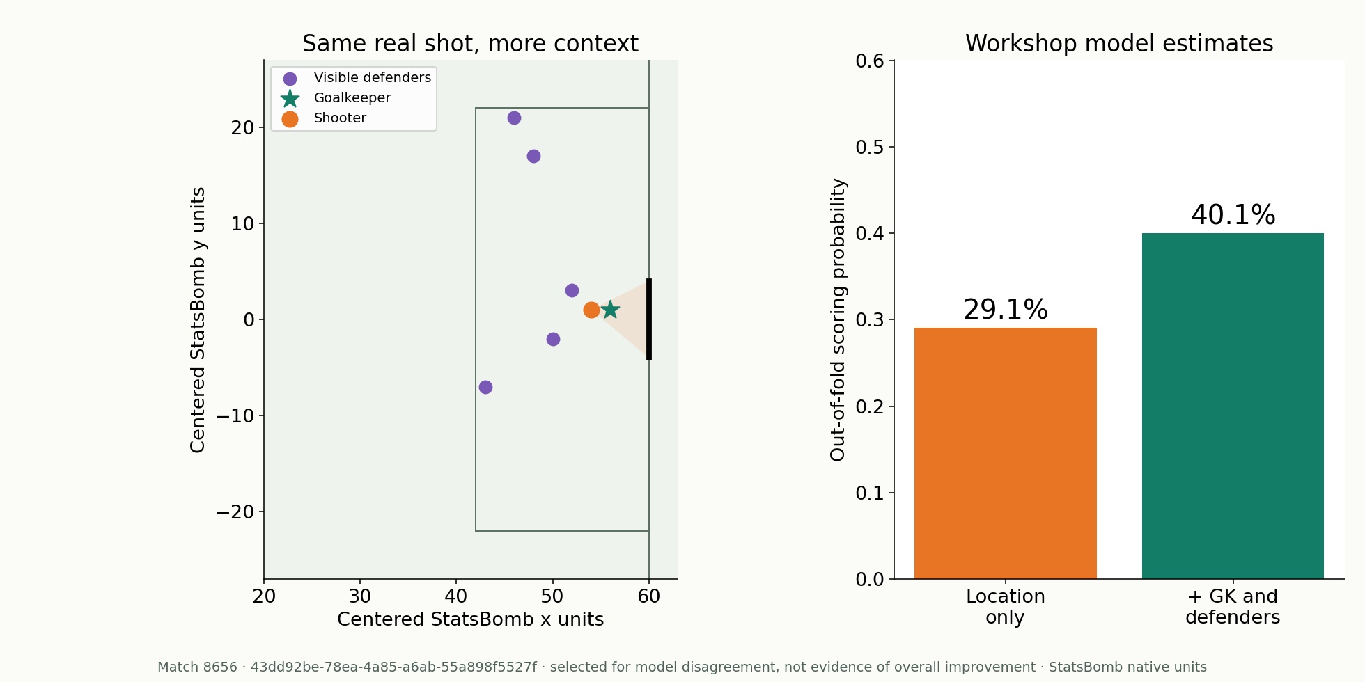
Game modeling
How does context change a shot estimate?
Problem
Location alone cannot describe the goalkeeper and defenders.
Methods
Compare location-only and contextual logistic xG on the same shot.
StatsBomb shot freeze frame
The same real freeze frame receives two different held-out estimates.
StatsBomb: Upgrading Expected Goals
Notebook: 07_expected_goals.ipynb
25
Notes:
Actual out-of-fold predictions from notebook 07; no model used the example match during that fold’s training. Context includes goalkeeper distance/offset and defender geometry. Selected for model disagreement, not as evidence of aggregate improvement. Freeze-frame coverage is not continuous full tracking.
Notebook: 07_expected_goals.ipynb
https://github.com/zcochran27/tracking-data-applied-workshop/blob/main/notebooks/methods/07_expected_goals.ipynb
Sources:
StatsBomb: Upgrading Expected Goals
https://blogarchive.statsbomb.com/articles/soccer/upgrading-expected-goals/

Slide 26
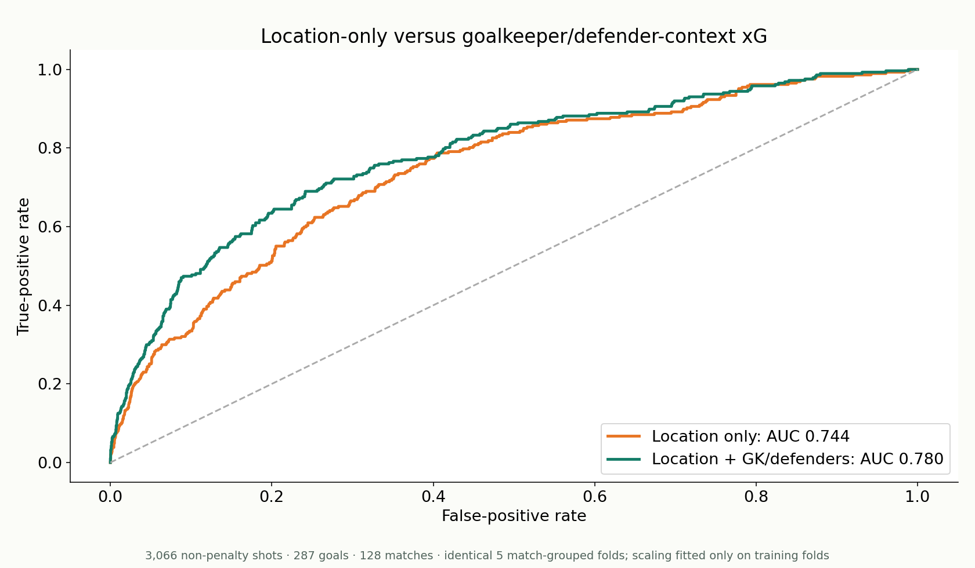
Game modeling
Does context improve xG discrimination?
Problem
Test contextual features across held-out matches, not one example.
Methods
Same five match-grouped folds for both logistic models.
3,066 shots · 128 matches
ROC AUC rises from 0.744 to 0.780 on the shared eligible cohort.
StatsBomb: Upgrading Expected Goals
Notebook: 07_expected_goals.ipynb
26
Notes:
Location AUC 0.743879, 95% match-bootstrap interval [0.713895,0.774165]; contextual 0.779870 [0.749411,0.809066]. Paired difference 0.035990 [0.021778,0.051104]. 1,000 match resamples of existing out-of-fold predictions, without refitting. Training-only scaling. ROC is discrimination, not calibration.
Notebook: 07_expected_goals.ipynb
https://github.com/zcochran27/tracking-data-applied-workshop/blob/main/notebooks/methods/07_expected_goals.ipynb
Sources:
StatsBomb: Upgrading Expected Goals
https://blogarchive.statsbomb.com/articles/soccer/upgrading-expected-goals/

Slide 27
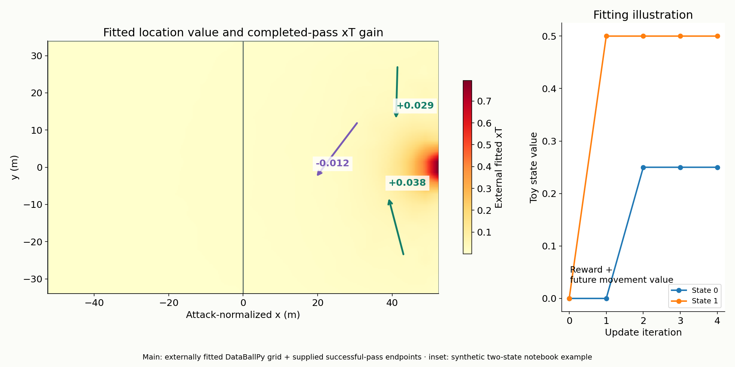
Game modeling
Which completed moves increase location value?
Problem
Value progression before a shot is taken.
Methods
Fitted location xT; value a completed move by V(end)−V(start).
External fitted model + supplied events
Actual completed passes gain or lose value on the fitted map.
Karun Singh: Expected Threat
DataBallPy fitted xT methodology
Notebook: 08_expected_threat.ipynb
27
Notes:
Main map: licensed fitted DataBallPy open-play grid; SkillCorner successful player-possession passes use release coordinates x_end/y_end and supplied reception coordinates. Attack-normalized 105 m x scaled to the model 106 m convention. Two highest positive and one highest negative gains are selected examples. Small inset: synthetic two-state fitting mechanics from notebook 08; not training the full grid on this sample. Source provenance JSON stores event IDs.
Notebook: 08_expected_threat.ipynb
https://github.com/zcochran27/tracking-data-applied-workshop/blob/main/notebooks/methods/08_expected_threat.ipynb
Sources:
Karun Singh: Expected Threat
https://karun.in/blog/expected-threat.html
DataBallPy fitted xT methodology
https://databallpy.readthedocs.io/en/main/features/xt_models.html

Slide 28
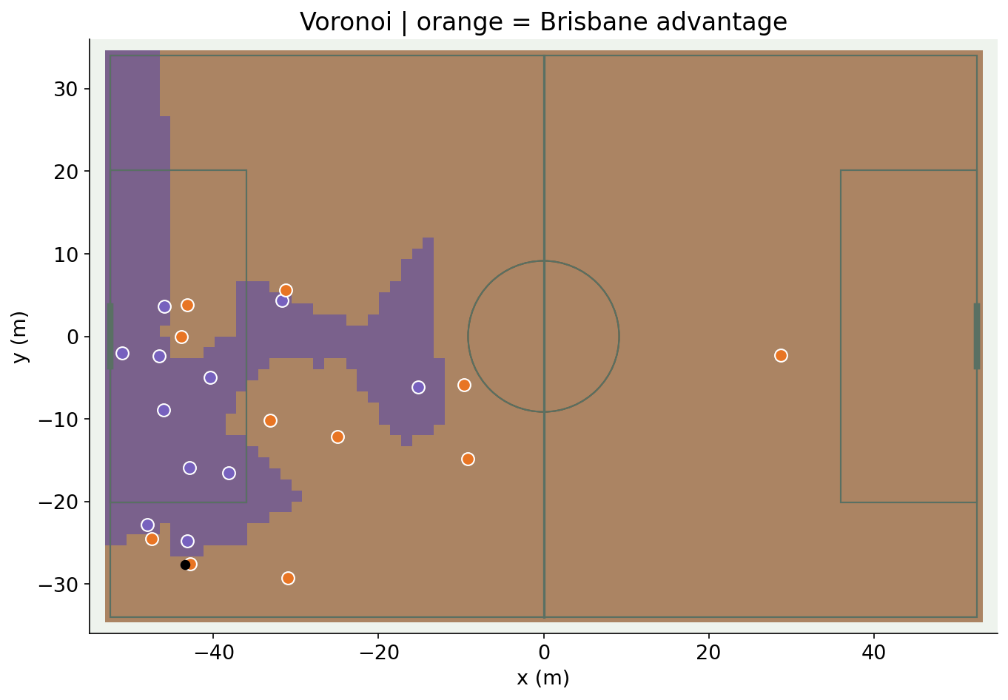
Game modeling
Who is closest to each patch of space?
Problem
Build a transparent geometric control baseline.
Methods
Voronoi regions from nearest-player distance.
Geometric baseline
Hard boundaries partition the pitch into nearest-player regions.
Space and Control in Soccer (2021)
Wide Open Spaces, Fernández & Bornn (2018)
Notebook: 09_voronoi_control.ipynb
28
Notes:
Grid approximation to Voronoi on a real frame. Strength: simple and interpretable. Limitation: ignores player movement, ball travel and uncertainty.
Notebook: 09_voronoi_control.ipynb
https://github.com/zcochran27/tracking-data-applied-workshop/blob/main/notebooks/methods/09_voronoi_control.ipynb
Sources:
Space and Control in Soccer (2021)
https://www.frontiersin.org/journals/sports-and-active-living/articles/10.3389/fspor.2021.676179/full
Wide Open Spaces, Fernández & Bornn (2018)
https://static.capabiliaserver.com/frontend/clients/barca/wp_prod/wp-content/uploads/2018/05/Wide-Open-Spaces.pdf

Slide 29
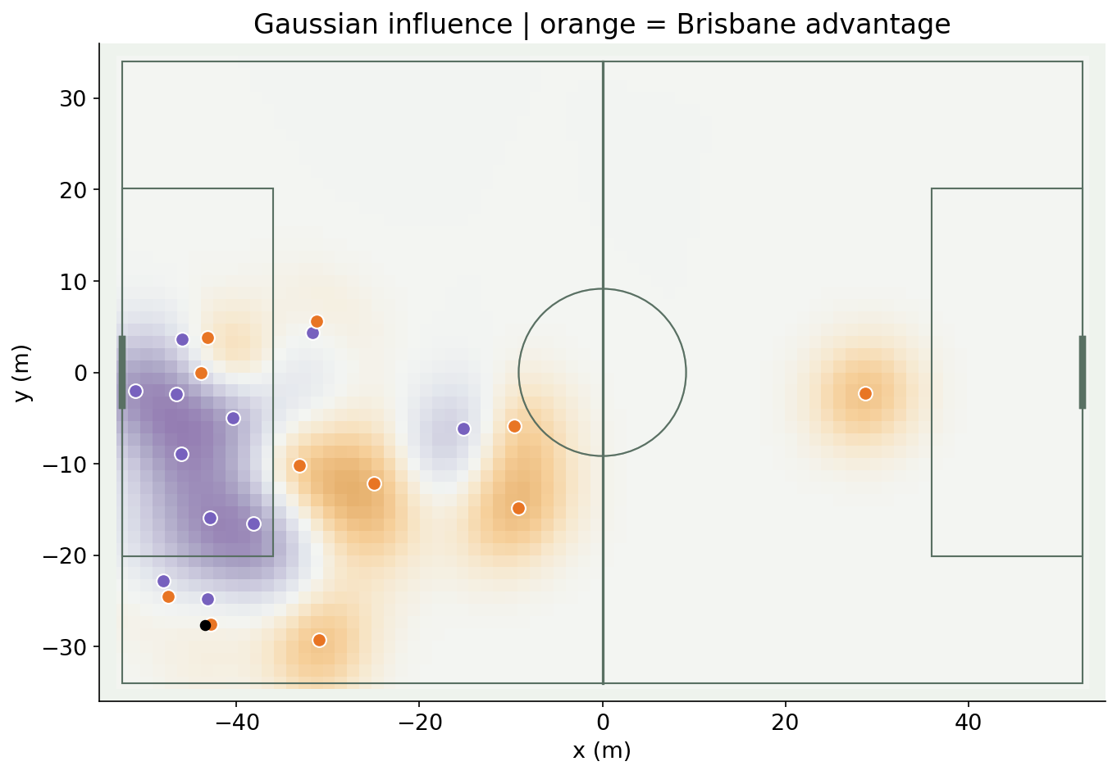
Game modeling
How does movement shape spatial influence?
Problem
Replace hard boundaries with smooth directional influence.
Methods
Projected Gaussian player influence, aggregated by team.
Uncalibrated influence score
A continuous team-influence surface reflects movement direction.
Wide Open Spaces, Fernández & Bornn (2018)
Notebook: 10_gaussian_control.ipynb
29
Notes:
Directional Gaussian teaching parameterization, not exact Fernández/Bornn covariance. Bounded team comparison is not calibrated possession probability. Velocity and covariance affect the surface; contribution is not causal importance.
Notebook: 10_gaussian_control.ipynb
https://github.com/zcochran27/tracking-data-applied-workshop/blob/main/notebooks/methods/10_gaussian_control.ipynb
Sources:
Wide Open Spaces, Fernández & Bornn (2018)
https://static.capabiliaserver.com/frontend/clients/barca/wp_prod/wp-content/uploads/2018/05/Wide-Open-Spaces.pdf

Slide 30
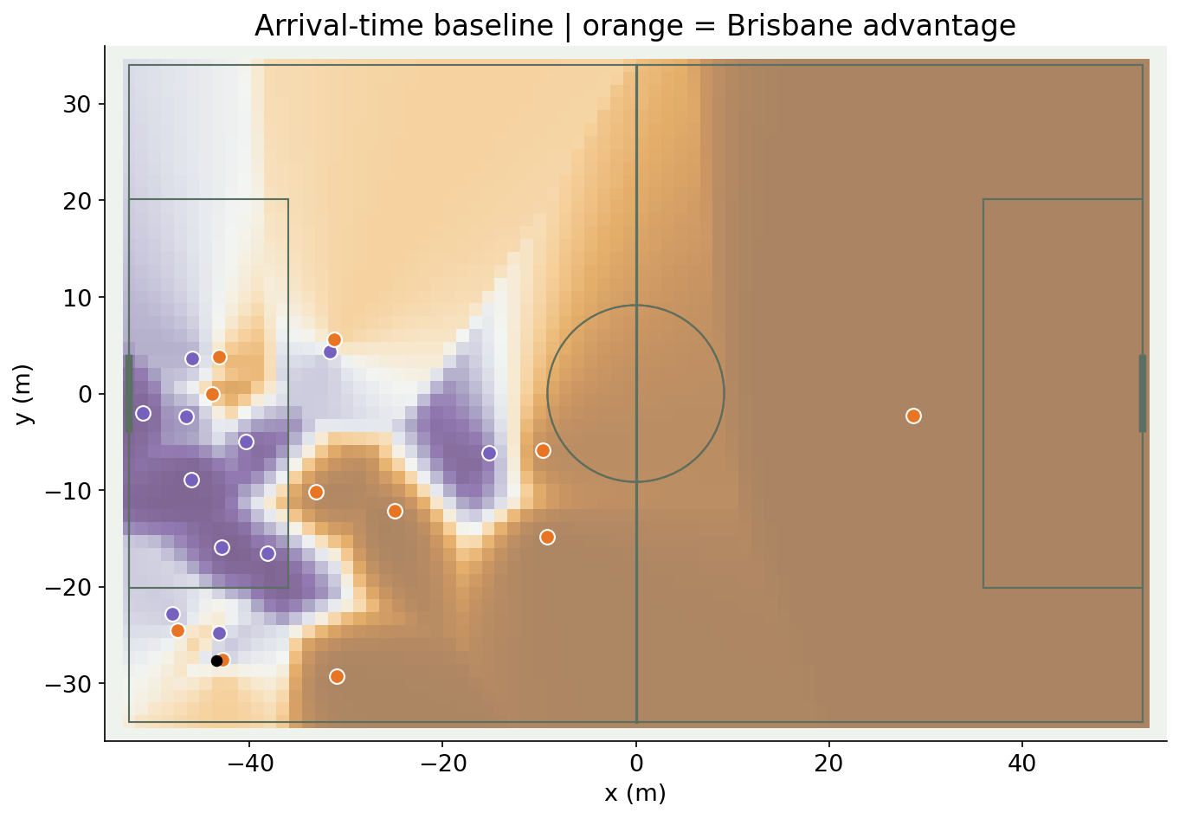
Game modeling
Which team reaches a target sooner?
Problem
Model the race to space rather than only proximity.
Methods
Reaction/projection time and earliest team travel time.
Simplified timing model
The arrival-time score exposes contested and reachable regions.
Beyond Expected Goals, Spearman (2018)
Space and Control in Soccer (2021)
Notebook: 11_arrival_time_control.ipynb
30
Notes:
0.7 s projection/reaction and 5 m/s travel baseline. No full ball-flight, acceleration optimization or competing interception-rate integration. Not the full Spearman model.
Notebook: 11_arrival_time_control.ipynb
https://github.com/zcochran27/tracking-data-applied-workshop/blob/main/notebooks/methods/11_arrival_time_control.ipynb
Sources:
Beyond Expected Goals, Spearman (2018)
https://static.hudl.com/craft/downloads/SSAC2018_Beyond_Expected_Goals.pdf?mtime=20180327111214
Space and Control in Soccer (2021)
https://www.frontiersin.org/journals/sports-and-active-living/articles/10.3389/fspor.2021.676179/full

Slide 31
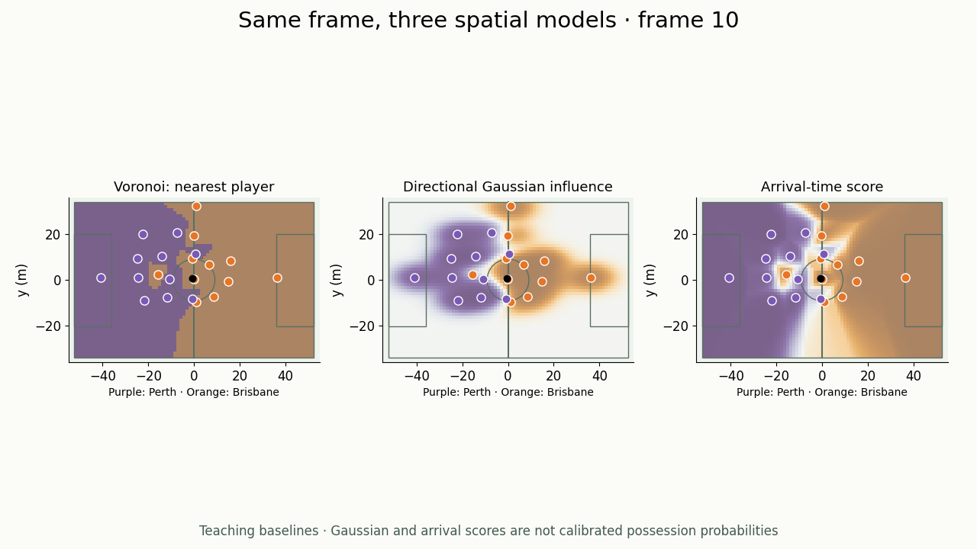
Game modeling
How do the control assumptions change the answer?
Problem
Compare methods without changing the tracking situation.
Methods
Voronoi, Gaussian and arrival-time baselines on identical frames.
Same frame · same grid
▶ Click video to play
The moving comparison makes each model’s different boundaries visible.
Wide Open Spaces, Fernández & Bornn (2018)
Beyond Expected Goals, Spearman (2018)
Notebook: 11_arrival_time_control.ipynb
31
Notes:
Original synchronized comparison video. Scores are teaching outputs, not calibrated possession probabilities; parameter choices are stated in assets/videos/README.md. Sampled at 5 Hz with real-time playback.
Notebook: 11_arrival_time_control.ipynb
https://github.com/zcochran27/tracking-data-applied-workshop/blob/main/notebooks/methods/11_arrival_time_control.ipynb
Embedded video (click to play): assets/videos/control_comparison.mp4
Original synchronized comparison video. Scores are teaching outputs, not calibrated possession probabilities; parameter choices are stated in assets/videos/README.md. Sampled at 5 Hz with real-time playback.
Sources:
Wide Open Spaces, Fernández & Bornn (2018)
https://static.capabiliaserver.com/frontend/clients/barca/wp_prod/wp-content/uploads/2018/05/Wide-Open-Spaces.pdf
Beyond Expected Goals, Spearman (2018)
https://static.hudl.com/craft/downloads/SSAC2018_Beyond_Expected_Goals.pdf?mtime=20180327111214

Slide 32
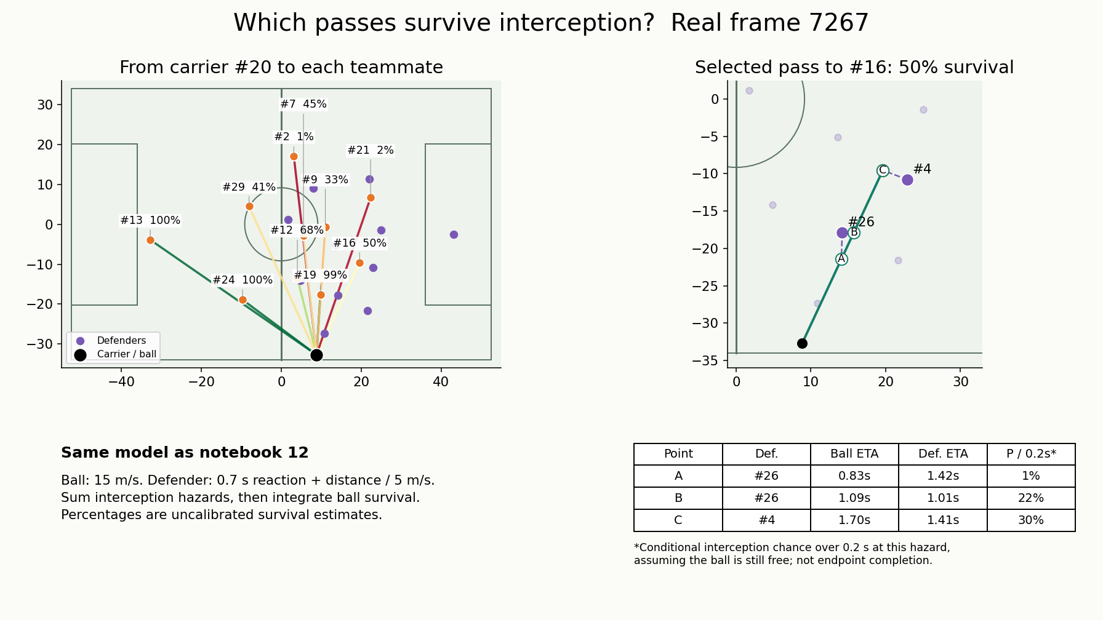
Game modeling
Which passes survive interception?
Problem
Compare passing options and identify where defenders threaten a ball path.
Methods
Simulate ball travel, estimate defender arrival, then integrate interception risk.
Uncalibrated teaching model; hypothetical ground passes.
▶ Click video to play
Passing scores and defender probes come from the same survival model.
Beyond Expected Goals, Spearman (2018)
Notebook: 12_pass_completion.ipynb
32
Notes:
Same interception_components as notebook 12, not the accessible-space main map previously used here. Real frame with known nearby carrier and 22 players; ten teammate options excluding carrier. Constant ball speed 15 m/s, player arrival 0.7 s + distance/5 m/s, hazard 2*sigmoid((ball_time-arrival)/0.15), 40 path points, trapezoidal integration and exp(-cumulative hazard). Selected pass has 15–80% survival and at least two potential interceptors under the assumed model. Dashed defender-to-path links and table compare ball and defender ETAs at three points. Per-defender local P over 0.2 s = 1-exp(-hazard*0.2), conditional on a free ball and constant local hazard; these are not whole-pass completion probabilities and cannot be added. Percentages on teammate rays are endpoint ball-survival estimates. Receivers do not move or need to control the ball; offside, pass execution error and height are not modeled. No calibration or accuracy claim. The model is an independent teaching construction, not an exact Spearman implementation.
Notebook: 12_pass_completion.ipynb
https://github.com/zcochran27/tracking-data-applied-workshop/blob/main/notebooks/methods/12_pass_completion.ipynb
Embedded video (click to play): assets/videos/pass_survival_options.mp4
Same interception_components as notebook 12, not the accessible-space main map previously used here. Real frame with known nearby carrier and 22 players; ten teammate options excluding carrier. Constant ball speed 15 m/s, player arrival 0.7 s + distance/5 m/s, hazard 2*sigmoid((ball_time-arrival)/0.15), 40 path points, trapezoidal integration and exp(-cumulative hazard). Selected pass has 15–80% survival and at least two potential interceptors under the assumed model. Dashed defender-to-path links and table compare ball and defender ETAs at three points. Per-defender local P over 0.2 s = 1-exp(-hazard*0.2), conditional on a free ball and constant local hazard; these are not whole-pass completion probabilities and cannot be added. Percentages on teammate rays are endpoint ball-survival estimates. Receivers do not move or need to control the ball; offside, pass execution error and height are not modeled. No calibration or accuracy claim. The model is an independent teaching construction, not an exact Spearman implementation.
Sources:
Beyond Expected Goals, Spearman (2018)
https://static.hudl.com/craft/downloads/SSAC2018_Beyond_Expected_Goals.pdf?mtime=20180327111214

Slide 33
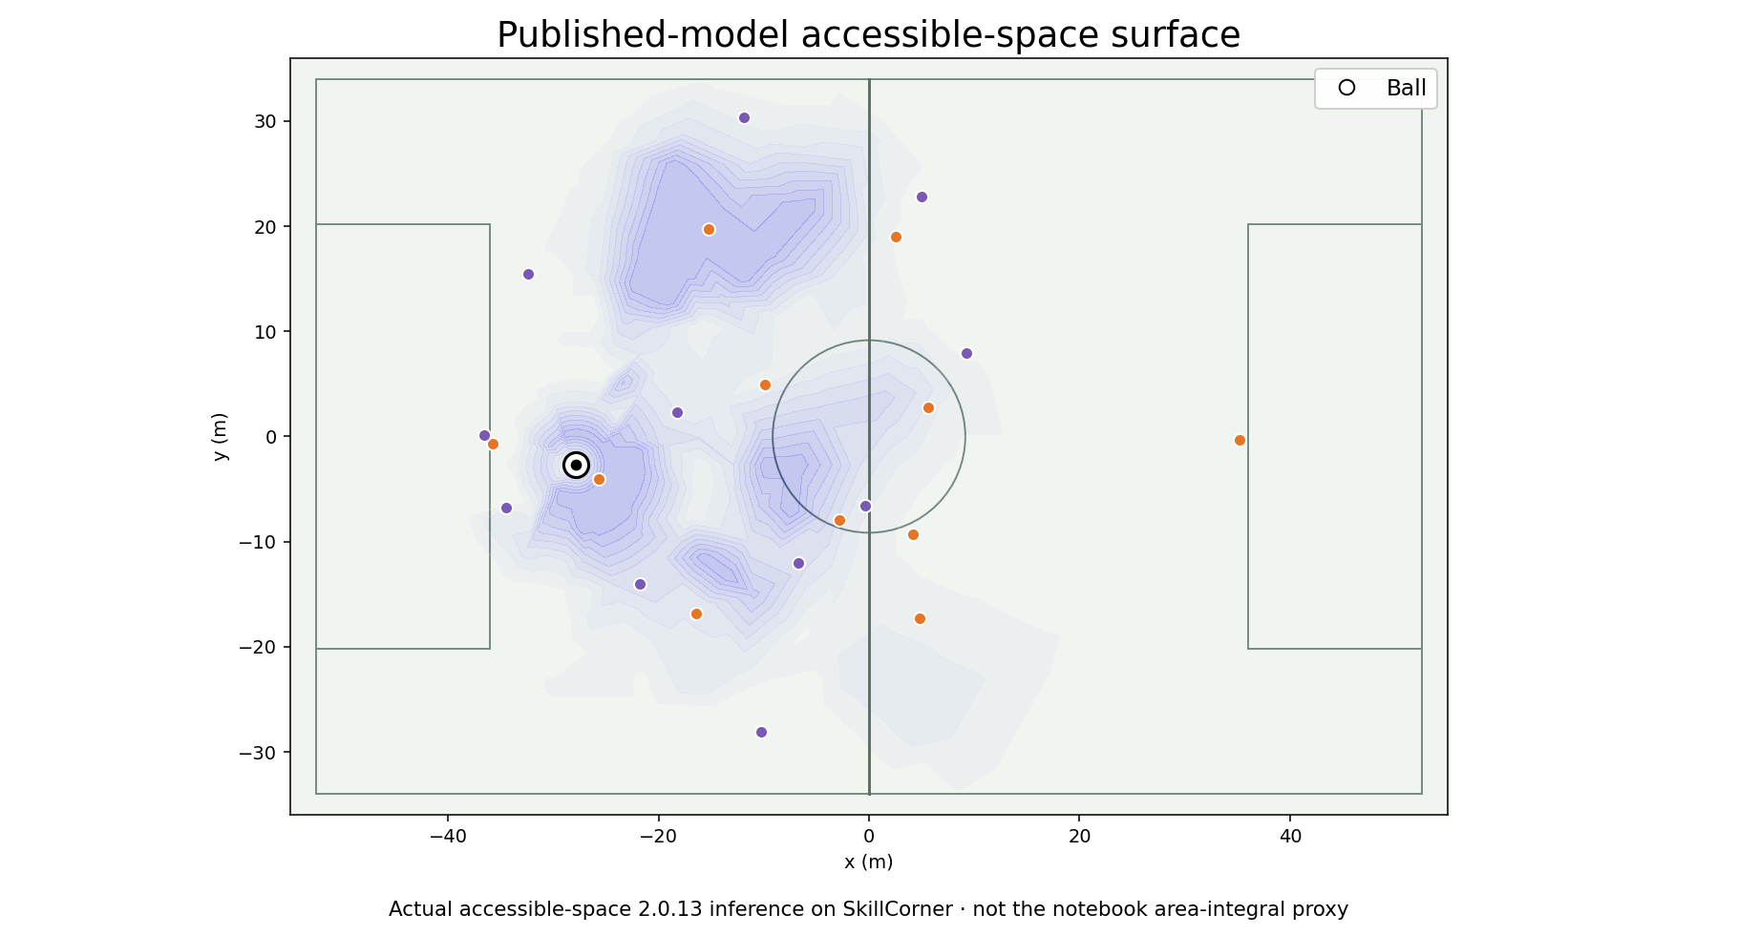
Game modeling
Where can the attacking team receive?
Problem
Measure space that is accessible through potential passes.
Methods
Published pass-flight and player-interception simulation.
Published implementation output
The accessible-space surface identifies receiving opportunity.
Dangerous Accessible Space: paper and implementation
DataBallPy DAS and expected completion
Notebook: 13_space_and_danger.ipynb
33
Notes:
Actual accessible-space inference. Public model simulation settings and frame provenance are recorded in assets/results/space_result_provenance.json. Notebook 13 demonstrates a simpler area-integral proxy; it is not this published output. AS is an area quantity; individual accessible regions may overlap.
Notebook: 13_space_and_danger.ipynb
https://github.com/zcochran27/tracking-data-applied-workshop/blob/main/notebooks/methods/13_space_and_danger.ipynb
Sources:
Dangerous Accessible Space: paper and implementation
https://github.com/jonas-bischofberger/accessible-space
DataBallPy DAS and expected completion
https://databallpy.readthedocs.io/en/main/features/dangerous_accessible_space.html

Slide 34
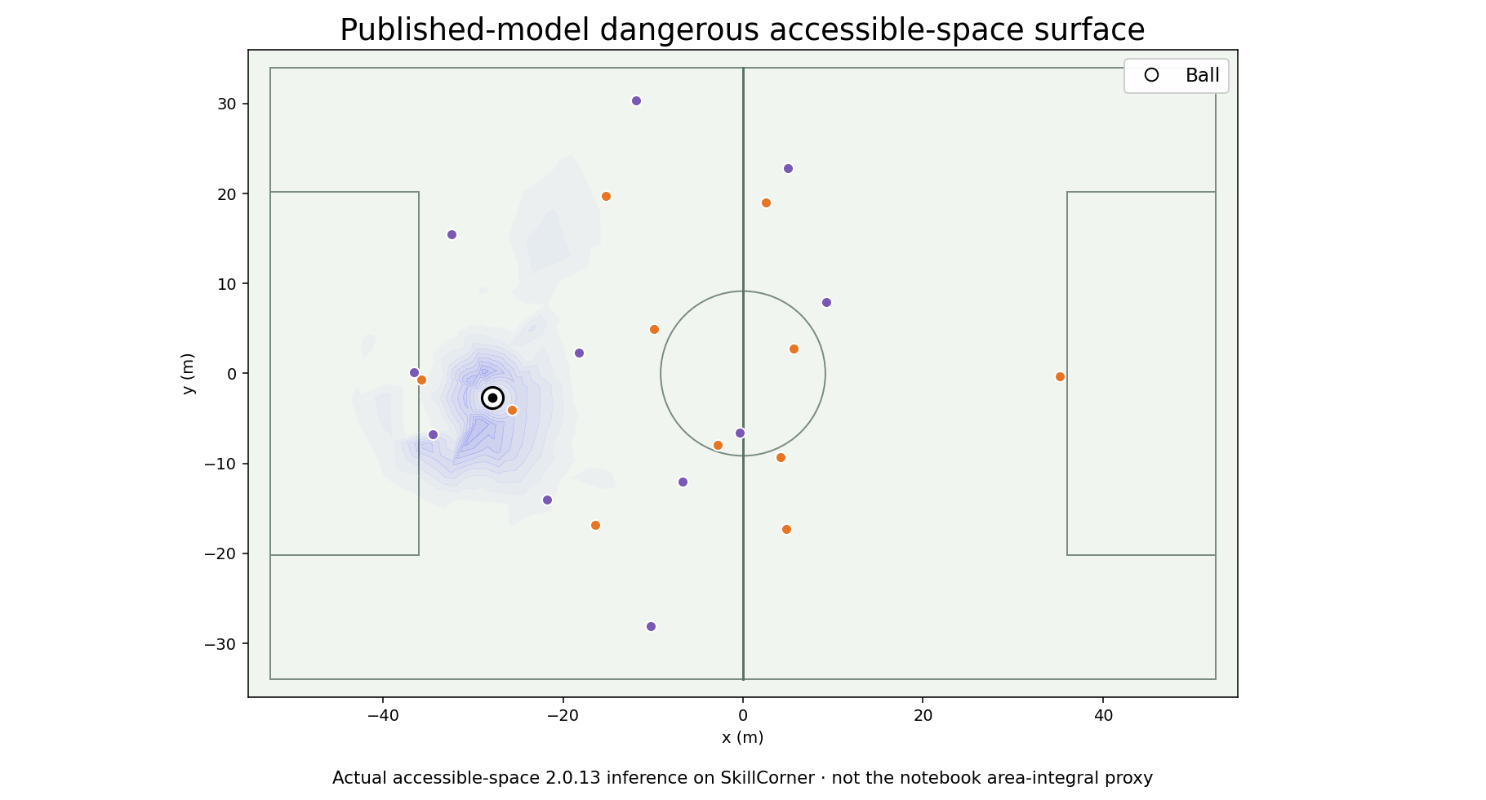
Game modeling
Which accessible space is dangerous?
Problem
Separate available territory from valuable territory.
Methods
Weight published accessibility by the model’s danger definition.
Danger-weighted area, not xG
Danger weighting concentrates attention on useful receiving space.
Dangerous Accessible Space: paper and implementation
DataBallPy DAS and expected completion
Notebook: 13_space_and_danger.ipynb
34
Notes:
Published dangerous-accessible-space output on the same frame as AS. DAS units are danger-weighted square metres, not scoring probability. The notebook’s chosen distance-based danger proxy is separate.
Notebook: 13_space_and_danger.ipynb
https://github.com/zcochran27/tracking-data-applied-workshop/blob/main/notebooks/methods/13_space_and_danger.ipynb
Sources:
Dangerous Accessible Space: paper and implementation
https://github.com/jonas-bischofberger/accessible-space
DataBallPy DAS and expected completion
https://databallpy.readthedocs.io/en/main/features/dangerous_accessible_space.html

Slide 35
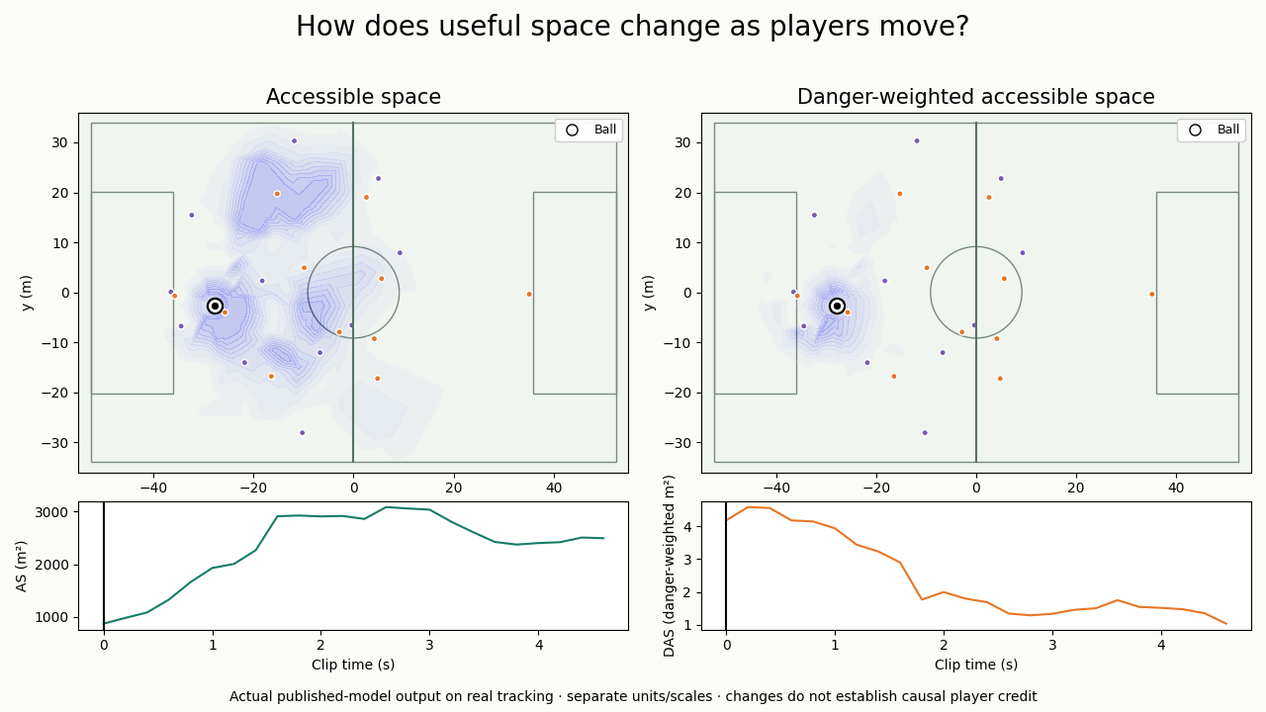
Game modeling
How does useful space change during play?
Problem
Connect movement to changing options over time.
Methods
Recompute published AS and DAS on successive real frames.
Actual model output over time
▶ Click video to play
The video links changing surfaces with their own value traces.
Dangerous Accessible Space: paper and implementation
DataBallPy DAS and expected completion
Notebook: 13_space_and_danger.ipynb
35
Notes:
Published accessible-space outputs at 5 Hz; traces show AS m² and DAS danger-weighted m² separately. Team/possession context must be read with the clip. Before/after movement does not establish causal player credit.
Notebook: 13_space_and_danger.ipynb
https://github.com/zcochran27/tracking-data-applied-workshop/blob/main/notebooks/methods/13_space_and_danger.ipynb
Embedded video (click to play): assets/videos/dangerous_space_ball.mp4
Published accessible-space outputs at 5 Hz; traces show AS m² and DAS danger-weighted m² separately. Team/possession context must be read with the clip. Before/after movement does not establish causal player credit. The black-centered white marker shows the ball in both panels.
Sources:
Dangerous Accessible Space: paper and implementation
https://github.com/jonas-bischofberger/accessible-space
DataBallPy DAS and expected completion
https://databallpy.readthedocs.io/en/main/features/dangerous_accessible_space.html

Slide 36
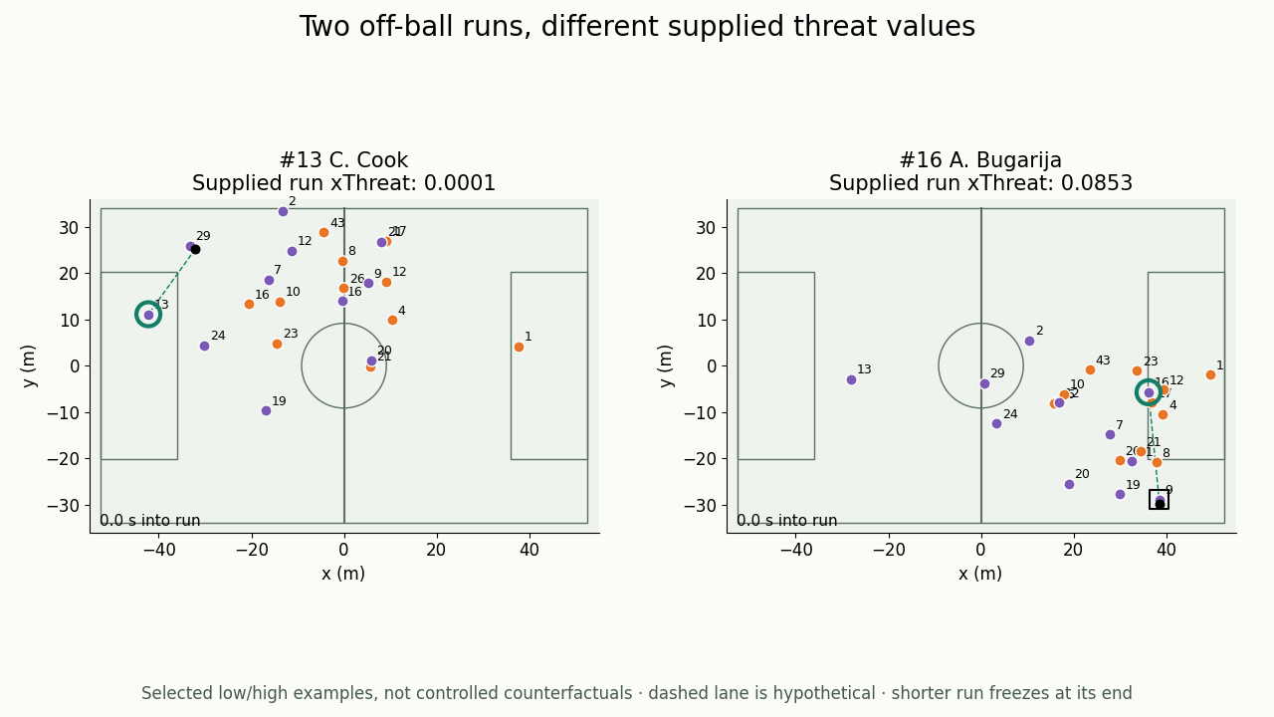
Game modeling
Which off-ball run offers more threat?
Problem
Recognize useful runs even when a pass is not played.
Methods
Compare supplied SkillCorner run-threat estimates in context.
Provider outputs, not reconstructed xT
▶ Click video to play
Two actual runs receive contrasting supplied threat values.
SkillCorner: Expected Threat for off-ball runs
SkillCorner open data and schema
36
Notes:
Selected low/high off-ball-run events fully covered by the sample. Each panel is synchronized to its own run start; the shorter run freezes at the end. A square marks supplied ball carrier when available; dashed lane is hypothetical. Values are supplied event-level xthreat fields, not locally fitted or controlled causal effects.
Embedded video (click to play): assets/videos/run_comparison.mp4
Selected low/high off-ball-run events fully covered by the sample. Each panel is synchronized to its own run start; the shorter run freezes at the end. A square marks supplied ball carrier when available; dashed lane is hypothetical. Values are supplied event-level xthreat fields, not locally fitted or controlled causal effects.
Sources:
SkillCorner: Expected Threat for off-ball runs
https://www.linkedin.com/posts/skillcorner_game-intelligence-expected-threat-activity-7057009275247689728-NVPh
SkillCorner open data and schema
https://github.com/SkillCorner/opendata

Slide 37
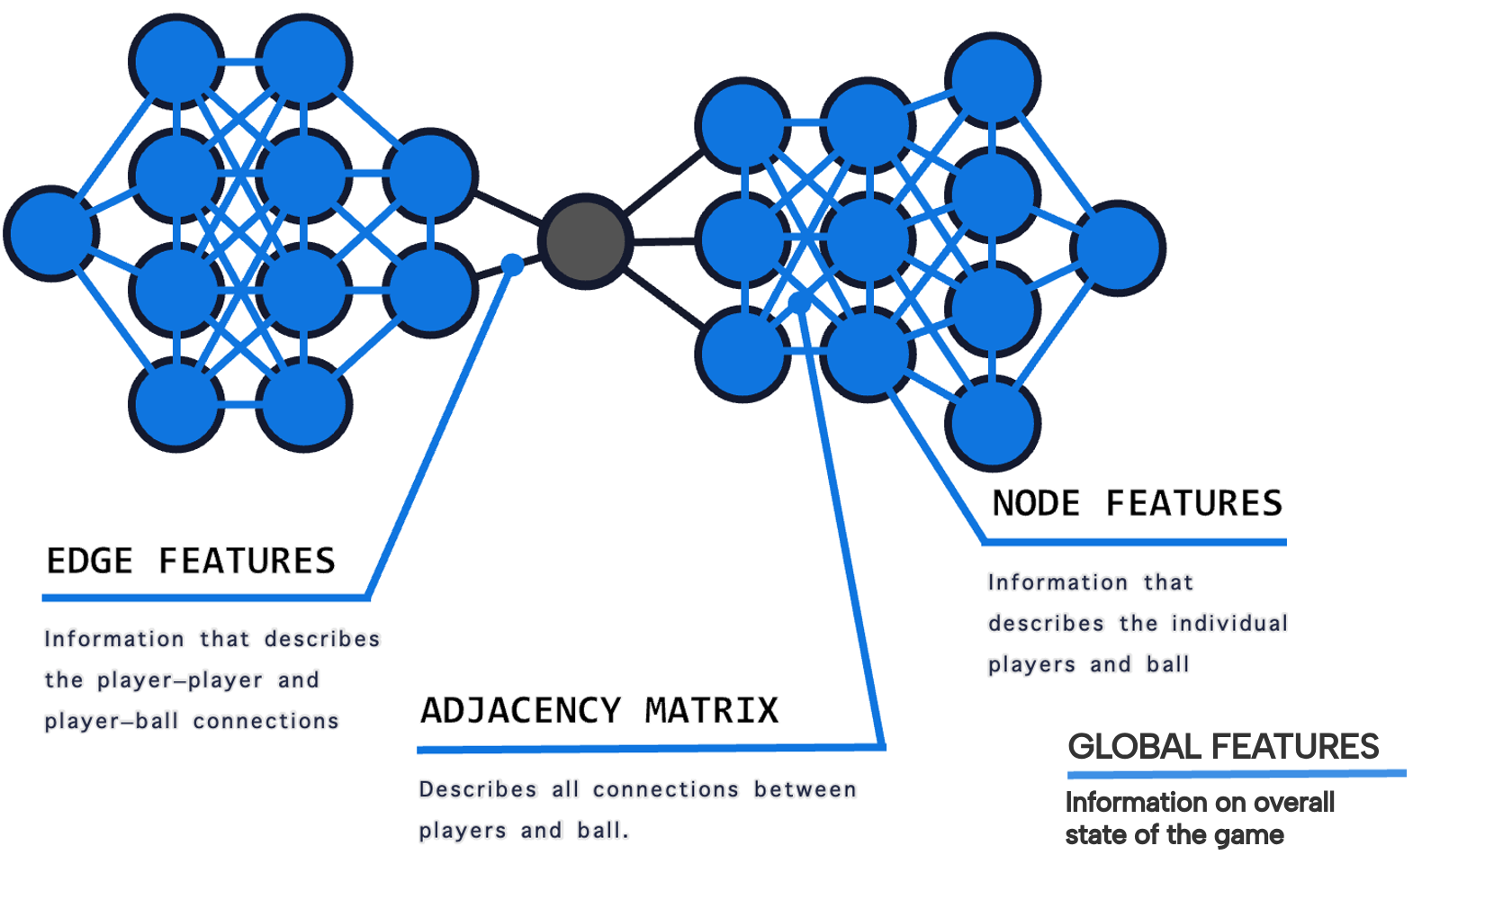
Game modeling
Why represent football as a graph?
Problem
Positions alone hide who relates to whom.
Methods
Players and ball as nodes; relationships as edges.
Joris Bekkers · original keynote visual
A graph encodes interactions without relying on player row order.
Joris Bekkers: GraphEPV, PyData London 2025
Notebook: 16_graph_epv.ipynb
37
Notes:
Original graph illustration from Bekkers, PyData London 2025. General representation explanation before EPV: player/ball nodes, player-player and player-ball relations, adjacency and global context. The picture is conceptual, not a trained prediction. Source URL and attribution in assets/references/bekkers/attribution.json.
Notebook: 16_graph_epv.ipynb
https://github.com/zcochran27/tracking-data-applied-workshop/blob/main/notebooks/methods/16_graph_epv.ipynb
Sources:
Joris Bekkers: GraphEPV, PyData London 2025
https://rawcdn.githack.com/UnravelSports/keynotes/main/html/20250607-PyData-London.html

Slide 38
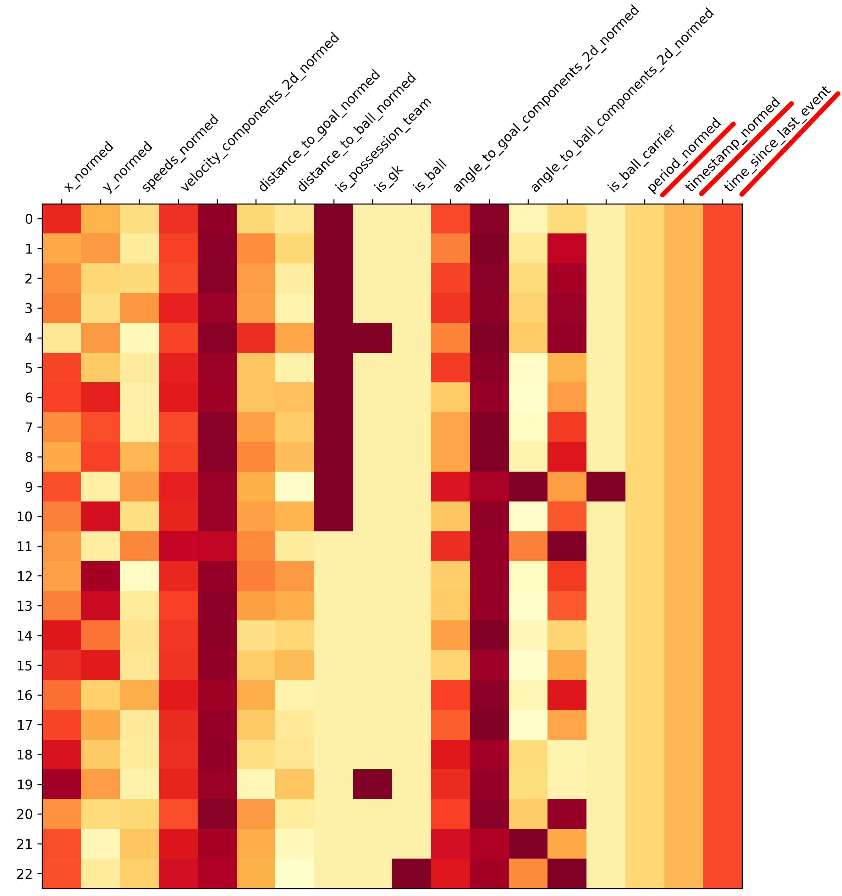
Game modeling
What information should a graph carry?
Problem
Describe players and game context in machine-readable form.
Methods
Node feature vectors plus global match-state features.
Original Bekkers feature illustration
The feature matrix captures geometry and context for every node.
Joris Bekkers: GraphEPV, PyData London 2025
UnravelSports soccer GNN tutorial
Notebook: 16_graph_epv.ipynb
38
Notes:
Original node/global-feature matrix from the linked keynote. This is a general feature menu; do not imply our independent workshop GNN includes every displayed velocity, acceleration or global feature. Its actual features are current-frame geometry and identity/context indicators, specified in notebook 16.
Notebook: 16_graph_epv.ipynb
https://github.com/zcochran27/tracking-data-applied-workshop/blob/main/notebooks/methods/16_graph_epv.ipynb
Sources:
Joris Bekkers: GraphEPV, PyData London 2025
https://rawcdn.githack.com/UnravelSports/keynotes/main/html/20250607-PyData-London.html
UnravelSports soccer GNN tutorial
https://unravelsports.readthedocs.io/en/latest/tutorials/soccer_gnn.html

Slide 39
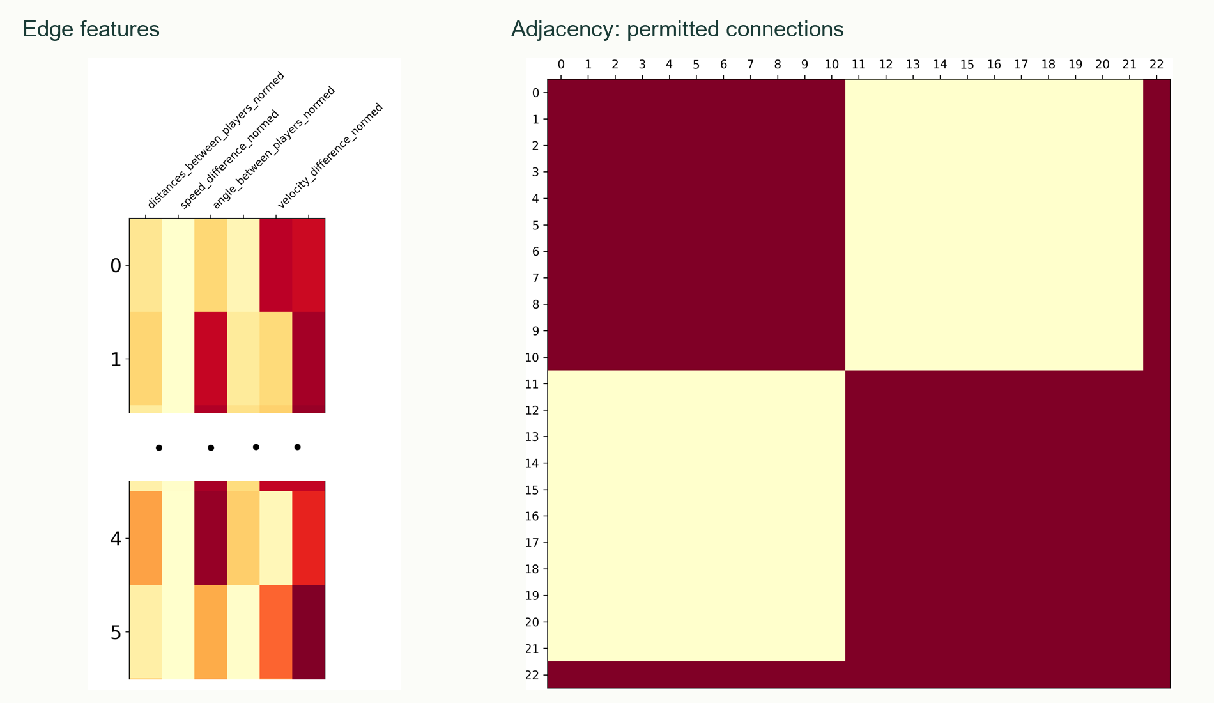
Game modeling
Which relationships can the model exchange information over?
Problem
Choose which interactions a graph can represent.
Methods
Edge attributes and an explicit adjacency structure.
Original Bekkers adjacency example
Connectivity defines the available routes for relational information.
Joris Bekkers: GraphEPV, PyData London 2025
UnravelSports soccer GNN tutorial
Notebook: 16_graph_epv.ipynb
39
Notes:
Keynote adjacency matrix shows one documented team/ball connection configuration, not a unique universal GraphEPV topology. Edge features can describe distance, relative geometry and team relations; the actual workshop model uses 20 m radius edges plus ball links, not this matrix. The main visual combines original edge-feature and adjacency illustrations from the same keynote; both source files are retained and credited.
Notebook: 16_graph_epv.ipynb
https://github.com/zcochran27/tracking-data-applied-workshop/blob/main/notebooks/methods/16_graph_epv.ipynb
Sources:
Joris Bekkers: GraphEPV, PyData London 2025
https://rawcdn.githack.com/UnravelSports/keynotes/main/html/20250607-PyData-London.html
UnravelSports soccer GNN tutorial
https://unravelsports.readthedocs.io/en/latest/tutorials/soccer_gnn.html

Slide 40
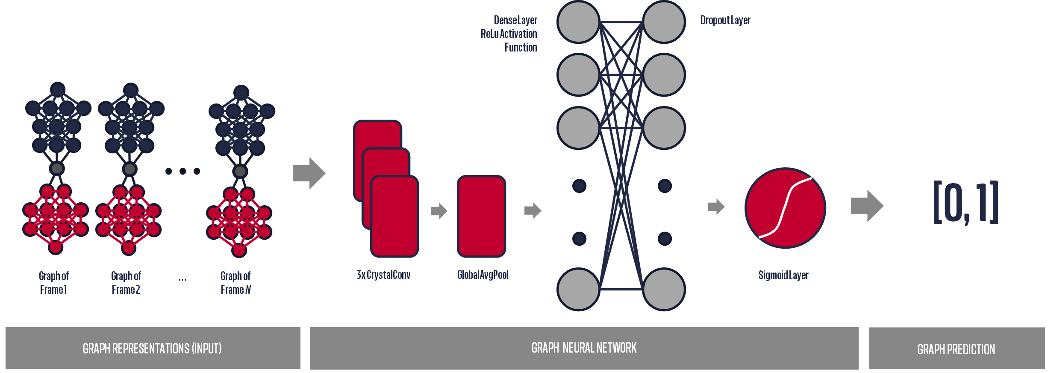
Game modeling
What does a graph neural network learn?
Problem
Use player relationships to predict a task outcome.
Methods
Shared message passing, graph pooling and a task-specific readout.
Published architecture illustration
Relational representations become a prediction for the chosen task.
Joris Bekkers: GraphEPV, PyData London 2025
U.S. Soccer: counterattack GNNs with SkillCorner (2023)
Notebook: 16_graph_epv.ipynb
40
Notes:
Original Sahasrabudhe & Bekkers architecture image reused in the keynote, attributed to its authors. General GNN explanation: shared updates, permutation-invariant aggregation and task-specific output. This is not our independent 353-parameter teaching architecture. No standalone temporal-network/encoder slides are included.
Notebook: 16_graph_epv.ipynb
https://github.com/zcochran27/tracking-data-applied-workshop/blob/main/notebooks/methods/16_graph_epv.ipynb
Sources:
Joris Bekkers: GraphEPV, PyData London 2025
https://rawcdn.githack.com/UnravelSports/keynotes/main/html/20250607-PyData-London.html
U.S. Soccer: counterattack GNNs with SkillCorner (2023)
https://github.com/USSoccerFederation/ussf_ssac_23_soccer_gnn

Slide 41
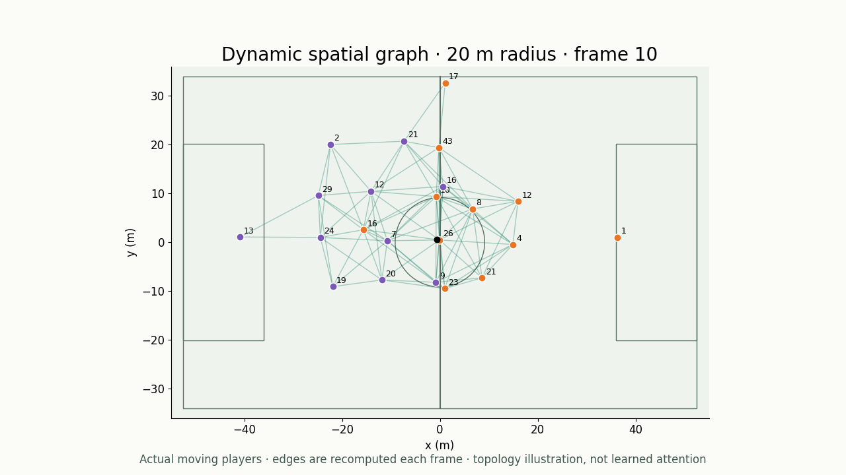
Game modeling
How does the graph change as players move?
Problem
A useful relationship at one instant may disappear at the next.
Methods
Recompute 20 m player-radius edges on real tracking frames.
Dynamic spatial graph · not a temporal GNN
▶ Click video to play
The video reveals changing spatial neighborhoods in actual play.
Joris Bekkers: GraphEPV, PyData London 2025
UnravelSports soccer GNN tutorial
Notebook: 16_graph_epv.ipynb
41
Notes:
Player-only real radius graph at native 10 Hz. The trained workshop graph additionally includes a ball node and ball links. Recomputing spatial edges over time is not itself a trained temporal network or learned attention.
Notebook: 16_graph_epv.ipynb
https://github.com/zcochran27/tracking-data-applied-workshop/blob/main/notebooks/methods/16_graph_epv.ipynb
Embedded video (click to play): assets/videos/dynamic_graph.mp4
Player-only real radius graph at native 10 Hz. The trained workshop graph additionally includes a ball node and ball links. Recomputing spatial edges over time is not itself a trained temporal network or learned attention.
Sources:
Joris Bekkers: GraphEPV, PyData London 2025
https://rawcdn.githack.com/UnravelSports/keynotes/main/html/20250607-PyData-London.html
UnravelSports soccer GNN tutorial
https://unravelsports.readthedocs.io/en/latest/tutorials/soccer_gnn.html

Slide 42
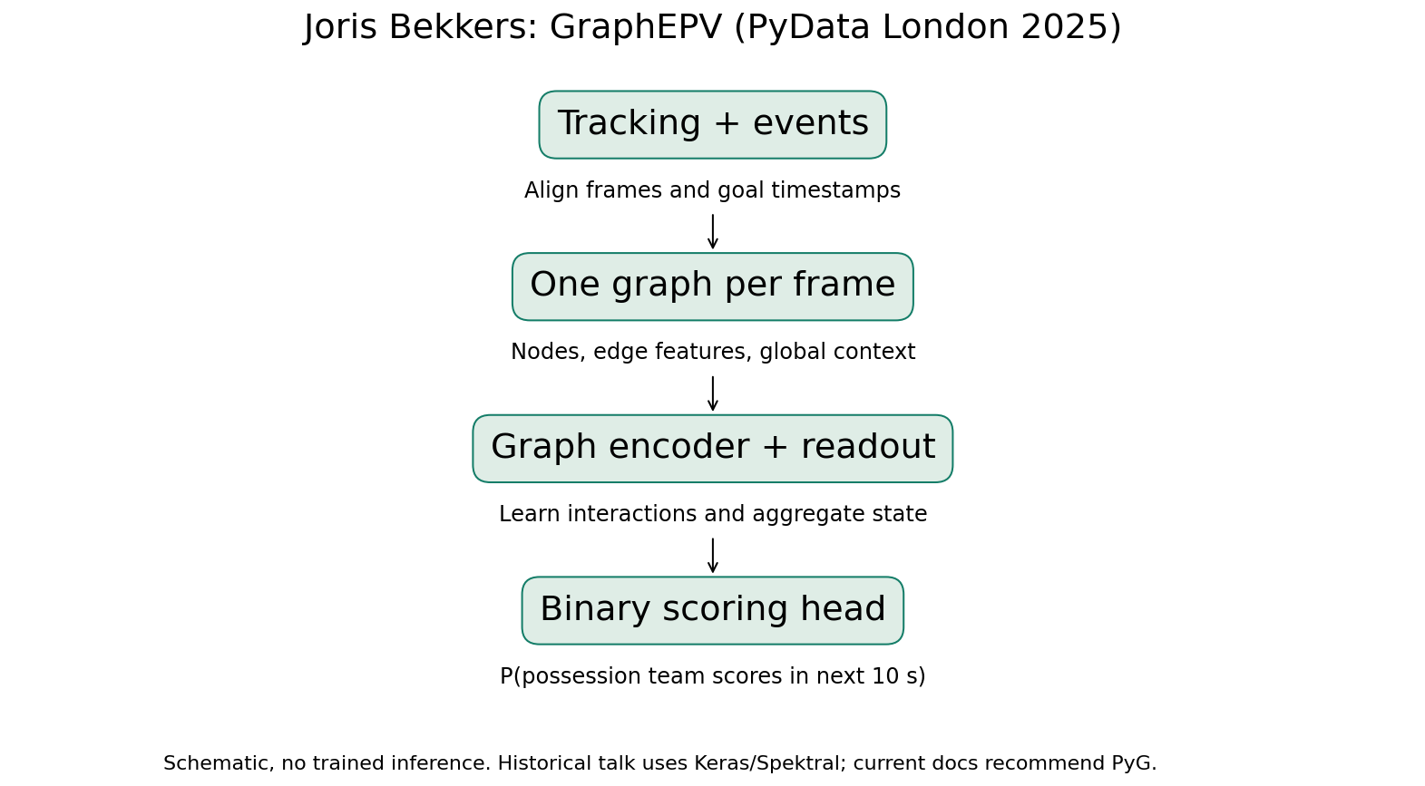
Game modeling
Graph EPV: what exactly are we predicting?
Problem
Turn a tracking state into a clearly defined future outcome.
Methods
Bekkers: one frame graph; goal by the possession team within 10 s.
Bekkers target; independent workshop implementation
A scoring probability belongs to a stated team and time horizon.
Joris Bekkers: GraphEPV, PyData London 2025
Notebook: 16_graph_epv.ipynb
42
Notes:
Published PyData London 2025 target uses World Cup PFF tracking and event-aligned goals, respecting team and period. Our notebook trains an independent frame GNN on SkillCorner with reconstructed, score-audited goal timing. It is not Bekkers’ CrystalGraph architecture/weights or a full action-decomposed EPV reproduction.
Notebook: 16_graph_epv.ipynb
https://github.com/zcochran27/tracking-data-applied-workshop/blob/main/notebooks/methods/16_graph_epv.ipynb
Sources:
Joris Bekkers: GraphEPV, PyData London 2025
https://rawcdn.githack.com/UnravelSports/keynotes/main/html/20250607-PyData-London.html

Slide 43
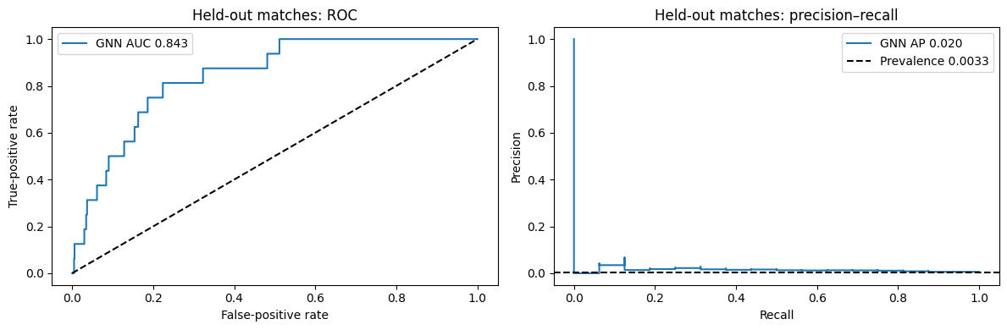
Game modeling
Does our graph model generalize to unseen matches?
Problem
Evaluate predictions beyond the training matches.
Methods
Match-level holdout; validation-only model selection and calibration.
Test: 3 matches, 16 positive states
Brier .003335 vs .003308 baseline
AUC 0.843; AP 0.020—ranking improves, probability reliability is limited.
SkillCorner open data and schema
Joris Bekkers: GraphEPV, PyData London 2025
Notebook: 16_graph_epv.ipynb
43
Notes:
16 included matches total: 10 train, 3 validation, 3 test. Test has 4,846 sampled states and 16 positives, not 16 independent goals. AP baseline prevalence 0.00330. Log loss improves 0.02363→0.02158; Brier worsens 0.003308→0.003335. Model mean prediction 0.00858 versus test prevalence 0.00330. Goal timing is reconstructed and not video-verified. ROC and PR are actual saved notebook results; no temporal model was trained.
Notebook: 16_graph_epv.ipynb
https://github.com/zcochran27/tracking-data-applied-workshop/blob/main/notebooks/methods/16_graph_epv.ipynb
Sources:
SkillCorner open data and schema
https://github.com/SkillCorner/opendata
Joris Bekkers: GraphEPV, PyData London 2025
https://rawcdn.githack.com/UnravelSports/keynotes/main/html/20250607-PyData-London.html

Slide 44
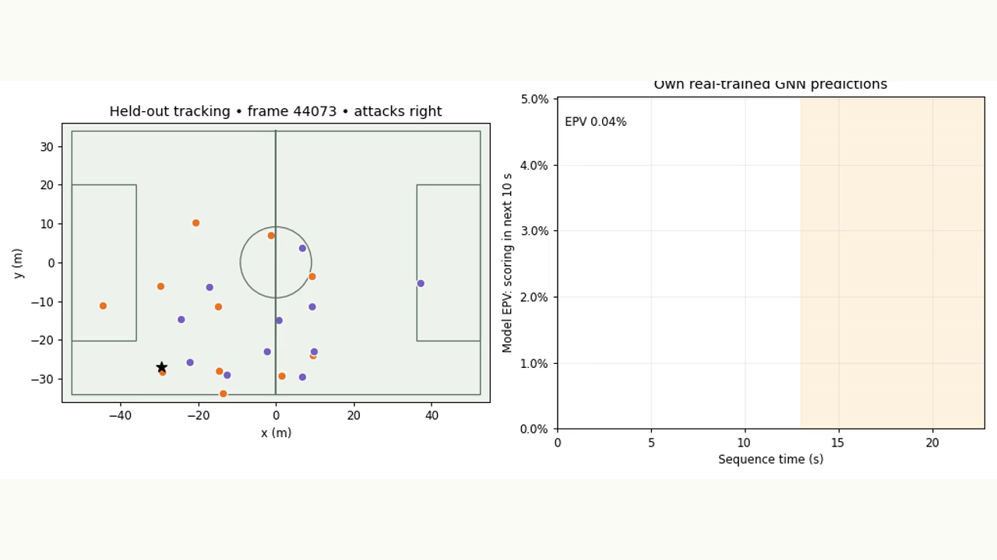
Game modeling
What does EPV look like during a possession?
Problem
Read a predicted scoring probability alongside the actual play.
Methods
Frozen workshop GNN evaluated frame by frame on an unseen match.
Actual held-out predictions
▶ Click video to play
The goal buildup’s predicted value evolves with player and ball positions.
SkillCorner open data and schema
Joris Bekkers: GraphEPV, PyData London 2025
Notebook: 16_graph_epv.ipynb
44
Notes:
Actual independent trained model output from notebook 16. Display case is selected by goal context, not high prediction; not a performance sample. Shading indicates retrospective target window, not an input. Model features use the current frame only. User requested goal buildup plus separate performance results; non-goal example stays in the notebook.
Notebook: 16_graph_epv.ipynb
https://github.com/zcochran27/tracking-data-applied-workshop/blob/main/notebooks/methods/16_graph_epv.ipynb
Embedded video (click to play): assets/videos/graph_epv_possession.mp4
Actual independent trained model output from notebook 16. Display case is selected by goal context, not high prediction; not a performance sample. Shading indicates retrospective target window, not an input. Model features use the current frame only. User requested goal buildup plus separate performance results; non-goal example stays in the notebook.
Sources:
SkillCorner open data and schema
https://github.com/SkillCorner/opendata
Joris Bekkers: GraphEPV, PyData London 2025
https://rawcdn.githack.com/UnravelSports/keynotes/main/html/20250607-PyData-London.html

Slide 45
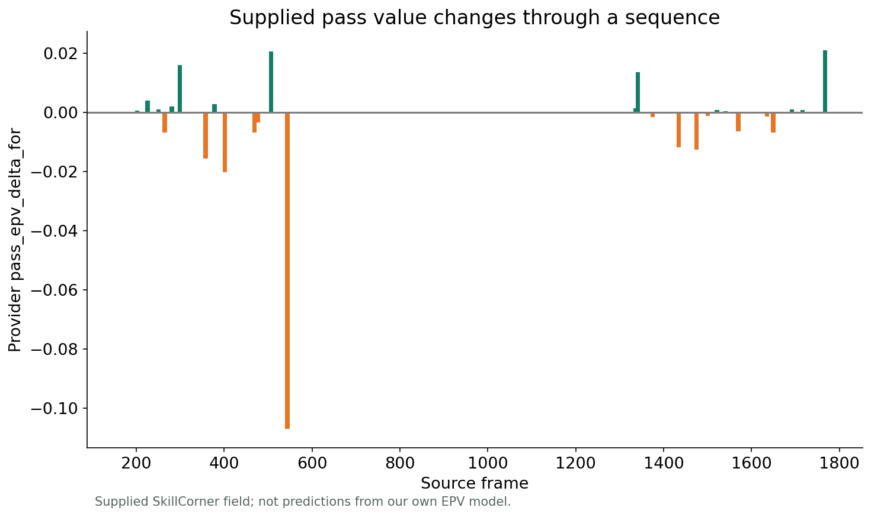
Game modeling
How do supplied pass values differ across events?
Problem
Inspect provider estimates without mixing model definitions.
Methods
Join supplied event-value fields to their tracking context.
Supplied SkillCorner EPV fields
Pass EPV changes identify events worth examining in context.
SkillCorner open data and schema
Fine-grained expected possession value (2021)
45
Notes:
Actual pass_epv_delta_for event fields. Provider output is separate from our ten-second scoring model, classic location xT and Fernández’s action-decomposed EPV framework. Show original field name, target/horizon distinctions and source documentation; no reconstruction or cross-model numerical equivalence is asserted.
Sources:
SkillCorner open data and schema
https://github.com/SkillCorner/opendata
Fine-grained expected possession value (2021)
https://pmc.ncbi.nlm.nih.gov/articles/PMC8570314/

Slide 46
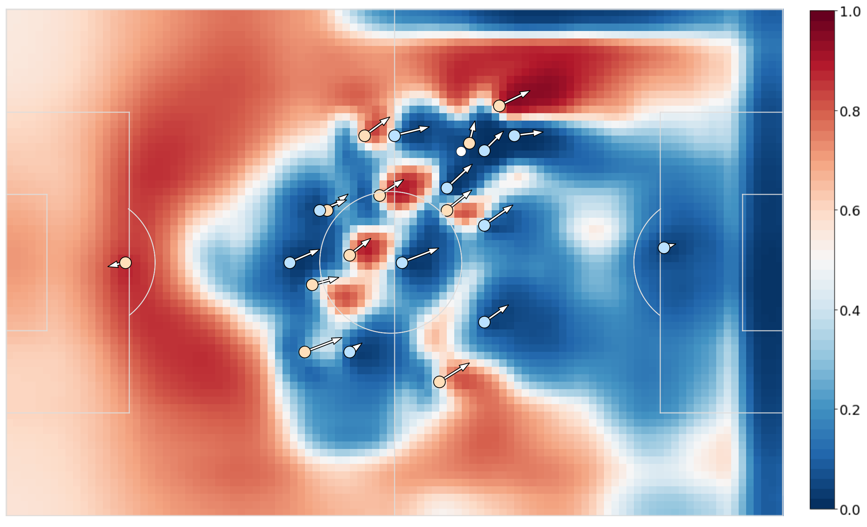
Game modeling
SoccerMap: score every possible passing location
Problem
Predict a surface rather than one chosen pass endpoint.
Methods
Fully convolutional network over spatial tracking feature channels.
Published result · Fernández & Bornn
The published model produces a field-wide pass-success surface.
SoccerMap (2020)
46
Notes:
Original SoccerMap Figure 3, arXiv 2010.10202v1. Yellow/blue attacking/defending players, arrows are velocity, white circle is ball; original probability color scale retained. A CNN, not a GNN. This result is from the paper’s data/model, not our SkillCorner inference. Other heads can address pass selection and expected pass value.
Sources:
SoccerMap (2020)
https://arxiv.org/abs/2010.10202

Slide 47
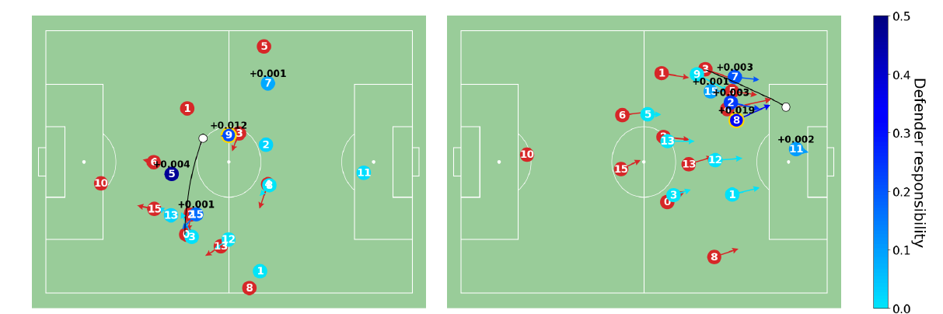
Game modeling
DEFCON: credit defensive positioning
Problem
Value prevention beyond tackles and interceptions.
Methods
Graph-based action values and defender responsibility estimates.
Published result · Kim et al.
Published defensive credits distribute value among involved defenders.
DEFCON: GNN-based defensive EPV (2026)
47
Notes:
Original DEFCON paper Figure 3, page 7. Two intercepted passes; color is defender responsibility and numeric text is assigned defensive credit. Credit follows the framework’s assumptions, not causal proof. Cropped figure only, no values changed. Not model inference on our sample; authors’ underlying club dataset is not public.
Sources:
DEFCON: GNN-based defensive EPV (2026)
https://github.com/hyunsungkim-ds/defcon

Slide 48
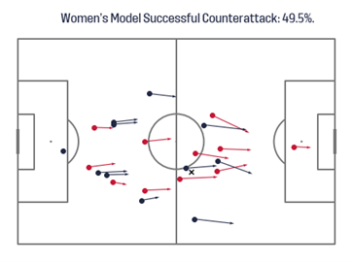
Game modeling
Counterattacks: will this attack reach the box?
Problem
Predict counterattack success from team interactions.
Methods
Graph classifiers trained on synchronized tracking and events.
Published example · Sahasrabudhe & Bekkers
The published example shows a 49.5% model estimate for box entry.
U.S. Soccer: counterattack GNNs with SkillCorner (2023)
48
Notes:
Original Figure 5a from A Graph Neural Network deep-dive into successful counterattacks. Women’s-model example predicts ending in the opponent penalty box with probability 49.5%. This is the published event-frame task; do not mix with additional all-frame goal-label datasets in the repository. Not our local model output.
Sources:
U.S. Soccer: counterattack GNNs with SkillCorner (2023)
https://github.com/USSoccerFederation/ussf_ssac_23_soccer_gnn

Slide 49
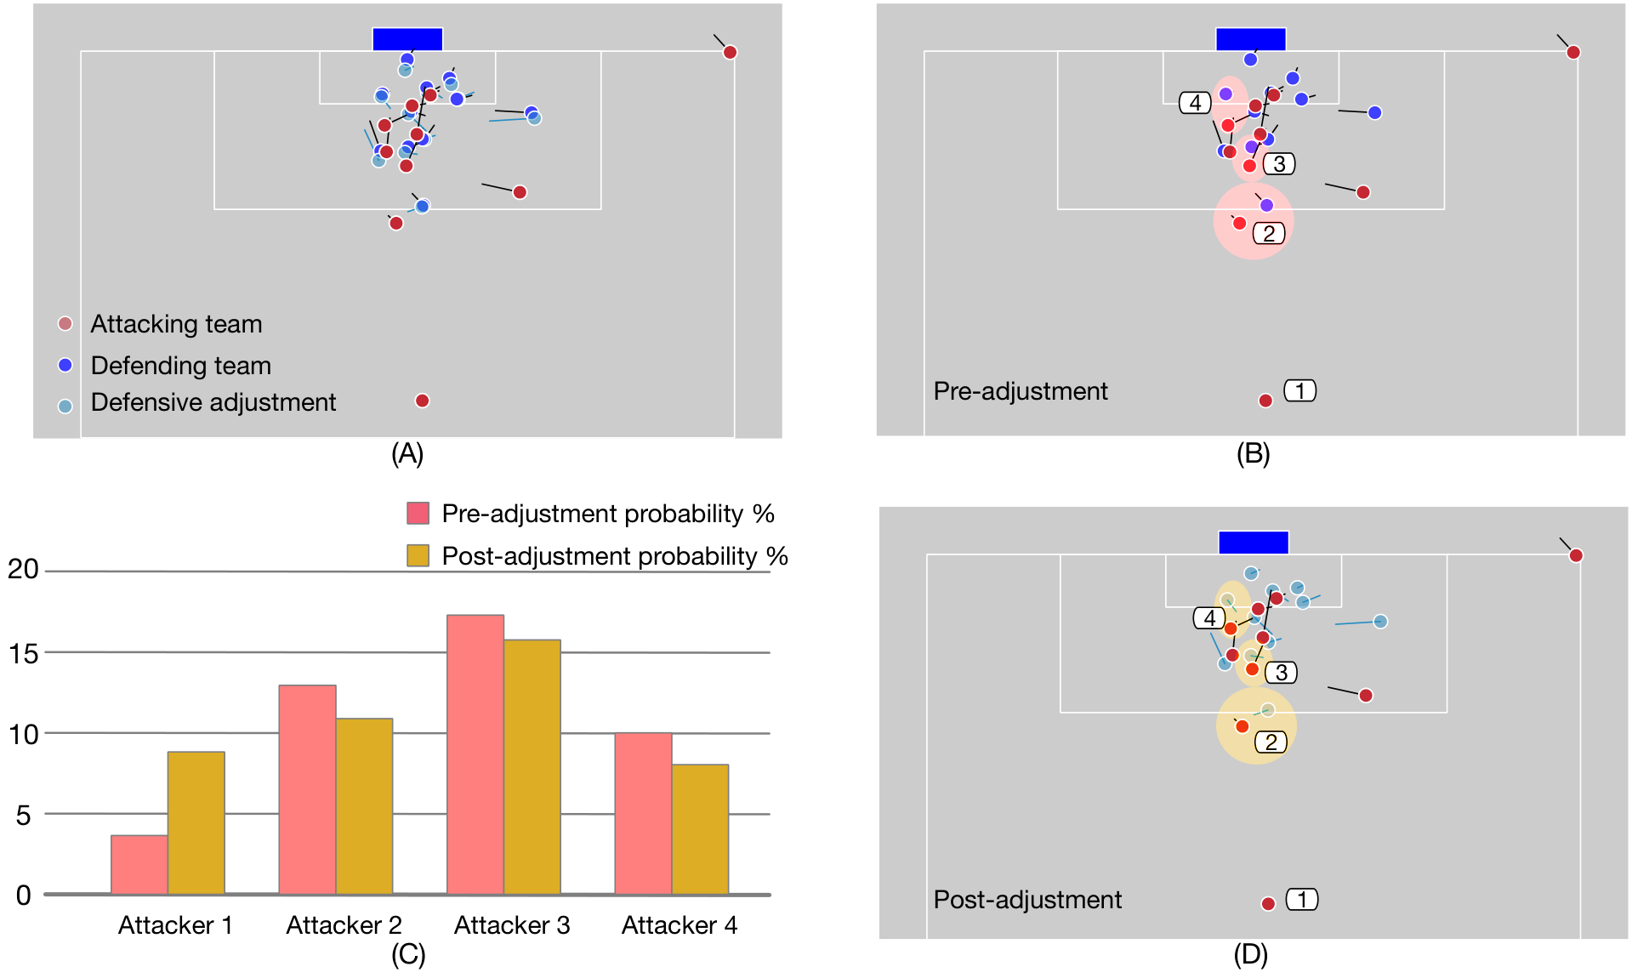
Game modeling
TacticAI: improve a corner-kick setup
Problem
Support decisions about receivers and player positioning.
Methods
Geometric graph learning with predictive and generative components.
Published result · Wang et al.
The published example compares receiver probabilities before and after adjustment.
TacticAI (2024)
49
Notes:
Original TacticAI Figure 3 from arXiv 2310.10553v1. Corner adjustment and predicted receiver probabilities are authors’ results, not interventions proven to improve match outcomes. Pre/post tactical suggestions are not locally generated or trained on SkillCorner. Retain original figure labels and legend.
Sources:
TacticAI (2024)
https://www.nature.com/articles/s41467-024-45965-x

Slide 50
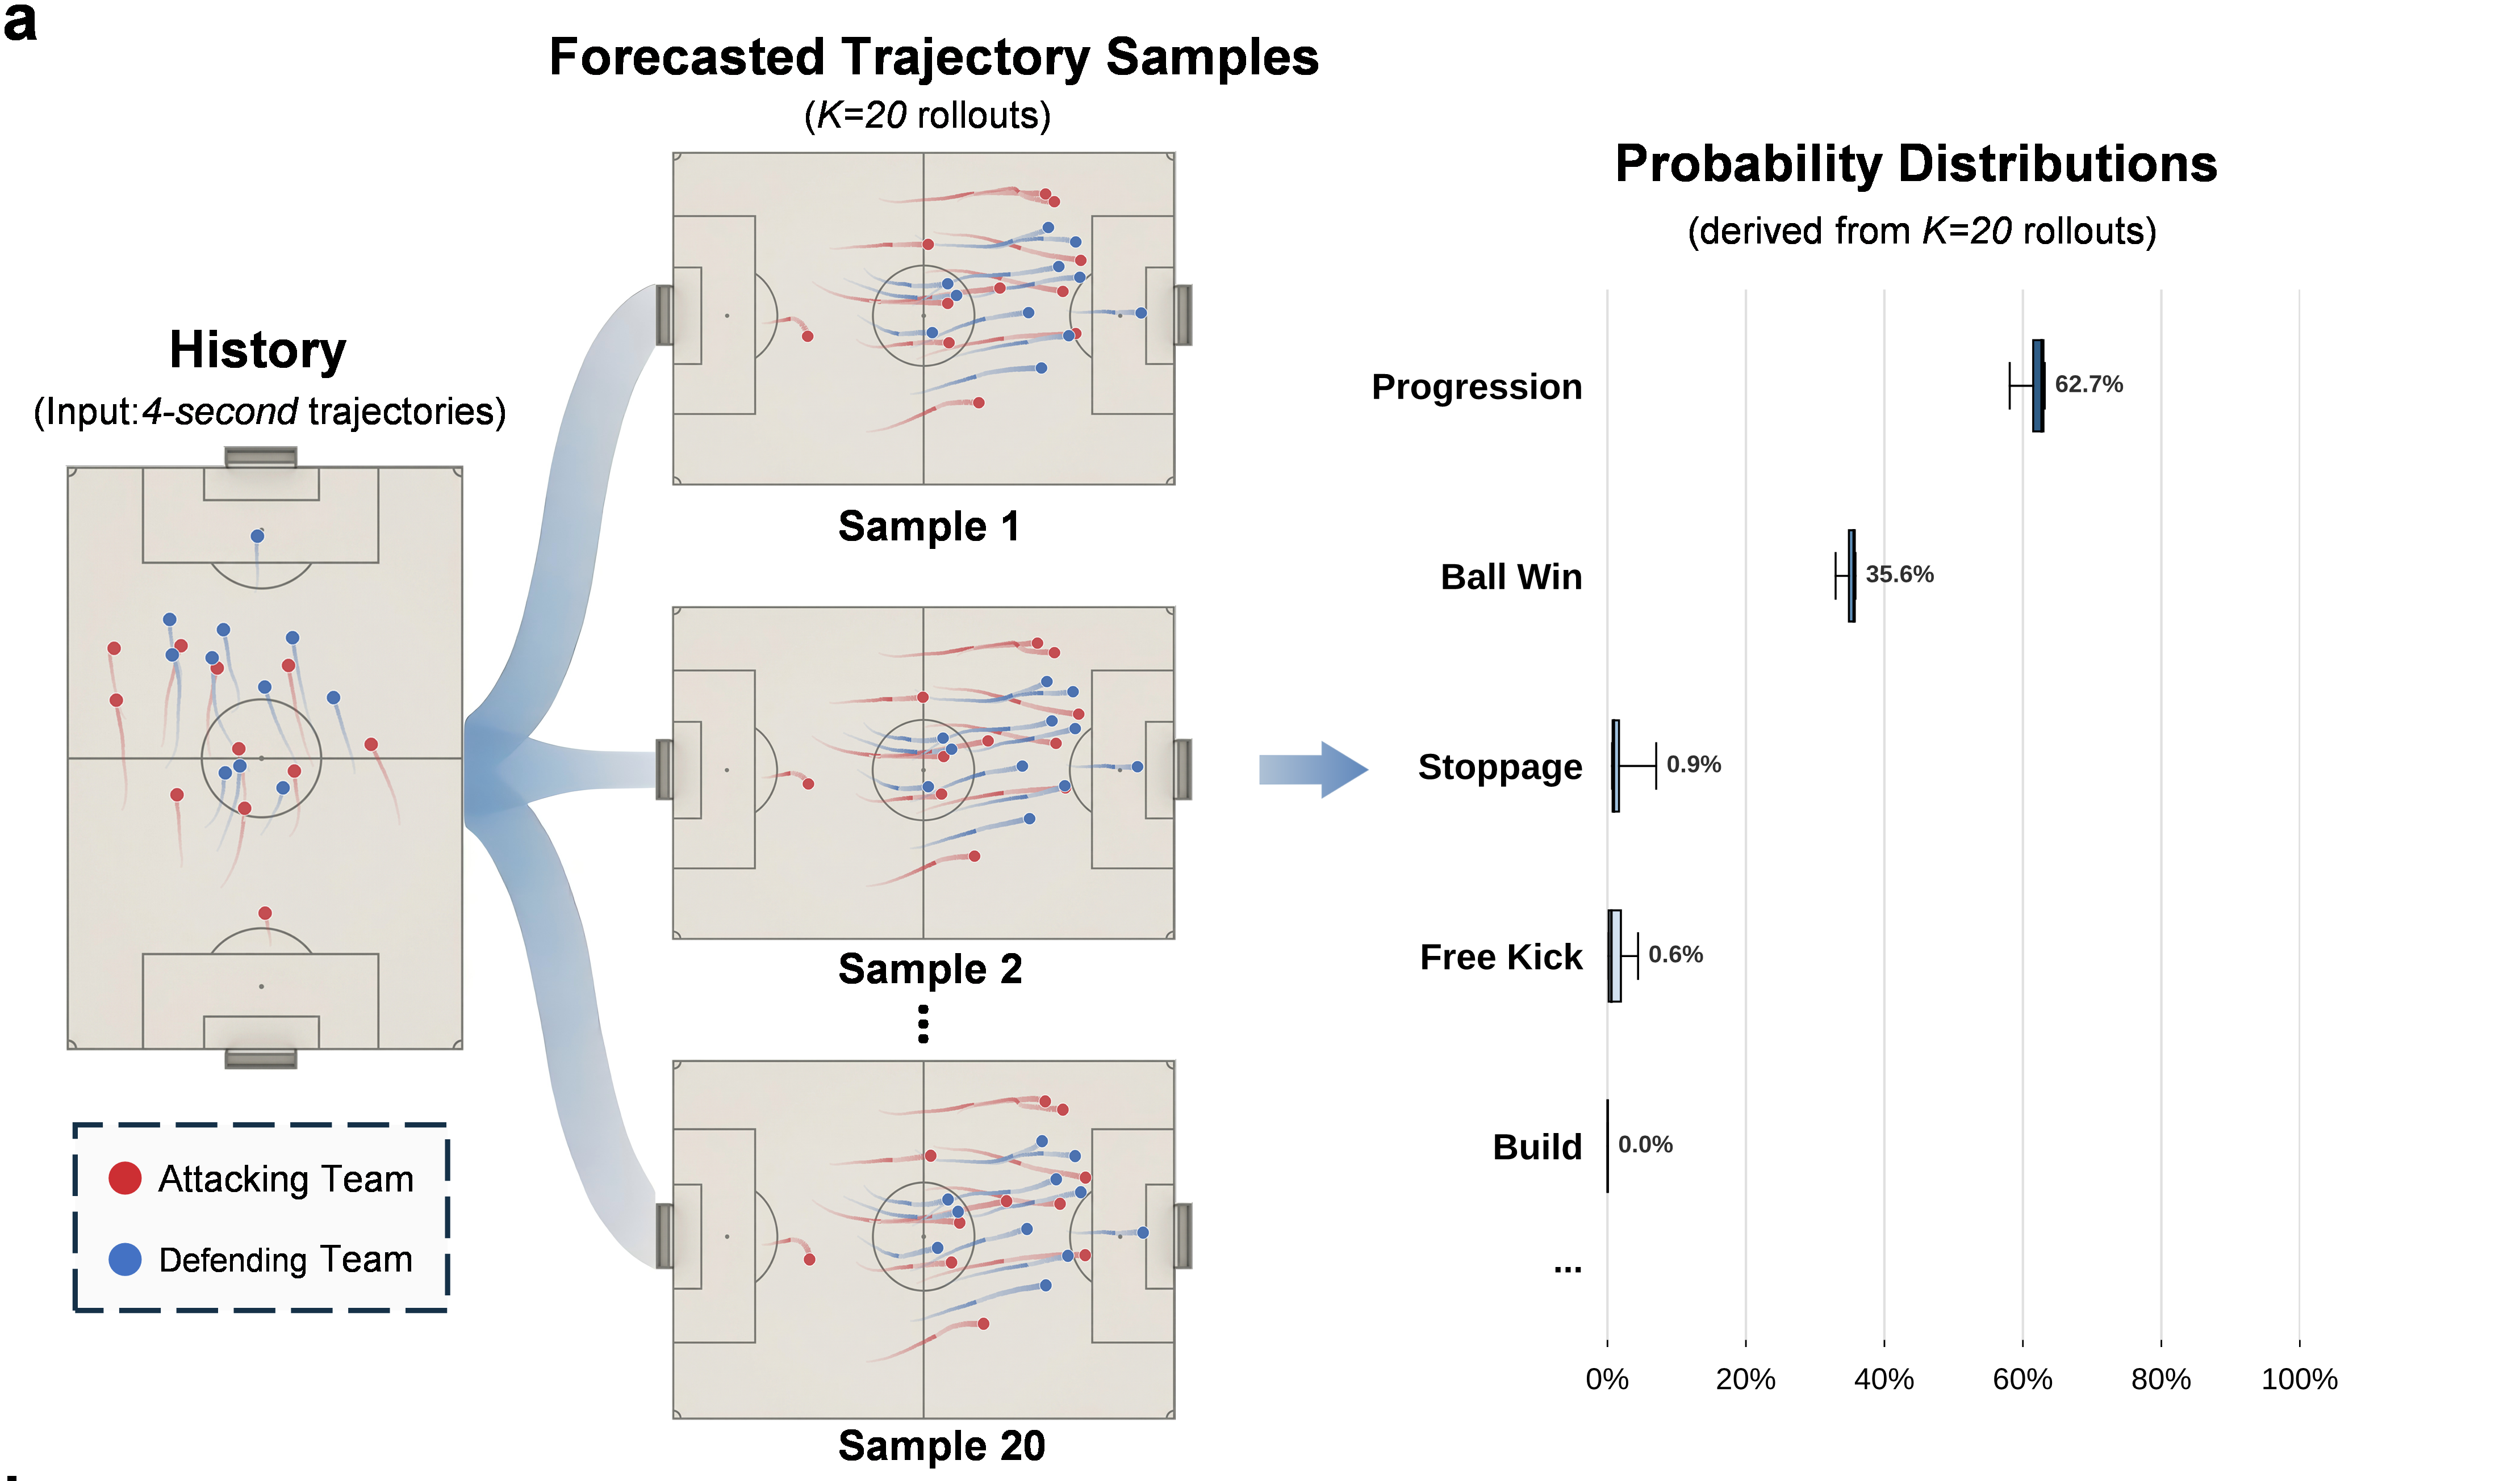
Game modeling
GenTac: forecast multiple plausible continuations
Problem
Represent uncertainty about how play may develop.
Methods
Diffusion-based multi-player trajectory generation and event prediction.
Published preprint result · Rao et al.
Published forecast samples imply a distribution of possible tactical outcomes.
GenTac: trajectory forecasting (2026 preprint)
50
Notes:
Original GenTac Figure 5 panel a, arXiv 2604.11786v1. Four-second history, 20 generated rollouts and resulting event distribution are from the paper. Cropped original panel, no probabilities changed. Not a workshop-trained forecast, not a standalone temporal-network architecture slide and not causal intervention evidence.
Sources:
GenTac: trajectory forecasting (2026 preprint)
https://arxiv.org/abs/2604.11786

Slide 51
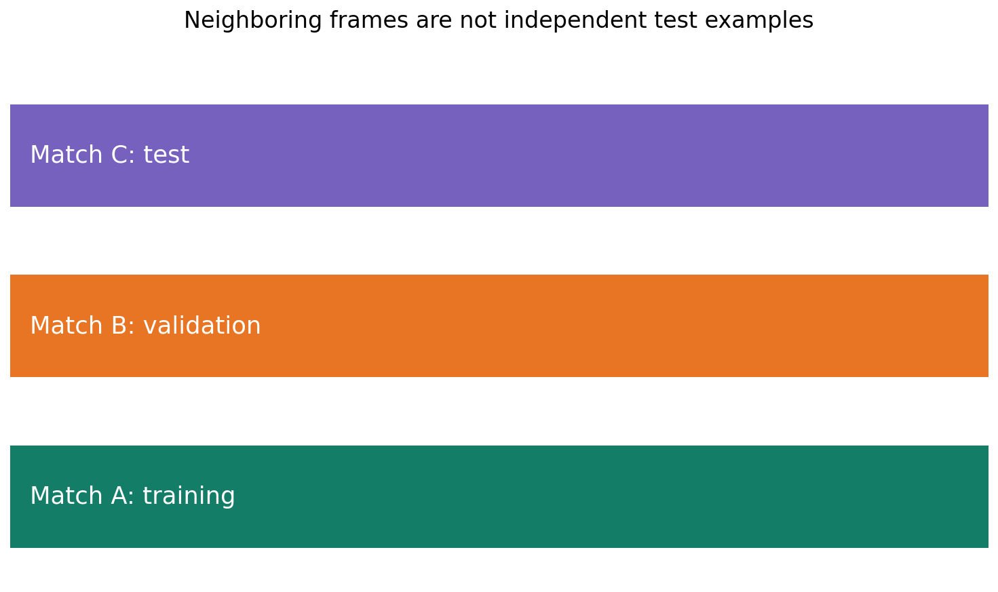
Validation
What would make these results trustworthy?
Problem
Distinguish an explanatory example from a reliable model.
Methods
Independent match splits; task-specific error and probability checks.
Apply to every analytical avenue
A useful result states its target, evidence, uncertainty and failure modes.
SkillCorner open data and schema
Fine-grained expected possession value (2021)
51
Notes:
Event detection needs reviewed timing-tolerant matching. Formation/role labels require tactical ground truth. Physical comparisons require exposure and preprocessing definitions. Probability models need calibration and rare-event baselines. Stress-test extrapolated tracking, missing data, attack direction and domain shift. Current slide diagram is conceptual, not an extra experiment.
Sources:
SkillCorner open data and schema
https://github.com/SkillCorner/opendata
Fine-grained expected possession value (2021)
https://pmc.ncbi.nlm.nih.gov/articles/PMC8570314/

