Slide 1
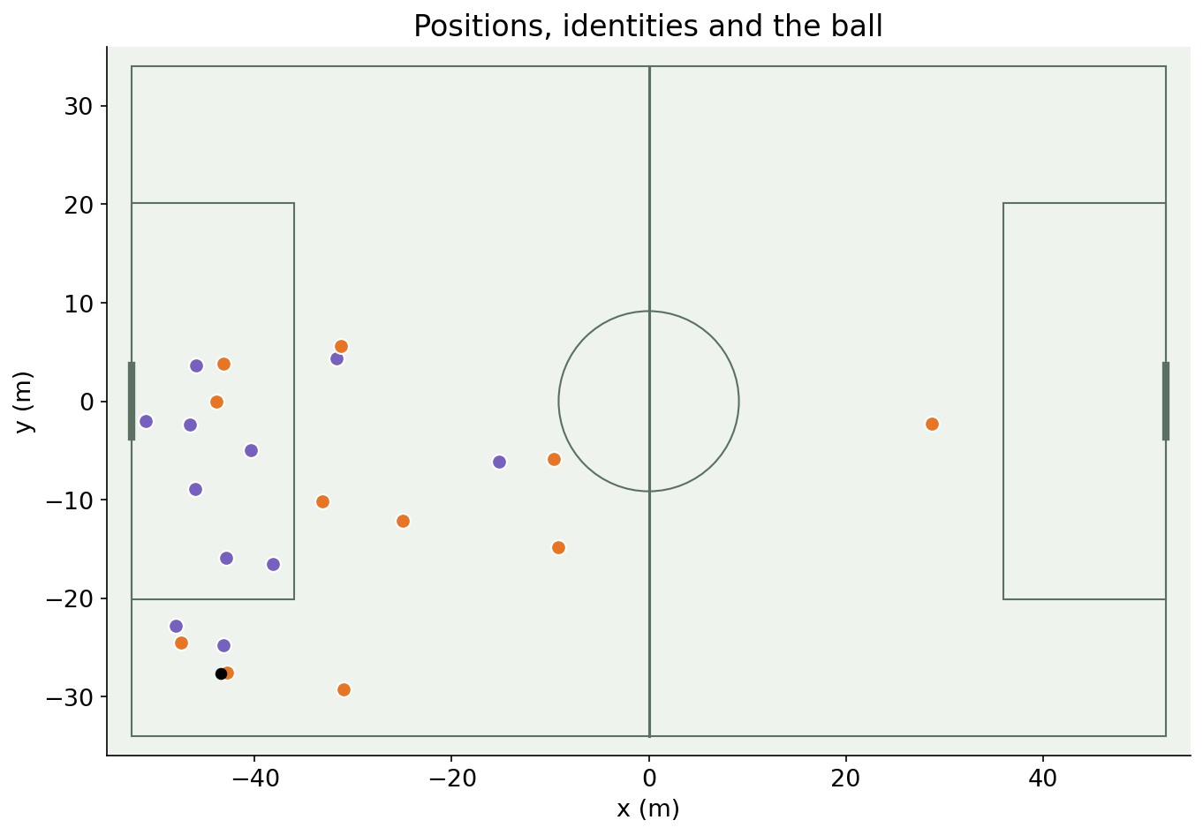
Tracking Data Applied
01
Soccer analytics with SkillCorner
02
From coordinates to football questions
03
Methods, assumptions and interpretation
SkillCorner open data and schema
1 / 61
Notes:
Introduce the match and the distinction between observed tracking, extrapolated tracking and derived labels.
Sources:
SkillCorner open data and schema
https://github.com/SkillCorner/opendata

Slide 2
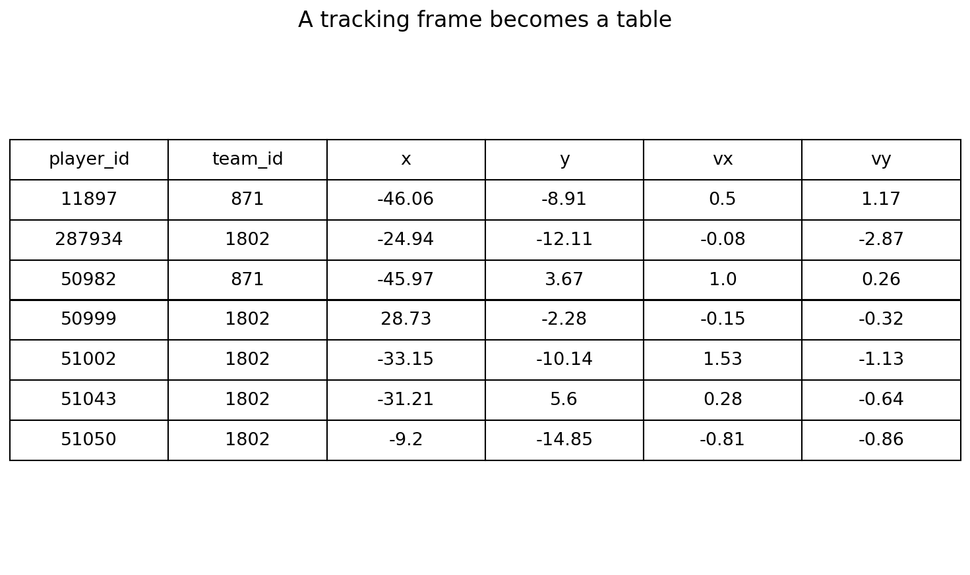
Data and documentation
01
SkillCorner/opendata: tracking and supplied labels
02
kloppy: load and standardize
03
DataBallPy: metric explanations and models
SkillCorner open data and schema
kloppy SkillCorner loader
DataBallPy covered distance
2 / 61
Notes:
The opening entries are linked. Full sources are in the reading list. Real sample: Brisbane vs Perth, 21 December 2024, match 1925299.
Sources:
SkillCorner open data and schema
https://github.com/SkillCorner/opendata
kloppy SkillCorner loader
https://kloppy.pysport.org/reference/providers/skillcorner/
DataBallPy covered distance
https://databallpy.readthedocs.io/en/main/features/covered_distance_page.html

Slide 3
Loading tracking data
01
Load match metadata and JSONL with kloppy
02
Retain frame IDs, periods and native metres
03
Convert to a dataframe for analysis
NOTEBOOK · load and inspect
kloppy SkillCorner loader
3 / 61
Notes:
The figure contains actual dataframe values; velocity columns are derived after loading.
NOTEBOOK · load and inspect
Sources:
kloppy SkillCorner loader
https://kloppy.pysport.org/reference/providers/skillcorner/

Slide 4
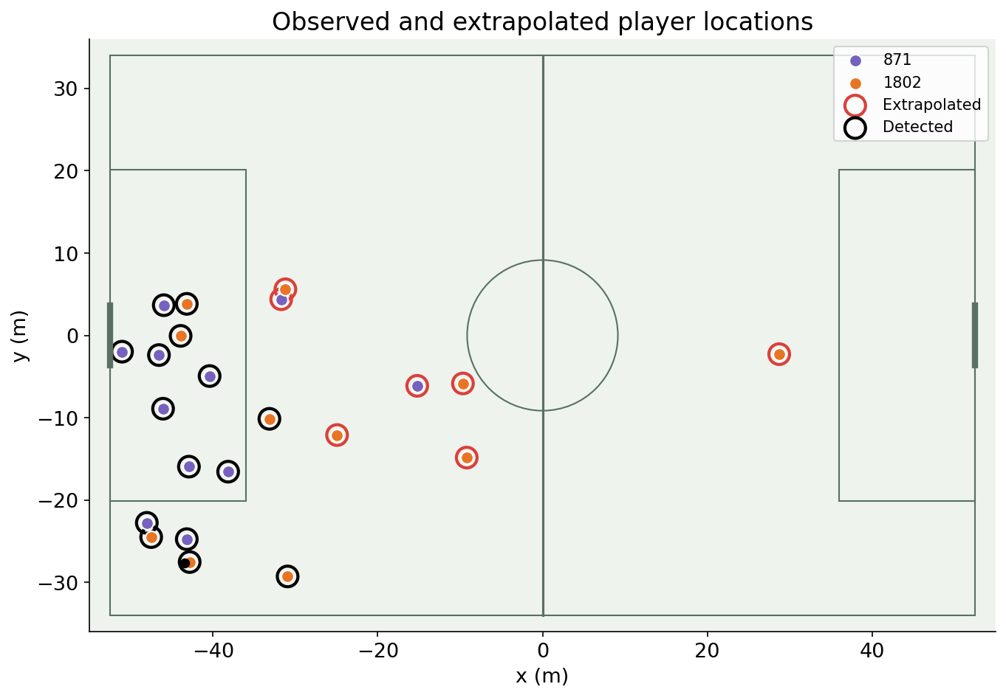
Tracking quality and visibility
01
Separate detected from extrapolated positions
02
Keep missingness and coverage visible
03
Avoid derivatives across gaps or periods
SkillCorner open data and schema
DataBallPy preprocessing
4 / 61
Notes:
Red rings mark extrapolated players according to raw is_detected. Coordinates can exist without a direct camera observation. All subsequent models inherit this uncertainty.
Sources:
SkillCorner open data and schema
https://github.com/SkillCorner/opendata
DataBallPy preprocessing
https://databallpy.readthedocs.io/en/main/getting_started/preprocessing_options.html

Slide 5
Plotting a tracking frame
01
Draw the pitch in the data’s coordinate system
02
Color by team and identify the ball
03
Check direction before calculating goal-related features
SkillCorner open data and schema
5 / 61
Notes:
Use actual pitch dimensions. A visually plausible frame is a useful first check, but does not prove identity or position accuracy.
Sources:
SkillCorner open data and schema
https://github.com/SkillCorner/opendata

Slide 6
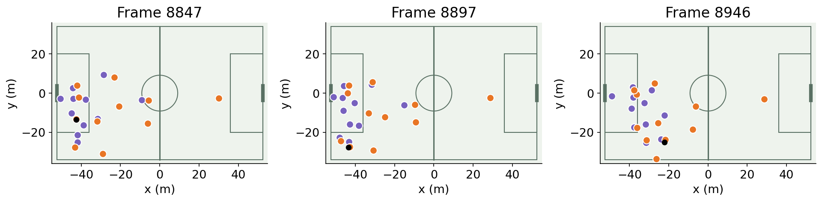
Animating a sequence
01
Keep player identities consistent across frames
02
Use playback to inspect motion and tactical context
03
Overlay model outputs on the same sequence
NOTEBOOK · play the sequence
kloppy SkillCorner loader
Friends of Tracking: pitch control and EPV tutorials
6 / 61
Notes:
Three snapshots are from the real selected clip. The notebook contains a full embedded animation.
NOTEBOOK · play the sequence
Sources:
kloppy SkillCorner loader
https://kloppy.pysport.org/reference/providers/skillcorner/
Friends of Tracking: pitch control and EPV tutorials
https://github.com/Friends-of-Tracking-Data-FoTD/LaurieOnTracking

Slide 7
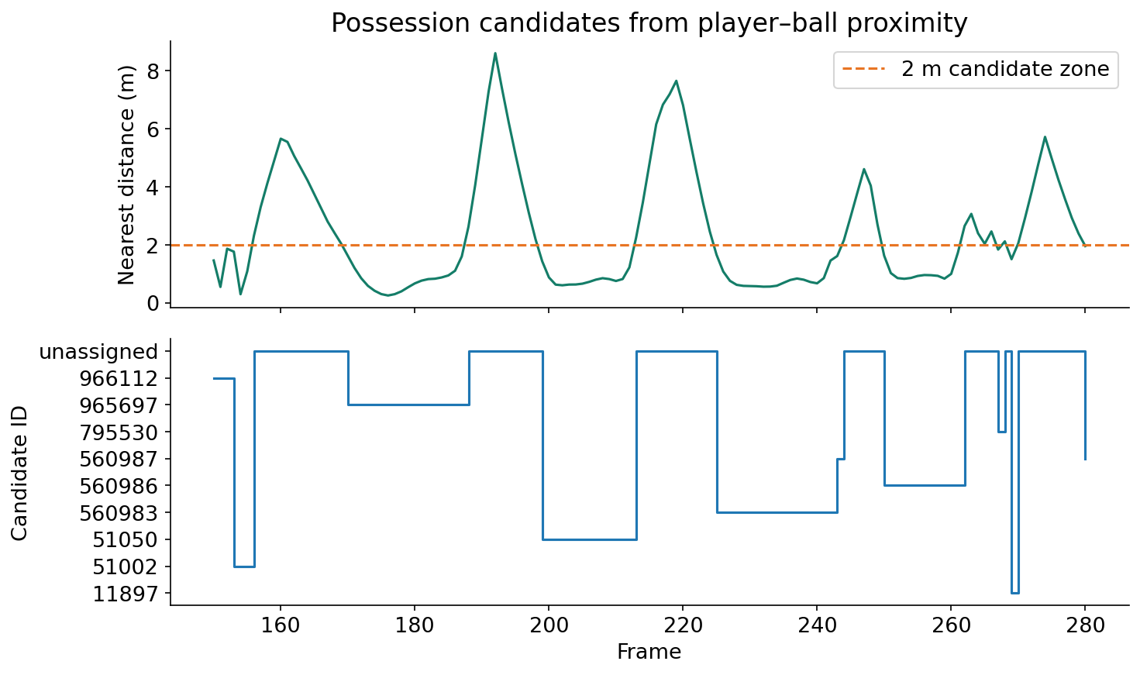
Possession detection
01
Find the nearest player inside a candidate zone
02
Use ball motion to distinguish touches from flyovers
03
Leave ambiguous frames unassigned
NOTEBOOK · inspect the candidate detector
DataBallPy preprocessing
PathCRF: player trajectories to events (2026)
7 / 61
Notes:
Figure is an actual 2 m proximity heuristic, not the full Vidal-Codina or PathCRF method. Pros: transparent and quick. Cons: aerial balls, duels and tracking uncertainty. Compare with supplied possession labels; evaluate timing-aware accuracy.
NOTEBOOK · inspect the candidate detector
Sources:
DataBallPy preprocessing
https://databallpy.readthedocs.io/en/main/getting_started/preprocessing_options.html
PathCRF: player trajectories to events (2026)
https://github.com/hyunsungkim-ds/pathcrf

Slide 8
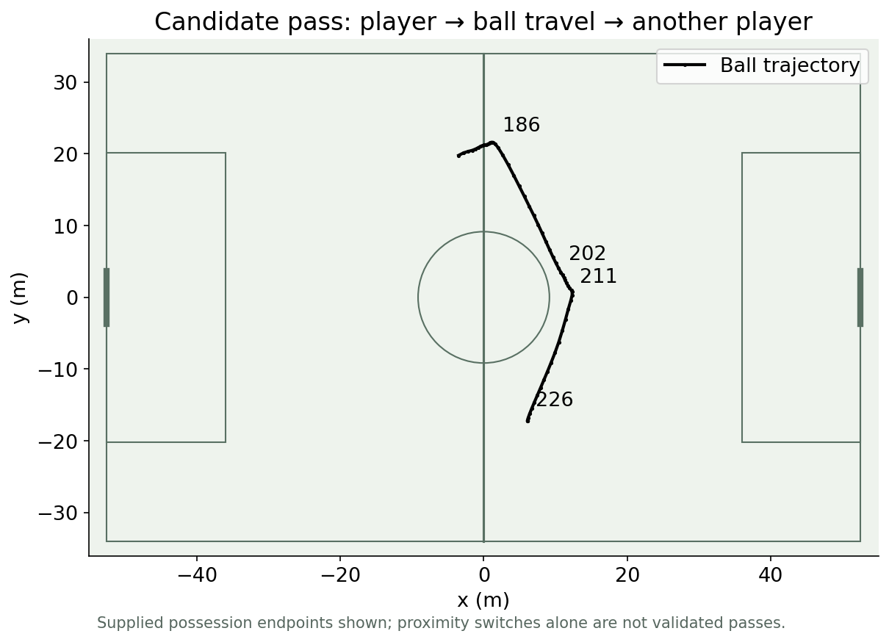
Pass-event detection
01
Detect release, ball travel and reception cues
02
Track a change between plausible player possessions
03
Validate event timing against video or labels
PathCRF: player trajectories to events (2026)
DataBallPy preprocessing
8 / 61
Notes:
The real ball path is annotated at supplied possession endpoints. This is an explanatory candidate sequence, not a validated recovered pass. Pros: converts continuous signals to actionable events. Cons: missing ball data and multi-touch ambiguity.
Sources:
PathCRF: player trajectories to events (2026)
https://github.com/hyunsungkim-ds/pathcrf
DataBallPy preprocessing
https://databallpy.readthedocs.io/en/main/getting_started/preprocessing_options.html

Slide 9
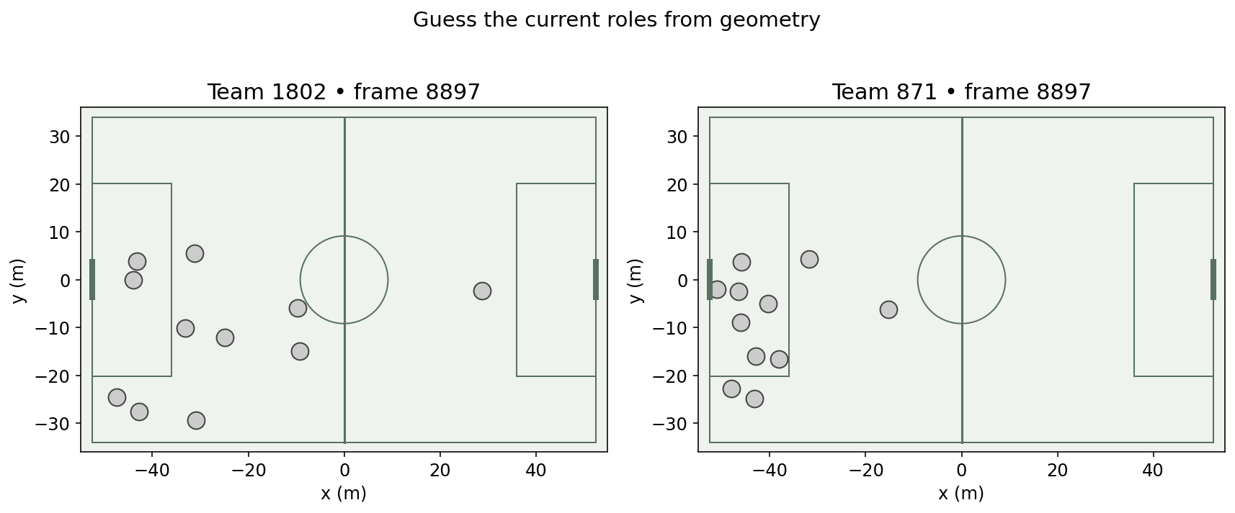
Guess the current player roles
01
Inspect two real team snapshots
02
Distinguish assigned position from occupied role
03
Use relative geometry to explain your answer
Devin Pleuler: Fixed to Fluid (2024)
9 / 61
Notes:
Audience prompt inspired by the supplied reference. These are actual SkillCorner frames, with identities hidden. A single snapshot is ambiguous; metadata positions are not frame-level role truth.
Sources:
Devin Pleuler: Fixed to Fluid (2024)
https://github.com/devinpleuler/research/blob/master/frame-by-frame-position.md

Slide 10
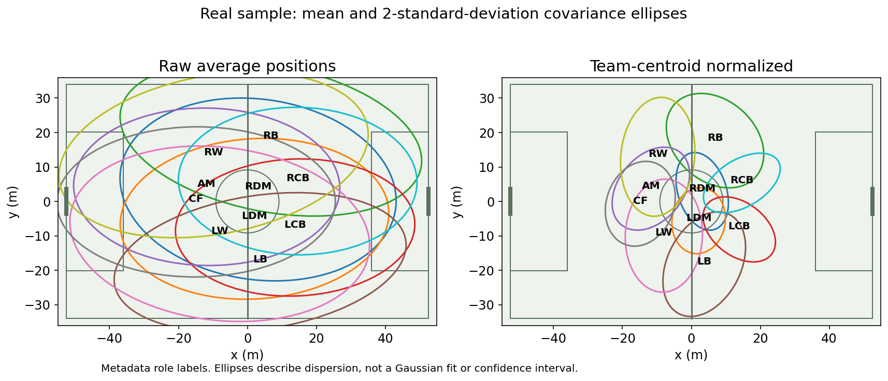
Position distributions and centering
01
Plot a mean and covariance for each player
02
Subtract the team centroid in every frame
03
Compare dispersion before assigning a formation
Devin Pleuler: Fixed to Fluid (2024)
Shaw & Glickman: Dynamic Analysis of Team Strategy
10 / 61
Notes:
Independently generated from SkillCorner. Two-standard-deviation covariance ellipses, not confidence regions. Labels are metadata roles. Pros: removes team translation. Cons: averaging still mixes phases and rotations; covariance can hide multimodal behavior. Use identical qualifying samples in both panels.
Sources:
Devin Pleuler: Fixed to Fluid (2024)
https://github.com/devinpleuler/research/blob/master/frame-by-frame-position.md
Shaw & Glickman: Dynamic Analysis of Team Strategy
https://static.capabiliaserver.com/frontend/clients/barca/wp_prod/wp-content/uploads/2020/01/83c87dfe-barca_poster_shaw.pdf

Slide 11
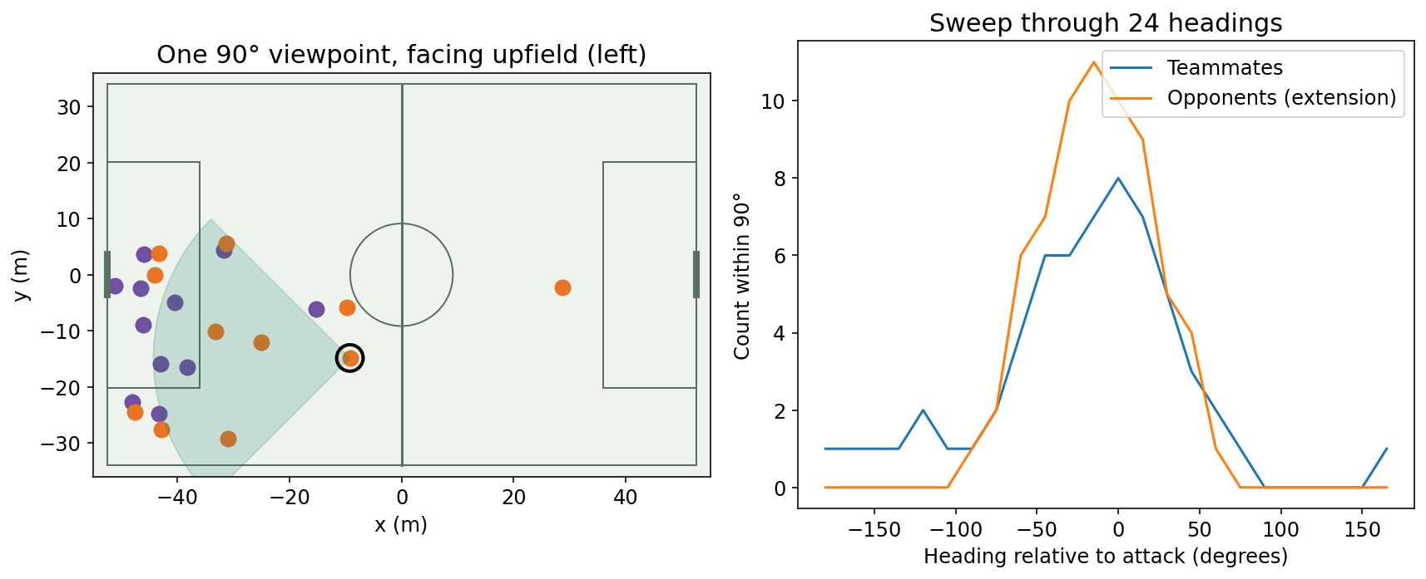
Pleuler: rotating player viewpoints
01
Place the origin at the player
02
Rotate a geometric viewing sector
03
Count teammates at each heading
NOTEBOOK · inspect angular count features
Devin Pleuler: Fixed to Fluid (2024)
11 / 61
Notes:
Pleuler (June 2024), independently implemented. Our choices: 24 headings and overlapping 90-degree sectors. This is geometric context, not observed head orientation, actual sight or occlusion. Attack-normalize both axes. Opponent-count channel is our extension. Pros: translation-invariant and intuitive. Cons: angular resolution, orientation and missing players affect features.
NOTEBOOK · inspect angular count features
Sources:
Devin Pleuler: Fixed to Fluid (2024)
https://github.com/devinpleuler/research/blob/master/frame-by-frame-position.md

Slide 12
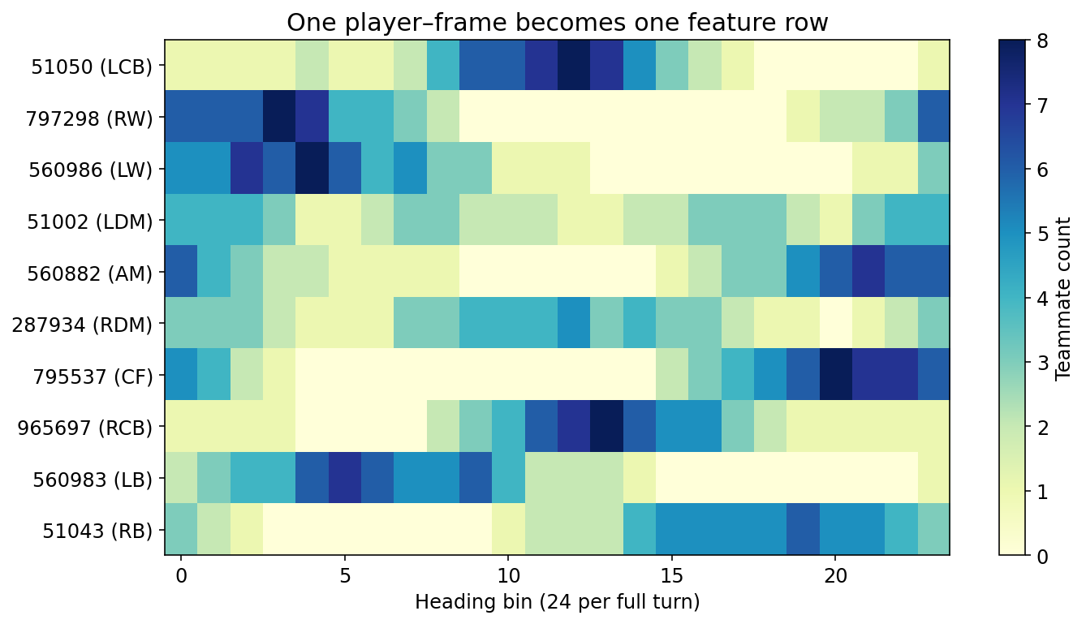
From angular features to role labels
01
Create one feature row per player and frame
02
Fit a supervised role classifier on labeled matches
03
Retain role probabilities for uncertain states
Devin Pleuler: Fixed to Fluid (2024)
12 / 61
Notes:
Pleuler used XGBoost. This notebook manufactures features but does not train or claim accuracy from a single match. Assigned-position metadata gives weak labels during rotations. For credible evaluation use manually reviewed frame roles and held-out matches/players. Add opponent counts as a separate tested extension. Pros: flexible nonlinear classification. Cons: label noise and domain shift.
Sources:
Devin Pleuler: Fixed to Fluid (2024)
https://github.com/devinpleuler/research/blob/master/frame-by-frame-position.md

Slide 13
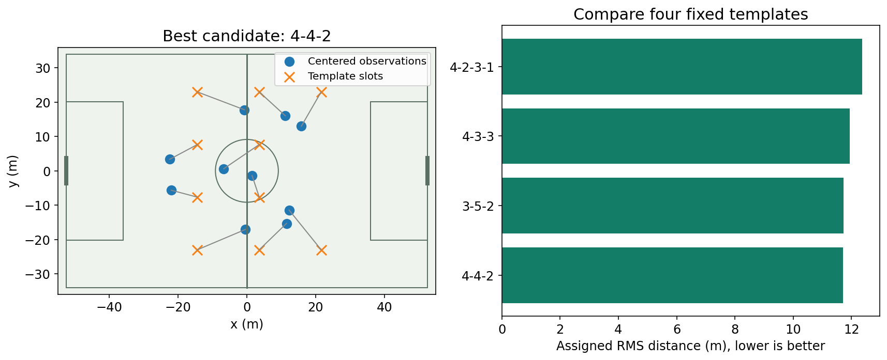
Formation prediction by assignment
01
Compare centered shape with candidate templates
02
Match ten outfield players to ten slots
03
Select the lowest assignment cost
NOTEBOOK · inspect template scores and assignments
Joris Bekkers: Elastic Formation and Position Identification
UnravelSports EFPI tutorial
13 / 61
Notes:
Teaching baseline: four fixed templates, Hungarian minimum squared-distance assignment, attack-right orientation. RMS residual is not a probability. Unlike EFPI, this implementation has no elastic template optimization. Pros: interpretable assignments and no player-order dependence. Cons: template inventory, scale and asymmetry determine results.
NOTEBOOK · inspect template scores and assignments
Sources:
Joris Bekkers: Elastic Formation and Position Identification
https://arxiv.org/abs/2506.23843
UnravelSports EFPI tutorial
https://unravelsports.readthedocs.io/en/latest/tutorials/formation_detection.html

Slide 14
Bekkers: elastic formation identification
01
Allow templates to adapt to team shape
02
Assign players to formation roles
03
Analyze comparable windows and possession states
Joris Bekkers: Elastic Formation and Position Identification
UnravelSports EFPI tutorial
14 / 61
Notes:
EFPI is the published extension using elastic templates and linear assignment. The displayed visualization is our simpler fixed-template baseline, not an EFPI result. Follow the linked tutorial for package inference. Pros: formation and role assignment together. Cons: parameter choices, substitutions, partial tracking and tactical ambiguity. Compare output to video-reviewed labels.
Sources:
Joris Bekkers: Elastic Formation and Position Identification
https://arxiv.org/abs/2506.23843
UnravelSports EFPI tutorial
https://unravelsports.readthedocs.io/en/latest/tutorials/formation_detection.html

Slide 15
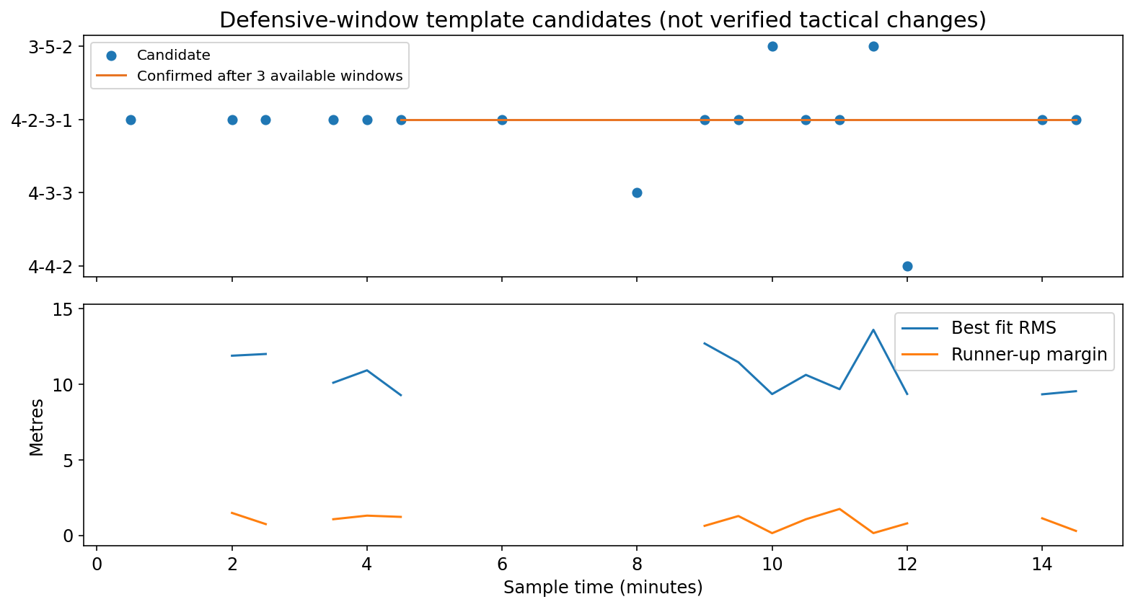
Detecting formation-change candidates
01
Score successive windows in the same phase
02
Require persistent evidence before switching
03
Review changes alongside substitutions and video
NOTEBOOK · candidate timeline and persistence
Devin Pleuler: Fixed to Fluid (2024)
Joris Bekkers: Elastic Formation and Position Identification
15 / 61
Notes:
Plot uses real defensive-context windows with at least 50 qualifying frames. Three consecutive available 30-second bins confirm a label; missing bins reset the candidate count. Existing confirmed state is retained through missing bins, not evidence of ongoing stability. This is an educational rule, not EFPI change logic. Pleuler explicitly proposed change detection without testing it. No tactical ground truth is available here. Role swaps alone need not imply formation changes.
NOTEBOOK · candidate timeline and persistence
Sources:
Devin Pleuler: Fixed to Fluid (2024)
https://github.com/devinpleuler/research/blob/master/frame-by-frame-position.md
Joris Bekkers: Elastic Formation and Position Identification
https://arxiv.org/abs/2506.23843

Slide 16
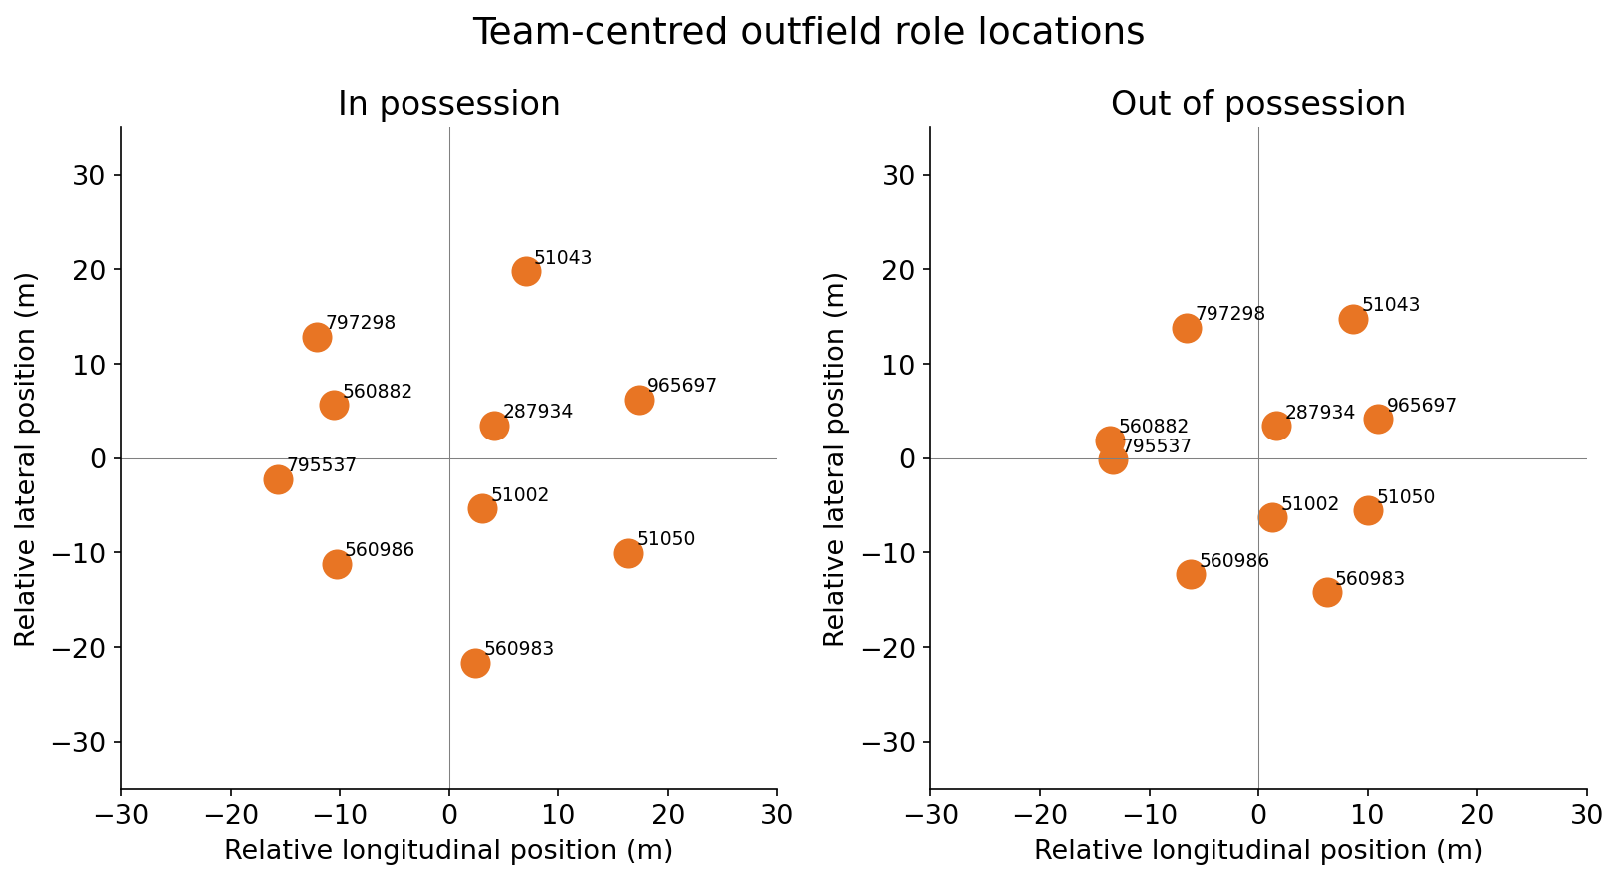
Formation detection
01
Remove team translation with centered coordinates
02
Separate in-possession and defensive samples
03
Estimate stable role locations over a window
Shaw & Glickman: Dynamic Analysis of Team Strategy
16 / 61
Notes:
Real median outfield positions are shown separately by possession. Pros: summarizes organization beyond a team sheet. Cons: averaging mixes roles and game states; these are not asserted formation labels.
Sources:
Shaw & Glickman: Dynamic Analysis of Team Strategy
https://static.capabiliaserver.com/frontend/clients/barca/wp_prod/wp-content/uploads/2020/01/83c87dfe-barca_poster_shaw.pdf

Slide 17
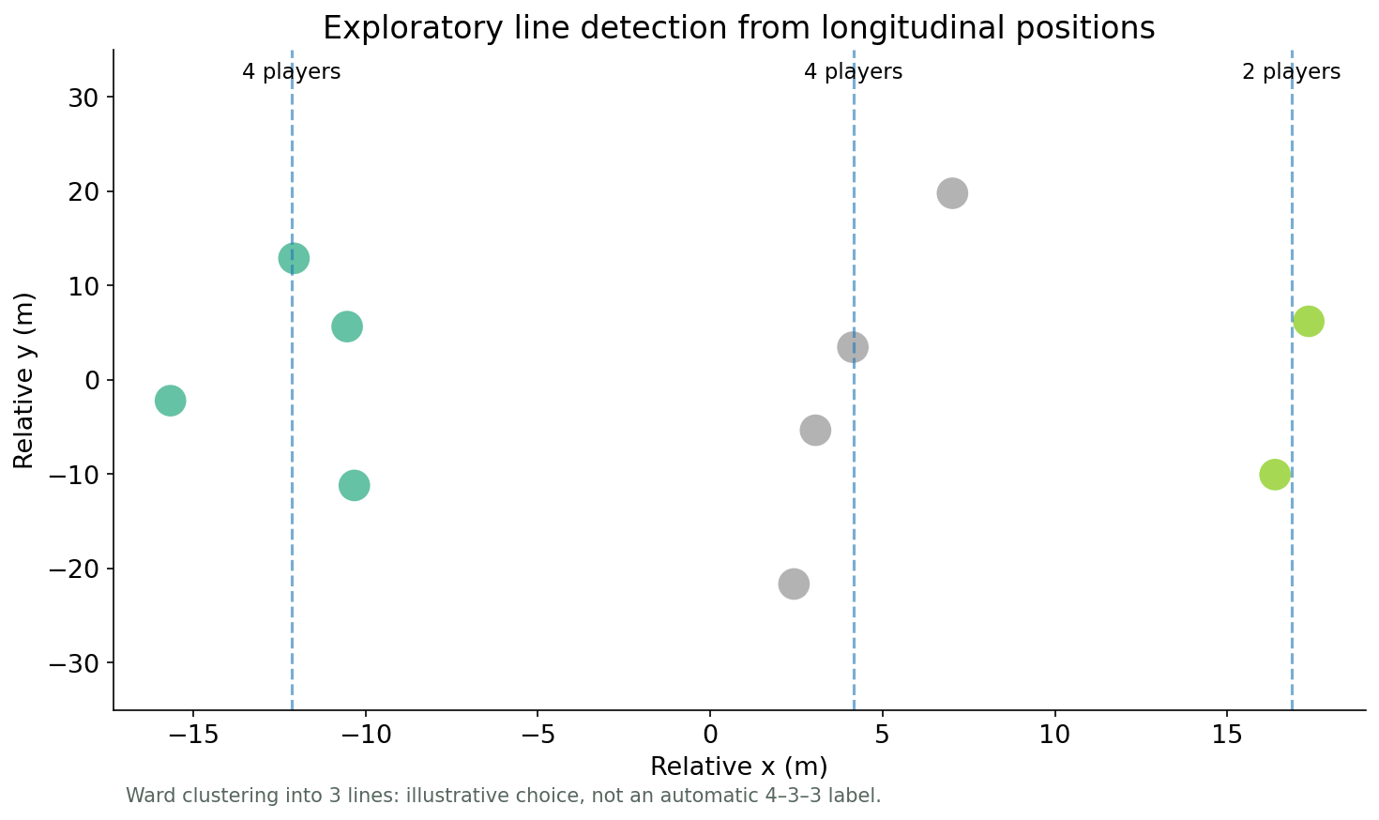
Player-role and line detection
01
Group longitudinal positions into candidate lines
02
Assign roles consistently through player exchanges
03
Treat cluster count as a modeling choice
Shaw & Glickman: Dynamic Analysis of Team Strategy
17 / 61
Notes:
Ward clustering of real centered x positions into three groups is a teaching baseline. It is not a validated named-formation classifier. Pros: interpretable. Cons: fixed line counts, overlaps and rotations.
Sources:
Shaw & Glickman: Dynamic Analysis of Team Strategy
https://static.capabiliaserver.com/frontend/clients/barca/wp_prod/wp-content/uploads/2020/01/83c87dfe-barca_poster_shaw.pdf

Slide 18
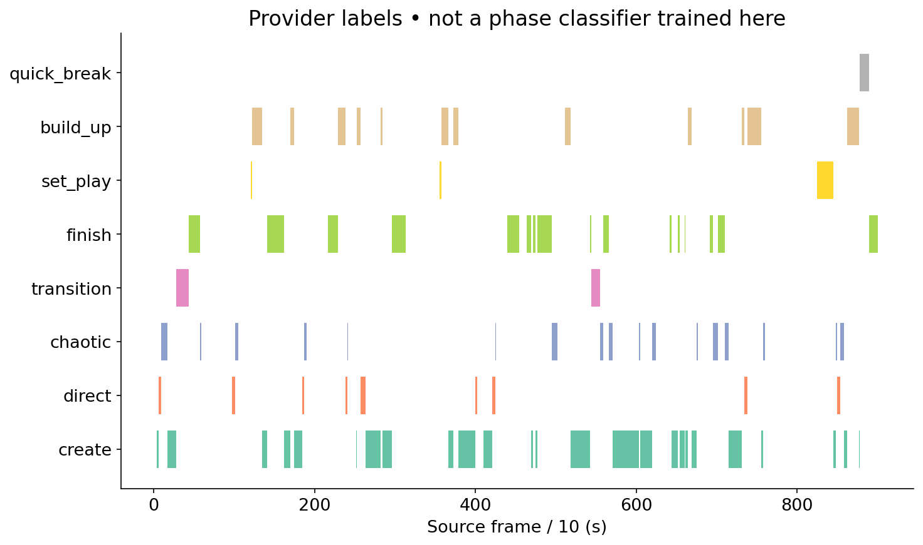
Phase-of-play segmentation
01
Represent phases as intervals rather than single events
02
Join intervals to tracking by period and frame
03
Compare structure and effort within tactical context
NOTEBOOK · join phase intervals
SkillCorner open data and schema
Augmented possession and phases framework (2025)
18 / 61
Notes:
The plot shows supplied SkillCorner labels, not predictions from a classifier trained here. Pros: makes context explicit. Cons: taxonomy-dependent and sensitive to boundary definitions.
NOTEBOOK · join phase intervals
Sources:
SkillCorner open data and schema
https://github.com/SkillCorner/opendata
Augmented possession and phases framework (2025)
https://doi.org/10.1177/22150218241290988

Slide 19
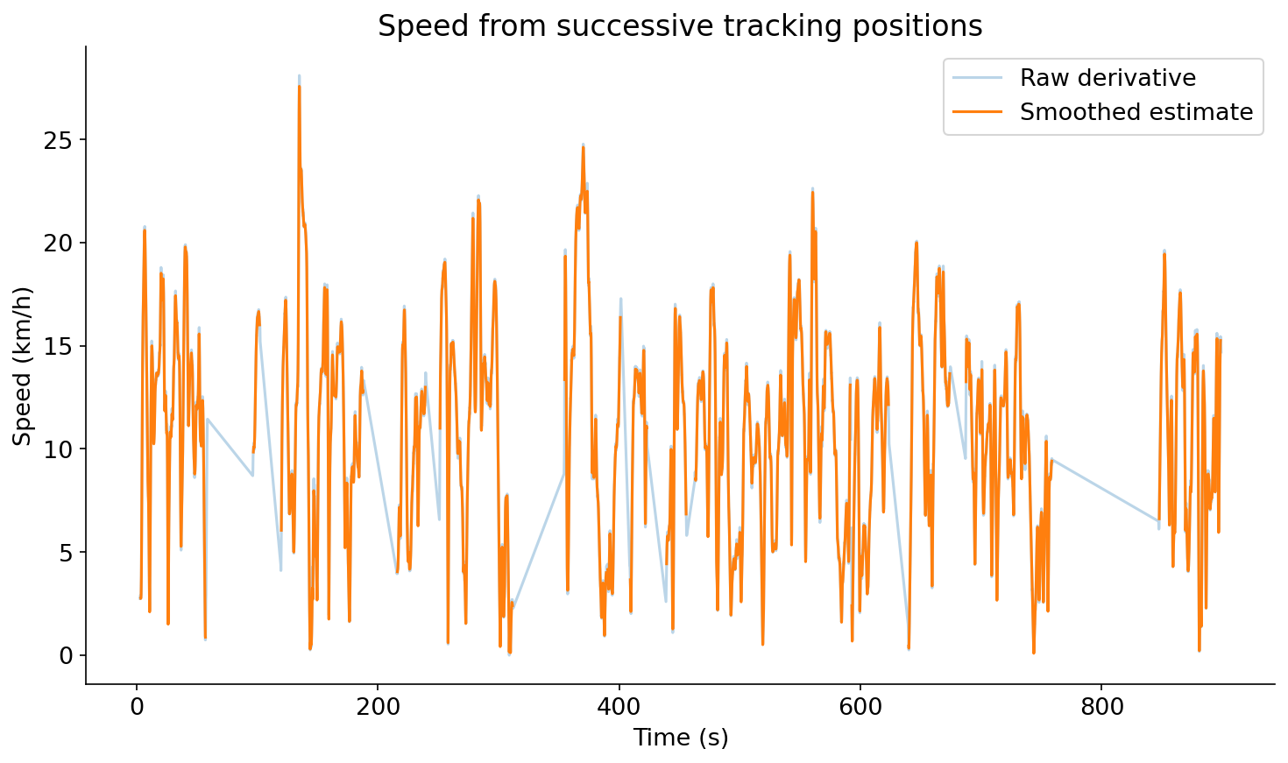
Estimating player speed
01
Smooth positions within valid continuous segments
02
Differentiate coordinates using elapsed time
03
Convert m/s to km/h for running bands
DataBallPy preprocessing
19 / 61
Notes:
Actual speed curves are shown. Pros: foundation for physical and tactical features. Cons: derivatives amplify noise; smoothing removes some short peaks.
Sources:
DataBallPy preprocessing
https://databallpy.readthedocs.io/en/main/getting_started/preprocessing_options.html

Slide 20
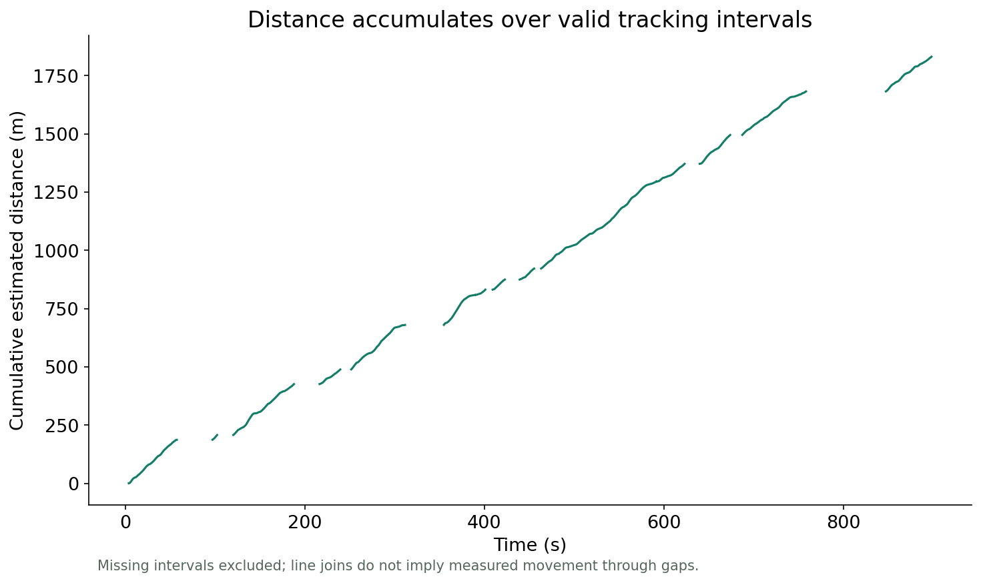
Distance covered
01
Integrate speed across valid intervals
02
Distance ≈ Σ speed × Δt
03
Report coverage alongside the total
DataBallPy covered distance
SkillCorner physical thresholds and time-to metrics
20 / 61
Notes:
The real sample’s cumulative distance excludes missing derivatives. No full-match extrapolation. Pros: simple workload volume measure. Cons: incomplete and extrapolated tracking affect accuracy.
Sources:
DataBallPy covered distance
https://databallpy.readthedocs.io/en/main/features/covered_distance_page.html
SkillCorner physical thresholds and time-to metrics
https://skillcorner.com/us/articles/scouted-brazilian-centre-backs

Slide 21
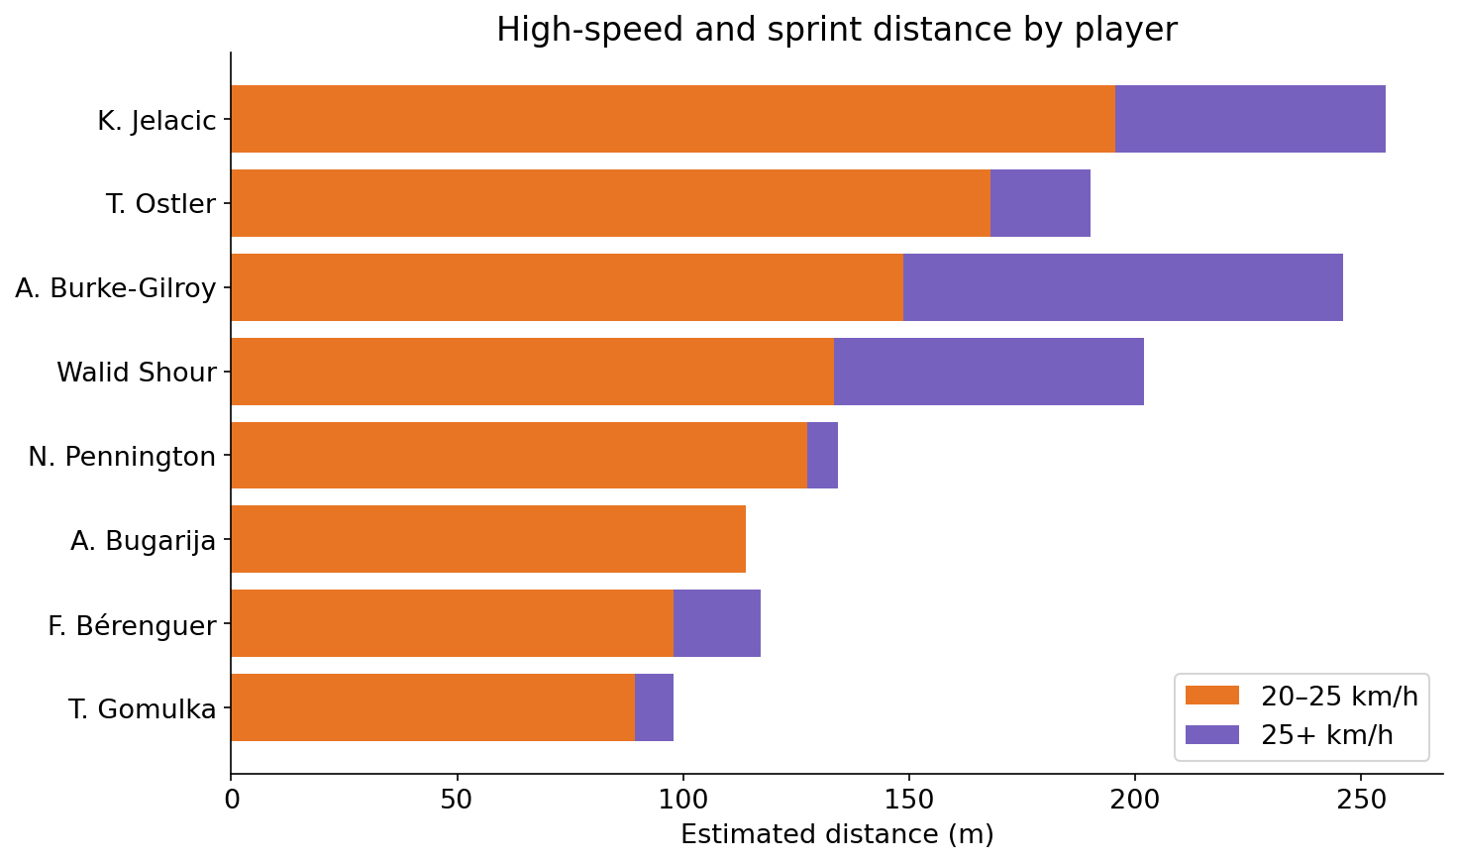
High-speed and sprint distance
01
HSR: documented men’s band 20–25 km/h
02
Sprint: above 25 km/h
03
Accumulate distance separately in each band
SkillCorner physical thresholds and time-to metrics
DataBallPy covered distance
21 / 61
Notes:
Our code uses [20,25) and [25,infinity) to avoid overlap; exact equality handling is a teaching convention. Pros: distinguishes intensity from volume. Cons: thresholds and exposure affect comparisons.
Sources:
SkillCorner physical thresholds and time-to metrics
https://skillcorner.com/us/articles/scouted-brazilian-centre-backs
DataBallPy covered distance
https://databallpy.readthedocs.io/en/main/features/covered_distance_page.html

Slide 22
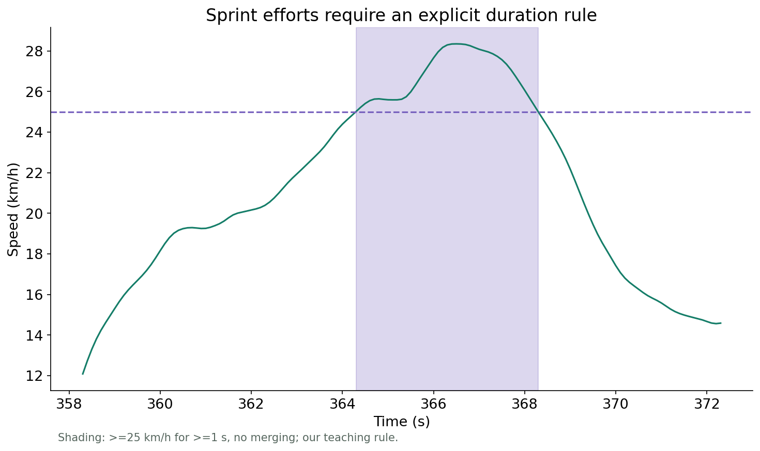
Sprint-effort counts
01
Group consecutive threshold-exceeding frames
02
Require a stated minimum duration
03
Define whether brief gaps are merged
SkillCorner physical thresholds and time-to metrics
22 / 61
Notes:
Shaded segments are our >=1 s, no-merging teaching rule. They are not exact SkillCorner production sprint counts. Pros: repeated-effort view. Cons: sensitive to thresholds, smoothing and merging rules.
Sources:
SkillCorner physical thresholds and time-to metrics
https://skillcorner.com/us/articles/scouted-brazilian-centre-backs

Slide 23
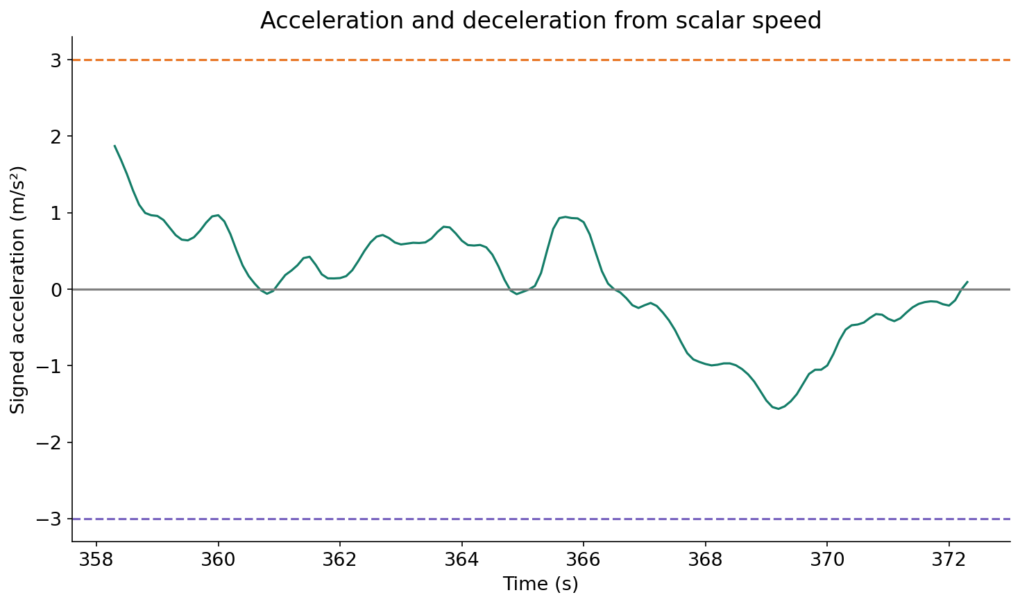
Acceleration and deceleration
01
Differentiate scalar speed for speeding up or slowing down
02
Keep signed acceleration distinct from vector magnitude
03
Check duration as well as peak acceleration
DataBallPy preprocessing
SkillCorner explosive accelerations
23 / 61
Notes:
The plot uses real signed speed derivatives. A direction change can produce acceleration-vector magnitude without increasing scalar speed. Pros: captures bursts and braking. Cons: highly noise-sensitive; threshold crossing alone does not qualify a production explosive effort.
Sources:
DataBallPy preprocessing
https://databallpy.readthedocs.io/en/main/getting_started/preprocessing_options.html
SkillCorner explosive accelerations
https://skillcorner.com/articles/new-feature-explosive-accelerations

Slide 24
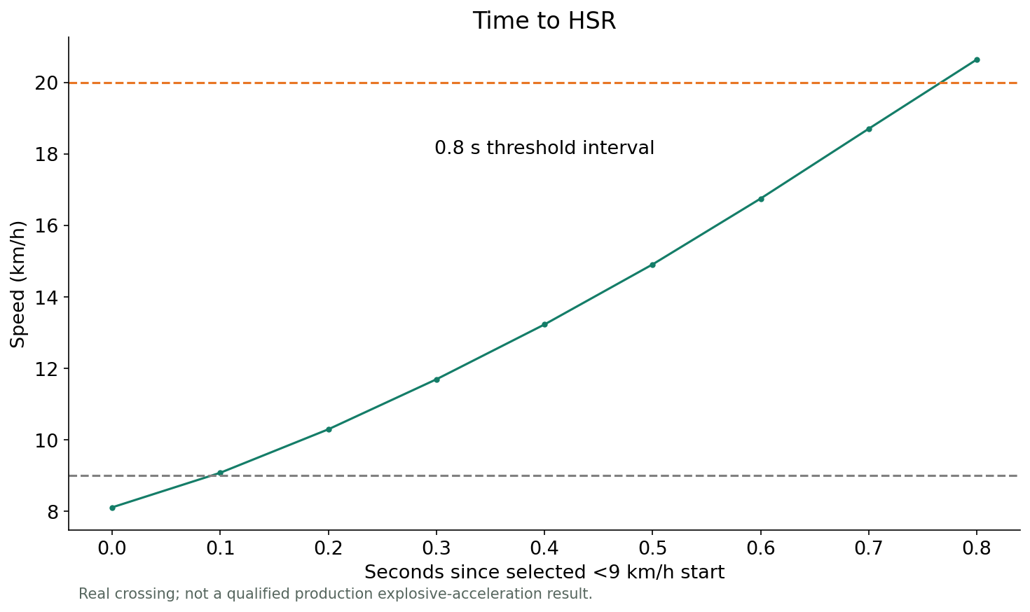
Time to high-speed running
01
SkillCorner measures the 9 → 20 km/h interval
02
Use a qualifying explosive acceleration
03
Compare the speed trajectory, not just peak speed
SkillCorner explosive accelerations
24 / 61
Notes:
The real crossing is illustrative, not production-qualified. The published metric is the minimum interval within qualifying explosive accelerations. Start detection, >0.7 s high-acceleration qualification and filtering matter.
Sources:
SkillCorner explosive accelerations
https://skillcorner.com/articles/new-feature-explosive-accelerations

Slide 25
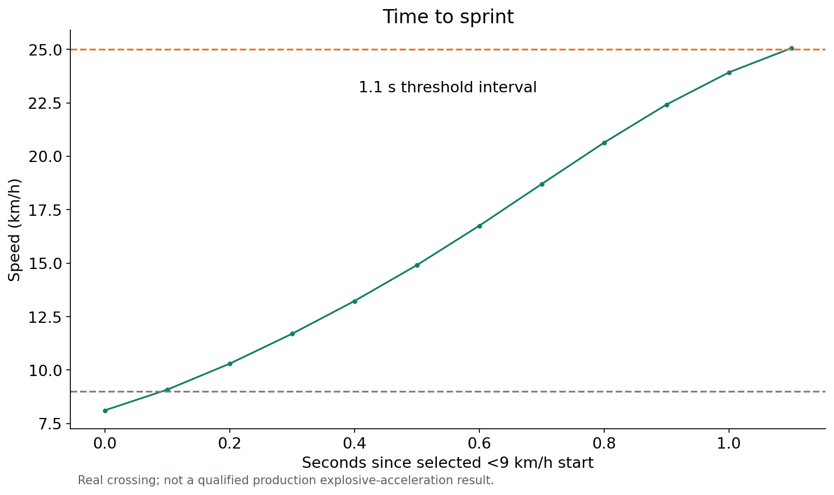
Time to sprint
01
SkillCorner measures the 9 → 25 km/h interval
02
A quick top speed does not imply a quick acceleration
03
Check the qualifying effort before reporting the metric
SkillCorner explosive accelerations
25 / 61
Notes:
Real observed crossing shown. No official Time to Sprint or Top 3 value is reconstructed. Pros: explosiveness/capacity. Cons: limited opportunities, sample size and qualification rules.
Sources:
SkillCorner explosive accelerations
https://skillcorner.com/articles/new-feature-explosive-accelerations

Slide 26
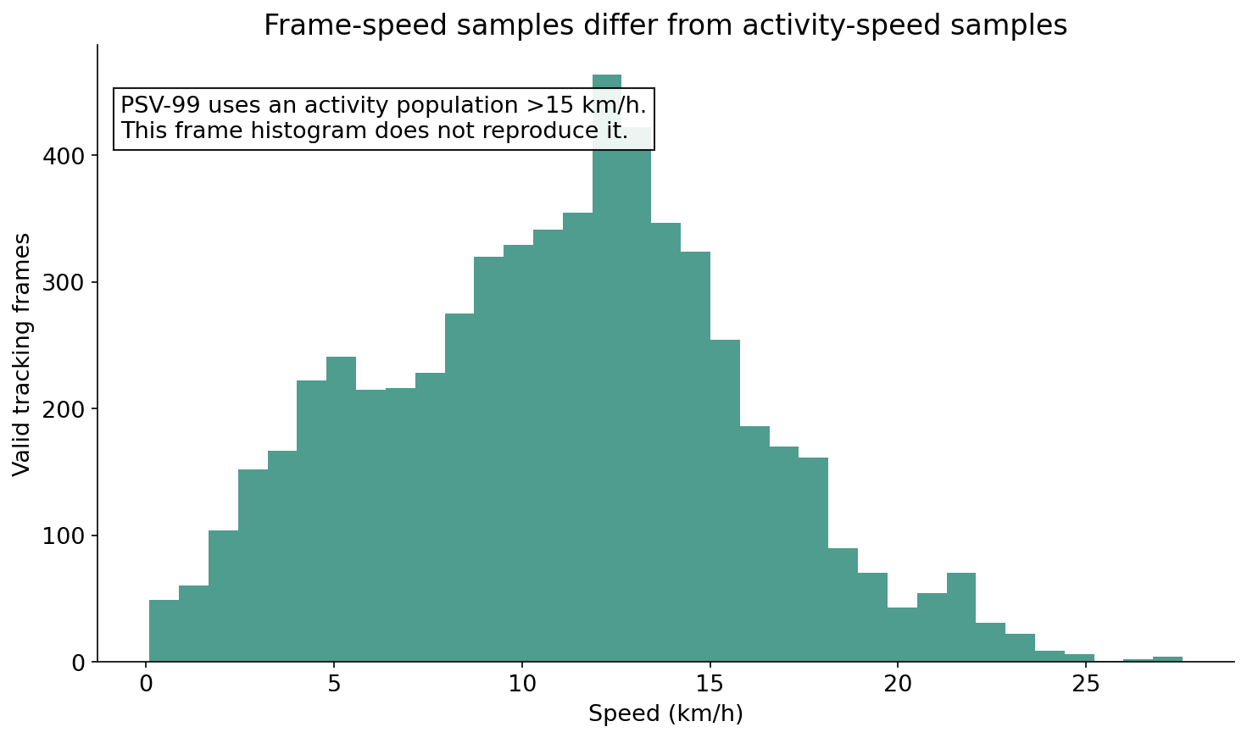
PSV-99: activity-based speed capacity
01
Use SkillCorner’s defined activity population
02
Summarize high-speed activity rather than all frames
03
Do not substitute an all-frame percentile
SkillCorner PSV-99 and Peak Velocity
26 / 61
Notes:
The real frame-speed distribution illustrates why populations matter. SkillCorner describes PSV-99 over physical activities above 15 km/h. This histogram is not the official PSV-99 calculation.
Sources:
SkillCorner PSV-99 and Peak Velocity
https://skillcorner.com/articles/skillcorner-releases-new-peak-velocity-metric

Slide 27
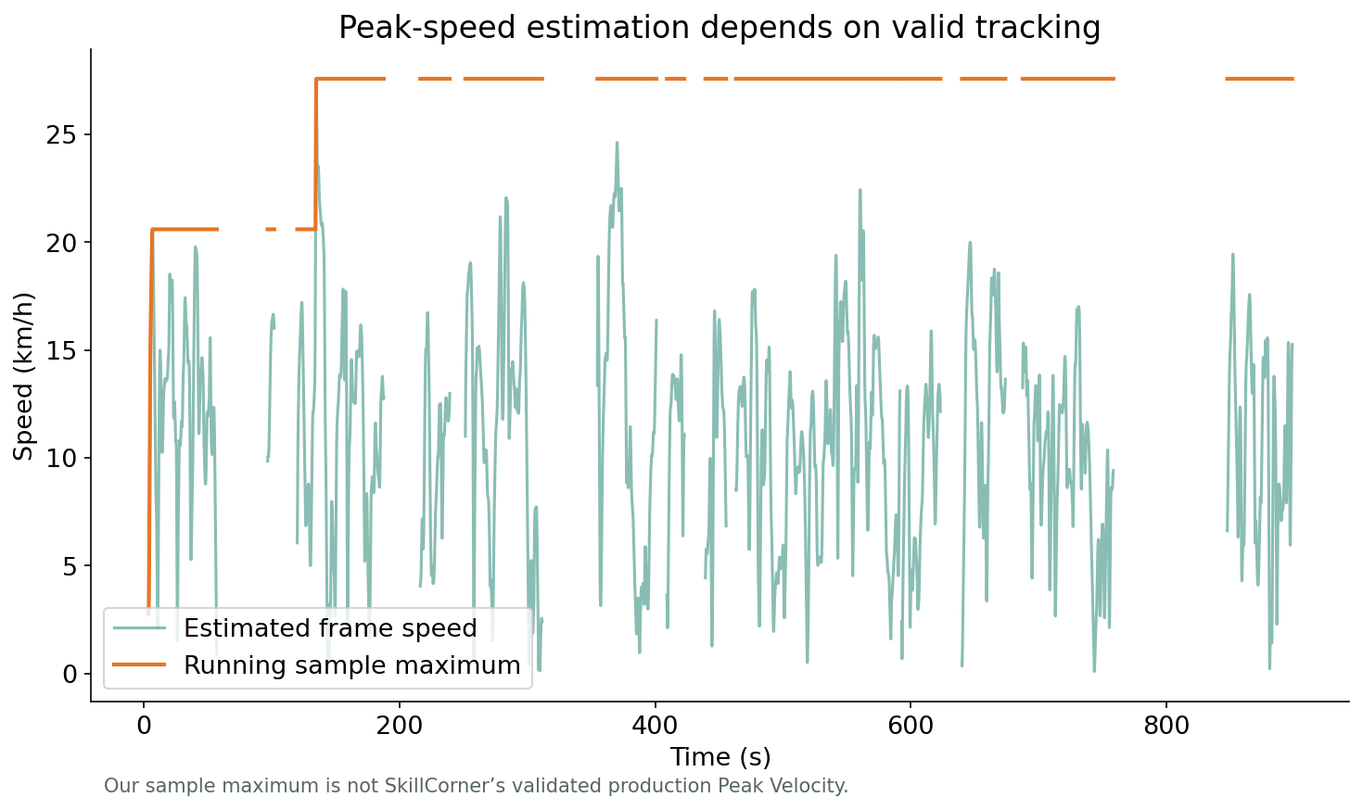
Peak Velocity: absolute top speed
01
Identify the highest reliably measured speed
02
Inspect the quality of the peak interval
03
Keep sample maxima separate from production metrics
SkillCorner PSV-99 and Peak Velocity
27 / 61
Notes:
The figure uses our smoothed sample-speed estimates. It does not reproduce SkillCorner’s validated production Peak Velocity. Pros: interpretable capacity measure. Cons: noisy spikes, short exposure and preprocessing dependence.
Sources:
SkillCorner PSV-99 and Peak Velocity
https://skillcorner.com/articles/skillcorner-releases-new-peak-velocity-metric

Slide 28
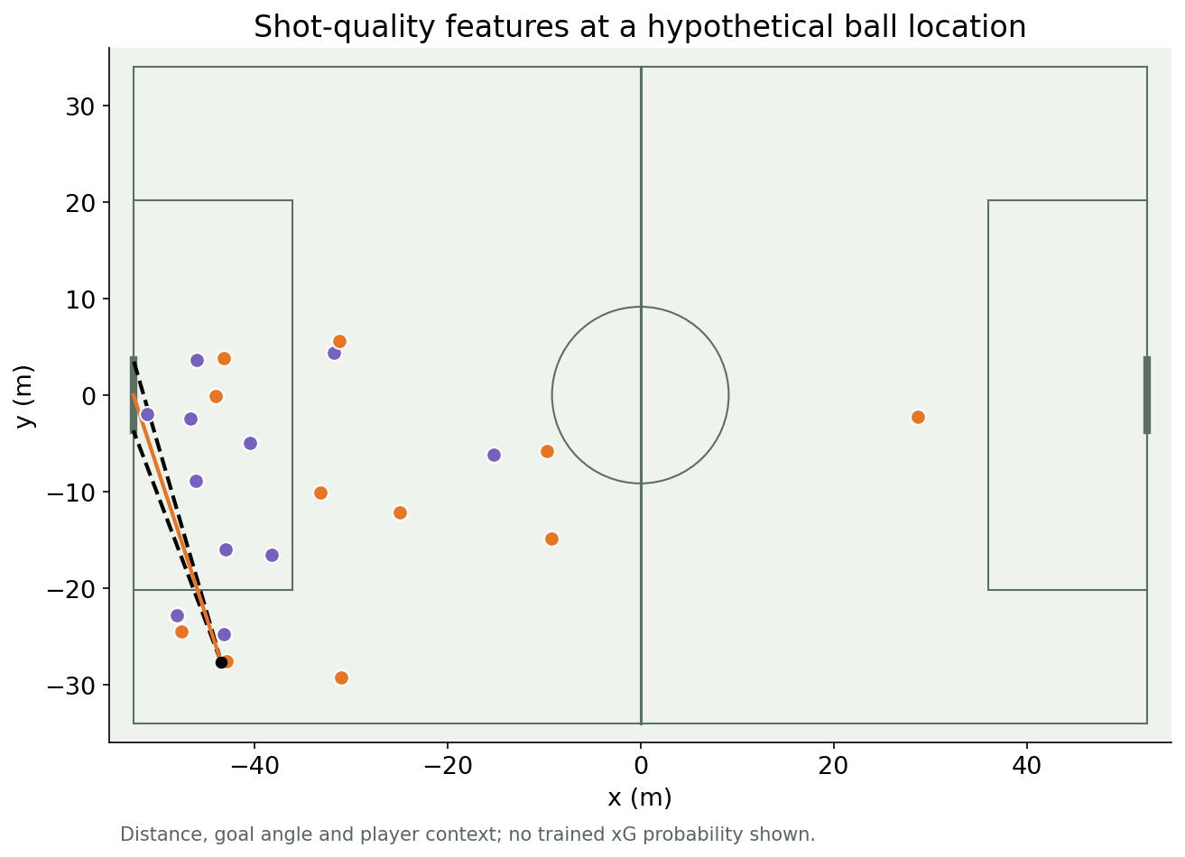
Expected goals: shot quality
01
Distance and angle form a simple feature baseline
02
Tracking adds keeper and defender context
03
Fit and calibrate on many labeled shots
StatsBomb: Upgrading Expected Goals
28 / 61
Notes:
Hypothetical shot rays at a real ball location; no xG prediction is invented. Pros: familiar target and interpretable features. Cons: sparse shots, outcome imbalance and contextual bias.
Sources:
StatsBomb: Upgrading Expected Goals
https://blogarchive.statsbomb.com/articles/soccer/upgrading-expected-goals/

Slide 29
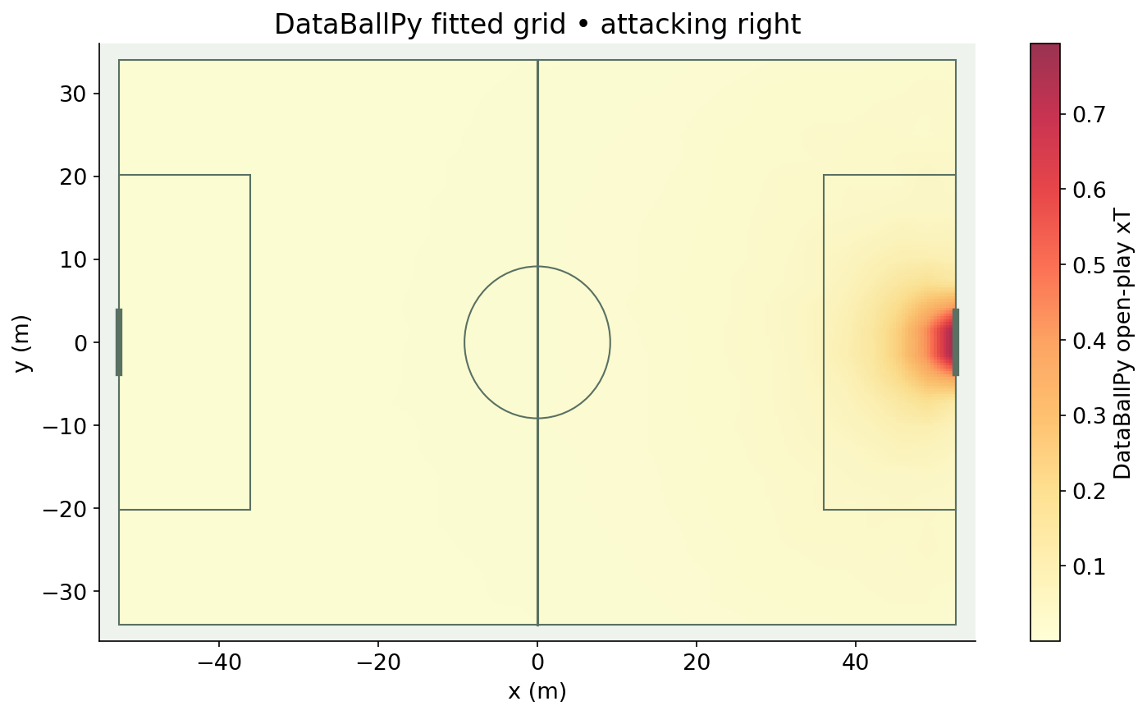
Expected Threat: location value
01
Divide the pitch into states
02
Combine shooting reward with future movement value
03
Iterate the transition equation to value continuation
Karun Singh: Expected Threat
DataBallPy fitted xT methodology
29 / 61
Notes:
Actual fitted DataBallPy open-play grid, not trained on this small sample. V(s)=P(shot|s)P(goal|shot,s)+sum P(successful move to s'|s)V(s'). Classic location xT does not use defender positions. State the model target and training domain.
Sources:
Karun Singh: Expected Threat
https://karun.in/blog/expected-threat.html
DataBallPy fitted xT methodology
https://databallpy.readthedocs.io/en/main/features/xt_models.html

Slide 30
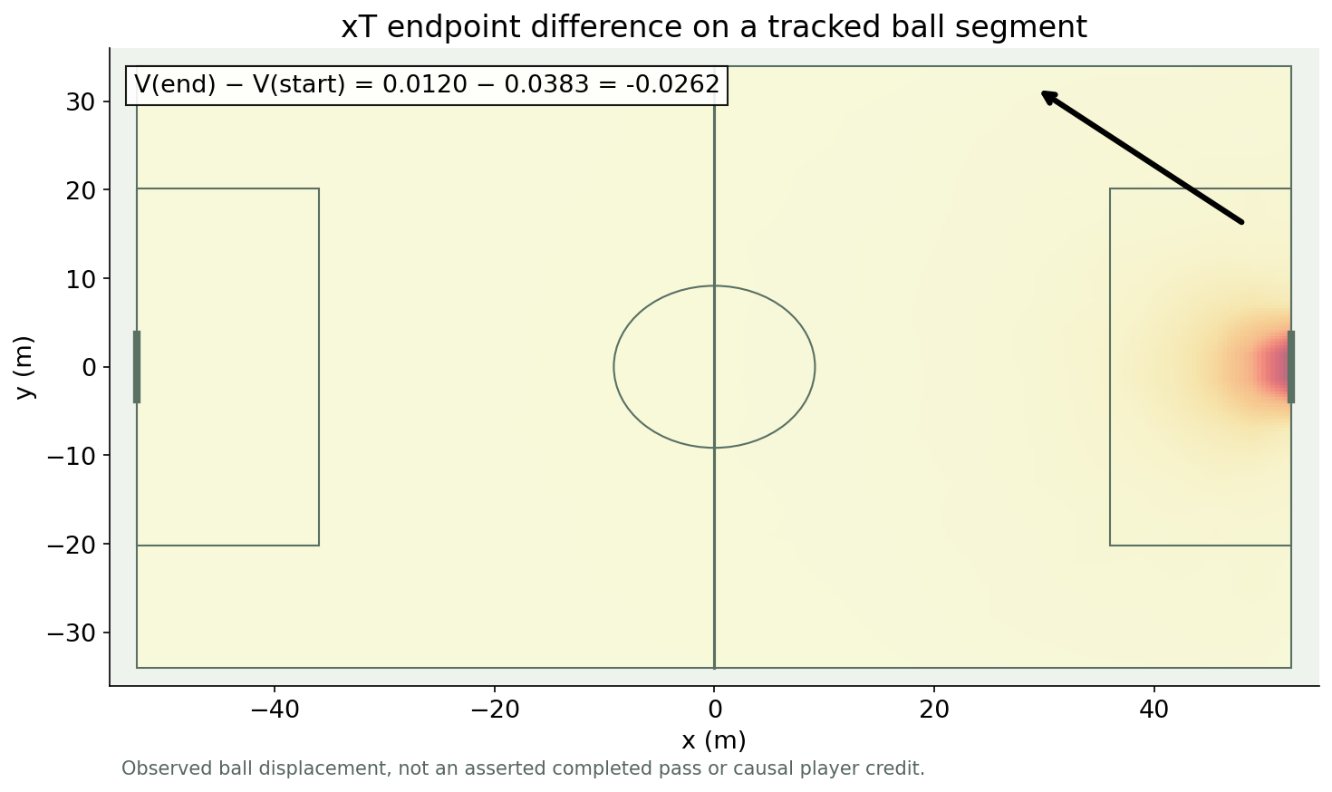
Expected Threat gained
01
Look up the value at both endpoints
02
Completed-action value: V(end) − V(start)
03
Use tracking context to explain what location-only xT misses
NOTEBOOK · xT lookup and endpoint difference
Karun Singh: Expected Threat
DataBallPy fitted xT methodology
30 / 61
Notes:
The arrow is real ball displacement in the selected clip, not an assertion of a single completed pass. Attack direction is normalized and 105 m scaled to the model’s 106 m convention. Pros: simple action valuation. Cons: path-independent, no defender context or causal attribution.
NOTEBOOK · xT lookup and endpoint difference
Sources:
Karun Singh: Expected Threat
https://karun.in/blog/expected-threat.html
DataBallPy fitted xT methodology
https://databallpy.readthedocs.io/en/main/features/xt_models.html

Slide 31
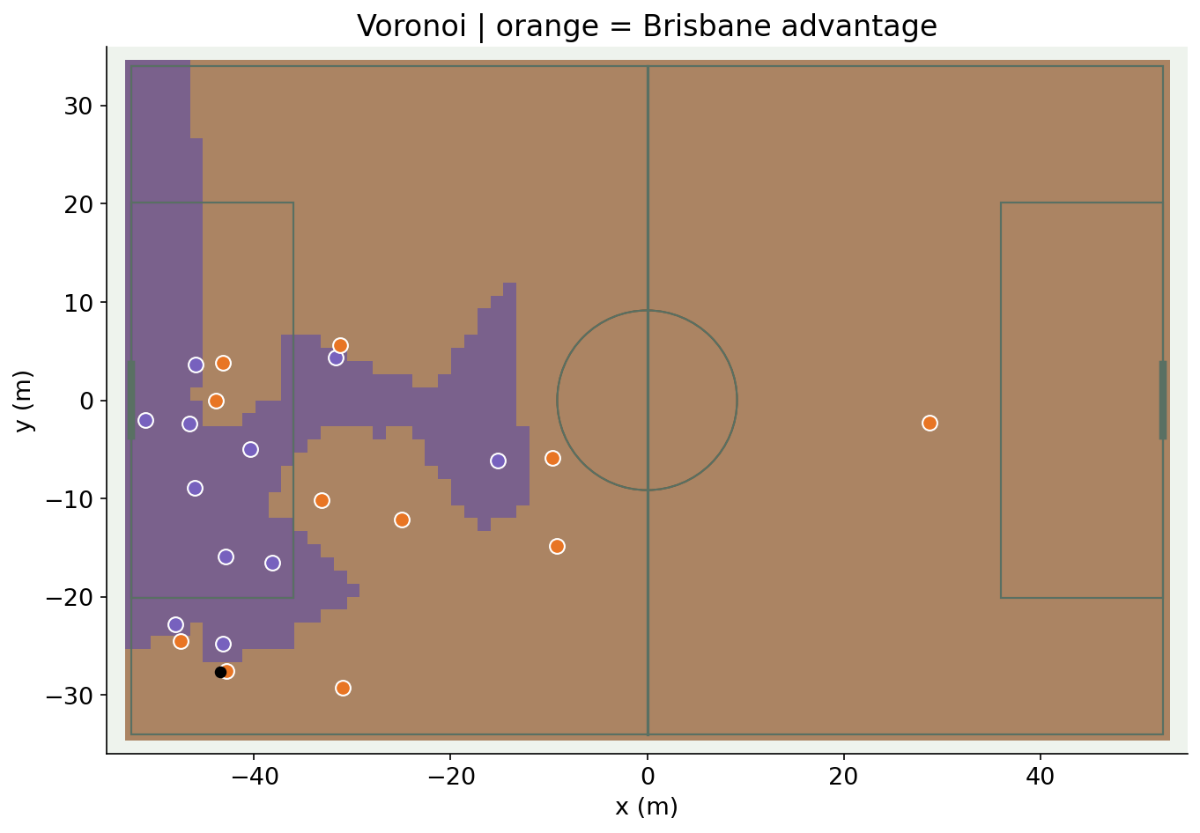
Voronoi space control
01
Assign every location to its closest player
02
Aggregate player regions by team
03
Use as a geometric baseline
DataBallPy space occupation
31 / 61
Notes:
Actual frame, grid approximation to a Voronoi partition. Pros: quick and interpretable. Cons: hard boundaries and no movement, ball-flight or uncertainty.
Sources:
DataBallPy space occupation
https://databallpy.readthedocs.io/en/main/features/space_occupation.html

Slide 32
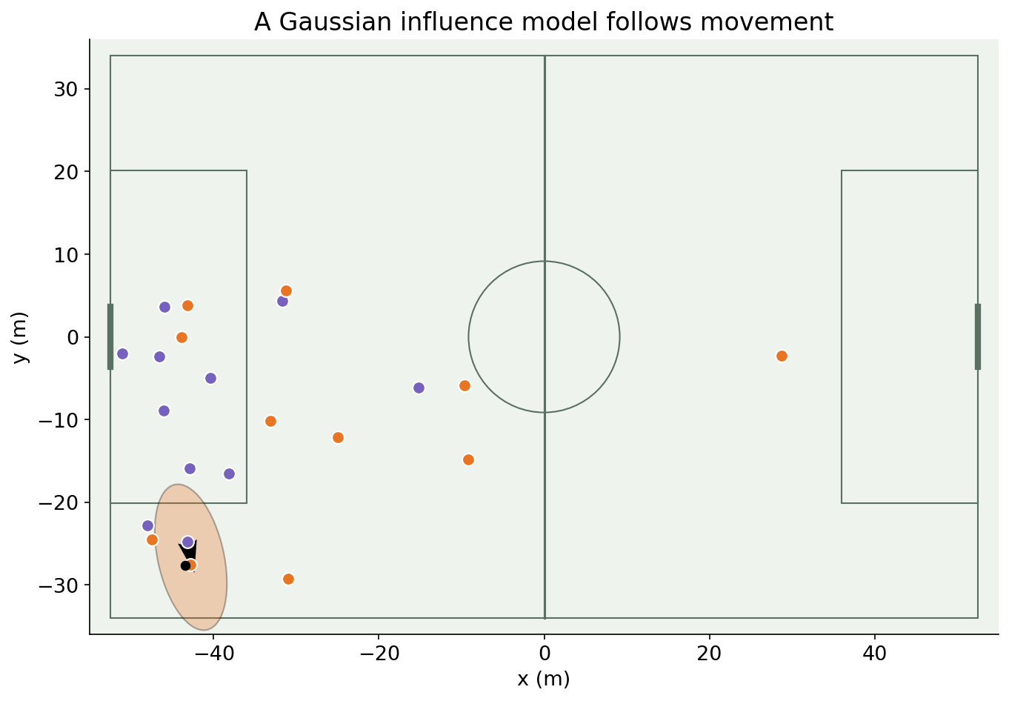
Gaussian player influence
01
Project influence in the player’s movement direction
02
Let covariance describe directional reach
03
Inspect the individual surface before aggregating
Wide Open Spaces, Fernández & Bornn (2018)
Space and Control in Soccer (2021)
32 / 61
Notes:
Real player velocity with an illustrative ellipse. The covariance is not the exact Fernández/Bornn parameterization. Pros: smooth and motion-aware. Cons: hand-set influence scale and simplified movement ability.
Sources:
Wide Open Spaces, Fernández & Bornn (2018)
https://static.capabiliaserver.com/frontend/clients/barca/wp_prod/wp-content/uploads/2018/05/Wide-Open-Spaces.pdf
Space and Control in Soccer (2021)
https://www.frontiersin.org/journals/sports-and-active-living/articles/10.3389/fspor.2021.676179/full

Slide 33
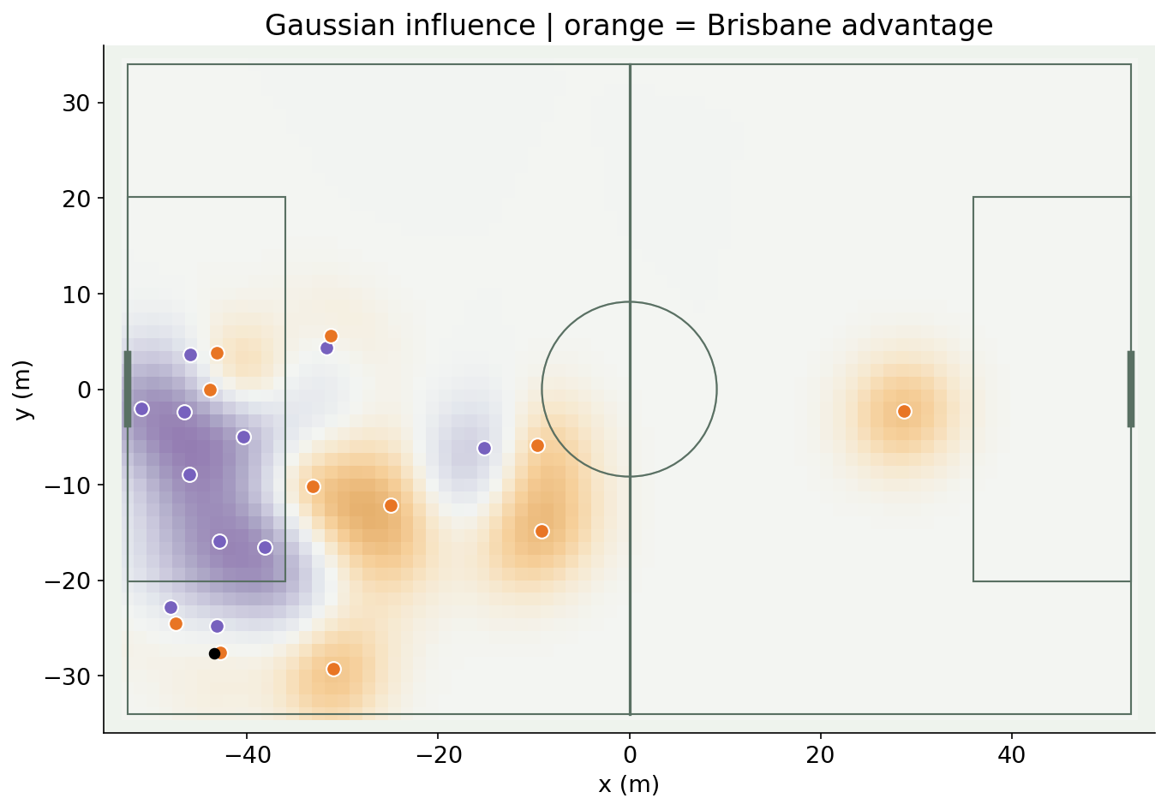
Gaussian team control
01
Aggregate individual influence by team
02
Compare team influence continuously across the pitch
03
Interpret the result as an influence score
Wide Open Spaces, Fernández & Bornn (2018)
DataBallPy space occupation
33 / 61
Notes:
Our logistic transformation bounds the team difference; it is not a calibrated possession probability. Pros: contested-space view. Cons: aggregation and covariance assumptions affect the surface.
Sources:
Wide Open Spaces, Fernández & Bornn (2018)
https://static.capabiliaserver.com/frontend/clients/barca/wp_prod/wp-content/uploads/2018/05/Wide-Open-Spaces.pdf
DataBallPy space occupation
https://databallpy.readthedocs.io/en/main/features/space_occupation.html

Slide 34
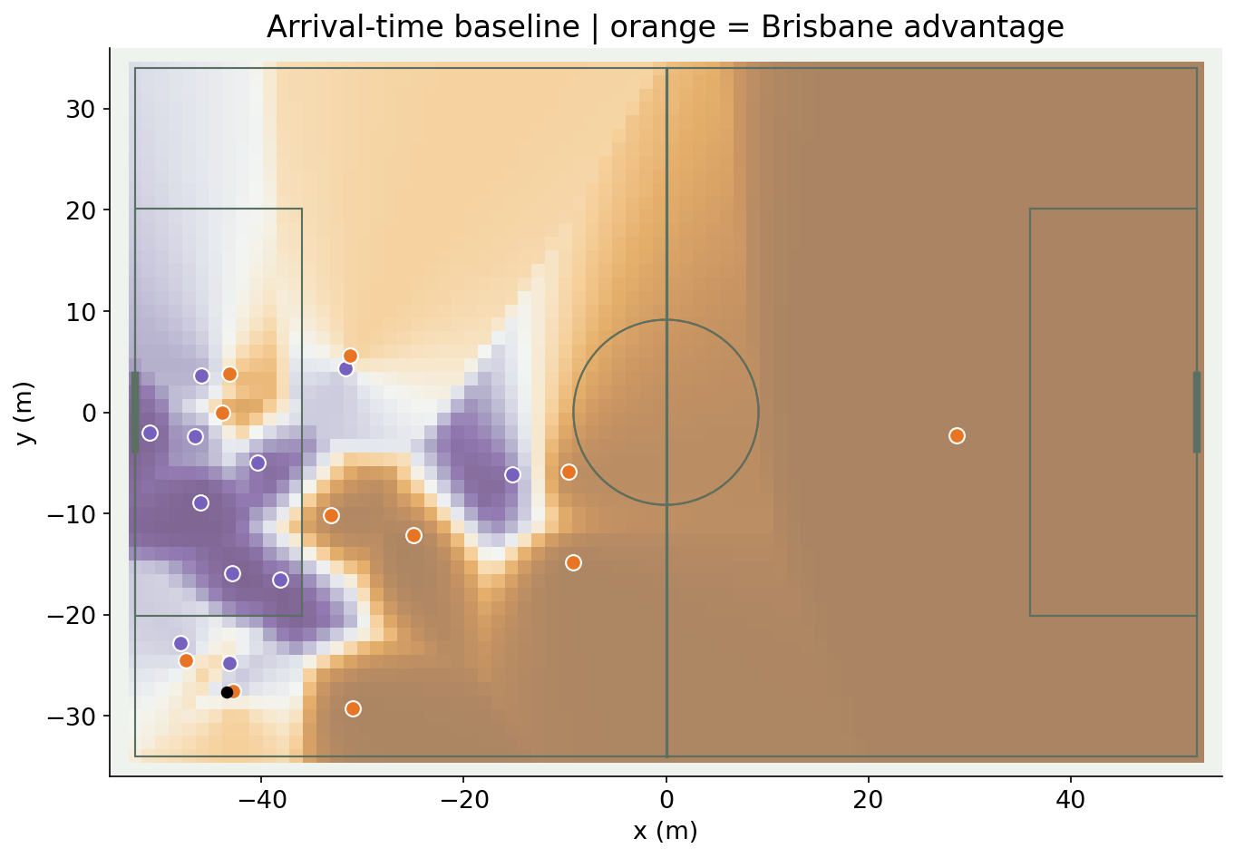
Arrival-time control
01
Estimate reaction and travel time to each location
02
Compare the earliest arrival for each team
03
Test sensitivity to movement assumptions
Space and Control in Soccer (2021)
Beyond Expected Goals, Spearman (2018)
34 / 61
Notes:
Actual frame with a simple 0.7 s projection and 5 m/s travel speed baseline. Pros: interpretable timing. Cons: no ball flight, acceleration optimization or interception-rate integration; not Spearman’s full model.
Sources:
Space and Control in Soccer (2021)
https://www.frontiersin.org/journals/sports-and-active-living/articles/10.3389/fspor.2021.676179/full
Beyond Expected Goals, Spearman (2018)
https://static.hudl.com/craft/downloads/SSAC2018_Beyond_Expected_Goals.pdf?mtime=20180327111214

Slide 35
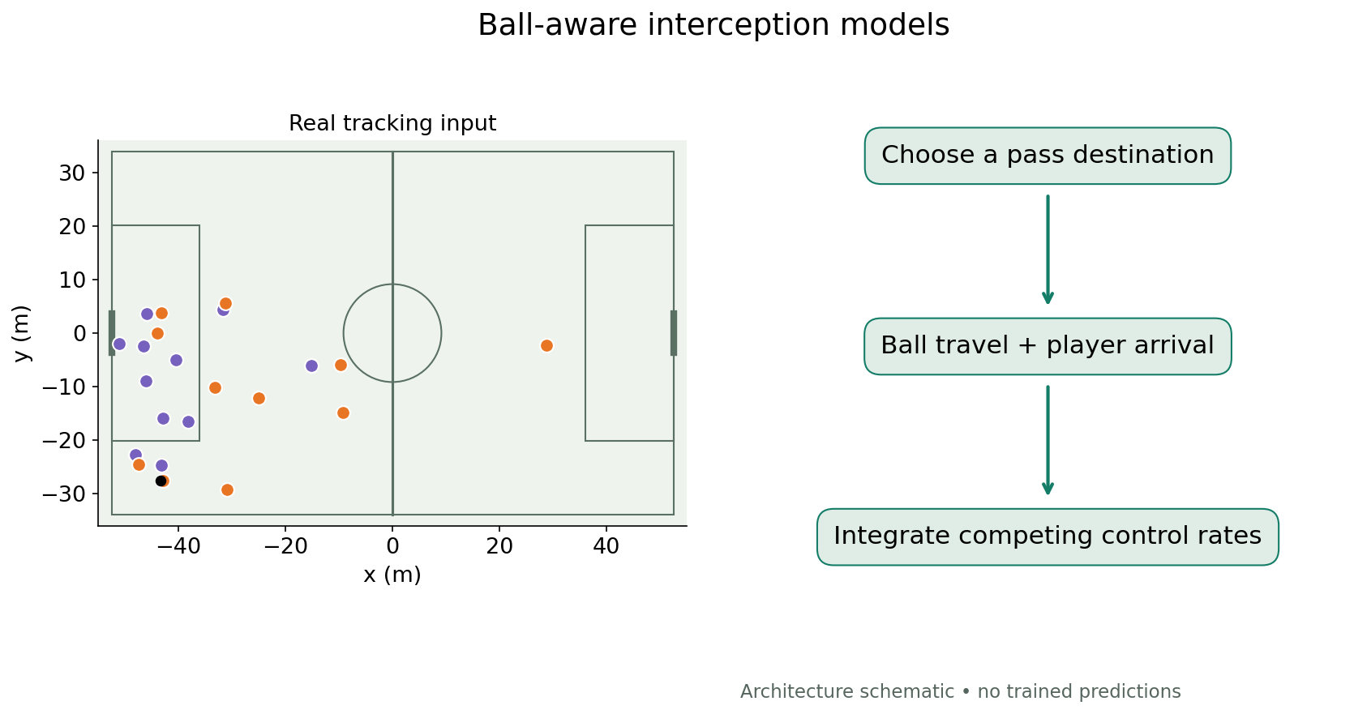
Ball-aware pitch control
01
Simulate how long the ball takes to reach a target
02
Estimate player interception and control over that interval
03
Combine competing control rates
Beyond Expected Goals, Spearman (2018)
35 / 61
Notes:
Architecture schematic on actual tracking context, not a computed Spearman surface. Pros: physical link to passing. Cons: uncertain reactions, speed and ball parameters. Separate from the arrival-time teaching baseline.
Sources:
Beyond Expected Goals, Spearman (2018)
https://static.hudl.com/craft/downloads/SSAC2018_Beyond_Expected_Goals.pdf?mtime=20180327111214

Slide 36
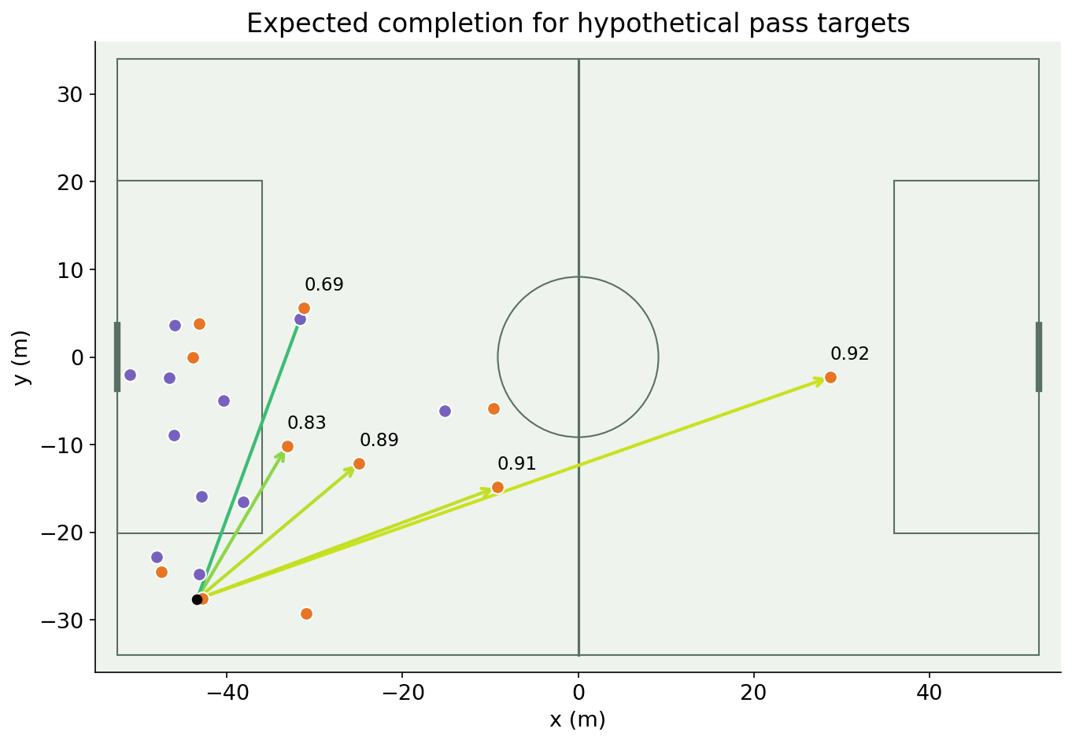
Expected pass completion
01
Specify a passer and candidate destination
02
Simulate ball travel and interception opportunities
03
Evaluate reliability on labeled attempts
NOTEBOOK · candidate-pass risk
DataBallPy DAS and expected completion
Dangerous Accessible Space: paper and implementation
36 / 61
Notes:
Actual accessible-space xC inference on hypothetical endpoints at real teammate positions. Pros: interpretable risk. Cons: model calibration, ball speed and offside conventions; candidates are not observed choices.
NOTEBOOK · candidate-pass risk
Sources:
DataBallPy DAS and expected completion
https://databallpy.readthedocs.io/en/main/features/dangerous_accessible_space.html
Dangerous Accessible Space: paper and implementation
https://github.com/jonas-bischofberger/accessible-space

Slide 37
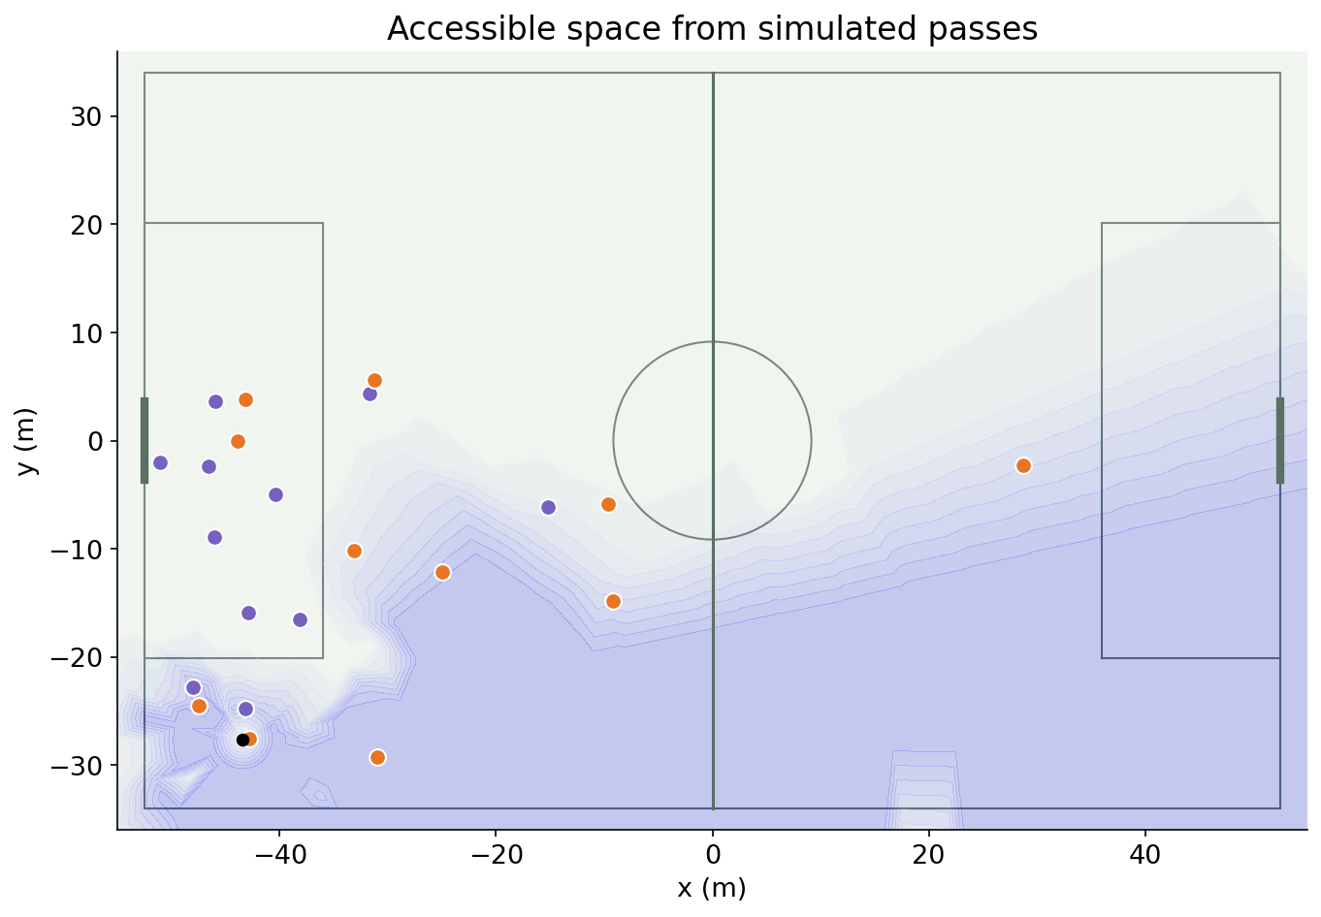
Accessible space
01
Simulate passes across directions and speeds
02
Estimate where the attacking team can receive
03
Integrate accessibility across the pitch
Dangerous Accessible Space: paper and implementation
DataBallPy DAS and expected completion
37 / 61
Notes:
Actual public-model output. Pros: incorporates ball and player movement. Cons: simulation assumptions and resolution; individual access can overlap.
Sources:
Dangerous Accessible Space: paper and implementation
https://github.com/jonas-bischofberger/accessible-space
DataBallPy DAS and expected completion
https://databallpy.readthedocs.io/en/main/features/dangerous_accessible_space.html

Slide 38
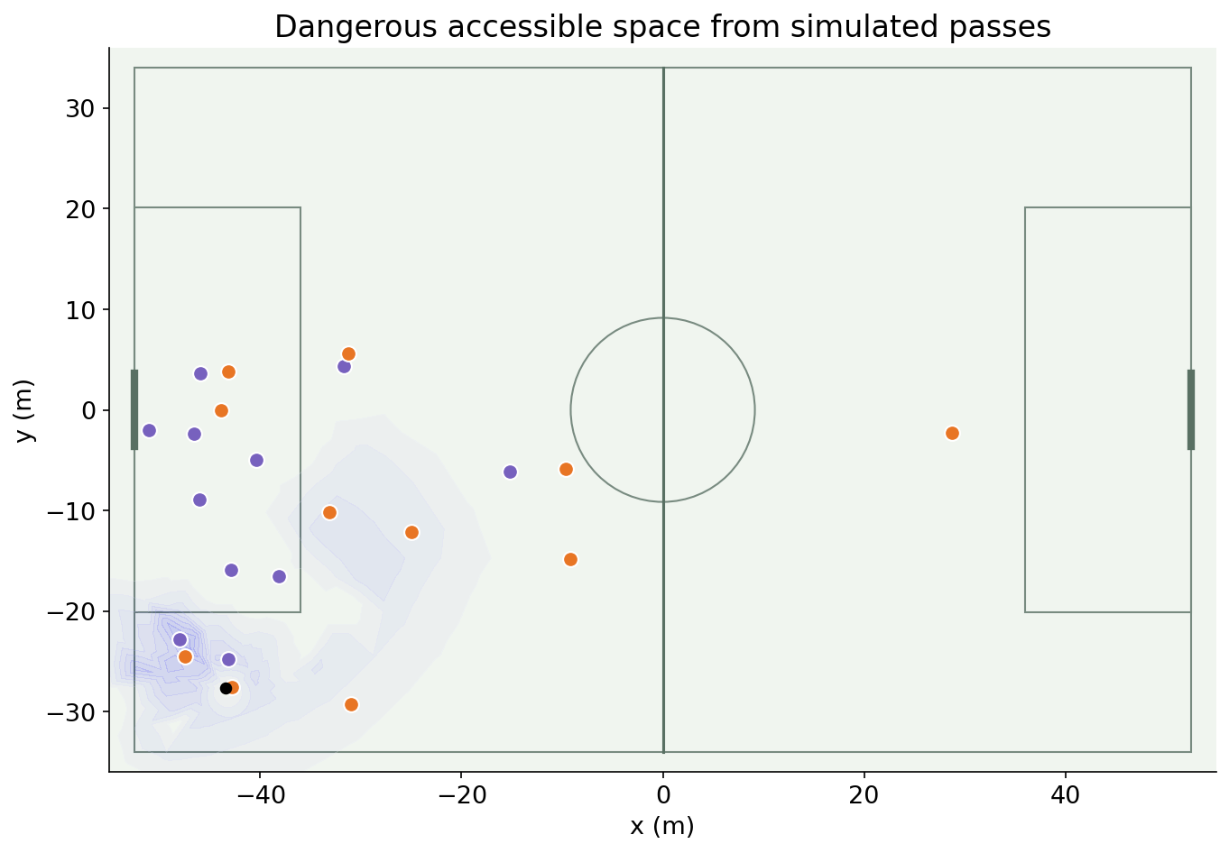
Dangerous accessible space
01
Weight accessible locations by goal danger
02
Integrate to obtain danger-weighted space
03
Keep danger-weighted area distinct from scoring probability
Dangerous Accessible Space: paper and implementation
DataBallPy DAS and expected completion
38 / 61
Notes:
Actual public-model dangerous surface. Pros: links access and useful territory. Cons: danger definition and physical assumptions; DAS units are danger-weighted square metres.
Sources:
Dangerous Accessible Space: paper and implementation
https://github.com/jonas-bischofberger/accessible-space
DataBallPy DAS and expected completion
https://databallpy.readthedocs.io/en/main/features/dangerous_accessible_space.html

Slide 39
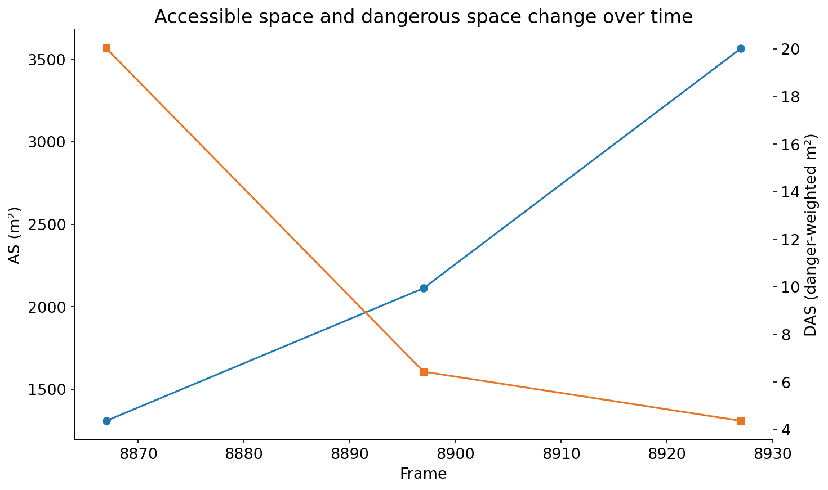
Changes in dangerous space
01
Compare the model on successive real frames
02
Report AS and DAS on their own scales
03
Inspect the movements that change available options
Dangerous Accessible Space: paper and implementation
39 / 61
Notes:
Actual model values on three frames. Pros: connects movement to changing opportunity. Cons: different team possession states and model noise must be checked; before/after changes alone are not causal credit.
Sources:
Dangerous Accessible Space: paper and implementation
https://github.com/jonas-bischofberger/accessible-space

Slide 40
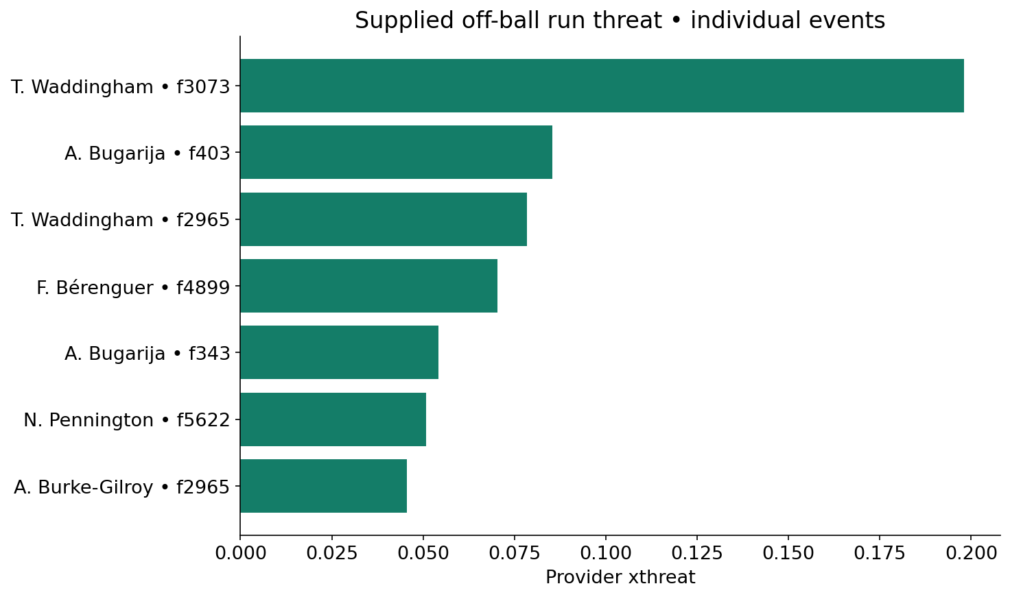
Off-ball run threat
01
Evaluate a run even when no pass is made
02
SkillCorner’s target considers a run being served
03
Separate run threat from location-based event xT
SkillCorner: Expected Threat for off-ball runs
SkillCorner open data and schema
40 / 61
Notes:
Actual supplied xthreat values for off-ball runs. The provider model is not reconstructed. Pros: visible unserved contributions. Cons: counterfactual assumptions, context and selection bias.
Sources:
SkillCorner: Expected Threat for off-ball runs
https://www.linkedin.com/posts/skillcorner_game-intelligence-expected-threat-activity-7057009275247689728-NVPh
SkillCorner open data and schema
https://github.com/SkillCorner/opendata

Slide 41
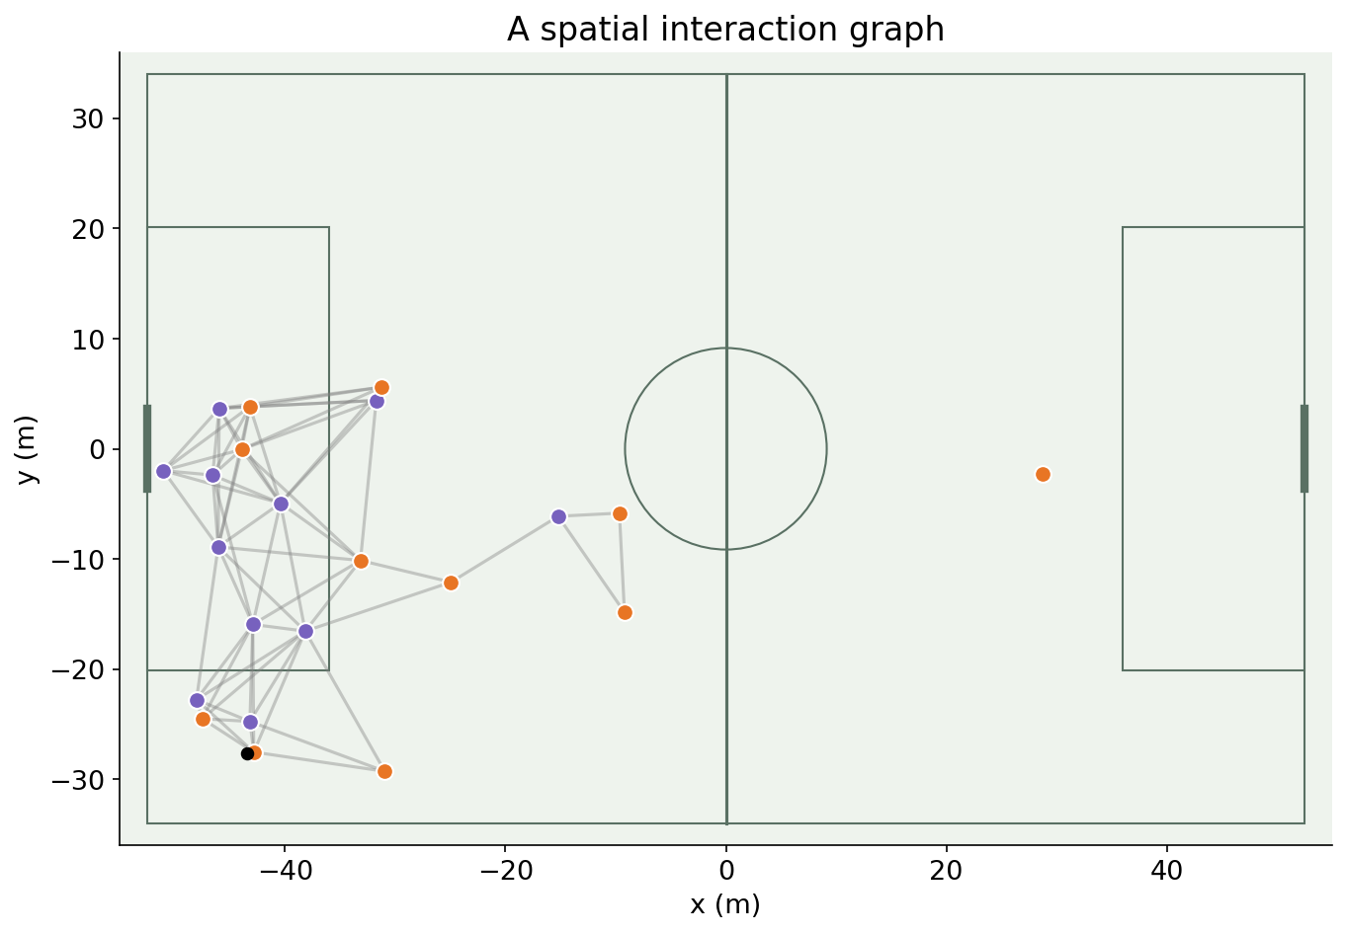
Tracking as a spatial graph
01
Represent players as nodes
02
Choose relationships that define spatial edges
03
Preserve identities while avoiding arbitrary row-order effects
U.S. Soccer: counterattack GNNs with SkillCorner (2023)
TacticAI (2024)
41 / 61
Notes:
Real radius graph. Pros: models relationships directly. Cons: radius edges miss distant tactical relationships; fully connected and learned connectivity are alternatives.
Sources:
U.S. Soccer: counterattack GNNs with SkillCorner (2023)
https://github.com/USSoccerFederation/ussf_ssac_23_soccer_gnn
TacticAI (2024)
https://www.nature.com/articles/s41467-024-45965-x

Slide 42
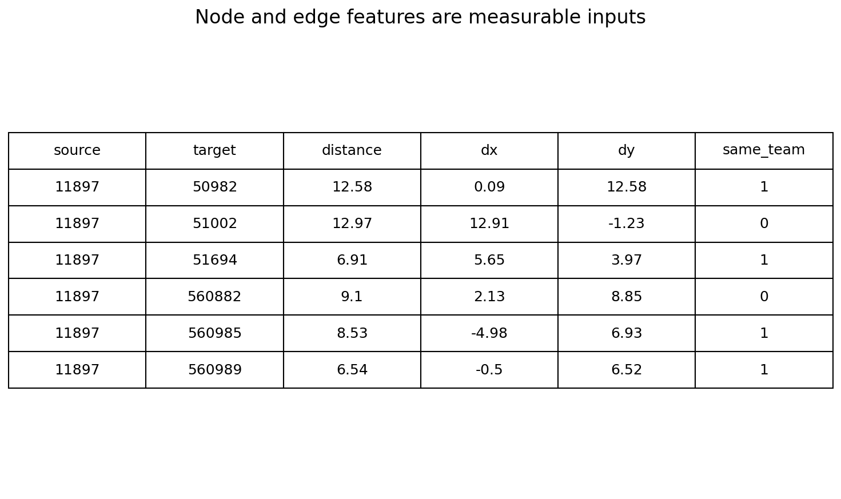
Node and edge features
01
Nodes: position, velocity, team and possession
02
Edges: distance, relative position and team relation
03
Normalize and mask missing features explicitly
U.S. Soccer: counterattack GNNs with SkillCorner (2023)
42 / 61
Notes:
Actual edge-feature rows. Edge direction controls the sign of relative position. Team IDs should be encoded meaningfully rather than treated as numeric magnitudes.
Sources:
U.S. Soccer: counterattack GNNs with SkillCorner (2023)
https://github.com/USSoccerFederation/ussf_ssac_23_soccer_gnn

Slide 43
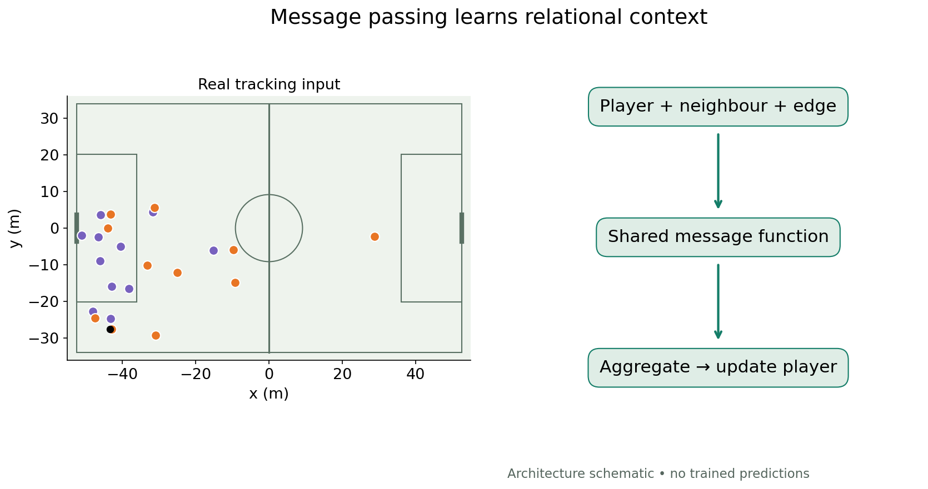
Graph neural message passing
01
Create messages from players and their relationships
02
Aggregate neighbour messages with shared functions
03
Update player representations for a prediction task
TacticAI (2024)
DEFCON: GNN-based defensive EPV (2026)
43 / 61
Notes:
Architecture schematic, not a trained result. Pros: relational inductive bias and shared updates. Cons: oversmoothing, connectivity choices and training requirements. Attention alone is not causal importance.
Sources:
TacticAI (2024)
https://www.nature.com/articles/s41467-024-45965-x
DEFCON: GNN-based defensive EPV (2026)
https://github.com/hyunsungkim-ds/defcon

Slide 44
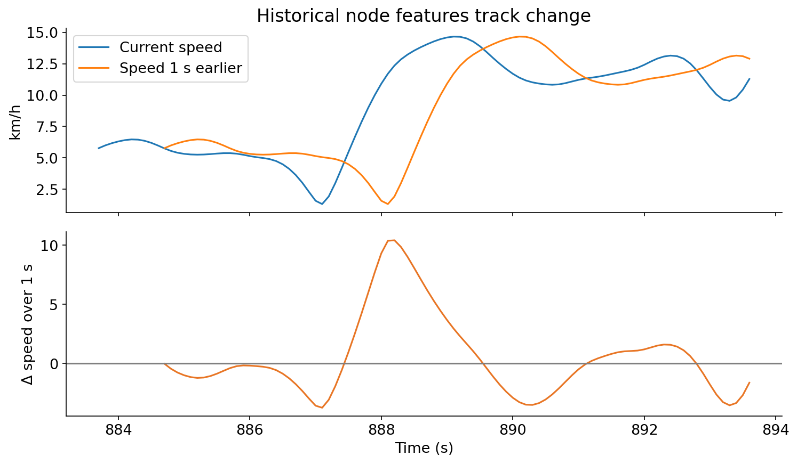
Temporal node features
01
Add lagged speed, displacement and relative movement
02
Use rolling history only up to prediction time
03
Include elapsed time and missing-history masks
NOTEBOOK · lagged features and masks
U.S. Soccer: counterattack GNNs with SkillCorner (2023)
DataBallPy preprocessing
44 / 61
Notes:
Actual one-second lag and speed change on a real player. Explicit lag frame checks prevent bridging gaps. Instantaneous velocity adds motion information but is not a substitute for full history.
NOTEBOOK · lagged features and masks
Sources:
U.S. Soccer: counterattack GNNs with SkillCorner (2023)
https://github.com/USSoccerFederation/ussf_ssac_23_soccer_gnn
DataBallPy preprocessing
https://databallpy.readthedocs.io/en/main/getting_started/preprocessing_options.html

Slide 45
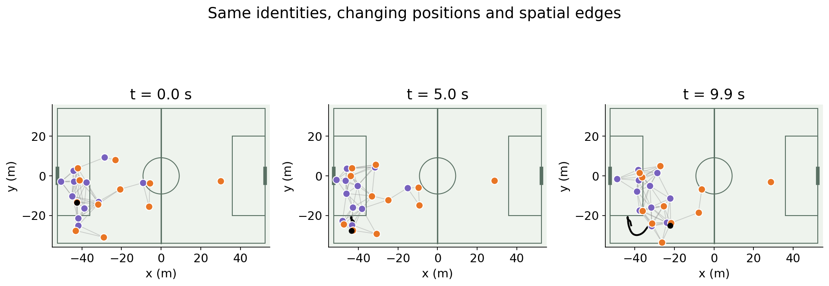
Dynamic graphs over time
01
Recompute spatial edges as players move
02
Maintain player identities across snapshots
03
Model changing passing lanes and defensive relationships
U.S. Soccer: counterattack GNNs with SkillCorner (2023)
PathCRF: player trajectories to events (2026)
45 / 61
Notes:
Actual snapshots and a player trail. A sequence of spatial graphs retains team interactions that change with time; a static aggregate passing network does not.
Sources:
U.S. Soccer: counterattack GNNs with SkillCorner (2023)
https://github.com/USSoccerFederation/ussf_ssac_23_soccer_gnn
PathCRF: player trajectories to events (2026)
https://github.com/hyunsungkim-ds/pathcrf

Slide 46
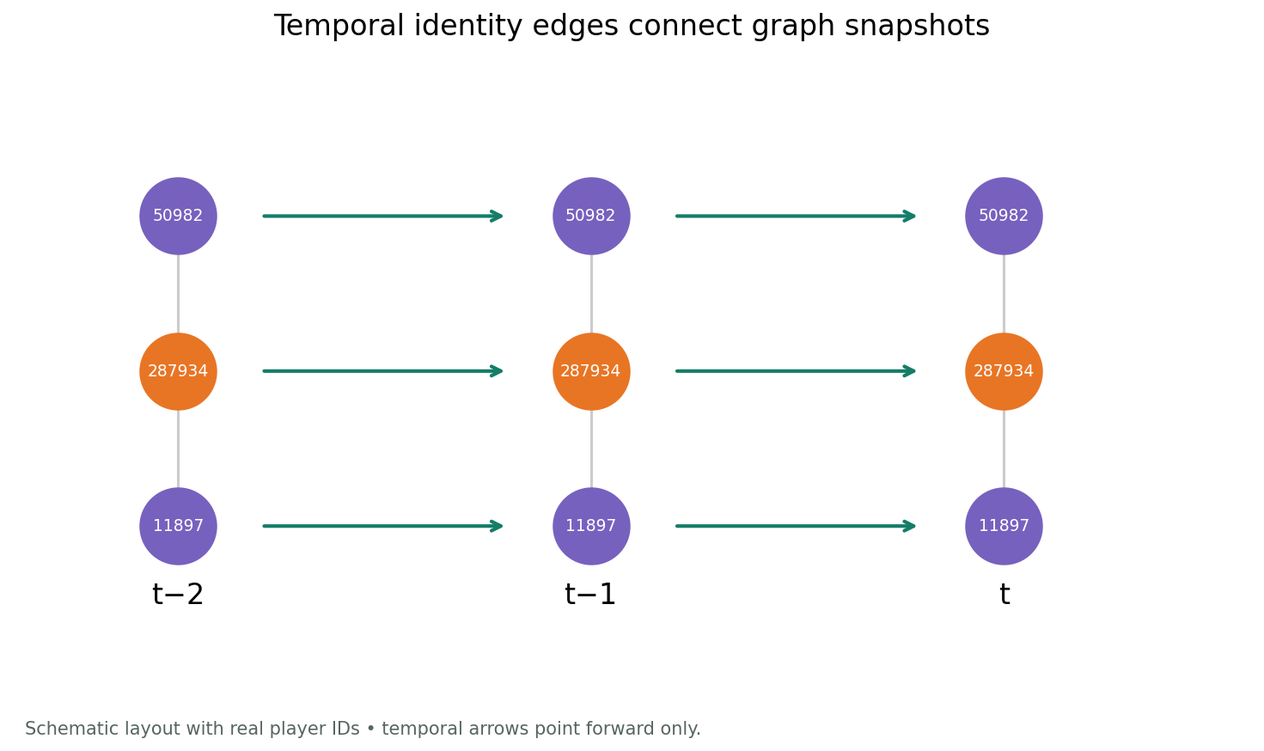
Temporal edges between snapshots
01
Link each player to their previous observed state
02
Retain spatial edges within each frame
03
Direct historical connections toward the prediction time
PathCRF: player trajectories to events (2026)
46 / 61
Notes:
Schematic topology with real player IDs. The notebook creates actual spatial and temporal edge records. Do not connect across substitutions or tracking gaps without an explicit rule; labels cannot leak future frames.
Sources:
PathCRF: player trajectories to events (2026)
https://github.com/hyunsungkim-ds/pathcrf

Slide 47

Recurrent temporal graph models
01
Encode each frame with a spatial GNN
02
Update a recurrent hidden state as frames arrive
03
Predict from the accumulated historical state
PyTorch Geometric Temporal architectures
47 / 61
Notes:
Architecture schematic rather than a claim about a specific cited model’s GRU implementation. Pros: sequential processing with a compact state. Cons: long-history retention and sequence alignment. No trained inference is shown.
Sources:
PyTorch Geometric Temporal architectures
https://pytorch-geometric-temporal.readthedocs.io/en/latest/modules/root.html

Slide 48
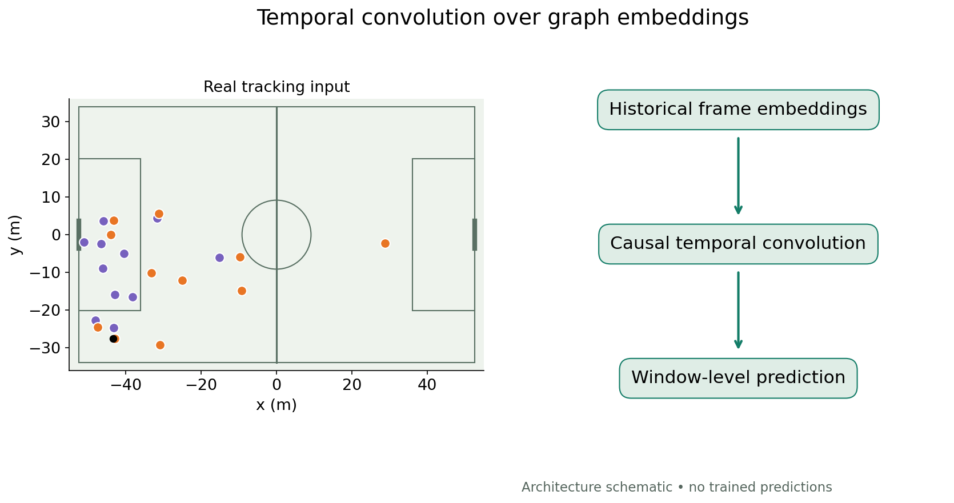
Temporal convolution on graph history
01
Stack frame-level graph embeddings over time
02
Apply causal filters across historical windows
03
Control the receptive field with layers and dilation
Temporal convolution for sequence modeling
48 / 61
Notes:
Architecture schematic. Pros: parallel computation and explicit receptive field. Cons: window length, dilation and sampling-rate choices. Filters must not access future frames at prediction time.
Sources:
Temporal convolution for sequence modeling
https://arxiv.org/abs/1803.01271

Slide 49
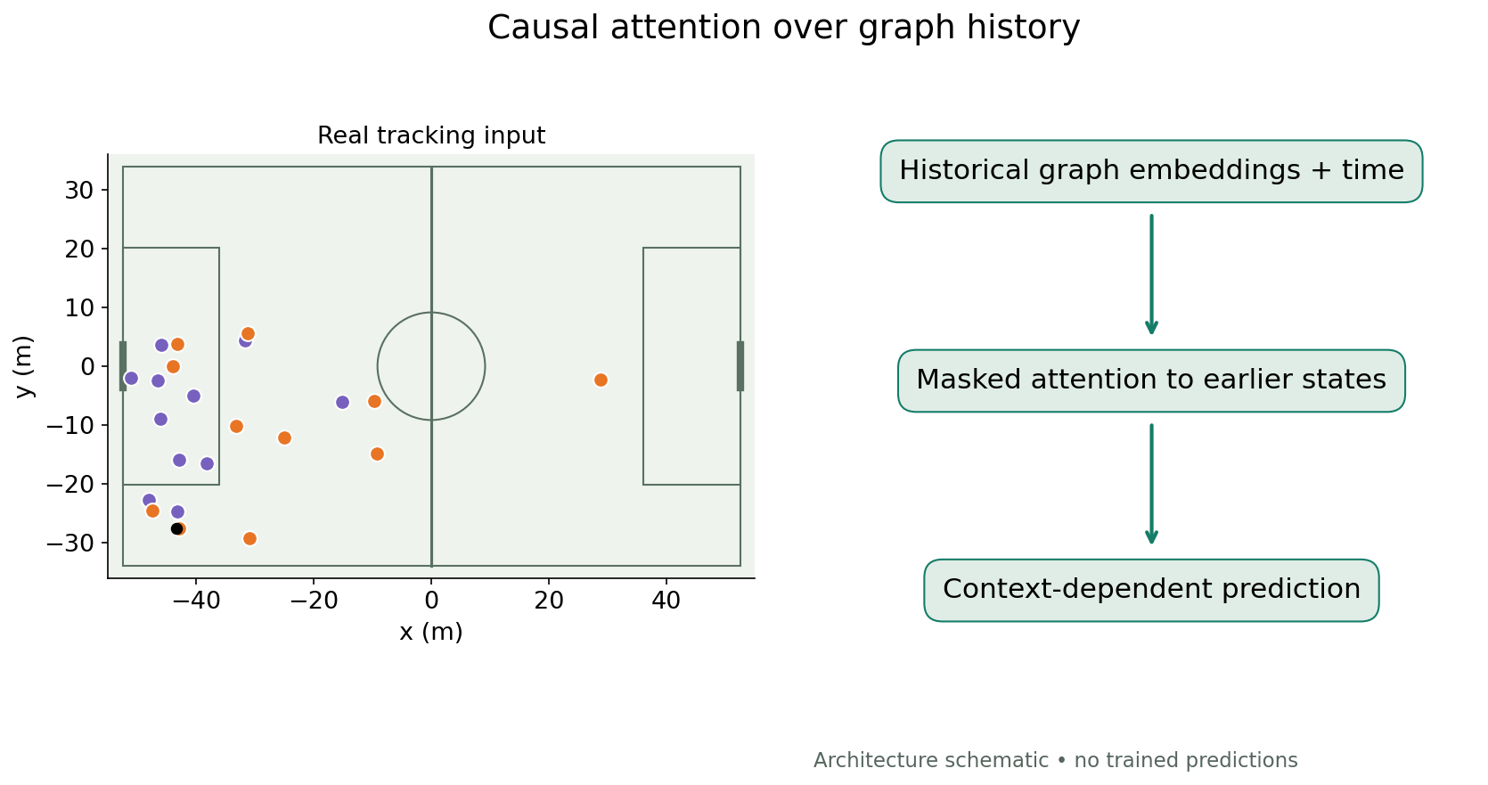
Causal temporal attention
01
Add time information to historical graph embeddings
02
Attend to relevant earlier states
03
Mask future frames and missing observations
Attention Is All You Need
PyTorch Geometric Temporal architectures
49 / 61
Notes:
Architecture schematic. Pros: flexible history selection and long-range dependencies. Cons: data/computation requirements, masking and leakage; attention weights do not establish causal importance.
Sources:
Attention Is All You Need
https://arxiv.org/abs/1706.03762
PyTorch Geometric Temporal architectures
https://pytorch-geometric-temporal.readthedocs.io/en/latest/modules/root.html

Slide 50
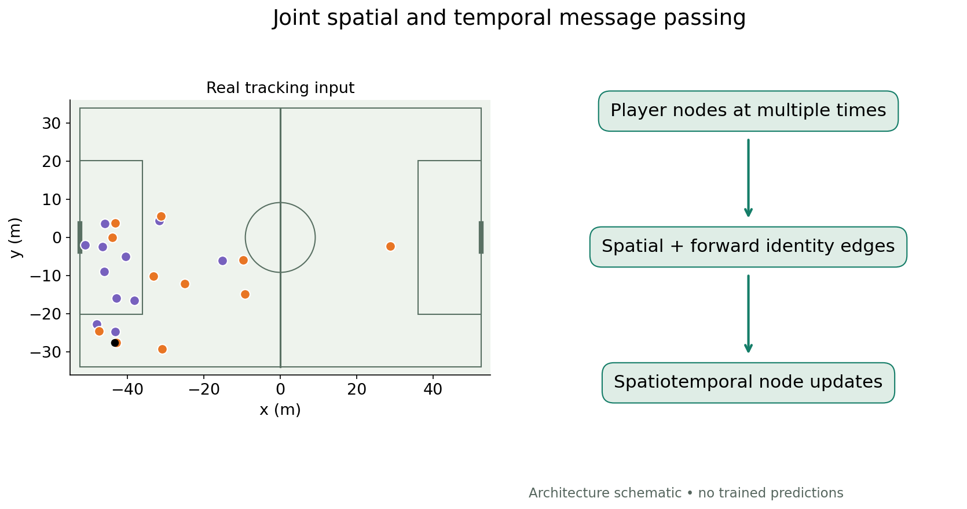
Spatiotemporal message passing
01
Connect spatial neighbors within each frame
02
Connect player identities across observed time
03
Learn updates over both relationship types
PyTorch Geometric Temporal architectures
PathCRF: player trajectories to events (2026)
50 / 61
Notes:
General architecture schematic, not a reproduction of PathCRF. Pros: joint relational/time structure. Cons: graph size, identity errors and edge construction choices.
Sources:
PyTorch Geometric Temporal architectures
https://pytorch-geometric-temporal.readthedocs.io/en/latest/modules/root.html
PathCRF: player trajectories to events (2026)
https://github.com/hyunsungkim-ds/pathcrf

Slide 51
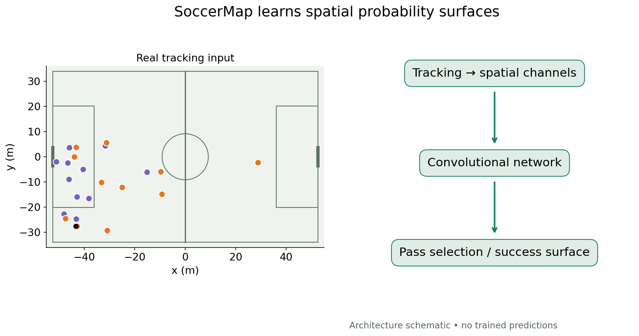
SoccerMap: spatial neural prediction
01
Convert tracking into spatial feature channels
02
Learn field-wide surfaces with convolutional networks
03
Use distinct heads or models for distinct targets
SoccerMap (2020)
51 / 61
Notes:
Architecture schematic. SoccerMap is a convolutional approach, not a GNN. Pros: field-wide outputs. Cons: rasterization and training data requirements; no pretrained inference is claimed.
Sources:
SoccerMap (2020)
https://arxiv.org/abs/2010.10202

Slide 52
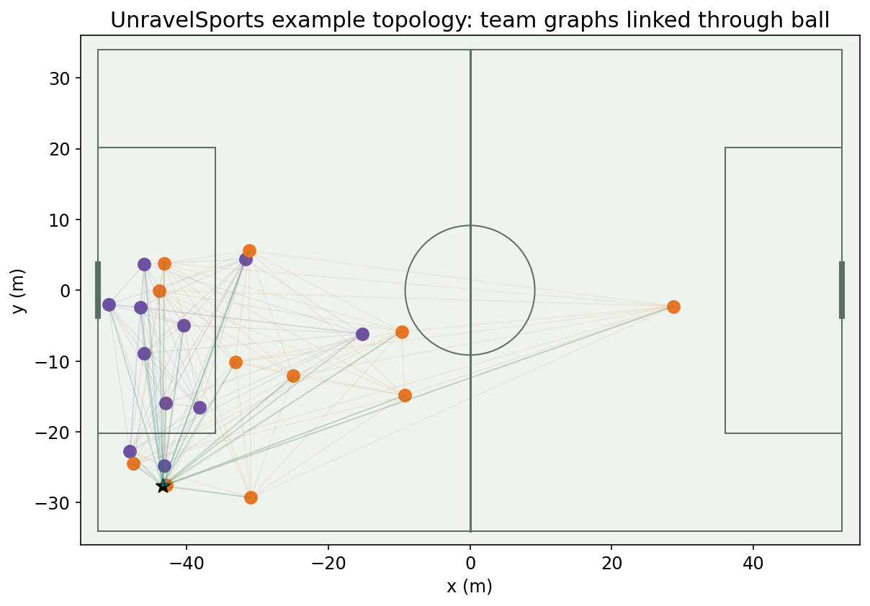
Bekkers: building a football graph
01
Represent players and ball as nodes
02
Encode team, motion and relative geometry
03
Choose edges to suit the prediction task
Joris Bekkers: GraphEPV, PyData London 2025
UnravelSports soccer GNN tutorial
52 / 61
Notes:
Real SkillCorner frame with one documented UnravelSports configuration: split-by-team connections plus ball links. This is not asserted as the unique GraphEPV topology. Pros: permutation-invariant aggregation and relational features. Cons: edges determine which interactions can be learned. Current documentation recommends PyTorch Geometric; the 2025 talk used Keras/Spektral.
Sources:
Joris Bekkers: GraphEPV, PyData London 2025
https://rawcdn.githack.com/UnravelSports/keynotes/main/html/20250607-PyData-London.html
UnravelSports soccer GNN tutorial
https://unravelsports.readthedocs.io/en/latest/tutorials/soccer_gnn.html

Slide 53
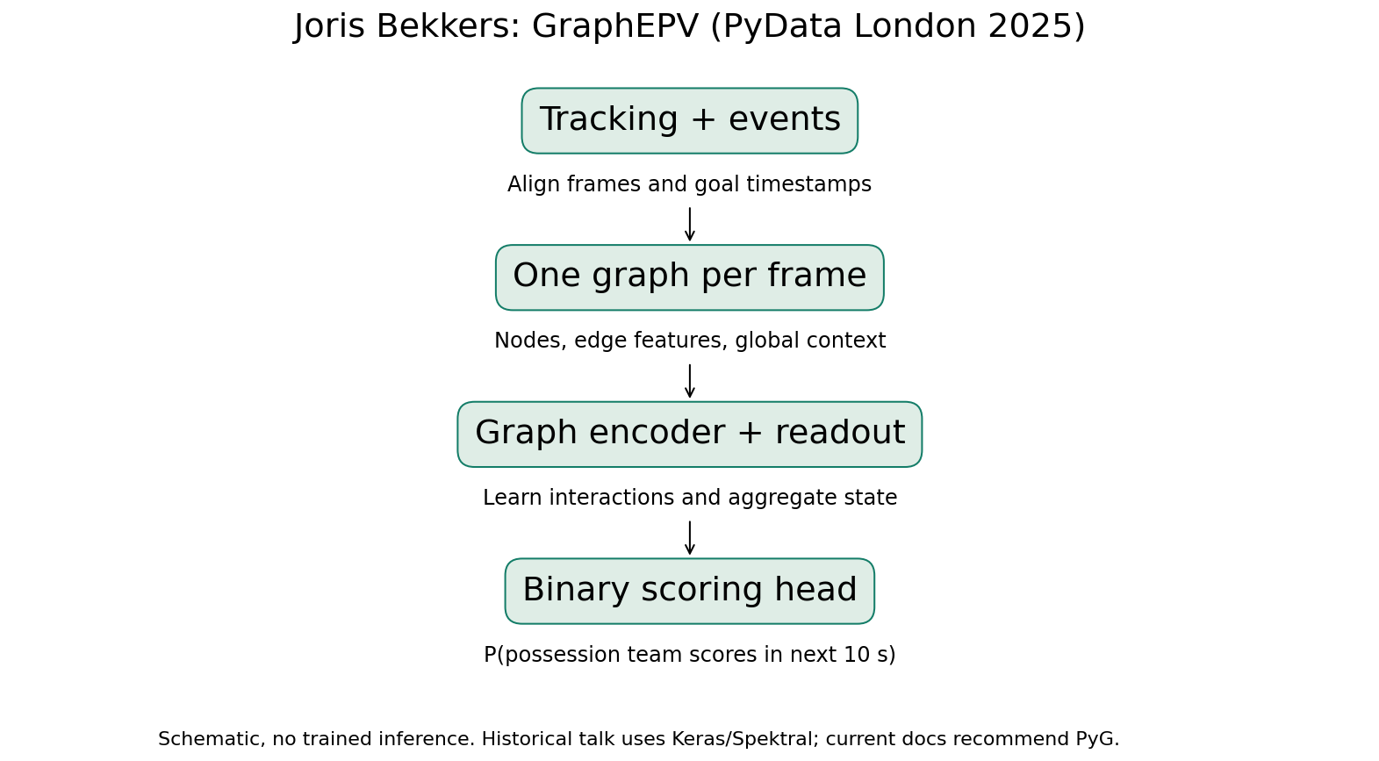
Bekkers: GraphEPV scoring target
01
One tracking frame becomes one graph
02
Label goals by the possession team within 10 seconds
03
Train a graph classifier to estimate that probability
Joris Bekkers: GraphEPV, PyData London 2025
UnravelSports soccer GNN tutorial
53 / 61
Notes:
PyData London, 7 June 2025. Talk uses World Cup 2022 PFF data across 64 matches, with labels respecting team and period. This is a ten-second scoring target, not automatically the complete action-decomposed Fernández EPV framework. Schematic only: no pretrained model inference here. Strength: includes off-ball context. Limitation: rare correlated labels, calibration and transfer to another competition.
Sources:
Joris Bekkers: GraphEPV, PyData London 2025
https://rawcdn.githack.com/UnravelSports/keynotes/main/html/20250607-PyData-London.html
UnravelSports soccer GNN tutorial
https://unravelsports.readthedocs.io/en/latest/tutorials/soccer_gnn.html

Slide 54
GraphEPV and temporal extensions
01
A frame model can use velocity features
02
History adds runs, pressure and changing lanes
03
Add temporal encoders with causal inputs
Joris Bekkers: GraphEPV, PyData London 2025
UnravelSports soccer GNN tutorial
54 / 61
Notes:
Our extension discussion, not a claim that the 2025 GraphEPV presentation trained a temporal GNN. Use the existing lagged features, GRU, TCN and attention slides as alternative temporal encoders. Keep whole matches/possessions together when splitting; account for the ten-second outcome window. Compare against location xT and non-graph models on the same target.
Sources:
Joris Bekkers: GraphEPV, PyData London 2025
https://rawcdn.githack.com/UnravelSports/keynotes/main/html/20250607-PyData-London.html
UnravelSports soccer GNN tutorial
https://unravelsports.readthedocs.io/en/latest/tutorials/soccer_gnn.html

Slide 55
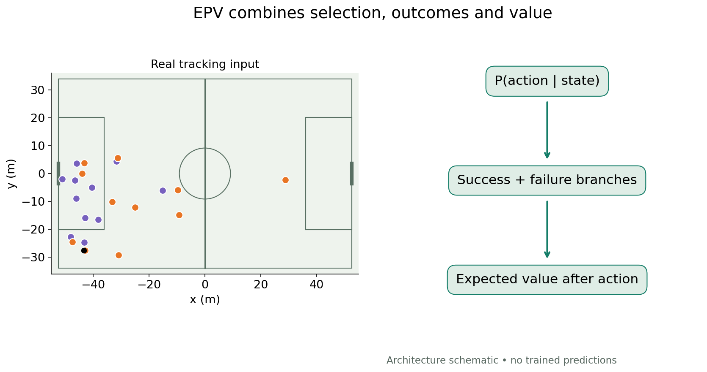
Expected possession value
01
Specify what outcome and horizon value means
02
Combine action selection, success and continuation
03
Include the value of failure and turnovers
Fine-grained expected possession value (2021)
DEFCON: GNN-based defensive EPV (2026)
55 / 61
Notes:
Conceptual decomposition: sum over actions P(action|state) times outcome-conditional value, including failure. EPV is a framework/target, not a synonym for GNN. Different EPV definitions must not be mixed.
Sources:
Fine-grained expected possession value (2021)
https://pmc.ncbi.nlm.nih.gov/articles/PMC8570314/
DEFCON: GNN-based defensive EPV (2026)
https://github.com/hyunsungkim-ds/defcon

Slide 56

Observed passes and supplied EPV
01
Inspect value changes on actual pass events
02
Compare valuable actions with their tracking context
03
Keep supplied predictions separate from our calculations
NOTEBOOK · supplied event-value fields
SkillCorner open data and schema
Fine-grained expected possession value (2021)
56 / 61
Notes:
Actual pass_epv_delta_for fields in SkillCorner dynamic events. This is the provider’s model output; not a reconstructed Fernández or DEFCON prediction. The field name is shown rather than assuming undocumented equivalence.
NOTEBOOK · supplied event-value fields
Sources:
SkillCorner open data and schema
https://github.com/SkillCorner/opendata
Fine-grained expected possession value (2021)
https://pmc.ncbi.nlm.nih.gov/articles/PMC8570314/

Slide 57

DEFCON: defensive contribution
01
Use graph-based models for action components
02
Estimate the opponent’s possession value
03
Account for defenders’ contribution to reducing danger
DEFCON: GNN-based defensive EPV (2026)
57 / 61
Notes:
Architecture schematic only. Explain attribution assumptions before interpreting defensive credits. Actual frame is context, not DEFCON inference.
Sources:
DEFCON: GNN-based defensive EPV (2026)
https://github.com/hyunsungkim-ds/defcon

Slide 58

U.S. Soccer: counterattack graphs
01
Build graphs from synchronized SkillCorner and events
02
Define counterattack success explicitly
03
Evaluate predictions on held-out sequences
U.S. Soccer: counterattack GNNs with SkillCorner (2023)
58 / 61
Notes:
Architecture schematic. The published balanced event-frame study uses reaching the penalty area as success; the repository’s additional all-frame dataset has different goal labels. Do not mix those datasets or quote them as equivalent.
Sources:
U.S. Soccer: counterattack GNNs with SkillCorner (2023)
https://github.com/USSoccerFederation/ussf_ssac_23_soccer_gnn

Slide 59

TacticAI: corner-kick modeling
01
Predict receiver and shot outcomes
02
Represent player interactions with graph networks
03
Suggest alternative positional configurations
TacticAI (2024)
59 / 61
Notes:
Architecture schematic. The input illustration uses real tracking near a supplied corner-reception event; it is not the original TacticAI input or trained inference. Complete task-specific code/weights and licensed data are not released. Model-generated suggestions are not guarantees.
Sources:
TacticAI (2024)
https://www.nature.com/articles/s41467-024-45965-x

Slide 60

Trajectory forecasting
01
Encode observed player and team history
02
Generate multiple plausible continuations
03
Evaluate geometry, tactical coherence and uncertainty
GenTac: trajectory forecasting (2026 preprint)
60 / 61
Notes:
Architecture schematic; no invented future trajectories are shown as learned output. GenTac is a recent preprint example. Distinguish forecasting and causal intervention.
Sources:
GenTac: trajectory forecasting (2026 preprint)
https://arxiv.org/abs/2604.11786

Slide 61

Validating tracking models
01
Split data by matches or independent sequences
02
Evaluate calibration and task-specific outcomes
03
Stress-test missingness, direction and parameters
Fine-grained expected possession value (2021)
Dangerous Accessible Space: paper and implementation
61 / 61
Notes:
Schematic split only, not measured performance. Event detection needs timing tolerances; probability models need calibration; tactical labels need a clear taxonomy.
Sources:
Fine-grained expected possession value (2021)
https://pmc.ncbi.nlm.nih.gov/articles/PMC8570314/
Dangerous Accessible Space: paper and implementation
https://github.com/jonas-bischofberger/accessible-space

