Slide 1
Dark Energy
John Wright, Zachary Cohen, Dechong Wang
2024.10.9

Slide 2
Motivation
Methods
Methods
Conclusion
References
AI Statement
Contribution Statement
CONTENTS

Slide 3
01
Motivation

Slide 4

We can use this growth rate (Hubble’s constant) to find the age of the universe
Red shifting and dimmer light captured from farther away
Type Ia Supernovae as Standard Candles
We can use these measurements from a range of distances to calculate the growth rate of the universe
Consistent brightness during explosion
Consistent brightness opens the door for distance measurements

Slide 5
02
Methods

Slide 6
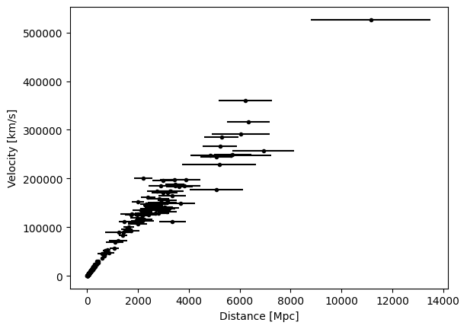
Methods
Hubble Diagram
Hubble Diagram

Slide 7

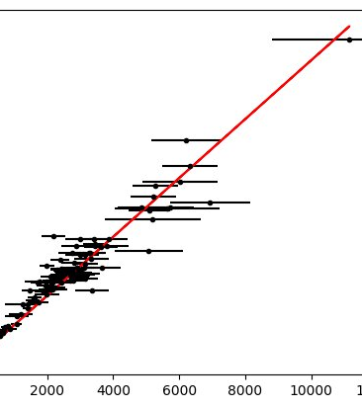
Methods
Hubble constant = slope of linear distance/velocity relation
Estimate with OLS
Hubble constant estimate: 48.5 km/Mpc s
Implied age of universe: 20.2 billion years

Slide 8
03
Conclusion

Slide 9

Conclusion
Type Ia supernovae serve as reliable standard candles for measuring cosmic distances due to their consistent brightness. Using these measurements and redshift data, we estimated the Hubble constant at 48.5 km/s per megaparsec, implying a universe age of around 20.2 billion years. The Hubble diagram confirms the linear relationship between distance and velocity, supporting the expanding universe model. This emphasizes the key role of accurate distance measurements in understanding the universe’s expansion and age.

Slide 10

References
The Astrophysical Journal, 594:1–24, 2003 September 1

Slide 11

AI Statement
No AI was used during this project.

Slide 12

Contribution Statement
Individual Contributions:
Zachary Cohen wrote the “Motivation”, “AI Statement”, “Contribution Statement”,and“References” slides
John Wright used his code to complete the “Methods” slides
Dechong Wang wrote the Conclusion slide, And the slides were redesigned and sorted out

Slide 13
THE END
THANKS

