Slide 1
Data Cleaning Case Study
E-Commerce Order Dataset

Slide 2
Objective: Identify and document formatting inconsistencies, missing values, incorrect inputs, and data-quality issues within the dataset
Dataset: A simulated e-commerce dataset containing customer order and transaction records for data-cleaning and quality-assurance analysis.
Rows:180
Columns:16
Tools: Python, pandas, NumPy, Jupyter Notebook, Excel
Geographic scope: AZ, USA
Issues Identified
  Inconsistent capitalization
  Missing values
  Duplicate records
  Invalid numeric values
  Inconsistent category labels
  Data type problems

Slide 3
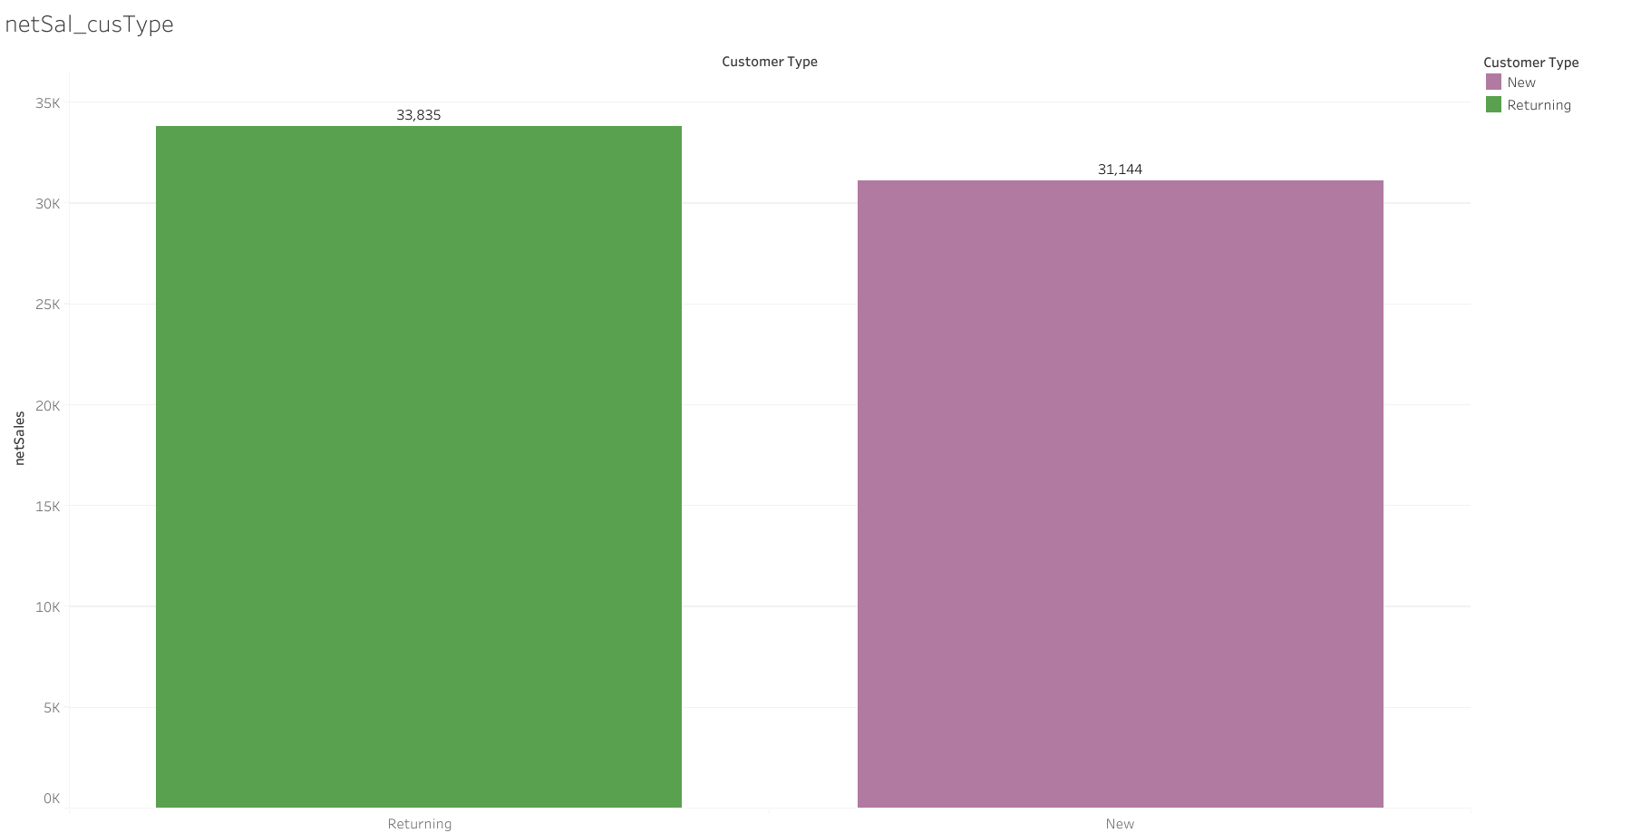
Overall net sales between new and returning customers
Net sales from new customers exceeded returning-customer net sales by approximately $2,600.
Total net sales reached $65,032, compared to gross sales of $70,057.
The approximately $5,025 difference between gross and net sales may reflect discounts, promotions, returns, or other adjustments, pending further analysis.

Slide 4
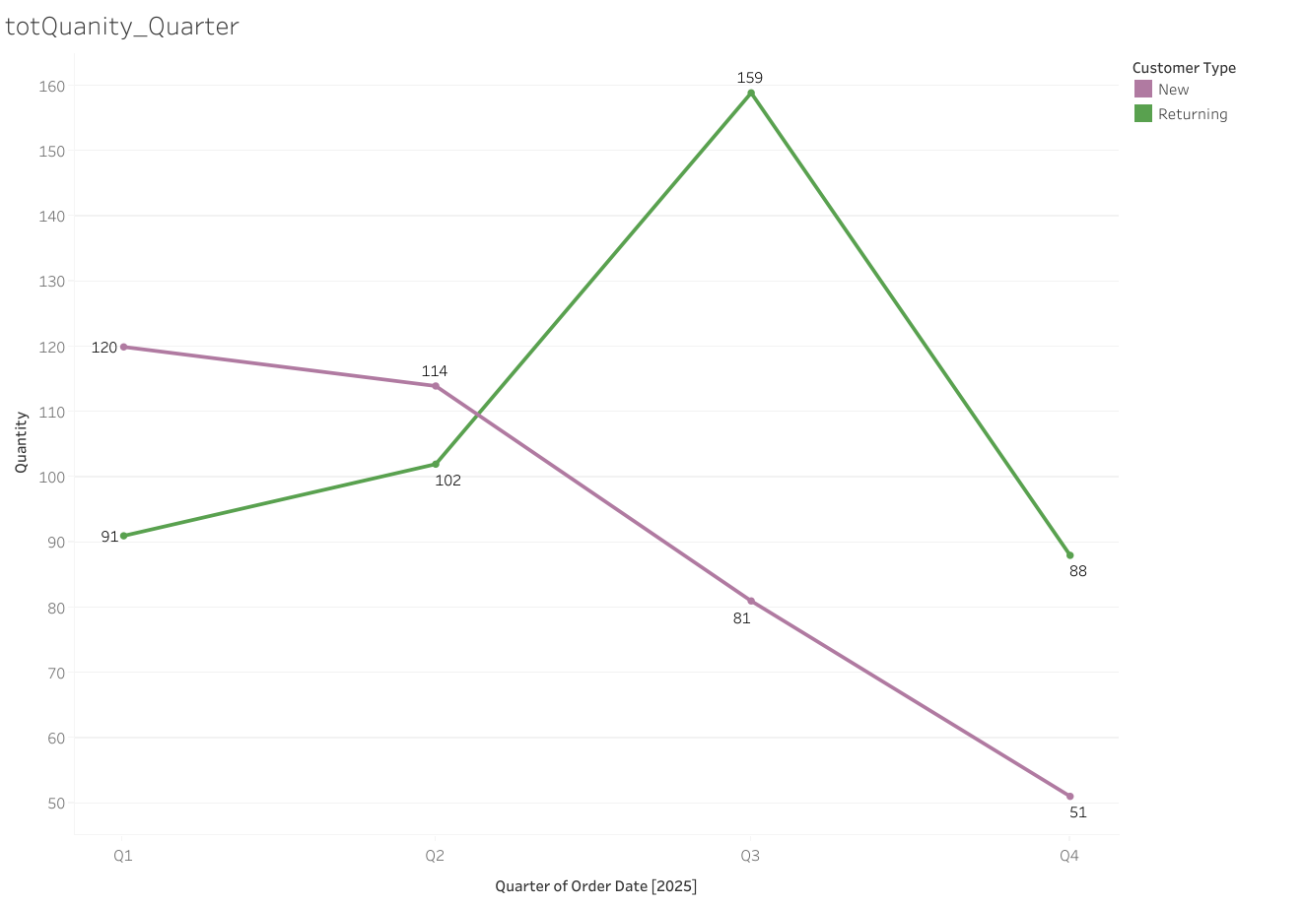
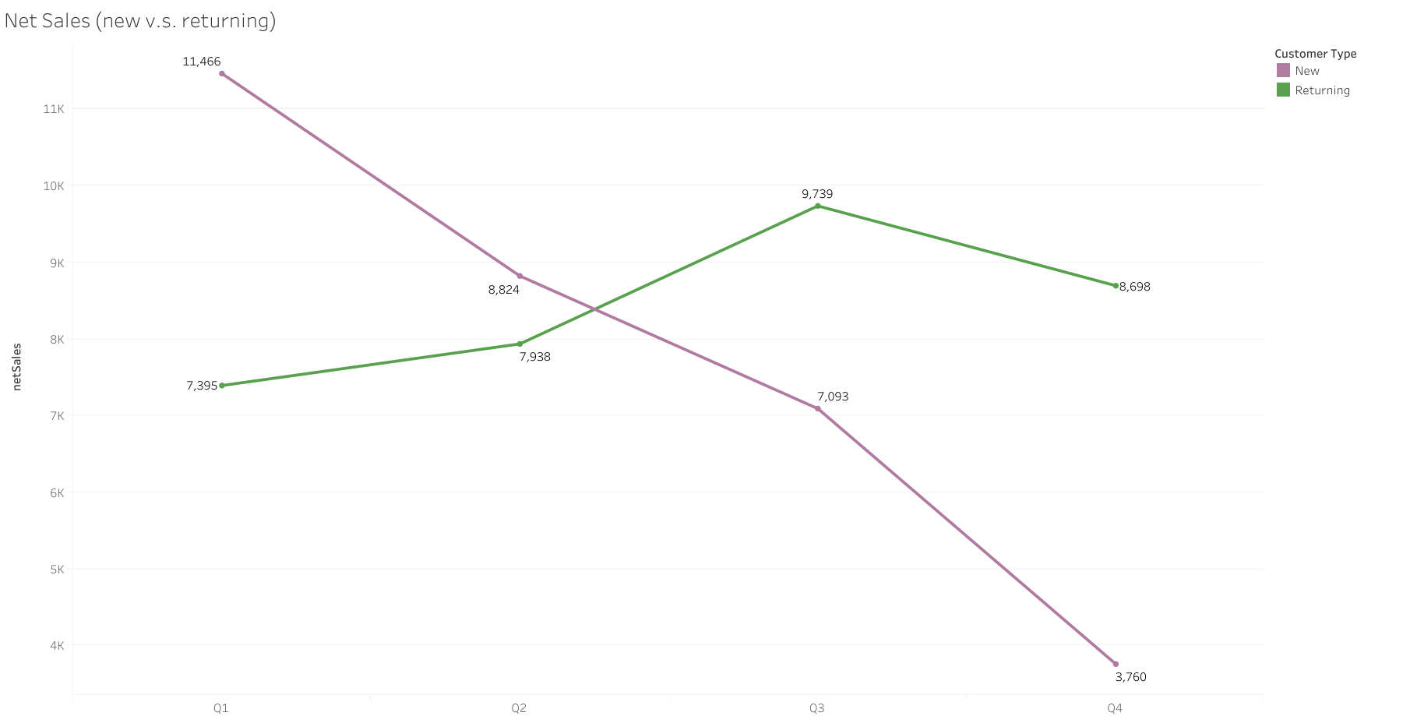
New vs Returning customers
New customer acquisition decreased by 56% from quarter 1 to 4.
Returning customer activity increased by approximately 75% from quarter 1 to 3 followed by a 45% decline in quarter 4.

Slide 5
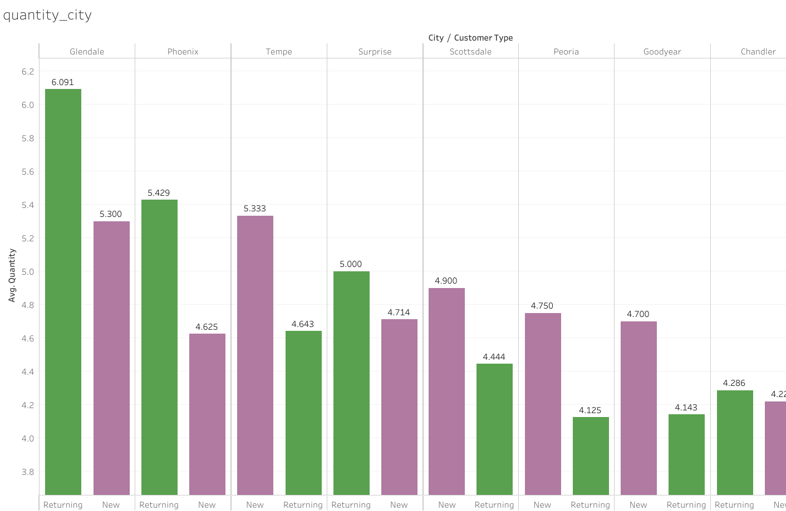
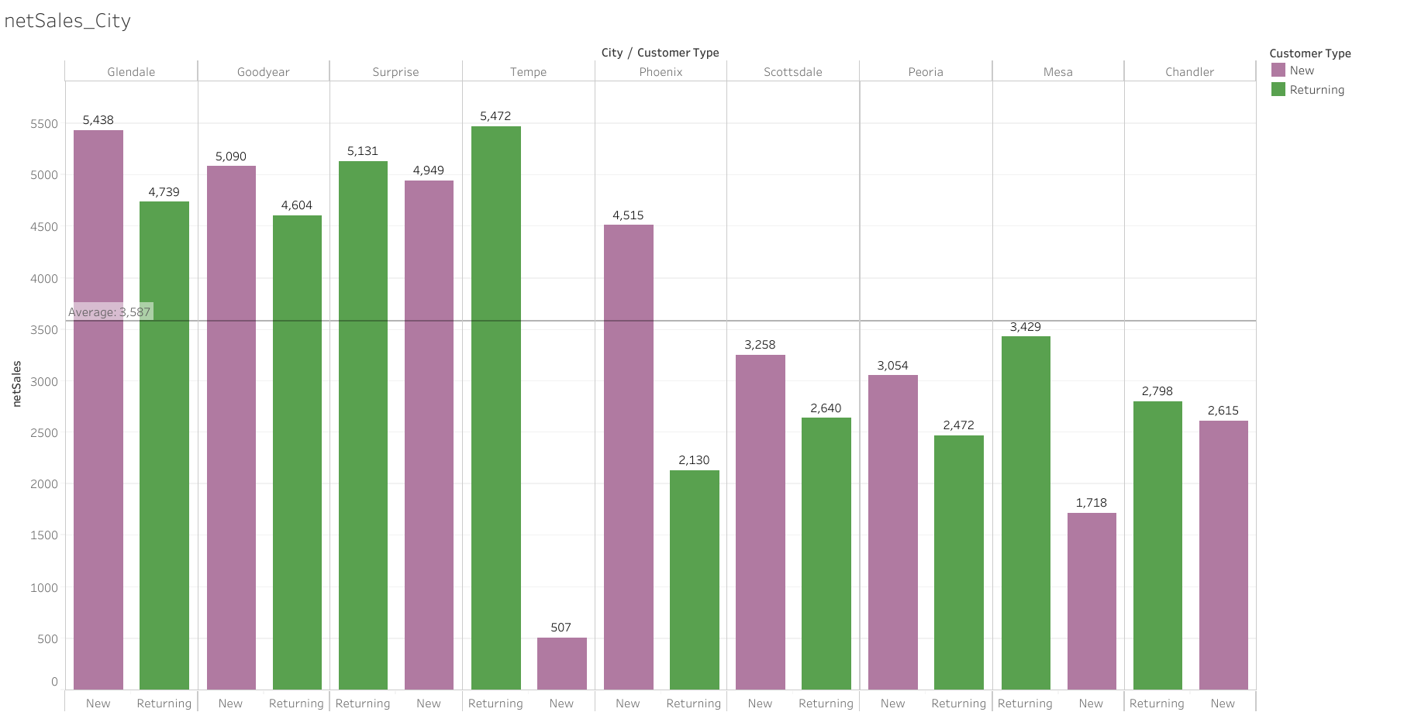
Where are sales coming from?

Slide 6
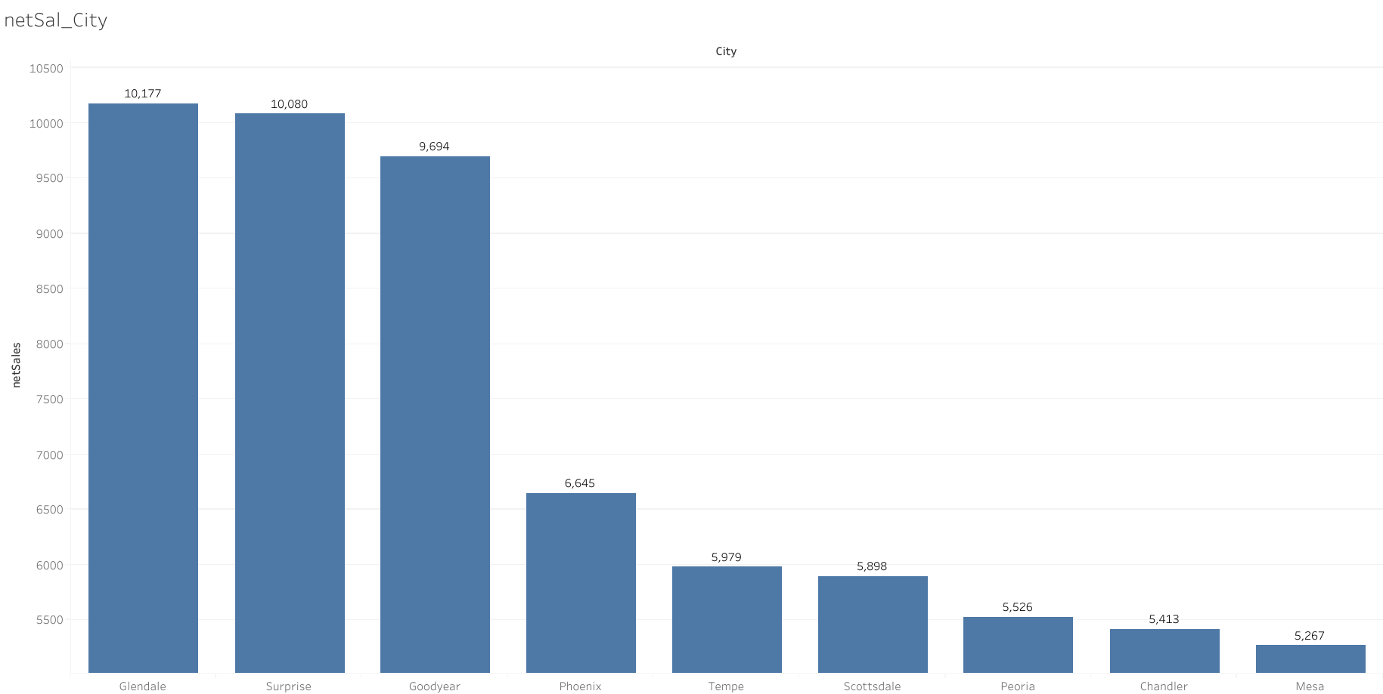
Net Sales
Highest Net Sales: Glendale, Surprise, and Goodyear.
Lowest Net Sales: Peoria, Chandler, and Mesa.

Slide 7
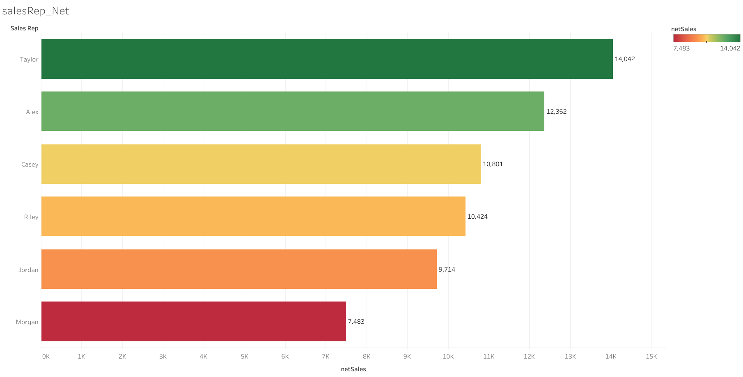
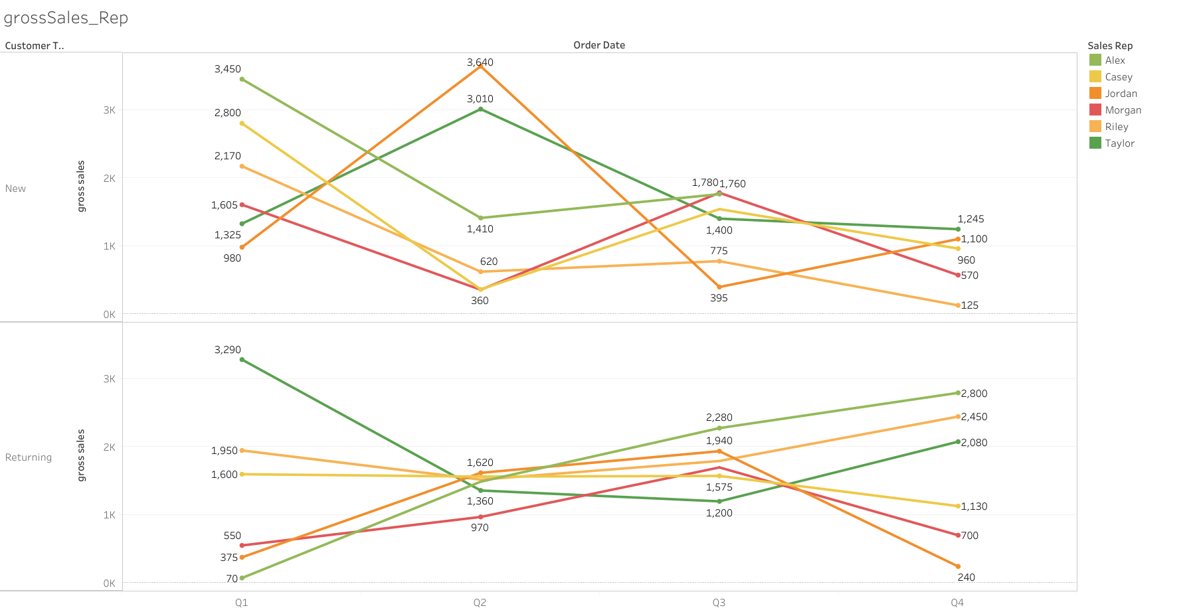
Sales rep performance over time

Slide 8
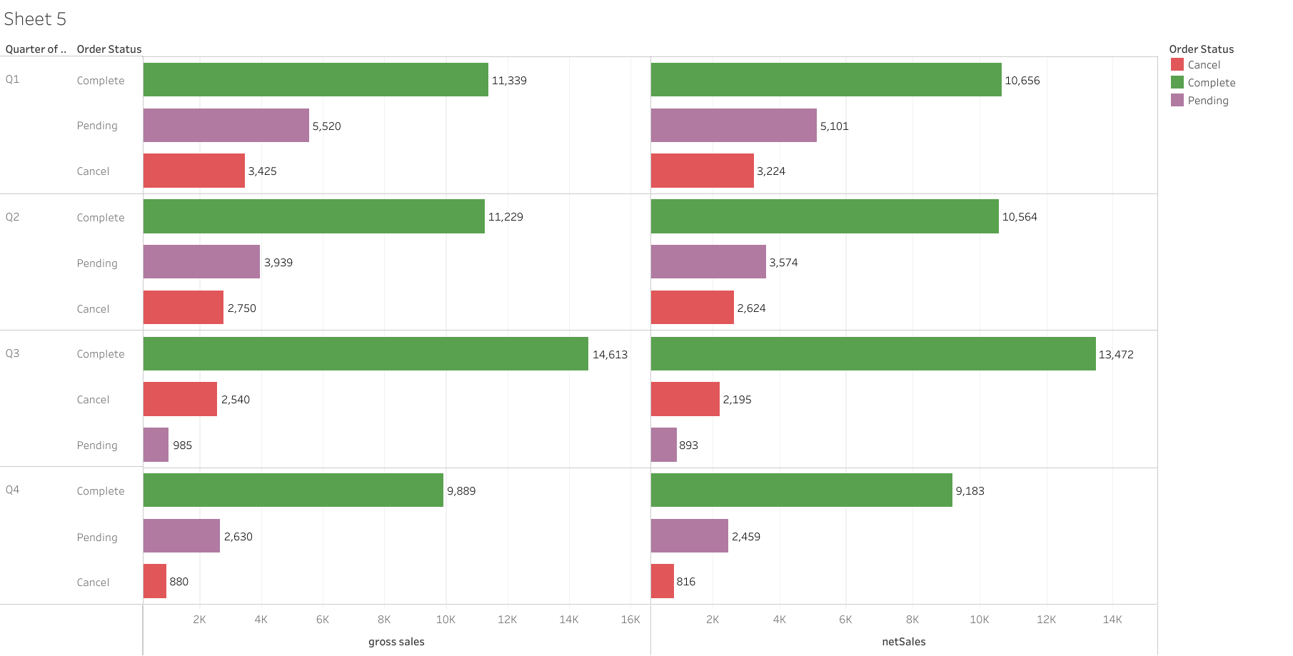
Order completion/Sales quality

Slide 9
Quarterly NetSales

Slide 10
Key findings

Slide 11
Future investigations

Slide 12
Project Resources & References
GitHub Repository
Data sources and limitations
Data source: Synthetic e-commerce transaction dataset created for analytical practice.
Data scope: Sales transactions Limitations:

